Slide 1
ACADEMIC PRIMARY
HEALTH CARE
WITH
PROFESSOR TRISH GREENHALGH
AND LAIBA HUSAIN

Slide 2
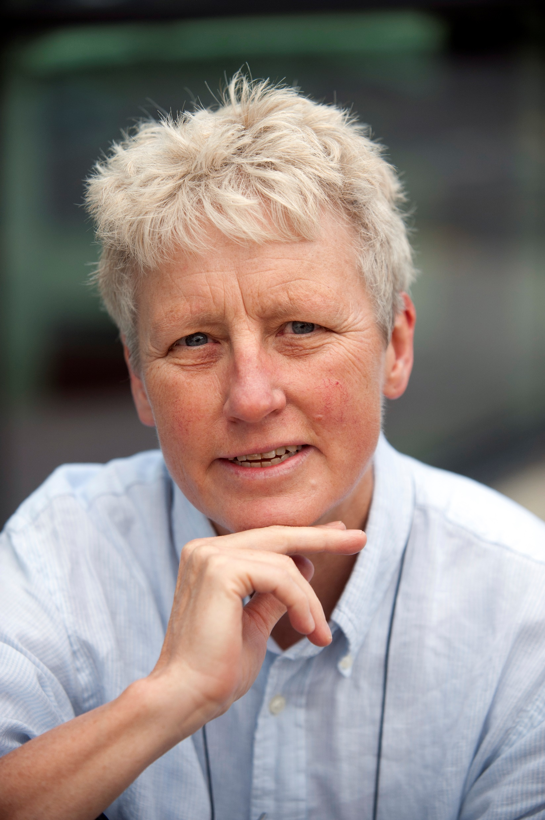
MEET TRISH
PROFESSOR TRISH GREENHALGH is Professor of Primary Care Health Sciences at the University of Oxford’s Medical Sciences Division.
She has been involved in both the academic and practical sides of healthcare.
During the pandemic, she has helped the health service adapt to a rapidly changing situation by researching how to make their Remote-by-Default Care system as effective as possible.
Let’s learn more about her work…

Slide 3
BENEFITS AND CHALLENGES OF REMOTE CONSULTATIONS
“Remote consultations were essential for reducing the spread of COVID in the early months of the pandemic. But their benefits need to be weighed against their disadvantages. They rely upon technology that may not work 100% of the time… and the devices that patients and clinicians have available,” explains Trish.
“It is an unfamiliar format for many, leading to frustrations, misunderstandings and even giving up. And it is impossible to examine the patient fully, including for possible symptoms of COVID-19.”
A physical examination for COVID-19 would involve taking a patient’s temperature, pulse and blood pressure, looking into their mouth and throat, listening to their lungs using a stethoscope, and using an oximeter to estimate blood oxygen levels.

Slide 4
This shift to remote consultations has had profound impacts for many patients, both those suffering from COVID-19 and from other illnesses.
This was especially apparent during the first wave of infections when COVID-19 symptoms were less well understood.
“Some people who were very sick were misdiagnosed as only moderately sick, and some people who were only moderately sick were misdiagnosed as very sick – and then sent to hospital where they were potentially exposed to COVID-19 infection from others,” says Trish.

Slide 5
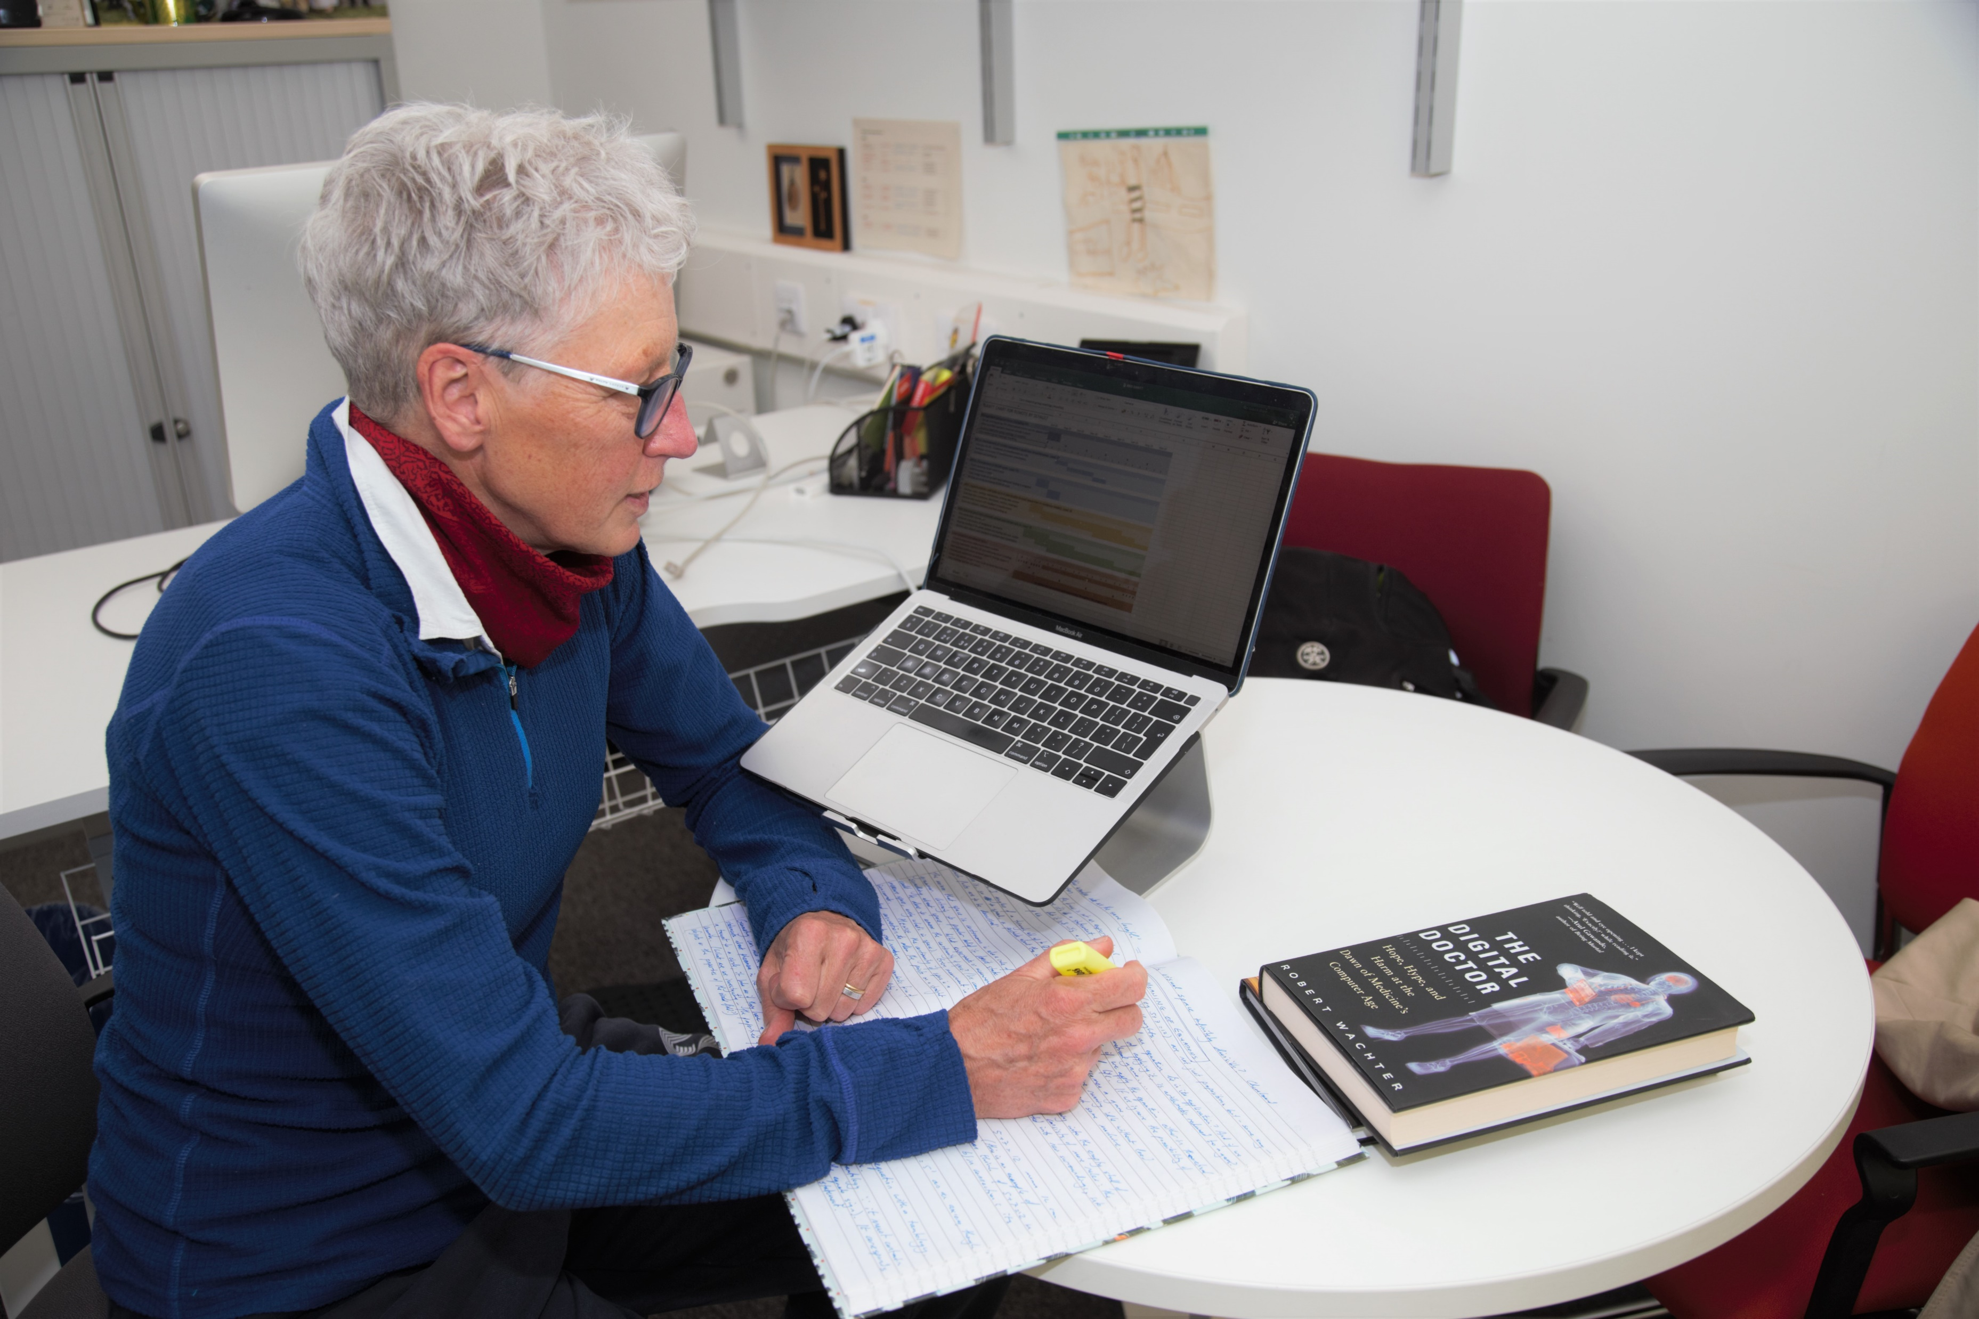
THE EARLY WARNING SCORE
In a study called RECAP (Remote COVID-19 Assessment in Primary Care), Trish worked with other researchers to develop an ‘early warning score’ – a series of questions that GPs can ask to accurately identify seriously unwell patients and fast-track them for urgent assessment.
“Questions cover the history of illness and symptoms, current symptoms, and some elements of physical examination or home tests that could be undertaken by the patient or someone else in the household,” says Trish. “Where kit wasn’t available, we investigated whether self-reported answers would suffice – for instance, could a description of ‘feeling hot and shivery’ replace a thermometer reading to confirm a fever?”
Trish analysing some data from the RECAP study.

Slide 6
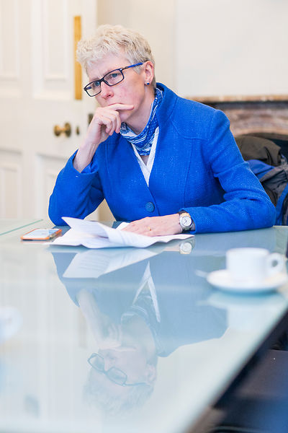
Trish’s team also interviewed over 100 people who had experienced COVID-19 infections, both mild and severe, to learn about their experiences of remote consultation.
This included recounting what doctors had asked them, and whether they felt their concerns over symptoms had been taken seriously.
“We also interviewed about 70 frontline clinicians to get their experiences of performing remote consultations,” says Trish. “They helped us draft a list of severity indicators, which we refined through online discussion. After a few weeks, we had produced a 10-item score which we then went on to validate.”

Slide 7
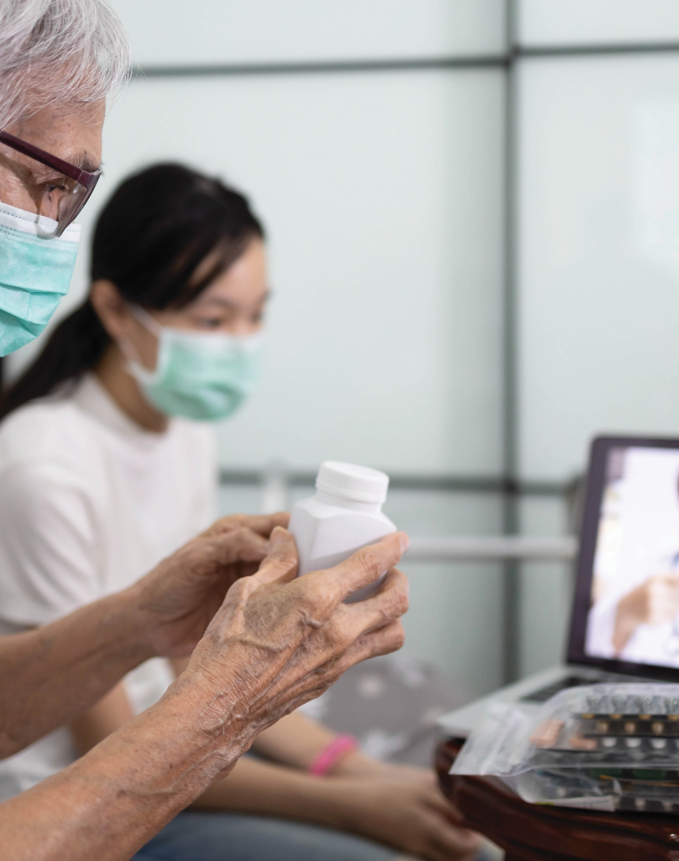
TALKING POINTS
What does a physical examination for COVID-19 involve?
What are the challenges of remote consultations?
What is the potential risk caused by misdiagnosing someone as ‘very sick’?
What is the ‘early warning score’?
How did Trish devise the list of ‘severity indicators’?

Slide 8
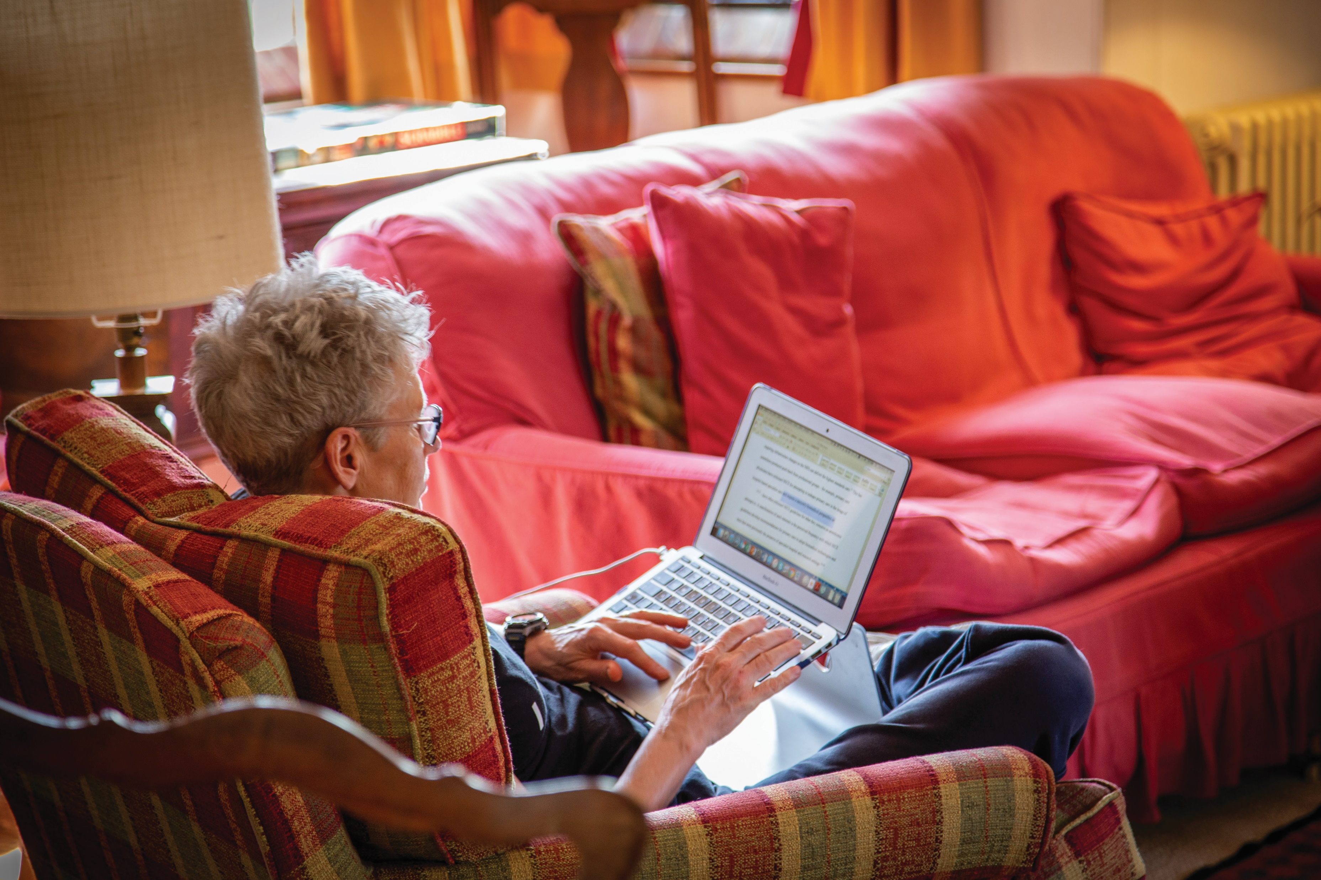
NUMBERS AND WORDS
“Questions such as ‘How breathless are you feeling compared to yesterday?’ seemed to be as accurate – and possibly more accurate – in identifying serious illness than so-called ‘objective’ measurements such as respiratory rate,” says Trish. “Open-ended questions drew rich descriptions of how the illness was affecting people, and experienced doctors could identify ‘red flags’ within these descriptions that would be missed by one-off measurements.”
While this qualitative data is useful for individual diagnoses, it is difficult to process on a large scale. Trish’s team had to find a way to convert it to quantitative data.
Trish writing an academic research paper.

Slide 9
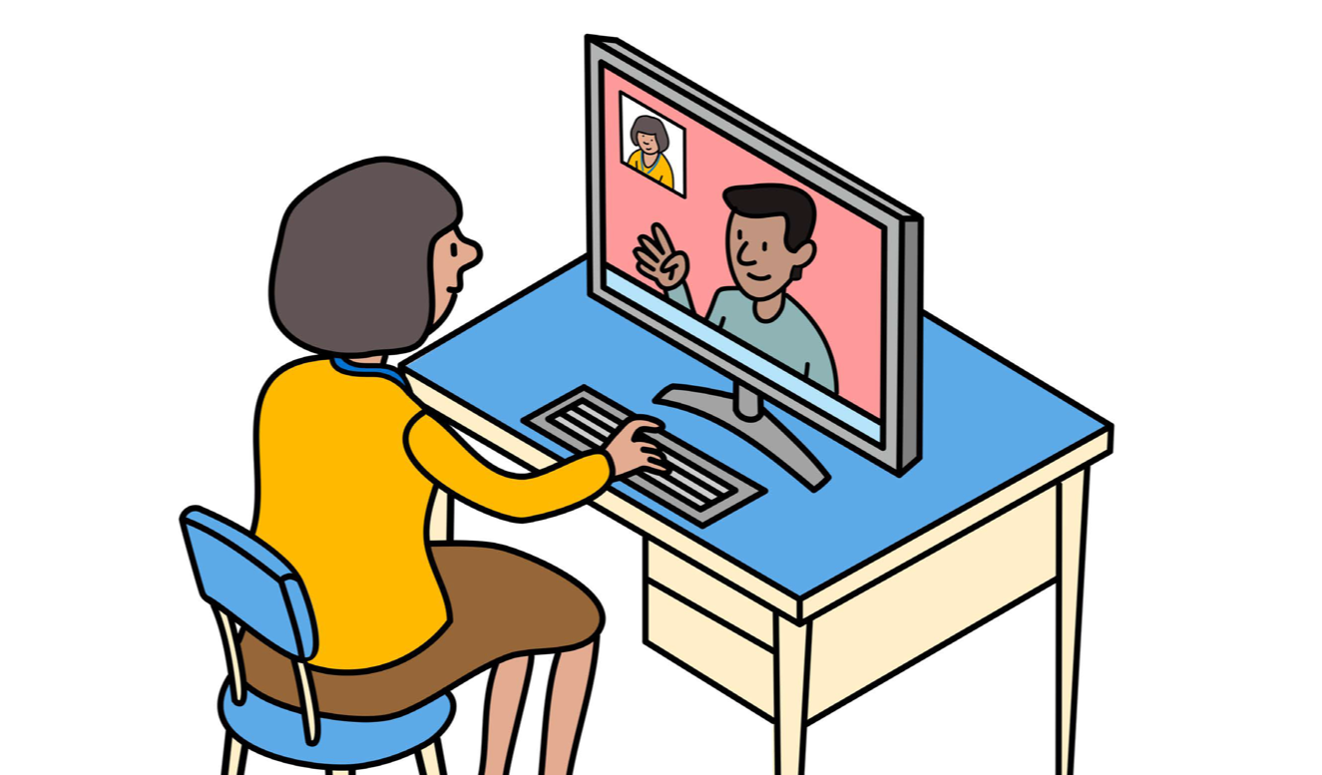
“Each response to our 10-item score is coded,” explains Trish. “For instance, responses to do with change in breathlessness may be categorised as ‘same or better than yesterday’, ‘worse than yesterday’, or ‘significant deterioration in the last hour’, each of which is assigned a different code.”
Once the responses of several thousand patients have been coded in this way, they start to form useful datasets for spotting trends.
“We use data linkage to see how these codes correlate with key outcomes we’re interested in: hospital admission, intensive care unit admission, and death within 28 days,” says Trish.

Slide 10
“Medical information is highly sensitive, and is rightly covered by data protection laws,” says Trish. “This means that compiling the datasets involves a lot of legal permissions, and special care to ensure no patient within the dataset can be identified with their name.”
Trish is interested in the role of an ‘integrated care dashboard’, which could streamline patient care. “The dashboard summarises both a patient’s health record and their social care record,” she says. “GPs will be able to give more informed consultations, and people at risk of a particular disease can be offered proactive checks.”

Slide 11
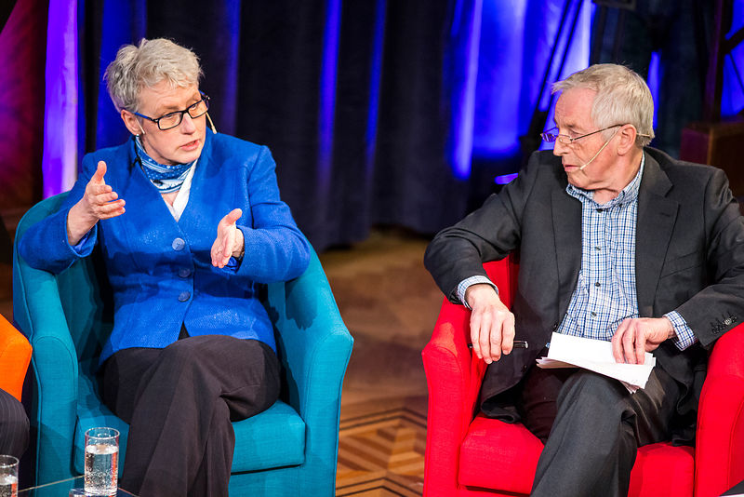
BEYOND THE PANDEMIC
“Some NHS staff would say the pandemic revealed the lack of resilience in the NHS, in terms of underfunding, understaffing, and lack of capacity,” says Trish.
“However, I also think the pandemic brought about the best in the NHS, with frontline teams pulling together and solving local problems with creativity and courage. One important insight is that decision-making works best if it is in the hands of the people closest to the problem, which is a lesson for both policymakers and healthcare professionals at every level.”
Trish being interviewed on TV about her research by Jonathan Dimbleby.

Slide 12
TALKING POINTS
What is the benefit of asking patients open-ended questions?
What is the difference between qualitative and quantitative data?
How did Trish convert qualitative data into quantitative data?
How does Trish use ‘data linkage’?
According to Trish, what has the pandemic revealed about the NHS?

Slide 13
ABOUT ACADEMIC PRIMARY HEALTH CARE
Primary health care covers the first point of contact for healthcare.
GPs are the best-known example of this, helping to diagnose patients and propose solutions such as prescriptions or referral to hospital departments.
Academic primary health care involves studying how to make this process as effective as possible, using evidence from research to propose changes to the ways that primary health care is undertaken.
“Almost all medically-qualified professors split their time between working in the NHS and in their academic role. I used to work two days a week as a GP and three in the university, though I later cut down to one day a week as a GP as my university job was very demanding. A few years ago, I dropped the clinical aspects of my job entirely, as my university research and teaching responsibilities expanded,” explains Trish.

Slide 14
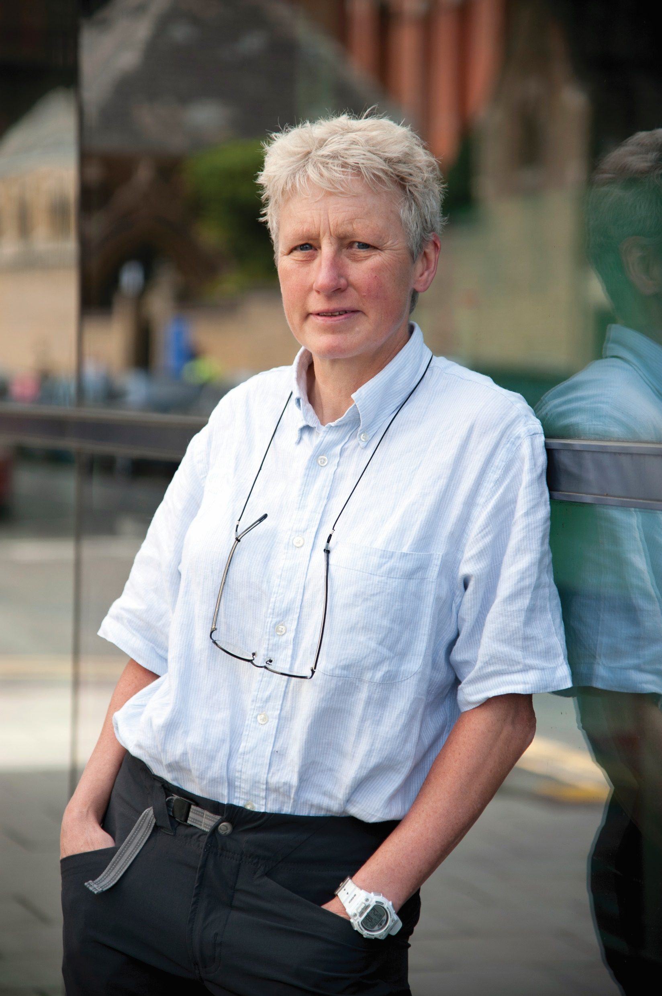
“… our duty is to do what’s best for the patient or client, while maintaining confidentiality and drawing on science and other relevant evidence when needed.
If you have a high level of scientific curiosity and enjoy discovering answers, you may be cut out for research.
Do you find the ideas of diagnostic tools and data linkage interesting?
Can you come up with any of your own ideas for improving assessment of patients, or consider any other scientific questions that could be answered through data linkage? If so, academic primary care could be for you.”
- Trish

Slide 15
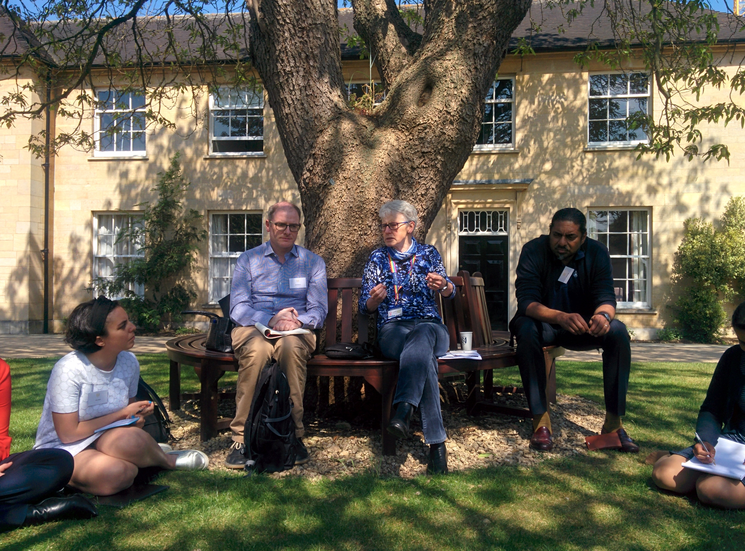
EXPLORE A CAREER IN PRIMARY ACADEMIC HEALTH CARE
Medicine is the most obvious subject to study at university to pursue a career in academic primary health care. A good understanding of the health service and the science behind it will be necessary for such a career.
Relevant work experience is often essential when applying to a medicine-based degree. The Medical Schools Council has some useful tips for getting started in this space.
Salaries for careers in medicine can vary substantially but are generally quite well-paid. The British Medical Association has more information.
Trish and some of her team discussing research findings at a residential retreat.

Slide 16
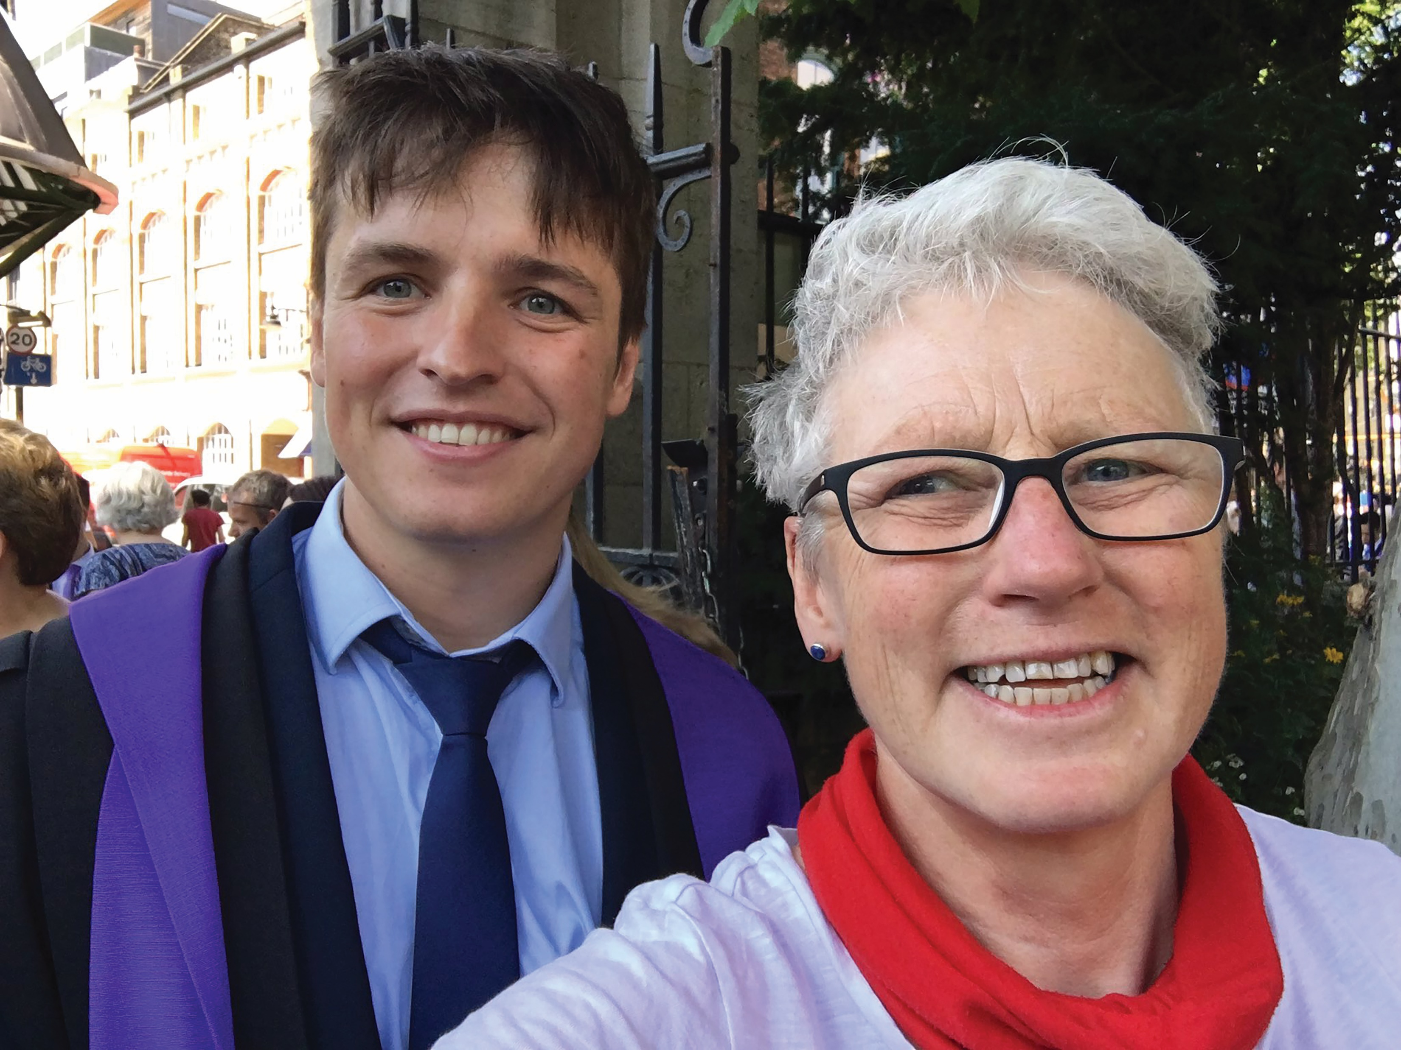
PATHWAY FROM SCHOOL TO ACADEMIC PRIMARY HEALTH CARE
Trish says to see what particular medical schools require at A-Level (typically biology, chemistry, and maths and/or physics).
She emphasises the importance of getting involved in research projects once at university – she says academic recruiters pay more attention to these research experiences than to the specific choice of A-level subjects.
Once you have your medical degree, you’ll need to do a PhD before being ready to lead your own research study. These can be done part-time while also pursuing your clinical training.
Trish with her son Al at his graduation when he qualified as a doctor in 2017.

Slide 17
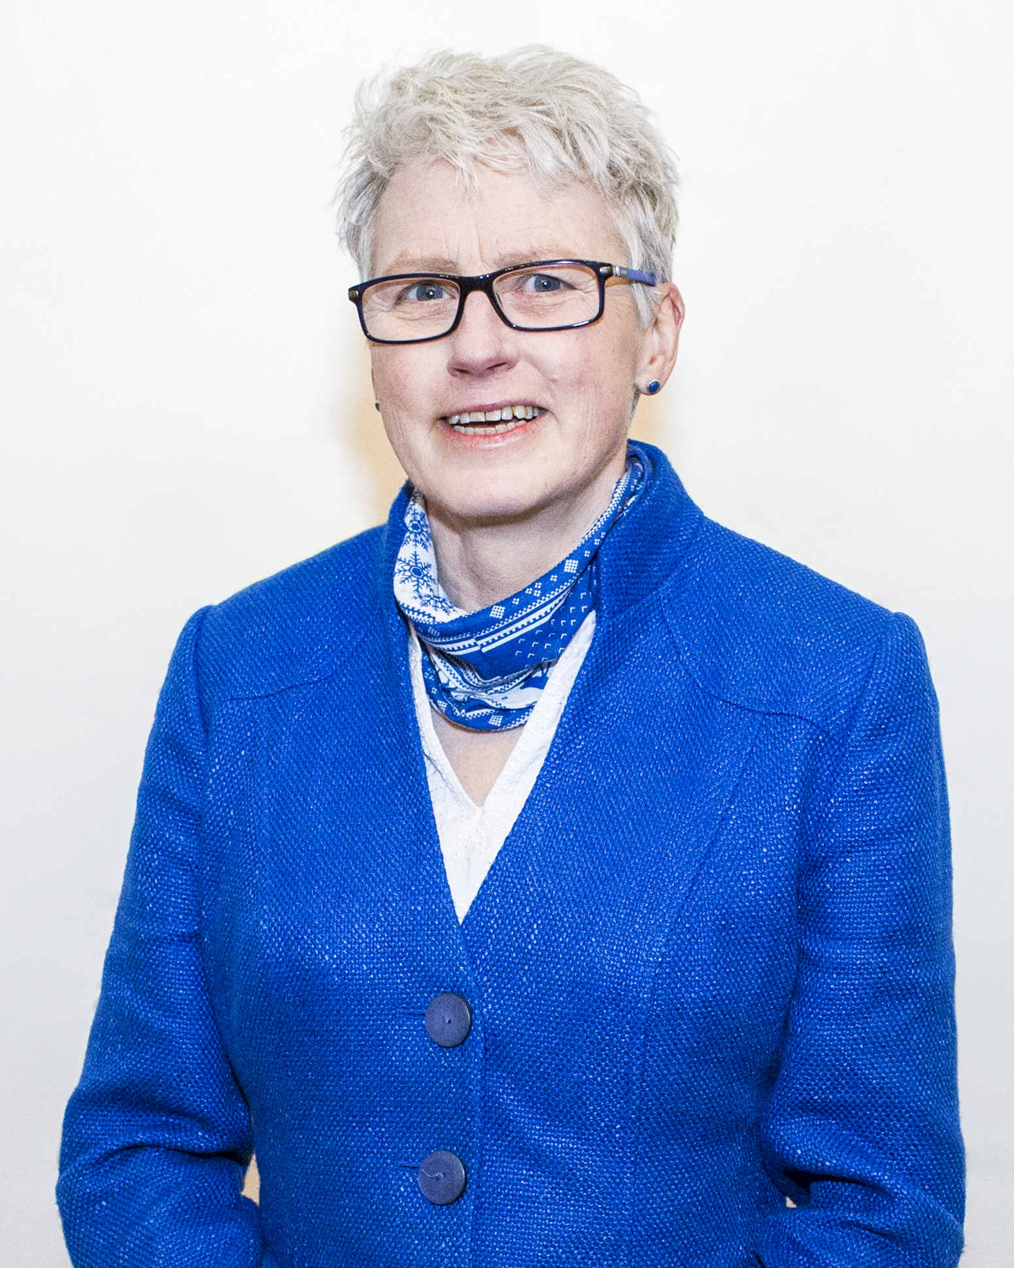
HOW DID TRISH BECOME A GP AND PRIMARY HEALTH CARE ACADEMIC?
WHAT WERE YOUR INTERESTS WHEN YOU WERE GROWING UP?
I did a lot of sport. I swam, played hockey, and ran cross-country. I was also in the St John Ambulance Brigade and the Royal Life Saving Society, which were excellent preparation for medical school. I still love sport, and after university I was briefly in the UK Ironman triathlon team. Sport was a great relaxation for me when studying hard for exams, which you have to do to succeed in medicine. It also taught me self-discipline and the value of teamwork. You don’t have to be good at sport to get into medical school – other leisure activities which prepare you well include music, drama or being on a school council.
WHAT INSPIRED YOU TO BECOME A GP?
A patient. I initially trained as a hospital doctor, specialising in diabetes. One patient, who I had helped with some tough challenges in her life, turned to me and said, “I wish you were my GP.” That made me realise that I wanted to care for all aspects of people’s health, not just diabetes.

Slide 18
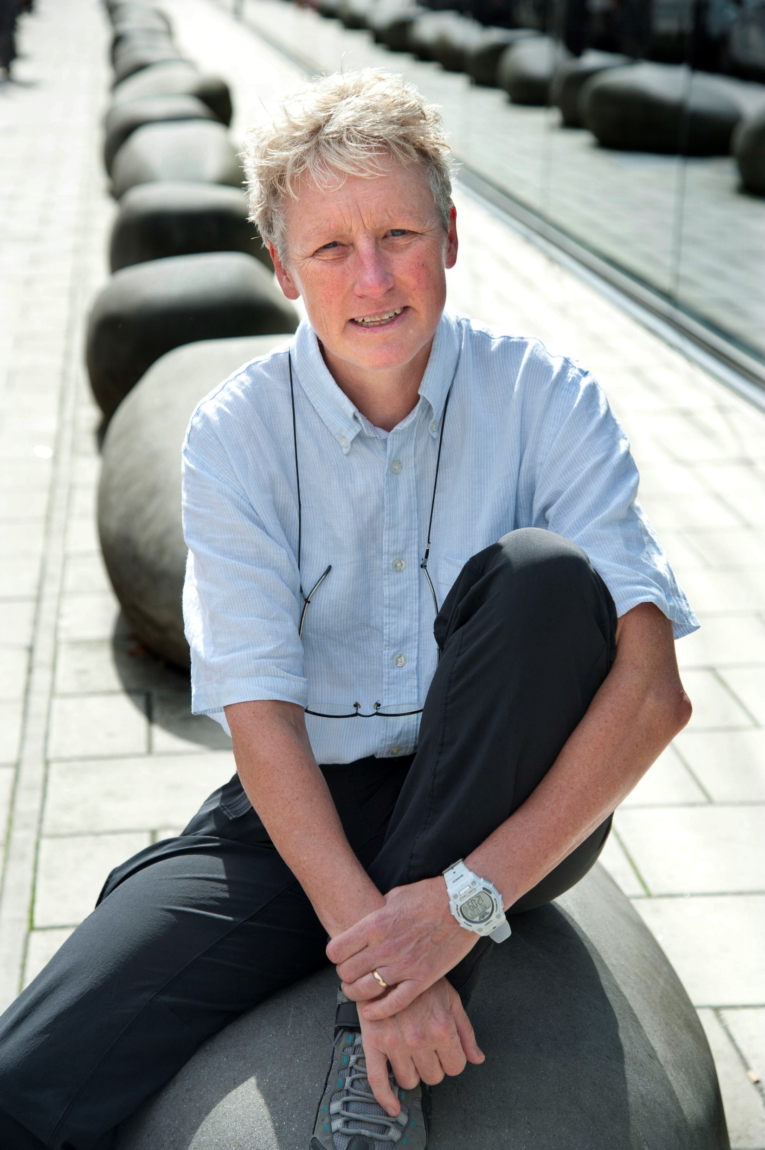
HAVE YOU HAD ANY EUREKA MOMENTS IN YOUR CAREER?
There have been few eureka moments. It’s a bit like motherhood – on a day-to-day basis it feels like slow progress, but when you look back at what you’ve created, be it a well-adjusted child or a life-saving research programme, you see it’s worth the grind.
HOW DO YOU SWITCH OFF FROM YOUR WORK?
I never go a day without exercise. I begin each day at 6am with 40 minutes of yoga and stretching. I am also a wild swimmer, plunging into the Thames all year round. With a husband and two grown-up children, I make sure I enjoy family life, as well as academia and medicine!
WHAT ARE YOUR PROUDEST CAREER ACHIEVEMENTS SO FAR?
In 2001, I received an OBE for Services to Medicine from the Queen. I also think I played a part in persuading UK policymakers to introduce mask mandates during the pandemic, which have probably saved many lives.

Slide 19
TALKING POINTS
What does academic primary health care involve?
What skills and attributes does Trish suggest you need for a career in her field? To what extent do you have these skills?
How could you develop your skills and knowledge in the subject areas Trish mentions?
How do you think you could get involved with research projects at university?
What do you think motivates Trish to do the work she does?

Slide 20
MEET LAIBA
LAIBA HUSAIN is a PhD student who works closely with Trish.
She has:
conducted interviews and facilitated virtual discussion groups with people who have had long COVID
led a design project to create resources for patients
been involved with the RECAP study to develop the tool for identification of COVID-19 patients who are at higher risk of poor outcome.
Let’s learn more about her work…

Slide 21
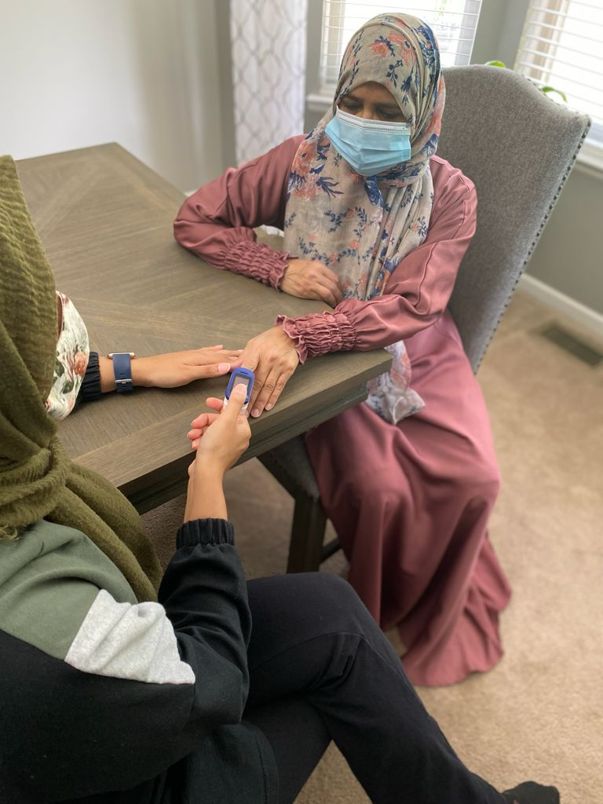
WHAT LED YOU TO THIS PROJECT?
Before moving to the UK, I was involved in community engagement projects with incoming Syrian refugees back home in Michigan, USA.
Once I had started my Fulbright Scholarship here in the UK, I began research into qualitatively exploring trust in healthcare within UK refugee and migrant populations.
I realised how valuable it is to work with vulnerable populations on their healthcare needs, especially if research can help those populations who don’t have a voice of their own.
After graduating, I worked with an autism charity to research ways of using video technology to diagnose autism.
When I began working with Trish on the Remote-by-Default Care project, I was able to further explore this interaction of vulnerable populations and digital inclusion, and here we are now!
Laiba measuring blood oxygen levels with an oximeter.

Slide 22
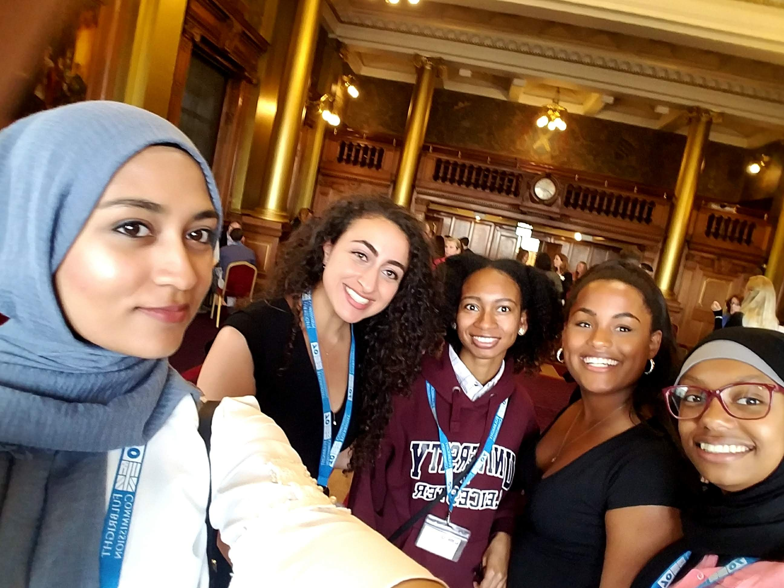
WHAT DOES YOUR PHD COVER?
My research question is: What are the barriers to remote consultations for those with low uptake (especially BAME, low-income, and older people), and how can we work in partnership with patients and the public to help overcome these?
HOW DOES YOUR PHD TIE IN TO THE REMOTE-BY-DEFAULT CARE PROJECT?
The pandemic has shown the usefulness of remote consultations to deliver care, but for them to be truly effective, they need to be a routinely used part of our health system. Remote consultations can be very different to in-person consultations, so there is a need to monitor and support adoption of this technology by patients as part of the implementation process. It is worth noting that COVID-19 has had a disproportionate impact on the elderly, the poor, and those from BAME groups. Ironically, these are also the groups who, overall, are least able to effectively access digital consultations. My PhD aims to produce a rich and detailed understanding of the barriers they face, and how they can be overcome, to ensure effective and equitable care for all.
Laiba and friends at a Fullbright event.

Slide 23
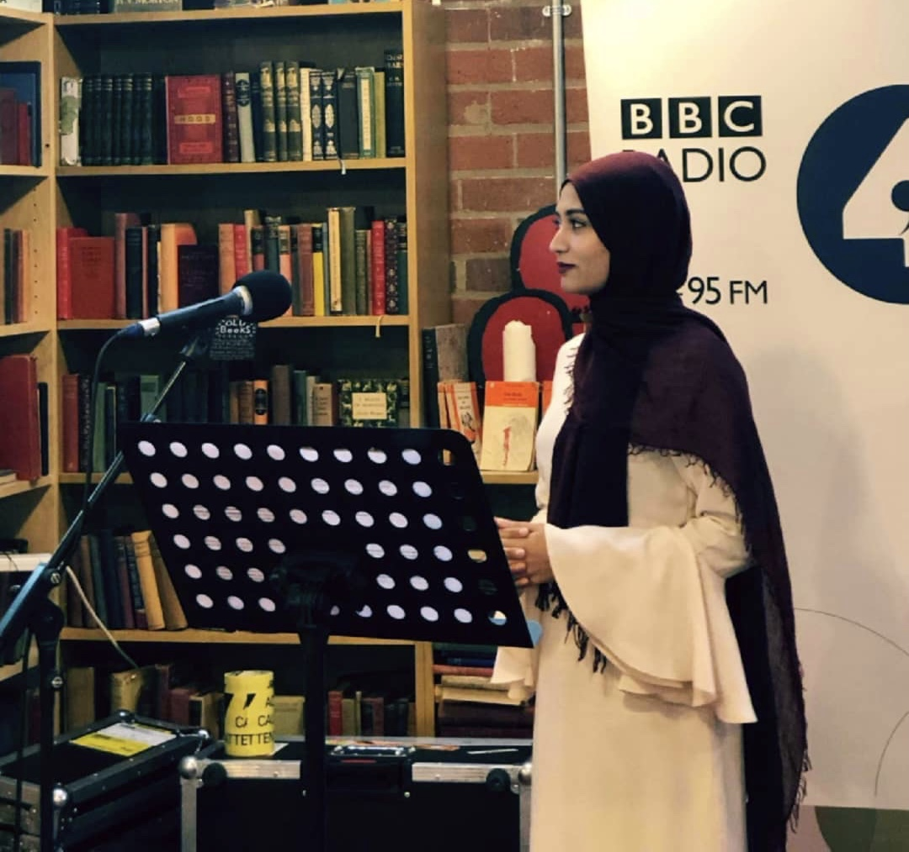
WHAT CHALLENGES DOES THIS RESEARCH POSE FOR YOU?
We’ve been organising structured sessions to address the challenges faced by clinicians and service providers when using video consultation platforms. These platforms have been successful within small-scale pilot projects, but the routine use of video consultations nationwide remains limited. This is because they bring in major changes to the nature of care, such as changes to workflows for clinicians and new barriers for patients, especially those with lower digital capabilities. These sessions have given me an in-depth understanding of the challenges involved in scaling up, and the barriers to patient adoption.
HOW HAVE YOU FOUND BEGINNING A PHD IN A PANDEMIC?
Being a PhD student involves a lot of independent study and work, and this has been amplified by the pandemic. I’ve learned to adapt and find it really helpful to maintain a routine and study schedule at home. I have my own study space and schedule breaks to get some exercise and fresh air, which makes all the difference.
Laiba giving a talk on BBC Four Thought on the empowerment of Muslim women.

Slide 24
PUBLIC HEALTH RESEARCH…
covers anything that affects the health of populations. This can be purely biological, such as genetics; environmental, such as air quality; or social, such as equity and accessibility. Research findings can be used to provide evidence for changes to policy, to improve population health and well-being.
“A career in research can be challenging. We are constantly made to question our assumptions and produce new outputs. However, the collaborative nature of research also broadens your mind, connecting you to people who help your research develop in unforeseen ways. A research career is quite holistic, involving adaptation, curiosity, and teamwork skills…
You are able to try out new ideas, experiment with cutting-edge technology, and take part in engaging discussions. I am proud to be part of a network that is working to improve people’s lives.”
“I recommend starting early to prepare for a career in public health research. Look for local volunteer work, involvement in non-profit organisations, and public health internships. This will give you a better sense of what a career in the field could entail. Some university courses offer a semester abroad in a global health programme, which can be a great way to gain an international perspective.”
- Laiba

Slide 25
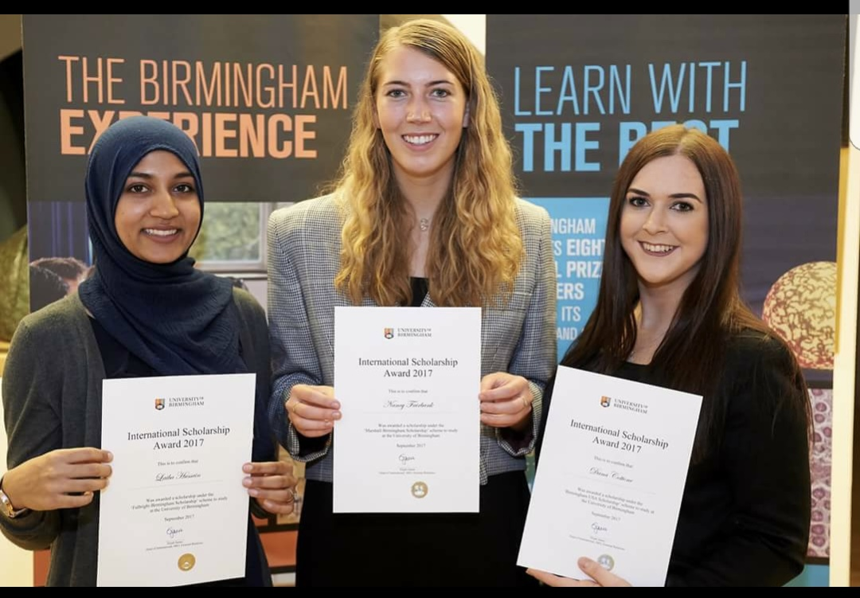
PATHWAY FROM SCHOOL TO PUBLIC HEALTH RESEARCH
Laiba recommends an undergraduate degree in one of the human sciences (such as psychology or sociology) and then seeking university master’s courses with a clear research component where you would learn qualitative methods (such as how to conduct interviews with people) and quantitative research methods (such as how to analyse datasets using statistics).
Laiba did a psychology and neuroscience bachelor’s and a public health master’s. Her route illustrates how people without a medical degree can build a career in a health-related subject with a view to going on to lead research in that field.
Laiba (left) was awarded the US-UK Fulbright Scholar Award to conduct public health research and study abroad.

Slide 26
HOW DID LAIBA BECOME A PUBLIC HEALTH RESEARCHER?
WHAT WERE YOUR INTERESTS WHEN YOU WERE GROWING UP?
I loved to read! I still try to find time to read now. When I was younger, I would practically live in the library.
WHAT INSPIRED YOU TO BECOME A RESEARCHER?
My mentor (and now PhD supervisor) Trish Greenhalgh has been my main inspiration. She is absolutely brilliant and watching her in action daily has exemplified what it means to be a successful researcher and an amazing woman. I can only dream of being at her level one day!
WHAT ATTRIBUTES HELP MAKE YOU SUCCESSFUL AS A RESEARCHER?
I think my curious nature and focused work ethic have played a big part. Resourcefulness, tenacity and strong attention to detail are also worthwhile traits.
HOW DO YOU SWITCH OFF FROM YOUR WORK?
I love art – I paint, crochet, and do design work in my free time. This creative outlet helps me relax and unwind.

Slide 27
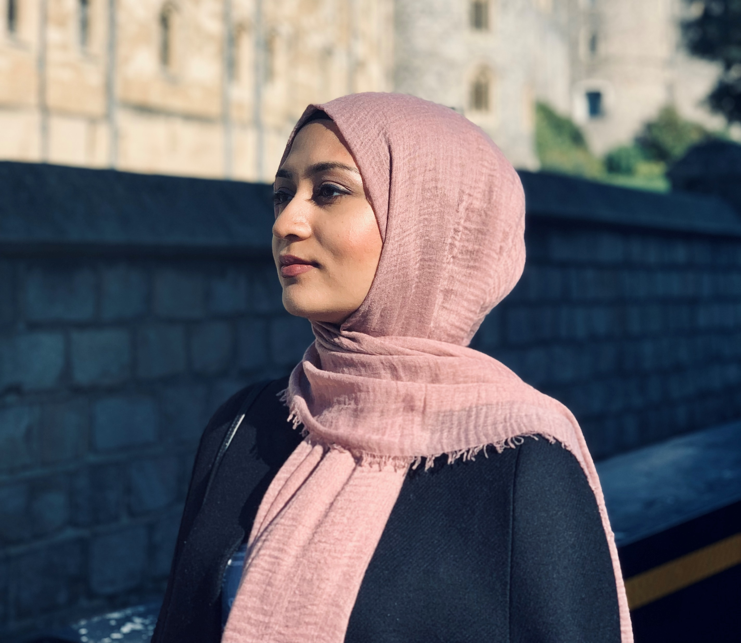
WHAT ARE YOUR PROUDEST CAREER ACHIEVEMENTS SO FAR?
I was proud to receive the THIS Institute Fellowship Award to do my PhD at Oxford! Another great moment was being awarded the US-UK Fulbright Scholar Award to conduct public health research and do my MPH abroad. Also up there is when I gave a talk on BBC Four Thought on the empowerment of Muslim women.
WHAT ARE YOUR GOALS AFTER YOU HAVE COMPLETED YOUR PHD?
I plan to do a post-doctoral fellowship and ultimately work my way up to professorship.
LAIBA’S TOP TIP
Always be open to new opportunities! Your university years will be a great time to step outside of your comfort zone and explore various fields outside of the classroom setting. Become a student researcher, get involved in student-run campus organisations, and don’t be afraid to ask professors and lecturers for advice.

Slide 28
TALKING POINTS
What types of people are considered ‘vulnerable’ in Laiba’s research?
What do you think motivates Laiba in the research she does?
What challenges does research pose? What rewards does it offer?
Which human science subjects interest you and why? Which would you like to explore further?
When did you last take advantage of an opportunity? What opportunities would you like to be able to seize in the future?

Slide 29
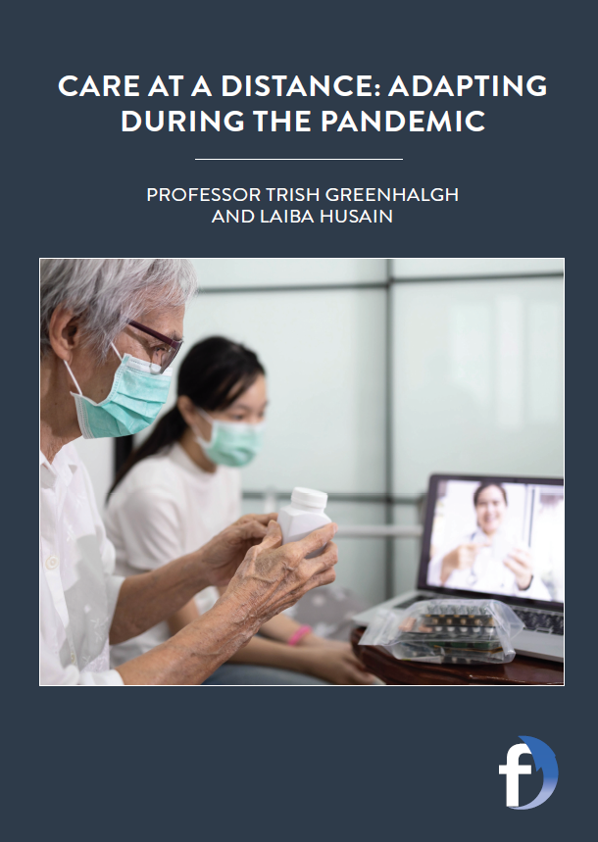
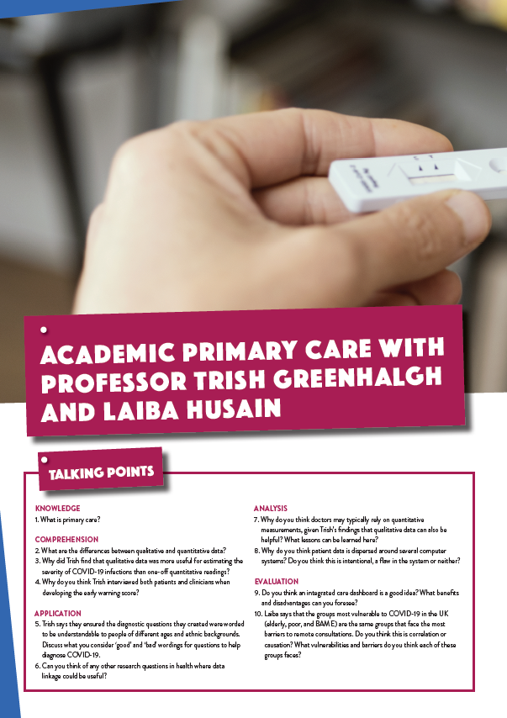
Dig deeper into Trish and Laiba’s research.
Download their activity sheet.

