Slide 1
Accounting research
with Dr Sanjay Banerjee
GET STARTED
www.futurumcareers.com

Slide 2
In this presentation:
Climate risks
Climate disclosure
What affects climate disclosure?
In the real world
Talking points
About accounting research
Pathway from school to accounting research
Explore careers in accounting
Talking points
Sanjay’s career
Sanjay’s top tips
Talking points
© Rawpixel.com/Shutterstock.com
02 futurumcareers.com

Slide 3
Meet Sanjay
At the University of Alberta, in Canada, Dr Sanjay Banerjee is looking at how climate change is affecting accounting and business.
He is studying what factors influence companies to voluntarily disclose the level of climate risk they face, what the consequences of such disclosures are, and what this means for the wider world of finance and policy.
Learn more about his work…
Dr Sanjay Banerjee
03 futurumcareers.com

Slide 4
Climate risks
Climate change presents two types of risks to businesses:
Physical climate risks refer to the direct effects of the changing climate, such as drought, wildfires, hurricanes or sea level rise. These can all affect businesses through damaging their production lines or stores, disrupting supply chains, or impacting the daily life of their workforce.
Transition risks refer to the uncertainties around the transition to a low-carbon economy. For example, companies may have to pay higher energy costs if carbon tax policies are introduced, or they may make investments in new, unproven green technologies.
“It’s estimated that large climate disasters cost the US between $300 to $500 billion every five years.”
– Sanjay
© metamorworks/Shutterstock.com
04 futurumcareers.com

Slide 5
Climate disclosure
Businesses rely on investors to provide the capital that keeps their operations running. This means that they listen closely to investors’ wants and needs to keep them happy.
“Investors are increasingly demanding climate disclosure, which involves companies sharing the level and type of climate risks that they are exposed to. This helps investors decide the value of the company and whether they should invest.”
– Sanjay
Sanjay is investigating how investors’ demands impact companies’ decisions to make such disclosures.
© William Potter/Shutterstock.com
05 futurumcareers.com

Slide 6
What affects climate disclosure?
Sanjay uses machine learning to study documents from thousands of companies and learn about their approaches to climate disclosure.
“We found evidence that companies are more likely to make voluntary climate disclosure if the company is a top emitter of greenhouse gases, if its investors are the so-called ‘Big Three’ (BlackRock, Vanguard and State Street), or if it received climate-related shareholder proposals.”
– Sanjay
There is growing incentive for climate disclosure, as investors see the value in such disclosures and will value the company’s stock higher, leading to more investment.
© Dillxr/Shutterstock.com
06 futurumcareers.com

Slide 7
In the real world
“Our findings will inform investors, regulators and companies about how investors’ demand for disclosure influences companies’ decisions. For instance, if investor demand is found to have insufficient impact, then regulators may have to step in to make climate disclosure compulsory.”
– Sanjay
Looking ahead, Sanjay wants to take a deep dive into physical climate risks – a topic with limited research, so far. It is only recently that models and datasets have grown sophisticated enough to perform this research, and he is excited to see what it reveals.
© Lucian Coman/Shutterstock.com
07 futurumcareers.com

Slide 8
Talking points
What are physical climate risks?
What are transition risks?
Why is it important that businesses listen to their investors?
Why are investors interested in climate risks?
What is climate disclosure?
What motivates companies to make climate disclosures?
08 futurumcareers.com

Slide 9
About accounting research
Accounting involves the recording and organisation of business’ financial transactions.
Accounting research examines these practices and how they affect the wider world.
Sanjay’s work involves examining businesses’ accounting practices and how these relate to business behaviour, policy, regulation and societal trends.
“I love to understand the ‘why’ behind the ‘what’. Why does a manager behave in a certain way? Why don’t companies disclose their climate risks as much as their investors demand? Why does a regulator make a certain policy decision? Why did the stock price of a company fall after a new regulation? I also love to have the freedom to choose what I want to investigate.”
– Sanjay
© TippaPatt/Shutterstock.com
09 futurumcareers.com

Slide 10
© SFIO CRACHO/Shutterstock.com
About accounting research
“Machine learning and artificial intelligence (AI) are transforming the field of accounting and will continue to do so. Accountants today and those in the future need to understand these. Already, big accounting firms are investing in training their employees in these areas, as AI is likely to set new trends in the future.”
“Accounting influences society in ways that, typically, we don’t realise. Investors’ decisions to invest depend on companies’ financial reports, which are audited by accountants. If this isn’t done properly, there are real-world impacts: investors will not feel confident to invest in companies, and, with a lack of investment, people might lose their jobs, a relative might lose part of their pension, for instance. Accountants are vital for investors to have trust in companies.”
– Sanjay
10 futurumcareers.com

Slide 11
Pathway from school to accounting research
You should be comfortable with numbers, be meticulous and precise, practise clear and concise writing, develop soft skills, and stay up to date with technology.
Subjects to study at school and beyond include mathematics, statistics, language and sciences.
For accounting practice, a professional licence in chartered (public) accountancy is needed. At university, a bachelor’s degree in business with a major in accounting can be helpful but not necessary. A bachelor’s degree in any discipline can be a starting point for someone to pursue a career in accounting, as long as they complete a certain number of credit-hours of accounting-related coursework and pass the professional licensing exam.
For accounting research, a licence is not needed; rather, a PhD in accounting is the right qualification. A bachelor’s degree in any discipline, including business, economics, engineering, mathematics and science, can be useful.
11 futurumcareers.com

Slide 12
Explore careers in accounting
The University of Alberta has a wide variety of outreach initiatives, which you can learn about in this report.
You can also learn more about the Department of Accounting and Business Analytics, where Sanjay works.
CPA Alberta and CPA Ontario provide information for high school students about careers in chartered accountancy and offer scholarships, ambassador programmes and events.
In Canada, a chartered accountant makes an average of CAN $80,000 per year, according to Talent.com.
© Rawpixel.com/Shutterstock.com
12 futurumcareers.com

Slide 13
Talking points
In what ways do you think accounting is making use of machine learning?
How can accounting and investment impact people’s everyday lives?
Of the skills mentioned on the ‘Pathway…’ slide, which are you confident in, and which do you need to develop further? How could you go about doing so?
13 futurumcareers.com

Slide 14
Sanjay’s career
“I never originally intended to pursue a career in accounting. My undergraduate degree was in aerospace engineering, and I later worked on missile design and in a variety of other industries. It was only while studying for my PhD that I found two courses especially interesting – and both focused on accounting.
“Before, I had subscribed to the common perception that accounting is boring. These two courses showed me otherwise. One, led by Professor Chandra Kanodia, covered how to develop models to understand and predict how accounting information impacts managers’ and investors’ strategic decision making. The other, by Professor John Dickhaut, looked at testing the predictions of these models by conducting experiments in the laboratory.”
Dr Sanjay Banerjee
14 futurumcareers.com

Slide 15
Sanjay’s career
“The publication of my first paper after my PhD was a proud moment. It was published in 2016 in an accounting journal and covered the banks’ response to the 2008 financial crisis. We conducted experiments in the laboratory to understand how people make decisions, and we uncovered interesting findings – that, sometimes, providing people with more information can lead them to make bad decisions!
“Much more work is required to mitigate climate risk right now. Even though there’s a lot of talk, we still need much more research and action. Another emerging area of interest to me is cryptocurrencies, which are currently subject to very little regulation. I want to study these areas in more detail – and to design a course on sustainability accounting, too.”
© Dillxr/Shutterstock.com
15 futurumcareers.com

Slide 16
Sanjay’s top tips
To be a good accountant you need to like numbers, precision and computers. But more than that, a diverse set of interests and experience of industry can help a lot.
It’s never too late to begin a career in accounting research – in fact, diverse experiences can help. My own career path was far from direct!
Always remain curious.
16 futurumcareers.com

Slide 17
Talking points
What changed Sanjay’s perceptions of accounting?
How do you think it feels to publish an academic paper? Why do you think this was such a proud moment for Sanjay?
Why do you think Sanjay is interested in studying cryptocurrencies? What types of research questions might he investigate in this area?
Which of Sanjay’s top tips do you find most useful, and why?
What do you think you would find rewarding about a career in accounting research, and why?
17 futurumcareers.com

Slide 18
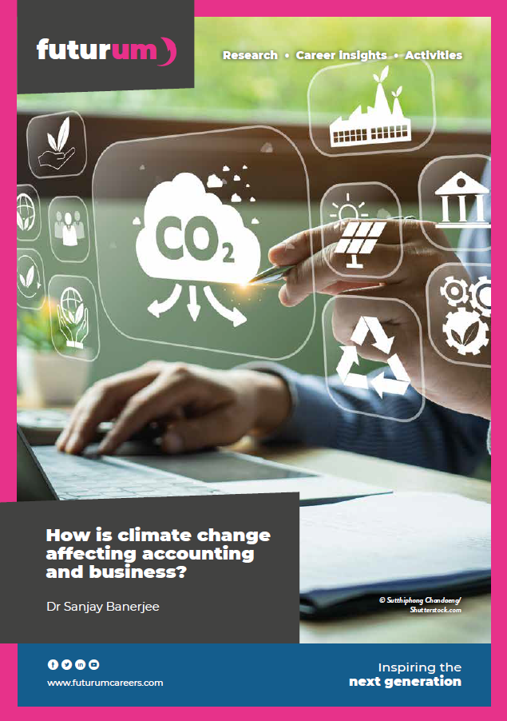
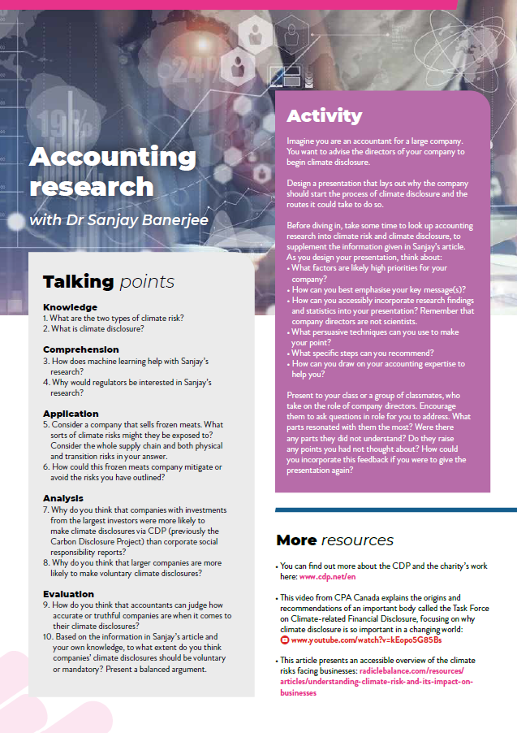
More resources
Download Sanjay’s activity sheet
Download the podcast PowerPoint
01
Download Sanjay’s article
02
03
Listen to
Sanjay’s podcast
04
16 futurumcareers.com

