Slide 1
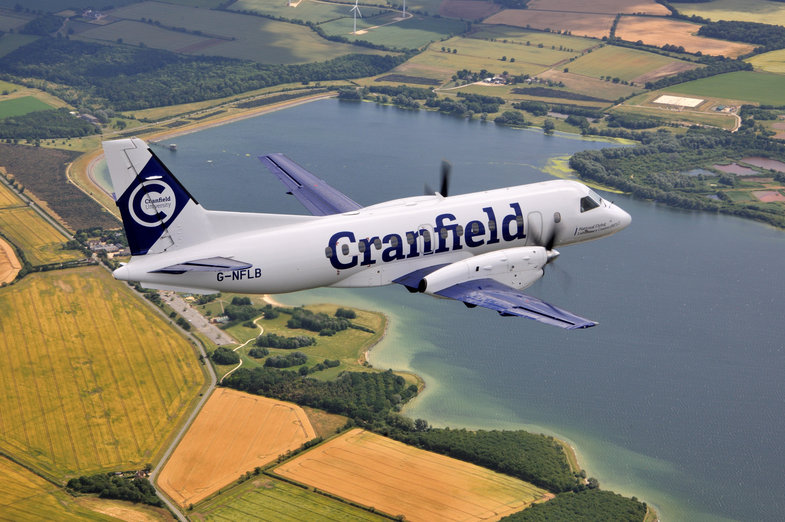
Careers in aviation
The Centre for Air Transport Management
and
The National Flying Laboratory Centre
at
Cranfield University
GET STARTED
www.futurumcareers.com
© Keith Wilson/SFB Photographic

Slide 2
In this presentation:
Introduction
Aviation careers:
Pilot
Engineering
Air transport
Aviation safety
Aviation sustainability
Pathways to careers in aviation
Talking points
Meet the team
Talking points
More resources
© Graham Braithwaite
2 www.futurumcareers.com

Slide 3
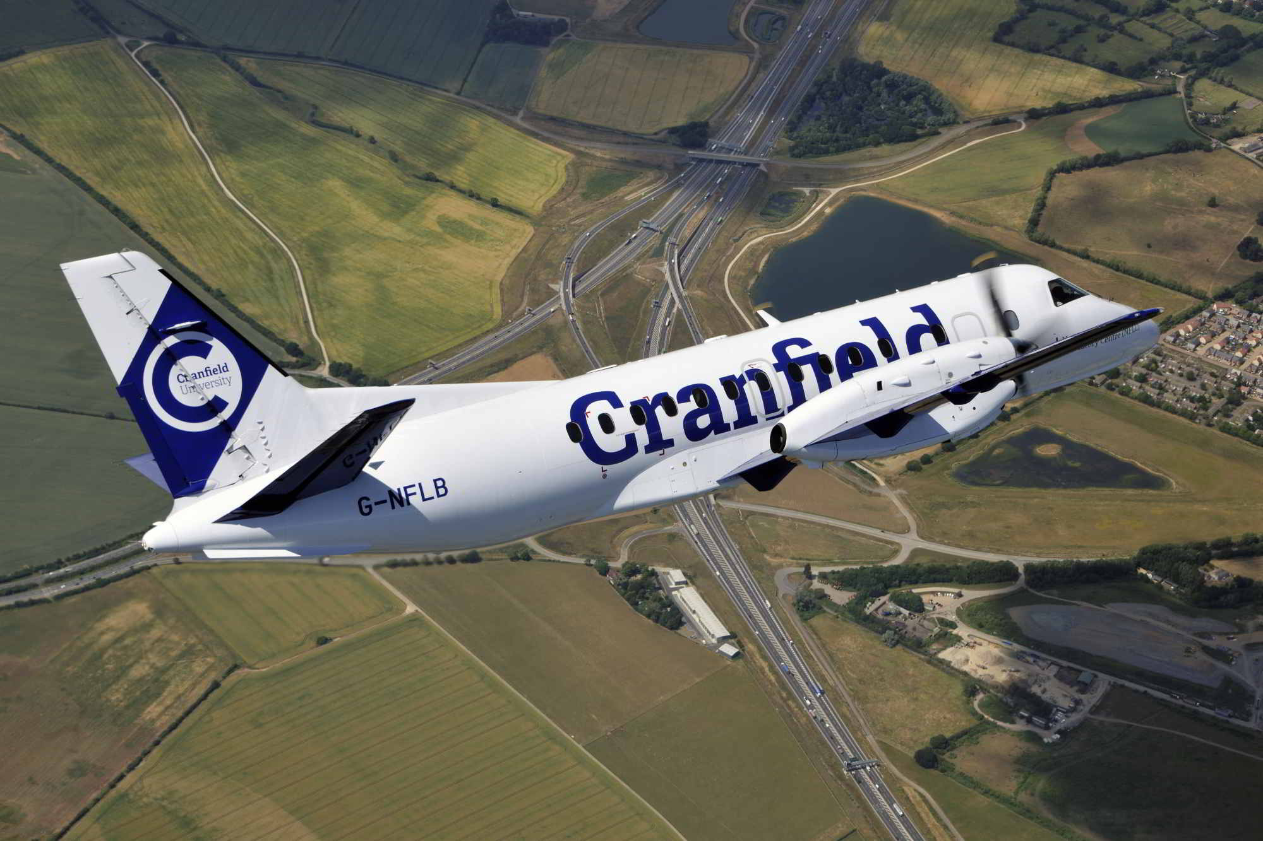
The sky is the limit!
In this presentation, members of the Centre for Air Transport Management and the National Flying Laboratory Centre (NFLC) at Cranfield University in the UK explain the breadth of possible careers in the aviation industry.
© Keith Wilson/SFB Photographic
3 www.futurumcareers.com

Slide 4
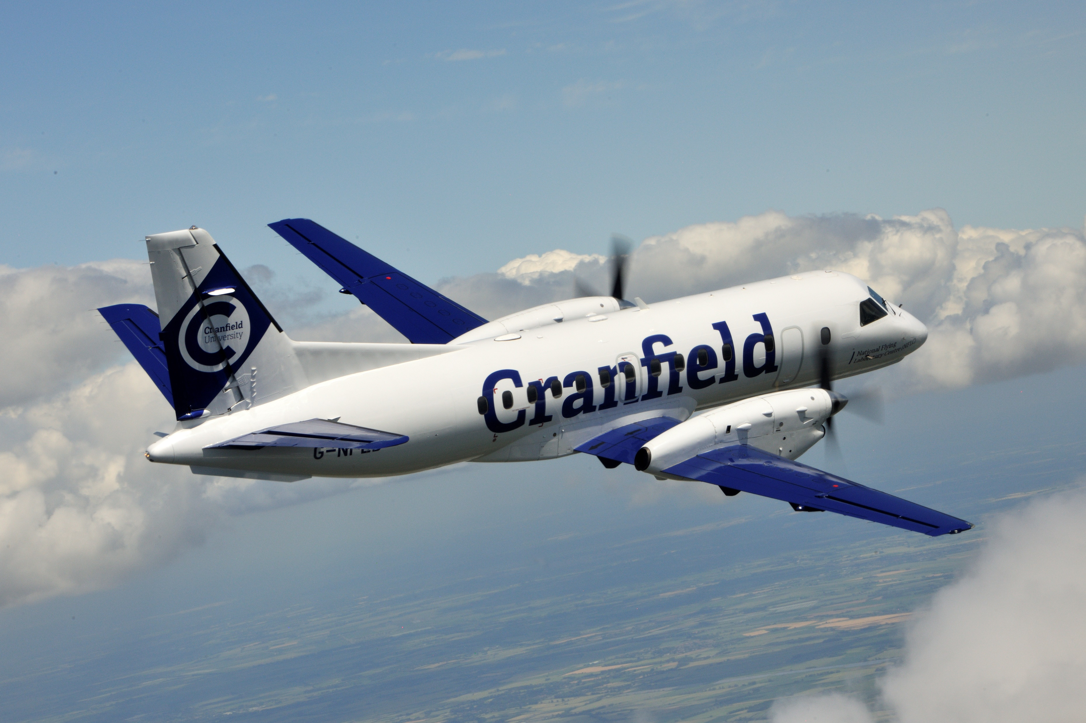
Careers in aviation
From the well-known roles of pilots, cabin crew and engineers, to lesser-known occupations in safety, compliance and air transport management, careers in aviation are diverse and interesting.
“Aviation remains one of the most exciting career options out there for young people!” – Rob Harrison, Head of the NFLC
4 www.futurumcareers.com
© Keith Wilson/SFB Photographic

Slide 5
Careers as a pilot
Rob Harrison has worked as a military pilot, flying jets on the front line of warzones, a commercial pilot, transporting goods and passengers around Europe, and a flight instructor, educating students in the NFLC’s aircraft.
A pilot must understand the technical complexities of the aircraft they are flying, and weather systems, which impact the safety and comfort of a flight.
Pilots need to be quick thinking, analytical and calm. Being able to constantly assess and respond to situations is essential.
“Having a Plan B is crucial when you’re a pilot. If something goes wrong, you can’t just stop and get out!” – Rob
Rob (left) is a pilot for the NFLC’s aircraft
© Cranfield University
5 www.futurumcareers.com

Slide 6
Pathway from school to
a career as a pilot
At school, focus on STEM subjects, especially maths and physics. Geography will teach you about weather systems, and foreign languages will open overseas travel opportunities.
There is no set degree for becoming a pilot, but you will need to undertake theoretical training and clock up many hours of flying before you qualify for a pilot licence.
“Join your local air cadet squadron, even if you’re not interested in a military career. You will be with other aviation-minded young people and have access to flying opportunities that do not exist elsewhere.” – Rob
In the UK, you can gain flight experience and pilot training as a Royal Air Force (RAF) Air Cadet.
Rob enjoys aerobatic flights!
6 www.futurumcareers.com

Slide 7
Careers in
aviation engineering
Aeronautical engineers design, develop and test all aspects of an aircraft, from the electronics in the navigation system to the turbines in the engines.
Other fields of engineering also contribute to the technological advances in aviation. Dr Simon Place is a mechanical engineer with a background in flight dynamics. He specialises in air transport engineering, aircraft systems and aviation safety.
With an engineering career in aviation, you could find yourself studying the aerodynamics of aircraft wings using wind tunnel experiments and computer simulations or testing new composite materials to build more efficient aircraft.
Aeronautical engineers test aircraft aerodynamics in Cranfield’s wind tunnel
© Cranfield University
7 www.futurumcareers.com

Slide 8
Pathway from school to aviation engineering
At school, focus on STEM subjects, especially maths and physics.
At university, consider a degree in aeronautical, aerospace, mechanical or electrical engineering.
If you want to learn on the job, without attending university, look for apprenticeships in the aviation industry with companies such as Airbus, BAE Systems, Marshall Aerospace, Rolls-Royce, British Airways and the RAF.
© Cranfield University
8 www.futurumcareers.com

Slide 9
Careers in air transport
The aviation industry is supported by a huge range of air transport professionals, including check-in agents, baggage handlers, cabin crew, air traffic controllers, technicians and fleet managers.
Professor Anna Smallwood spent many years managing the aircraft fleets and airline operations of commercial airlines.
“Taking delivery of the first Boeing 787 Dreamliner was the culmination of hard work that involved examining every aspect of operating the aircraft, from studying its safety and performance to determining its maintenance requirements, as well as preparing crew, IT systems and ground service equipment and personnel to be ready to deal with this new type of aircraft.” – Anna
© Cranfield University
9 www.futurumcareers.com

Slide 10
Pathway from school to careers in air transport
The range of careers in air transport means there are many pathways to reach them.
At school, English will improve your communication skills which is useful for all careers. Foreign languages will open overseas travel opportunities for cabin crew.
Careers in air transport management could benefit from a degree in business, management or economics.
The International Air Transport Association and the Airports Council International provide webinars and interesting reports about different topics relating to air transport.
© Cranfield University
10 www.futurumcareers.com

Slide 11
Careers in
aviation safety
Every part of the aviation industry includes roles specialising in safety to ensure that every aspect of flying is as risk-free as possible.
Rhiannon Daye is the NFLC’s aviation safety and compliance manager. This involves monitoring the safety of the NFLC’s aircraft to identify potential hazards before they become a safety concern and investigating aviation incidents around the world.
“We can take measures to reduce the likelihood of an incident happening, through training, communication, devising new procedures or even changing physical structures.” – Rhiannon
© Graham Braithwaite
11 www.futurumcareers.com

Slide 12
Pathway from school to aviation safety
At school and university, studying psychology will teach you about human behaviour. This is important for understanding the human factors in aviation safety.
Cranfield University offers a master’s degree in safety and human factors in aviation.
© Cranfield University
12 www.futurumcareers.com

Slide 13
Careers in
aviation sustainability
The aviation industry is infamous for its contribution to climate change. Airport and airline management, aircraft manufacture, industry and government regulatory bodies, and specialist consultancies all now include roles aimed at improving aviation sustainability.
For example, carbon strategy managers monitor carbon dioxide emissions from airports and devise ways to reduce these, while airline sustainability managers address environmental impacts, including carbon dioxide emissions, noise pollution and waste management.
Dr Thomas Budd specialises in aviation sustainability and is exploring whether hydrogen can be used as a ‘clean’ fuel for aircraft.
13 www.futurumcareers.com

Slide 14
Pathway from school to
aviation sustainability
The range of careers in aviation sustainability means there are many pathways to reach them.
At school, you will learn about the Earth’s natural processes and how human activity is affecting this balance in geography, and about fuels and reactions in chemistry.
With a degree in engineering, you could redesign aircraft to improve their energy efficiency.
“Because there is currently such a focus on aviation sustainability, it’s a really exciting time to be thinking about a career in this sector!” – Thomas
© Keith Wilson/
SFB Photographic
14 www.futurumcareers.com

Slide 15
Pathways to
careers in aviation
“There is no pre-prescribed route to careers in aviation.” – Thomas
With such a wide range of careers in aviation, you can follow any path that suits your interests and direct it towards your desired career.
Attend careers fairs, such as those organised by the Royal Aeronautical Society.
Cranfield University is a postgraduate university that offers courses in a wide range of aviation-related topics, from airport planning and aerospace dynamics to aircraft engineering and aviation safety.
15 www.futurumcareers.com
© Keith Wilson/SFB Photographic

Slide 16
Talking points
What skills and personal attributes does a pilot need?
How do engineers contribute to the aviation industry?
What does managing an aircraft fleet involve?
Why is an understanding of psychology important for ensuring safety across the aviation industry?
How is the aviation industry reducing its negative environmental impacts?
Which of the many careers in aviation most interests you, and why?
What pathway could lead you to this career? What qualifications and/or experience do you need, and how could you gain these?
16 www.futurumcareers.com
© Cranfield University

Slide 17
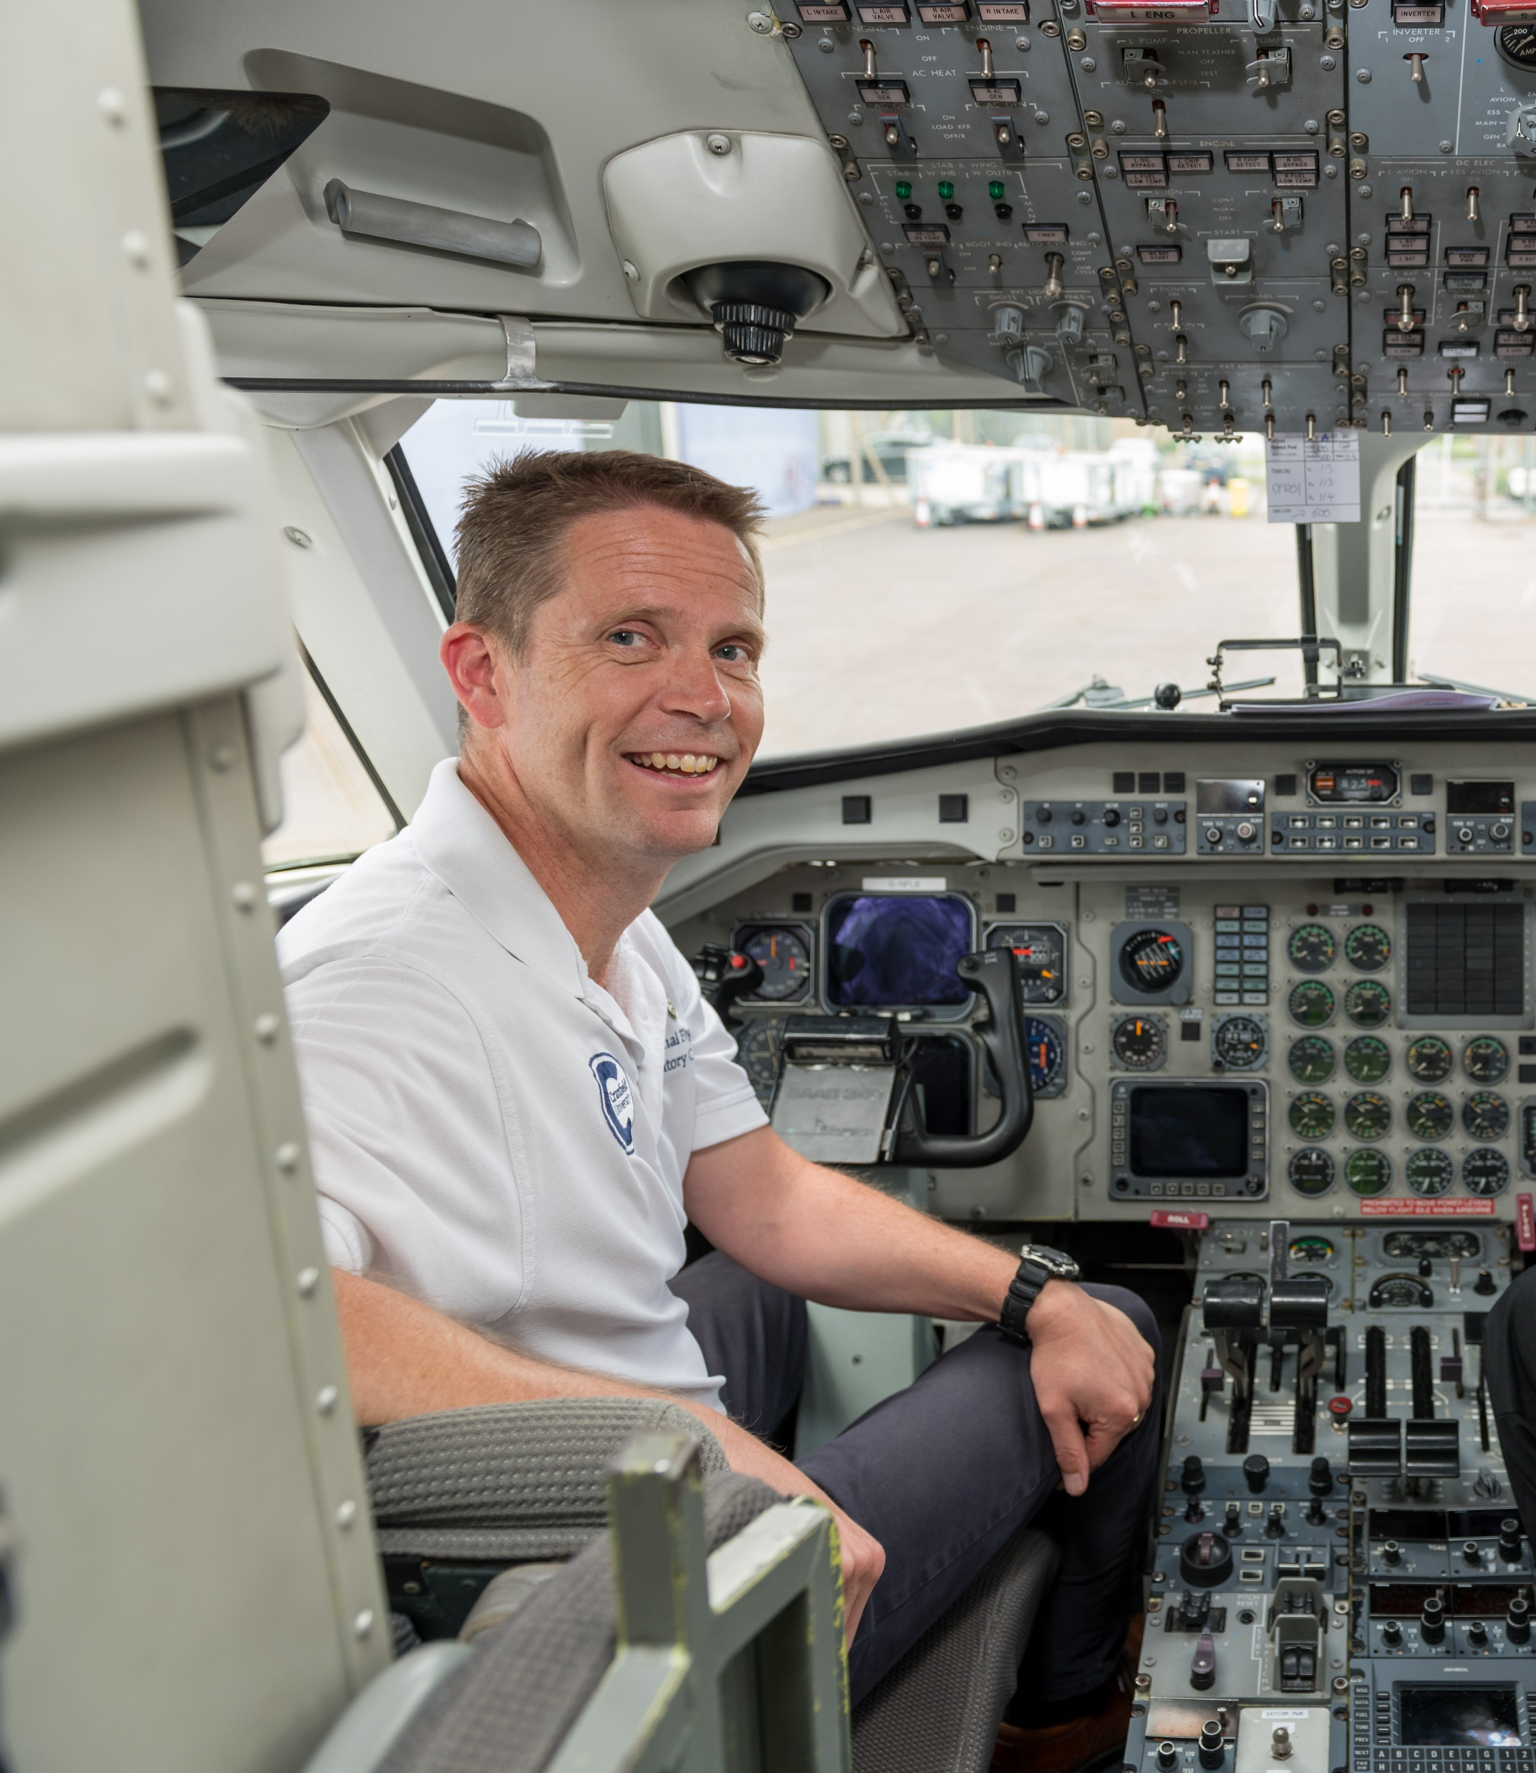
Meet Rob
I flew a plane for the first time when I was 14 years old. I’ve always wanted to be a pilot, and I’ve always been fascinated with the idea of flight. Aged 13, I joined the RAF Air Cadets which allowed me to achieve my dream of becoming a fighter pilot.
I studied astrophysics at university, then returned to the RAF. I flew the Tucano aircraft as a flight instructor and display pilot, then the Jaguar aircraft as a military pilot on the front line.
After leaving the RAF, I gained my commercial pilot licence and worked as a business jet pilot, travelling from the Arctic Circle to North Africa, and from beaches to high up in the Alps.
Being a pilot gives me a sense of freedom. The job is always a challenge, and there is a constant need to train and prepare. Every flight is different, and there is always something to learn, so it’s never boring.
17 www.futurumcareers.com
© Cranfield University

Slide 18
Meet Simon
I have always had a passion for aviation. My father and grandfather both served in the RAF, and my secondary school was next to the airport on the Isle of Man. I’m sure both these factors rubbed off on me!
At school, I enjoyed sciences and languages, and I studied engineering at university. I have worked in a variety of aviation related jobs over the years. I was an engineer in the RAF, where I was responsible for ground radar and communications, a software engineer at an aerospace company, and I spent three years studying helicopter gearboxes for my PhD.
I work as a member of the flight crew on the NFLC’s flying classroom, where I teach students during their flight. I don’t know anywhere else in the world where I could teach flight control theory while airborne!
18 www.futurumcareers.com
© Cranfield University

Slide 19
Meet Anna
I was inspired to pursue a career in aviation when, as a teenager, I went to an airport for the first time. Having grown up in a small Yorkshire village, I looked up at the large departures board and realised that there was a big world out there to be explored.
At school, I loved English literature because books had the power to transport me to other cultures and allowed me to travel in my mind. I almost studied economics at university, as I knew it would be helpful for a business career in the aviation industry. But I changed my mind and studied English literature and language.
I love the fact that aircraft designs are often inspired by nature. For example, the Airbus wingtips were inspired by the dorsal fins of sharks!
19 www.futurumcareers.com

Slide 20
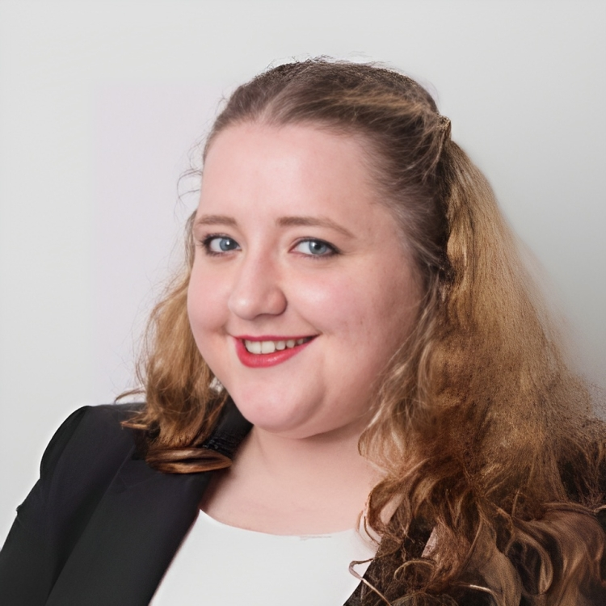
Meet Rhiannon
In January 2009, US Airways Flight 1549 lost all engine power and landed on the Hudson River in Manhattan, New York. Miraculously, everyone survived. Watching this on the news, I wondered what enabled such success in an emergency situation. This sparked an interest in aviation accidents and how to prevent them.
While studying psychology at university, I had an assignment to apply psychology to a real-world event. I chose the ‘Miracle on the Hudson’, which introduced me to the field of human factors and led me to a master’s in safety and human factors in aviation.
Almost everything on an aircraft is designed with safety in mind, from the lights in the aisle to the overhead storage. So, next time you are annoyed about your carry-on luggage being the wrong size, remember that the limits are for your safety!
20 www.futurumcareers.com

Slide 21
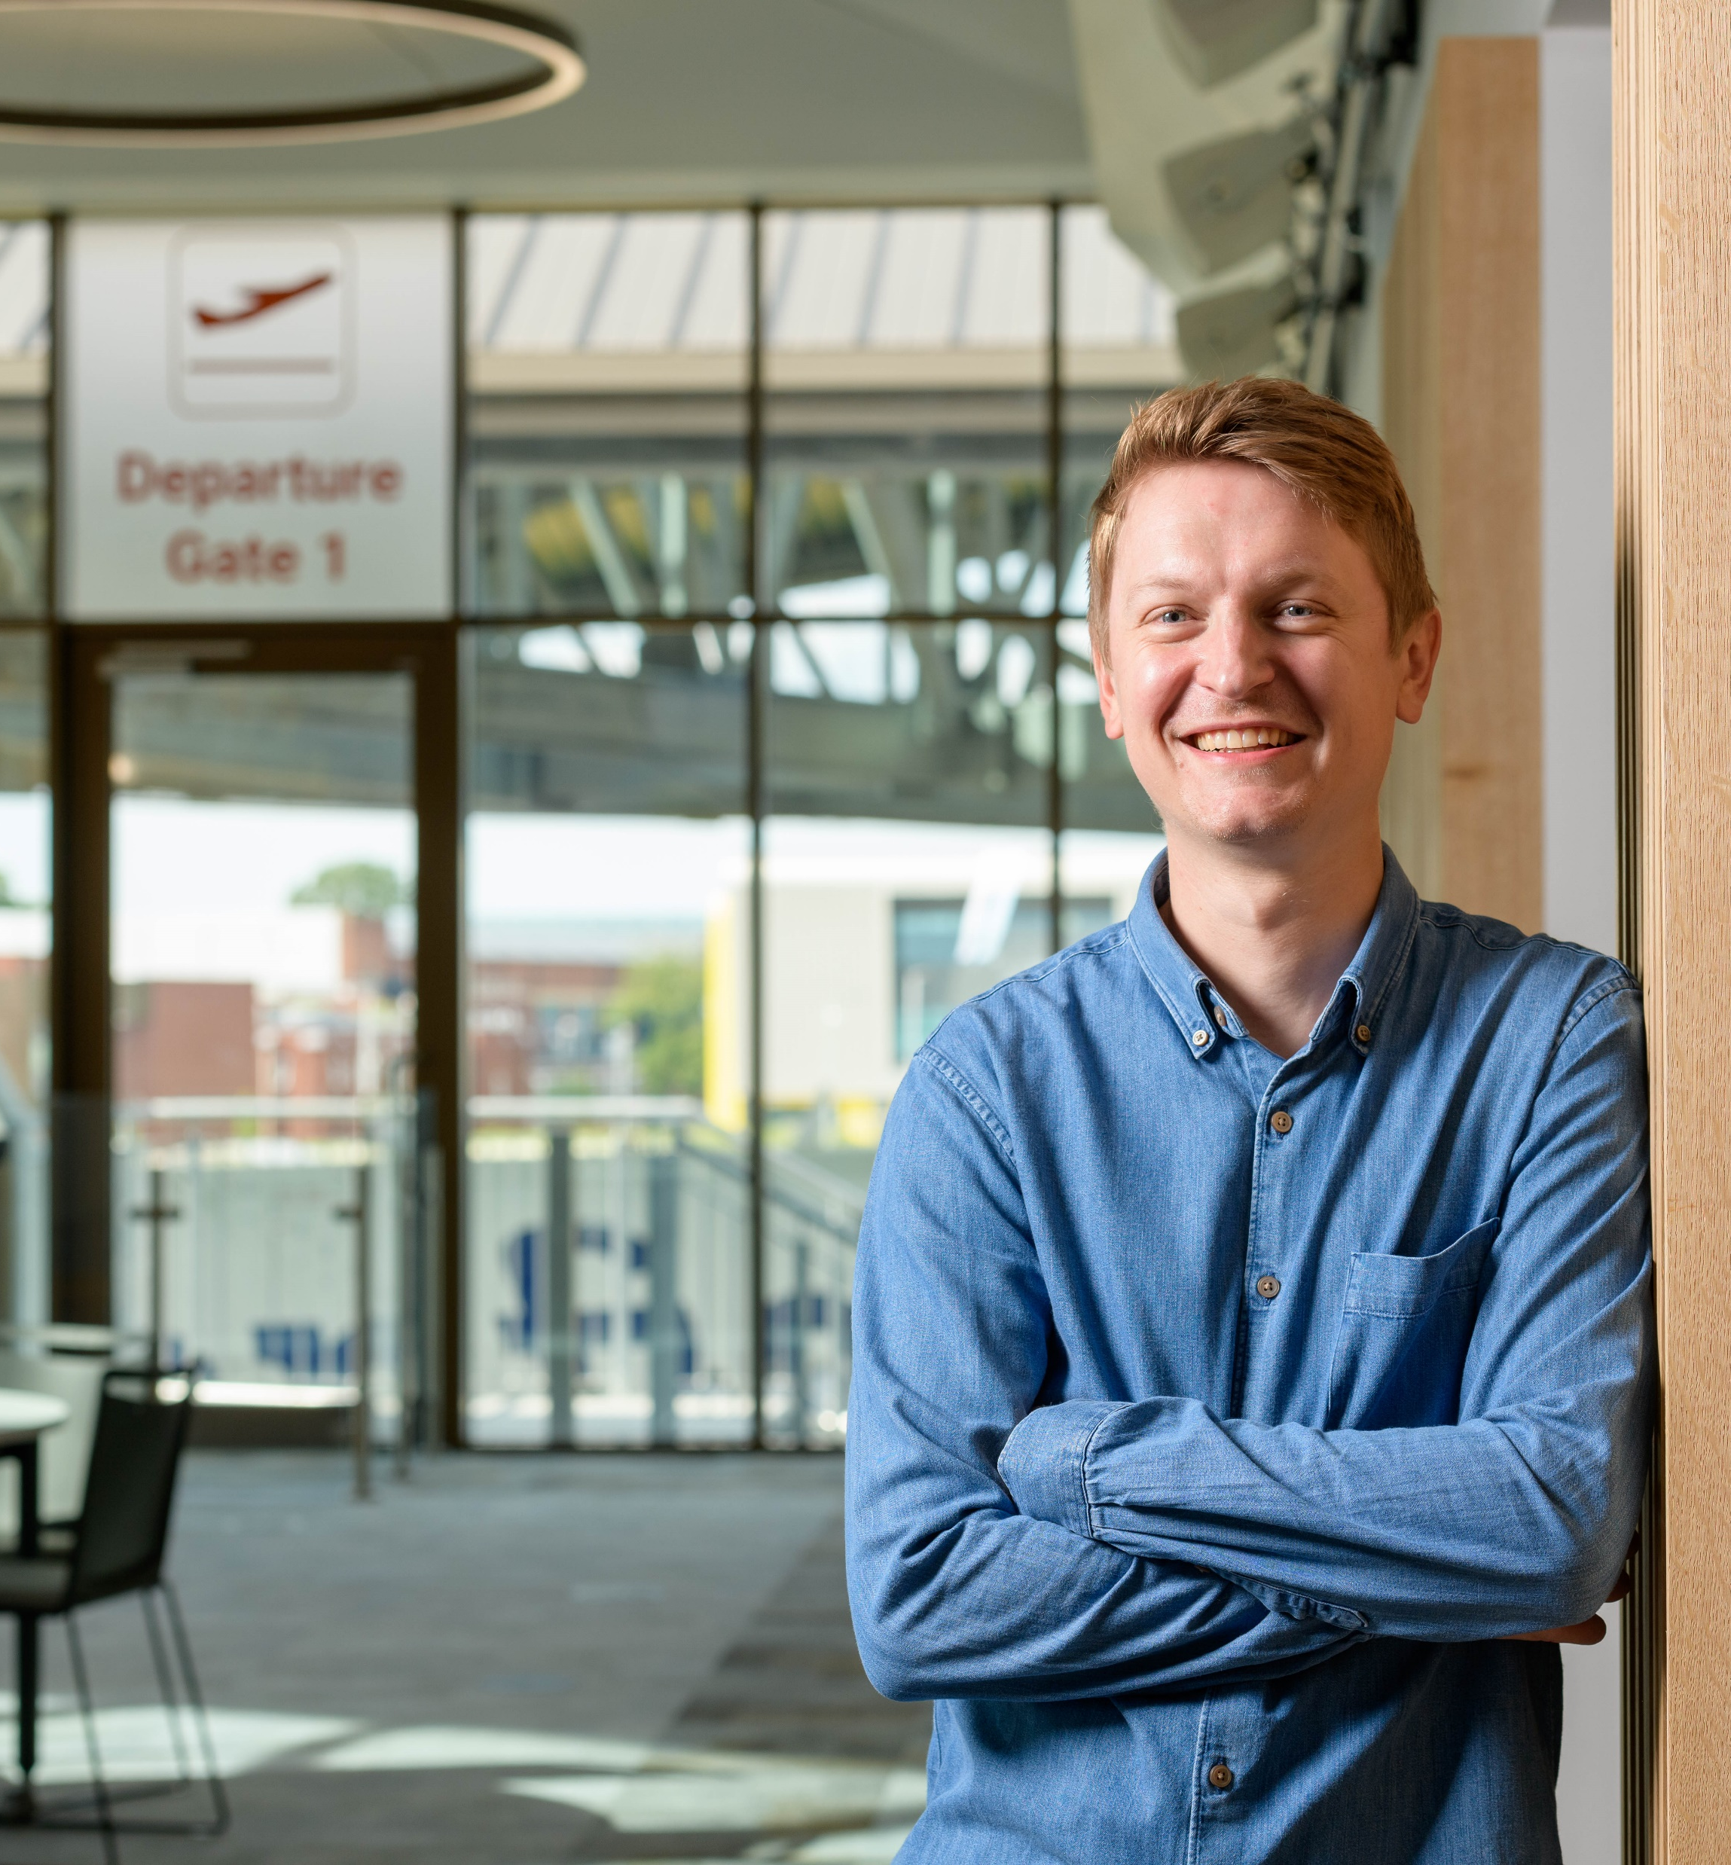
Meet Thomas
At school, I was fascinated by the environment and climate change. I studied physical geography at university. For my dissertation, I chose to investigate carbon offsetting, where people ‘offset’ their carbon dioxide emissions by paying for services that reduce carbon dioxide in the atmosphere. This set me on the path to working in aviation sustainability.
Climate change is the defining challenge facing society, and aviation has a crucial role to play in this. If aviation was a country, its carbon dioxide emissions would be the same as those of Japan! It’s not yet too late to change things, but we need to act now. My job allows me to be part of the solution.
21 www.futurumcareers.com
© Cranfield University

Slide 22
Talking points
How has each team member’s personal experiences influenced their career in aviation?
How could you apply your own interests and knowledge from your favourite subjects to a career in aviation?
What is the most interesting thing you have learnt about the aviation industry and/or careers in aviation?
22 www.futurumcareers.com
© Keith Wilson/SFB Photographic

Slide 23
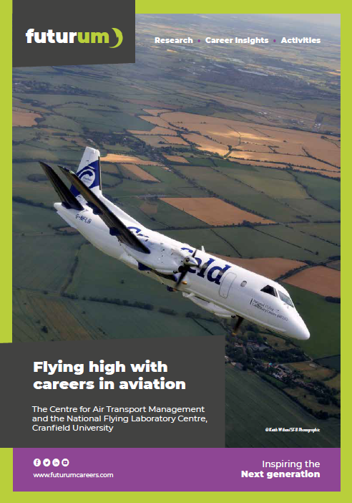
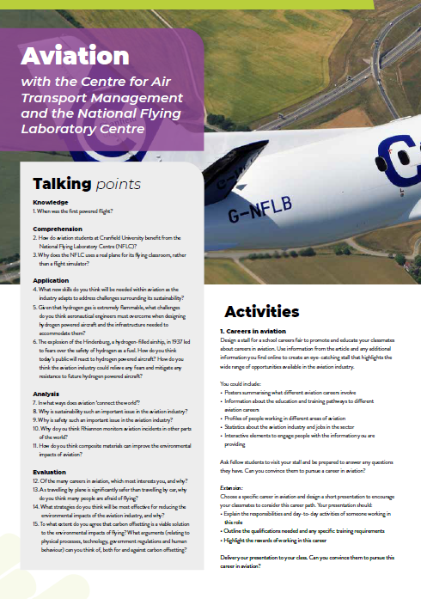
More resources
www.futurumcareers.com/flying-high-with-careers-in-aviation
Podcast coming soon…
Animation coming soon…
01
Download the article
02
Download the activity sheet
03
Listen to
the podcast
04
Watch the animation
23 www.futurumcareers.com
© Keith Wilson/SFB Photographic

Slide 24
24 www.futurumcareers.com

