Slide 1
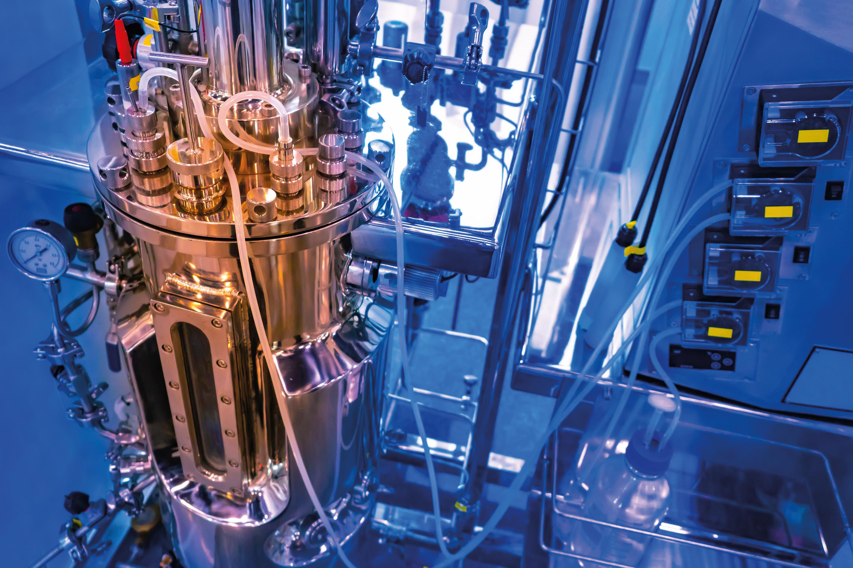
Biomanufacturing
PROFESSOR TUCK SENG WONG
© By Grispb

Slide 2
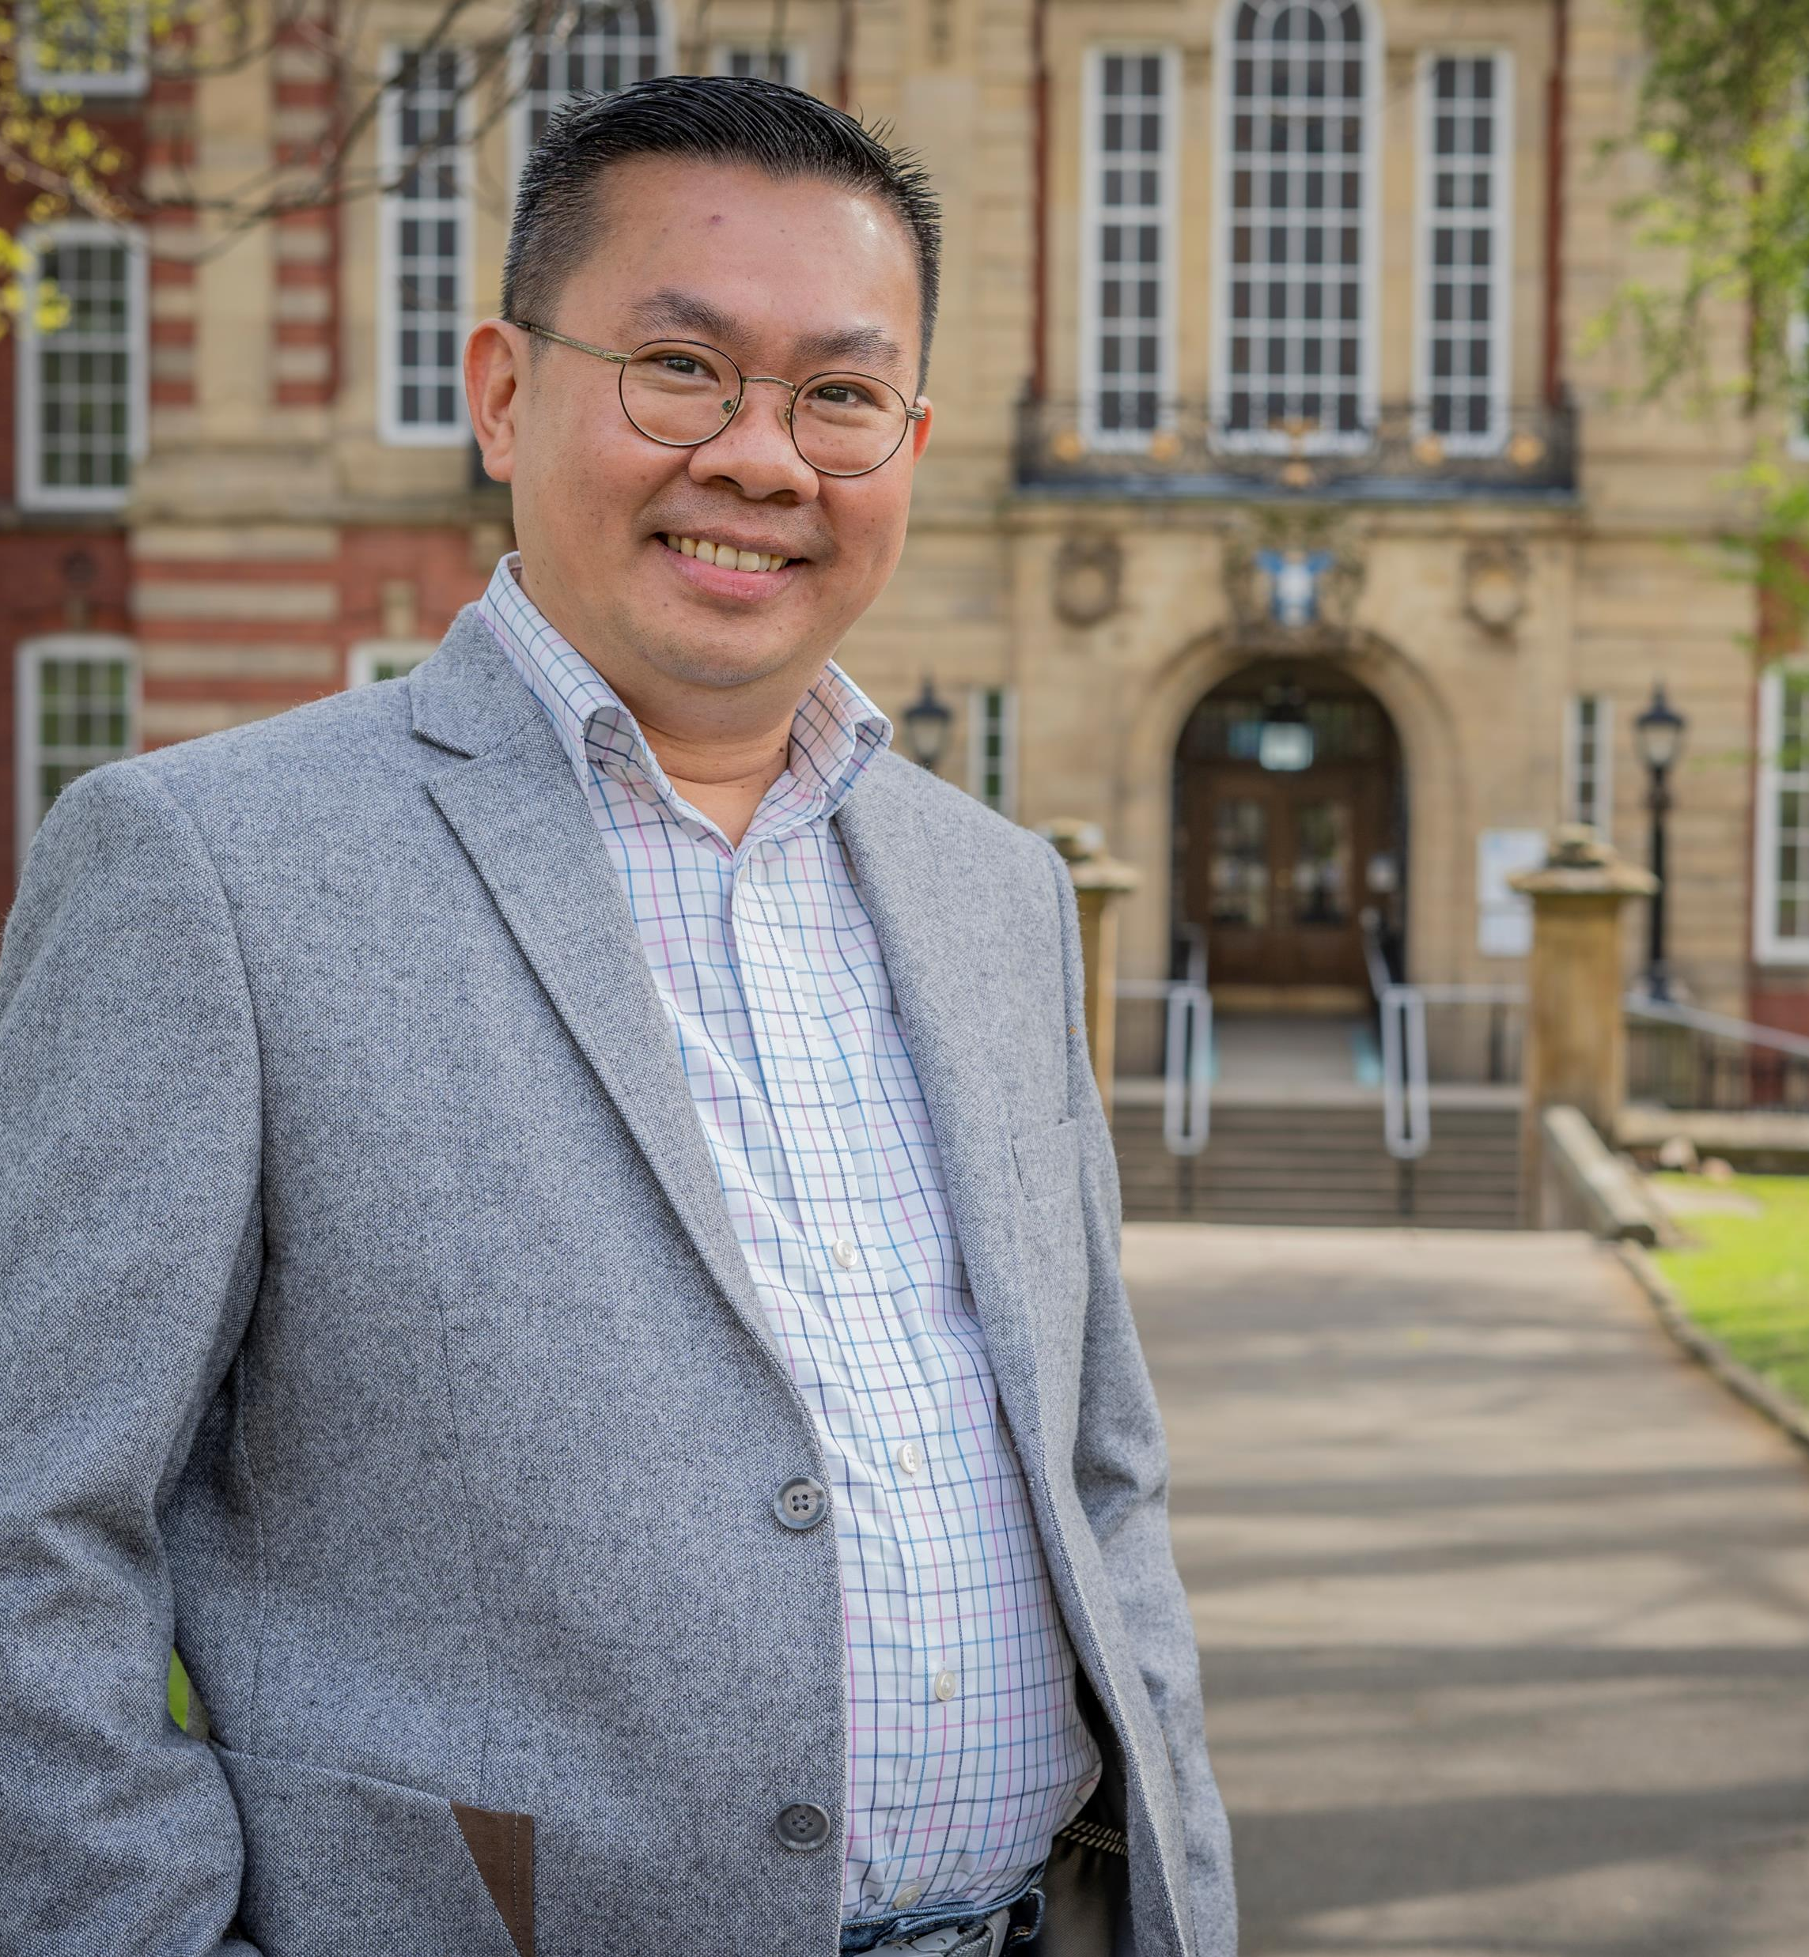
MEET TUCK
Professor Tuck Seng Wong is a chemical engineer and biomanufacturer based at the University of Sheffield in the UK.
He is applying the concept of Darwinian evolution to engineer biological systems for industrial applications.
Learn more about his work…

Slide 3
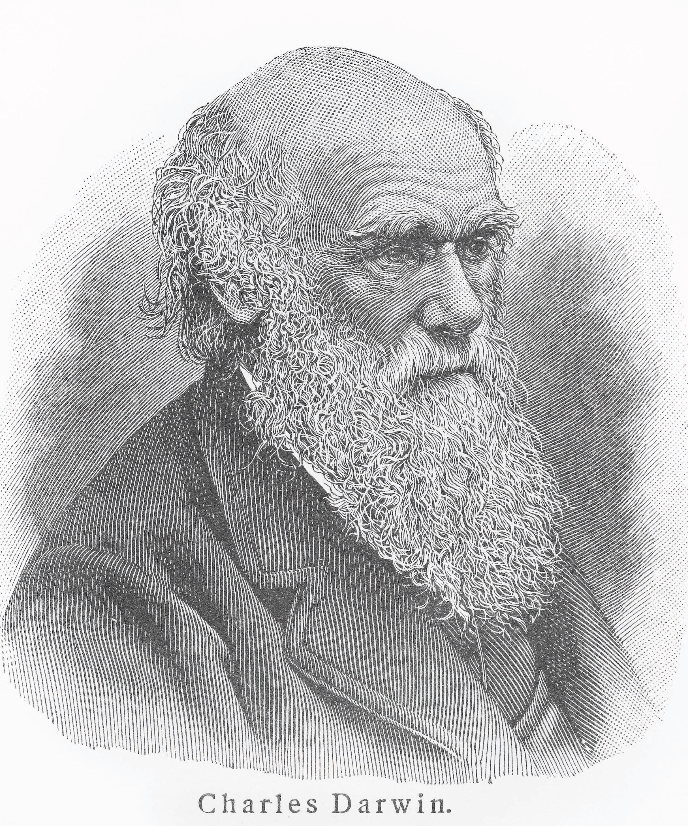
NATURAL SELECTION
Charles Darwin revolutionised our understanding of life on Earth when he presented his concept of natural selection in his ground-breaking book On the Origin of Species in 1859.
Natural selection is the process by which living organisms change and adapt and is a key mechanism of evolution.
Organisms that are better adapted to their environment are more likely to survive, which means the genes that enabled their survival are more likely to be passed on.
© By nickolae

Slide 4
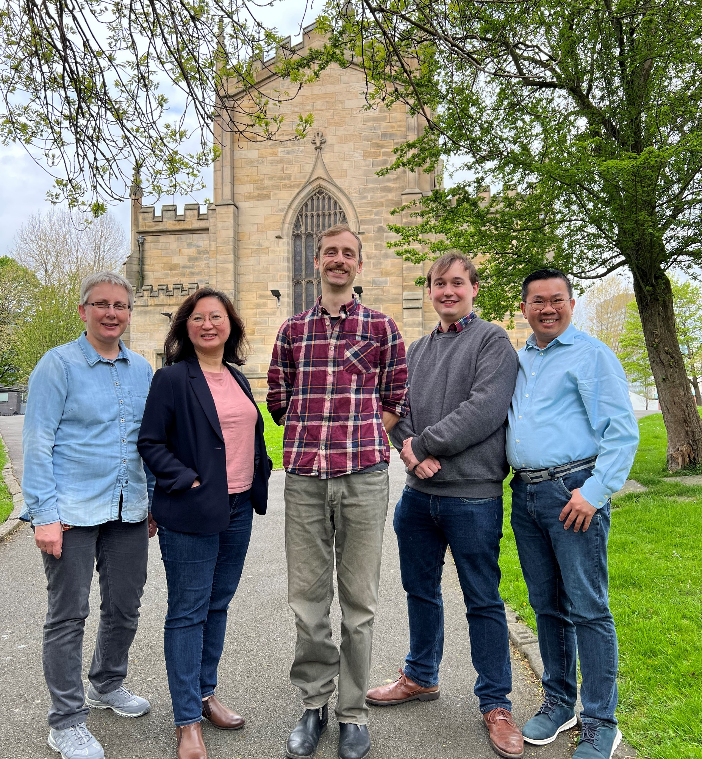
Tuck and his team believe that applying this Darwinian concept to biomanufacturing will help provide the solutions we need for a sustainable future.
“We deliberately introduce mutations into a biological system (e.g., a gene encoding an enzyme) and apply artificial selection to perpetuate a desirable trait (e.g., an enzyme with higher activity) in order to expedite the process of evolution.”
- Tuck
The Evolutor team (from left to right: Dr Iwona Smaczynska-de Rooij, Assistant Professor Kang Lan Tee, Joe Price, Matthew Hutchinson and Professor Tuck Seng Wong)

Slide 5
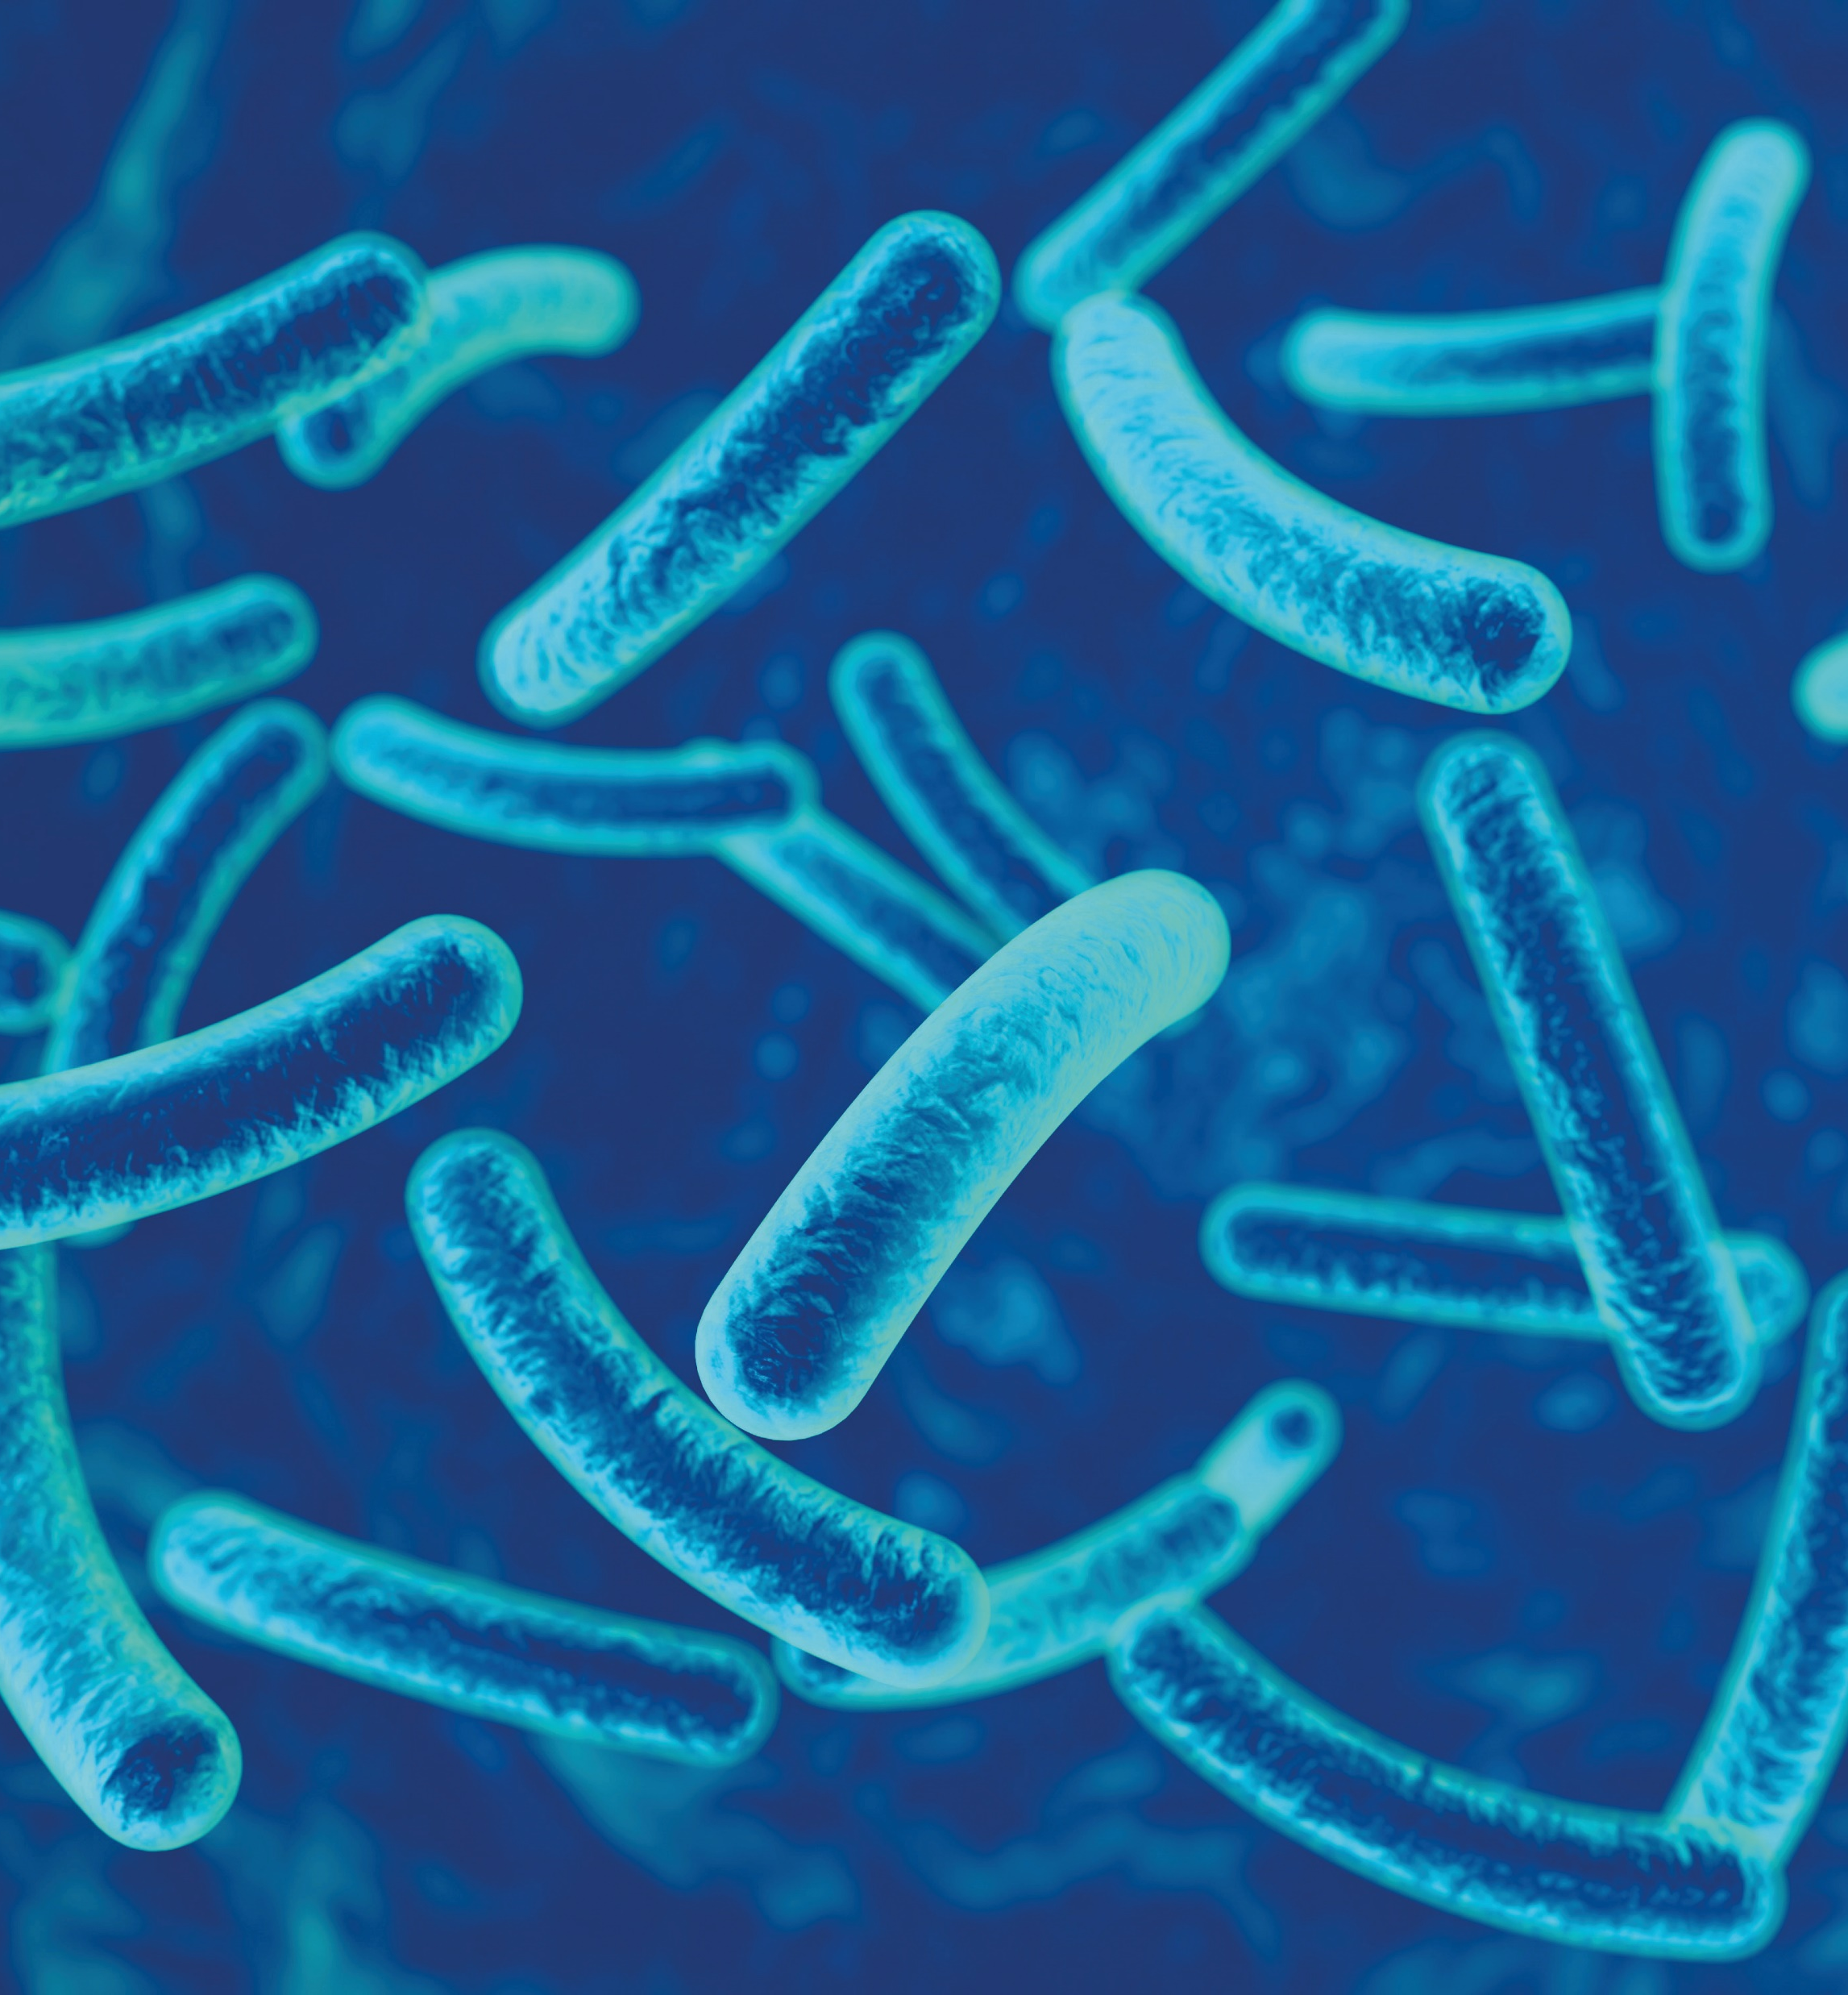
EVOLUTOR
By evolving microbes, the team can optimise natural resources.
“Bacteria and yeast can be adapted to turn waste products into food ingredients, biodegradable plastics, biofuels and other valuable resources.”
- Tuck
Microbes need to be evolved and adapted to do these specific jobs, and Tuck and his team have developed Evolutor to do just that.
The Evolutor technology enables them to evolve microbes with specific properties and, importantly, with accuracy and predictability.
© By Maryna Olyak

Slide 6
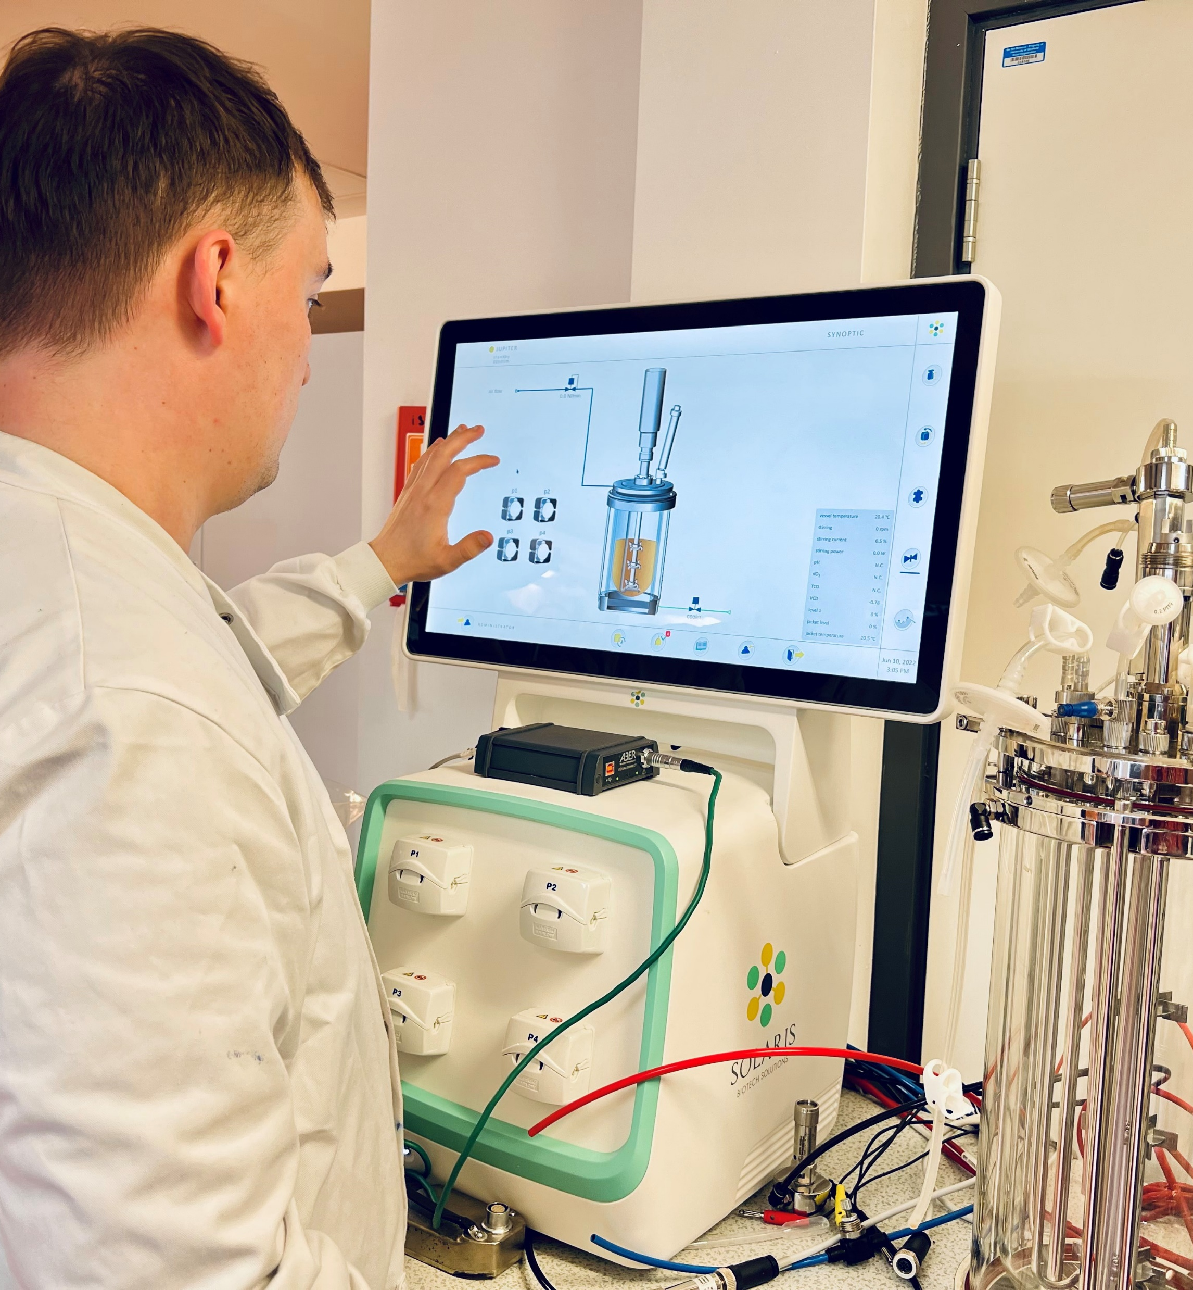
GENOME SEQUENCING
Genome sequencing allows the team to ‘read’ the genetic alphabets in a genome.
“By comparing a DNA sequence against a reference, engineers or scientists can quickly identify the genetic variations that are responsible for a trait. For example, if we isolate a baker yeast variant that produces more biofuel, such as isobutanol, we will be able to understand the genetic basis of this improvement in productivity through sequencing the genome of this yeast variant. Mutations responsible for trait improvement are commonly referred to as beneficial mutations.”
- Tuck
Matthew Hutchinson using a Solaris Biotech fermenter for large-scale microbial cultivation

Slide 7
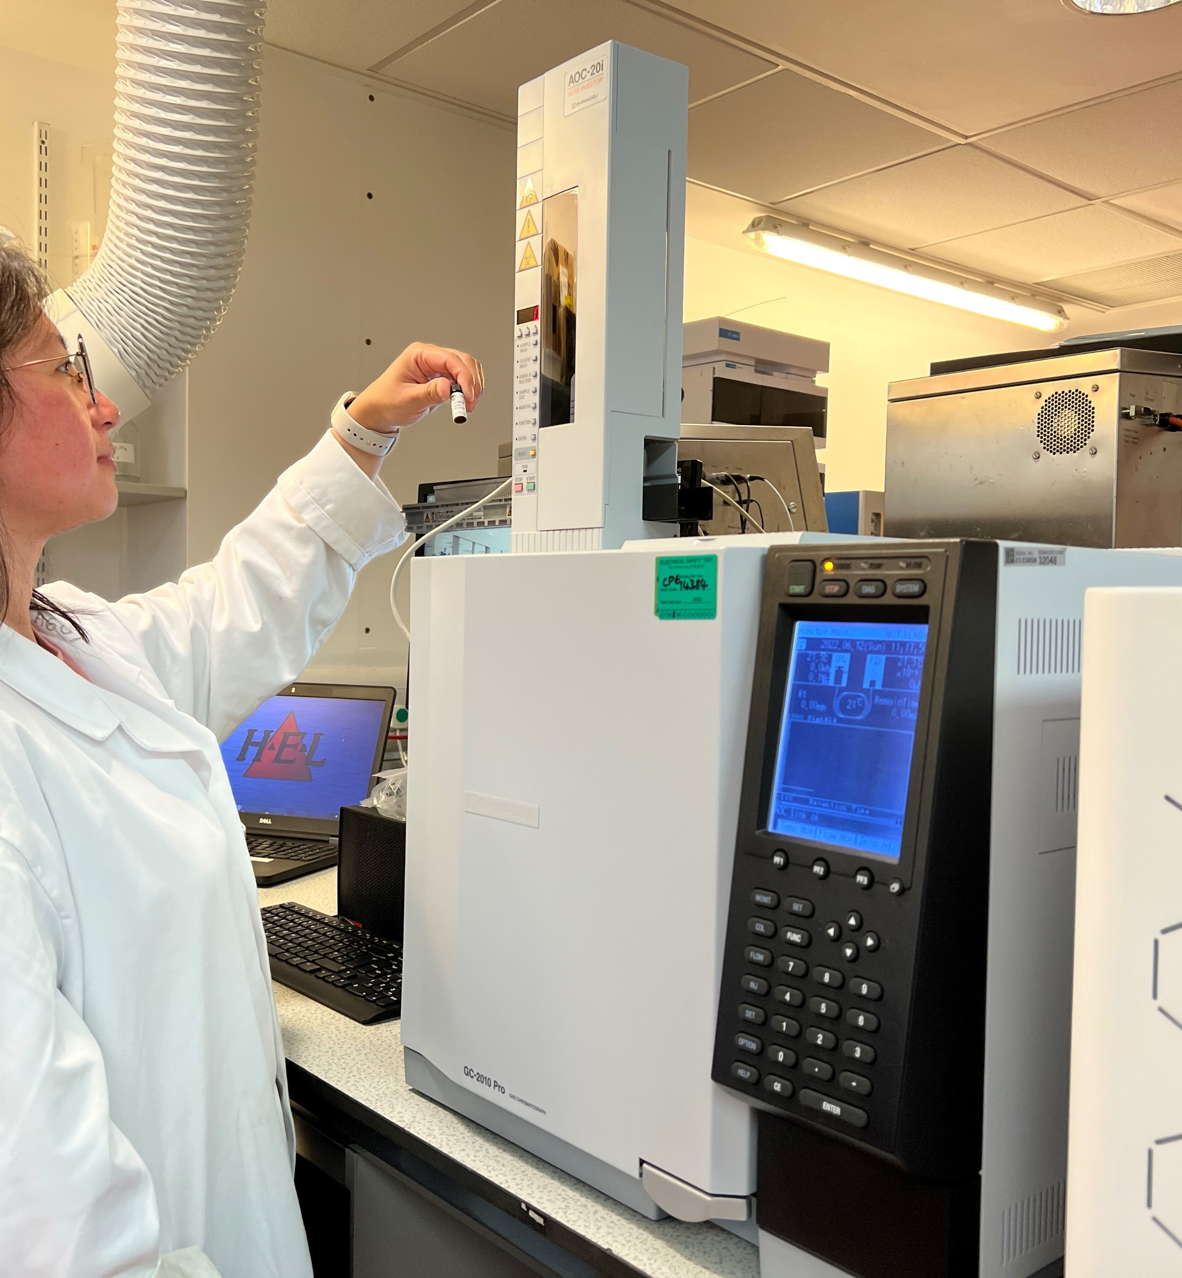
EVOLVING PROPERTIES
“Evolutor is a clever device, which allows us to manipulate and control the conditions of microbial growth. Through increasing or reducing the temperature of the microbial cultivation chamber, we can select microbial sub-population that tolerates high temperature (evolving for thermotolerance) or low temperature (evolving for cold adaptation).
Depending on how we design the experiment or operate the Evolutor, we can evolve a wide range of microbial properties such as carbon utilisation (microbes need food to grow and to manufacture a product), pH tolerance, inhibitor tolerance, product tolerance and productivity.”
- Tuck
Assistant Professor Kang Lan Tee using a Shimadzu gas chromatography system to analyse bioplastics samples

Slide 8
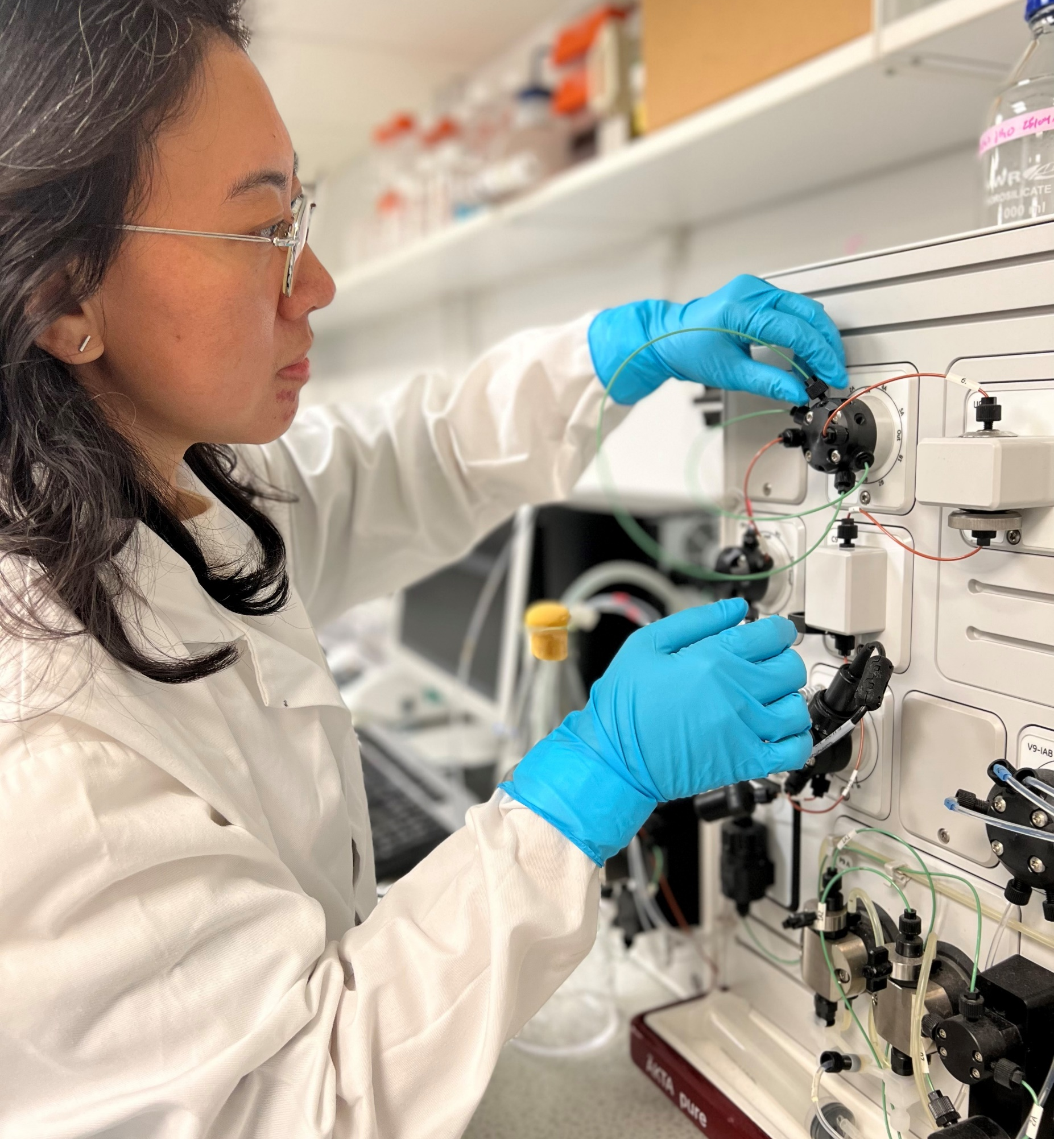
APPLICATIONS IN MANUFACTURING
Evolutor’s microbe optimisation capabilities can be widely applied across many biotech industries. Due to the team’s evolution-based approach, it is able to optimise any microbe, regardless of the availability or confidentiality of genetic information.
“The next-level microbe development capabilities of the Evolutor technology are especially relevant for bio-manufacturers in food and drink, pharmaceuticals and biologics, chemicals, agri-tech, biofuels, nutritional ingredients and microbiome health, materials, and flavours and fragrances.”
- Tuck
Dr Yee Han Tee using an ÄKTA Pure to purify recombinant protein produced by microbe

Slide 9
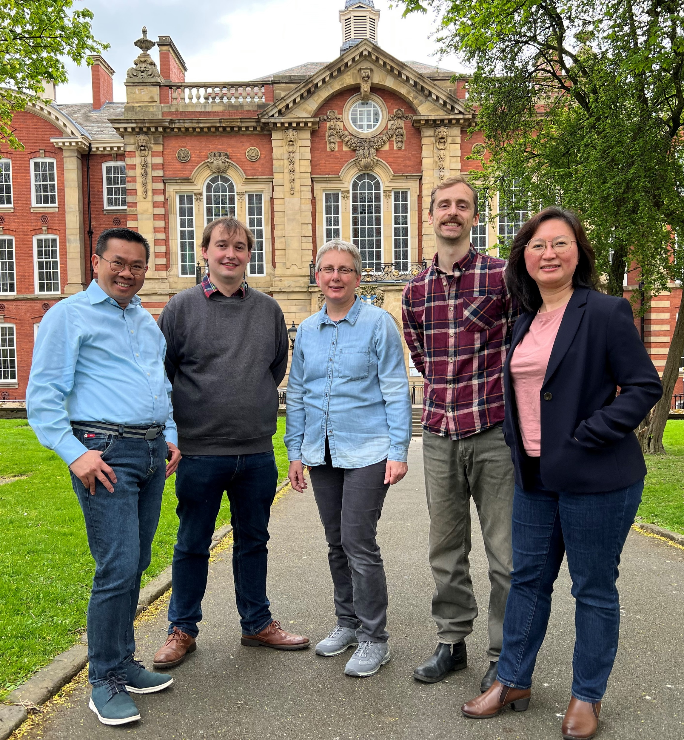
For Tuck, it would not have been possible to develop Evolutor without the input of every team member who brings their own experience, skill, enthusiasm, commitment, persistence and hard work to the project.
The team now wants to understand biological blueprints through the lens of evolution.
“Biology is complex. Microbial cell factories can manufacture fascinating molecules (e.g., bioplastic and antibiotics). How these factories are designed and constructed is still a puzzle to engineers and scientists. Through laboratory evolution, we hope to develop a better understanding of the genetic makeup of a microbe, the gene function and how the genes are regulated.”
- Tuck
The Evolutor team (from left to right: Professor Tuck Seng Wong, Matthew Hutchinson, Dr Iwona Smaczynska-de Rooij, Joe Price and Assistant Professor Kang Lan Tee)

Slide 10
TALKING POINTS
What process does Darwin’s concept of natural selection describe?
Why do Tuck and his team deliberately introduce mutations into a biological system?
What can bacteria and yeast be adapted to do?
What role does genome sequencing play in the team’s work?
What does the Evolutor device allow the team to do?
Which industries can the Evolutor technology be applied to?
© By Grispb

Slide 11
About biomanufacturing
© By Grispb

Slide 12
Biomanufacturing is a type of manufacturing or biotechnology that makes use of biological systems to produce a range of applications for use across various industries.
Scientists within the field can come from several different arenas, including chemical engineering, biochemical engineering, protein engineering, engineering biology, microbiology, molecular biology and genetics.
© By Maryna Olyak

Slide 13
“We turn sustainable and economical carbon feedstock into bio-products. Ultimately, this brings direct benefits to society.
Mother Nature is the best engineer! She has evolved some of the most interesting solutions for us to exploit (e.g., microbes that can capture and utilise carbon dioxide, microbes that produce bioplastics, microbes that make hydrogen, etc.). These are the opportunities for our next generation of biomanufacturers!”
- Tuck

Slide 14
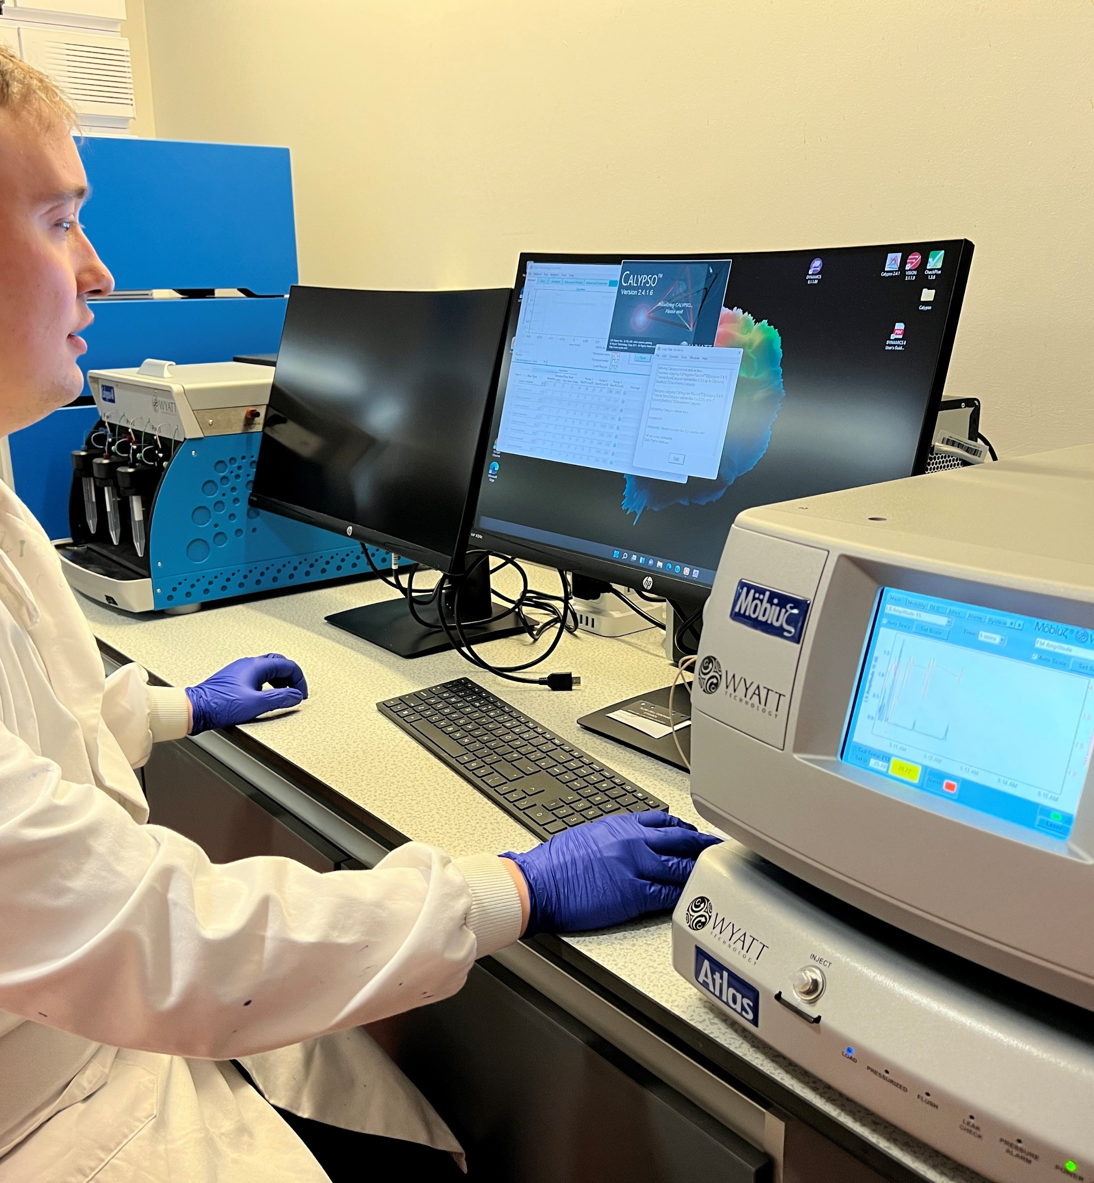
EXPLORE CAREERS IN BIOMANUFACTURING
The Department of Chemical and Biological Engineering, where Tuck and his team are based, offers public outreach to teach people about this field, and Tuck often delivers talks to sixth form colleges and international schools.
Built with Biology has some great information about the mind-blowing innovations that are happening across the bio-industry.
There are a range of science magazines and professional engineering institution webpages that could prove useful to those interested in pursuing a career in biomanufacturing. The Chemical Engineer, IChemE, Royal Academy of Engineering and The Scientist.
According to Prospects, the starting salary for graduates generally is between £19,000 and £24,000, although more experienced biotechnologists can earn between £25,000 and £50,000.
Matthew Hutchinson using BEACON suite (Wyatt Technology, funded by BBSRC BB/V019341/1) to analyse macromolecules in solution

Slide 15
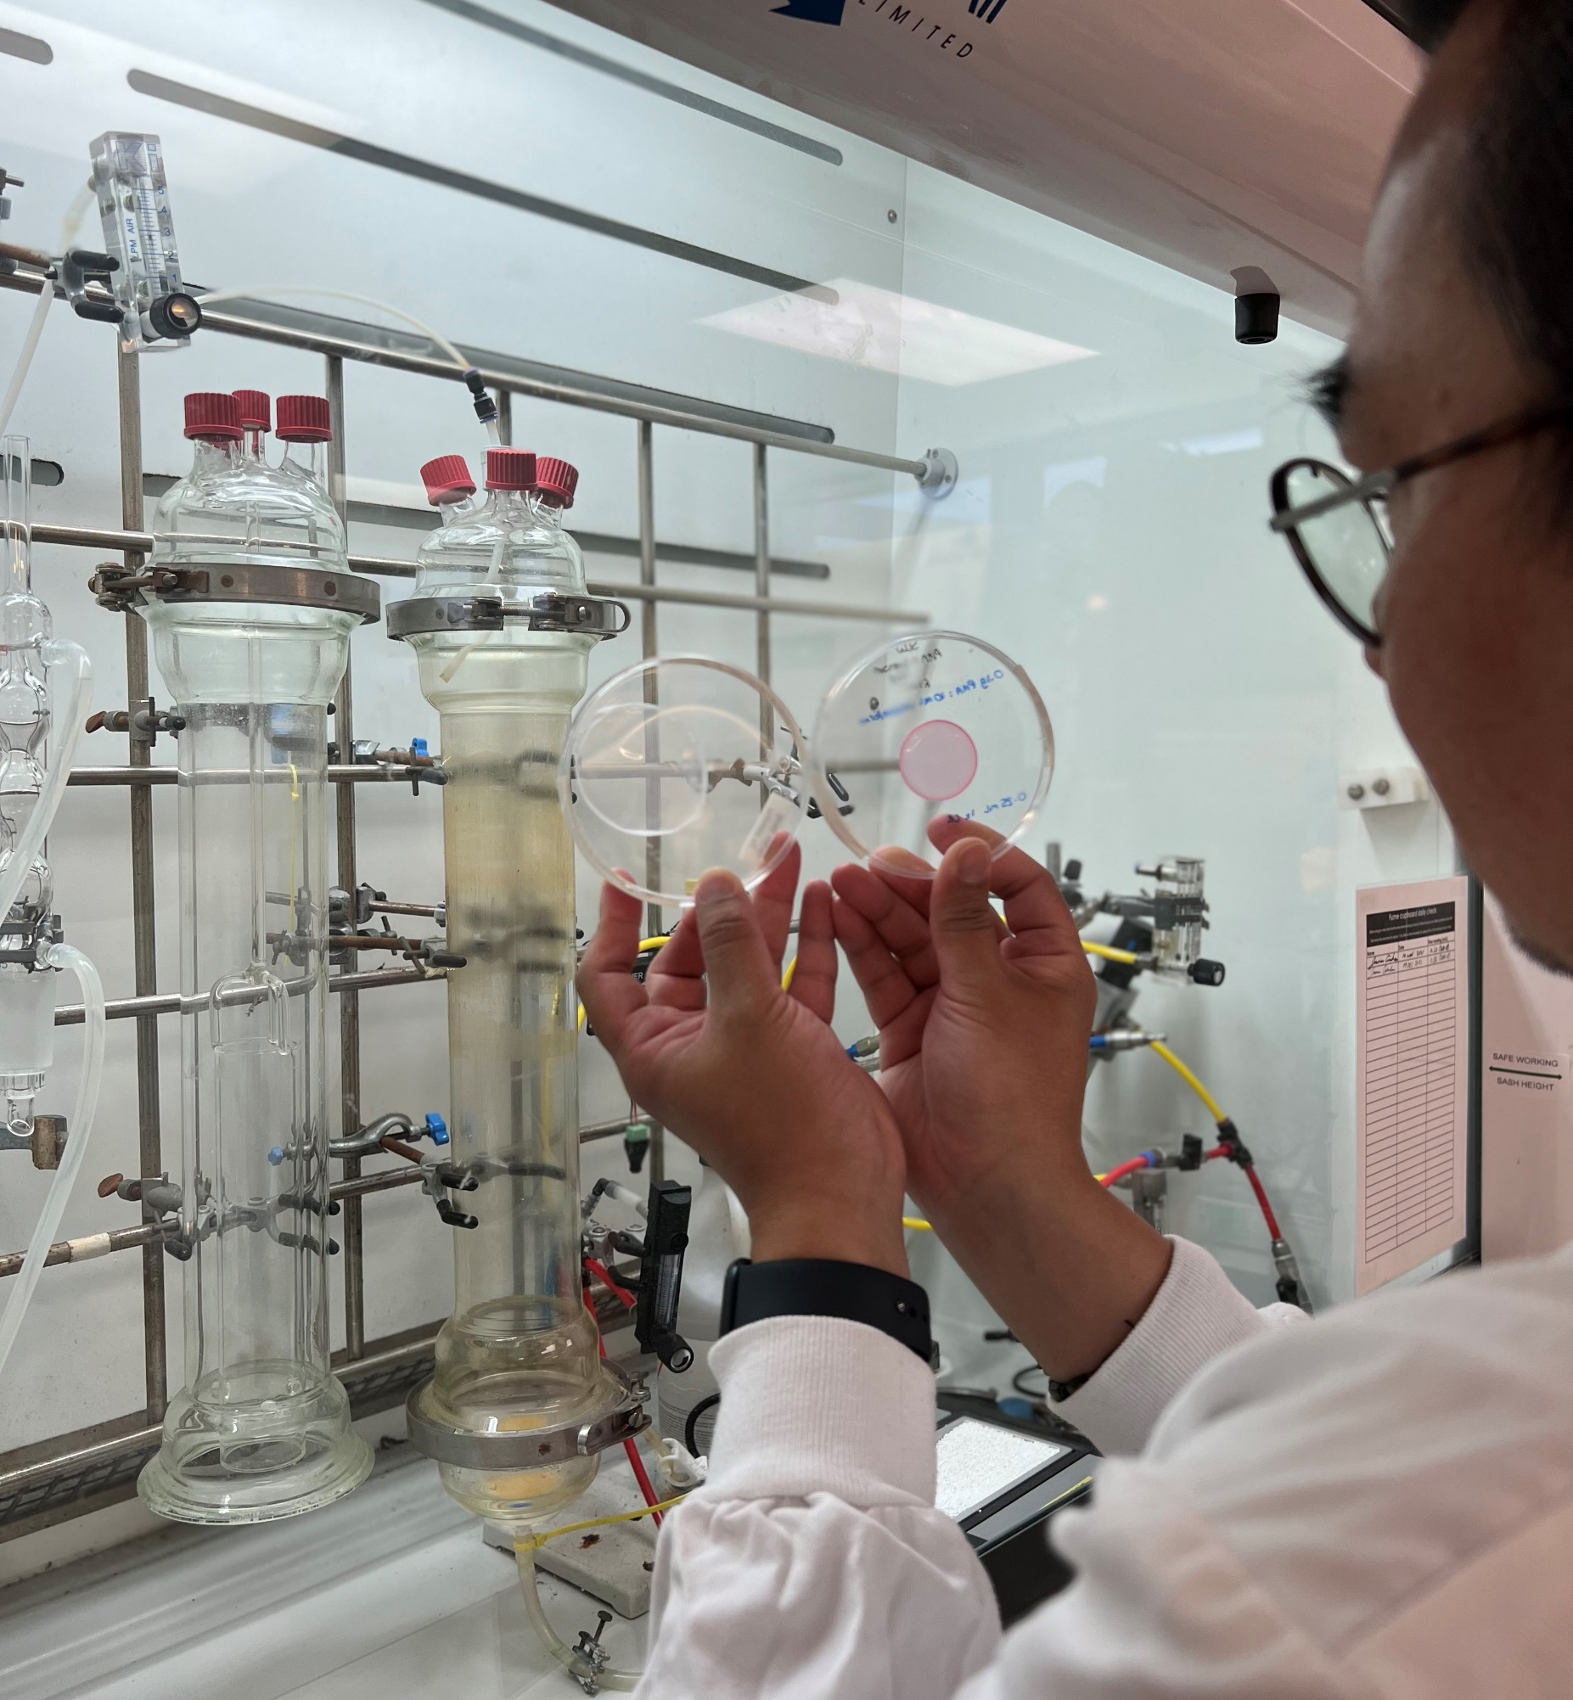
PATHWAY FROM SCHOOL TO BIOMANUFACTURING
Tuck recommends that students study mathematics, physics, chemistry and biology to enter the field of biotechnology and biomanufacturing.
You will usually need a degree in a relevant scientific subject such as biotechnology, bioscience, microbiology, biochemistry or chemical engineering.
Find out more: www.nationalcareers.service.gov.uk/job-profiles/ biotechnologist
Professor Tuck Seng Wong inspecting polymer films, made of polyhydroxyalkanoate (PHA) produced by bacteria

Slide 16
TALKING POINTS
Which areas related to the field of biomanufacturing interest you the most? Why?
To what extent do you agree with Tuck that Mother Nature is the best engineer? Give specific examples to support your opinion.
If you had the chance to attend one of Tuck’s talks, what questions would you ask him about the field of biomanufacturing?
Where do your strengths lie in mathematics, physics, chemistry and biology? Which areas do you need to develop your skills in? What could you do to achieve this?
© By Grispb

Slide 17
Meet the Evolutor team
© By Grispb

Slide 18
PROFESSOR TUCK SENG WONG
“I wanted to be a medical doctor when I was young. Unfortunately, my parents couldn’t afford my tuition fee in a medical school. I started my engineering education after winning a full scholarship, offered by the Department of Chemical Engineering at the National University of Singapore. It turned out that engineering suits me!
I have been greatly inspired by Nobel Laureate Professor Frances H. Arnold (Nobel Prize in Chemistry 2018). I was awarded a Summer Undergraduate Research Fellowship by the California Institute of Technology when I was still an undergraduate student studying chemical engineering. The fellowship allowed me to spend time in Arnold’s lab, and my passion in laboratory evolution was kindled by this experience.
I owe my success to not giving up! I am always curious and want to do more and better.”

Slide 19
“A eureka moment in my career was when I received a Proof of Concept fund from the Royal Academy of Engineering for my Evolutor idea on my second attempt (I failed in my first attempt). Without this fund, it would not have been possible for us to establish Evolutor Ltd. A Proof of Concept fund is by invitation only. The scheme is only open to academics holding fellowships awarded by the Royal Academy of Engineering. I held two fellowships from the Royal Academy of Engineering – an Industrial Fellowship in 2016 and The Leverhulme Trust Senior Research Fellowship in 2019.
My top three proudest achievements are: establishing Evolutor Ltd, publishing my protein engineering textbook and winning six awards for Excellence in Learning & Teaching.
My ambitions for the future: (1) continue to create impact through the science we do in Sheffield, (2) help South-East Asian countries (where I come from) to develop their Research and Development (R&D). I am currently a Visiting Professor at BIOTEC in Thailand and an Adjunct Professor at the Bandung Institute of Technology in Indonesia, (3) coach young researchers from Black, Asian and minority ethnic (BAME) backgrounds.”

Slide 20
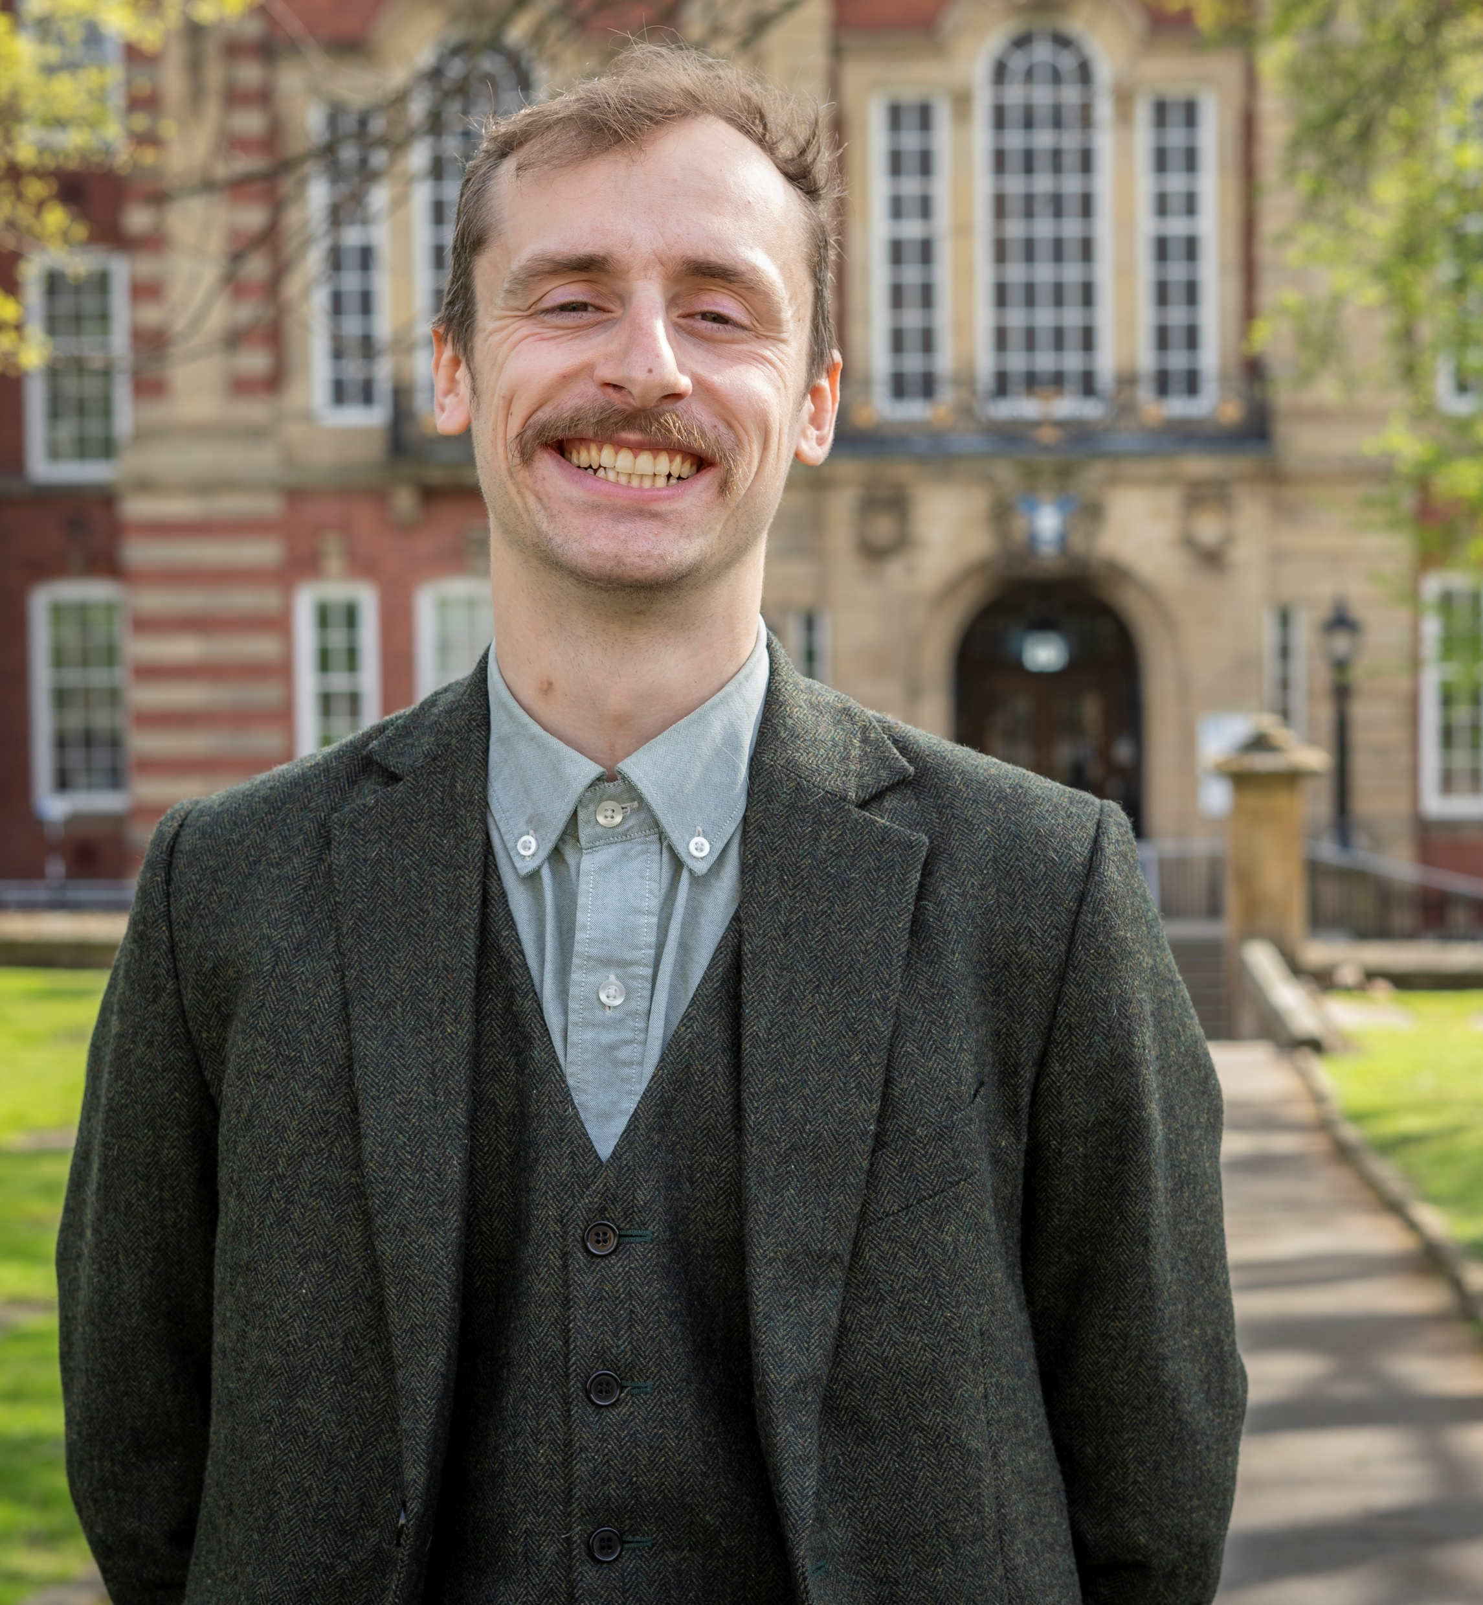
JOE PRICE
Joe describes himself as “the interface between the team’s research and the commercial world”.
“I’ve always loved biology and nature. This passion inspired me to study zoology and introduced me to the exciting world of bio-industry.
My career, so far, has been driven by wanting to disrupt old-fashioned systems and industries. My biggest eureka moment was when I first discovered how our bio-factories can change the world.
Speaking to businesses across the globe and learning about everything they are doing to solve some of our world’s biggest problems have been highlights for me.
My ambition is to lead Evolutor Ltd. to be the leading developer of biological factories in the UK and, one day, beyond!”

Slide 21
A DAY IN THE LAB IN THREE WORDS:
“Exciting. Thought-provoking. Busy!”
JOE’S TOP TIP:
“Start to think now about what your interests are, how you can pursue them and how you can make a positive impact in the world.”

Slide 22
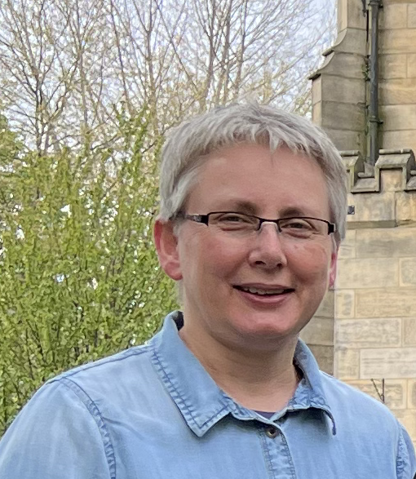
DR IWONA SMACZYNSKA-DE ROOIJ
Iwona uses almost thirty years of expertise in physiology, molecular biology, and genetics of common and pathogenic yeasts to construct new strains that can withstand a variety of growing conditions and produce substances useful in medicine, food and chemical industries.
“The person who inspired me to become a scientist was Professor Tomasz Umiński, who later became my zoology lecturer. I first met him when I was 11 years old. He told me then that there is nothing more beautiful than the variety and complexity of life, and that if I decided to study its secrets in the future, it might not be an easy road, but it would certainly be a rewarding one.
Throughout my scientific career, I have always worked with yeasts, trying to unlock the secrets of their life and function. Now, it is time for me to make changes in them and alter their functioning myself.”

Slide 23
A DAY IN THE LAB IN THREE WORDS:
“Genetic-manipulation. Cultivation. Research.”
IWONA’S TOP TIPS:
“Do not to be afraid to challenge yourself. Do not give up your dreams.”

Slide 24
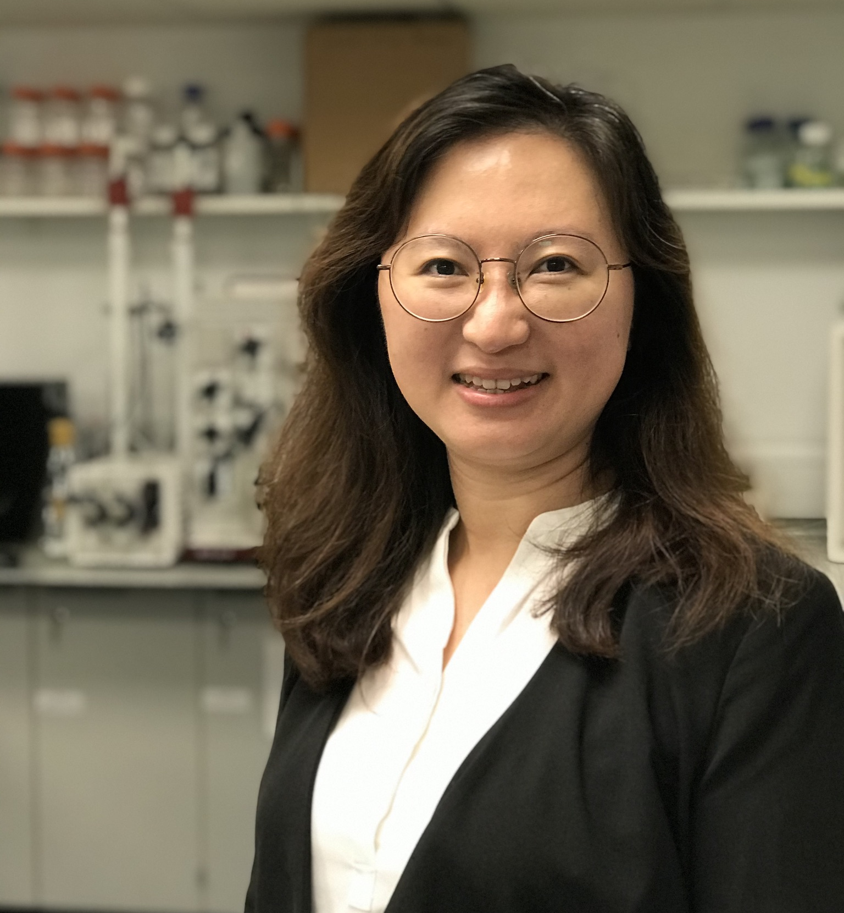
ASSISTANT PROFESSOR KANG LAN TEE
Kang Lan co-creates ideas with Tuck and has been conducting research in the field of engineering biology for over 20 years.
“I find the idea of applying scientific knowledge to solve real-life challenges very exciting and the outcome very rewarding.
I always enjoyed STEM subjects in school. I liked their logic and how they help us understand the things around us. From everyday events like how the colours in a rainbow are created and why fish do not freeze in winter, to more complex systems like how the age-old concept of evolution can improve industrial biomanufacturing.
Developing Evolutor, I enjoyed working with this great team. The incorporation of Evolutor Ltd. to enable more people to benefit from our technology is also a highlight.”

Slide 25
A DAY IN THE LAB IN THREE WORDS:
“Design. Analyse. Solve.”
KANG LAN’S TOP TIP:
“A good plan is half the battle won, but the unknown is worth exploring.”

Slide 26
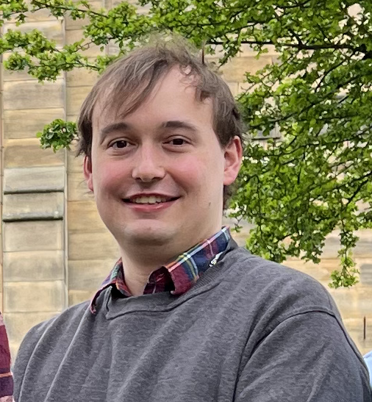
Matthew Hutchinson
Matthew is a research scientist and manager providing laboratory support to the group.
“Growing up, I always had an interest in science, and I’ve been lucky enough to follow my interest into my career.
I’ve worked in multiple labs in different research areas, but all of them have helped me grow as a scientist and develop various skills I use in my research today. My eureka moment was when I learned it’s okay to ask questions!
It’s always interesting working on the translation of scientific principle into something practical – with Evolutor, it’s exciting because it’s so novel and so close to commercial use. I want to be able to see something in the real world and be able to say, I helped make it happen.”

Slide 27
A DAY IN THE LAB IN THREE WORDS:
“Plan. Experiment. Analyse.”
MATTHEW’S TOP TIP:
“Be adaptable and willing to learn new things. You never know how exactly your career will develop and what opportunities may become available.”

Slide 28
TALKING POINTS
Tuck says he owes his success to not giving up. At what times in your life have you demonstrated this quality?
Joe wants to “disrupt old-fashioned systems”. Which societal systems do you consider ‘old-fashioned’? How would you like to see science innovating new systems?
Iwona was inspired by a professor she met when she was 11 years old. Who inspires you?
Kang Lan likes the logic of STEM subjects. What do you find rewarding about these subjects? What do you find challenging?
Matthew says it was significant for him when he realised it was okay to ask questions. How confident are you in asking questions? What questions would you ask the team? What questions would you like to explore as a scientist?
© By Grispb

Slide 29
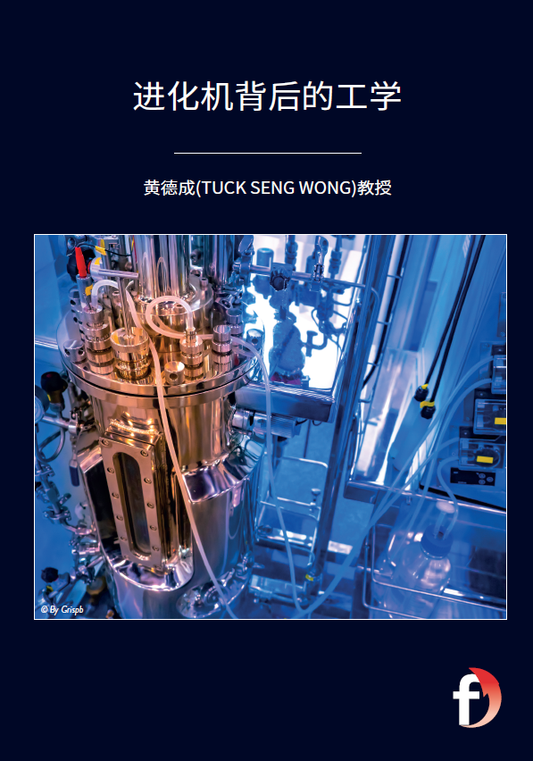
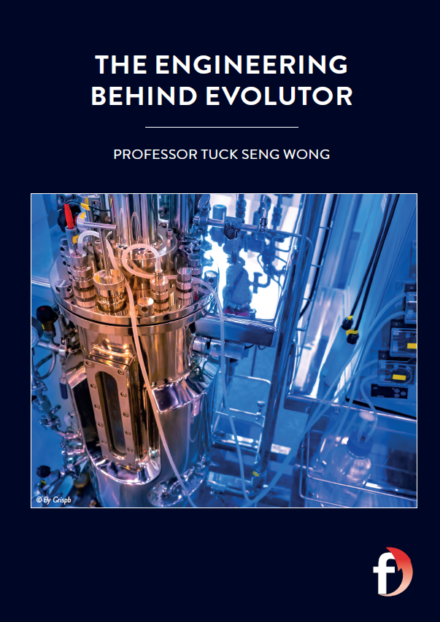
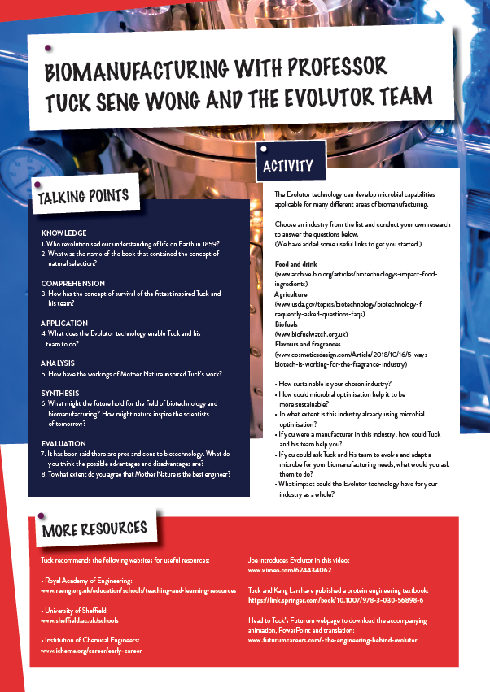
Download the activity sheet
Download the animation
Download Tuck’s article
Download the Mandarin translation

Slide 30
