Slide 1
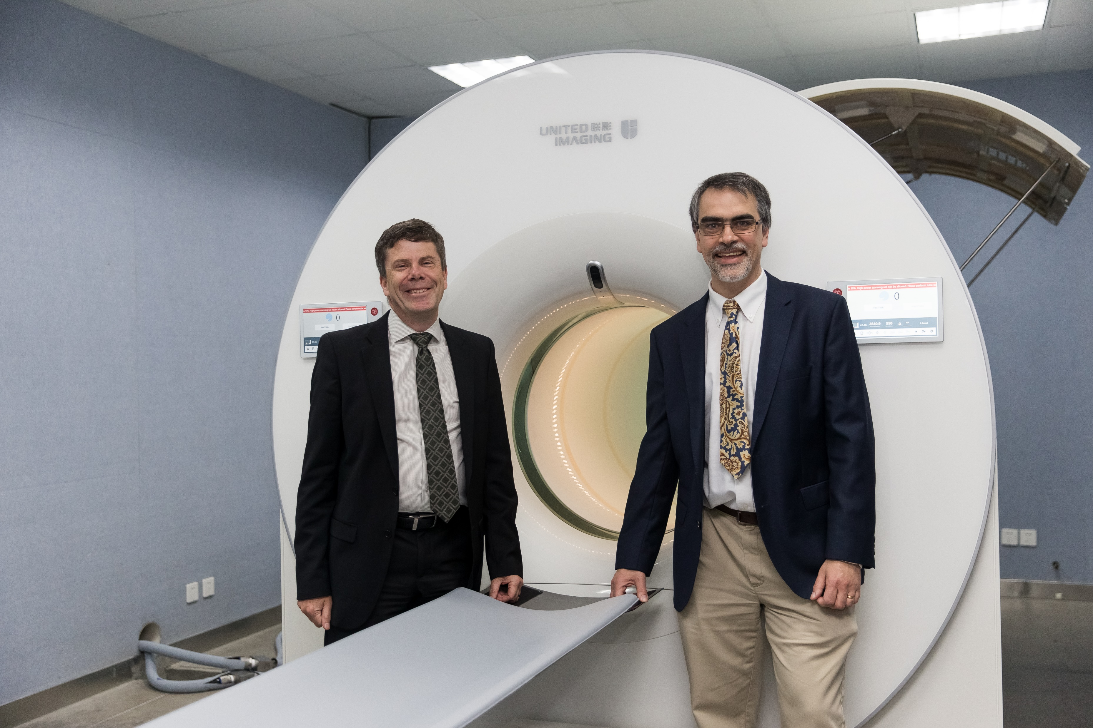
Biomedical imaging
Professor Simon Cherry and
Professor Ramsey Badawi
GET STARTED
www.futurumcareers.com

Slide 2
In this presentation:
Meet Simon and Ramsey
Physics in medicine
Positron emission tomography (PET)
Radioactive decay
The EXPLORER total-body PET scanner
Talking points
Pathway from school to biomedical imaging
Explore careers in biomedical imaging
Meet Simon
Meet Ramsey
Talking points
More resources
2 www.futurumcareers.com

Slide 3
Meet
Simon and Ramsey
Professor Simon Cherry and Professor Ramsey Badawi are biomedical engineers at the University of California Davis in the US.
They have developed the world’s first biomedical imaging device that can capture an image of the entire body in a single snapshot, which has the potential to revolutionise medicine and biomedical research.
Professor Simon Cherry
Professor Ramsey Badawi
3 www.futurumcareers.com

Slide 4
How does physics impact medicine?
Every day, doctors in hospitals use the laws of physics to diagnose and treat their patients.
X-ray machines, ultrasound devices and positron emission tomography (PET) scanners were all developed using concepts and theories based in physics.
These biomedical imaging techniques capture internal images of parts of the body, allowing medical professionals to diagnose a wide range of health conditions, from broken bones to cancer.
A PET image of
the body
4 www.futurumcareers.com

Slide 5
Positron emission tomography (PET)
Before having a PET scan, a patient is injected with radiotracer, a chemical compound to which a radioisotope has been attached.
The radiotracer circulates throughout their body and is taken up by their cells. The more metabolically active the cells are, the more of the radiotracer they take up.
The patient is then placed in a PET scanner, which can detect when the radioisotope in the radiotracer undergoes radioactive decay, allowing doctors to locate metabolically active cancer cells in the patient.
Simon and Ramsey’s total-body PET scanner
5 www.futurumcareers.com

Slide 6
Radioactive decay
When the radioisotope in the radiotracer undergoes radioactive decay,
it emits a positron.
“Positrons are antiparticles of electrons, meaning radioactive decay
produces antimatter!” – Ramsey
Matter and antimatter cannot coexist. Almost immediately, the positron will find an electron and both particles will be annihilated. In the process, the positron and electron disappear, and their mass is converted into energy according to Einstein’s famous E = mc² equation.
This energy is released as two high-energy photons emitted in opposite directions, which are detected by the radiation detectors in the PET scanner.
6 www.futurumcareers.com

Slide 7
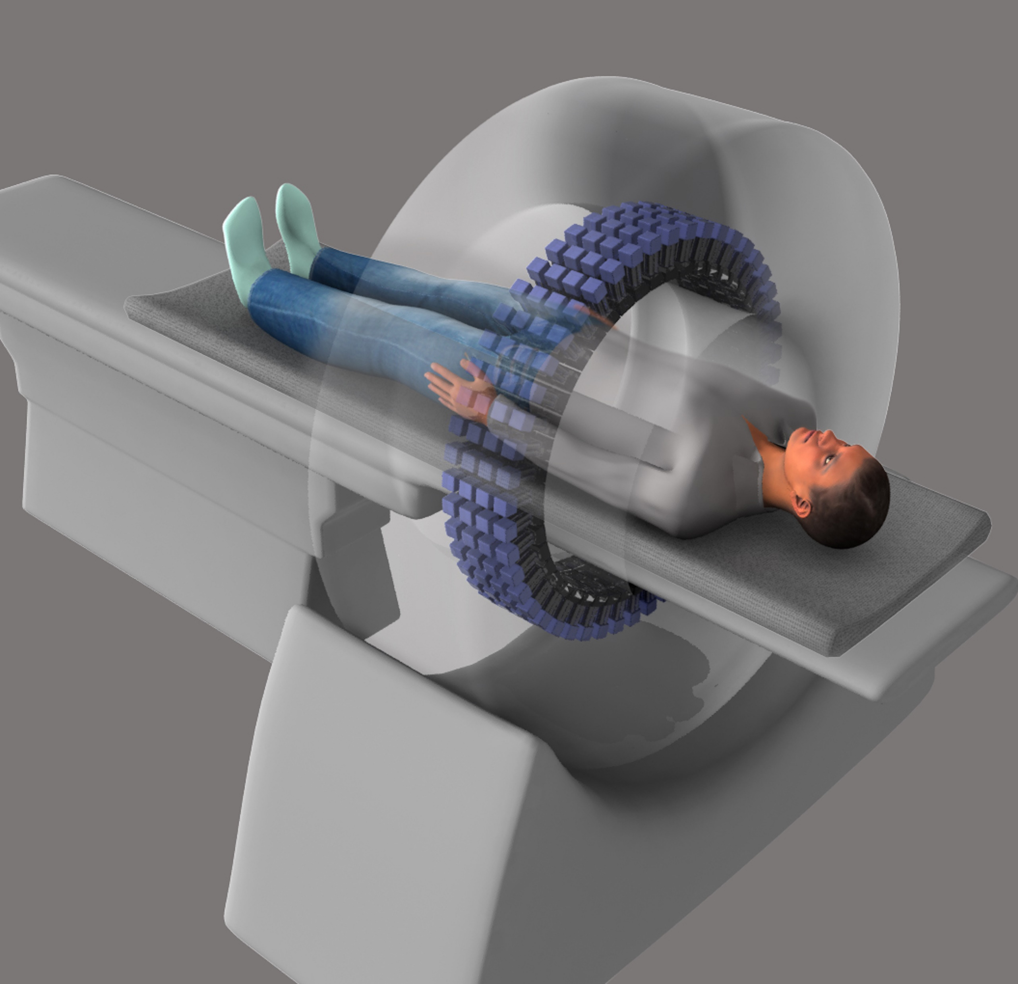
The EXPLORER total-body PET scanner
Conventional PET scanners have a small array of radiation detectors and can only image part of
the body at a time.
Conventional PET scanners have a small array of radiation detectors
7 www.futurumcareers.com

Slide 8
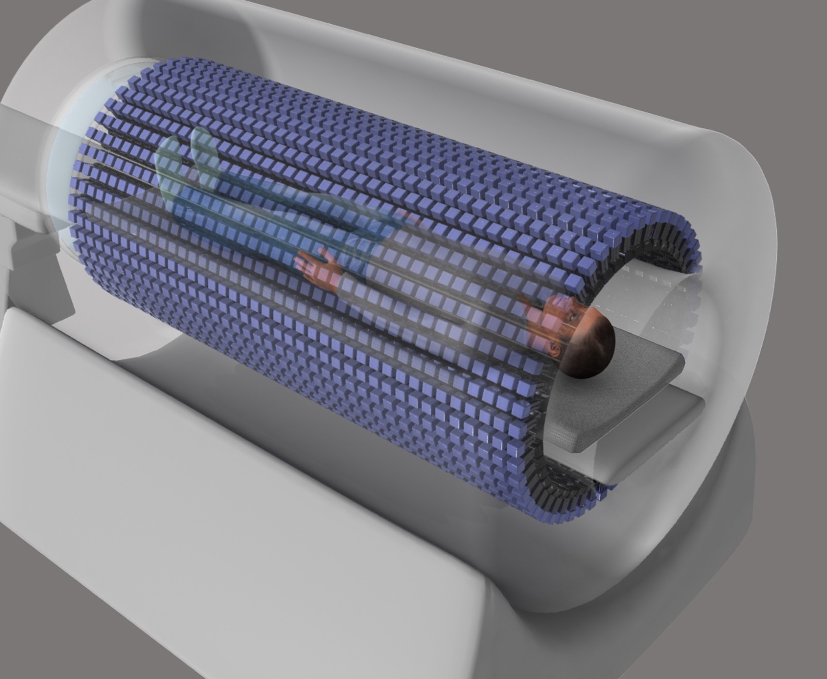
The EXPLORER total-body PET scanner
Conventional PET scanners have a small array of radiation detectors and can only image part of
the body at a time.
Simon and Ramsey have developed the EXPLORER total-body PET scanner. It has radiation detectors that cover the entire length of the body.
This allows it to capture images of the whole body in a single scan – the world’s first biomedical imaging device to do so.
EXPLORER has radiation detectors covering the entire length of the body
8 www.futurumcareers.com

Slide 9
Benefits of EXPLORER
With detectors covering the whole length of the body,
EXPLORER can detect radiation much more efficiently than
conventional PET scanners.
For a given scan time or radiation dosage, EXPLORER can collect
40 times more signal, generating higher quality images of the body.
Or it can conduct scans 40 times faster, meaning a total-body scan
can be completed in less than two minutes.
Or the patient can be injected with a radioactive dosage that is 40 times lower, reducing the patient’s exposure to radiation.
“The real game changer is that EXPLORER can see the radiotracer wherever it is in the body at any moment in time.” – Simon
Simon and Ramsey stand in
front of EXPLORER
9 www.futurumcareers.com

Slide 10
Talking points
In what ways does physics impact medicine?
What happens when a positron and electron annihilate each other?
How does positron emission tomography (PET) produce internal images of the body?
How does the EXPLORER total-body PET scanner differ from conventional PET scanners?
How do you think doctors balance the trade-offs between image quality, scan time and radiation dosage when using EXPLORER to scan patients?
10 www.futurumcareers.com

Slide 11
Pathway from school
to biomedical imaging
You will learn about the processes behind biomedical imaging in physics, about human anatomy in biology, and how to use and manipulate equations in maths. If classes are available, computer science and engineering will also be very useful.
If you want to design and build biomedical imaging devices, consider a degree in almost any field of engineering (biomedical, mechanical, electrical or even aerospace), biomedical imaging, physics or medical physics.
If you want to use biomedical imaging techniques while working with patients, consider a degree in radiography or medicine.
Look for research opportunities and internships with biomedical research labs or work experience and job shadowing opportunities with radiographers and medical imaging technicians in your local hospital.
A total-body PET scan made by EXPLORER
11 www.futurumcareers.com

Slide 12
Explore careers
in biomedical imaging
Biomedical engineers and medical physicists develop new biomedical imaging technologies and methods.
Chemists develop new radiotracers for PET scanning.
Radiographers operate biomedical imaging devices in hospitals.
Medical technicians and hospital physicists maintain biomedical imaging devices in hospitals.
Doctors, who may specialise in radiology or nuclear medicine, interpret biomedical scans and use them to diagnose and treat patients’ conditions.
Biomedical researchers use biomedical images to learn more about the human body.
The National Institute of Biomedical Imaging and Bioengineering has a wealth of resources for students, including fun facts, competitions, games and advice for future scientists.
A total-body PET scan made by EXPLORER
12 www.futurumcareers.com

Slide 13
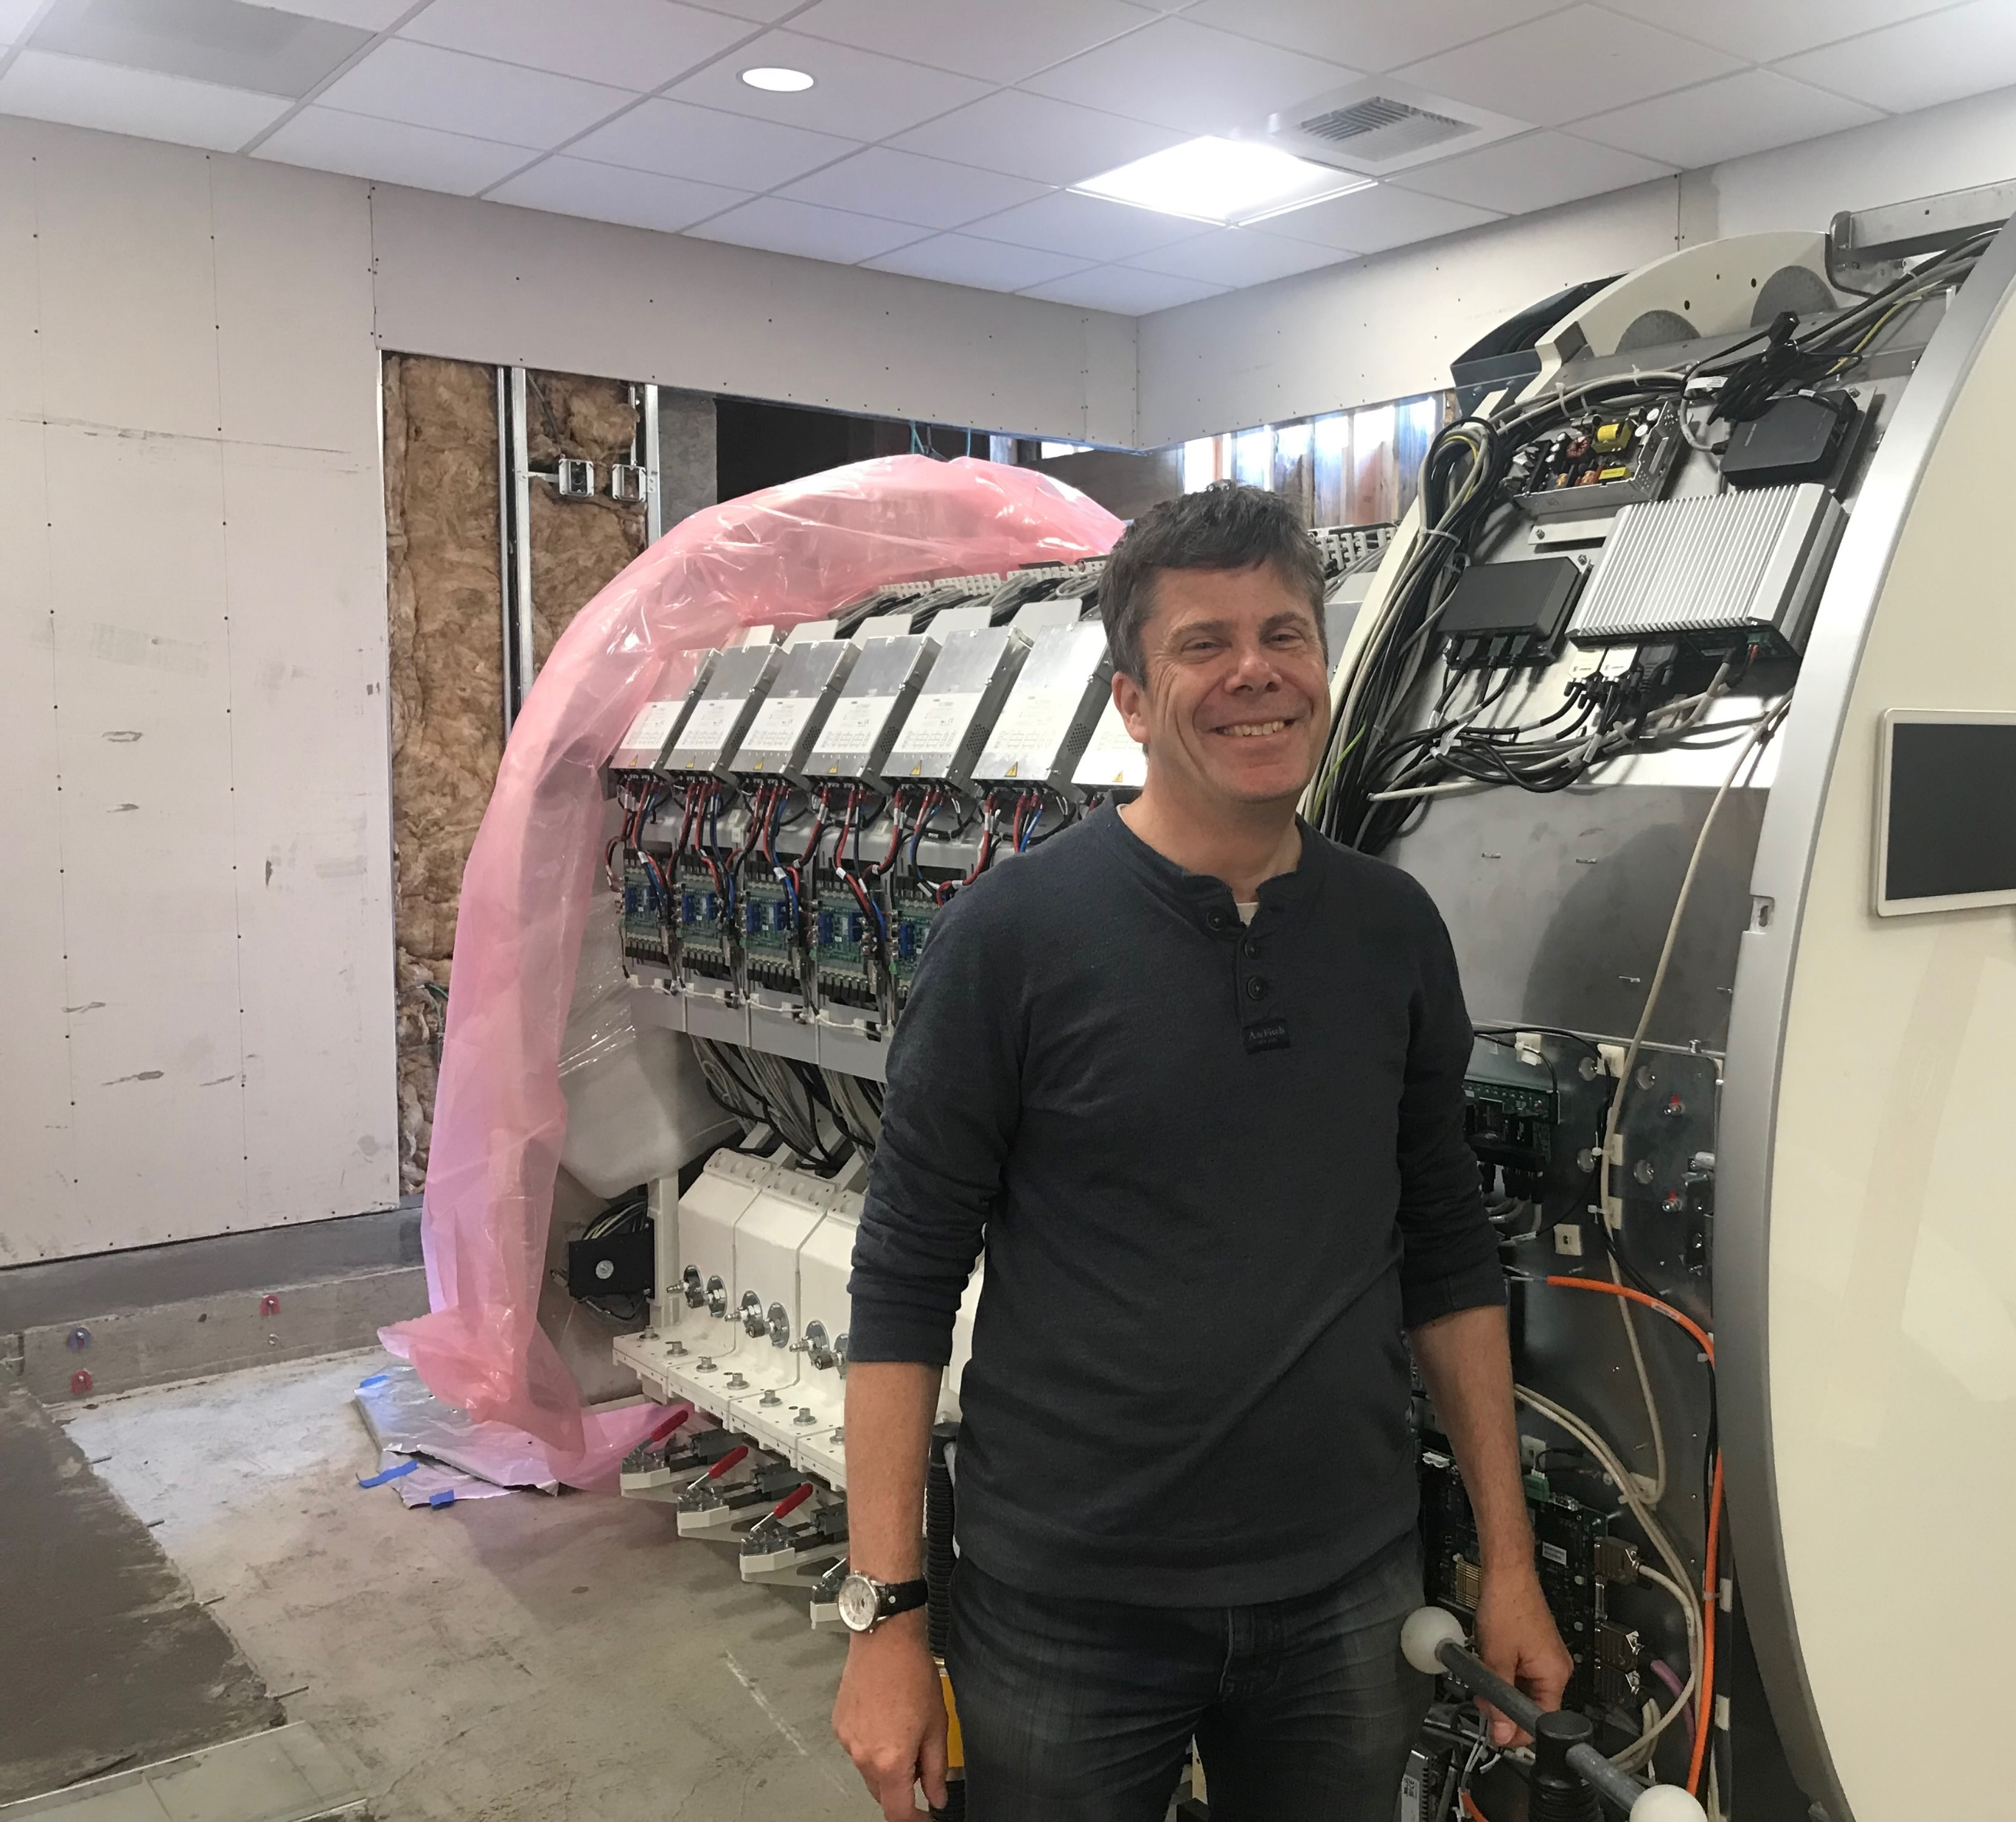
Meet Simon
My father was a biophysicist, and I would visit his labs
during the holidays. This, combined with my love of
astronomy and my great physics and chemistry teachers,
gave me a love of science.
At university, I studied physics with astronomy. I wanted to continue with physics research for a PhD, but I didn’t know which area I wanted to work in. I had never heard of medical physics, but when I discovered it involved the atomic and nuclear physics topics that interested me, combined with very direct practical applications in medical imaging and radiation therapy, I decided to focus on it.
I love the fact that with PET imaging, we are using fundamental theories and discoveries of physics. Radioactive decay, antimatter and the conversion of positrons and electrons into photons based on Einstein’s famous E = mc² equation sounds like science fiction, but we use this every day in hospitals to help patients.
13 www.futurumcareers.com

Slide 14
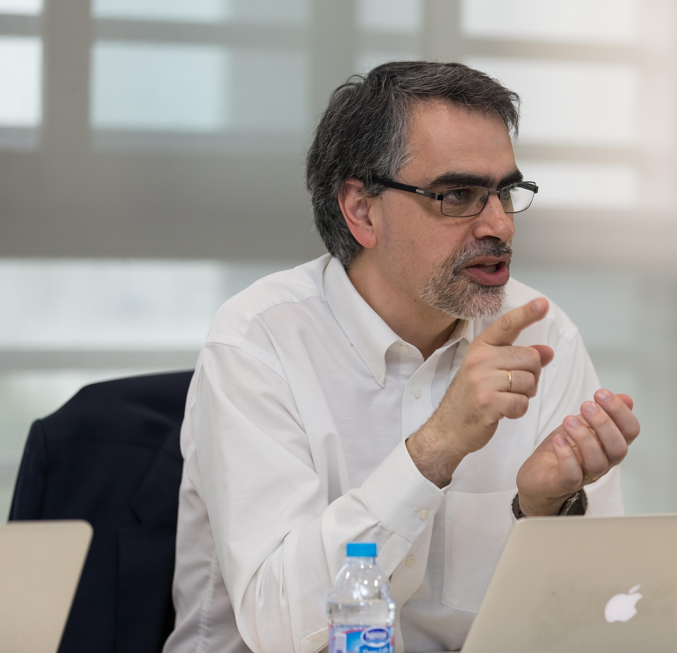
Meet Ramsey
I always knew I wanted to be a scientist – strangely
enough, from even before I really knew what it meant! In
high school, I was good at physics and chemistry, and I had
tremendous teachers in those subjects.
I got a job at the Clinical PET Centre at St. Thomas’ Hospital in
London. I barely knew what PET was at the time, but it caught
my interest and before I knew it, I was doing a part-time PhD in PET imaging!
Science is too broad for one person to master. If you want to make
an impact, you need to collaborate, so the ability to work with and get
on with other people is really important.
I love the way that PET allows you to see fundamental processes of biology, like the metabolism of sugar, happening right before your eyes in the living body. It’s an astonishing trick!
14 www.futurumcareers.com

Slide 15
Talking points
Which of the many careers in biomedical imaging most interests you, and why?
What similarities and differences do you think exist between the skills needed by biomedical engineers and radiographers?
How could you find out about research opportunities, internships, work experience and job shadowing opportunities in biomedical imaging?
How do you think you would benefit from such an experience?
How have Simon and Ramsey’s personal experiences influenced the work they now do?
15 www.futurumcareers.com

Slide 16
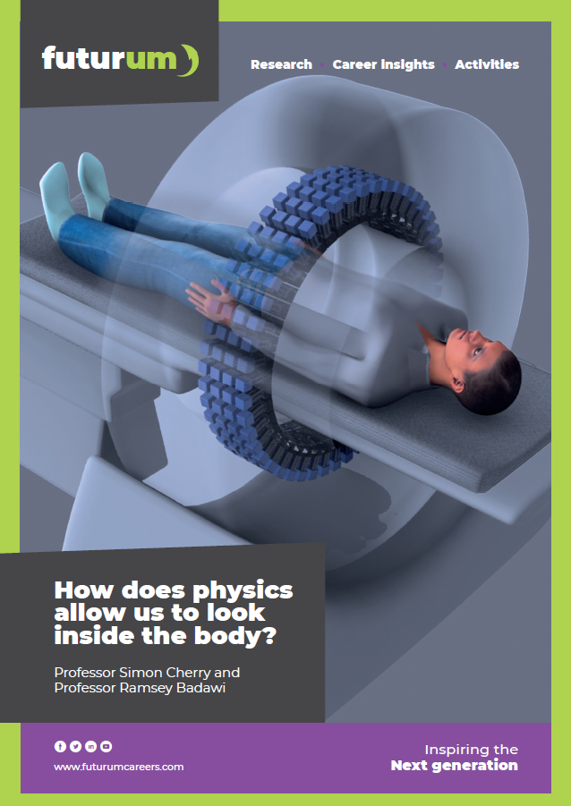
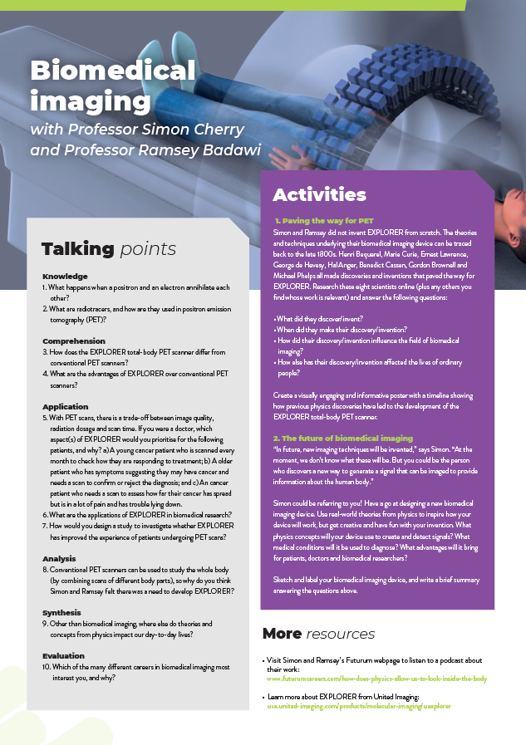
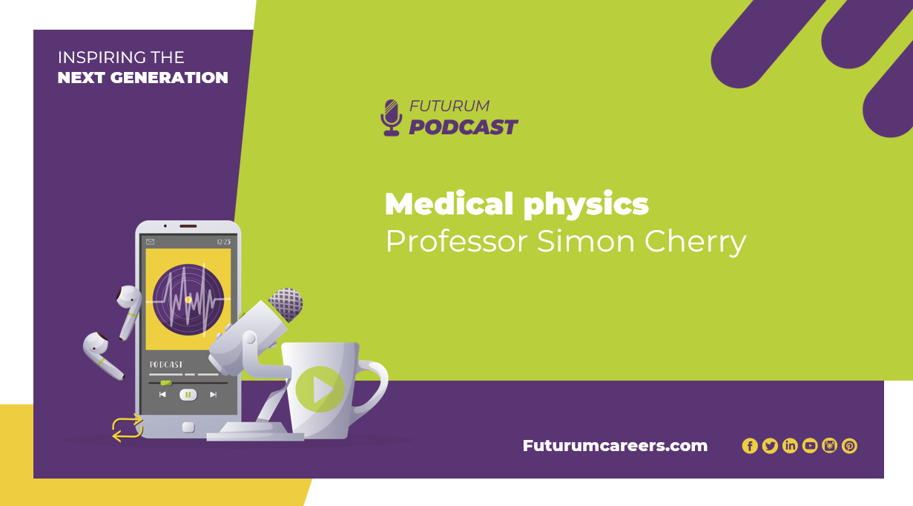
More resources
Visit Simon and Ramsey’s Futurum webpage
Download the article
Download the activity sheet
Listen to
the podcast
01
02
03
04
16 www.futurumcareers.com

Slide 17
17 www.futurumcareers.com

