Slide 1
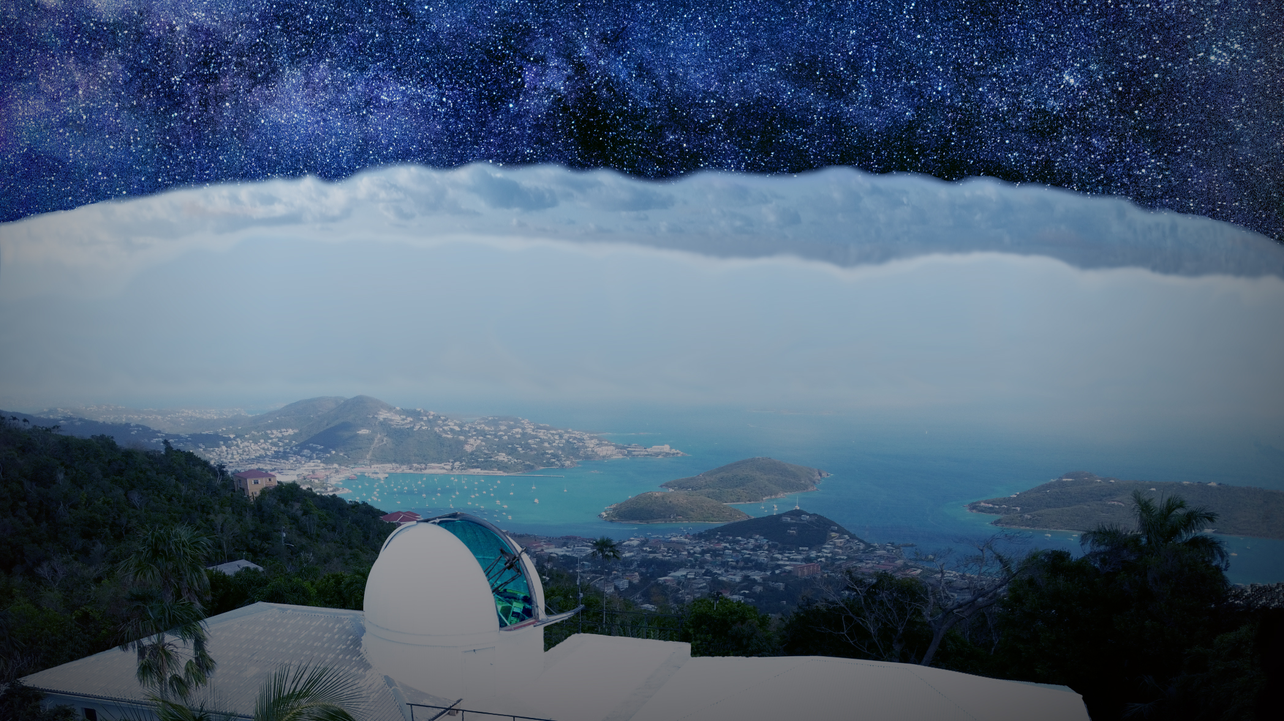
ASTROPHYSICS
WITH
DR BRICE ORANGE
&
DR DAVID MORRIS

Slide 2
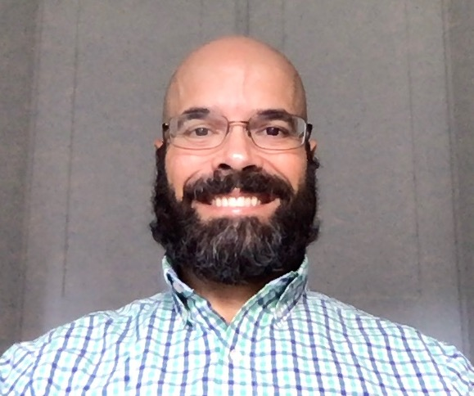
MEET BRICE AND DAVID
Dr David Morris is the
Director of the Etelman
Observatory
DR BRICE ORANGE and DR DAVID MORRIS are astrophysicists at the University of the Virgin Islands (UVI) in the US Virgin Islands. They run the Etelman Observatory, home of the Virgin Islands Robotic Telescope.
Besides conducting cutting-edge astrophysics research, Etelman provides key engineering training components in UVI’s physics and engineering degree programmes.
Brice and David are focused on educating a new generation of students in physics, astronomy and engineering.
Dr Brice Orange is the Executive Director of the Etelman Observatory

Slide 3
THE VIRGIN ISLANDS ROBOTIC TELESCOPE
The Virgin Islands Robotic Telescope (VIRT) is an astronomical telescope whose main science goal is rapid follow-up of rare and short-lived transients known as gamma-ray bursts. Gamma-ray bursts are some of the most powerful explosions in the Universe and are the only astrophysical event observed, so far, in both optical light and gravitational waves.
The VIRT is available to researchers and students who want to conduct hands-on projects related to robotic telescope control systems, astrophysical observations, data processing and management, and data analysis.
The observatory has a range of research workstations dedicated to solar atmospheric physics, high-energy astrophysics and extreme climate variability studies.
Brice lectures UVI undergraduate physics students on the roof of the Etelman Observatory about equipment used to study the solar eclipse in August 2017

Slide 4
THE ETELMAN OBSERVATORY
The Etelman team of dedicated staff, student researchers and volunteers shares a common vision of maximising the potential of the research initiatives to inspire the next generation of STEM scientists.
Indeed, the UVI has seen a dramatic increase in enrolment in physics and maths courses in recent years, which serves as testament to their efforts.
“The observatory serves as a teaching facility where we hold astrophysics lab courses,” explains David. “It is a tremendous education and outreach venue. We hold monthly outreach events that introduce students to astrophysics. These allow UVI faculty to interact with K-12 students and their parents, making them aware of opportunities to pursue physics and other STEM careers at UVI.”
Etelman Observatory staff and UVI summer undergraduate research interns

Slide 5
DIVERSITY IN PHYSICS AND ENGINEERING
UVI is a Historically Black College/University (HBCU), and its student population is predominantly of demographic groups who have been historically under-represented in STEM fields.
The percentage of women and African American students graduating from UVI’s physics programme is well above the national averages for diversity in physics graduates.
Etelman works to support young people in their studies and hires young researchers at the start of their career.
“We actively work to mentor undergraduate student researchers and encourage them in their pursuit of other internship opportunities, such as with NASA and the US Department of Agriculture,” says Brice. “We also support high school students in various observatory research initiatives to engage and inspire them to pursue a degree and career in STEM.”
The first class of UVI physics students graduating
with a Bachelor of Science degree, 2019

Slide 6
VISIONS FOR THE FUTURE
Brice envisions an increase of scientific production in the observatory’s key research areas, as well as further diversification of the research activities available to students.
“We are working to open up to tourism and astrotourism activities,” he says. “We want to pave the way for more scientists, undergraduate researchers, community members and visitors to experience all Etelman has to offer.”
David believes that the success of the facility reflects the ambition and talent of the territory, which shows no signs of stopping.
“The observatory has grown in prominence in the research community due to the commitment of faculty and students at UVI to pursue physics and astrophysics research,” he says.
Brice lecturing to a group of Etelman
Observatory cruise ship visitors

Slide 7
TALKING POINTS
Why are gamma ray bursts of interest to astrophysicists?
How do you think UVI students benefit from having access to the Etelman Observatory during their studies?
How do you think the US Virgin Islands benefit from having the Etelman Observatory in the territory?
Why do you think some demographic groups have been under-represented in STEM fields?
How is the Etelman Observatory helping to address this issue?

Slide 8
OPPORTUNITIES PROVIDED BY ETELMAN
“The physics programme at UVI continues to grow each year,” says David. “UVI is one of the nation’s leading HBCUs in producing physics graduates. We look forward to introducing more degree students to the excitement of astrophysics research and the potential for future careers in a wide range of STEM fields.”
“The multidisciplinary nature of the work we do at Etelman provides great training for students to begin their career path toward many different specialty areas,” he explains.
“Our physics graduates are pursuing careers in fields including astrochemistry, renewable energy, medicine, aerospace engineering, computational biology and investment banking. The Etelman Observatory has been a launching point for a remarkably diverse group of career paths, and we look forward to continuing that in the future.”
L-R: Ruel Mitchel, Ulric Baptiste Jr., Dr Brice Orange, Patrick Champey, taken after Ruel and Ulric completed
a summer research position at NASA’s Marshall
Space Flight Centre

Slide 9
AN ETELMAN STUDENT: RUEL MITCHEL
WHAT LED YOU TO THE ETELMAN OBSERVATORY?
While studying at UVI, I had the opportunity to work on solar astrophysics during a summer research experience. I saw it as an opportunity to grow as a young scientist, as well as begin my journey into a scientific discipline.
WHAT DID YOU GAIN FROM YOUR TIME AT THE ETELMAN OBSERVATORY?
I truly grew as a young scientist and engineer; I’m confident
in myself and my skills as a result. When I left my home university in the Virgin Islands to study engineering, I had
an advantage over many of my peers in terms of technical experience and critical thinking skills. During the tough moments in my education, experience I acquired from the mentoring at Etelman helped me stay focused and avoid emotional and mental pitfalls.

Slide 10
EXPLORE A CAREER IN ASTROPHYSICS
Study in the USA has a section dedicated to studying astrophysics and astronomy which includes a map you can click on to find a school in the area where you are interested in studying.
Science for the Public has put together an exhaustive list of resources relating to astronomy and astrophysics.
According to the National Careers Service, salaries for astrophysicists can range anywhere between £15,000 and £60,000, depending on experience.

Slide 11
PATHWAY FROM SCHOOL TO ASTROPHYSICS
Brice and David are keen to emphasise the importance of mathematics in becoming an astrophysicist.
“First learn math. Then learn more math. Then, once you know math well, start taking physics courses,” says David. “Once you have learned the basics of physics, you can begin learning astronomy, which is where the fun begins!”
You will need a degree in a relevant subject for postgraduate study.

Slide 12
TALKING POINTS
What do you think UVI physics students gain from their time at Etelman that enables them to pursue such diverse career paths?
How did Ruel’s experience at Etelman prepare him for his later studies in engineering?
What question would you like to ask Ruel about his time at Etelman?
Why do you think it is so important to understand mathematics before studying astronomy?
Is there an observatory or research institution that you could visit to learn more about careers in physics, astrophysics and engineering?

Slide 13
HOW DID BRICE BECOME AN ASTROPHYSICIST?
I have been inspired by my father, and one of his favourite quotes: “knowledge is power”. He always encouraged, supported and pushed me to think beyond the limits of any box.
My success boils down to a relentless pursuit of my own metric – the measure of success rivals the vastness of your own mentality.
My ‘eureka’ moment happened after graduating undergrad, while I was working as a surf instructor. I realised that my passion and career, whatever they ended up metamorphosing into, would require much more involvement from my brain. So, I made the decision that it might be worth trying my hand at graduate school.
Brice with the Virgin Islands Robotic Telescope

Slide 14
HOW DID BRICE BECOME AN ASTROPHYSICIST?
I love dabbling in science Research & Development (R&D) through my company, OrangeWave. I have been involved in solar atmospheric and plasma physics, robotic telescope control systems, environmental/climate science technology R&D, high-energy astrophysics, software engineering, vertical flight R&D, development of radiation shielding technology, and R&D for an experimental plasma physics/magnetic reconnection system to mimic solar flares.
I am a small-town kid, who loves all things to do with the ocean – particularly surfing – and spending time with family and friends, gardening, travelling, trying out new food, and trying (with an emphasis on trying!) to learn Norwegian from my Norwegian wife.
Brice surfing in Oceanside California

Slide 15
HOW DID DAVID BECOME AN ASTROPHYSICIST?
Many years ago, I studied astrophysics as an undergraduate at the University of Massachusetts. I did research at a small observatory, similar to Etelman. I trace my passion for the work I do now back to those days.
After several years in aerospace contracting, I returned to graduate school and then I worked at NASA’s Goddard Space Flight Center. Later, a relative saw an advertisement for a faculty position at the University of the Virgin Islands and to also take on directorship of a small observatory, not unlike the one I did research at as an undergraduate!
It seemed like a tremendous opportunity to build a program that would allow me to do the science that I was passionate about while also giving UVI’s students access to the same kind of hands-on science projects that I had as an undergraduate.
It was a chance I couldn’t pass up!

Slide 16
HOW DID DAVID BECOME AN ASTROPHYSICIST?
I have always been fascinated with the fundamental questions of where the Universe came from, if there is life elsewhere and how life began. These questions can only be approached through science, especially physics and astronomy.
Physics and astronomy are fields that allow you to dive deeply into understanding the Universe around you through math and data. If you do it right, you see connections on all scales. Sharing my appreciation of these connections with students is one of my greatest satisfactions. It is gratifying to hear students express this same sense of wonderment.
Dedication, patience, and commitment to learning always have helped me throughout my career. I believe a scientist is a person who sees every day as a chance to study things around them and to learn.
David with his son off Honeymoon Bay on the island of St. John, a favourite boating and hiking spot

Slide 17
BRICE AND DAVID’S TOP TIPS
Science is everywhere, and everything, you just have to know how to listen and find what parts of it set your heart and brain on fire.
Never forget where you come from. Combine that with high levels of passion and dedication and you will be on the path to success.
Do your best to listen to what you are being told and exhibit critical thinking and reasoning skills.
Commit to every step of your journey, whether you know where it will lead or not. Try and enjoy it!

Slide 18
TALKING POINTS
What do you understand by the quote ‘knowledge is power’? What power does your knowledge give you?
How do you think Brice applies his physics knowledge when conducting science Research & Development with his company?
What influence do you think David’s past has had on his passion for the Etelman Observatory?
How can you ensure you take every day as a chance to learn new things?
Why do you think it is important to ‘never forget where you come from’?

Slide 19
Dig deeper into the Etelman Observatory Download the activity sheet

Slide 20
