Slide 1
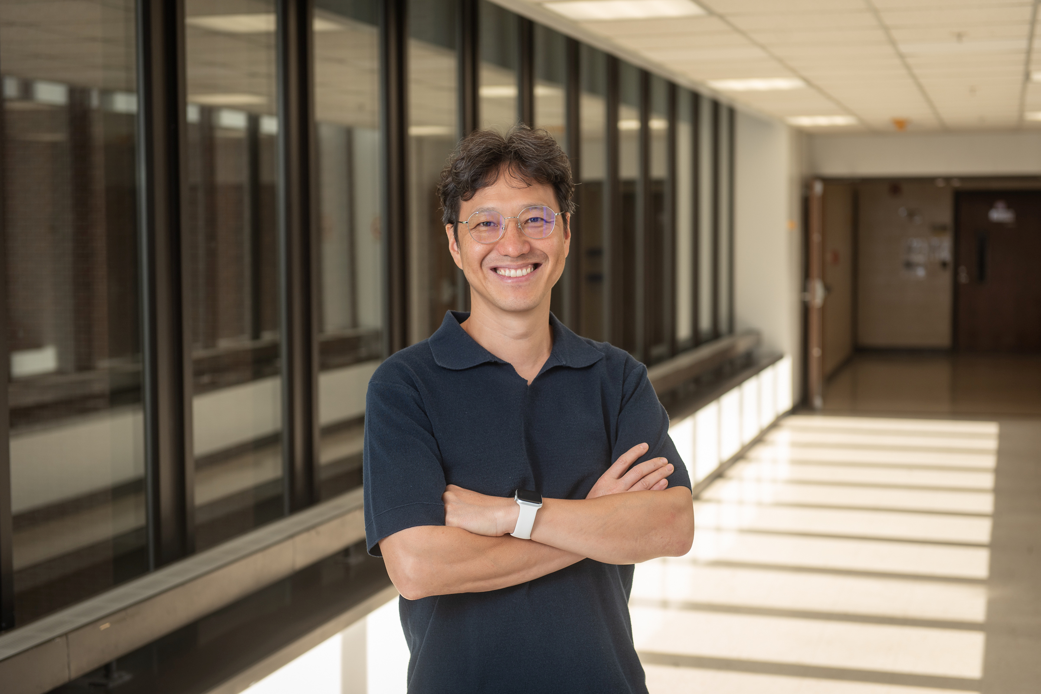


Wake Forest University School of Medicine
Mitochondrial Biology
with
Dr. Bumsoo Ahn
GET STARTED

Slide 2



In this Presentation:
Introduction
Bumsoo’s Research and Career Journey
Talking Points
About Mitochondrial Biology
Pathway from School to Mitochondrial Biology
Careers in Mitochondrial Biology
Meet Bumsoo
Talking Points
More Resources
© Kateryna Kon/Shutterstock.com
02 futurumcareers.com

Slide 3
Meet Bumsoo
Wake Forest University School of Medicine
Dr. Bumsoo Ahn is a mitochondrial biologist at Wake Forest University School of Medicine in the US.
He is investigating how functional decline in our mitochondria leads to sarcopenia, the age-related degeneration of muscles.
His research focuses on how exercise training and a hormone called unacylated ghrelin could help to slow this decline.
Dr. Bumsoo Ahn
03 futurumcareers.com

Slide 4
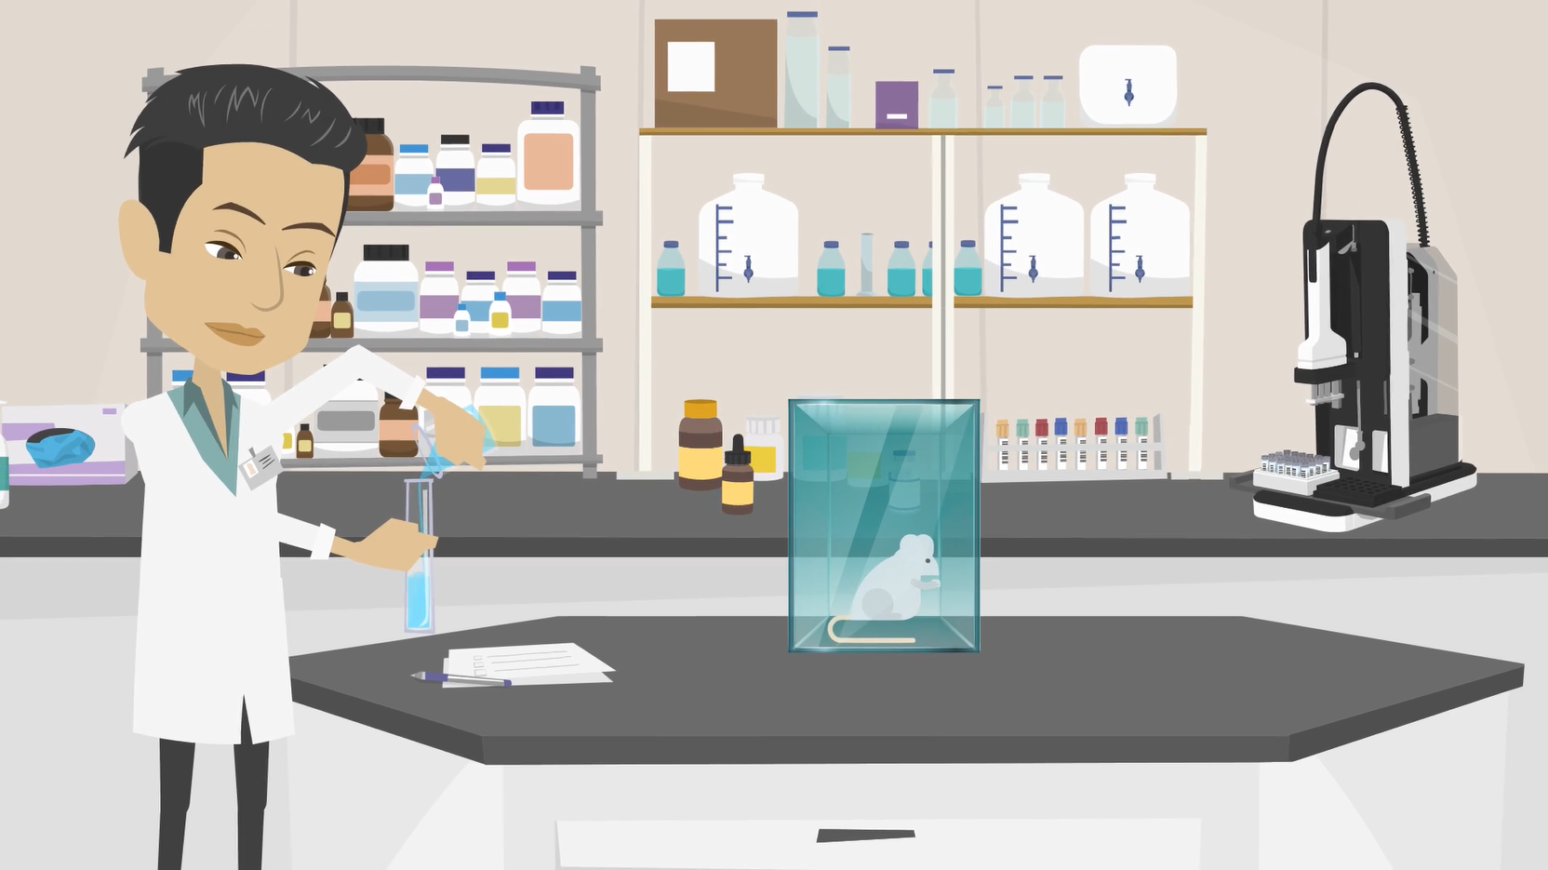
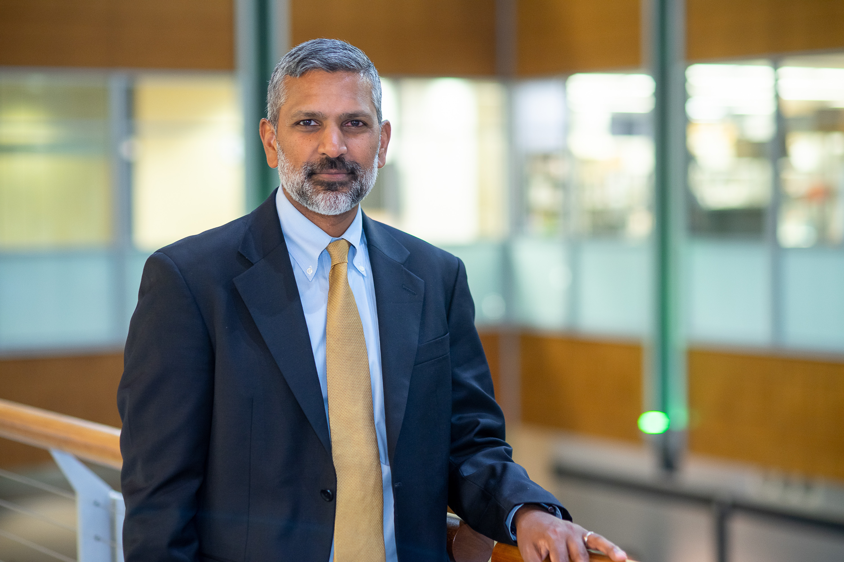
Learn about Bumsoo’s Research and Career Journey
The animation on the following slide will introduce you to Bumsoo’s research and career journey.
You can also find it on Bumsoo’s Futurum page: www.futurumcareers.com/mitochondrial-biology-with-dr-Bumsoo-ahn
Or watch it on YouTube:
https://youtu.be/hbXN-xDZfXo
04 futurumcareers.com

Slide 5

Embed animation here

Slide 6

Animation Summary
Growing up in South Korea, Bumsoo spent much of his time playing sports. He was fascinated by how exercise made his body feel stronger and more alive, which sparked his dream of studying human physiology.
After spending three years in industry, Bumsoo realized that he missed life as a research scientist, so he returned to academia. Working in a research lab, Bumsoo experienced the excitement of scientific discoveries and gained the confidence and curiosity that continue to drive his research today.
Bumsoo has conducted experiments showing that a hormone called ghrelin may counteract age-related muscle degradation. When used in conjunction with exercise training, ghrelin may enhance mobility and independence in older adults suffering from sarcopenia.
06 futurumcareers.com

Slide 7


Talking Points
How did Bumsoo’s love of sports influence his educational and career journey?
What did Bumsoo learn from his three years in industry?
How does the activity of mitochondria contribute to sarcopenia?
What role does ghrelin play in the body, and how can it counteract sarcopenia?
© Lordn/Shutterstock.com
07 futurumcareers.com

Slide 8
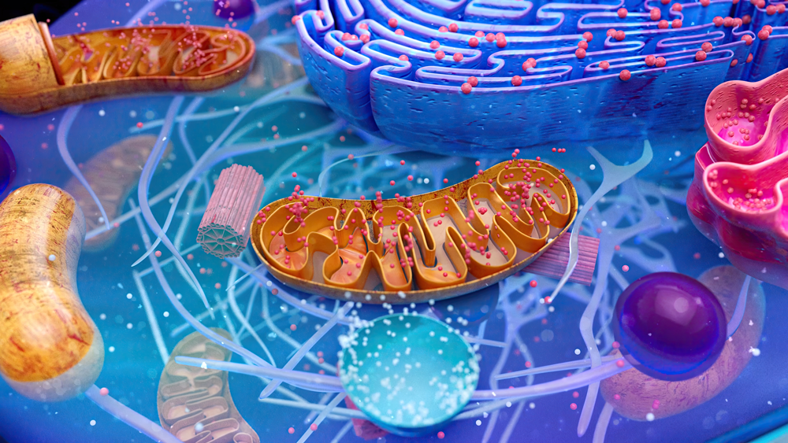
About Mitochondrial Biology
Because mitochondria are central to nearly every aspect of human physiology, the field of mitochondrial biology offers opportunities to make meaningful advances in medicine, aging research, and personalized health.
Because mitochondria have many and varied roles, many researchers around the world are studying them, each with a unique research angle. This leads to exciting collaborations and interdisciplinary work.
“Artificial intelligence can accelerate the discovery of mitochondria – targeting drugs, as well as the analysis of imaging to assess incidences of disease. A new chapter for mitochondrial biology is just around the corner – it’s a very exciting time.” – Bumsoo
08 futurumcareers.com
© Julien Tromeur/Shutterstock.com

Slide 9
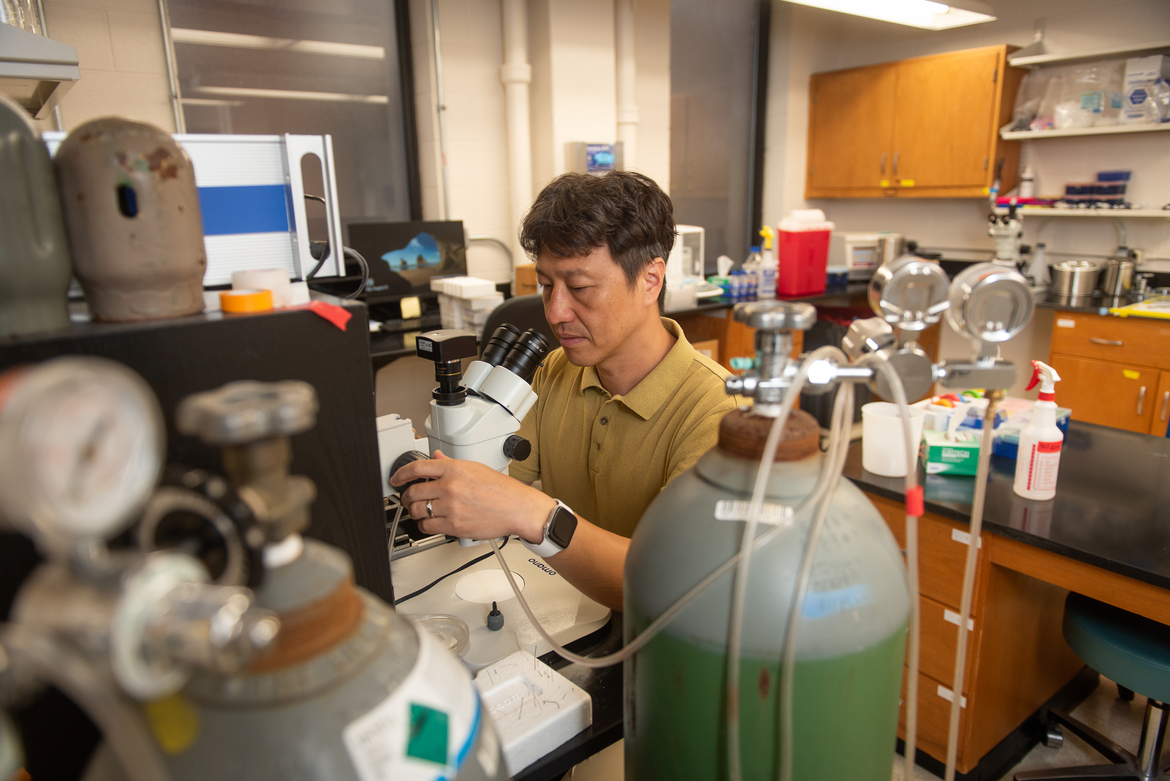
Pathway from School to Mitochondrial Biology
Wake Forest University School of Medicine
Build a strong foundation in biology, chemistry, and physics at school.
At college and university, Bumsoo suggests seeking
courses or modules in biochemistry, cell biology,
physiology, and genetics.
“Beyond undergraduate studies, further training in molecular biology, bioinformatics, and data analysis is becoming increasingly important. Modern mitochondrial research relies heavily on genomic and proteomic tools.” – Bumsoo
Bumsoo looking through a microscope in his lab
09 futurumcareers.com

Slide 10

Pathway from School to Mitochondrial Biology
If a more applied route appeals to you, biomedical
engineering, pharmacology, and exercise physiology
provide opportunities to develop interventions to
improve mitochondrial health.
“You can learn a great deal from hands-on
experience, so I would highly recommend seeking
opportunities for laboratory experience.” – Bumsoo.
S.Singha/Shutterstock.com
10 futurumcareers.com

Slide 11

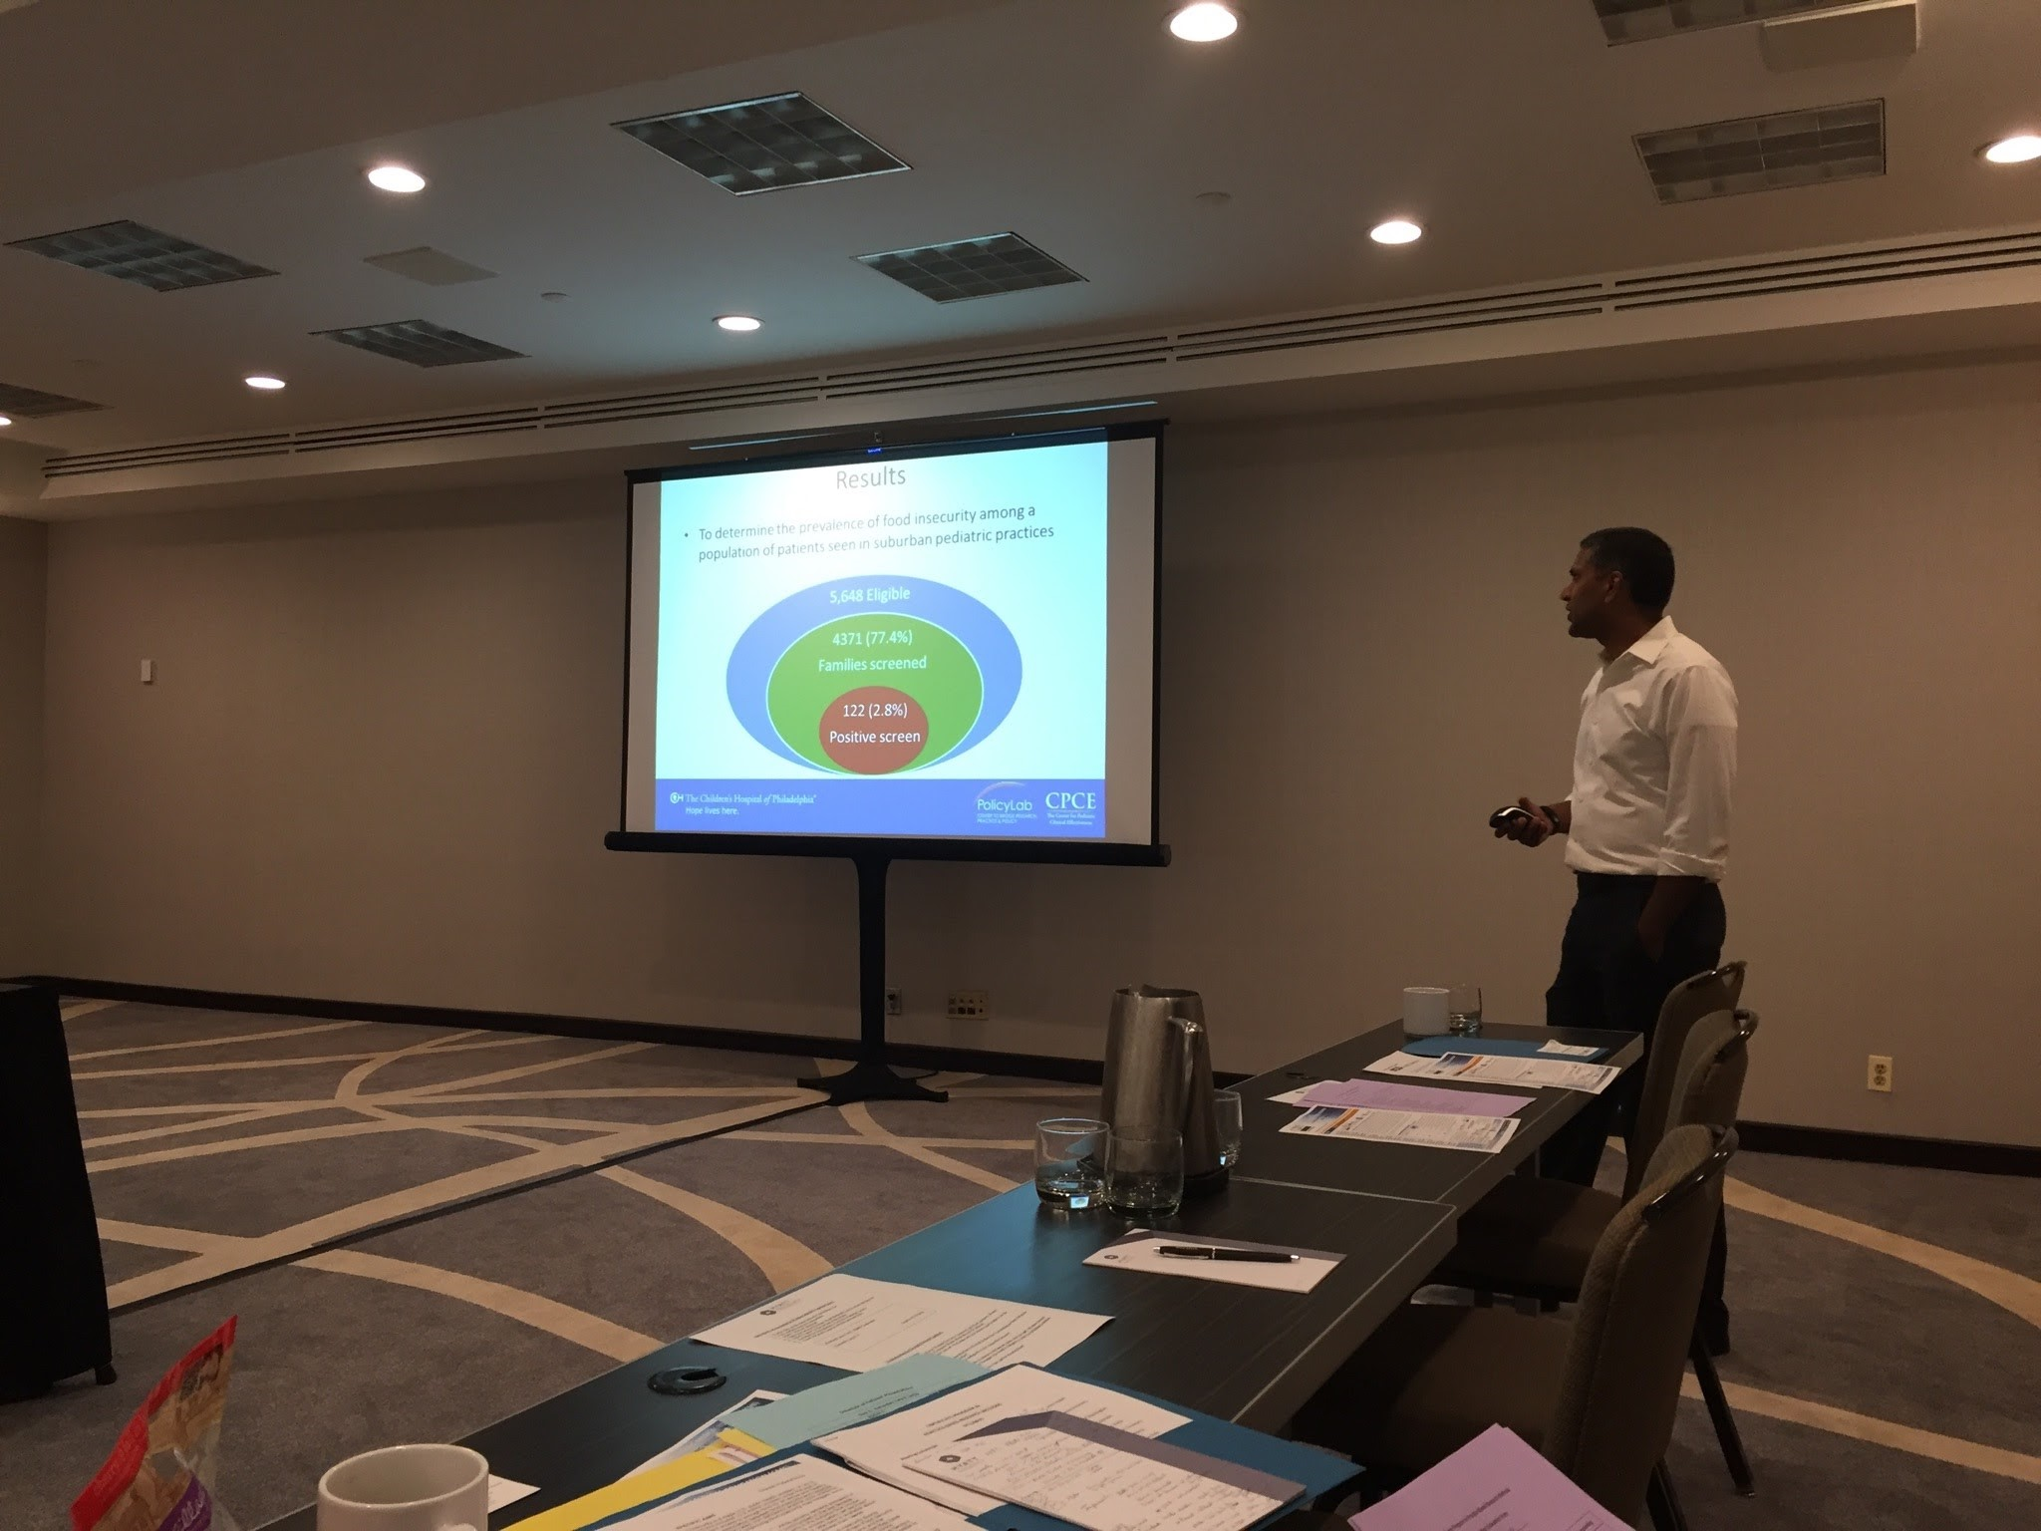
Student Opportunities
Wake Forest University School of Medicine
offers several summer programs for high school students.
The LEAP Internship Program provides STEM lab experience and mentorship to high school students.
The Summer Immersion Program provides a diverse range of experiences to help students discover their passions and goals.
© Wavebreakmedia/Shutterstock.com
11 futurumcareers.com

Slide 12
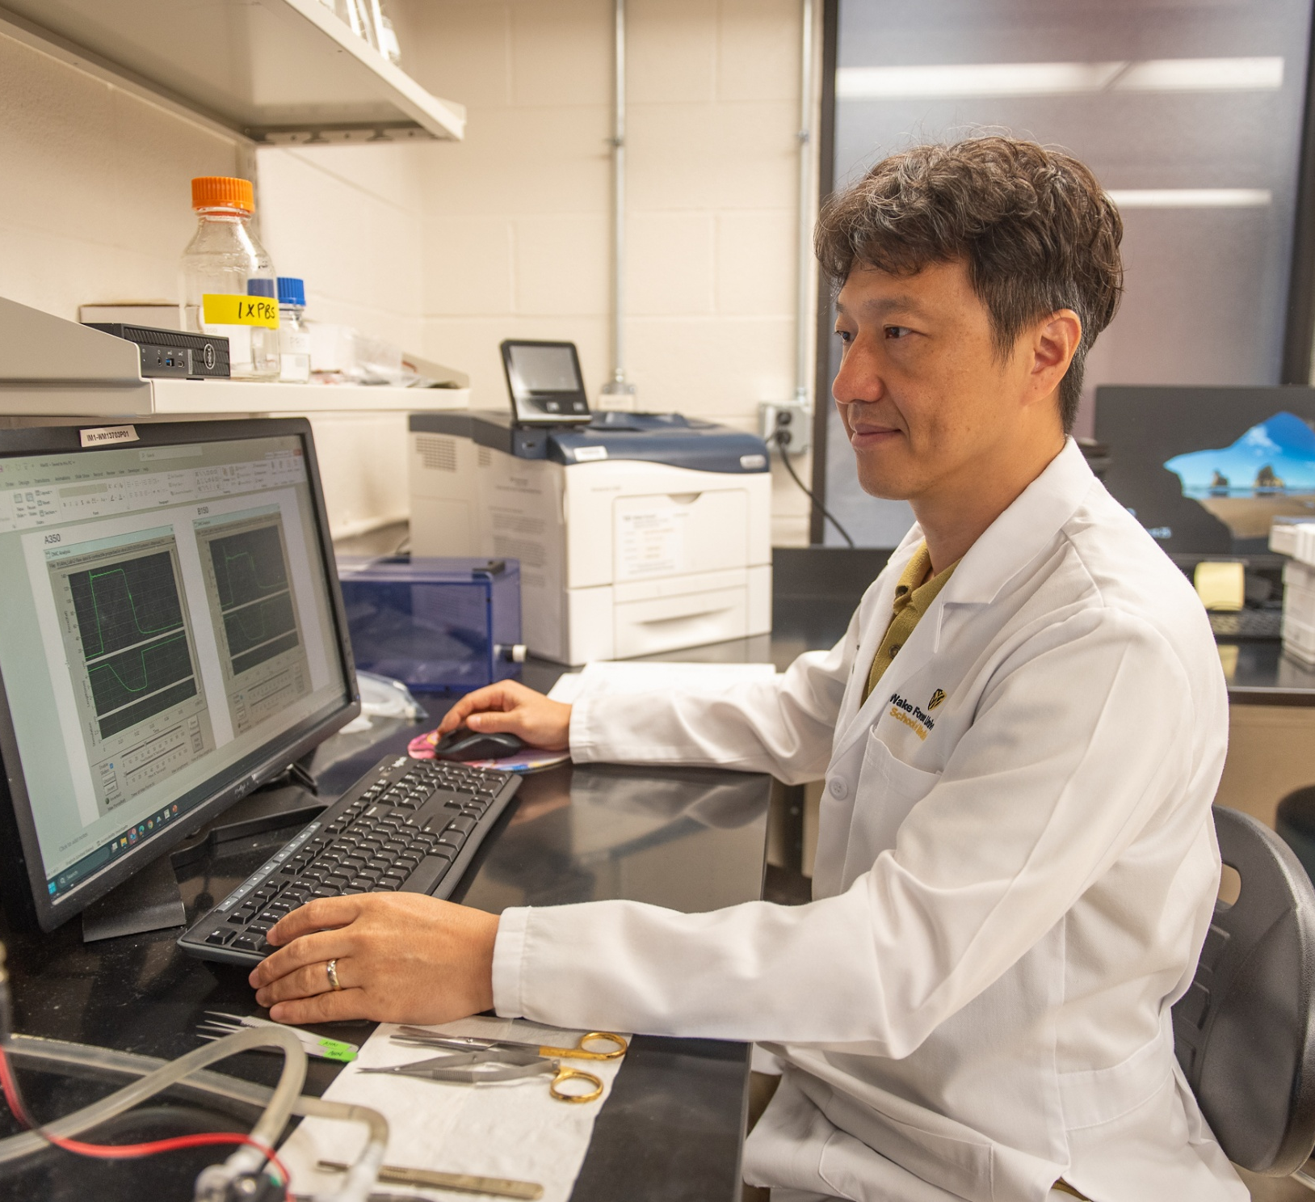
Explore Careers in Mitochondrial Biology
Wake Forest University School of Medicine
Careers in mitochondrial biology fall into two broad camps: academia, which involves primary research, and biotechnology and pharmaceuticals, which involve translating academic discoveries into ways to improve mitochondrial function.
Bumsoo recommends visiting Bioblast as a good starting point for anyone interested in keeping up with the latest research on mitochondrial function.
Bumsoo analyzing experimental data
12 futurumcareers.com

Slide 13
Talking Points
How do you think artificial intelligence can be used to improve research in mitochondrial biology?
Which of the subjects mentioned on the Pathways slides are you most confident in? Which could you develop your skills in, and how could you go about this?
“Careers in mitochondrial biology fall into two broad camps: academia, and biotechnology and pharmaceuticals,” says Bumsoo. Which type of career appeals to you most, and why?
16 futurumcareers.com
© Kateryna Kon/Shutterstock.com

Slide 14
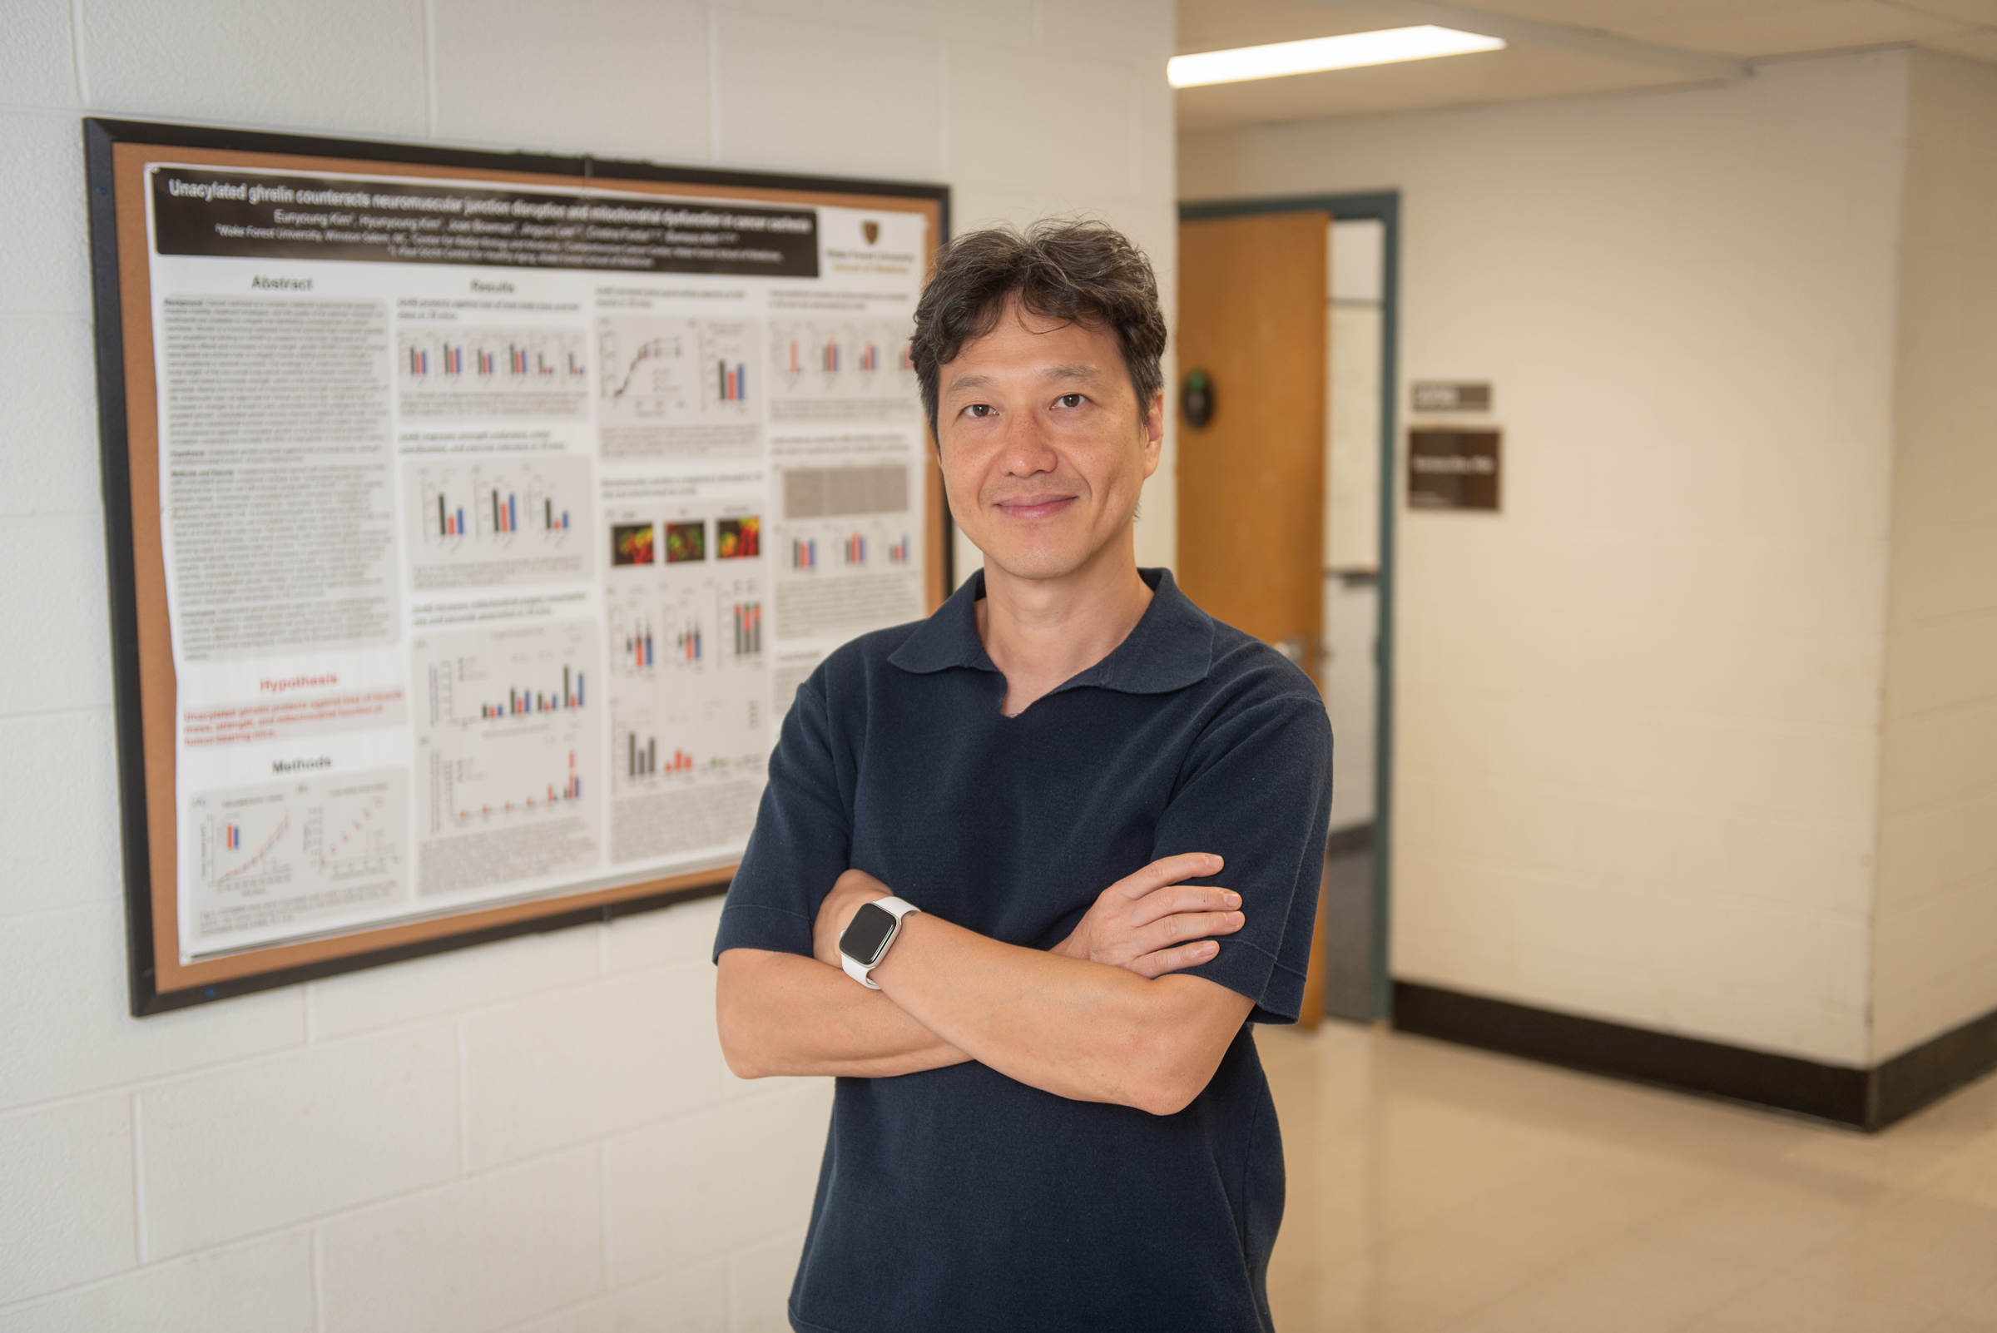
Meet Bumsoo
Wake Forest University School of Medicine
During my mandatory army service in South Korea, I had to do parachute jumping. It was a terrifying experience at the time, but it has now become an interesting memory. Sometimes we don’t see the benefits of our actions until later.
I worked in the private sector prior to my academic career, and those three years were crucial for convincing me to pursue academia. You don’t need to have your whole career planned out; sometimes, the only way to really know what you enjoy is through experience.
Bumsoo with a poster explaining his research
13 futurumcareers.com

Slide 15
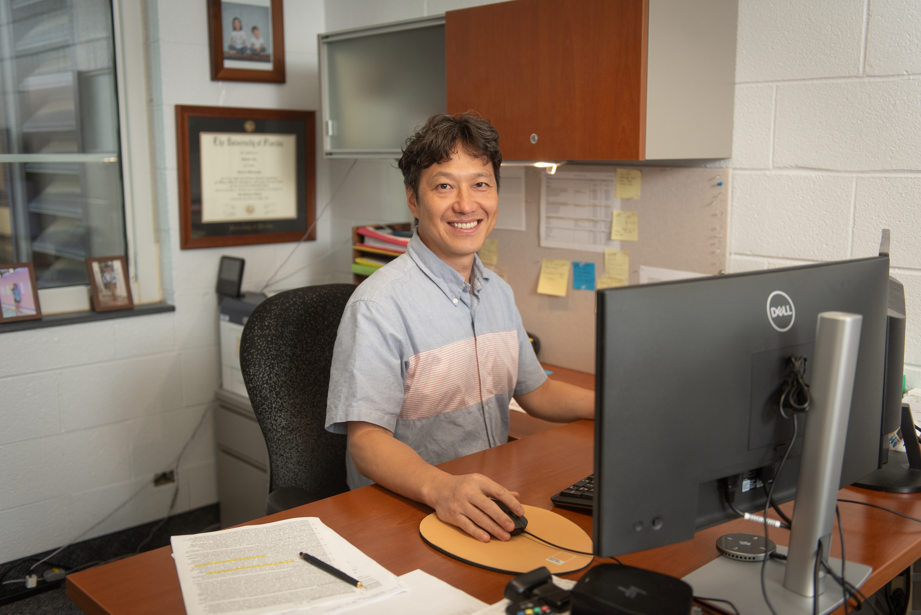
Meet Bumsoo
I like that science, at its best, is transparent and based on merit. In research, the data you generate becomes your own scientific credit, regardless of position or seniority. This system of open recognition creates a sense of fairness and accountability that I deeply appreciate.
I enjoy the collaborative and global nature of science – traveling to conferences, sharing findings, and learning from others around the world are privileges that make this career especially fulfilling.
I still exercise a lot, especially running, which helps clear my mind. I also like to play tennis with my son and chess with my daughter. And when we can, we all go to the mountains to hike as a family.
Wake Forest University School of Medicine
Bumsoo working in his office
14 futurumcareers.com

Slide 16
Bumsoo’s Top Tip
Wake Forest University School of Medicine
Dive into whatever excites you right now. The experiences you gain by doing so will help you find the next step of your career.
15 futurumcareers.com

Slide 17
Talking Points
What experiences have you had that were scary at the time, but which you look back on with fondness? What did these experience teach you?
Why is it important that science is transparent and based on merit?
Why does collaboration play such a key role in mitochondrial biology? When have you collaborated on a project? What were the rewards and challenges of this experience?
16 futurumcareers.com
© Kateryna Kon/Shutterstock.com

Slide 18
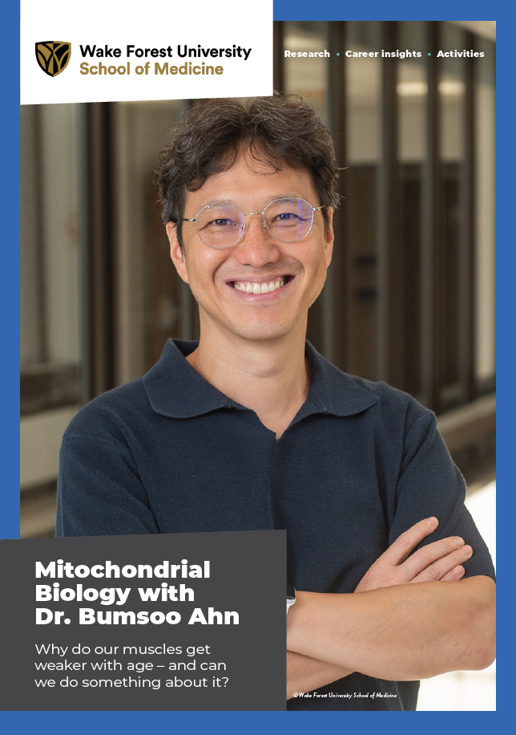
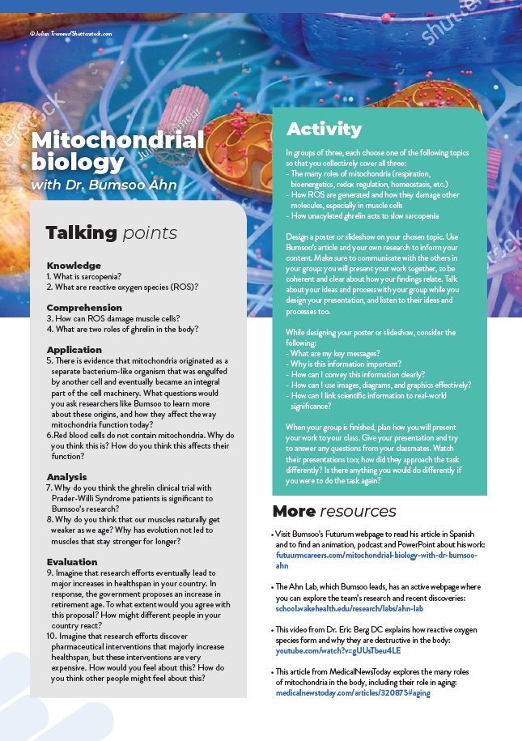
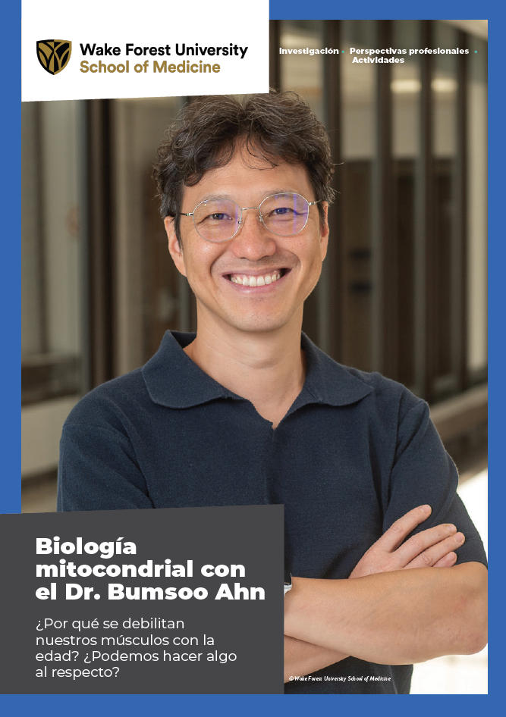



More Resources
Read the article
Complete the activities
Listen to the podcast
Watch the animation
Download the Spanish resources
17 futurumcareers.com
© Julien Tromeur/Shutterstock.com

Slide 19
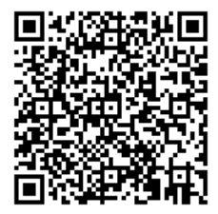



This educational material has been produced by Wake Forest University School of Medicine in partnership with Futurum and with grant support from The Duke Endowment.
The Duke Endowment is a private foundation that strengthens communities in North Carolina and South Carolina by nurturing children, promoting health, educating minds and enriching spirits.
Let us know what you think of this educational and career resource.
To provide input, simply scan the QR code or access the link below:
https://redcap.school.wakehealth.edu/surveys/?s=NPK347RYHCR3FNDC

