Slide 1


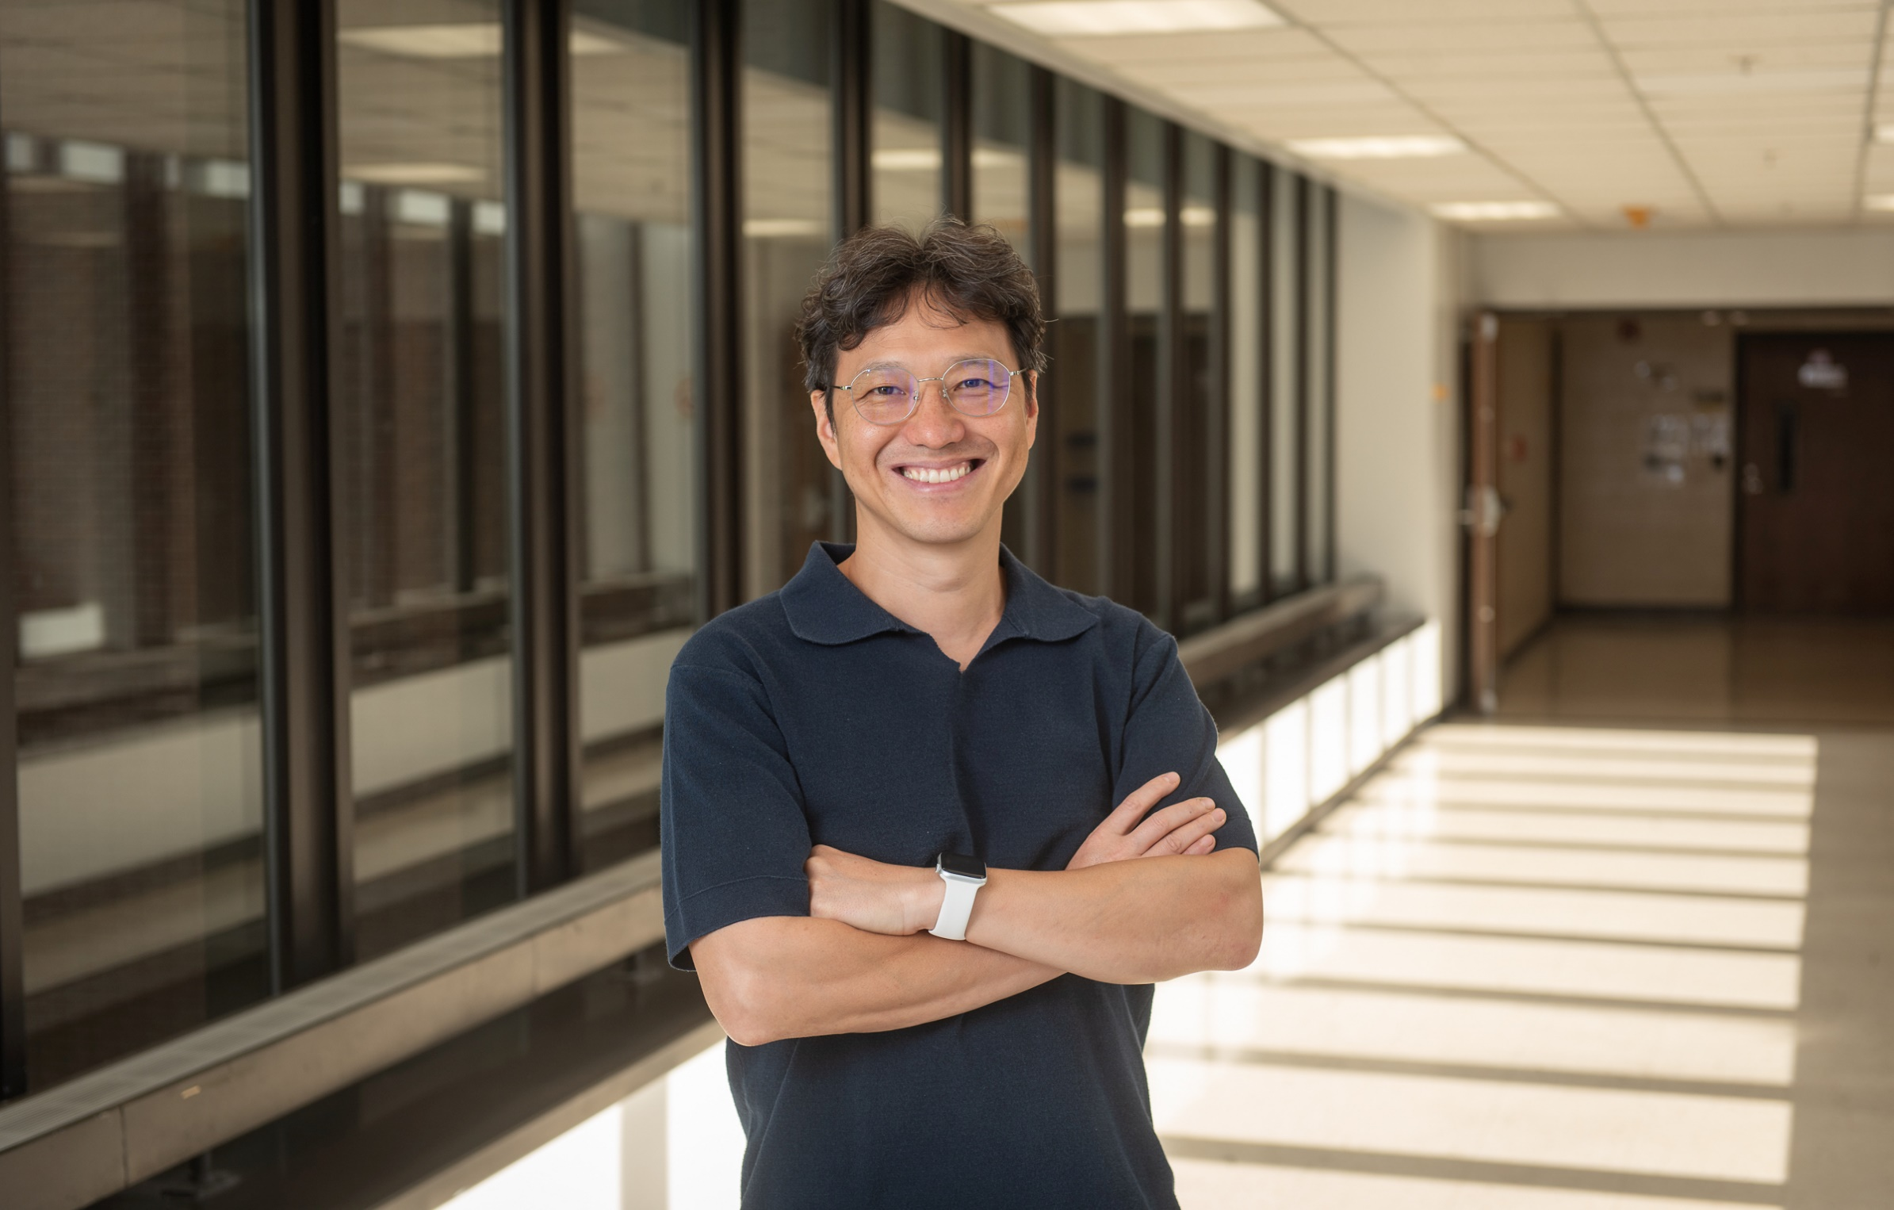
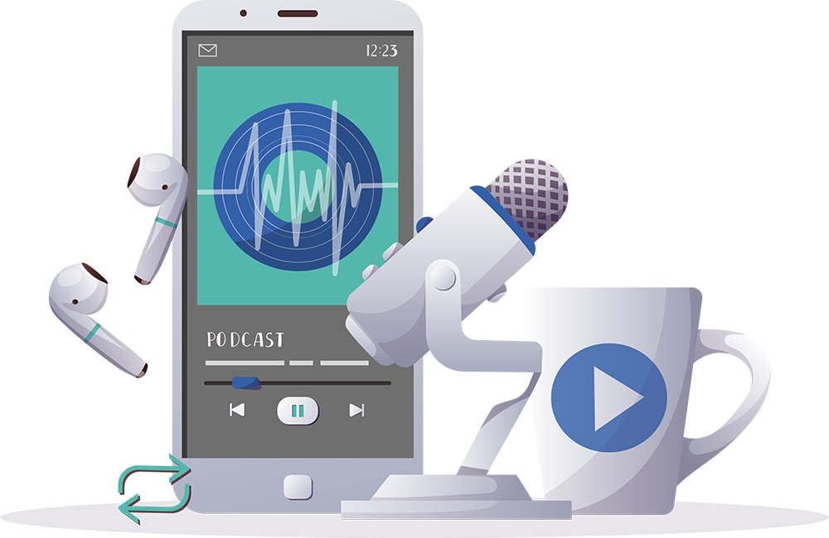

Inspiring the
Next Generation
FUTURUM
PODCAST
In Conversation with
Dr. Bumsoo Ahn

Slide 2

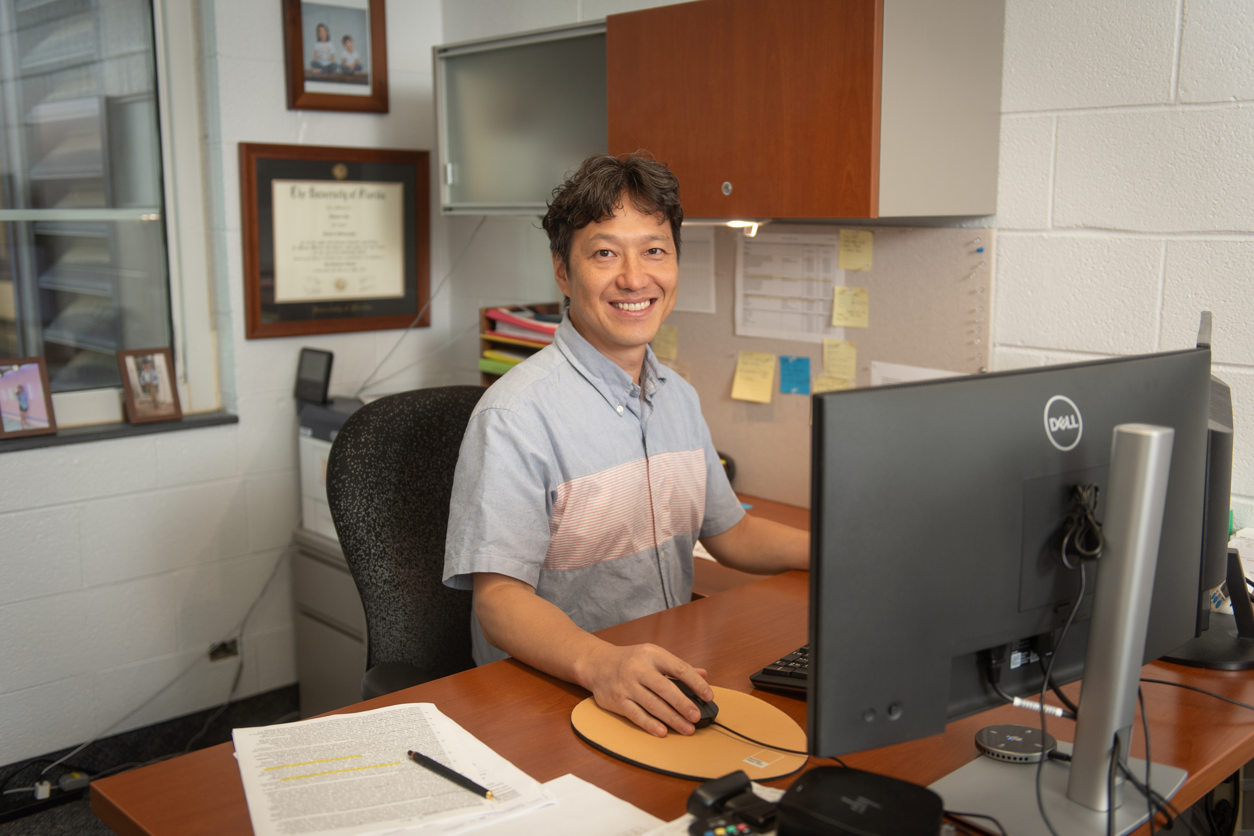
Pre-listening | Break it Down | Post-listening | Learn More
Meet
Dr. Bumsoo Ahn
Pre-listening:
In this podcast, Dr. Bumsoo Ahn discusses the excitement of making new scientific discoveries, how trial and error can be useful both in the lab and in our career journeys, and how his experiences serving in the South Korean army have shaped his life and career.
What do you think a career in mitochondrial biology involves?
How do you think it feels to make a new scientific discovery?
Why do you think trial and error is important, both in science and in careers?
Profile
Wake Forest University School of Medicine, USA
Field of Research
Mitochondrial biology; ghrelin biology
“Jump into different experiences. These will be the dots in your life. If you are creative enough to connect the dots, that will make your experience very strong.”

Slide 3


Pre-listening | Break it Down | Post-listening | Learn More
Break Bumsoo’s Conversation Down:
Up to 05:50
What is sarcopenia? What role do mitochondria play in this disease?
How do you think Bumsoo tests the effects of unacylated ghrelin on muscle growth?
What questions do you have about your hobbies and interests? How could you find answers to these questions and explore them further?
How important is it to you to have ownership of and control over your work?

Slide 4

Pre-listening | Break it Down | Post-listening | Learn More
05:50 – 09:48
Why is unacylated ghrelin better suited to treating sarcopenia than acylated ghrelin?
Why does Bumsoo say that finding unexpected results was a challenge? How did he overcome that challenge?
Why is it important to get experience in a range of different scientific settings? How can trial and error help you figure out which career path is right for you?

Slide 5

Pre-listening | Break it Down | Post-listening | Learn More
09:48 – end
Have you ever done something that terrified you? What did it feel like to face your fears? What did you learn from the experience?
How much do you value your freedom? What responsibilities come with being independent? How does the prospect of leaving home make you feel?
How long does it take you to make decisions? Do you prefer to follow your instincts or your reason?
What do you think Bumsoo means when he says you must be creative to join the dots of your experiences?

Slide 6


Pre-listening | Break it Down | Post-listening | Learn More
Post-listening:
To what extent do you think you would find a career in mitochondrial biology to be rewarding and interesting, and why?
“I would recommend students to jump into what's most interesting to them,” says Bumsoo. What interests you the most, at the moment? How could this interest lead to a fulfilling career?
How could you seek out opportunities to work in different scientific laboratories?
Which piece of Bumsoo’s advice did you find most useful, and why?
What further questions would you ask Bumsoo about mitochondrial biology and/or his career?*
Submit questions to Bumsoo here

Slide 7

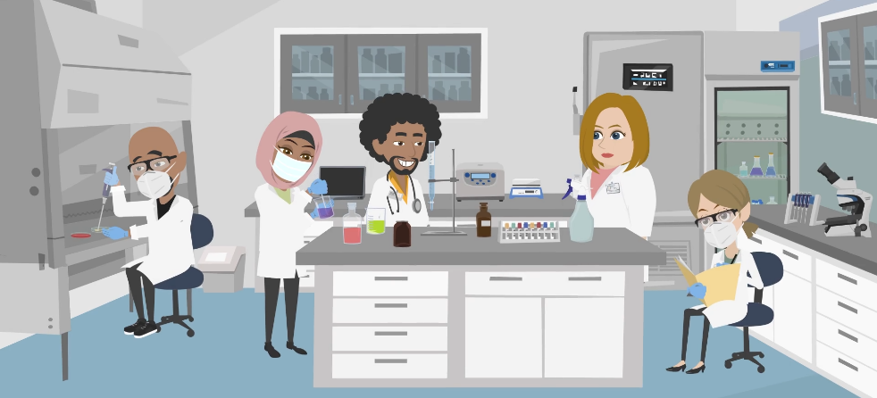
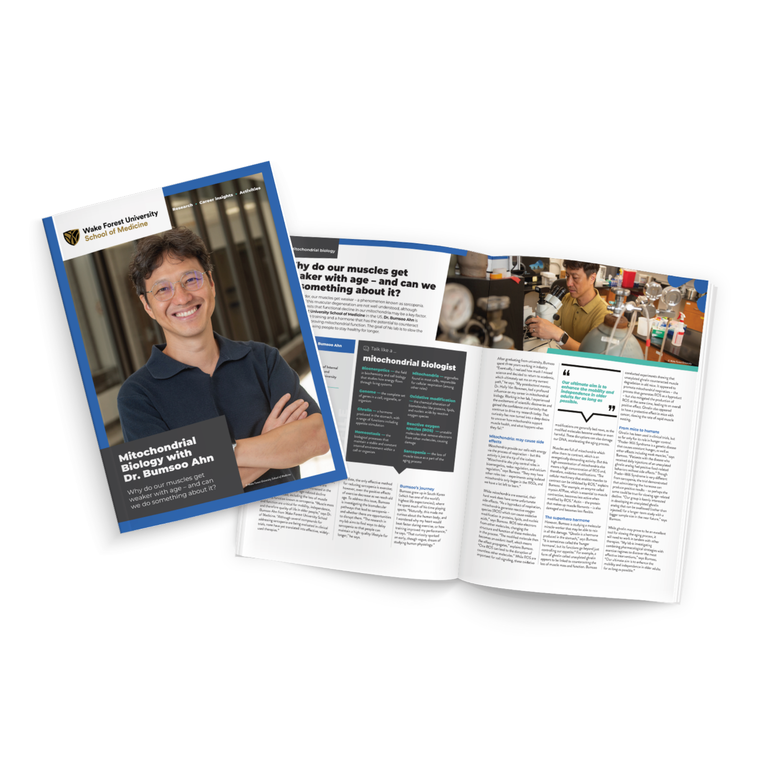
Pre-listening | Break it Down | Post-listening | Learn More
Learn More About Bumsoo’s Work:
Read Bumsoo’s article
Download Bumsoo’s activity sheet
Watch Bumsoo’s animation
Download Bumsoo’s careers PowerPoint
Read Tina’s resources in Spanish
Inspiring the
Next Generation

Slide 8
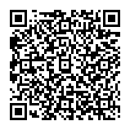



This educational material has been produced by Wake Forest University School of Medicine in partnership with Futurum and with grant support from The Duke Endowment.
The Duke Endowment is a private foundation that strengthens communities in North Carolina and South Carolina by nurturing children, promoting health, educating minds and enriching spirits.
Let us know what you think of this educational and career resource.
To provide input, simply scan the QR code or access the link below:
redcap.link/dh5j1nes

