Slide 1



Inspiring the
next generation
FUTURUM
PODCAST
In conversation with
Dr Marcia Ostashewski and the Centre for Sound Communities

Slide 2

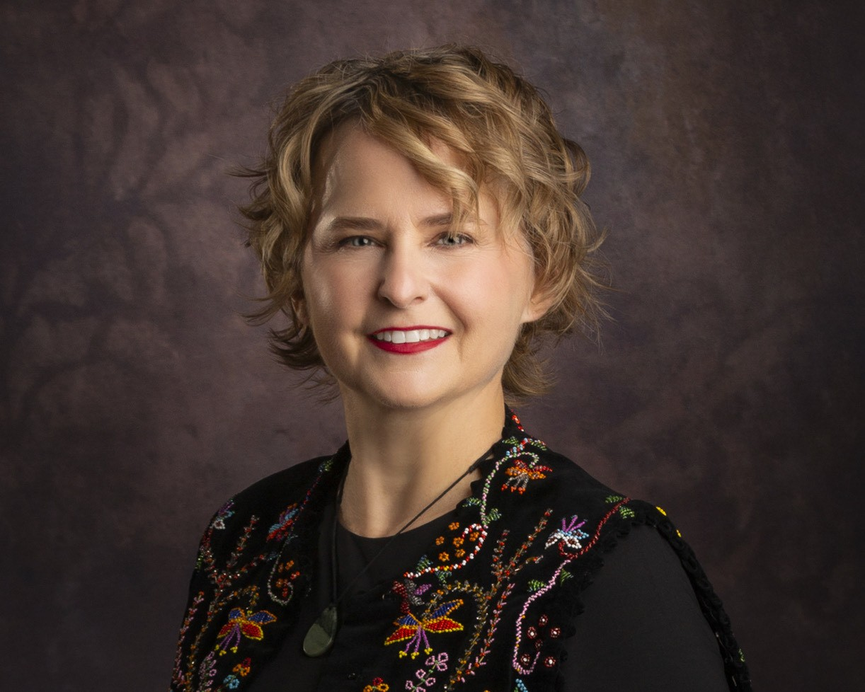

Pre-listening | Break it down | Post-listening | Learn more
Meet Marcia
Pre-listening:
Profile
Founding Director, Centre for Sound Communities, Cape Breton University, Canada
In this podcast, Dr Marcia Ostashewski tells us about her journey to becoming an ethnomusicologist, and we'll hear from her colleagues and research assistants who share their advice for those of you who are interested in this field.
What do you think when you hear the word ‘ethnomusicology’?
What do you think an arts-based social innovation hub is?
What role does music play in your life?
Fields of research
Ethnomusicology; dance ethnography
The Centre for Sound Communities (CSC) is an arts-based social innovation hub that uses collaborative, participatory ethnomusicology research to work with and support equity-deserving communities and facilitate decolonisation and reconciliation within the music industry.

Slide 3


Pre-listening | Break it down | Post-listening | Learn more
Break the podcast down:
Up to 05:00 minutes
Why do you think Marcia felt uncomfortable bringing the music she had grown up with into university settings?
Why is it important to study a range of musical traditions and practices beyond western art music?

Slide 4
Pre-listening | Break it down | Post-listening | Learn more
Break the podcast down:
05:00 – 08:52
How could you find out more about the breadth of career opportunities available to students who are interested in music?
What aspects of university interest and excite you? What other post-high-school opportunities might also allow you to connect with new people and experience new ways of being and knowing?
How can you find and nurture supportive relationships throughout your educational journey? Who currently supports you in your education, and how?

Slide 5

Pre-listening | Break it down | Post-listening | Learn more
Break the podcast down:
09:33 – 12:16
How could you use your skills, passions and experiences to inspire younger generations? Why is this an important thing to do? Have you had any experience of working with or mentoring younger students? What did you gain from the experience?
What do you think Jen means when she says, “Always give yourself grace”? How can you apply this life to your own life?

Slide 6
Pre-listening | Break it down | Post-listening | Learn more
Break the podcast down:
12:16 – 15:07
When have you taken on a challenge that you didn’t feel qualified or prepared for? How did you overcome the challenge? What did you gain from the experience?
How often are you involved in creating music? How could you find new opportunities for making music? How often and how do you experience/enjoy music that other people make?
Why is it important to learn about and experience many different opportunities early in your career?

Slide 7
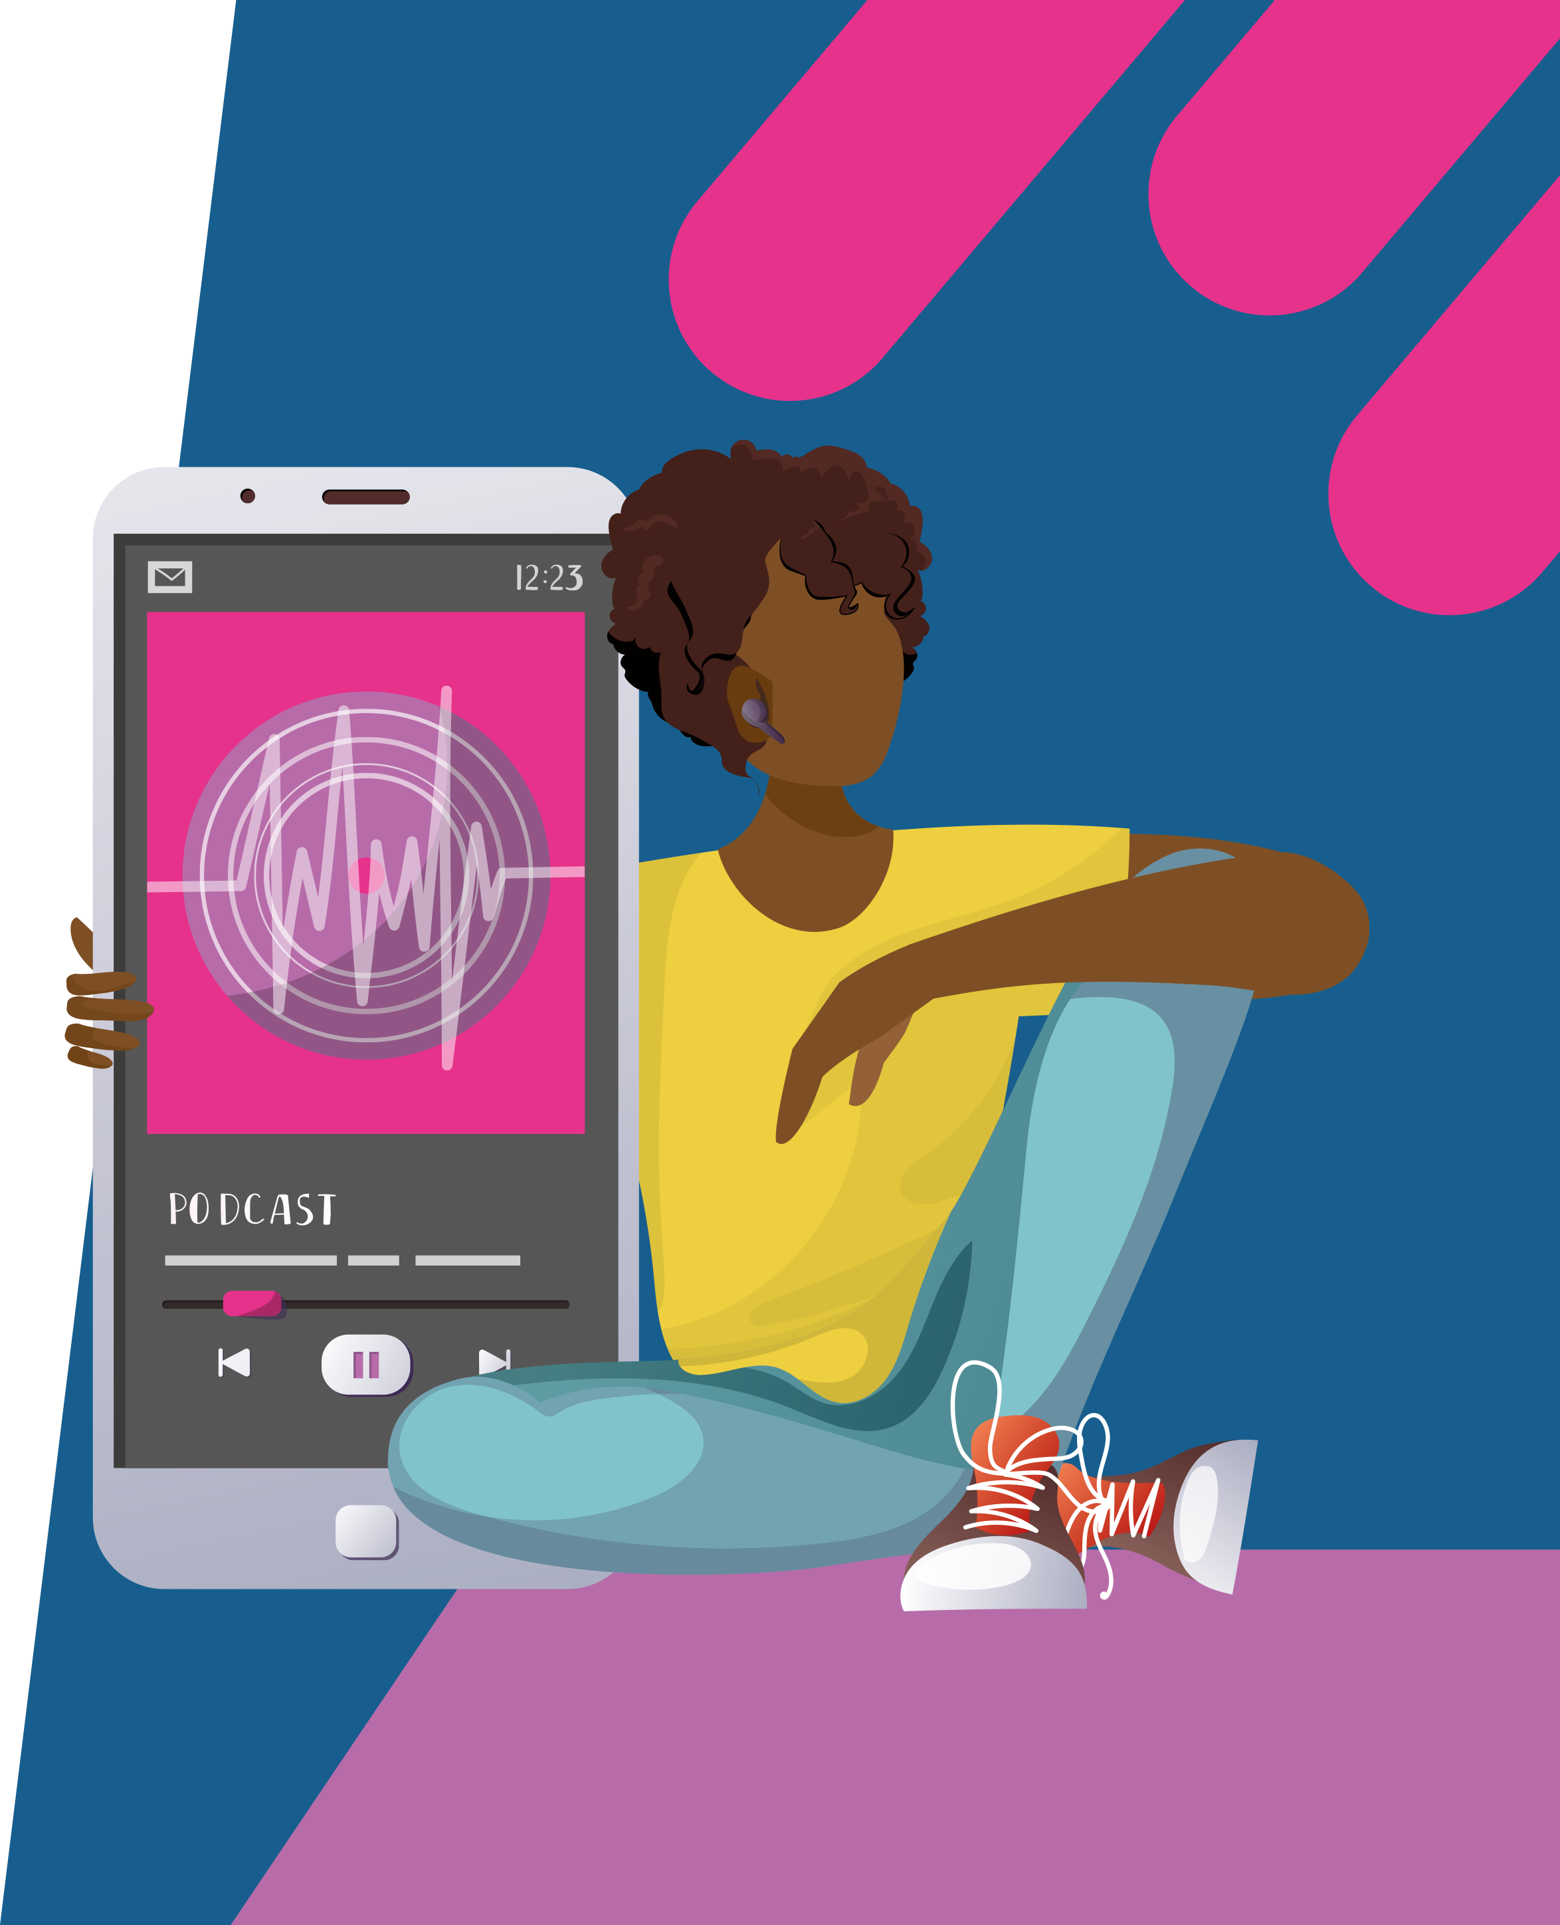
Pre-listening | Break it down | Post-listening | Learn more
Break the podcast down:
15:50 – 18:28
What is a powwow, and what role do they play in Mi’kmaw communities?
How could you find out more about the effects of colonisation on First Nation Peoples in Canada and North America? How could you find out more about the process of revitalisation?

Slide 8
Pre-listening | Break it down | Post-listening | Learn more
Break the podcast down:
18:28 – end
What do you think Leim means when he says, “Not all research is about looking through books”? What other methods do you think ethnomusicologists might use, and why?
To what extent are you proud of your community and culture? How could you learn more about and become more involved in your community and its musical practices?

Slide 9


Pre-listening | Break it down | Post-listening | Learn more
Post-listening:
How would you describe the CSC and its research to someone who has not listened to Marcia’s podcast?
What questions would you ask Marcia to learn more about her musical heritage and upbringing?
Whose advice did you find most useful, and why? How could you use this advice to help you in your educational/ career journey?
In this podcast, we heard music from Lassana Diabate, a virtuoso balafon player from Guinea. How did the music make you feel? How could you find out more about Lassana, his music and his musical heritage?
What further questions would you ask Marcia to learn more about the CSC and/or her career journey?*
Submit questions to Marcia and the team here

Slide 10

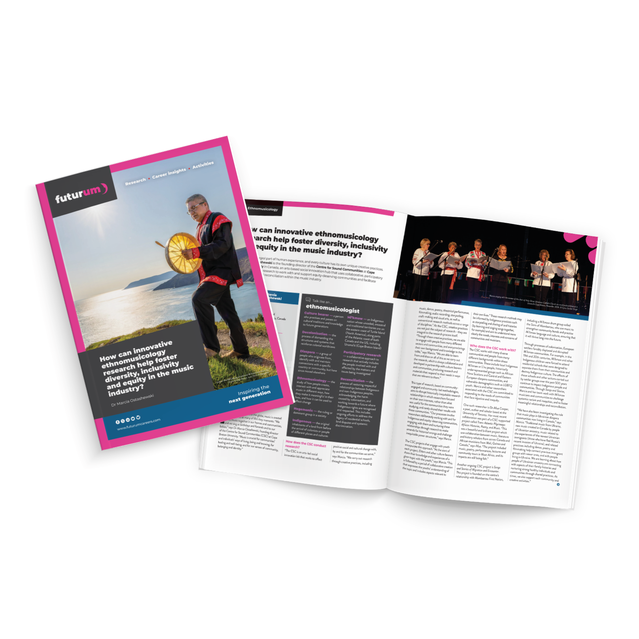
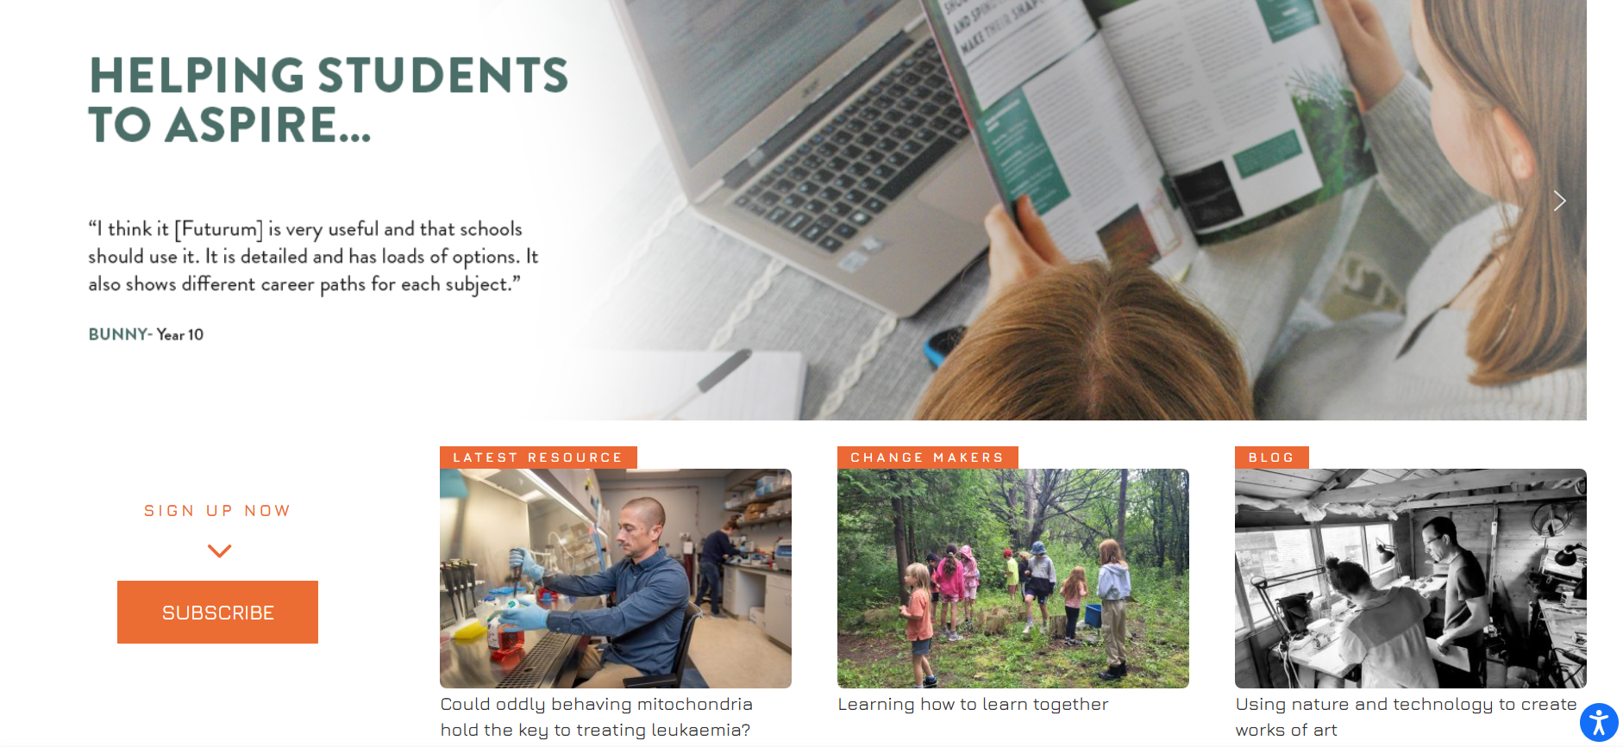
We would like to thank Luke Henderson, a music teacher at Halifax Regional Centre for Education, for his contribution to this PowerPoint.
Pre-listening | Break it down | Post-listening | Learn more
Learn more about Marcia’s work at the CSC:
A
Read the article here
A
Download the activity sheet here
Download the PowerPoint here
Read the article in here
Inspiring the
Next generation
ftlyp
futurumcareers.com

