Slide 1
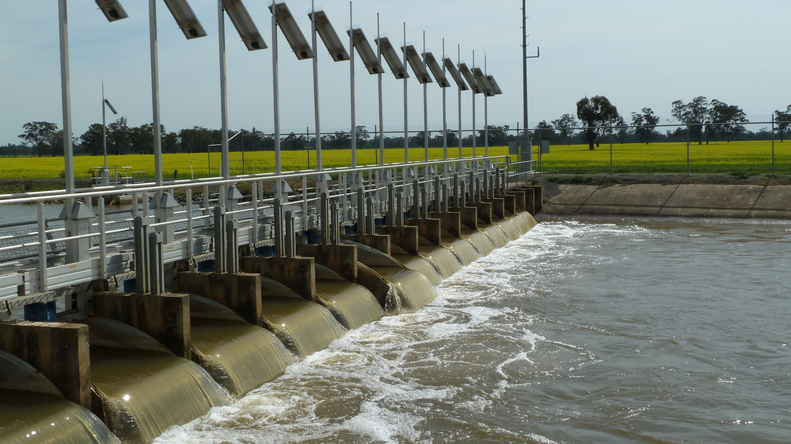
CONTROL ENGINEERING
WITH THE UNIVERSITY OF MELBOURNE AND RUBICON WATER

Slide 2
Globally, less than 60% of the water diverted into irrigation networks is used productively.
This inefficiency is partly due to outdated infrastructure and manual operating practices that can result in wasteful spillage at the end of the open-water distribution channels and poor service to farmers.
To address this, Professor Michael Cantoni and Professor Erik Weyer, from the University of Melbourne, Australia, are collaborating with engineers at Rubicon Water, including Professor Iven Mareels, Dr Adair Lang and Dr Yuping Li, to improve the efficiency of gravity-fed irrigation networks.
By applying techniques from control engineering, they are developing a system that automatically adjusts water supply to more efficiently meet demand.
Let’s learn more about their research…

Slide 3
Irrigation challenges
“Half of the world’s accessible fresh water is used in large-scale irrigation for our food and natural fibre production,” explains Iven. Population growth and rising living standards are driving increased demand for irrigation. “Without large gains in water productivity, the world could run out of economically available water,” Iven warns.
Most agricultural water distribution systems consist of open channels partitioned by gates into stretches of stored water, called pools. The gates set the flow of water between these pools. To irrigate their fields, farmers extract water at supply points.
It is important that the supply of water through the irrigation system meets the demands of farmers extracting water.

Slide 4
Total Channel ControlTM
To achieve this, the team developed Total Channel ControlTM (TCC). TCC is an automatic control system for maintaining desired water levels in an irrigation network.
With TCC, gates are equipped with sensors to monitor the water level in pools, actuators to adjust the gate positions to change water flow, and radio communications for the exchange of information between gates. “The goal is to coordinate the gate flows along the channels to keep water levels at supply points close to target values as demand varies across the network,” explains Michael.
TCC relies on feedback control to ensure water supply matches unpredictable demand.

Slide 5
Feedback control
“Feedback control is one of the essential elements of life as we know it,” Iven says. In nature, for example, it keeps warm-blooded animals at a constant internal body temperature. If our body becomes too warm, we sweat to reduce our temperature, while if we get too cold, we shiver to warm up. In this way, our core body temperature is maintained close to 37 °C.
In feedback control, adjustments are made to a system when the measured value of a regulated quantity does not match its target value.

Slide 6
Feedback control in TCC
Feedback in TCC causes the gates to respond to measured water level errors by adjusting the gate flows along the channel.
The outflow gate at the downstream end of each pool measures the difference between the observed water level and the desired water level. This information is communicated to the inflow gate, which determines how the upstream inflow to the pool should be adjusted to return the downstream water level to the desired setpoint.

Slide 7
Successes of TCC
A key advantage of TCC is that water supply is demand-driven, which prevents wastage of unused water. Automation means the system does not require human input to adjust water flow as the feedback control system autonomously reacts to real-time changes in demand.
To date, Rubicon Water has installed over 35,000 control gates in irrigation networks around the world. The Goulburn-Murray Irrigation District in northern Victoria, Australia, has been operating under TCC for more than a decade, resulting in water losses being reduced by 50% compared to pre-automation operations.
As our global demand for water increases, control engineers will play a key role in helping to ensure our world has water security.

Slide 8
Talking points
Why is the global demand for fresh water increasing?
Why is it important that, with TCC, water supply is demand-driven?
What is feedback control?
What examples of feedback loops can you think of, in both natural and artificial systems?
How does the TCC system respond when there is a downstream change in demand for water?

Slide 9
About control engineering
Control engineers are often responsible for the design and implementation of crucial components in larger engineering systems. “Feedback control systems enable intended behaviour to be reliably achieved in unpredictable operating environments,” explains Michael. For example, in power and water distribution networks, control systems allow the supply of electricity and water to be automatically adjusted to meet unpredictable changes in demand.
“Control engineering is everywhere around us,” says Iven. “For example, our mobile phones use just enough power to make a call, but as little as possible to avoid draining the battery.” Cruise control on a car maintains the car’s speed and the autopilot in aircraft maintains specified altitude and direction. Thermostats use simple controls to keep your home at a constant temperature, regardless of the weather outside.

Slide 10
About control engineering
“Control engineering is a discipline that has very wide applicability,” says Iven. It is essential in all modern industrial settings, playing a critical role in improving the energy and resource efficiency of processes.
While the TCC project is reducing water waste, control engineering can also increase sustainability in other contexts. “Control engineering has a significant role to play in making our industrial society more sustainable,” says Erik.

Slide 11
Pathway from school to control engineering
“To become an engineer, maths and physics are fundamentally important at both school and university level,” says Michael. “Computer science is also important.”
Computer programming skills are essential in most engineering jobs, so learn coding languages as soon as you can. “Working on hobby projects that involve coding is a great way to practice and develop these skills,” suggests Adair.
At university, control engineering is taught within general undergraduate engineering degrees, such as electrical, mechanical, aerospace and chemical engineering. Some universities will then offer postgraduate degrees specifically in control engineering.

Slide 12
Explore careers in control engineering
Control engineers can find themselves working in a wide range of industries. From contributing to the green energy revolution in electric power grids, to enhancing the sustainability of water and transportation networks, control engineers are always in demand. You could also find yourself developing artificial intelligence for surgical robotics or designing autopilots in the aerospace industry.
Prospects provides information about careers in control engineering, including the work you are likely to do, the skills you will need and the salary you can expect.
The Control Systems Society of the Institute of Electrical and Electronics Engineers has published a report on the impact of control technology with examples of how control is used in a huge range of applications, from drones to medical rehabilitation to Formula One racing.

Slide 13
Talking points
What role might a control engineer play in an electricity supply company?
Can you code? How could you develop your computer coding skills?
Aside from improving the efficiency of irrigation systems, how else could control engineers make our industrial society more sustainable?
Which of the many applications of control engineering most appeals to you, and why?

Slide 14
Professor Michael Cantoni Professor of Electrical and Electronic Engineering University of Melbourne
My father is an electrical engineer, my mother trained as a civil engineering draftsperson and I have grandparents who were technicians. At the end of high school, it was maths and physics that I enjoyed the most, so engineering seemed like a natural path to follow at university.
I enjoy the process of applying mathematical thinking to achieve desired outcomes and to balance competing objectives. There is such a wide range of practical contexts in which control engineering is relevant – water and power distribution networks, heating and ventilation systems, telecommunications, manufacturing and aerospace.
I am proud to have contributed to the success of Rubicon Water, both through my own research and by training engineers who played a key role in translating innovations from research into real-world outcomes.

Slide 15
Professor Iven Mareels Non-executive Director, Rubicon Water
My dad and two uncles were electrical engineers, so engineering was always in the family. When I was younger, I was encouraged to take things apart and put them together again, and my dad would explain technical ideas to me.
The collaboration with Rubicon Water is one of the highlights of my career. In 1998, when I worked at the University of Melbourne, I was approached by someone at Rubicon who was a former engineering student of mine. Rubicon was having control problems with an irrigation channel system they were managing, and my former student wondered if I could help. The University of Melbourne has worked with Rubicon Water ever since.
I want to see science and engineering make a positive difference for people and for society.

Slide 16
Professor Erik Weyer Professor of Electrical and Electronic Engineering University of Melbourne
At school, I always liked maths, and then later, physics. At university, it was natural for me to study something where maths played a big role.
I have always paid attention to details. The overall design and concept of a project are, of course, very important. But, for a project to work, all the details also need to be right. At the same time, I like to do things my own way, which sometimes has led me to new ideas and improved methods for problem solving. Even if I discover that the standard approach works better than my new suggestion, I know I have learnt something new from trying it my own way.
I enjoy working on interesting and challenging problems. There is a satisfaction in seeing that a system works after you have designed, implemented and tested it.

Slide 17
Dr Adair Lang Innovation Manager, Rubicon Water
During high school, I didn’t really know what an engineer was. I pursued my interests in physical sciences and maths and, while still in school, I was fortunate enough to undertake work experience at the National Measurement Institute in the Australian Government’s Department of Industry, Science and Resources. This experience led me to enrol in physics, maths and introductory engineering courses at university. After learning more about engineering, how it sits at the interface between scientific study and practical application, I chose to major in electrical systems.
I enjoy designing and implementing novel solutions to real-world problems that have a large impact on saving water and increasing farm productivity. I like getting involved with multiple projects, both at a technical level and in a coordination role. A real highlight is when a solution is deployed and the client is able to witness the benefits of automation in their water distribution network.

Slide 18
Dr Yuping Li Senior Control Engineer, Rubicon Water
My mum is an electronics engineer and she inspired me to follow this career.
My research interests are in the distributed control of large-scale water distribution networks, model approximation and validation. At Rubicon Water, I do research and development work on irrigation networks and provide technical training on our systems, both internally and to customers. Part of my operational work is to identify control issues within existing irrigation networks and organise ways to rectify them.
I enjoy seeing a design implemented in a real system and achieving the performance aims that we were targeting. Working on irrigation networks, I get the opportunity to see control engineering problems in practice, which motivates me to learn new techniques and use the knowledge that I have to help solve them.

Slide 19
Talking points
What do you think you would most enjoy about a career in engineering?
How have the experiences and backgrounds of each team member inspired them to become engineers?
Why is it important that TCC is a collaboration between academic engineers (University of Melbourne) and industrial engineers (Rubicon Water)?
“I want to see science and engineering make a positive difference for people and for society,” says Iven. How can scientists and engineers achieve this?

Slide 20
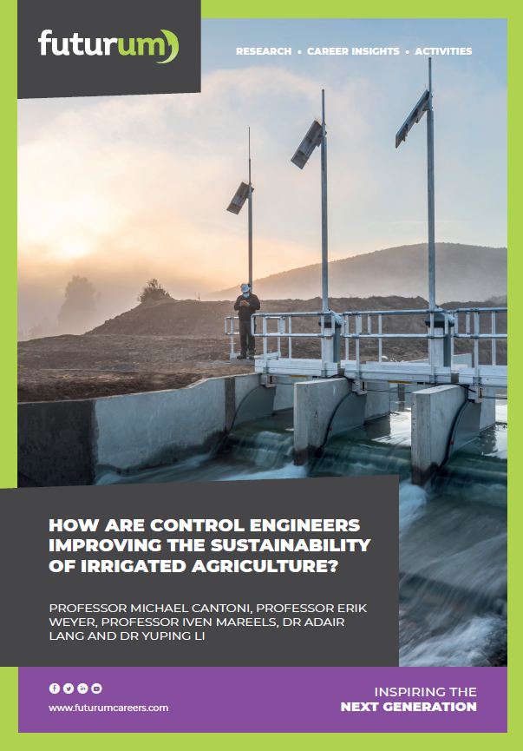
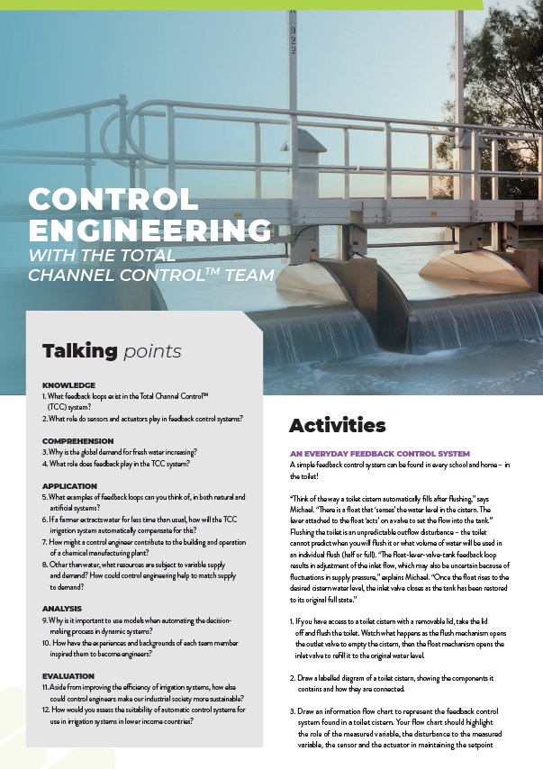
Dig deeper into the team’s research:
Read the article
Download the activity sheet

Slide 21
All images © Rubicon Water

