Slide 1
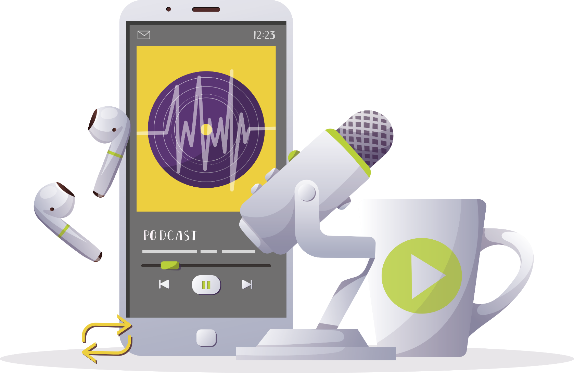
INSPIRING THE
NEXT GENERATION
FUTURUM
PODCAST
Dietetics & Technology
Professor Deborah Kerr
ftlyp
Futurumcareers.com

Slide 2
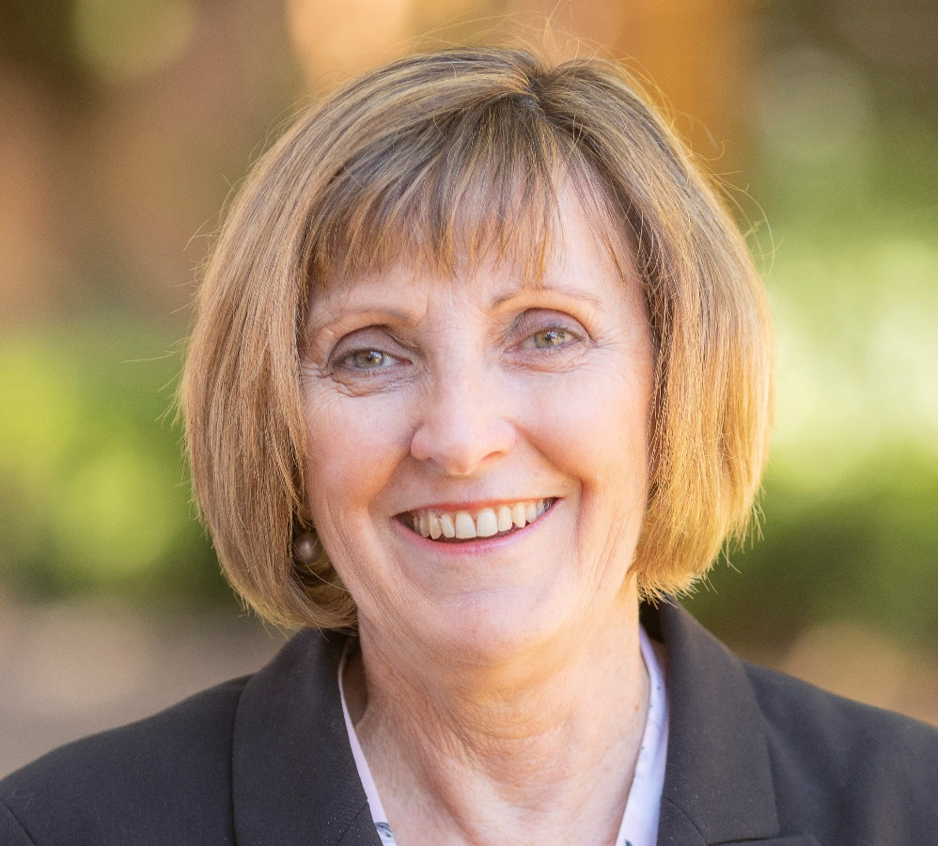
Pre-listening | Break it down | Post-listening | Learn more
Meet
Professor Deborah Kerr
Pre-listening:
Deborah is a research dietitian. She is part of a team of dietitians and engineers who are creating an app to help dietitians monitor people’s nutritional intake.
What do you think a research dietitian’s job involves?
What skills and knowledge do you think this job requires?
Why do you think Deborah’s team contains both dietitians and engineers?
What challenges do you think Deborah and the team have faced while creating their app?
Profile
Curtin University, Australia
FIELDS OF RESEARCH
Dietetics, Nutrition Science
“Be open to opportunities and don’t feel burdened with having to have it all figured out”

Slide 3
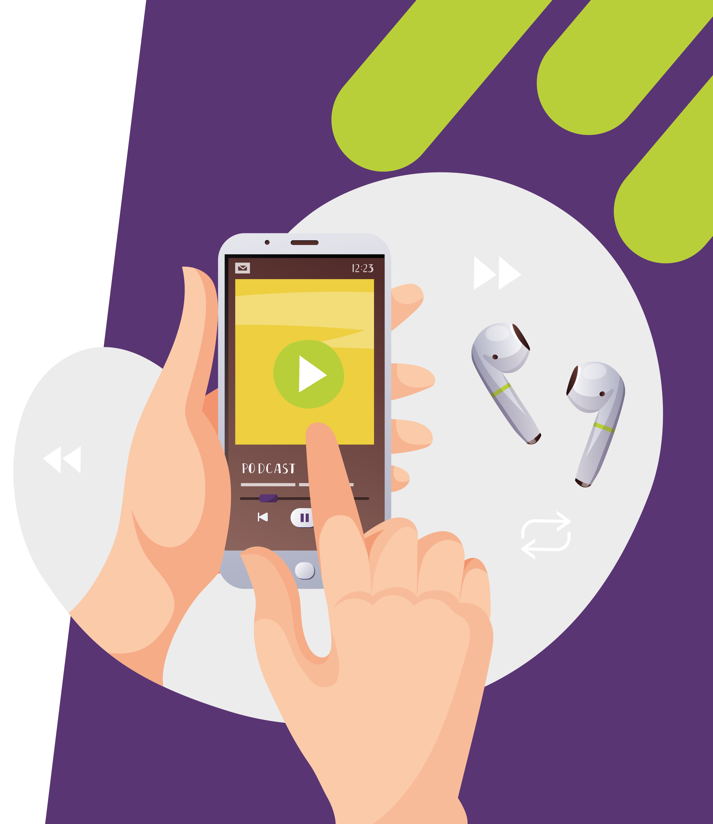
Pre-listening | Break it down | Post-listening | Learn more
Break the podcast down:
Up to 04:30
What motivated Deborah to design a new method for assessing what people eat?
How do the engineers contribute to the project, and why is their input essential for the app’s success?
What are the challenges of applying image recognition to food?
04:30 – 06:50
What do you think are the most important skills that the dietitians and engineers each bring to the project?
Why is it important for elite athletes to assess their diet?

Slide 4
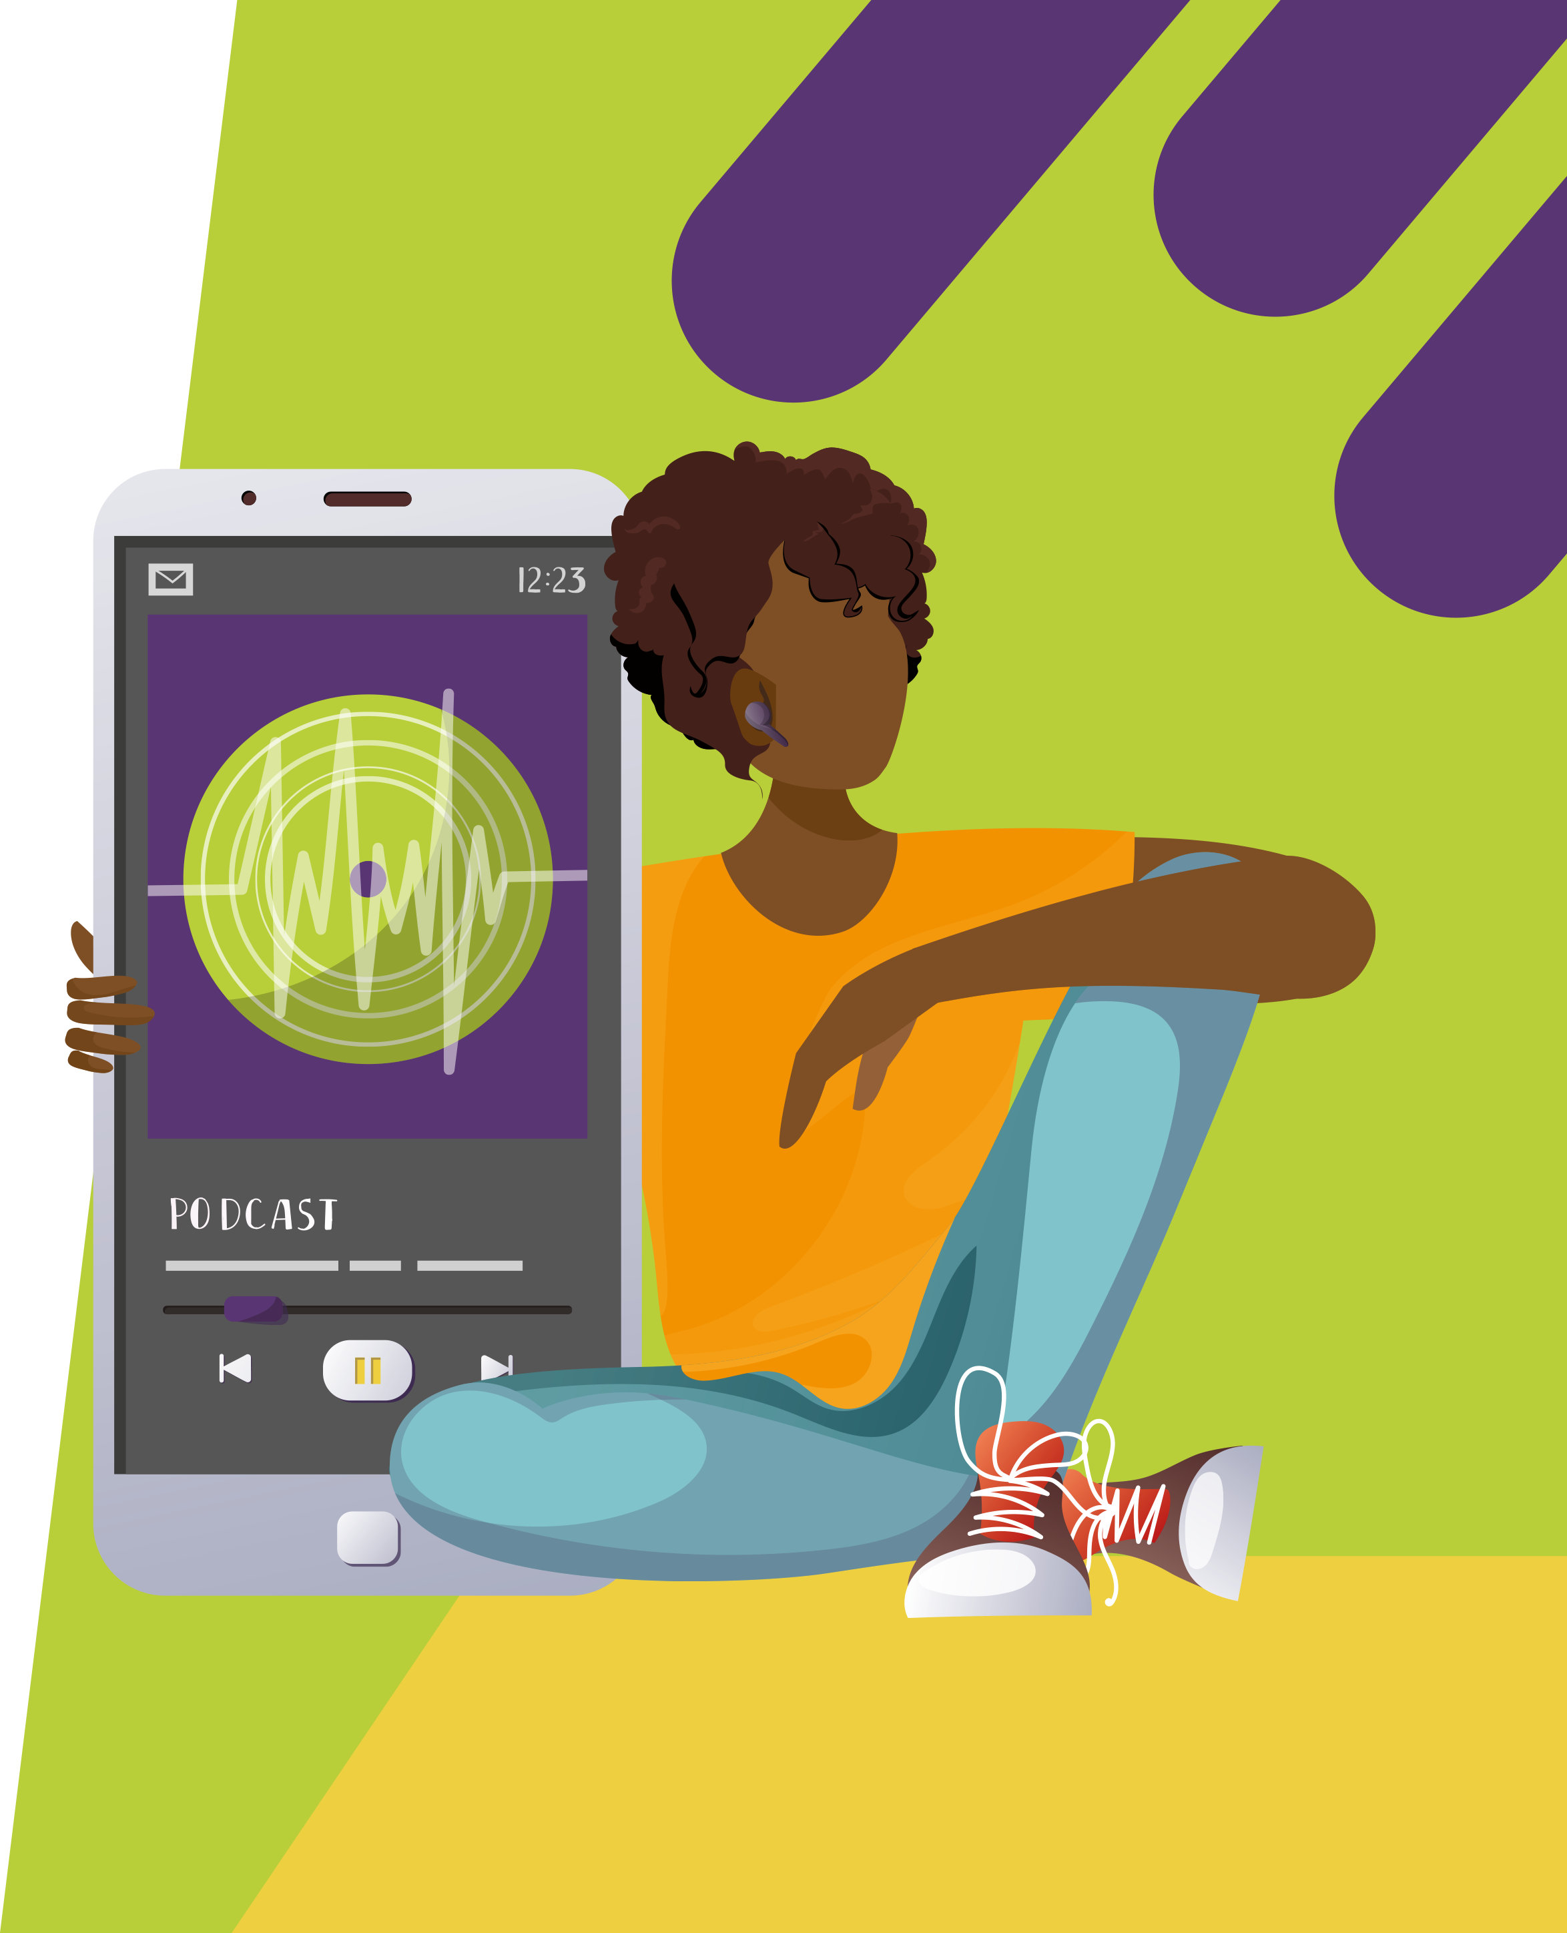
Pre-listening | Break it down | Post-listening | Learn more
06:50 – 11:00
What are the ‘Why’ questions that you have about the world? What field(s) of research could help you answer them?
When was the last time you took an opportunity that came your way? How did you benefit from it?
Do you prefer the idea of having a plan to follow in life, or just taking things as they come? What are the pros and cons of each approach?
Do you feel like you have ‘it all figured out? If not, to what extent does Deborah’s advice reassure you?
11:00 – end
What are your passions? What career could use your hobbies and interests?

Slide 5
Pre-listening | Break it down | Post-listening | Learn more
Post-listening:
Which piece of Deborah’s advice did you find most useful, and why?
How have the people around you influenced your decisions and pathway through life?
Who do you collaborate with in your day-to-day life? How do you benefit from interacting with them?
What further questions would you ask Deborah about dietetics and/or her career?*
Now that you have heard Deborah talk, how interested are you in dietetics and/or technology, and why?
Would you prefer a career as a clinical dietitian (e.g., a sports dietitian), a research dietitian, or an engineer applying your skills in the field of dietetics? Why?
Do you find it exciting or scary, not knowing where a pathway will lead you? How could you change your mindset to view unknown opportunities as adventures?
*Submit questions to Deborah here.

Slide 6
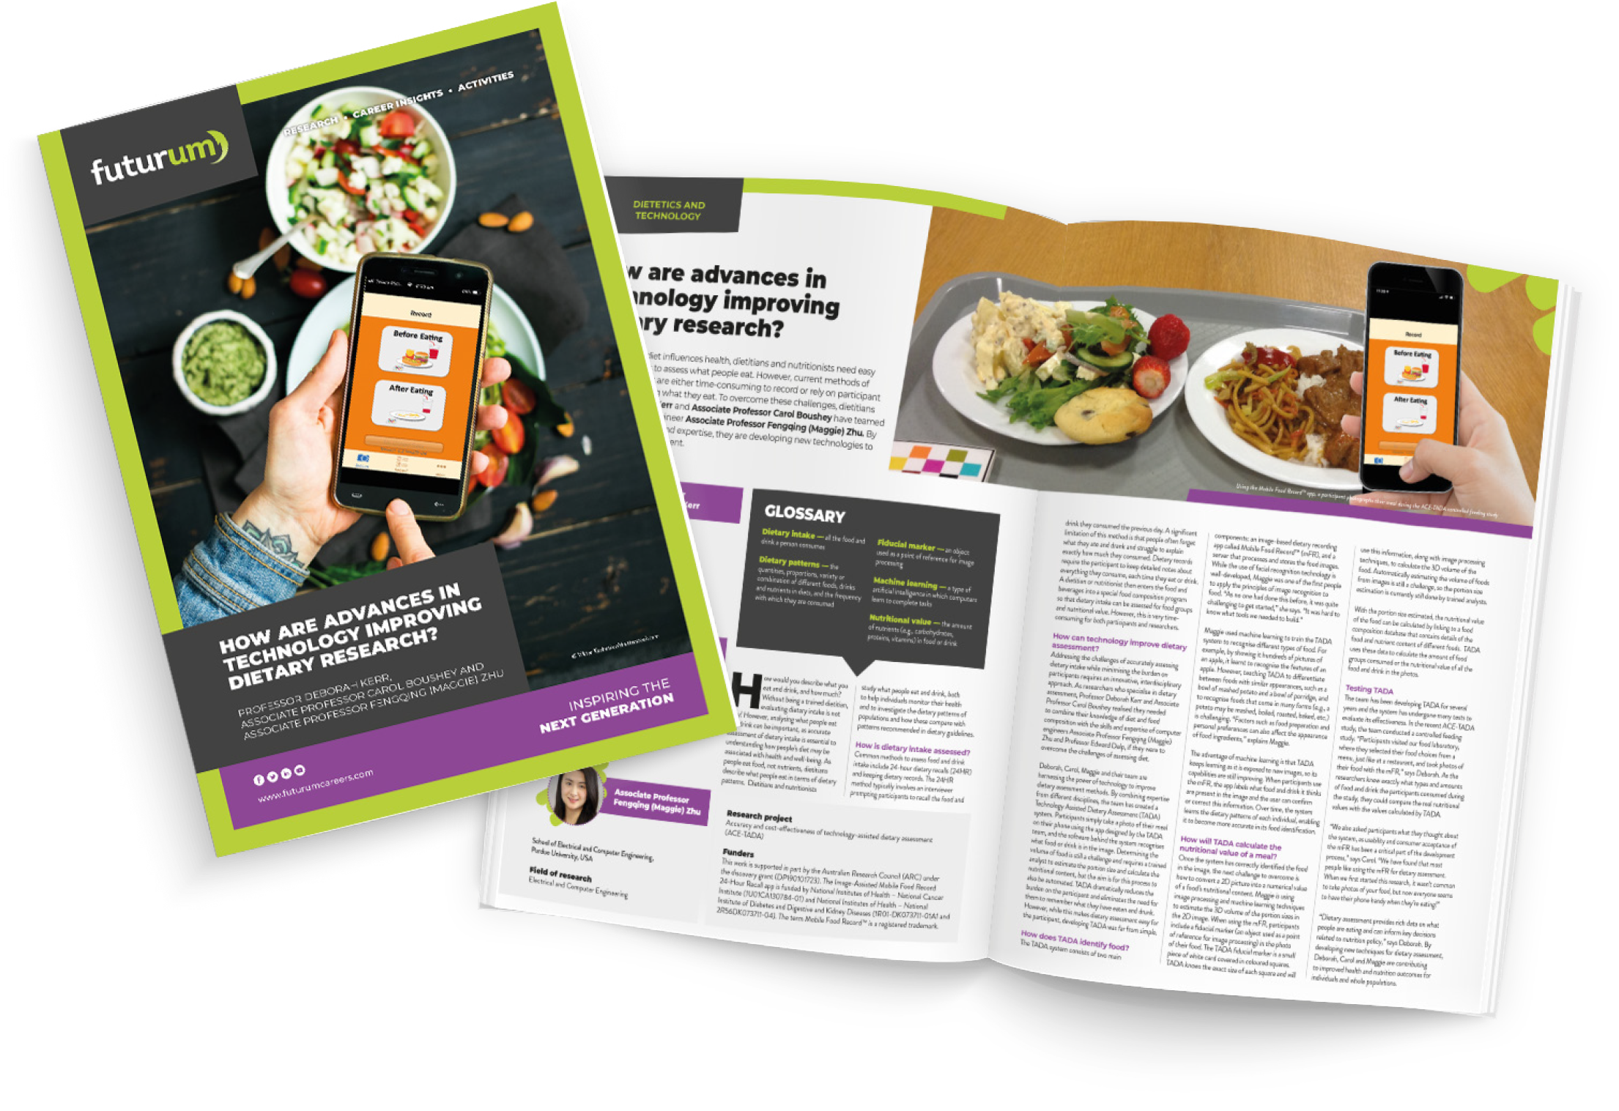
Pre-listening | Break it down | Post-listening | Learn more
Learn more about
Deborah’s work:
A
Read the article here
A
Watch the animation here
Download the activity sheet here
A
Futurumcareers.com
ftlyp

