Slide 1
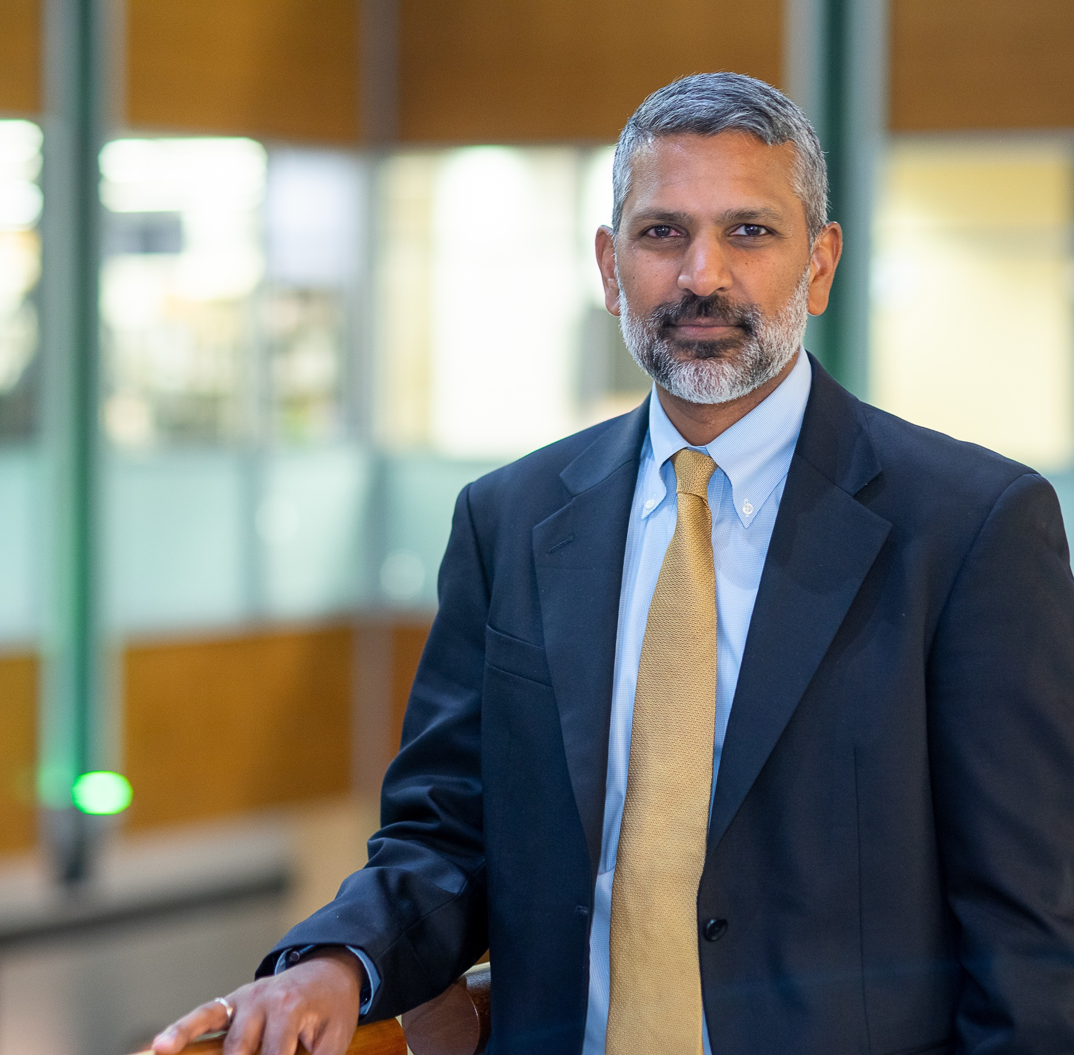


Public Health Research
with
Dr. Deepak Palakshappa
GET STARTED

Slide 2



In this Presentation:
Introduction
Deepak’s Research and Career Journey
Talking Points
About Public Health Research
Pathway from School to Public Health Research
Careers in Public Health Research
Meet Deepak
Talking Points
More Resources
02 futurumcareers.com

Slide 3
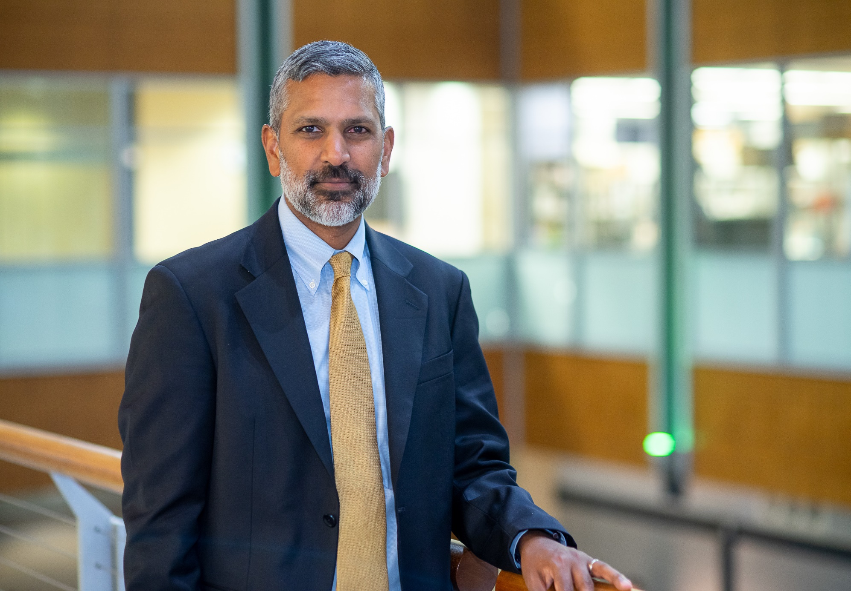
Meet Deepak
Dr. Deepak Palakshappa is a public health researcher at Wake Forest University School of Medicine in the US.
He is investigating how food insecurity affects people’s health, and how healthcare systems can help address these issues.
His research focuses on developing interventions to help households overcome food insecurity and improve their health.
Dr. Deepak Palakshappa
03 futurumcareers.com

Slide 4


Learn about Deepak’s Research and Career Journey
The animation on the following slide will introduce you to Deepak’s research and career journey.
You can also find it on Deepak’s Futurum page: futurumcareers.com/public-health-research-with-dr-deepak-palakshappa
Or watch it on YouTube: youtube.com/watch?v=TovhWj2djP8
04 futurumcareers.com

Slide 5

Embed animation here

Slide 6

Animation Summary
When he was younger, Deepak volunteered with a community engagement program, delivering meals to older, home-bound adults. This inspired him to think about how he could find a career that would allow him to help others.
During his medical training, Deepak noticed that many of his patients couldn’t afford their medication because they were struggling to pay for food. These experiences inspired Deepak to focus his research on food insecurity and social determinants of health.
Food insecurity is the inability to access adequate food due to a lack of money or other resources. But food insecurity does not always mean going hungry; it can also mean only having access to foods with low-nutritional value, such as cheap fast food.
06 futurumcareers.com
© GaudiLab

Slide 7
Animation Summary
Food insecurity can increase the risk of obesity, diabetes, and high blood pressure, as well as mental health conditions, such as chronic stress, anxiety, and depression.
Although the US is a developed country, more than one in eight households live with food insecurity. Some nationwide interventions have been developed which provide financial support to help people buy food. Unfortunately, not everyone is eligible for these support programs.
Deepak’s research focuses on developing new interventions and studying how they can improve the lives of people living with food insecurity. In one study, Deepak’s team delivers meals to food-insecure households and examines whether this helps to alleviate high blood pressure.
07 futurumcareers.com

Slide 8


Talking Points
How did Deepak’s volunteering experiences shape his career path?
What is food insecurity and how does it affect health?
How do you think food insecurity might affect different people e.g., old vs. young or parent vs. child?
Why is it important that Deepak works closely with healthcare professionals?
08 futurumcareers.com
© David Pereiras

Slide 9

About Public Health Research
Public health researchers study and implement ways of making people and communities healthier, from preventing the spread of disease, to tackling pollution, to running healthy lifestyle educational campaigns.
Tackling food insecurity is a core aspect of public health, as it helps to prevent the physical and mental health conditions that arise from insufficient nutrition.
“When I first started, most people considered food insecurity outside the scope of healthcare, but rather the focus of public health and public policy organizations.” – Deepak
In recent years, healthcare professionals have begun to acknowledge how food insecurity impacts health and, therefore, the need for healthcare to address it.
09 futurumcareers.com
© DavideAngelini

Slide 10

About Public Health Research
Besides food insecurity, public health depends on many other social determinants.
“Factors including poverty, structural racism, and educational inequality all affect health. These factors that affect entire communities filter down to individuals; for instance, lack of transportation, housing instability, and domestic violence may all be the result of these structural issues.” – Deepak
Public health research has the substantial task of addressing structural inequalities to improve the health of communities and of individuals – a complex and multifaceted challenge.
“A career in public health research needs passion. It’s a long journey with many bumps and turns, but it’s very exciting and meaningful.” – Deepak
10 futurumcareers.com
© SofikoS

Slide 11

Pathway from School to Public Health
At school or college, Deepak suggests getting a
good foundation in math (especially statistics) and
science, as well as psychology, social sciences, and
economics, if possible.
At university, Deepak recommends courses or modules
in statistics, psychology, economics or public health to prepare for a career in public health research. He also recommends seeking practical experience, such as volunteering or interning with a public health organization or social health research group.
© Drazen Zigic
11 futurumcareers.com

Slide 12

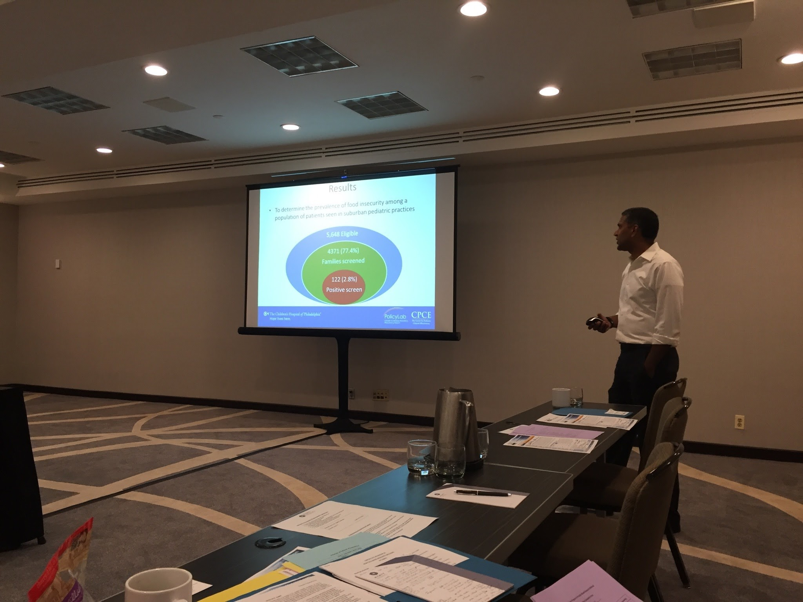
Student Opportunities
Wake Forest University has a number of Pre-College Programs that enable high school students to take part in learning experiences across a number of disciplines.
Current programs include Summer Immersion Programs based on specific academic fields, Online Immersion Programs available year-round, and College LAUNCH, a free program focusing on social justice and leadership development.
Many universities and institutions provide similar programs and offer a range of resources that can help you explore topics around public health.
© Wavebreakmedia
12 futurumcareers.com

Slide 13

Explore Careers in Public Health
The Centers for Disease Control and the World Health Organization both provide useful insights into what public health looks like in action at the national or international levels.
A public health degree can lead to many different careers including working in academia as a researcher, becoming a healthcare consultant, or helping your community by becoming a community health nurse.
© Monticello
13 futurumcareers.com

Slide 14
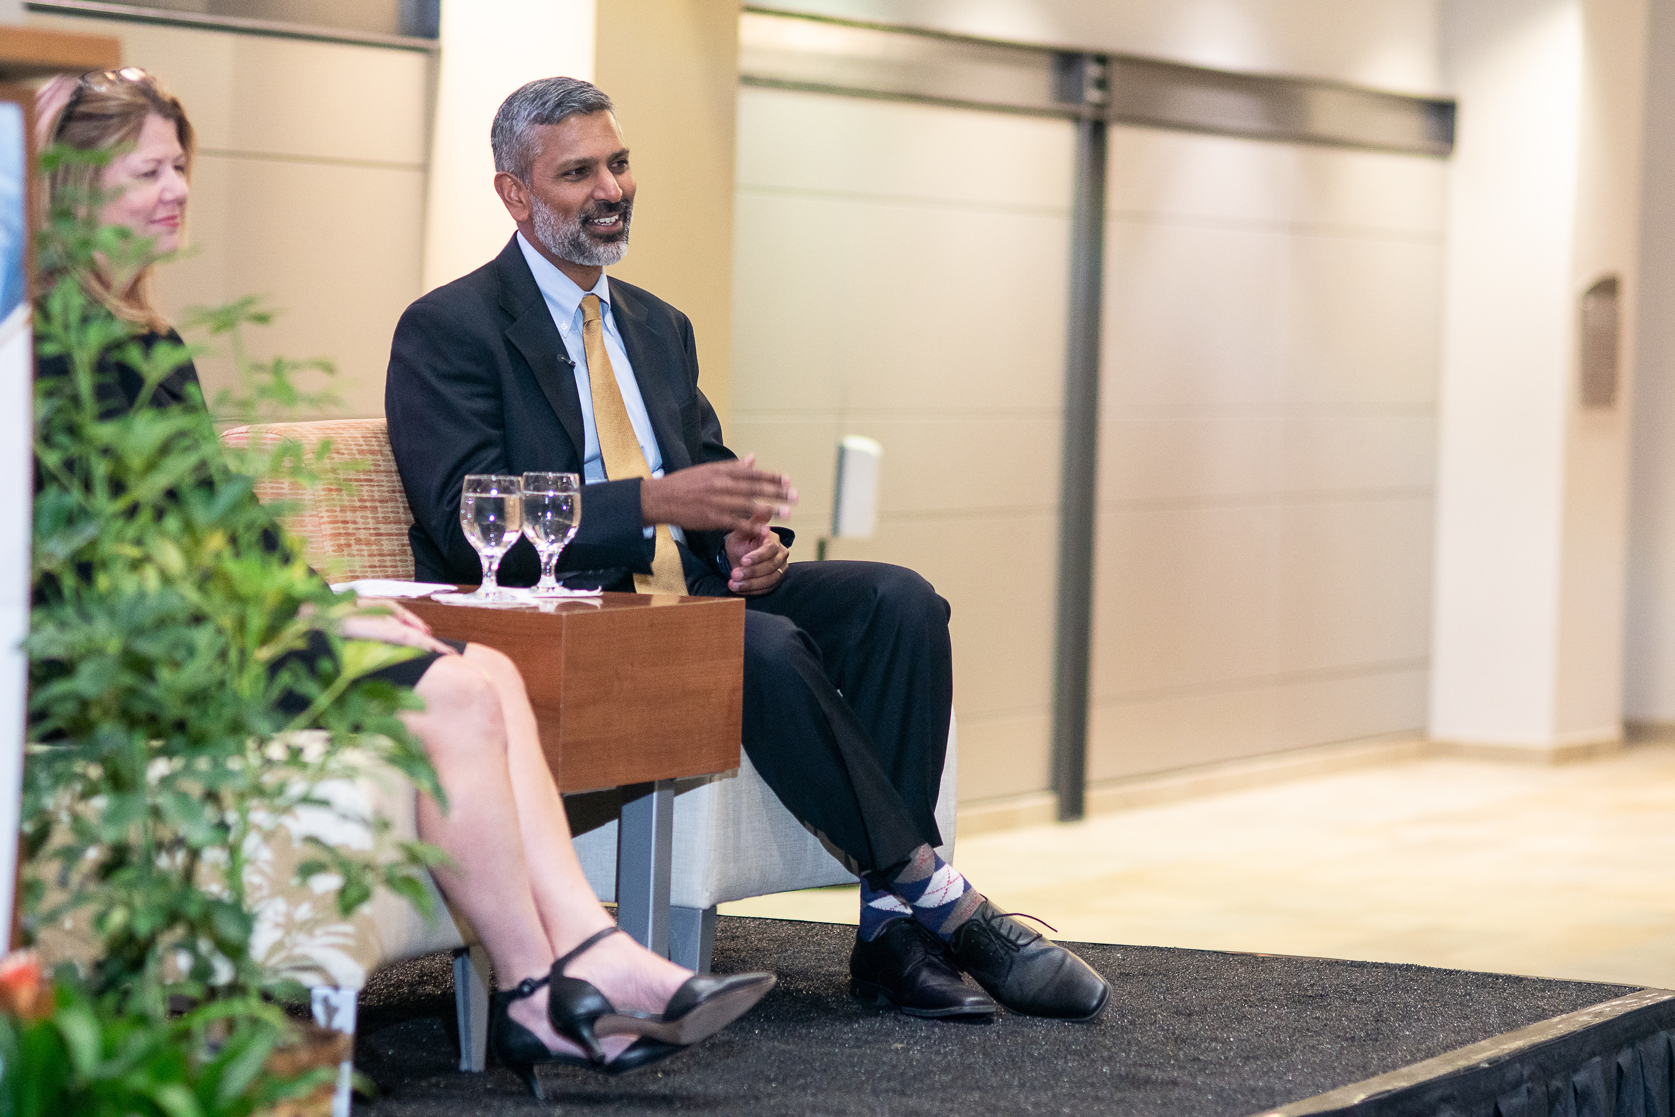
Meet Deepak
My parents are immigrants to the US and my father grew up poor. Education is what helped him reach a better quality of life, which ensured I didn’t face those same struggles. Because I was so fortunate, I felt driven to help others.
My volunteering has seen me help to build a school in Africa and deliver meals to older home-bound adults, giving me a first-hand look at some of the social issues people faced.
I took a year off after university to work for AmeriCorps. I taught mathematics in a neighborhood of low-income, underrepresented minority groups. These experiences made me think about how to better address people’s unmet social needs.
14 futurumcareers.com

Slide 15

Meet Deepak
In medical school, I became interested in public health. In particular, my passion was sparked by the role of research in improving the health of communities. The level of inequity that exists both in the US and globally is still a driving force for me – the need to change this motivates me every day.
I really enjoy the process of research. In the clinic, I love talking to people, hearing their stories and finding ways to improve their health. But I also enjoy the days when I’m just doing statistics on the computer.
I find mentoring trainees especially fulfilling. Getting excited about different topics, learning from them and transforming ideas into solutions is incredibly rewarding. Of course, ideas don’t always work out, but that’s okay.
15 futurumcareers.com

Slide 16
Deepak’s Top Tip
Find your passion and pursue it. The best way to figure out if you are interested in something is to try it out as early as you can. Getting involved, even when in high school, such as through volunteering or work experience, will help you work out what you want to do long term.
Deepak presenting his team's work at a research seminar.
16 futurumcareers.com

Slide 17
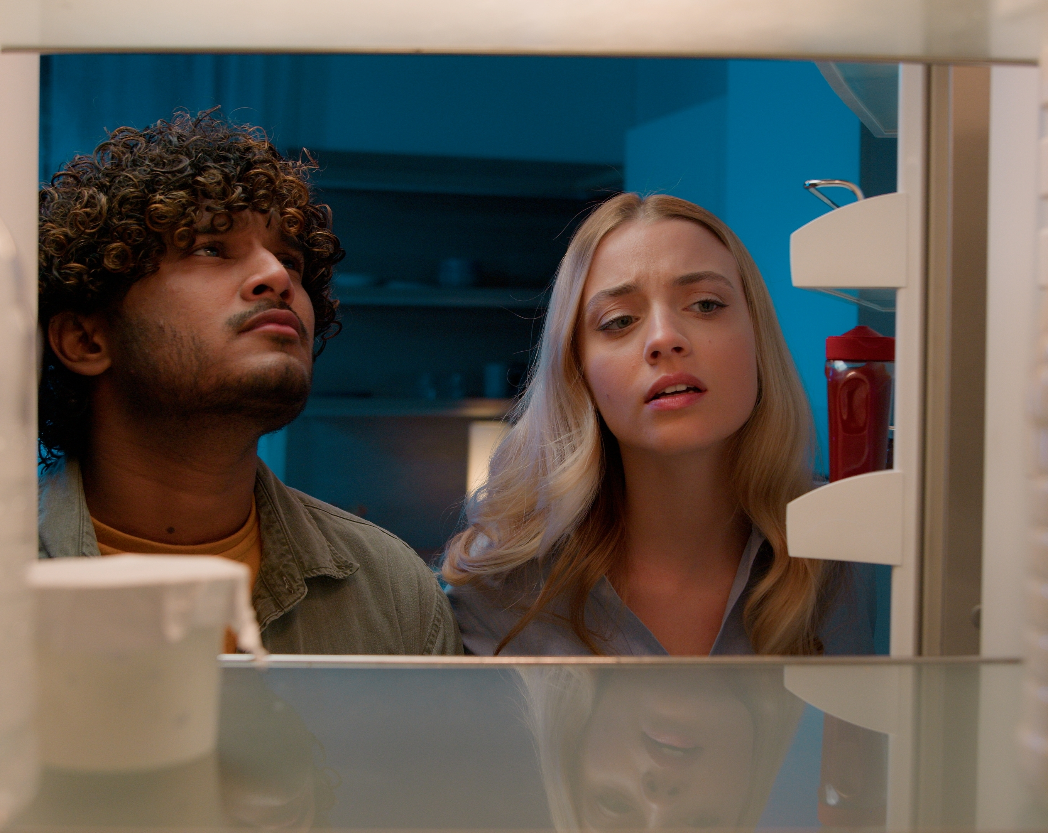
Talking Points
“Factors including poverty, structural racism and educational inequality all affect health,” says Deepak. What types of health issues might these factors lead to, and how? Give several examples.
To what extent do you think that addressing food insecurity should be the responsibility of healthcare professionals?
To what extent is food insecurity an issue in your local community? What steps could be taken to help your community address this issue?
17 futurumcareers.com
© Mayalab

Slide 18

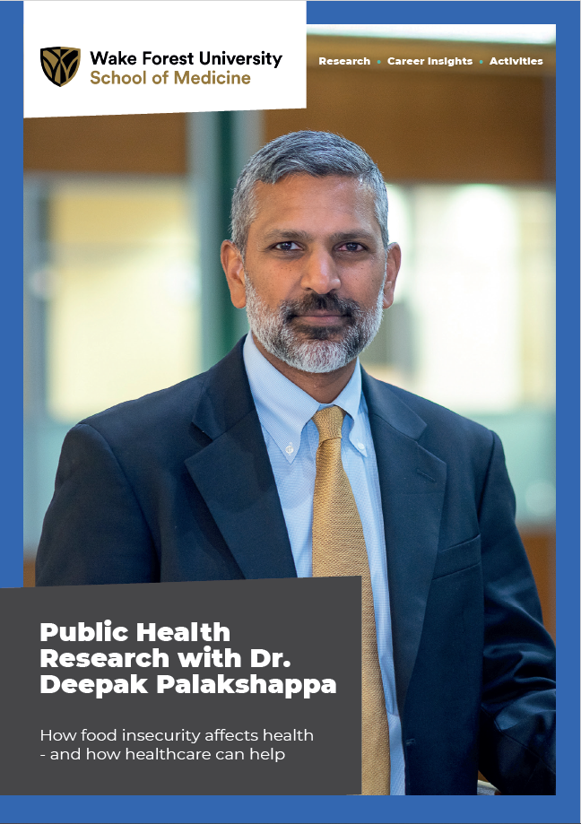
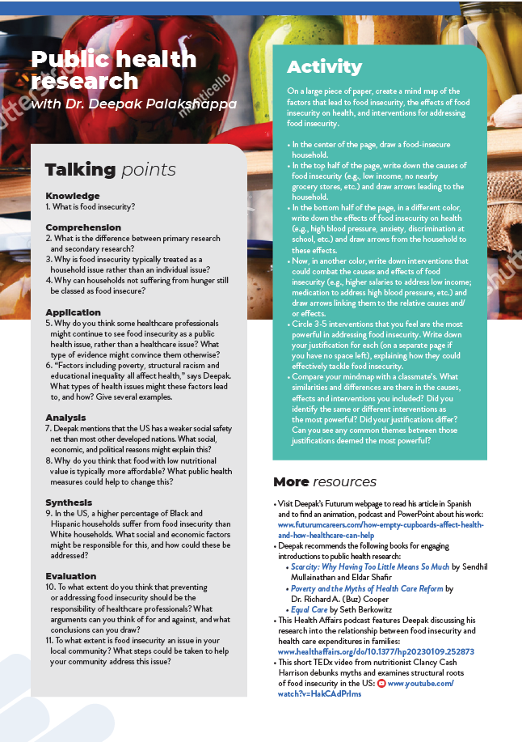
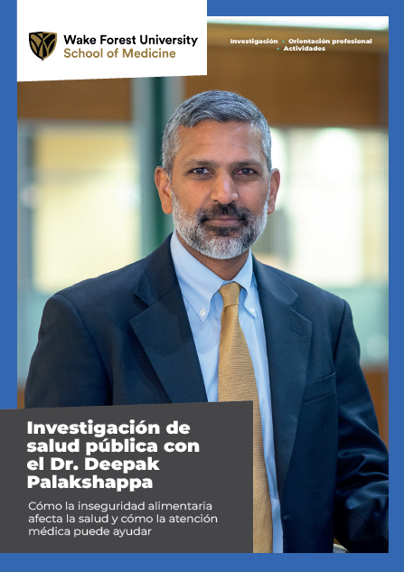



More Resources
Read the article
Complete the activities
Listen to the podcast
Watch the animation
Download the Spanish resources
18 futurumcareers.com
© Ellyy

Slide 19




This educational material has been produced by Wake Forest University School of Medicine in partnership with Futurum and with grant support from The Duke Endowment.
The Duke Endowment is a private foundation that strengthens communities in North Carolina and South Carolina by nurturing children, promoting health, educating minds and enriching spirits.
Let us know what you think of this educational and career resource.
To provide input, simply scan the QR code or access the link below:
redcap.link/dh5j1nes

