Slide 1
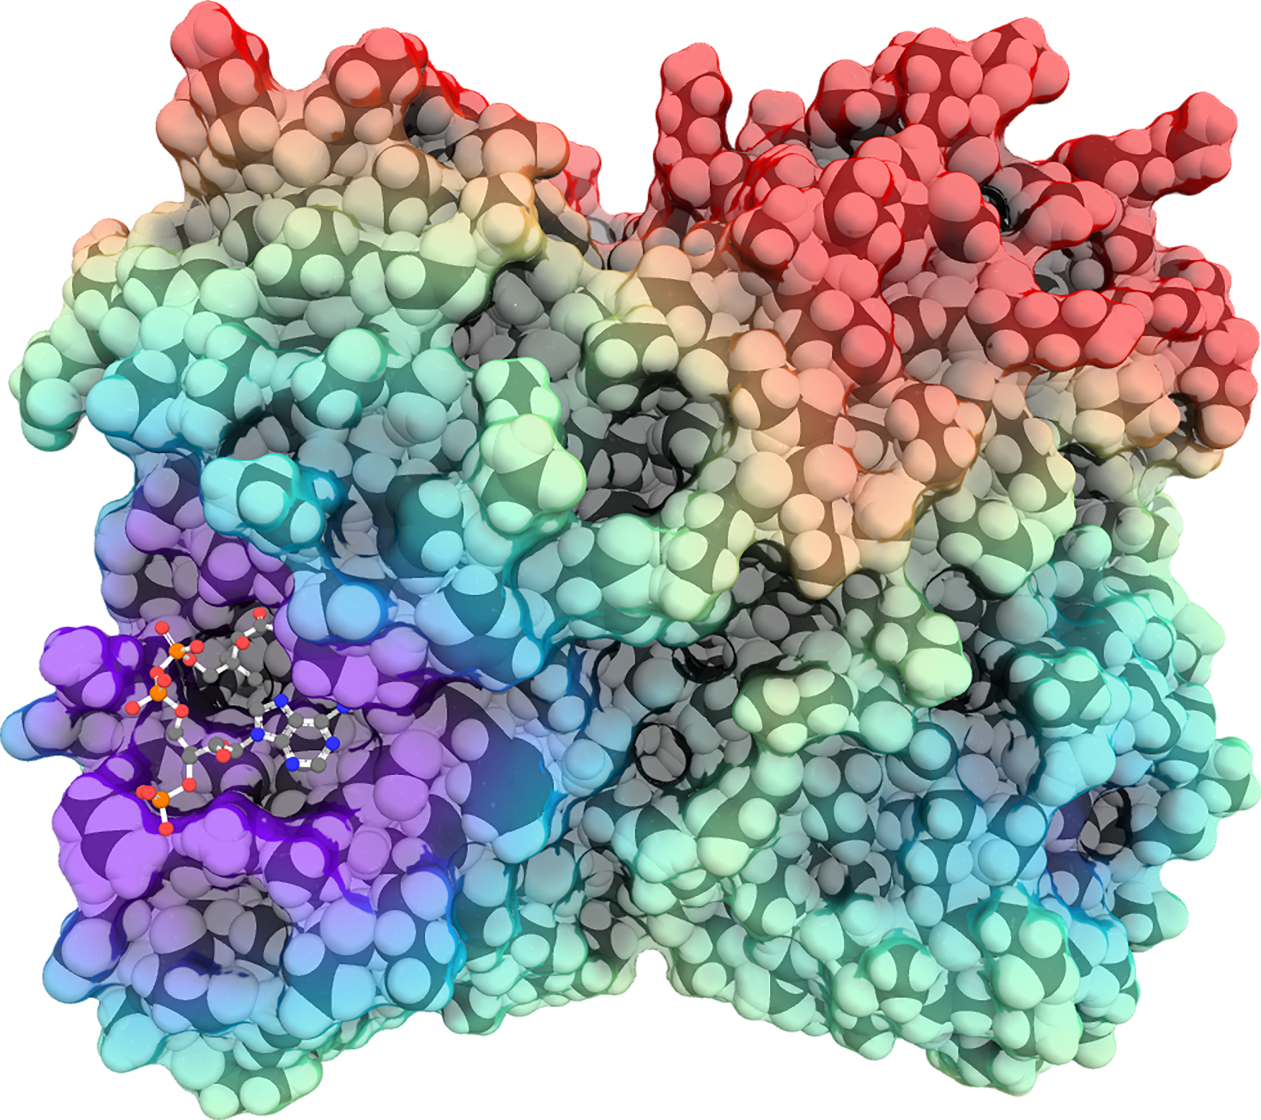
WHAT CAN WE LEARN FROM PLANT PROTEINS?
STRUCTURAL BIOLOGY WITH
DR CHARLES STEWART JR.

Slide 2
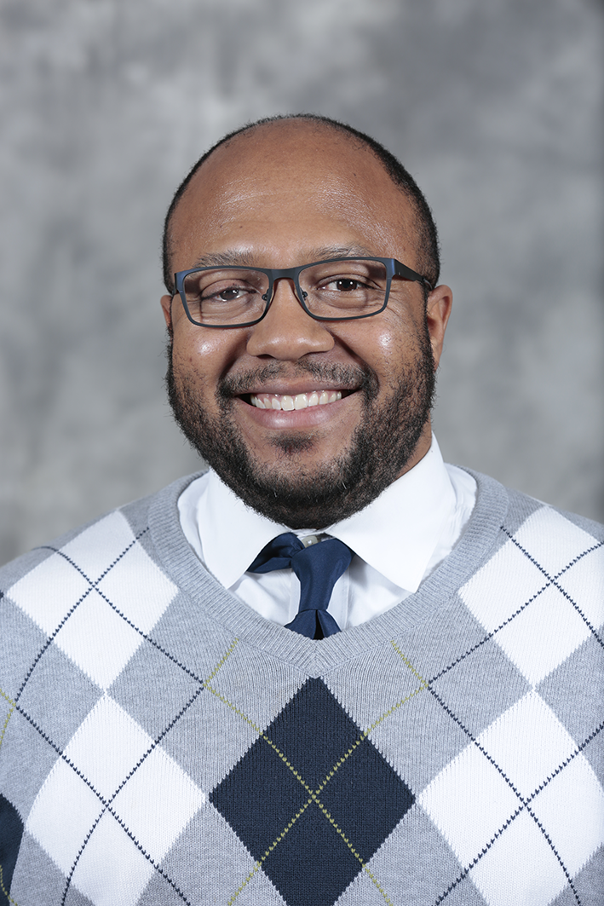
MEET CHARLES
DR CHARLES STEWART JR. is a structural biologist and Manager of the Macromolecular X-ray Crystallography Facility at Iowa State University in the US.
He is investigating the 3D structure of proteins to understand their function.
Let’s learn more about his research…

Slide 3
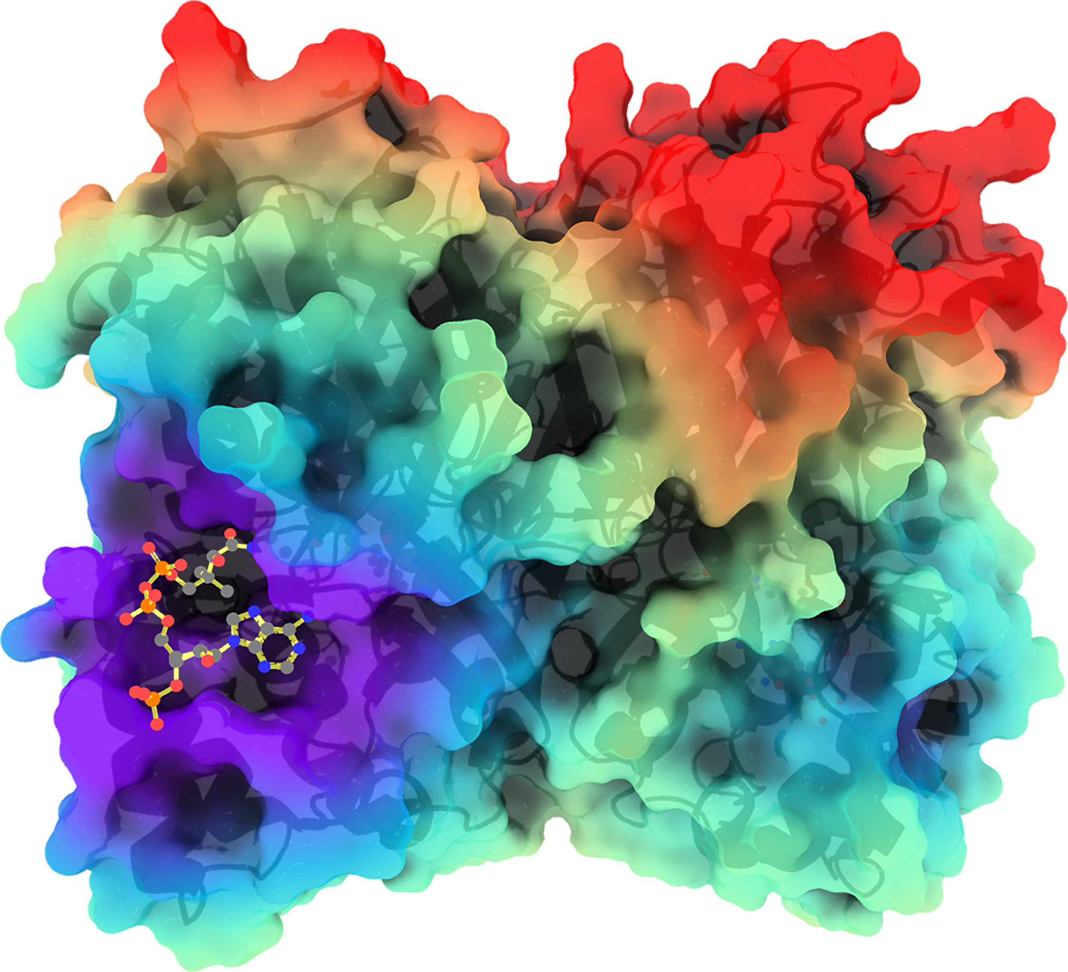
AMAZING PROTEINS!
Proteins are biological molecules that contribute to almost all activities in an organism.
From antibodies which fight viruses, to hormones which coordinate biological processes, and to haemoglobin which carries oxygen in the blood, we could not function without proteins.
Protein molecules are far too small to be examined by eye under a microscope as most are less than 10 nanometres in diameter (equivalent to 0.00001 mm).
Charles studies the proteins found in plants, specifically the enzymes responsible for plant metabolism.

Slide 4
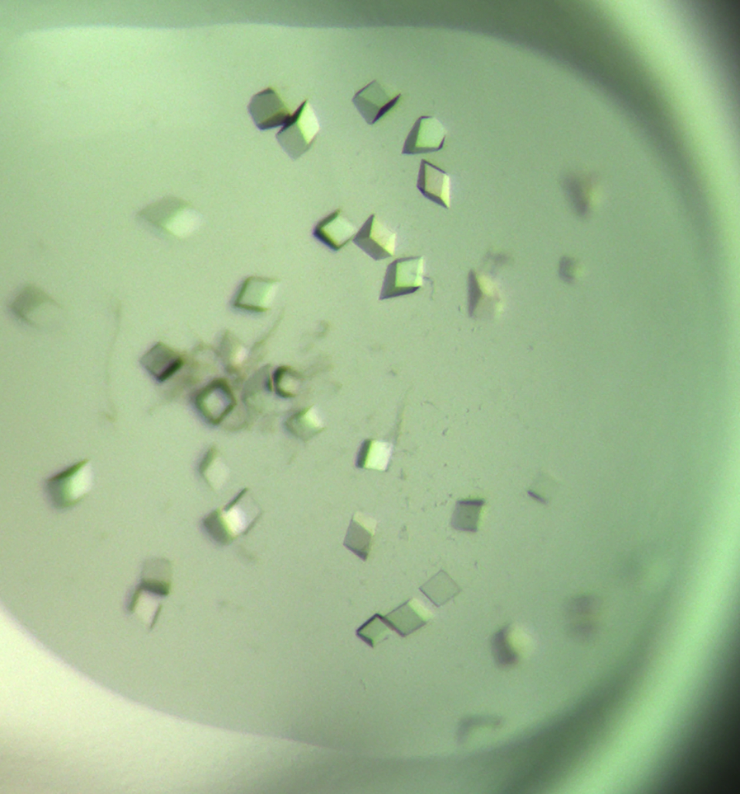
X-RAY CRYSTALLOGRAPHY
A beam of X-rays is fired at a rotating protein crystal, and these rays are diffracted (bent) by the protein molecules within it. The intensity and degree of diffraction of the rays are recorded by a detector, which, when combined with the laws of physics underlying X-ray diffraction, enables scientists to build a 3D model of the protein’s molecular structure.
Charles must first grow the protein crystal in the laboratory. “Although there are general scientific principles to follow, the growing of protein crystals is mostly based on trial-and-error,” he explains. However, technological advances are helping to address these issues, and robots can now greatly improve the speed of screening different crystallisation parameters.
Charles is using X-ray crystallography to study…

Slide 5
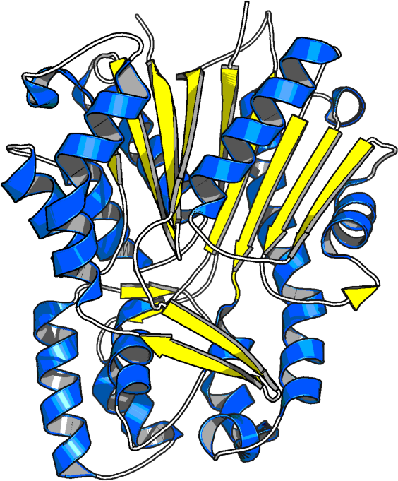
POLYKETIDE SYNTHASES (responsible for making defensive molecules) and METHYLTRANSFERASE (thought to transfer a methyl group onto a nitrogen atom)
The metabolic pathways catalysed by these two enzymes produce tropane alkaloids, a group of molecules made by various plant species that are commonly used in medicines (treating Parkinson’s disease and pesticide poisoning amongst other conditions).
“I aim to clarify the biosynthetic pathway of tropane alkaloids by focusing on the polyketide synthase and methyltransferase that initiate the process,” explains Charles. “I would like to know not only how these enzymes work, but just as important, what the molecular changes of each enzyme are that determine which products are made in different plants.”

Slide 6
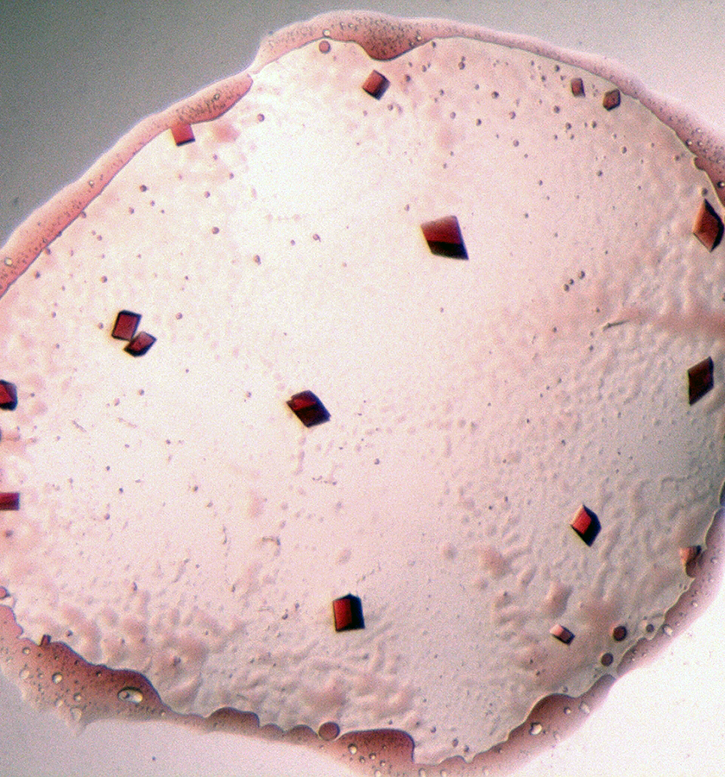
SUCCESSES – SO FAR
Charles has confirmed that a polyketide synthase is involved in the production of tropane alkaloids, however this particular enzyme uses a different reaction mechanism than common polyketide synthases.
He has also discovered that the methyltransferase he has been studying catalyses a biochemical reaction that was previously unknown.
“These findings indicate that there are novel enzymes and biochemical pathways still waiting to be discovered,” he explains.

Slide 7
TALKING POINTS
Name an organism’s function that proteins contribute to.
What types of proteins is Charles studying?
How does X-ray crystallography enable scientists to build a 3D model of the protein’s molecular structure?
What are tropane alkaloids commonly used for?
What discoveries has Charles made so far?

Slide 8
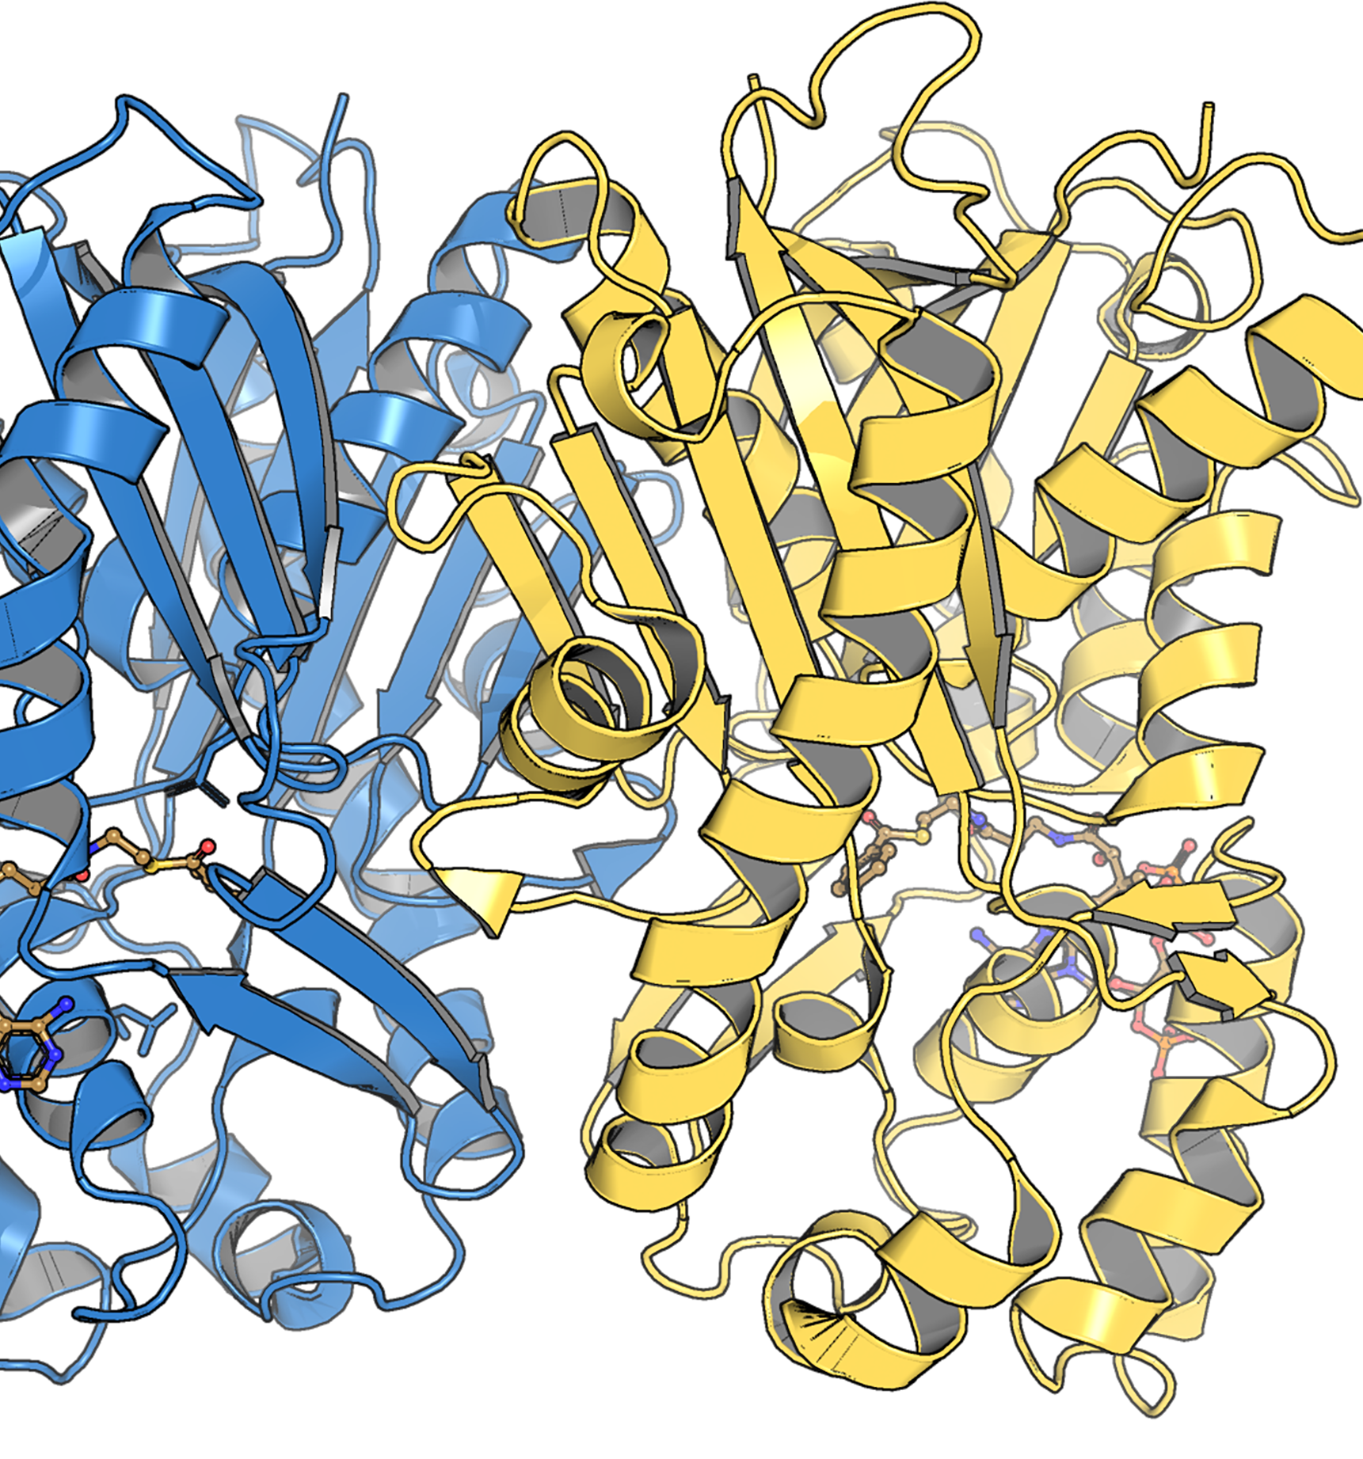
STRUCTURAL BIOLOGY
The field is necessary for any discipline which involves understanding how proteins function at a molecular level, including: biochemistry, immunology, plant sciences, evolution, microbiology and bioengineering.
At the Macromolecular X-ray Crystallography Facility that Charles manages, researchers are:
finding the structure of a protein that predisposes people to mental illness.
studying the structure of an enzyme from the parasite that causes malaria, which could lead to the basis of antimalarial treatment.
studying enzymes that are critical for sending signals within cells, which can cause a range of illnesses if disrupted.

Slide 9
Charles works on a wide variety of projects with colleagues from around the world. “Some projects are geared towards fundamental advances in science,” he says, “while others are directly tied to an output that has immediate and obvious benefits to society.”
Charles predicts that advances in machine learning and artificial intelligence will transform all science disciplines. He explains, “As machine learning software becomes more user-friendly, scientists from all fields are going to make new discoveries.”
For structural biology, this revolution has already begun. In 2020, a project led by Google, using its artificial intelligence initiative DeepMind, paved the way to overcoming one of the greatest challenges in the field – how to accurately determine the structure of a protein from its amino acid sequence. Future structural biologists will be able to take advantage of these technological innovations to further enhance our understanding of the building blocks of life.

Slide 10
EXPLORING CAREERS IN STRUCTURAL BIOLOGY
Charles runs tours of the Macromolecular X-ray Crystallography Facility at Iowa State University for people interested in learning more about the work his team does. If you want to discover what is involved in structural biology, find out if there is a facility near you that you can visit.
According to PayScale, in the USA a structural biologist can expect an average salary of $105k.

Slide 11
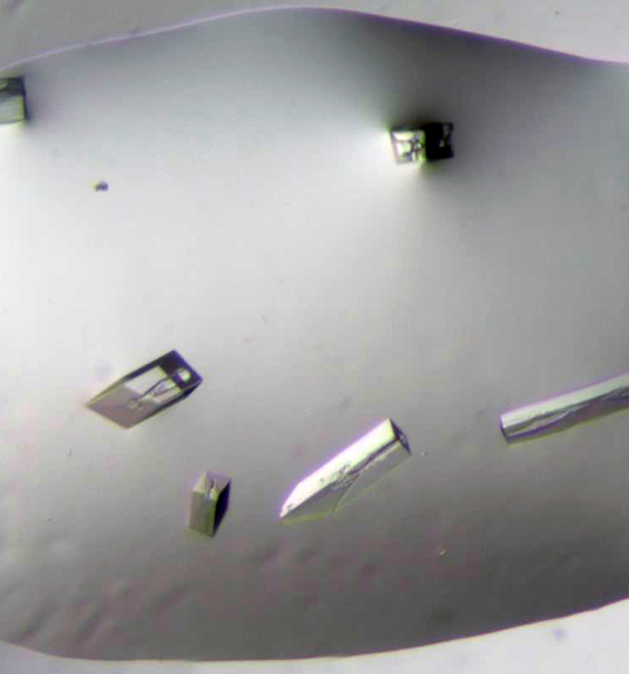
PATHWAY FROM SCHOOL TO STRUCTURAL BIOLOGIST
Charles recommends studying the basic science courses such as biology, chemistry, genetics and physics. “But also look for courses that pique your curiosity,” he says. “It is hard to predict what courses and experiences are going to fuel your creative flair.”
A degree in biology or a related subdiscipline is a common route into structural biology. As an interdisciplinary field, other degrees including biochemistry and biophysics can also lead into a career in structural biology.
To become a structural biologist, you will have to complete a master’s degree or PhD after your initial university studies.

Slide 12
TALKING POINTS
What type of research is taking place in the Macromolecular X-ray Crystallography Facility?
What does Charles predict will have a big impact on scientific disciplines? Do you agree with him and, if so, why?
What subjects could lead to a career in structural biology?
What level of education does the field require?

Slide 13
A CHALLENGE FROM CHARLES
Can you identify the secondary structures shown in this image?
The secondary structure of a protein consists of regular, recurring shapes formed by amino acids near each other. The three most common secondary structure elements are helices, beta sheets and loops. The image provided is of a polyketide synthase (pdb code 5wc4).
Hint: look at the shapes associated with each colour.

Slide 14
HOW DID CHARLES BECOME A STRUCTURAL BIOLOGIST?
“I was a curious child. I liked music (singing), math, history and science. I enjoyed the outdoors and re-modelling houses with my father.
My father, who worked in a factory, stressed the importance of science as a career option. He knew that manufacturing jobs were on the decline in America and foresaw that STEM careers would be growing.
Equally important was my participation in a high school program called Science Bound, operated by Iowa State University, which opened my eyes to the various careers that a major in STEM could provide. I was in the initial class of Science Bound students and had the honor of being the first Science Bound student to graduate from Iowa State University.”

Slide 15
“I think having an intrinsic level of curiosity is necessary for success in science. The ability to pay attention to detail and a determination to work through problems are also important.
If I face an obstacle, I step back and take a break. When I return to the problem, I will try to break down the obstacle into pieces and figure out which piece is causing the problem. Or I will try to understand if I am making incorrect assumptions. Of course, I will ask others for advice if I feel that they can help me.
All the places that I’ve studied or worked have provided invaluable knowledge, wisdom, friendships and memories. I am proud of my work launching the Macromolecular X-ray Crystallography Facility here at Iowa State University. It pushed me out of my comfort zone and allowed me to develop, not only as a scientist, but also as a leader.
I want to keep doing research that furthers our understanding of how nature works. I also want to expand the reach of scientific research to countries and communities that have historically lacked the resources.
I would like to attract scientists to the facility who may not be experts in crystallography, but who want to use this method to solve their own research problems. Additionally, I would like to develop outreach projects to help young students learn about STEM, not only as a career option, but also as a way to better understand the world we live in.”

Slide 16
CHARLES’ TOP TIPS
01 Develop a strong foundation in science.
02 Be willing to learn new things.
03 Find a mentor – someone who you can ask questions of and get feedback from.

Slide 17
TALKING POINTS
Have you ever participated in a programme like Science Bound? What did you gain from the experience? If you haven’t, are there programmes on offer in your school or area you could explore?
Do you have any of the personal qualities that Charles mentions? How could you develop these qualities?
What do you think motivates Charles to do the work he does?
What has he gained from his life as a scientist?
What would you find rewarding about being a scientist?

Slide 18
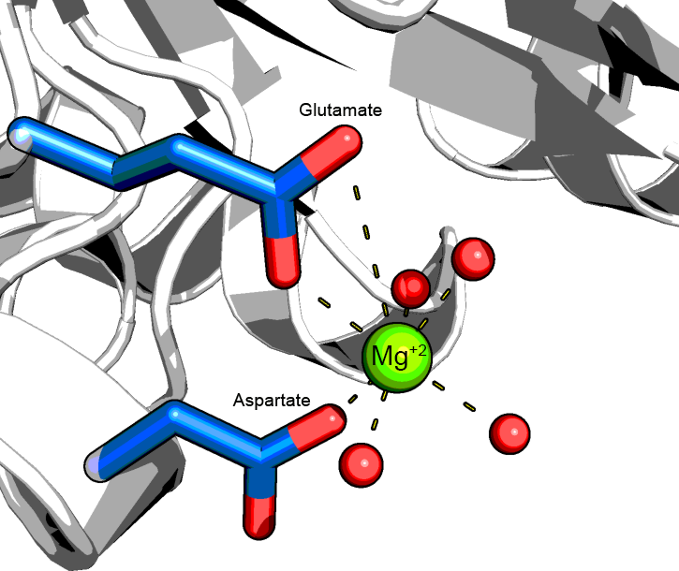
A CHALLENGE FROM CHARLES
How is this protein able to bind magnesium?
Some proteins bind metals. The image is of a component of a system of enzymes that transports phosphates, a chemistry functional group, in bacteria (pdb code 6v9k). The side chains of the amino acids that bind the magnesium ion are shown as sticks with their oxygen atoms coloured red. Additionally, the oxygens of nearby waters are also shown as red spheres.
Hint: Metal-binding involves an interaction between the positively charged metal and negatively charged amino acids. Water is special – it has both positively and negatively charged areas.

Slide 19
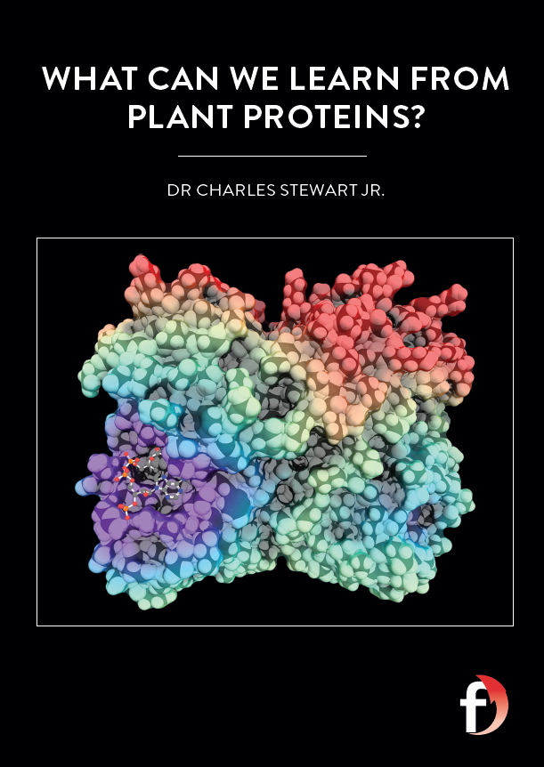
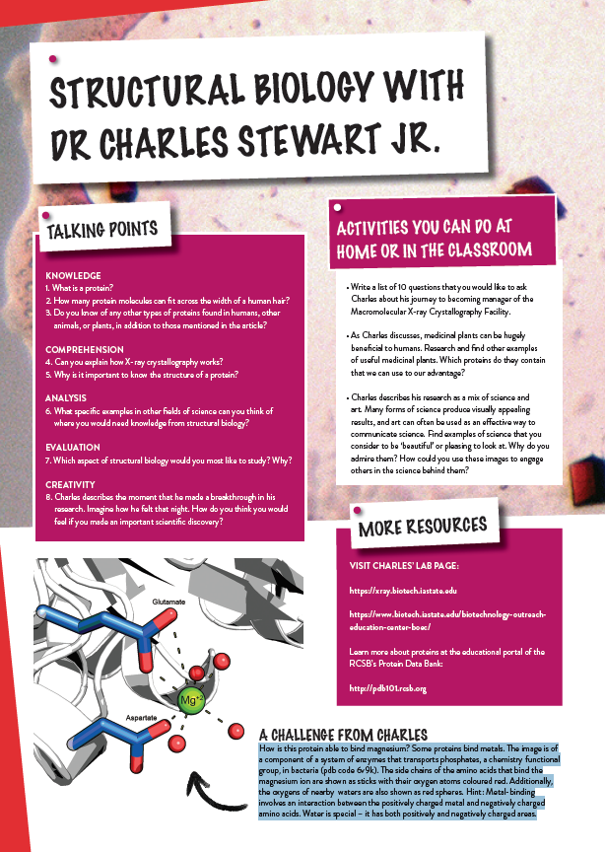
Dig deeper into Charles’ research
Download his activity sheet

