Slide 1
Did you this read right?
Cognitive Psychology
with Dr Jonathan Grainger

Slide 2
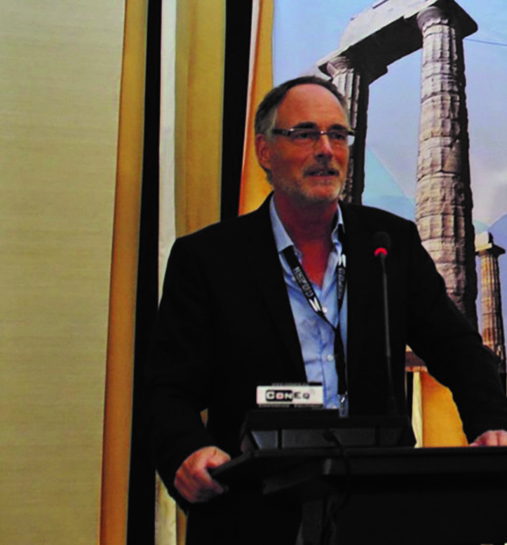
MEET JONATHAN
Jonathan is a Research Scientist at the Cognitive Psychology Lab, French National Centre for Scientific Research (CNRS) and Aix- Marseille University, France.
He’s using experimental techniques to determine how skilled readers process words and sentences.
Let’s learn more about his research…

Slide 3
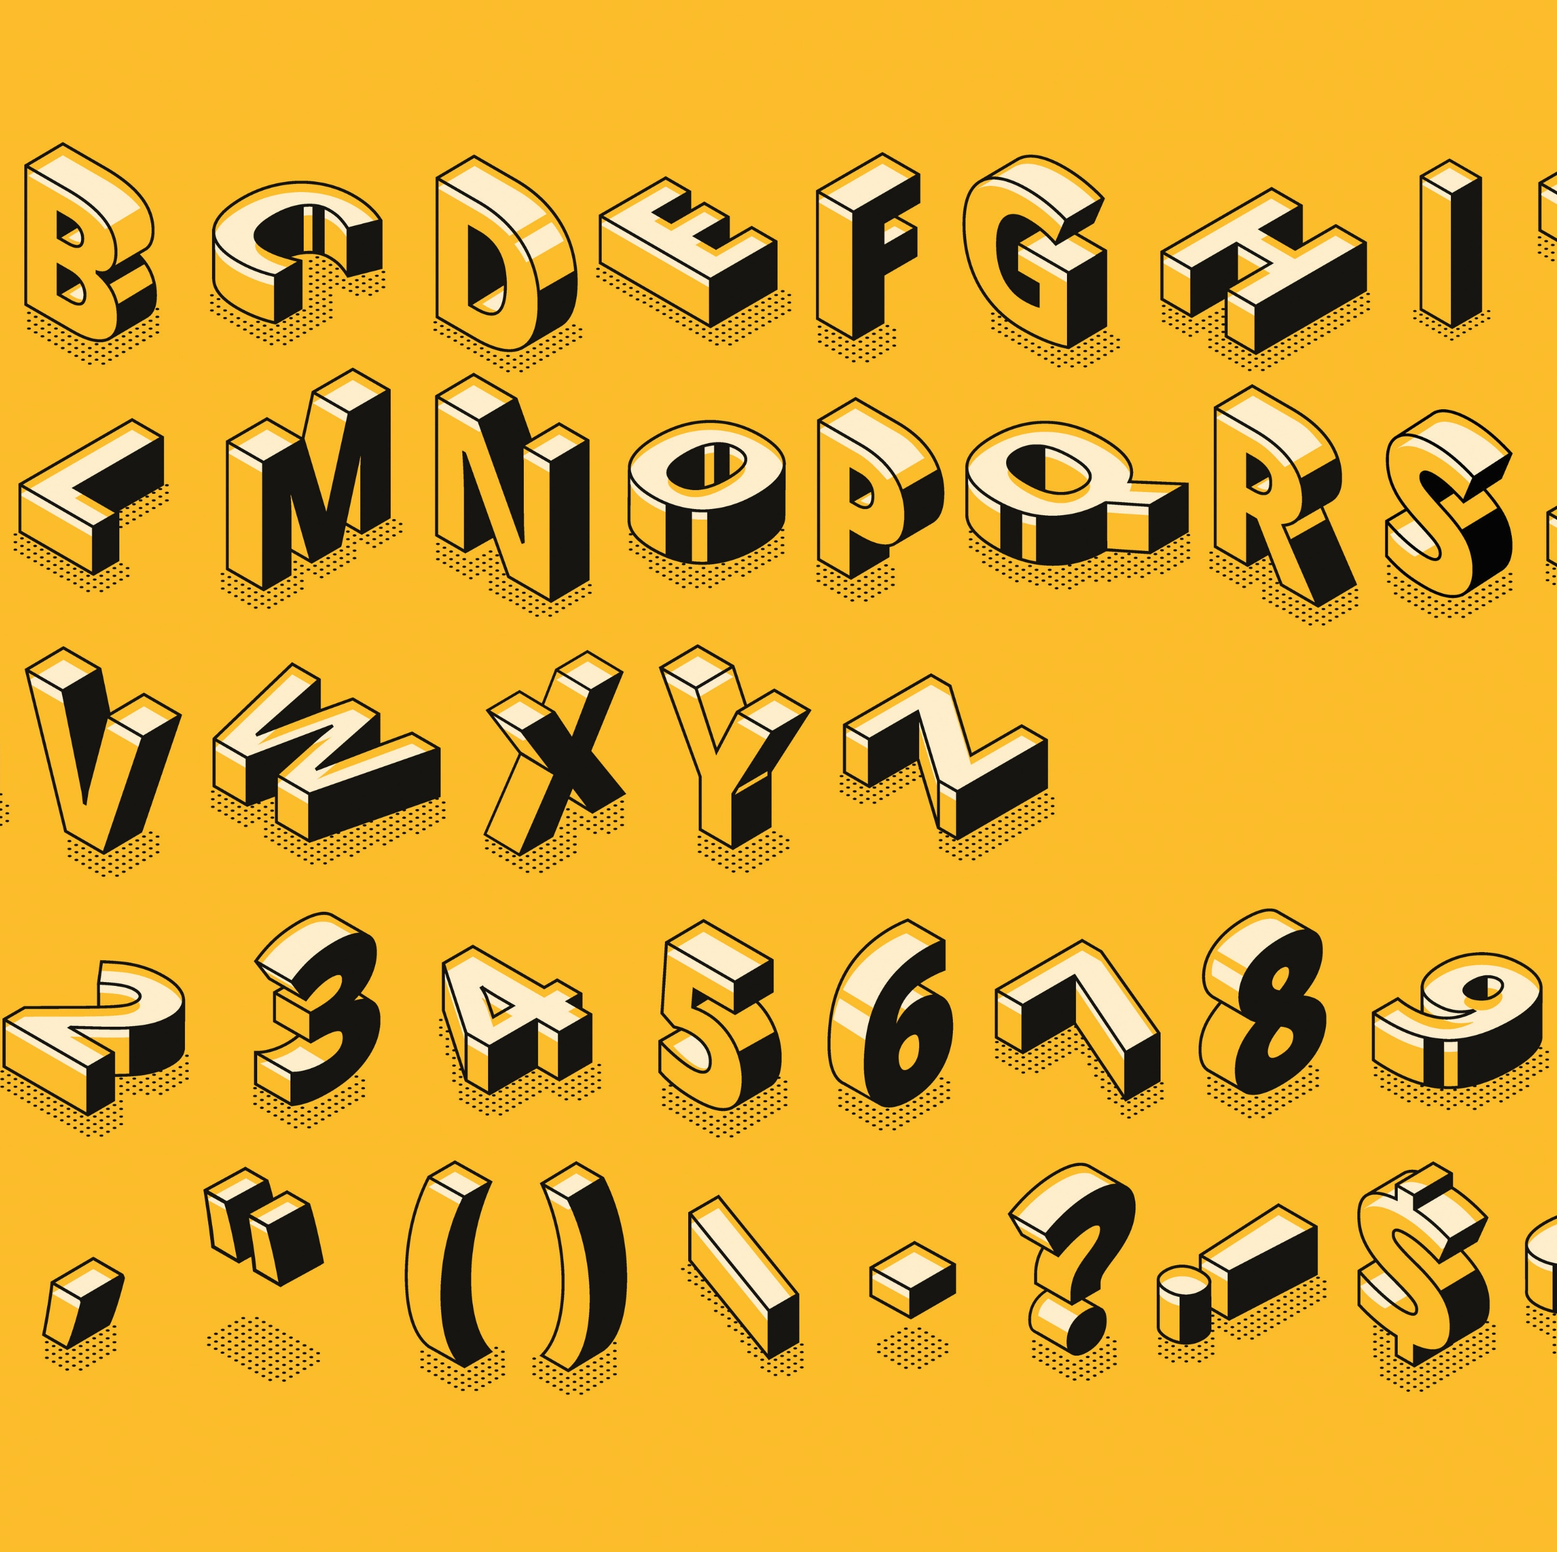
THE HUMAN BRIAN IS AMAZING!
The human brain is the most complex object in the known universe, and reading is among the most complex tasks it can do.
“Unlike spoken language skills, learning to read typically requires years of tuition and practice,” says Jonathan.
“The ultimate aim of my research is to describe the information processing performed by the brains of skilled readers like a computer program. I aim to uncover the mechanisms by which we can rapidly and efficiently extract meaning from extremely complex sequences of visual patterns.”

Slide 4
COMPREHENDING AND DECODING
Reading involves language comprehension – understanding the underlying language – and decoding – taking the symbols we see and translating them into the language we learned to speak.
Reading silently, which Jonathan focuses on, adds another level of complexity, because we are understanding words and sentences without hearing them at all. Jonathan explains, “It is thought to be the transition to silent reading that led to the introduction of spaces between words.”

Slide 5
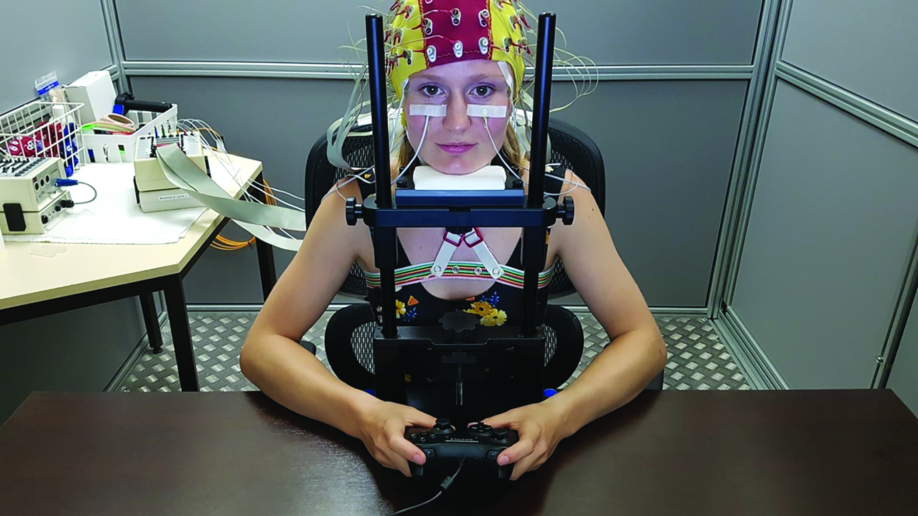
TRICKY TO TEST
Psychology’s subject matter, the mind, is abstract and virtually impossible to observe directly. How can we tell what is going on in someone’s mind when they are reading silently?
“We ask people to classify letter strings as real words or not (a lexical decision task) or ask them to classify word sequences as grammatically correct or not (a grammatical decision task),” explains Jonathan. By recording the accuracy of these decisions, and how long it takes participants to make them, Jonathan can infer the cognitive processes going on behind the scenes.

Slide 6
DISCOVERIES
Jonathan’s findings suggest that we do not process words letter-by-letter, or sentences word-by-word; rather, we process multiple letters or words at the same time, to increase reading efficiency.
People are also better at picking out certain elements in text that makes sense. “The word-superiority effect refers to people finding it easier to identify a single letter when it’s within a real word – such as the B in TABLE versus the B in TOBRE,” says Jonathan.

Slide 7
PROCESSING POWER
The real-world applications:
aid people who have dyslexia, helping them to find cognitive approaches to improve their decoding skills
inform education syllabuses, especially for those struggling to learn to read through conventional methods
help people trying to learn a second language

Slide 8
TALKING POINTS
What is the overall aim of Jonathan’s research?
What is meant by comprehension and decoding?
Why is silent reading so difficult to research?
How does Jonathan test reading skills?
How could Jonathan’s research help others?

Slide 9
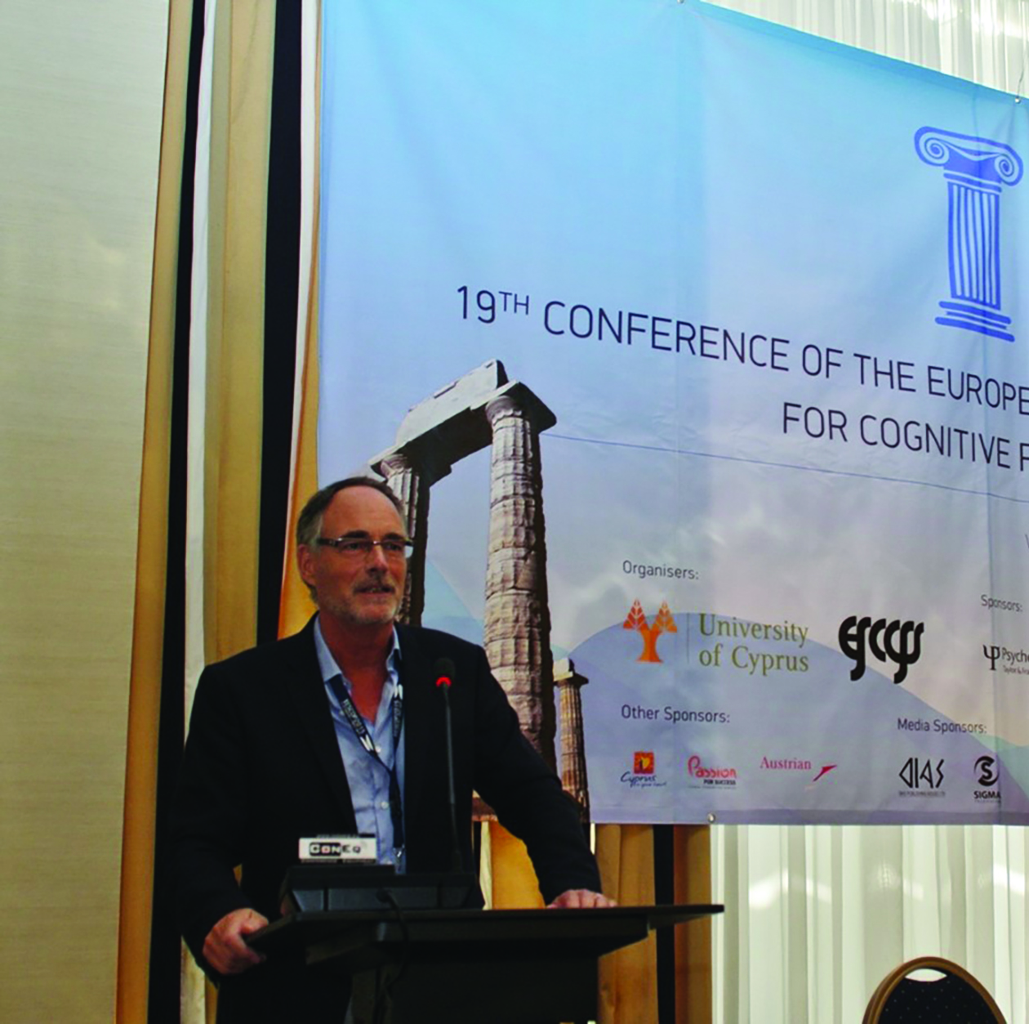
HOW CAN YOU BECOME A COGNITIVE PSYCHOLOGIST?
An undergraduate degree in psychology provides the most straightforward pathway to a career in cognitive psychology, although other subjects such as natural sciences or biology could also lead in the same direction.
A number of institutions, such as the NHS in the UK, offer apprenticeships in psychology. These tend to focus on clinical psychology more than cognitive psychology but, as an alternative, some universities offer ‘degree apprenticeships’ that combine part-time studying with employment.
According to Payscale, the average salary for a psychologist in the UK is around £35K. Jonathan points out that salaries in this field can vary widely, however.

Slide 10
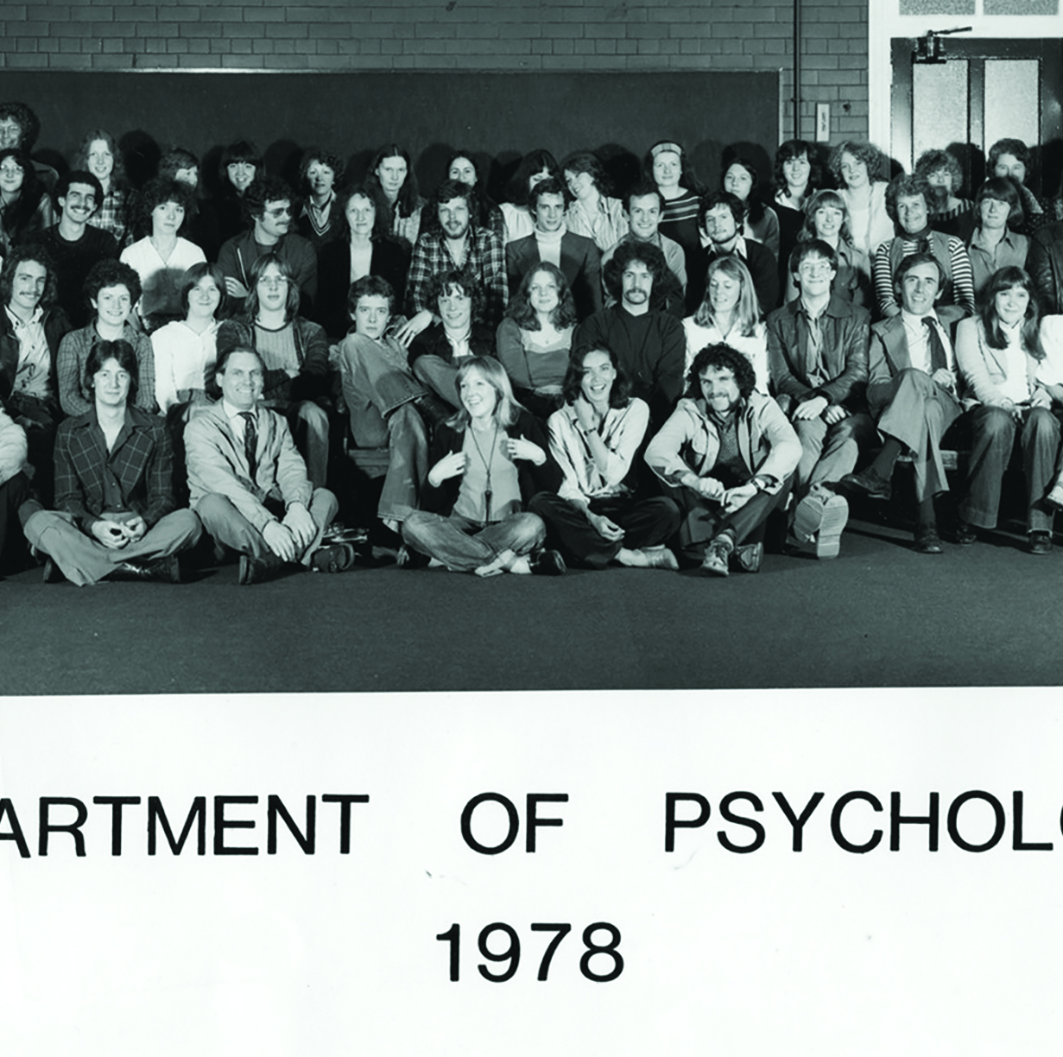
PATHWAY FROM SCHOOL TO COGNITIVE PSYCHOLOGIST
Jonathan says that taking maths is an essential at school. Biology, chemistry and physics are also useful for a scientific grounding. Some schools also offer psychology as a subject in itself. Some universities also suggest mixing sciences and humanities for a well-rounded foundation – this could include taking subjects such as English and history.
Can you spot Jonathan?!

Slide 11
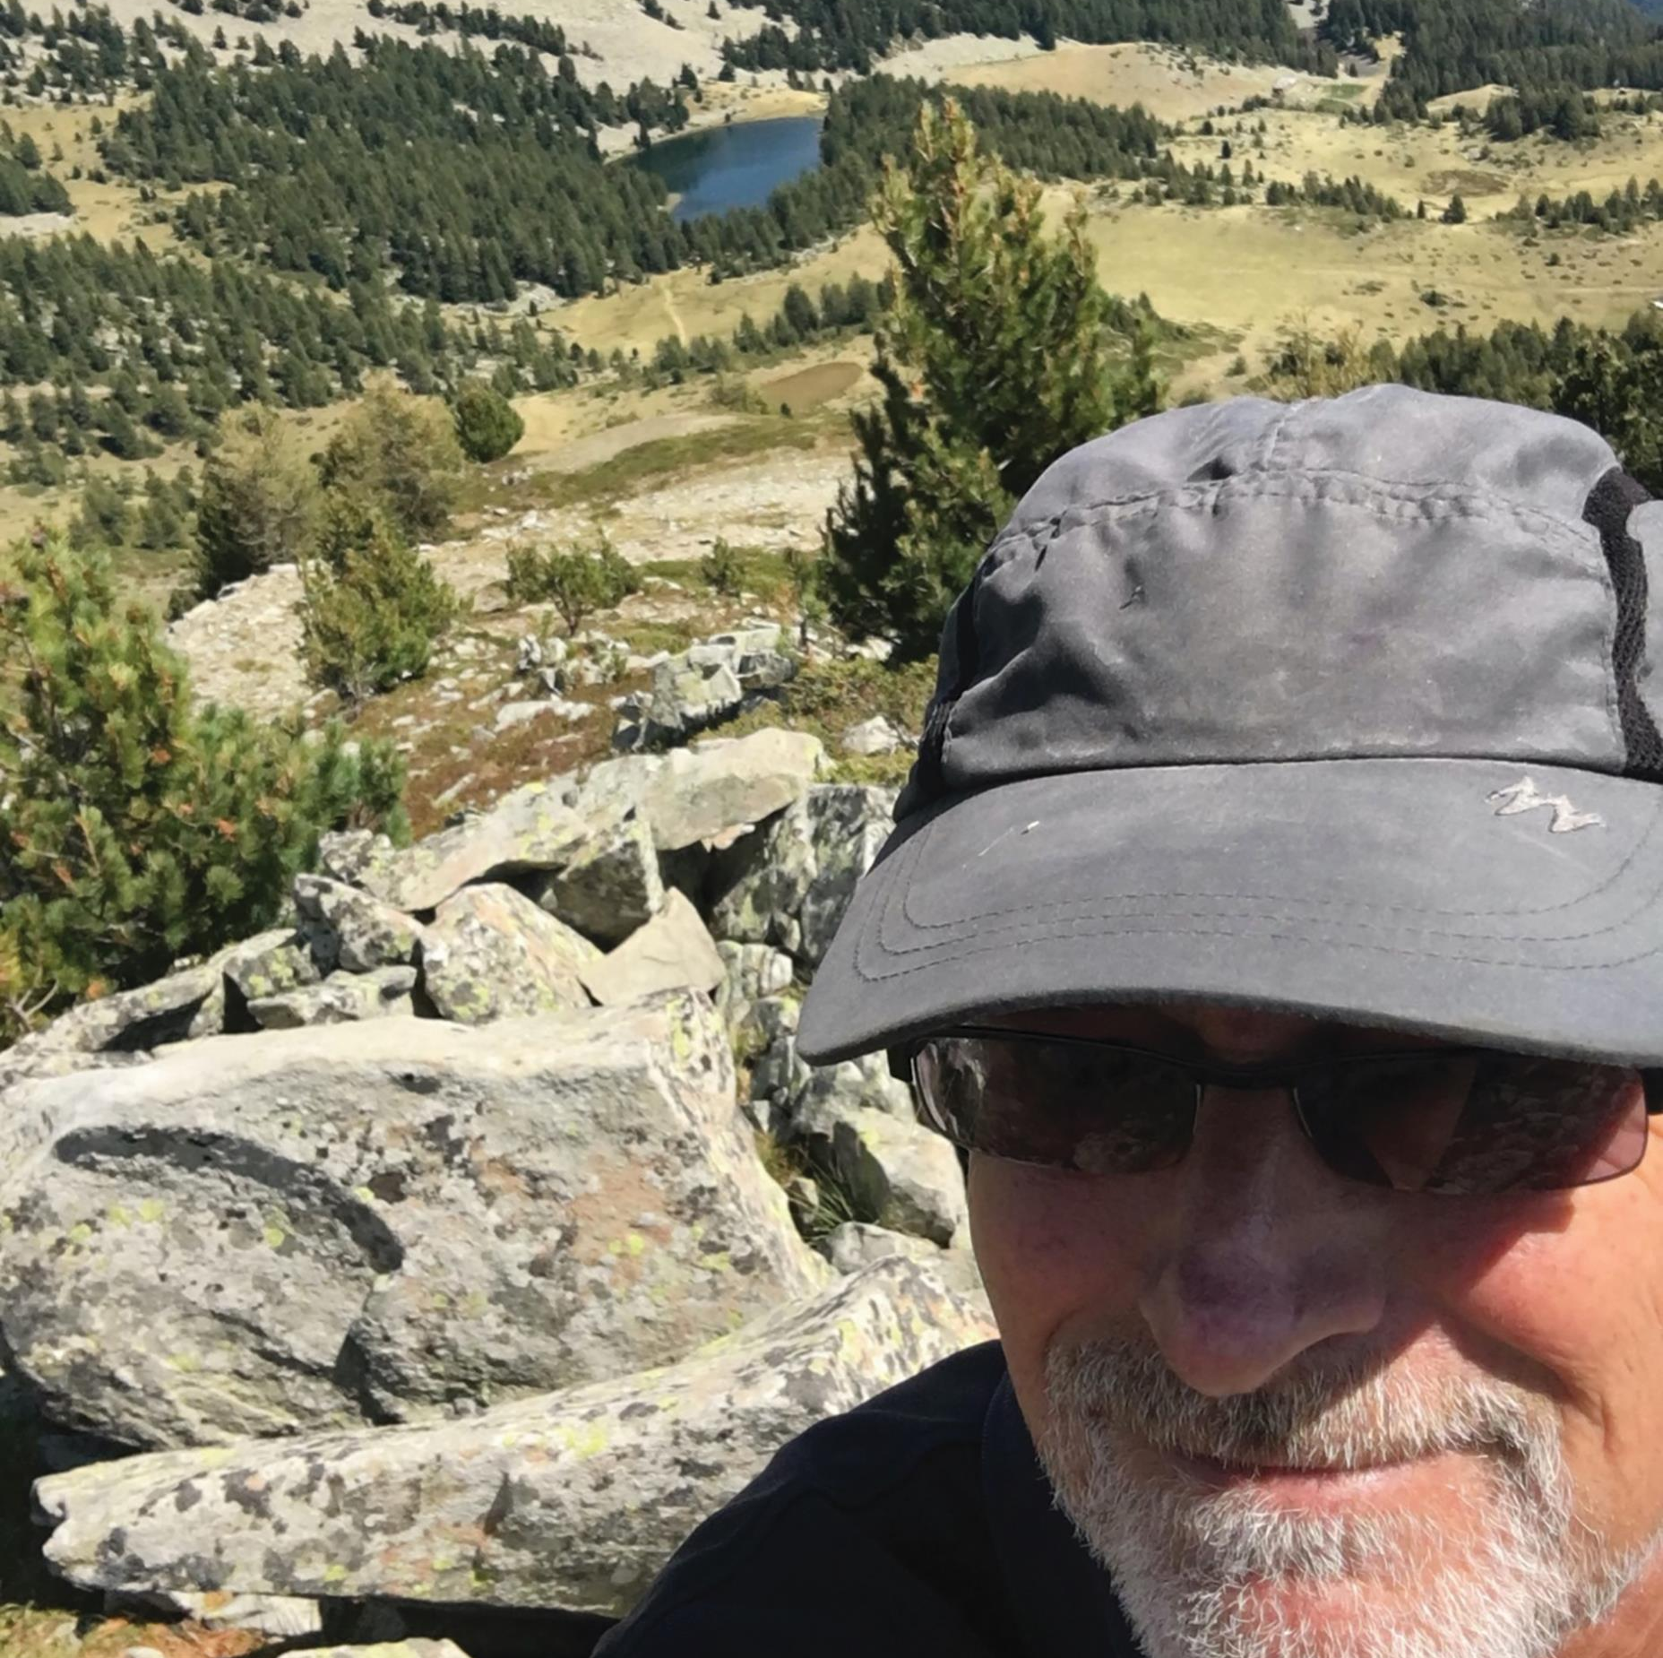
HOW DID JONATHAN BECOME A COGNITIVE PSYCHOLOGIST?
“When I was young, I aspired to become a philosopher. However, when I was in school, I was taught by a maths teacher who helped me excel in the subject and also suggested to me that psychology might offer an interesting compromise between philosophy and maths.”

Slide 12
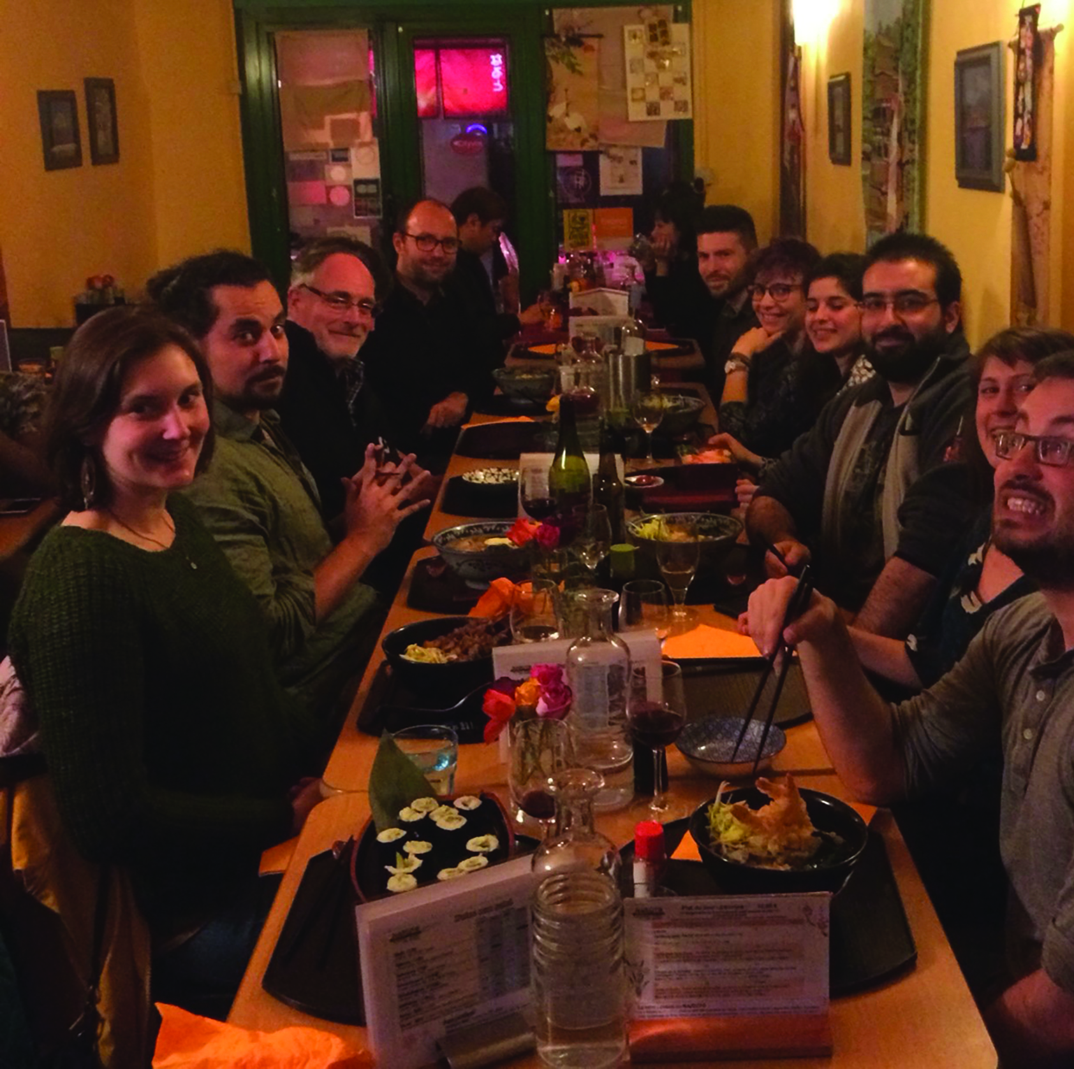
WHAT HAS INFLUENCED JONATHAN’S RESEARCH?
“I am English-French bilingual. After studying psychology at the University of Manchester, I moved to France and my French language skills became more proficient. This was the motivation for me to initially focus on bilingualism and second-language learning within my research.”

Slide 13
SO, WHAT DOES JONATHAN READ?!
“As a teenager, I read books that covered philosophical thought and psychological issues. This included novels such as The Glass Bead Game by Herman Hesse, Zen and the Art of Motorcycle Maintenance by Robert Pirsig, and The Catcher in the Rye by J. D. Salinger. I now read more down-to-earth novels, and I am currently enjoying Peter May’s Lewis trilogy, which paints a brilliant picture of the Outer Hebrides, not so far from where I grew up.”
What do you enjoy reading and why?

Slide 14
JONATHAN’S TOP TIPS
1 The greatest quality for a scientist is simple curiosity. This is followed by a good dose of creativity, to go beyond what has already been done.
2 You will need to find a balance between creativity and perseverance. You can’t go wildly chasing after everything that catches your interest, but bearing with one particular question can lead you to a satisfying answer.
3 Of course, to be able to answer the questions you raise, you need to be capable of mastering the techniques that will help you provide these answers. This implies not just technical skills, but mostly logical skills.

Slide 15
TALKING POINTS
Which subjects could lead to a career in cognitive psychology?
What interests influenced Jonathan’s career path? Do you share any of these interests?
Can you speak a second language? How could this help you in your future career?
Which of Jonathan’s tips stands out for you and why? Do you have the attributes Jonathan mentions? How could you develop these skills?

Slide 16
MORE RESOURCES
This article presents an accessible overview of how we learn to read.
This short video from HowStuffWorks explains the research behind the transposed-letter effect in more detail, including a critical look at some misleading conclusions.
This website has a demo of a lexical decision task that you can use to test yourself or others.

Slide 17
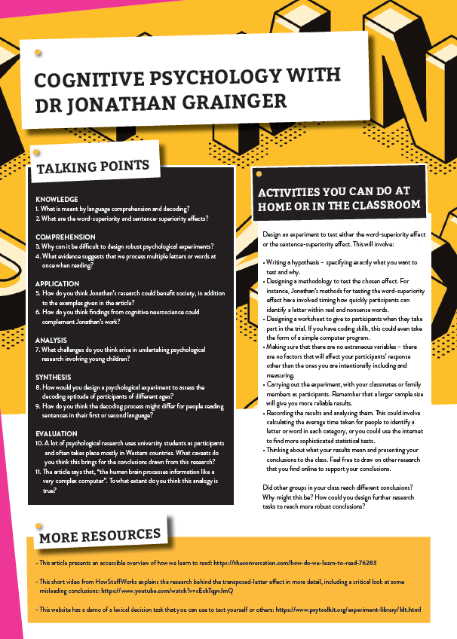
Dig deeper into Jonathan’s research Download his activity sheet

