Slide 1
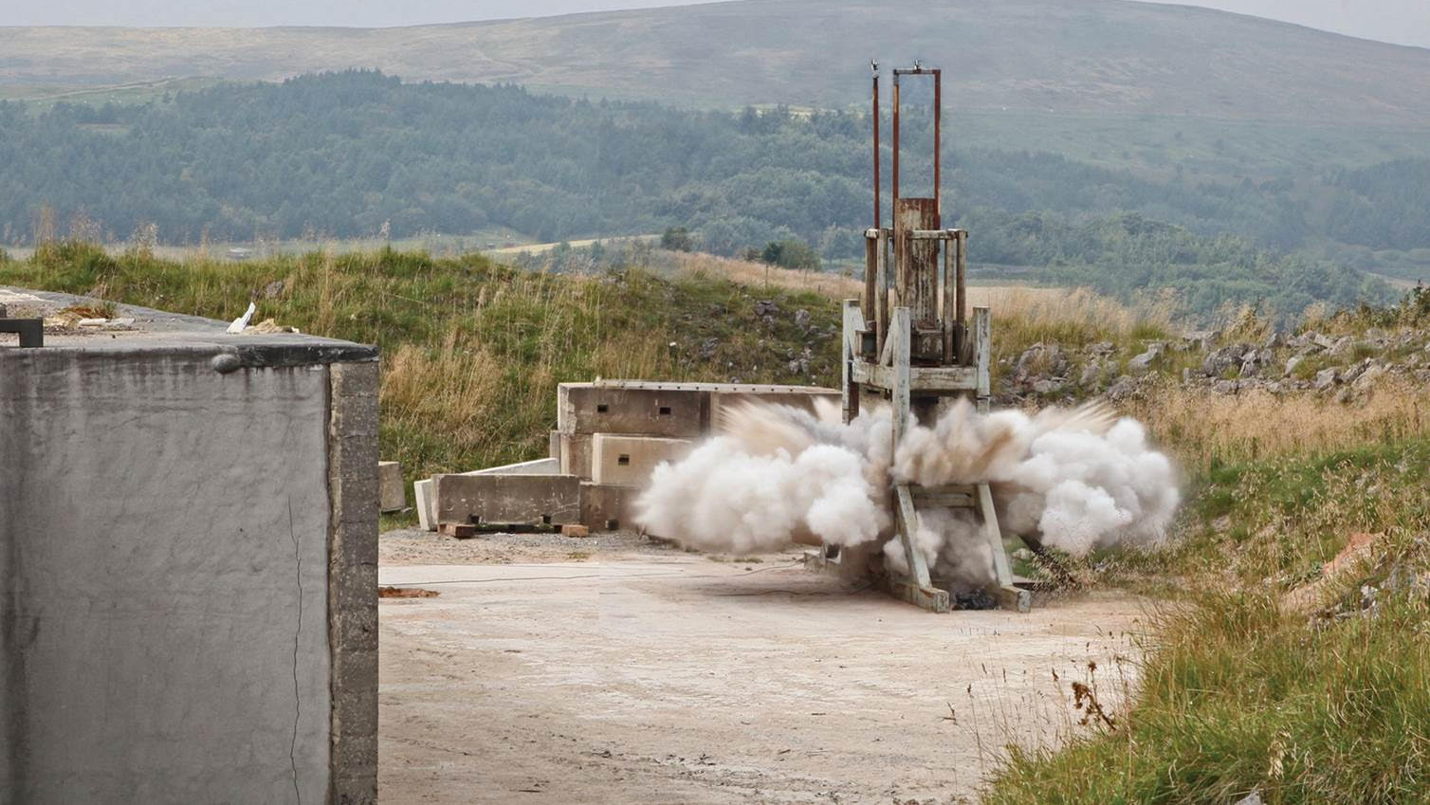
ENGINEERING
WITH THE BLAST AND IMPACT DIAGNOSTICS LAB

Slide 2
THE BLAST AND IMPACT DIAGNOSTICS LAB
Explosions are difficult to study because they happen so quickly and with such destructive power. Yet knowing how they work is important for protecting human lives.
So, a team of engineers at the University of Sheffield, UK, have established the Blast and Impact Diagnostics Lab, where they use the latest tech and experimental techniques to learn more about what happens when stuff blows up.
Let’s learn more about their research…
A small-scale landmine test at the Blast and Impact Diagnostics Lab.

Slide 3
WHAT IS AN EXPLOSION?
“Explosions happen when a lot of trapped energy is suddenly released,” explains Dr Sam Clarke, a civil engineer in the team.
“They are chemical reactions that convert an explosive material into a high-pressure, highly dense gas,” says Dr Sam Rigby, also a civil engineer. “This gas then rapidly expands and violently forces the air surrounding the explosive out of the way.”
The energy from the explosion creates a pressure wave, expanding outwards from the site of detonation, and it is this pressure wave that causes damage to people and infrastructure.

Slide 4
THE CHALLENGES OF MEASURING EXPLOSIONS
“It is tricky measuring what happens during an explosion,” says Professor Genevieve Langdon, a mechanical engineer.
“You need equipment that can record intense pressures (many times stronger than steel) which are applied and removed in a miniscule amount of time (less than a thousandth of a blink of an eye),” explains Sam R.
This requires equipment that is both robust enough to survive the explosion but sensitive enough to accurately record these very rapid changes in conditions.
The Blast and Impact Diagnostic Lab.

Slide 5
MEASURING EXPLOSIONS
The team uses ultra-high-speed cameras to film the event, collecting up to a million photos per second to show how the blast waves develop and interact with any structures in their path.
Infrared cameras measure temperature changes during the explosion, X-ray cameras allow the team to see inside the explosion and pressure gauges record the pressure applied by the blast wave.
By studying the magnitude of this pressure loading at different distances from the source of detonation, the team is learning how much pressure buildings in the path of an explosion will be subjected to.
A split Hopkinson pressure bar, used to measure the pressure during explosions.

Slide 6
EXPLOSIONS IN THE REAL WORLD
Lives and structures are most at risk from explosions in warzones. The team hopes their findings could help protect soldiers from improvised explosive devices, such as roadside bombs.
“We’ve been able to identify the properties of soil types which affect how dangerous a buried explosive may be,” says Sam C. “Next we will try to understand why these properties affect the explosion, which is where this new lab comes in.”
An experimental test of a ‘bomb-proof’ bag.

Slide 7
EXPLOSIONS IN THE REAL WORLD
Small-scale explosions conducted in the lab can also help engineers understand large, city-scaled explosions, such as the tragic explosion in Beirut in August 2020.
“Blast waves scale quite nicely according to ‘cube root’ scaling,” says Sam R. “This means the properties of a small and large explosion will be the same, just scaled according to their size.”
Ultimately, the work conducted by the Blast and Impact Diagnostics Lab will help save lives and protect people and infrastructure from the devastating effects of explosions.

Slide 8
Talking points
What is an explosion?
Why is it challenging to measure explosions? What considerations need to be taken into account?
What equipment does the team use to measure explosions? What data do these provide?
How can the team’s work be applied to help save lives from explosions in the real world?

Slide 9
Meet Sam C.
I’ve always been interested in construction – I loved LEGO sets as a kid. I couldn’t decide between architecture and engineering, so I completed the University of Sheffield’s unique Structural Engineering and Architecture degree. I soon realised that I loved engineering, especially soils, which always provide a challenge.
When British troops were deployed to Iraq and Afghanistan, we realised we had an opportunity to help protect them through understanding the engineering properties of soil. The characteristics of the soil in which an explosive is buried will determine how dangerous the explosion will be.
I enjoy the varied nature of my job, and the fact that no two days are the same. One day I’ll be in the classroom teaching students, and the next I’ll be out on-site blowing things up!

Slide 10
Meet Sam R.
Civil engineering, by definition, is about people. My research aims to protect people from explosions and knowing that my work could save lives spurs me on. I also love the variety of civil engineering, the mix of practical work with number crunching. This is very apparent in my job, where my time is split between blowing things up in a muddy field and computer programming at my desk.
I’ve seen close to 100 explosions in my lifetime, and it never gets boring! I like the fact that we get an insight into this hidden world where events happen so quickly, through our ultra-high-speed cameras.
I was always designing things when I was younger. I carried this inquisitive nature into school and became interested in maths and physics. I initially thought I wanted to be an architect, but as soon as I realised engineering involved creative design as well as mathematics, I was sold.

Slide 11
Meet Gen
I enjoy the challenge of unpicking what happens during an explosive event, and how to use this information to prevent damage and injury in the real world. Explosions and their effects are both devastating and fascinating to me.
Engineering is at the interface of science and the real world – taking theory and putting it into practice. I like the hands-on nature of experiments, and the chance to use my brain to interpret their results.
At school, I was one of only two girls to take GCSE Design & Technology. My one regret is being too narrowly focused on science-leaning subjects – I wish I had taken drama! I thought arts and engineering are incompatible, but they certainly are not.
Outside of work, I like to sing, write poetry and read, and I also preach at my local church. Though all these interests are very different to engineering, I find the range of perspectives they give me very stimulating and life-giving.

Slide 12
Meet Andy
I’m a technician in the lab, where I run a selection of high-speed video cameras, as well as doing on-site photography. I also help with the general day-to-day running of the laboratory.
It was through photographing BMX riding that I became interested in slow-motion filming. I understood the fundamentals of photography and became involved with filming explosions.
As a technician, a typical day starts off with a team meeting and discussing the plans for the day. Then we will prepare the test area and I will set up the cameras. Finally, it’s time to make a bang and retrieve the data we have just captured.
The sense of achievement that I get when our hard work produces great results is the best part of this project – as well as the chance to blow stuff up! I also enjoy getting to watch videos back in super slow motion, seeing exactly what happens during an explosion.

Slide 13
Talking points
The team members all mention the variety of work they do as engineers. Which aspects of their jobs would you most enjoy?
What motivates the different team members to study explosions?
How is engineering at the ‘interface of science and the real world’?
What skills and knowledge do you think engineers require to work at this interface?

Slide 14
PATHWAY FROM SCHOOL TO ENGINEERING
A-levels in physics and maths are necessary for most engineering courses, but Gen and Sam R. both suggest considering creative subjects too, to ensure diverse ways of thinking and connection with real-world issues.
Not all engineering roles require a university education. As a technician, Andy advises you to be hands on and open to learning new skills if you are interested in working in an engineering lab. “Offer to help wherever you can,” he says. “You never know where it might lead!”
A split Hopkinson pressure bar, used to measure the pressure during explosions.

Slide 15
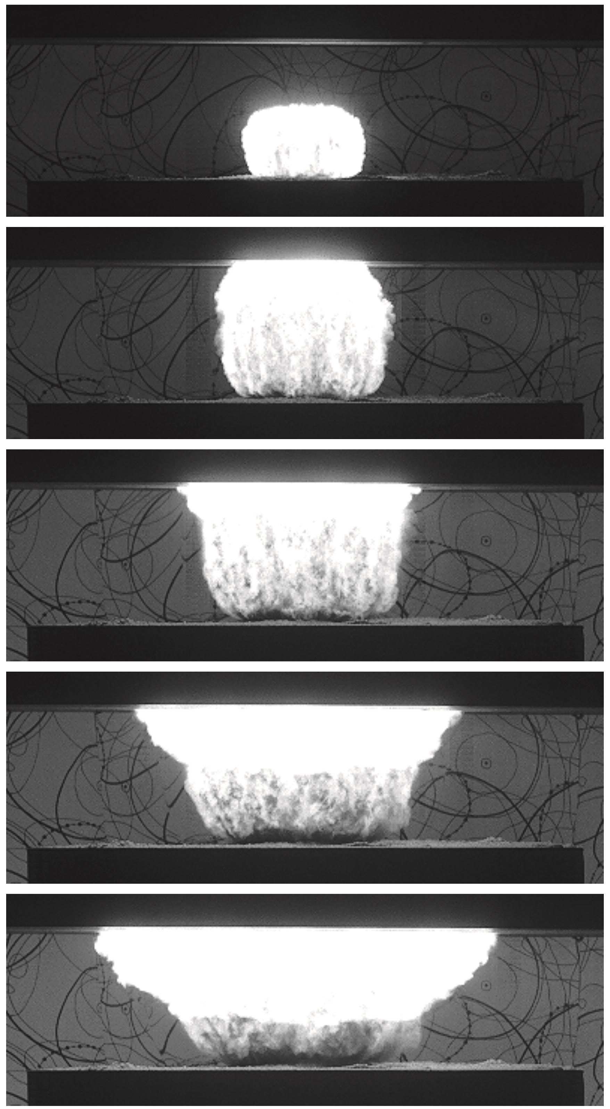
EXPLORE A CAREER IN ENGINEERING
Sam and Sam are civil engineers. The Institute of Civil Engineers provides a wealth of resources about civil engineering, including advice about what subjects to study and interviews with civil engineers at all stages of their career.
Gen is a mechanical engineer. The Institution of Mechanical Engineers and the Royal Academy of Engineers both provide information about careers in engineering and resources for schools.
Gen recommends finding work experience to learn more about what engineering actually is. “Engineers work everywhere – factories, laboratories, design offices, consultancy firms…” she says. “Go and see the variety of engineering roles for yourself.”
An explosion, captured at over 100,000 frames per second.

Slide 16
THE TEAM’S TOP TIPS
The better you do at school, the more choices you have in life. Try and give your best to whatever you do, without burning yourself out.
Find something that you enjoy, sparks your imagination and gets you excited to learn more. Don’t be afraid to follow what you love.
Don’t be put off if you don’t achieve what you want straight away. Things can take time.
Show interest and talk to people! Enjoy yourself and try to make a positive difference to the people around you.
A small-scale landmine test at the Blast and Impact Diagnostics Lab.

Slide 17
TALKING POINTS
Why do you think engineers will benefit from studying creative subjects at school?
Are there any factories, laboratories or offices near you where engineers may work? Could you contact them, or even visit them, to learn about their jobs?
If you were an engineer, what societal problems would you want to address?
What questions would you want to ask Sam, Sam, Gen and Andy about their work and their career paths?

Slide 18
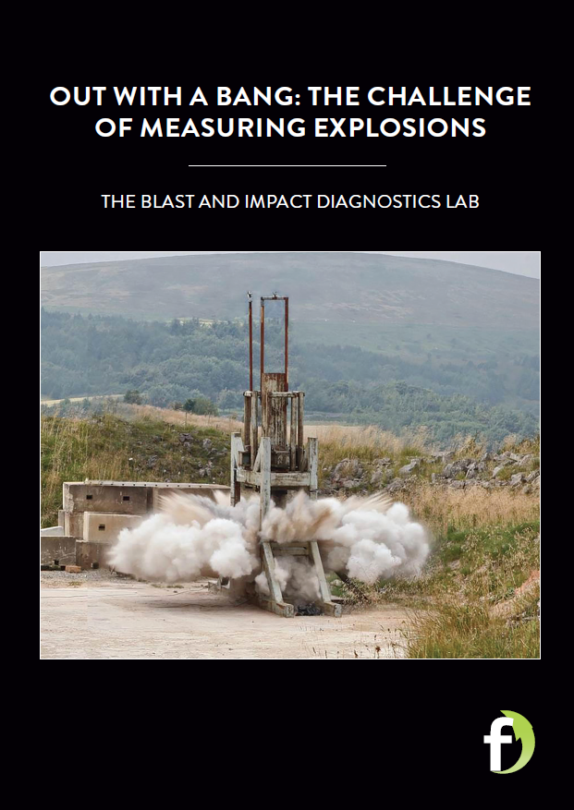
Read more about the team’s research here
Download their activity sheet

Slide 19
