Slide 1
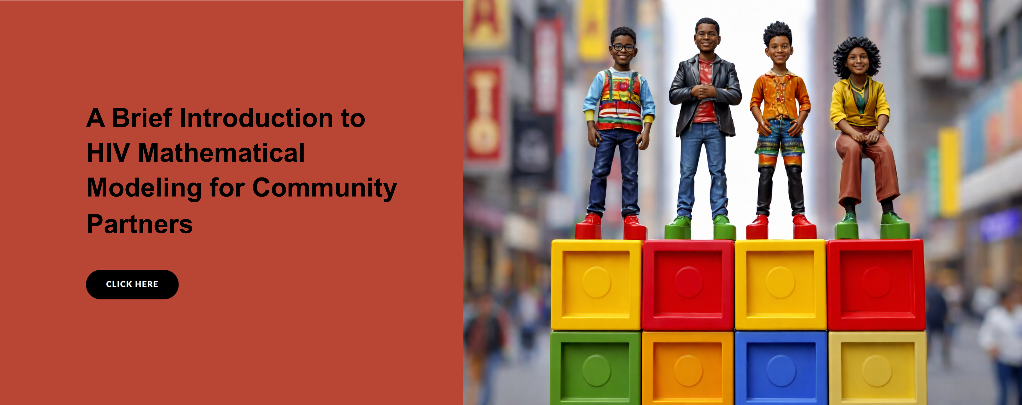

Epidemiology and social sciences
With Professor Sharmistha Mishra, Jeffrey Walimbwa, Nancy Tahmo and Dr Lisa Lazarus
GET STARTED
www.futurumcareers.com

Slide 2
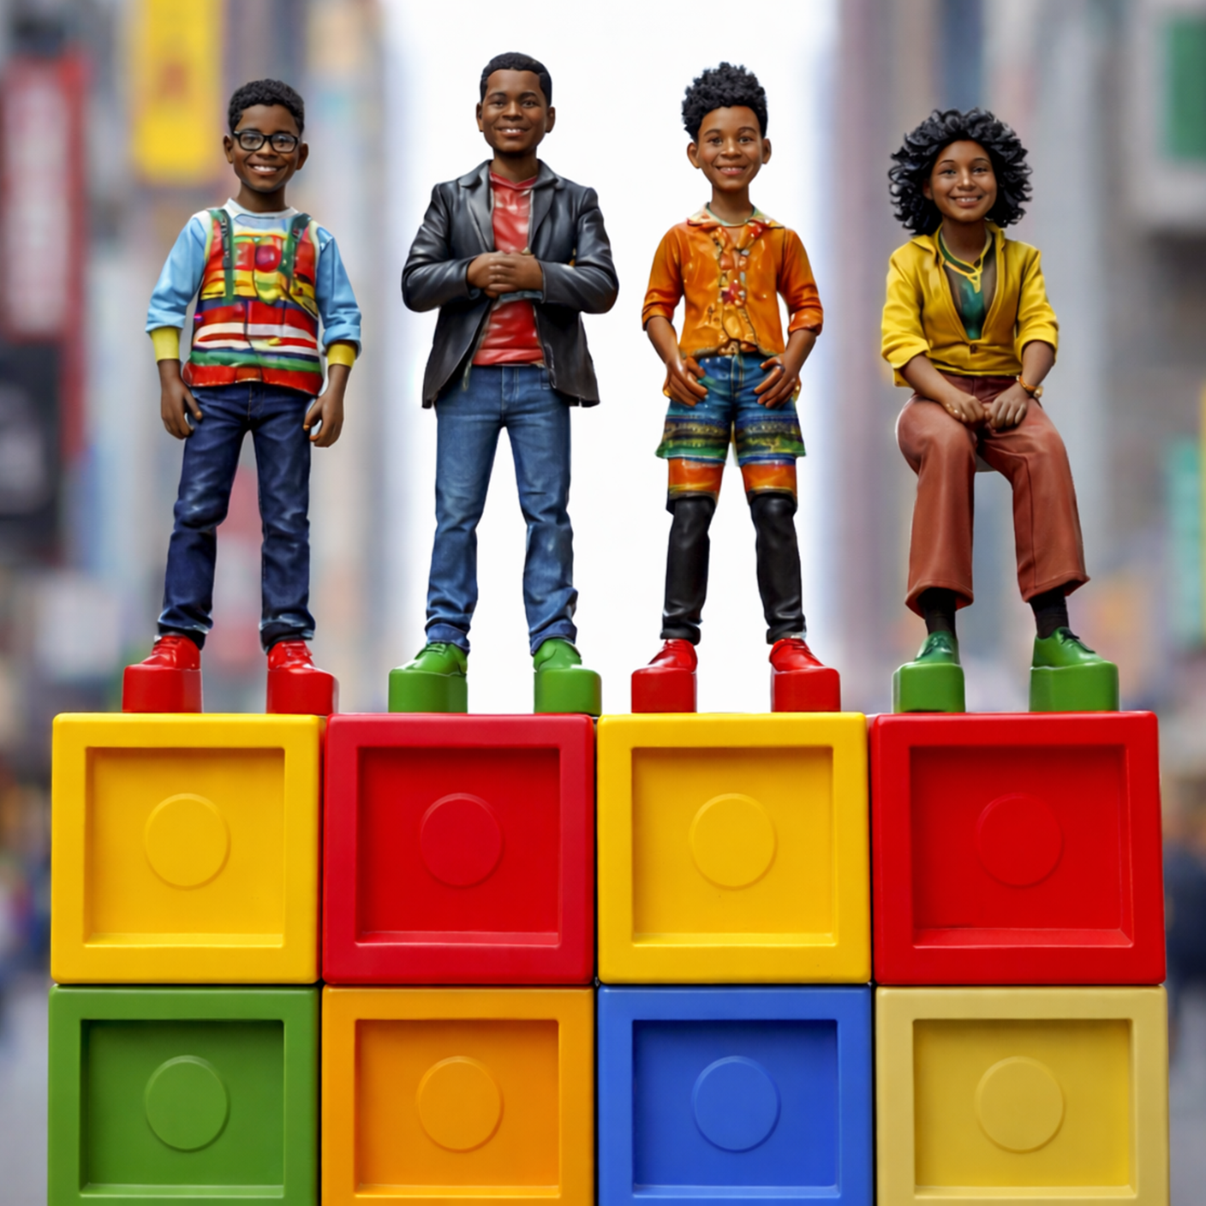
In this presentation
Introduction
About HIV
Mathematical and participatory modelling
Talking points
About epidemiology and social sciences
Pathway from school to epidemiology and social sciences
Explore careers in epidemiology and social sciences
Talking points
Meet the team
Talking points
More resources
02 futurumcareers.com

Slide 3
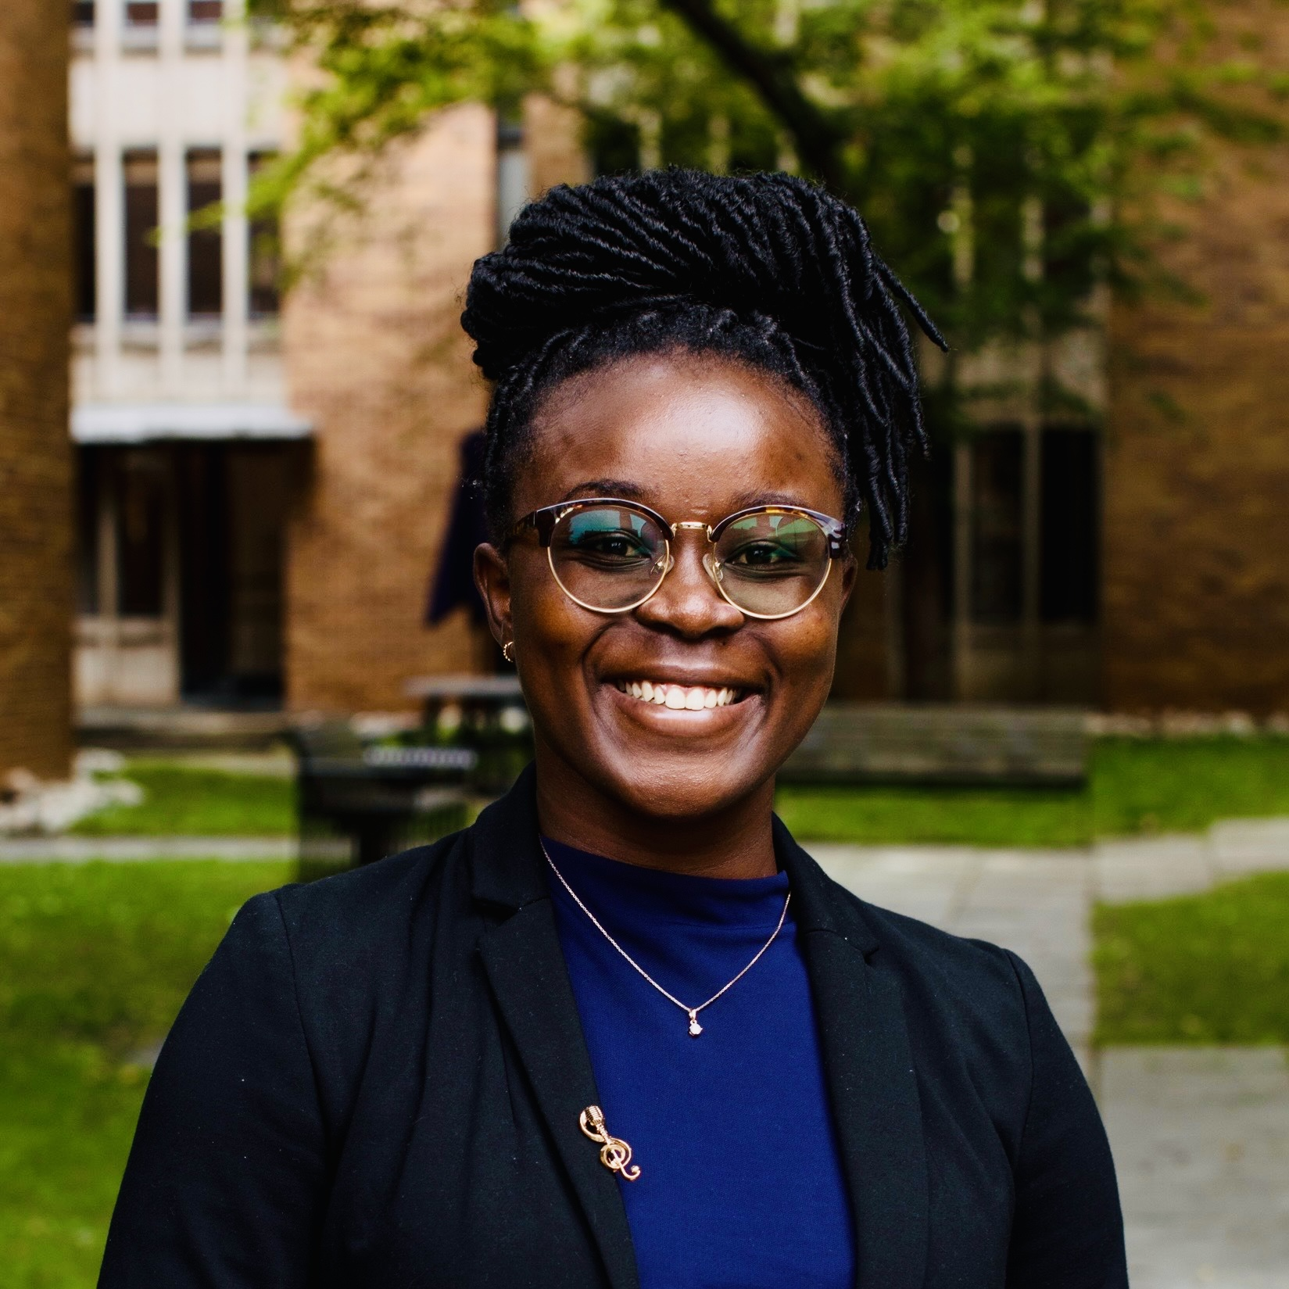
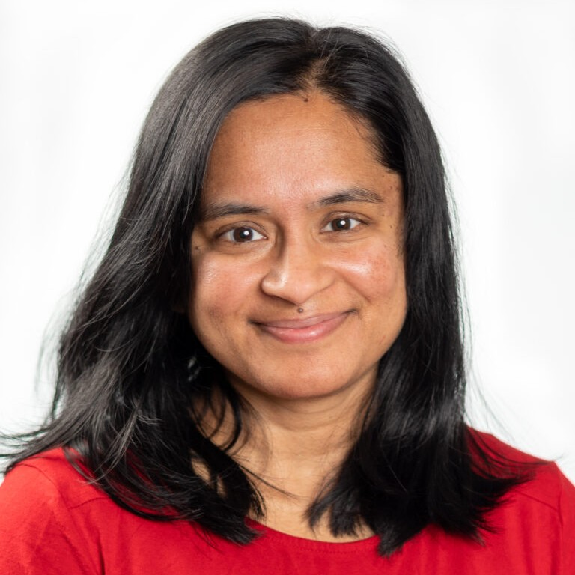
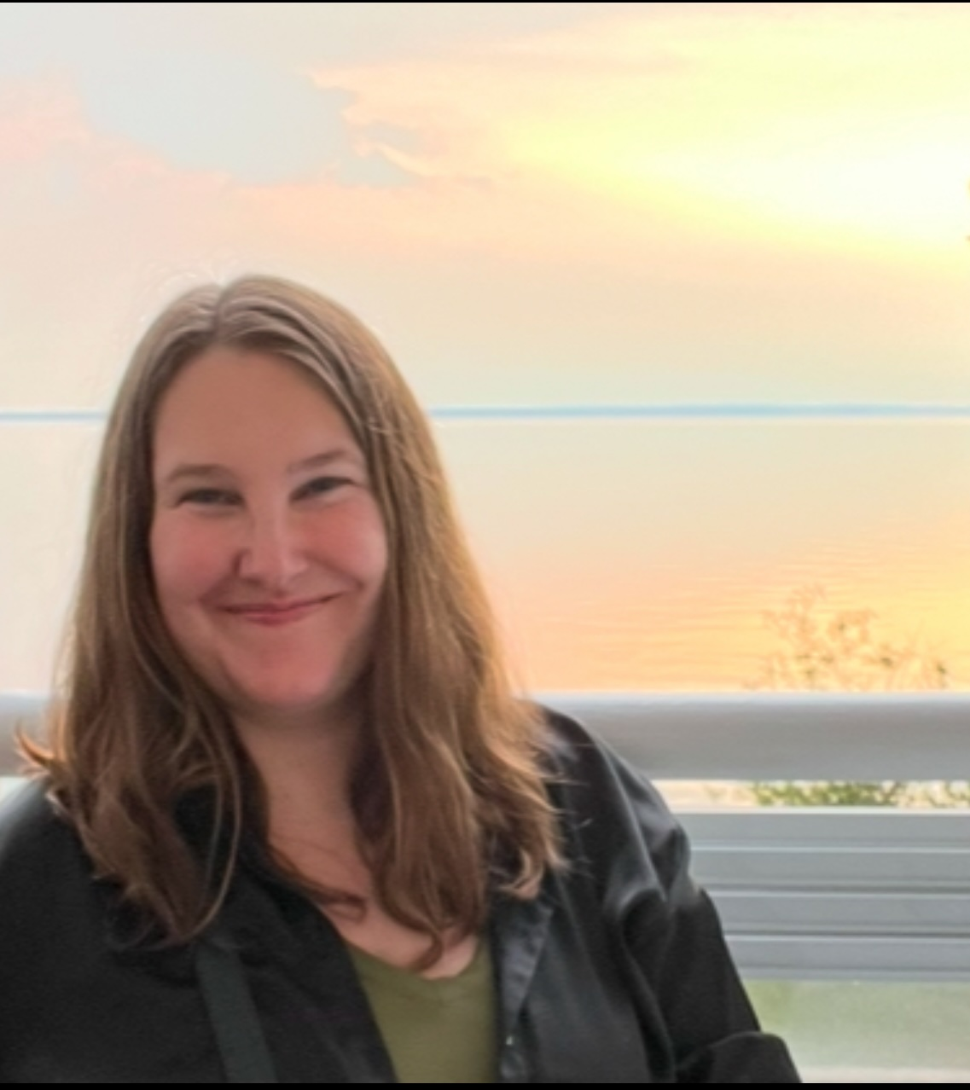
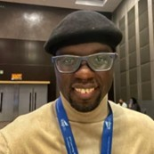
Meet the team
Professor Sharmistha Mishra
Epidemiologist and infectious diseases doctor
University of Toronto, Canada
Jeffrey Walimbwa
Programme manager
Ishtar MSM, Kenya
Nancy Tahmo
Epidemiology PhD student
University of Toronto, Canada
Dr Lisa Lazarus
Social scientist
University of Manitoba, Canada
Sharmistha, Jeffrey, Nancy and Lisa are co-developing mathematical models of HIV with affected communities in Kenya.
03 futurumcareers.com

Slide 4
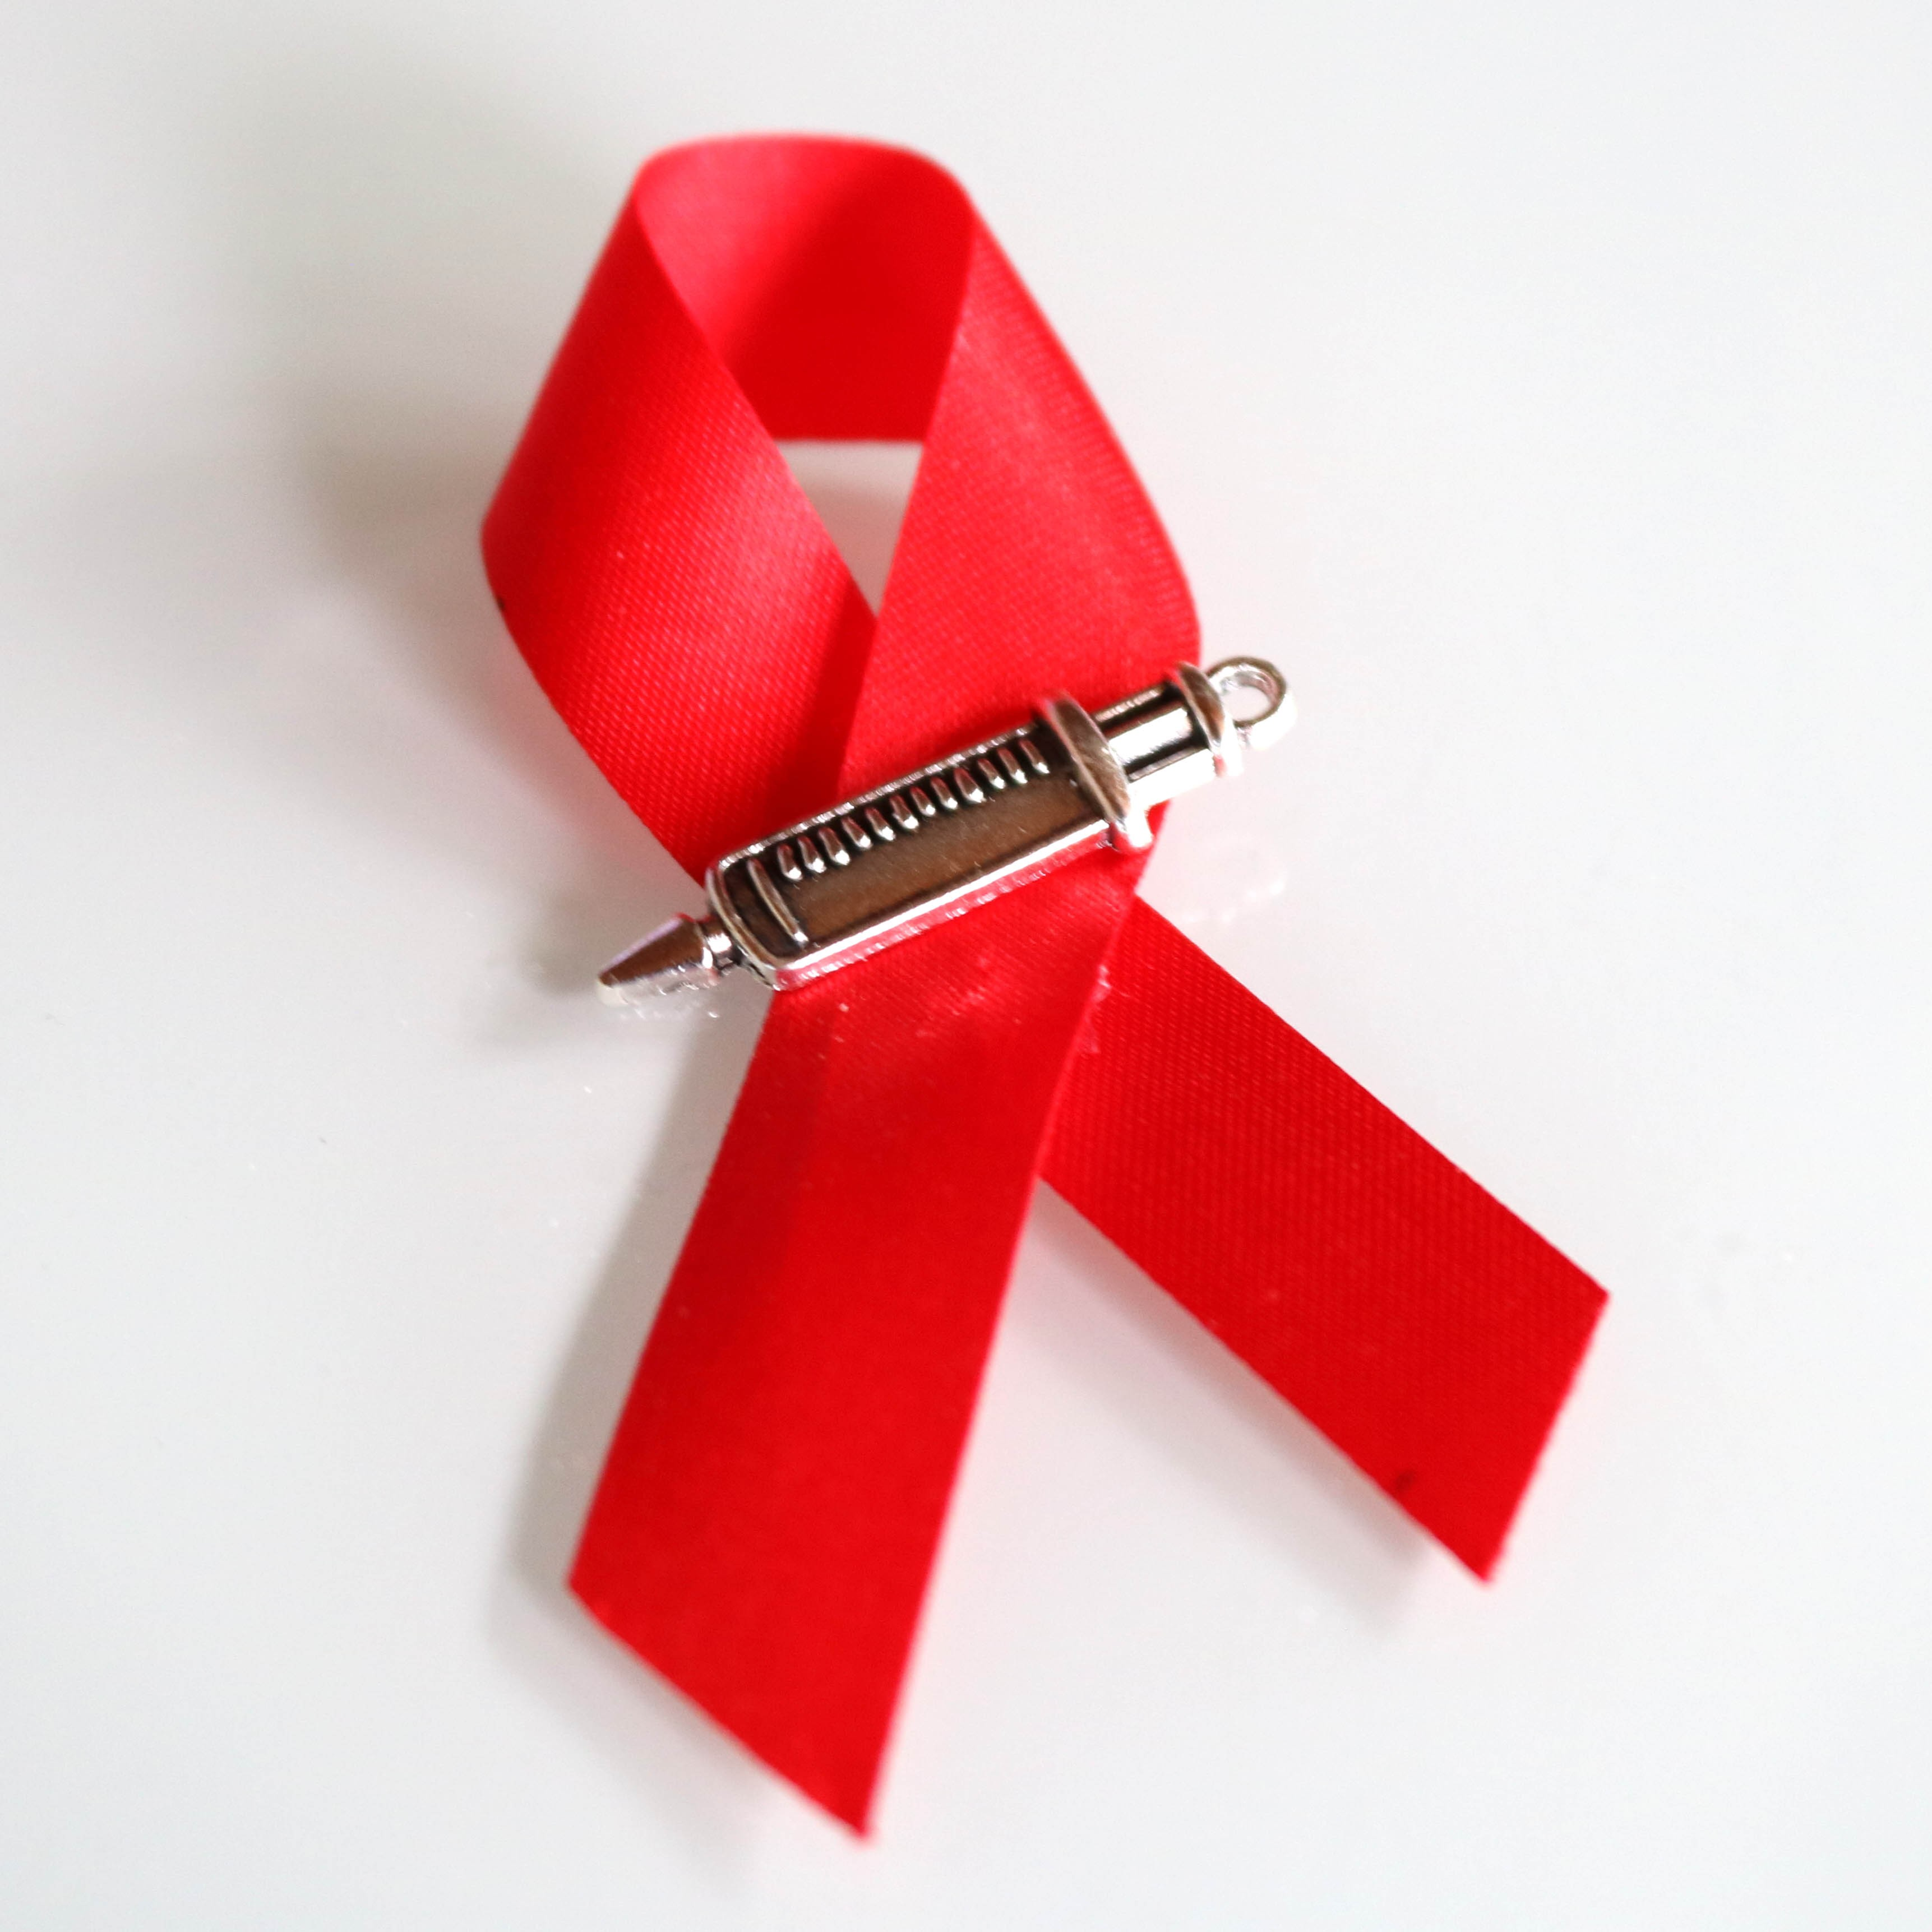
About HIV
HIV is a virus that weakens the immune system, leaving someone vulnerable to other infections.
Although there is currently no cure for HIV, there are medicines that can supress the virus and prevent it from being passed on.
Without these medicines, HIV can be spread through unprotected sex or blood-to-blood contact.
With the right medicines and prevention tools, HIV transmission can be reduced to zero.
© NIAID
04 futurumcareers.com

Slide 5
HIV in Kenya
In Kenya, 1.4 million adults are living with HIV.
Access to prevention and care is not equal for everyone. Men who have sex with men (MSM) are disproportionately affected. In 2019, HIV prevalence among MSM was around 18%, nearly three times higher than in the wider population.
“There are limited MSM-friendly services to provide HIV awareness, treatment and prevention in Kenya. Criminalisation of same-sex relationships means people are scared to seek help due to fear of arrest.” – Jeffrey
05 futurumcareers.com

Slide 6
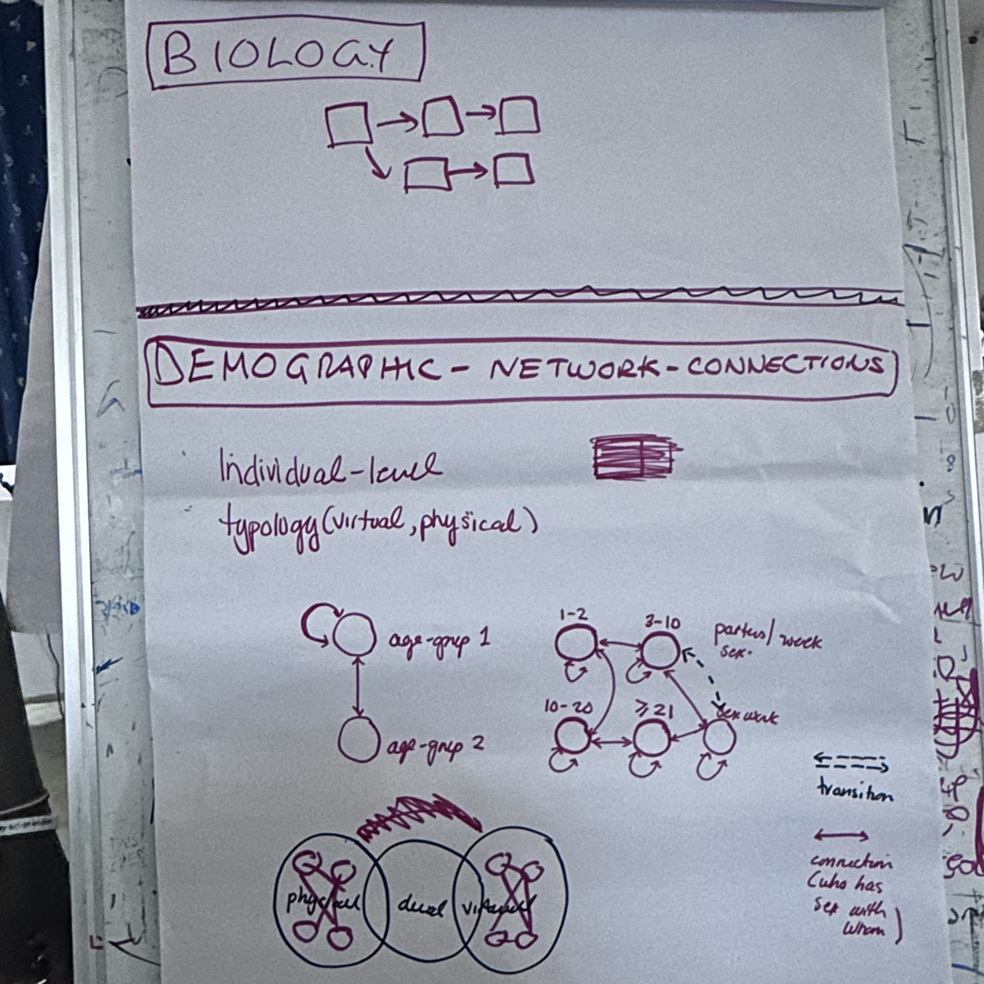
Mathematical modelling
Epidemiologists use mathematical models to understand how viruses spread through populations.
To create these models, they mathematically describe important mechanisms, such as how people come into contact in ways that could pass on the virus.
Then they add data to the model, such as infection rates, to test whether the model reflects how the virus is spreading in real life.
The model can then be used to explore the effects of different public health intervention strategies to reduce the spread of the virus.
Co-developing mathematical models of HIV with affected communities.
06 futurumcareers.com

Slide 7
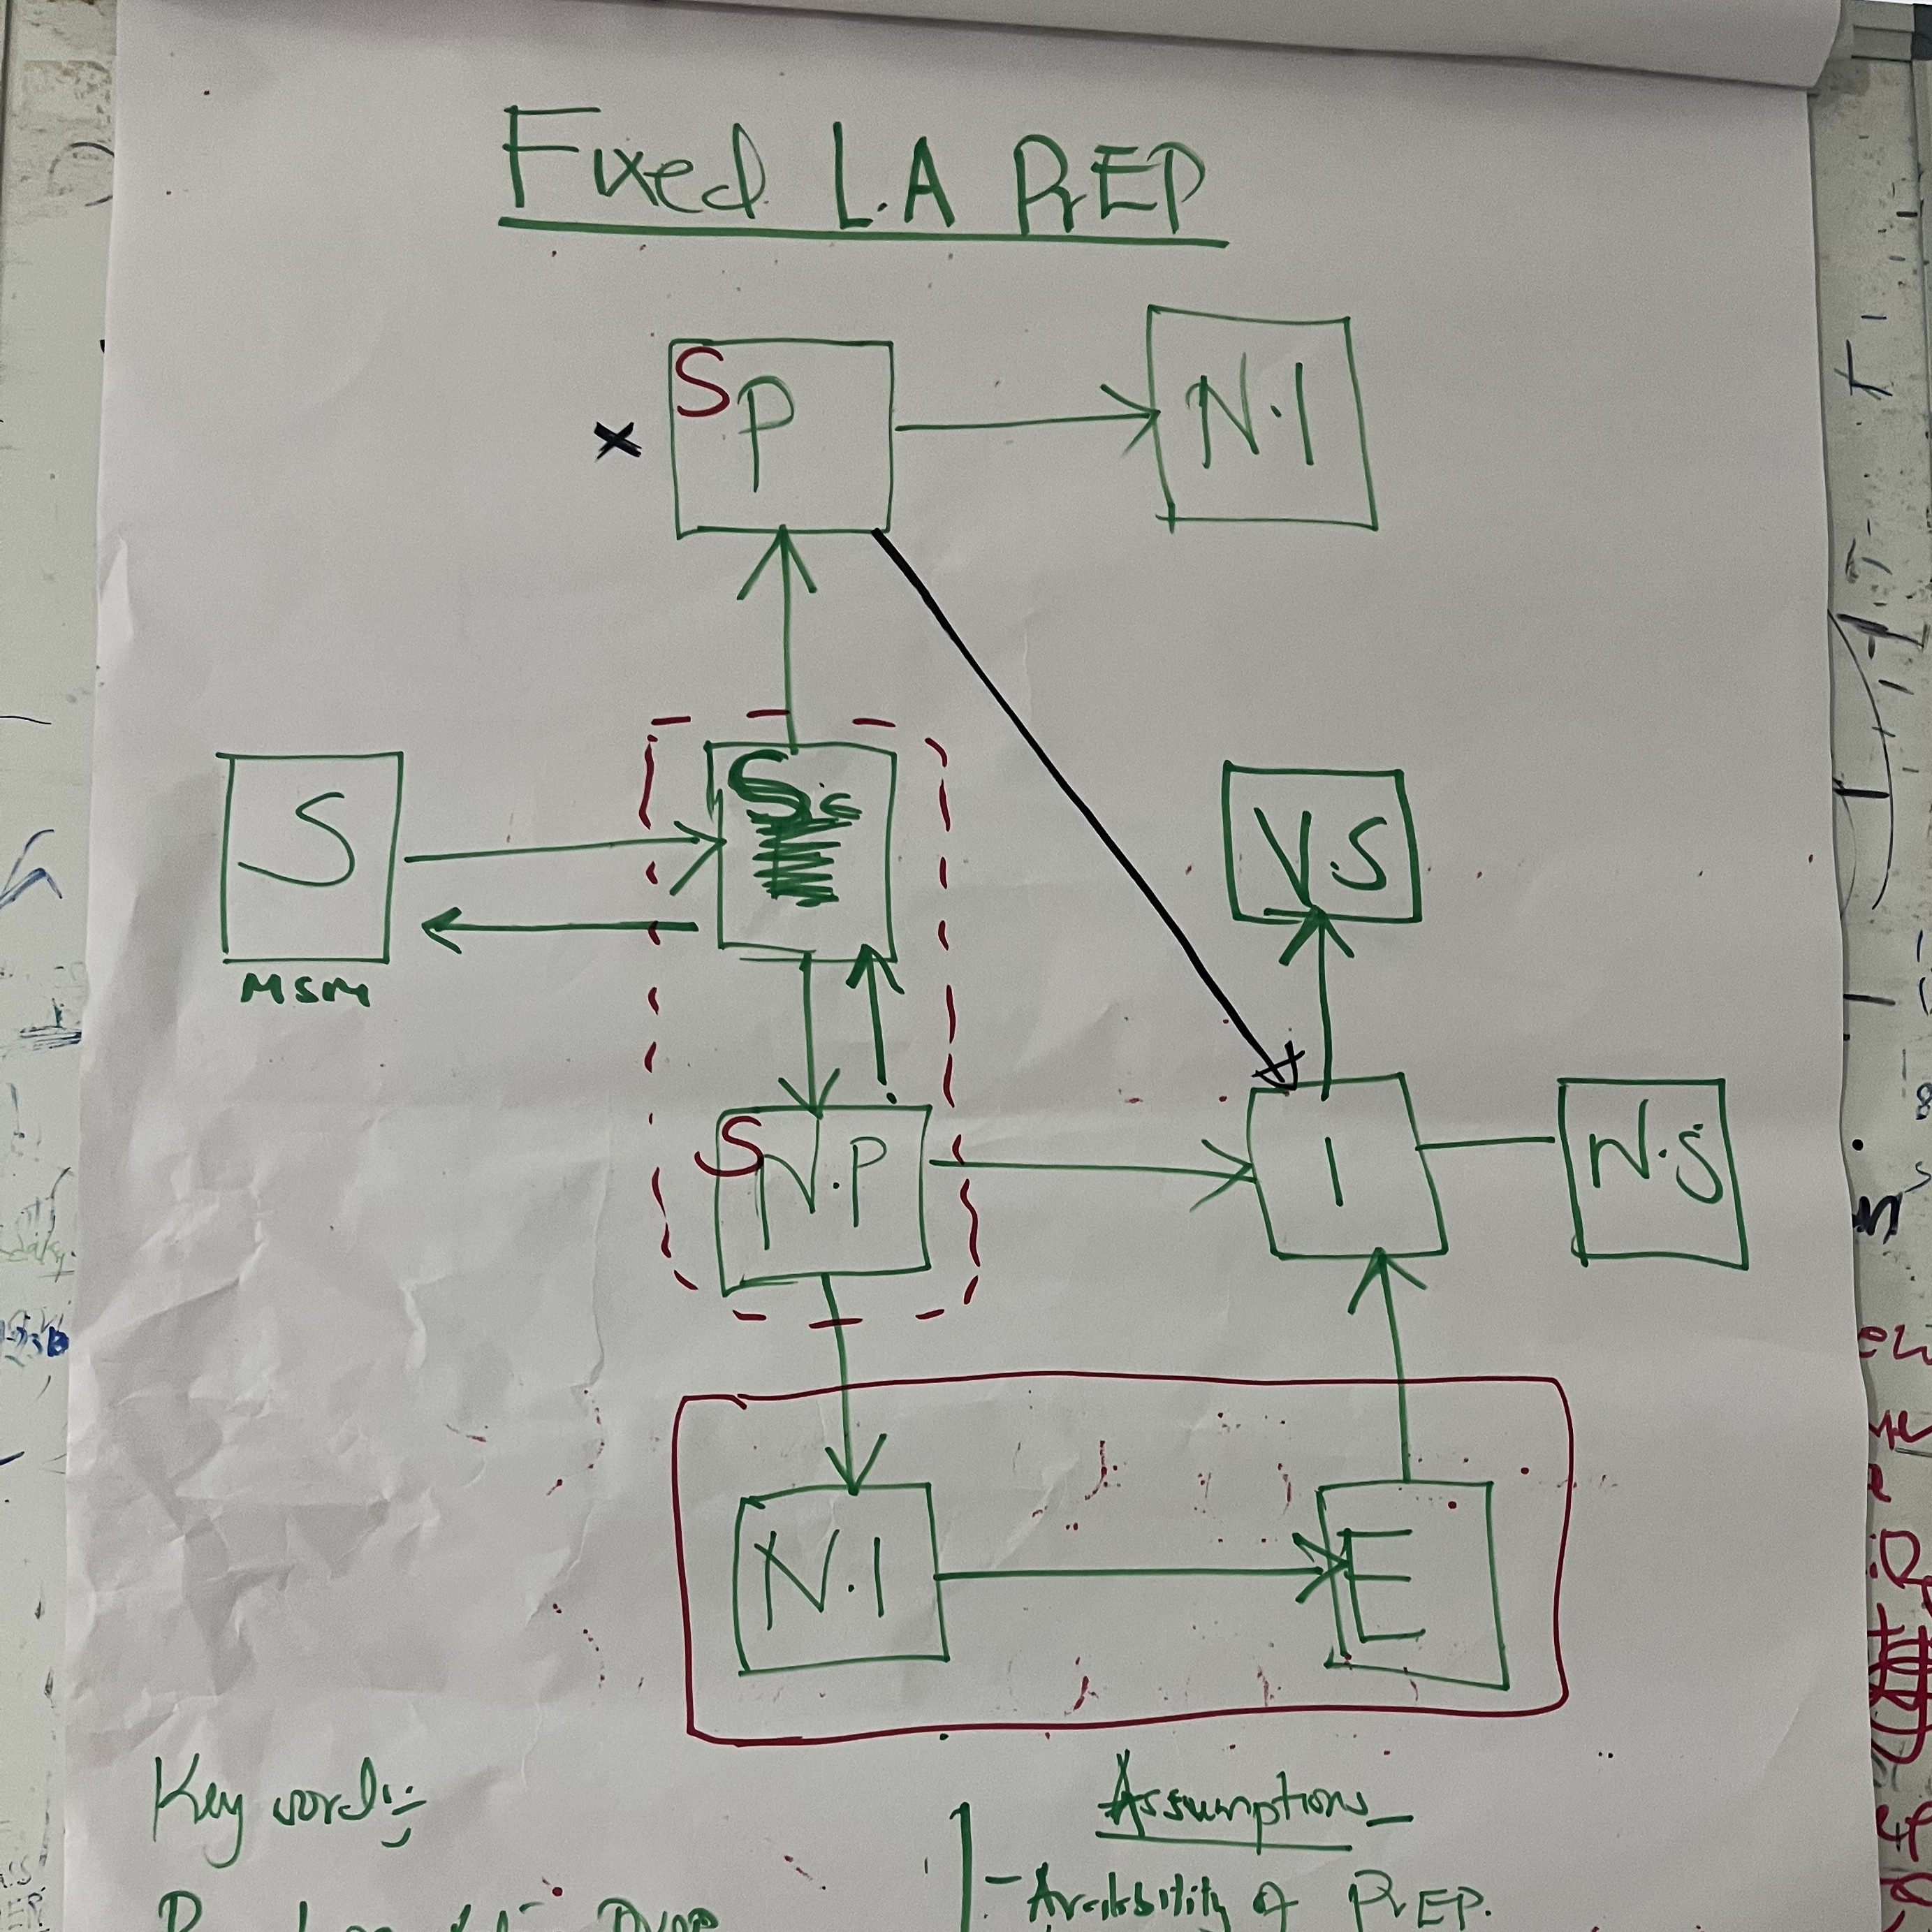
Participatory modelling
“Epidemiology models are used to inform public health interventions and decisions, so it is essential that the people whose lives are impacted by these decisions have ownership over the modelling process.” – Sharmistha
In this participatory modelling project, members of community organisations are co-developing models of how HIV spreads in MSM communities.
“Input from MSM shapes the epidemiology models we are building because, instead of models relying on assumptions from literature and academia, they are based on real lived experiences and knowledge from community members.” – Sharmistha
Co-developing mathematical models of HIV with affected communities.
07 futurumcareers.com

Slide 8
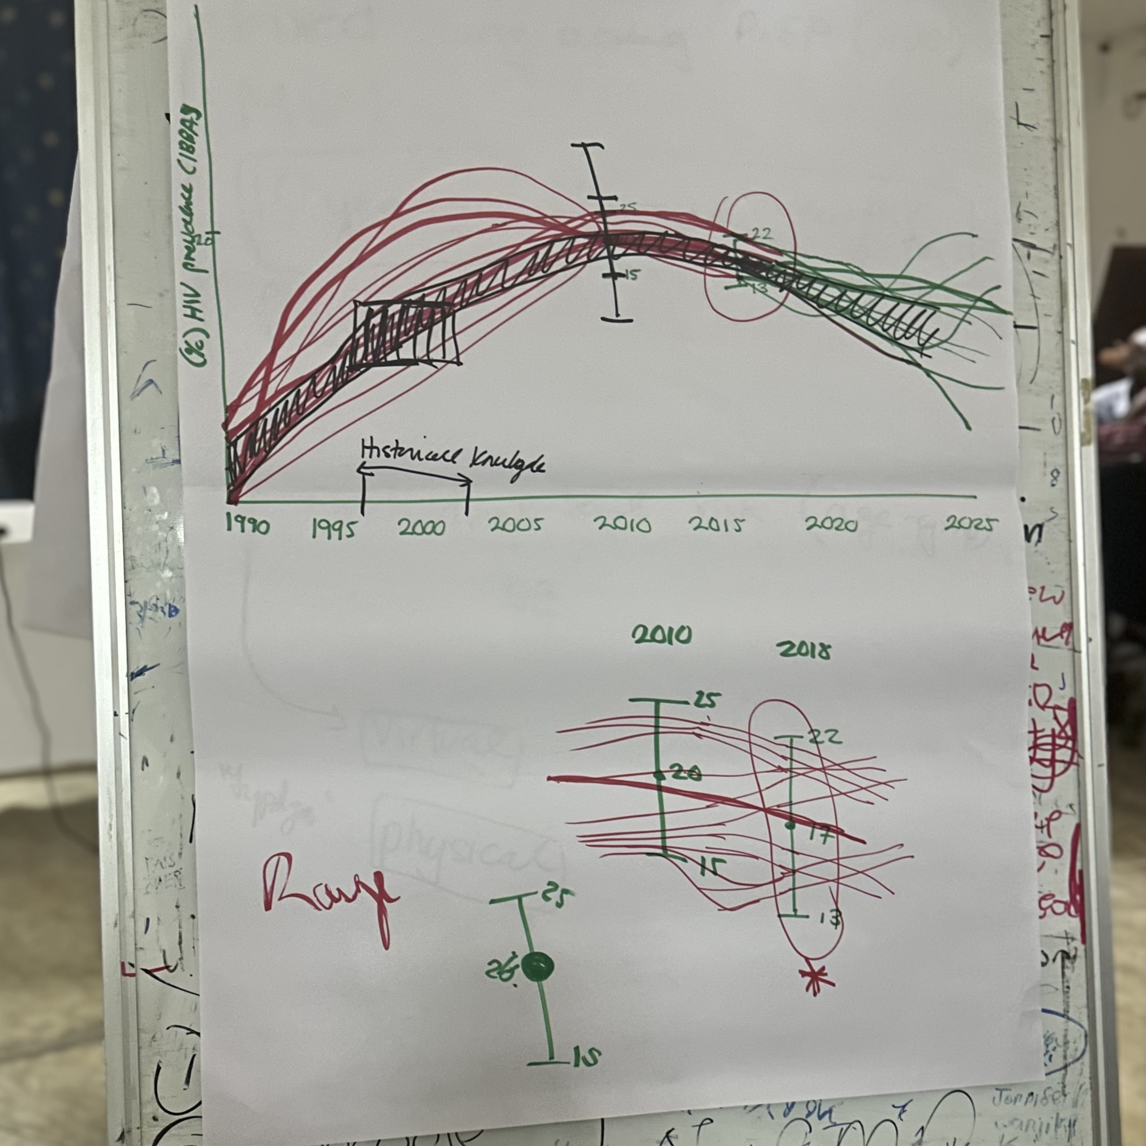
Participatory modelling
“Community researchers are learning how mathematical models are built and how their results can influence HIV services and policy decisions.” – Nancy
This helps community members engage more confidently with science and advocate for better care. It is important that communities who have historically been marginalised, such as MSM, have more knowledge, and therefore more power, to make decisions about their own health.
“We feel empowered to understand data in a professional way and we call ourselves ‘community professors’ with the knowledge and skills we have learnt.” – Jeffrey
Co-developing mathematical models of HIV with affected communities.
08 futurumcareers.com

Slide 9
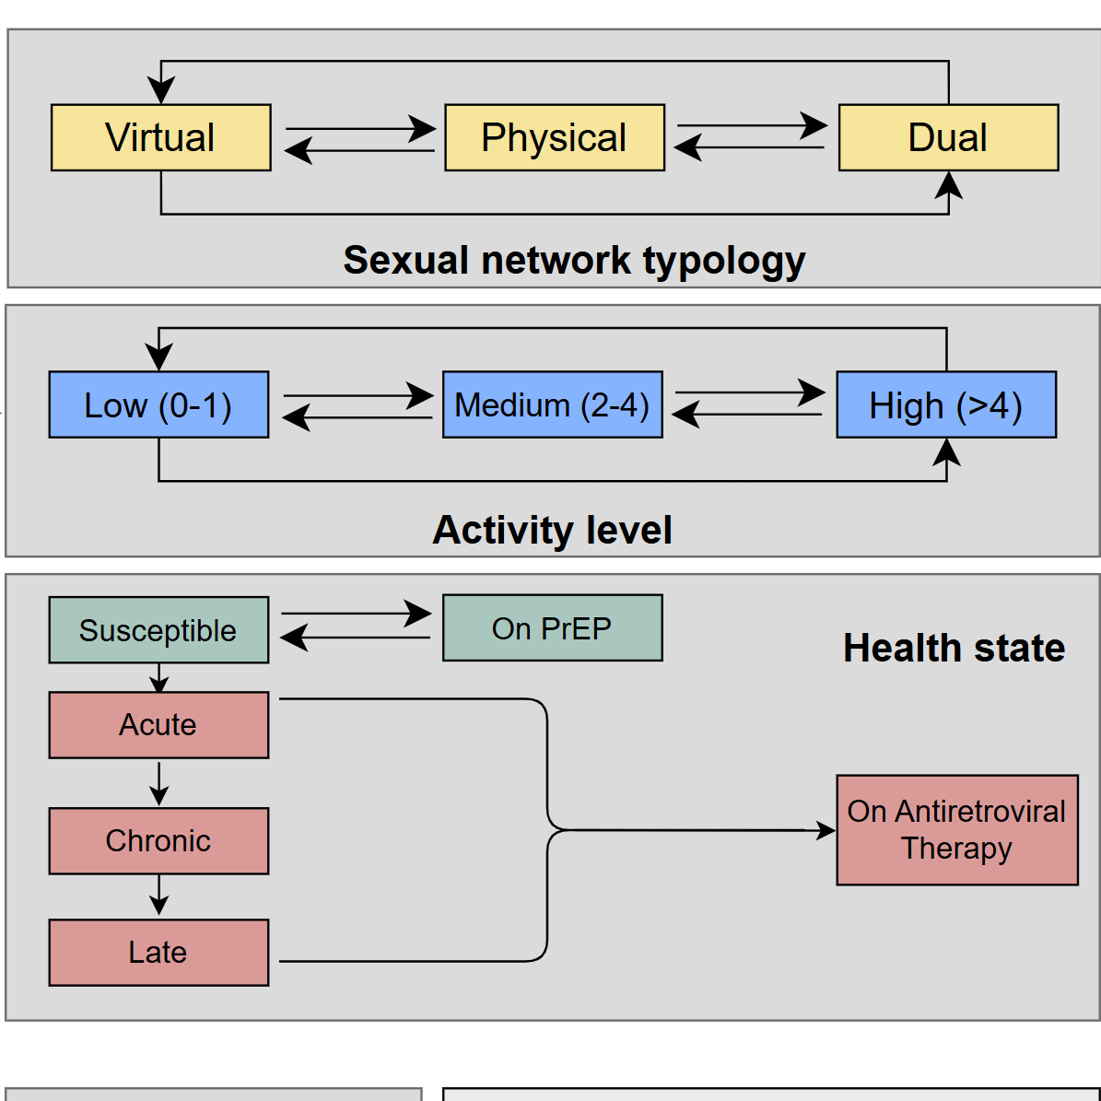
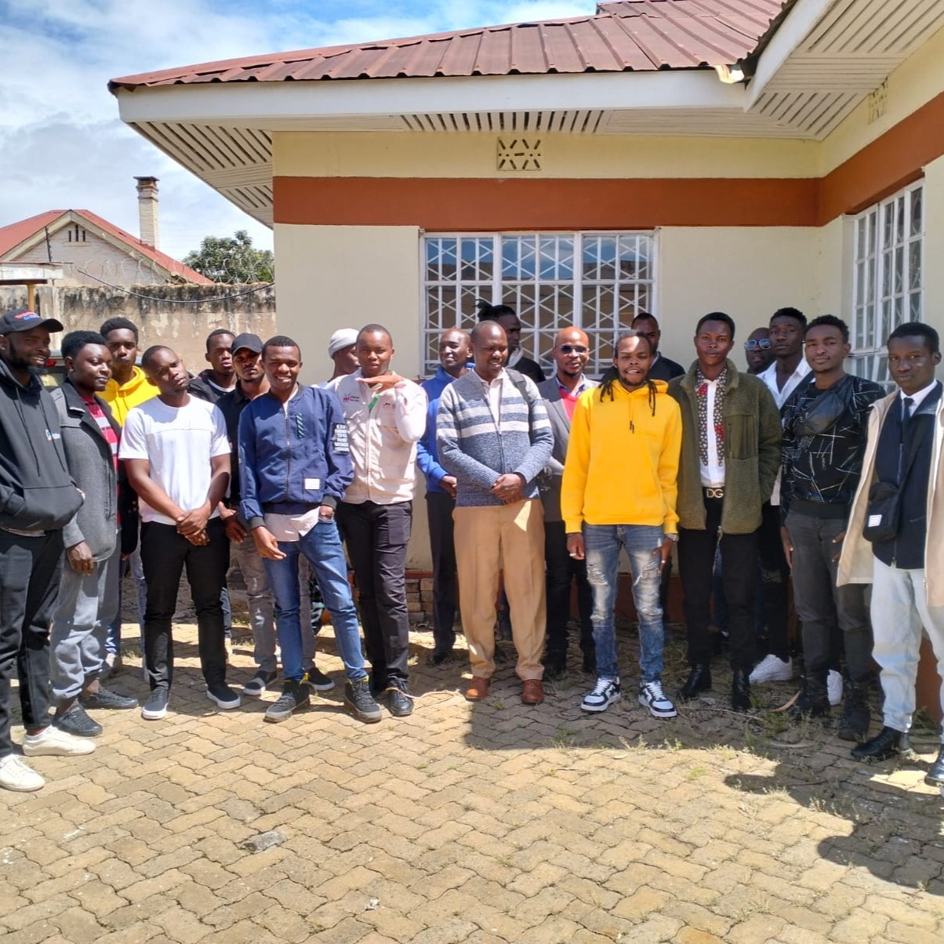
Project successes
During project workshops, community members have learnt about data analysis and mathematical modelling, and they have co-designed an epidemiological model to show how HIV spreads in MSM communities.
“When community voices drive modelling, results are richer and more impactful for advocacy and designing interventions. This participatory modelling process proves that community expertise is essential, and it challenges traditional assumptions about who can contribute to scientific understanding.” – Jeffrey
Part of the team’s mathematical model of HIV.
09 futurumcareers.com

Slide 10
Talking points
What is HIV?
In Kenya, why are MSM disproportionately affected by HIV?
How are mathematical models of diseases improved when they are co-created by affected community members?
How do community members benefit when they co-create mathematical models of diseases?
What do you think will be the most significant impacts of this participatory modelling project?
10 futurumcareers.com

Slide 11

About epidemiology and social sciences
Epidemiology is the study of how infections spread through populations and how they can be prevented or controlled.
When combined with insights from social sciences, epidemiology gains a deeper understanding of human behaviour, community dynamics and the structural factors that shape health outcomes.
This interdisciplinary approach ensures that models and public health interventions are grounded not only in biological and statistical data but also in lived experiences and community knowledge.
11 futurumcareers.com

Slide 12

Pathway from school to epidemiology and social sciences
Epidemiology, mathematical modelling and the social sciences are very broad and interdisciplinary, so almost any educational path could lead you to a career in these fields!
In high school, focus on mathematics, biology, computing, social studies and humanities.
At university, it would be useful to take courses in epidemiology, public health, social sciences, sociology, anthropology or health policy.
12 futurumcareers.com

Slide 13
Pathway from school to epidemiology and social sciences
“Epidemiologists and social scientists need critical thinking skills to question what they observe and critically analyse data, as well as communication skills to explain results. Epidemiologists also need to be able to think logically and creatively to solve problems – board games and escape rooms are great for developing these skills!” – Sharmistha
“Social scientists often work with social theories (which involves a lot of reading) and analyse qualitative data. Writing skills are also incredibly important.” – Lisa
13 futurumcareers.com

Slide 14
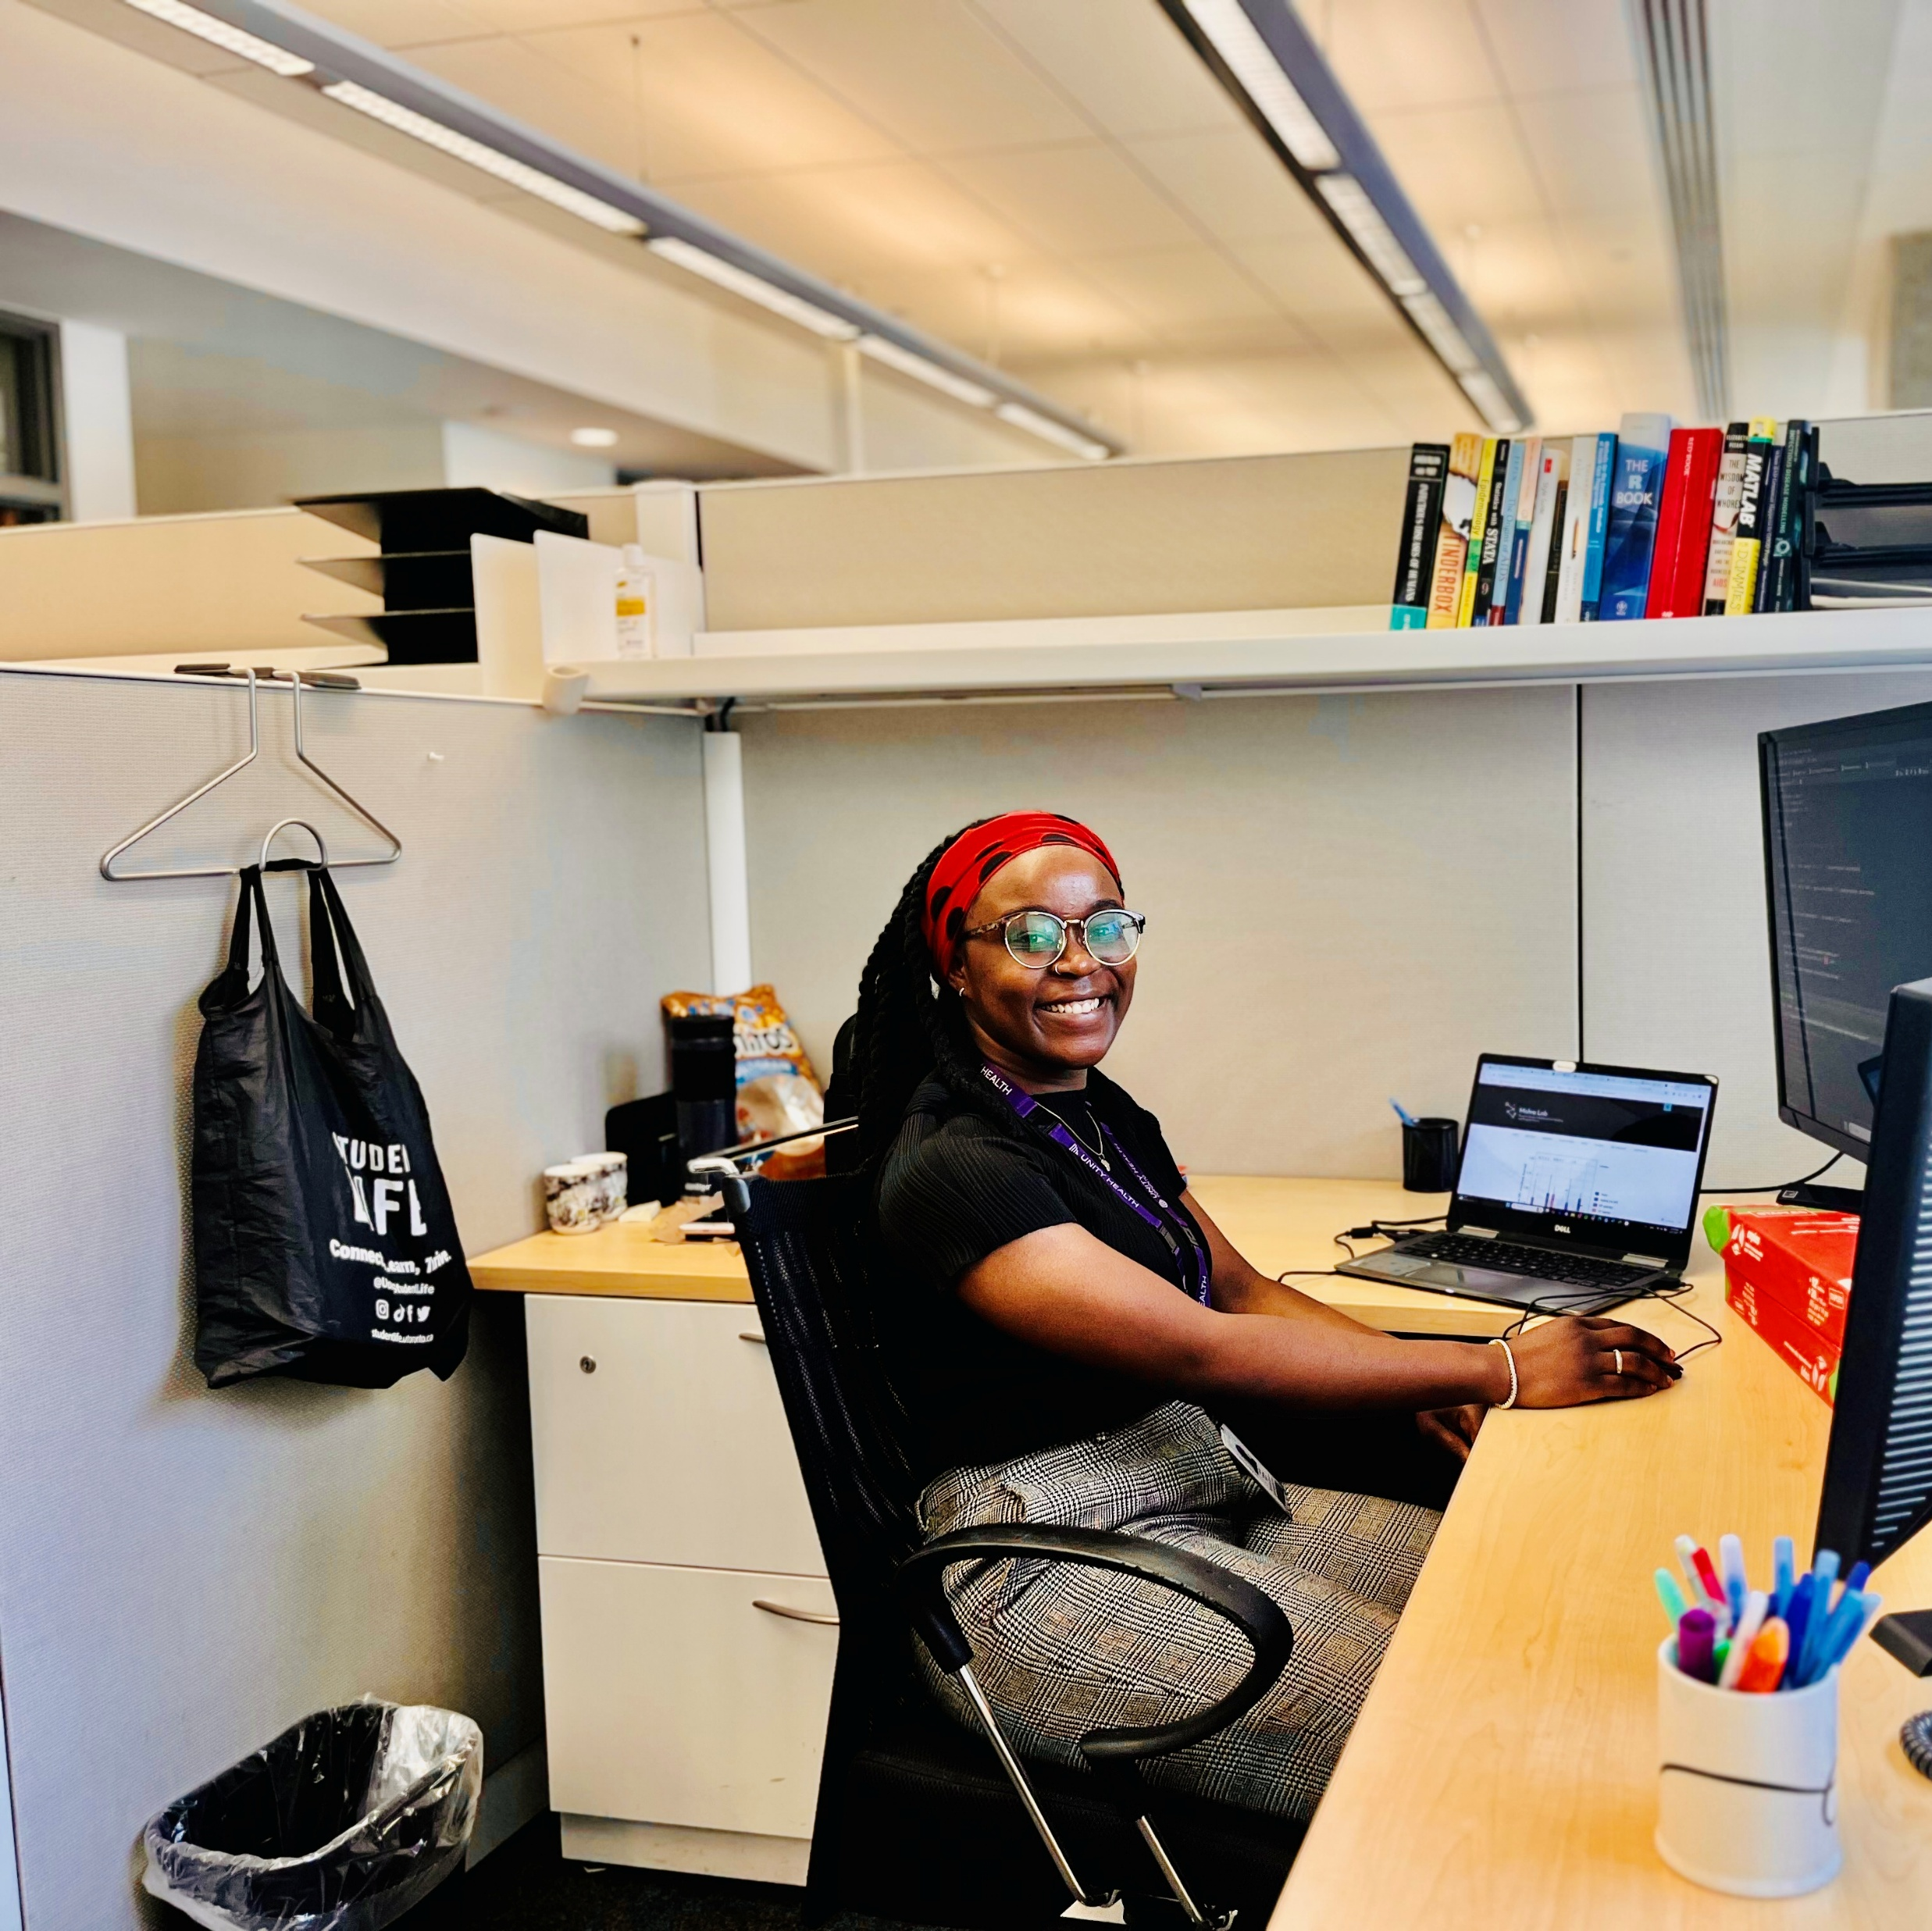
Pathway from school to epidemiology and social sciences
“If you’re interested in epidemiology or modelling, remember that numbers only make sense in context. Take every opportunity to connect with communities, because understanding the realities behind the data will make you a far stronger scientist.” – Nancy
“Volunteer with community-based organisations to build relationships and learn about community needs. Come in ready to listen to what people are telling you about their own needs, and partner in ways that support community-identified approaches.” – Lisa
Nancy at work at the University of Toronto.
14 futurumcareers.com

Slide 15
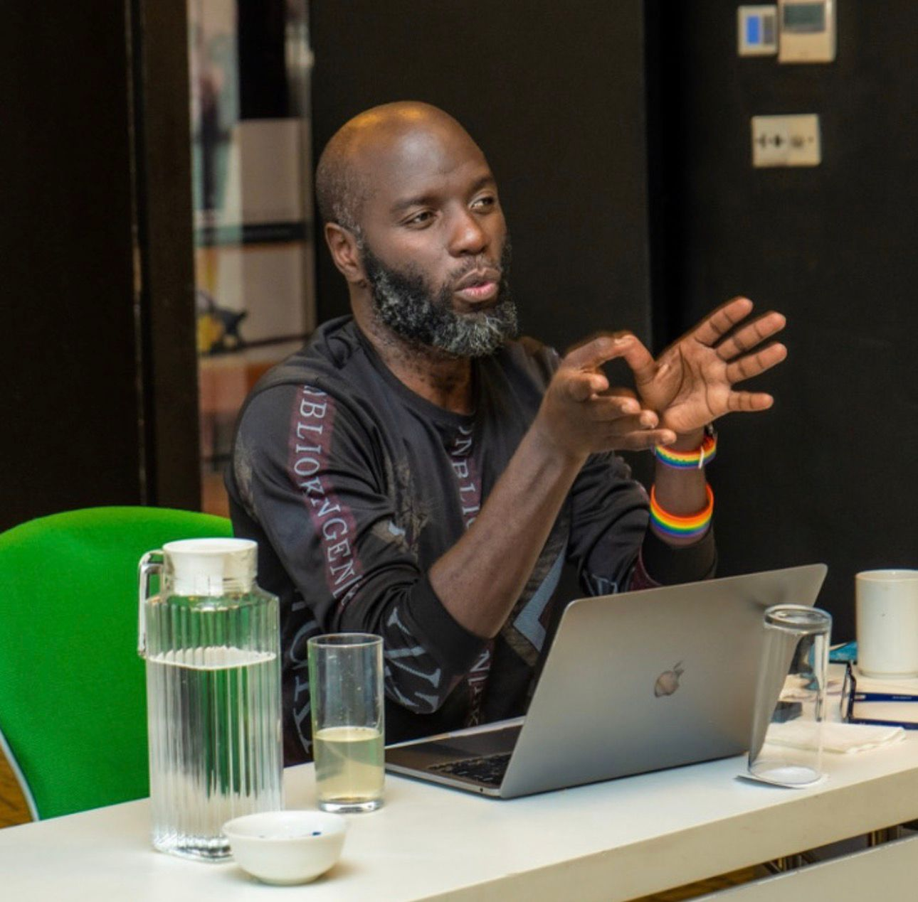
Explore careers in epidemiology and social sciences
“Epidemiologists critically examine data and try to explain what is going on. Social epidemiologists use epidemiology principles and tools to understand and address inequalities, not just in health but in any sector of society.” – Sharmistha
“Social sciences is not a single field, so there are endless career possibilities, depending on your interests.” – Lisa
Explore the learning resources, training opportunities and career insights from organisations such as the World Health Organization and UNAIDS.
Jefrey talks at a community training workshop.
15 futurumcareers.com

Slide 16
Talking points
Why is it important to combine epidemiology with insights from social sciences?
What skills do you currently have that could help you in a career in epidemiology or social sciences? How could you develop any skills you do not yet have?
How could you find opportunities to connect with community-based organisations? What do you think you would gain from these experiences?
If you were an epidemiologist or social scientist, what health-related issue would you want to address, and why?
16 futurumcareers.com

Slide 17
Meet Sharmistha
I was inspired to become an epidemiologist after listening to a talk about HIV in India at the end of my clinical training.
As an infectious diseases doctor, I spend my days seeing patients, listening to their stories, and trying to diagnose and treat their conditions.
As a mathematical modeller and epidemiologist, a typical day involves problem-solving by drawing diagrams of mechanisms and writing or debugging code to run epidemiology models.
17 futurumcareers.com

Slide 18
Meet Jeffrey
For me, research is never just about the data – it’s about the people behind the data.
I believe that communities are the experts in their own lives. For too long, research on gay men has been done to communities, not with them.
I am passionate about community-based participatory research because it centres the voices and expertise of those affected by the issues being studied. It is empowering to see how co-developing mathematical models of HIV fosters a sense of ownership among MSM as they take an active role in shaping the models.
18 futurumcareers.com

Slide 19
Meet Nancy
I wanted to be a doctor, so I studied science subjects at school and took the medical entrance examination in Cameroon. But I failed.
I studied biochemistry at university instead, where I found my true calling in infectious disease prevention and control. In hindsight, my interests have matured in a beautiful way because of that failure.
I have always wanted to bring hope to people, because I believe keeping hope alive helps people stay motivated and thrive. This led me toward community health, as I understood first-hand the vicious cycle of poor health and well-being.
19 futurumcareers.com

Slide 20
Meet Lisa
I started my professional career as a social worker at a hospital-based clinic in Montreal, working with people living with HIV. While I loved my job, I became interested in the recurring systemic issues within the healthcare system.
Community-based research allows me to address systemic health issues while collaborating with community members who have lived experiences of interacting with healthcare systems.
There are lots of avenues in public health research, so reach out to people who do work that interests you.
20 futurumcareers.com

Slide 21
Talking points
What career in epidemiology or social sciences most interests you, and why?
How do you think Sharmistha, Jeffrey, Nancy and Lisa’s backgrounds and past experiences have inspired their current project of co-creating mathematical models of HIV with affected communities?
Why is it so important that research about communities is done with those communities?
21 futurumcareers.com

Slide 22

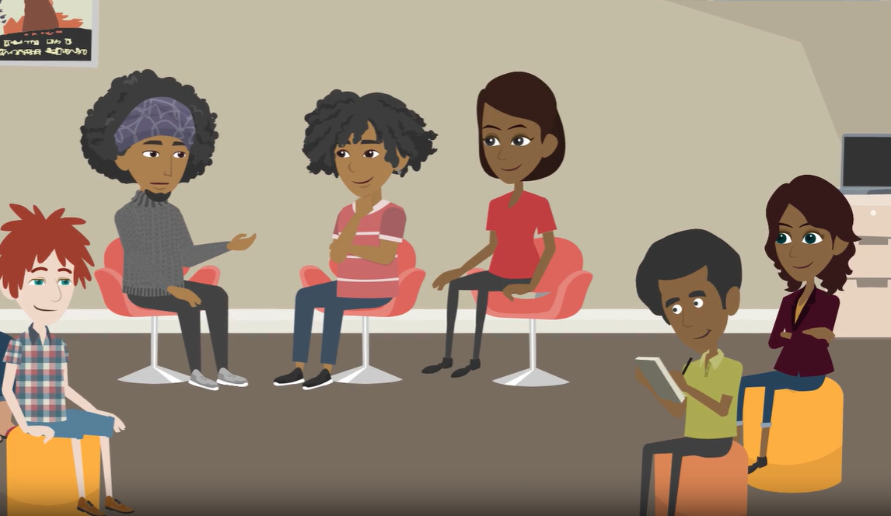
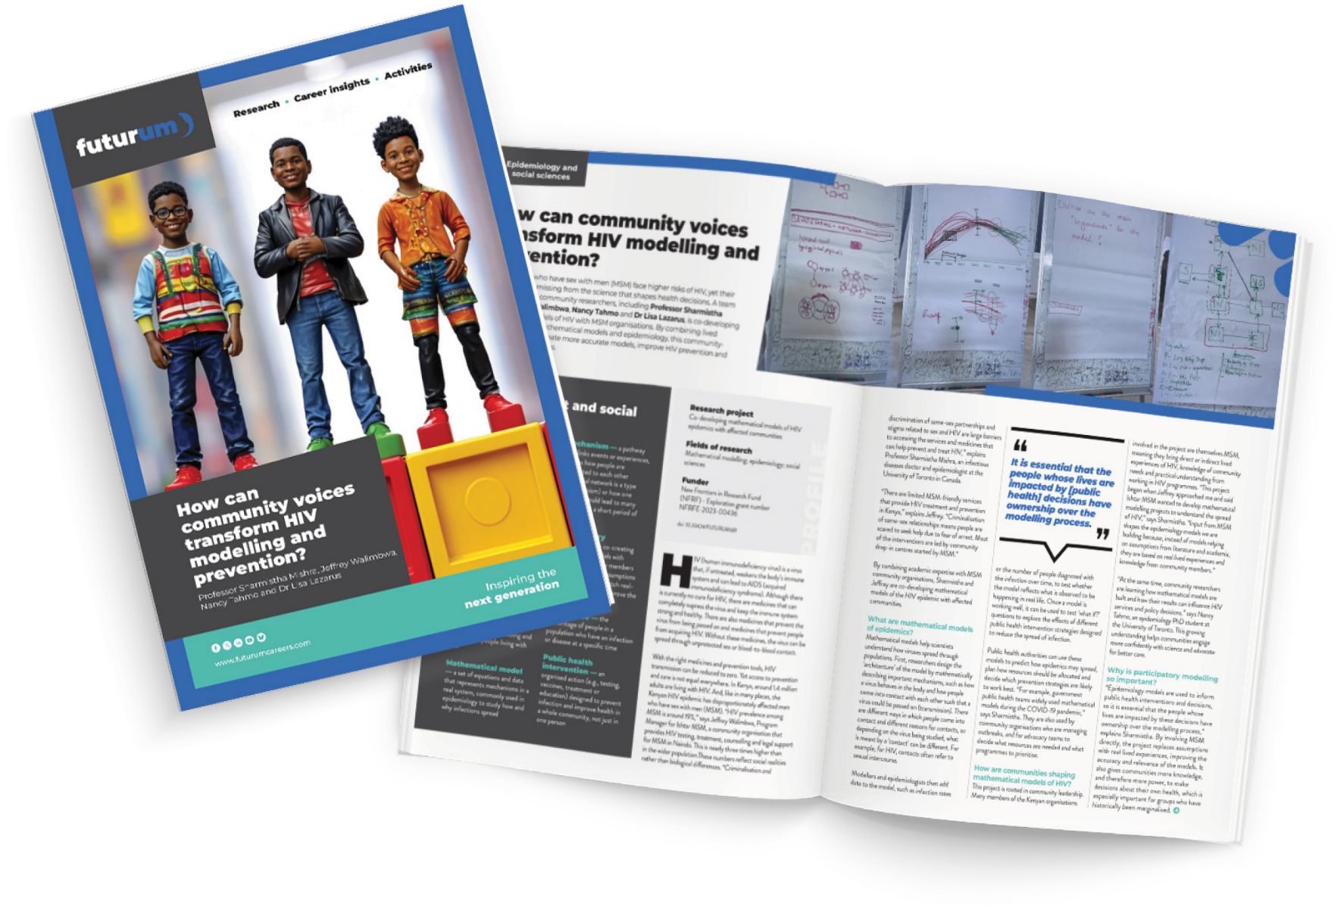
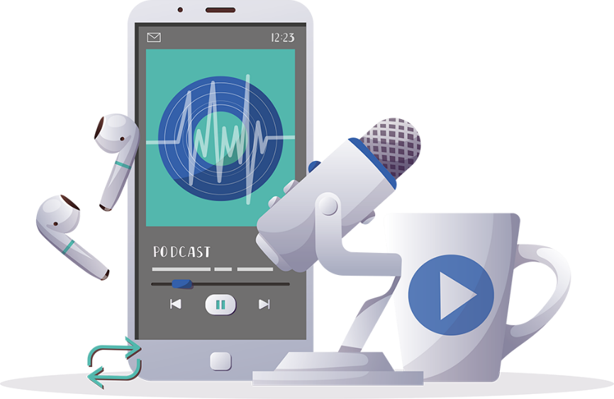
More resources
Read the article
Complete the activities
Read the article in Swahili, French and Spanish
Watch the animation
Listen to the podcast
22 futurumcareers.com

