Slide 1
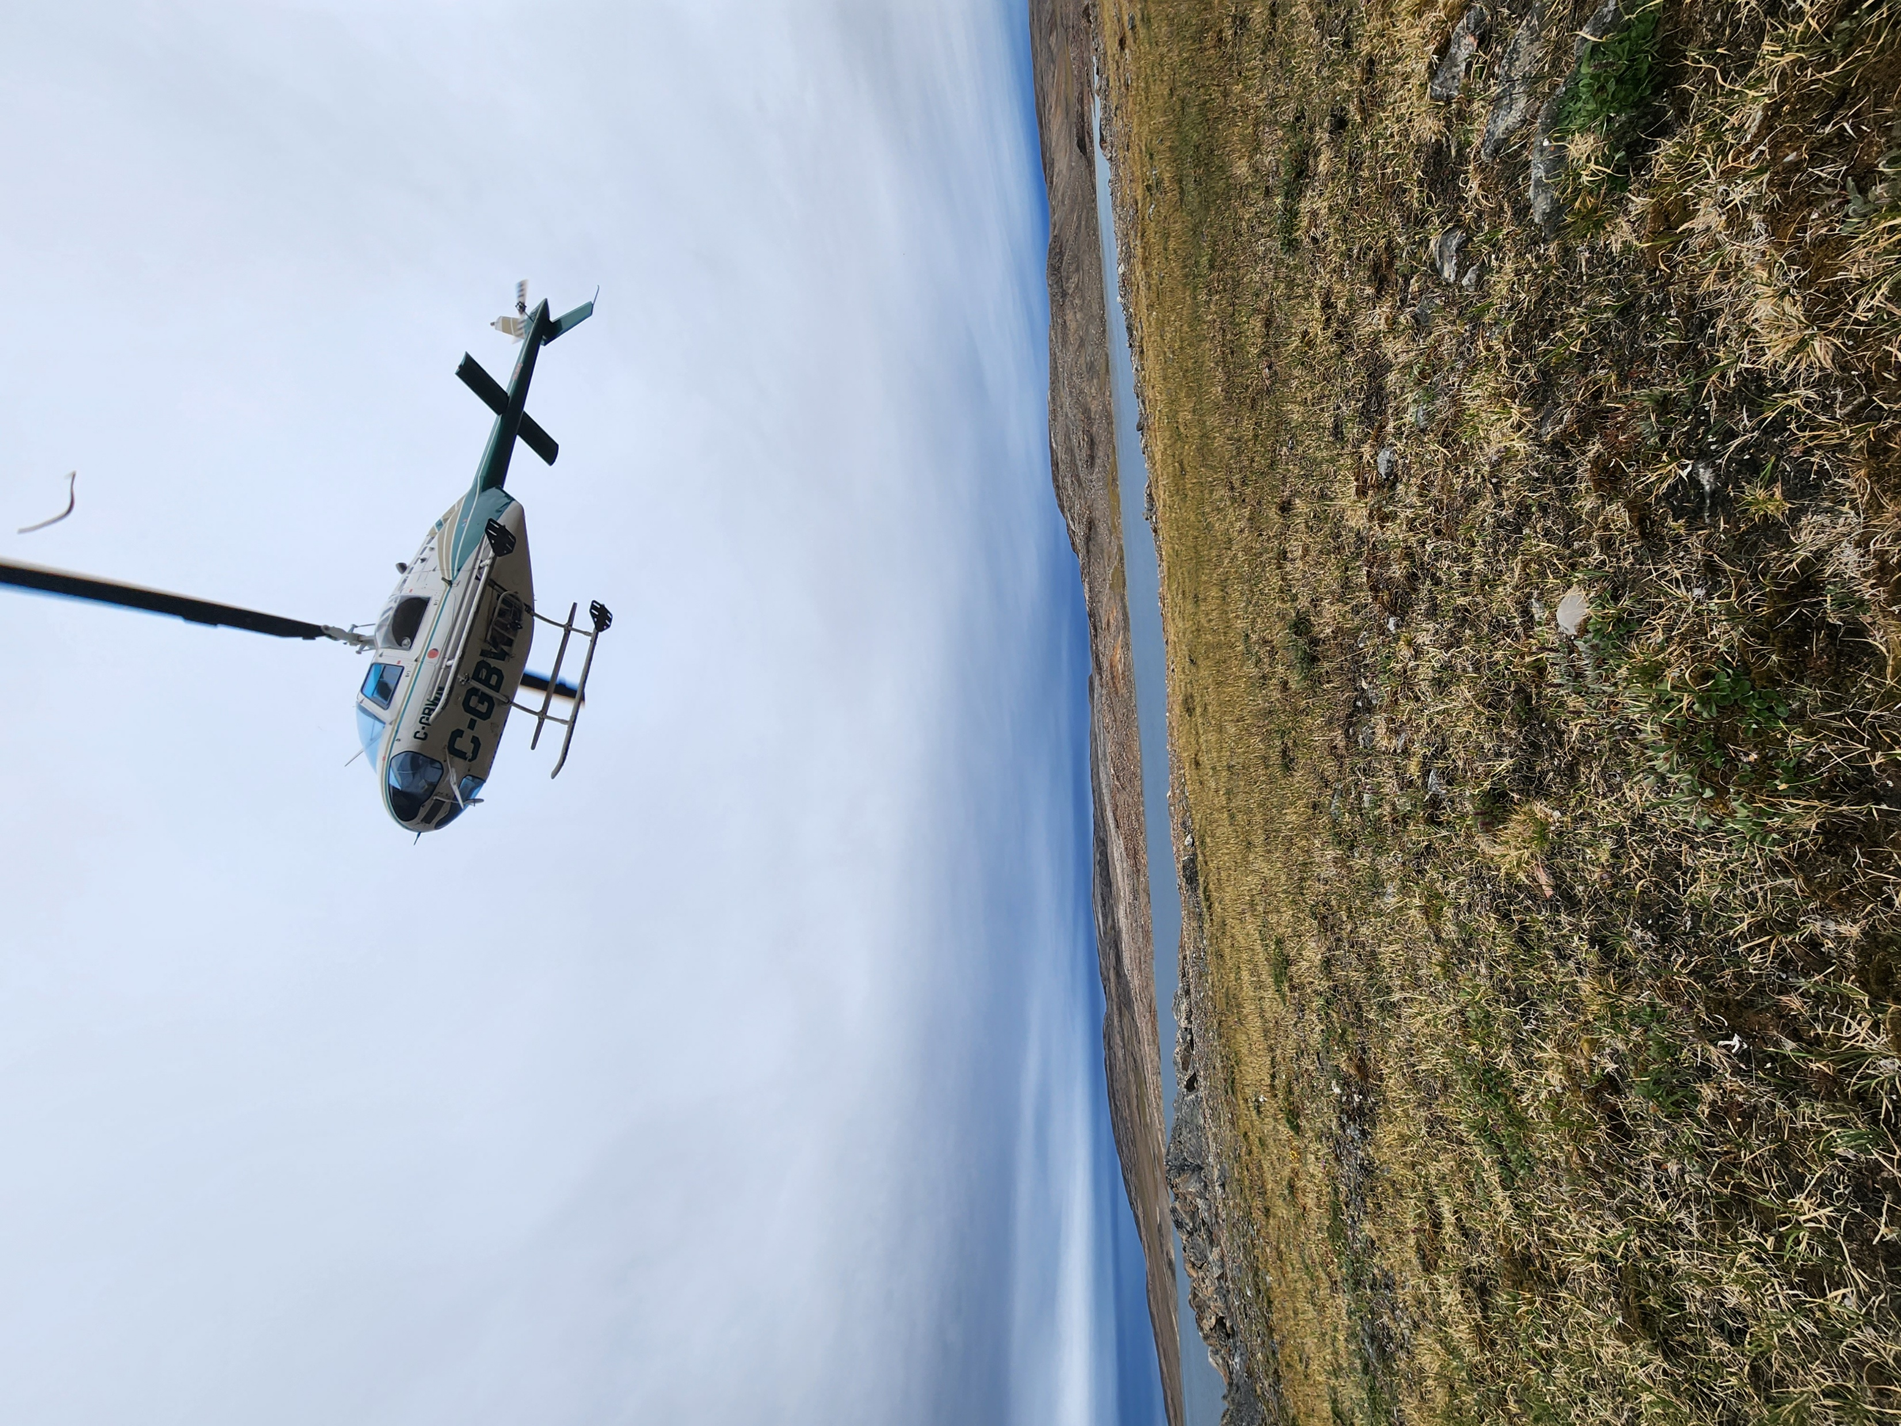

Geology
with
Dr James Mungall, Samuel Robb
and Karim El Ghawi
© James Mungall

Slide 2

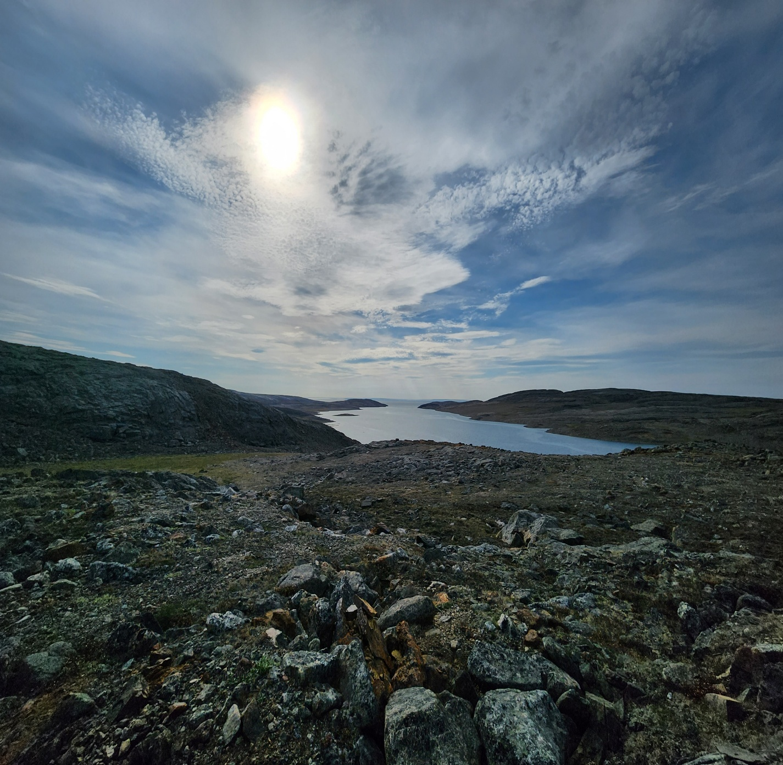

In this presentation
Meet the team
Mineral exploration: future-proofing the availability of essential metals
Talking points
About geology
Meet Samuel
Meet James
Talking points
Meet Karim
Pathway from school to geology
Explore careers in geology
Talking points
© James Mungall
02 futurumcareers.com

Slide 3
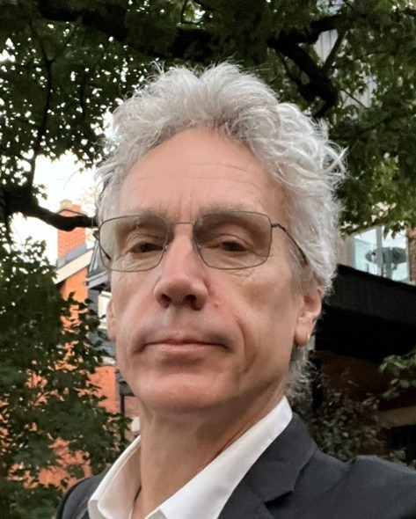
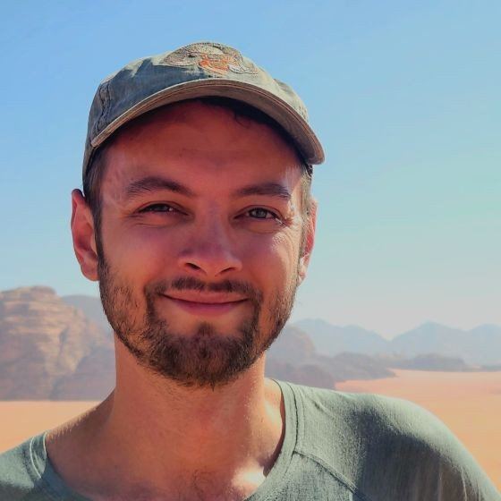
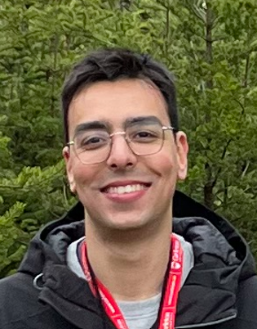

Meet the team
Dr James Mungall
Samuel Robb
Karim El Ghawi
Director and Vice President,
Bronzite Exploration
Chairman and President,
Bronzite Exploration;
Professor, Department of Earth Sciences, Carleton University
PhD student,
Department of Earth Sciences,
Carleton University, Canada
03 futurumcareers.com

Slide 4
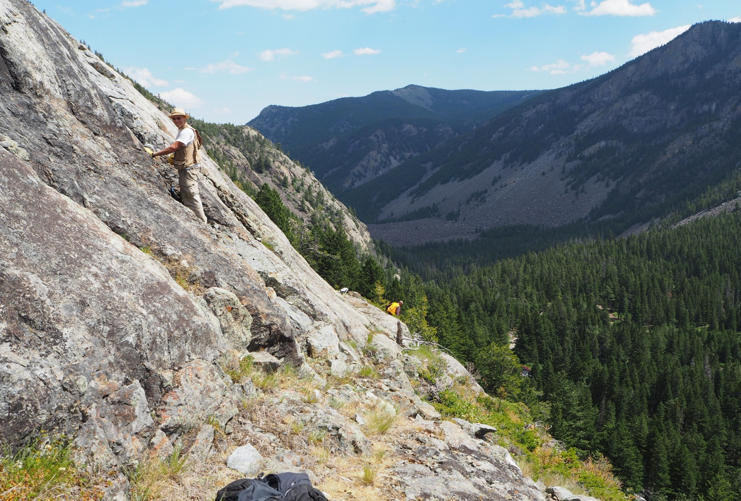
Mineral exploration:
future-proofing the availability of essential metals
Metals such as copper are not often talked about, but they are essential for many electrical items that we use every day. With the rapid rise in our technology use, these metals are becoming increasingly sought after.
James, Samuel and Karim are exploring unique locations and using remote sensing tools and laboratory techniques to discover potential new copper mining sites, and new ways of deciding which rocks may be useful for copper extraction.
© James Mungall
04 futurumcareers.com

Slide 5
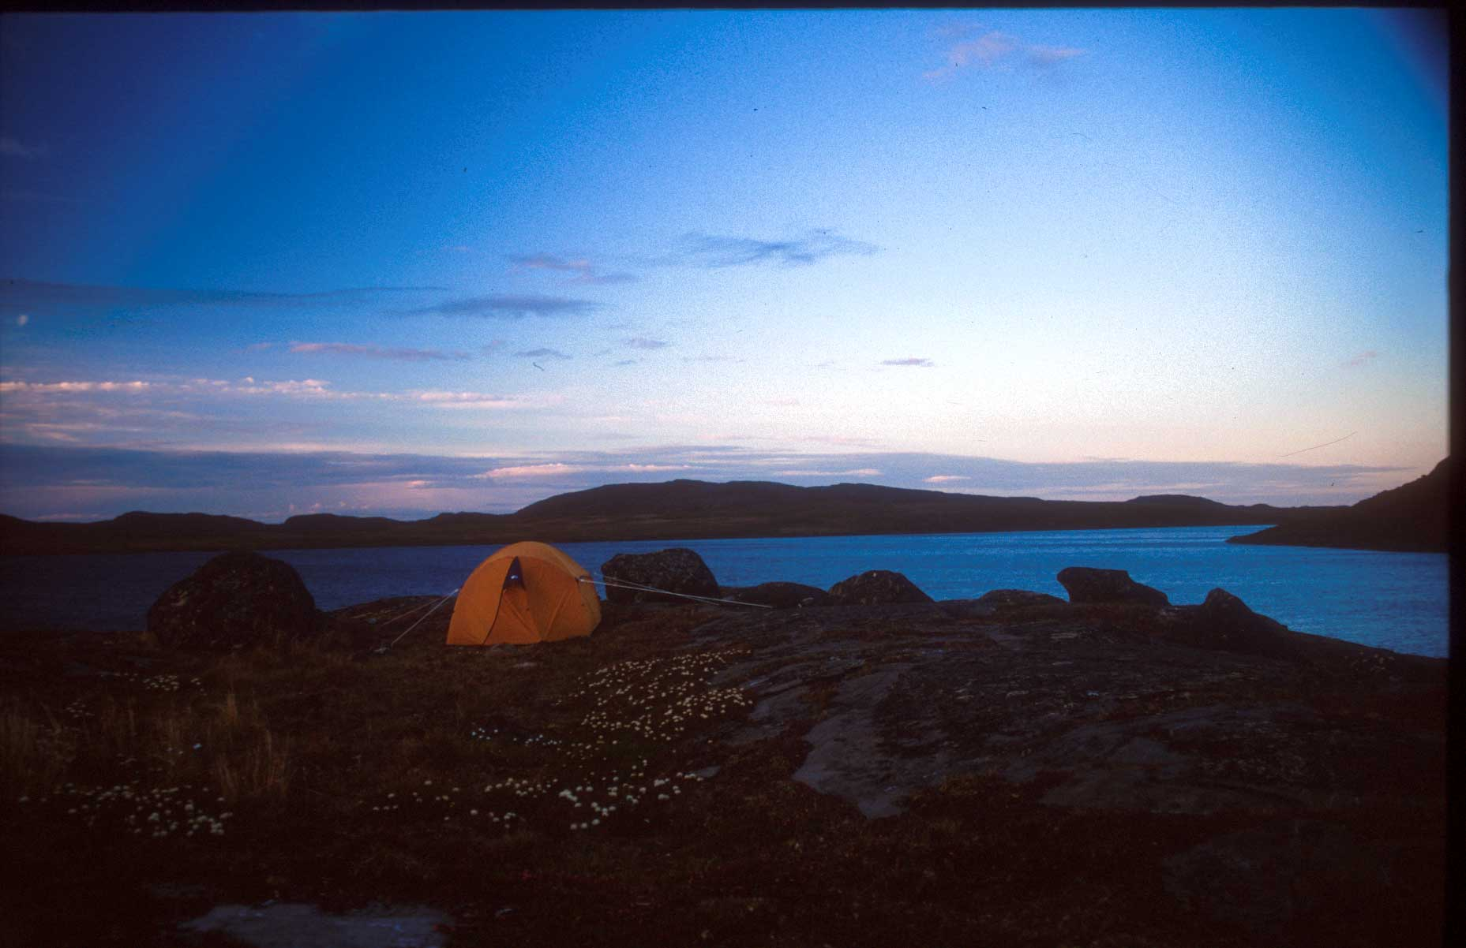
Mineral exploration
At some point today, you have probably used a mobile phone. That mobile phone, and the household wiring that allows you to charge it every night, contains copper – a metal mined from rocks.
James and Samuel set up Bronzite Exploration to identify new mining locations from which to extract metals and minerals.
“Overall, metal demand is expected to double by 2060, so the competition to find metals is going to be intense. This is a growing industry with huge career potential for decades to come.” – Samuel
© James Mungall
05 futurumcareers.com

Slide 6
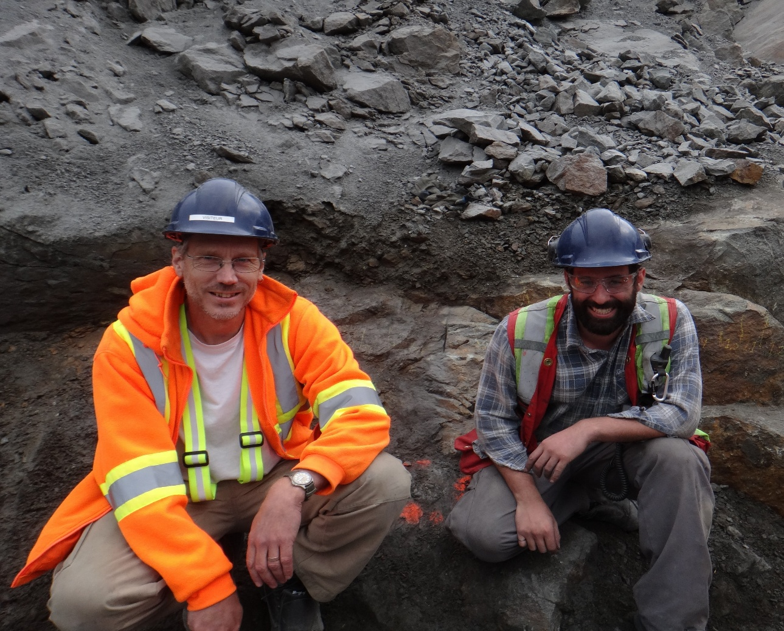
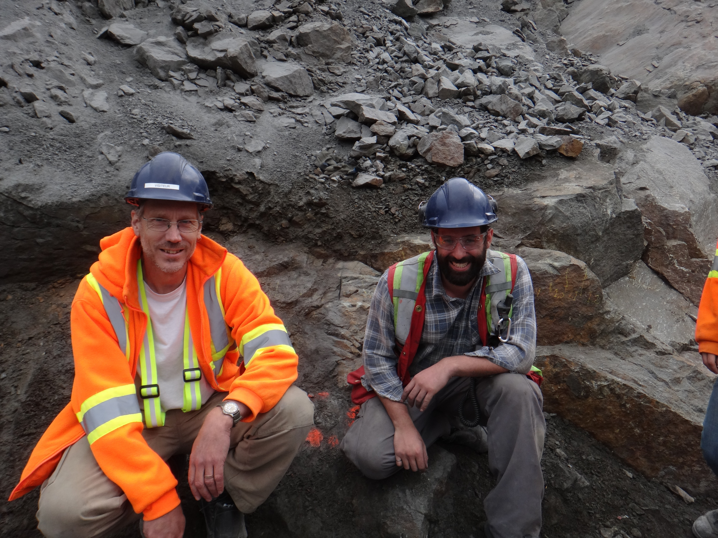

Copper in the Canadian Arctic
Bronzite Exploration’s leading project, the Somerset Trough Project, is based in Nunavut, which is the northernmost and biggest territory of Canada. Here, James and Samuel are investigating signs of copper, zinc and silver mineralisation.
On rare occasions, pure copper can form naturally in rocks. However, most of the world’s copper comes from copper minerals, which contain copper mixed with other elements, such as sulphur. These minerals are processed to extract the pure metal.
© James Mungall
“We need to broaden our view of what can be considered to be a metal ore. In the future, we can expect to find ourselves increasingly dependent on mining rocks currently regarded as subeconomic or merely as common rock.” – Karim
06 futurumcareers.com

Slide 7
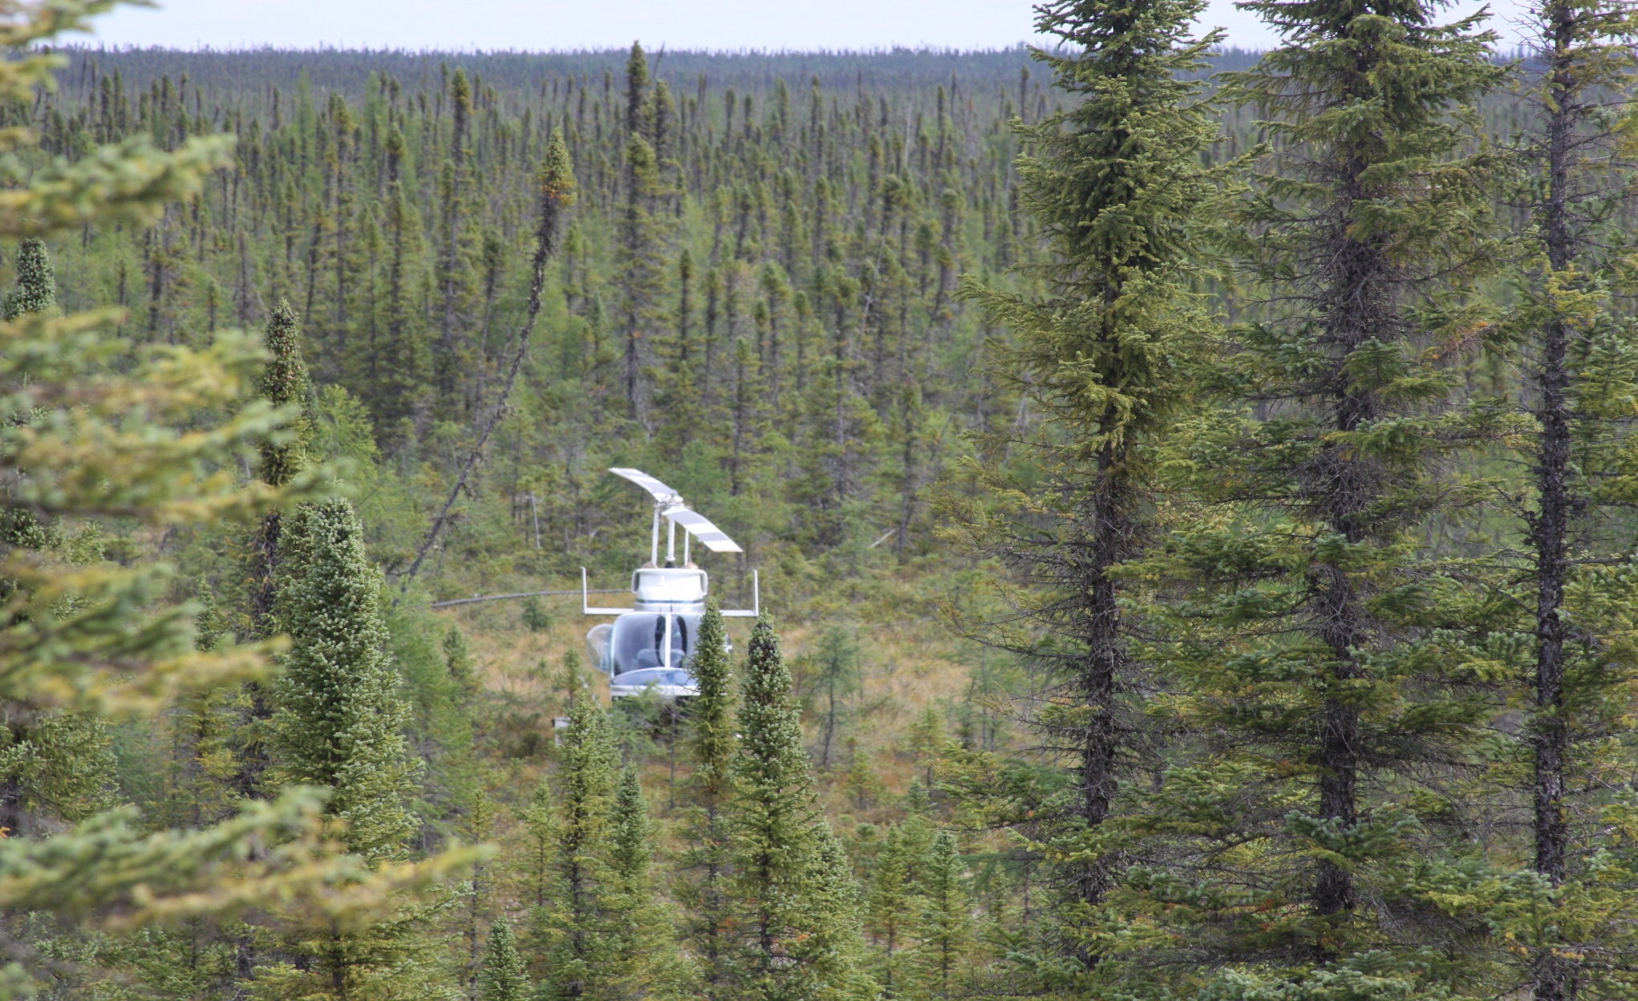
The techniques of mineral exploration
“We use remote sensing tools to collect detailed information about the Earth’s surface and what lies under the ground. Aircraft fly back and forth over the land, towing instruments through the air to collect data, such as the strength of the magnetic field and the gravitational field, or to detect the presence of electrical conductors under the ground.” – James
The team uses this geophysical data to make images that overlay satellite images and field observations, making a detailed map of the subsurface geology.
James and Samuel plan to carefully go through all the data they have collated, drill for samples, make 3D models of the subsurface geology and determine metal concentrations. They will model the economic feasibility of a mining operation and then seek permission to develop a mine.
© James Mungall
07 futurumcareers.com

Slide 8

Talking points
Why are metals, such as copper, increasingly sought after?
Why did James and Samuel set up Bronzite Exploration? What is their aim?
What does most of the world’s copper come from?
Why does Karim believe it is important to “broaden our view of what can be considered to be a metal ore”?
What are some of the techniques that James and Samuel use? What do these techniques help them do?
08 futurumcareers.com
© James Mungall

Slide 9
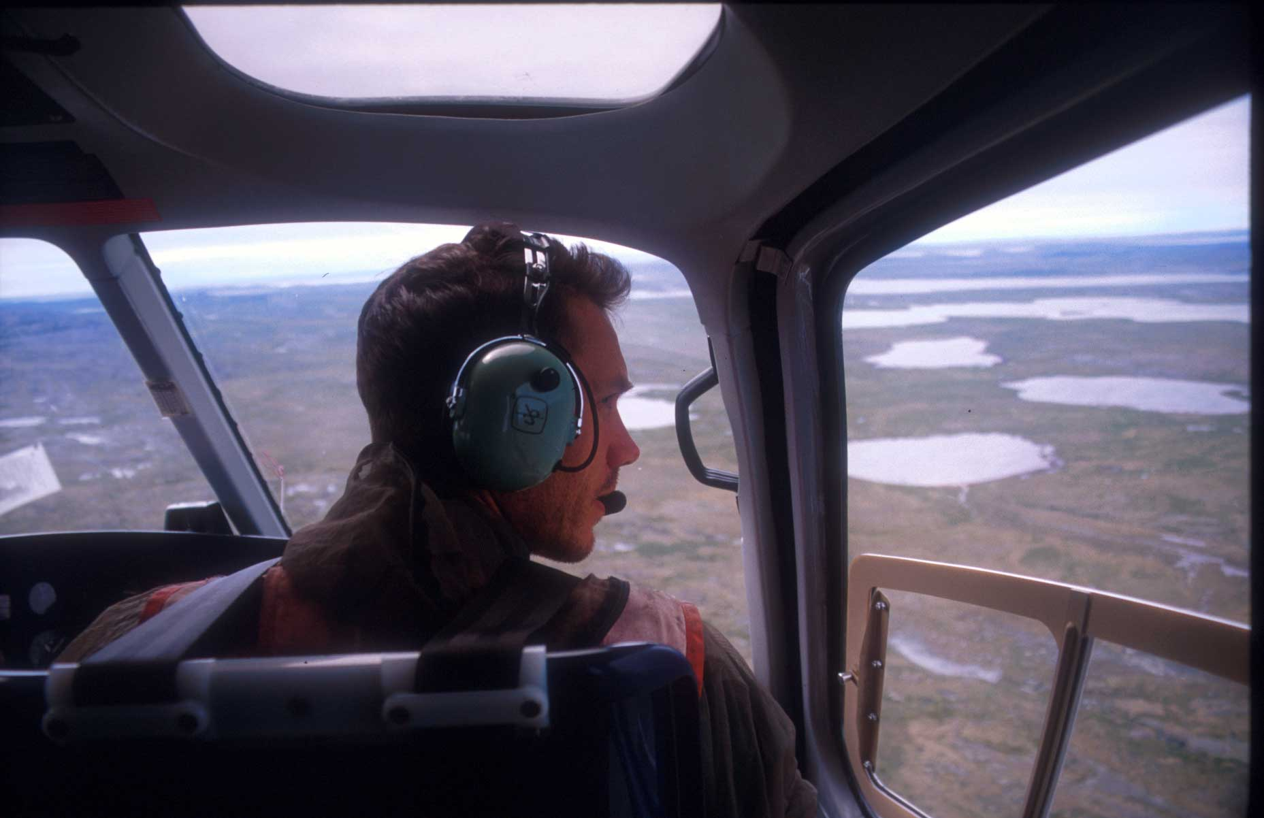
About geology
Geology is the science of understanding the planet we live on – studying rocks and mountains, volcanoes and earthquakes, and minerals and metals.
Geologists work to solve real-world problems, such as finding clean water, protecting the environment and building safe cities.
With an increasing urgency for the vast amounts of metals we need for our modern way of living, geology research is becoming increasingly valued.
© James Mungall
“Research in geology is fun and interesting because it combines all of the sciences and offers opportunities to travel the world. I’ve worked in laboratories, climbed mountains and crossed tundra and forests, and developed computer models…” – James
09 futurumcareers.com

Slide 10
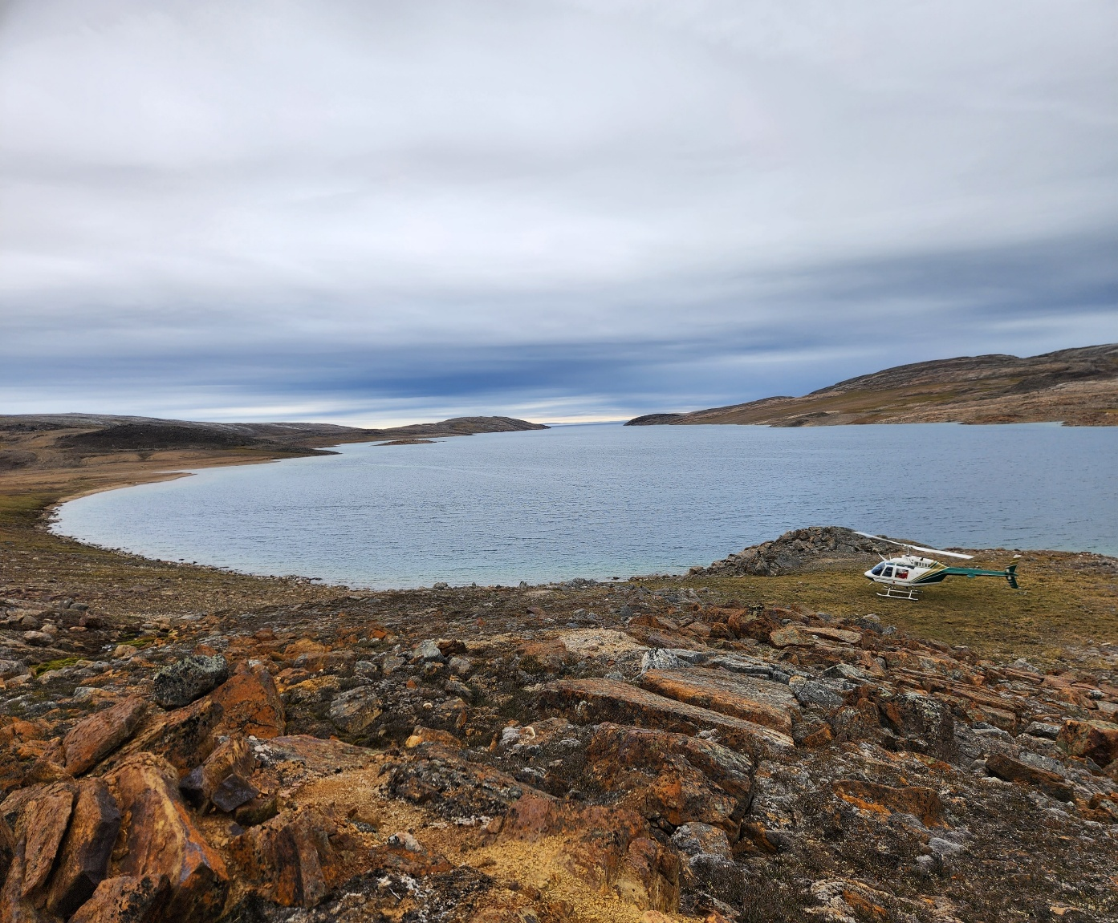
Protecting a sensitive environment
Working in remote locations is fascinating – but it can also be challenging.
The Canadian Arctic is home to fragile ecosystems including wildlife, glaciers and freshwater lakes. Digging can release greenhouse gases, and cold temperatures mean recovery from any environmental damage can take longer than in other areas.
To ensure their work is environmentally sustainable, James and Samuel study requirements for working in the region carefully and submit proposals for their work which are reviewed by experts and through community consultation.
© James Mungall
“We do our best to make sure local communities are informed about the exploration we are conducting.” – Samuel
10 futurumcareers.com

Slide 11
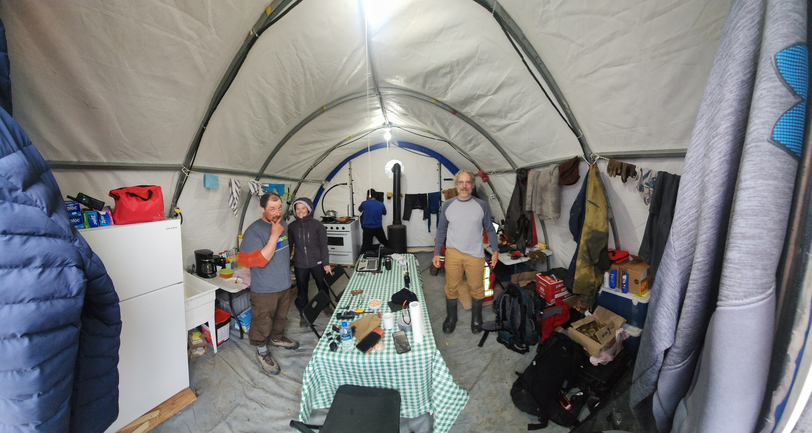
Protecting a sensitive environment
“What happens in the field is always dictated by the need to leave as few traces of our passage as possible. Water is taken from approved water sources and disposed of responsibly…, and when we leave a camp, nothing is left behind.” – James
“The Canadian Arctic land is sensitive to disturbances, so there are no trucks or roads, and access requires the use of charter aircraft, helicopters and hiking. Supplies are expensive and need to be flown in. We carry all our rock samples in large backpacks after we have been dropped into the area by a helicopter.” – Samuel
During fieldwork, James and Samuel live in tents and use diesel stoves for heat, diesel or gas generators for power, and an electric fence to repel wildlife like polar bears and wolves.
© Samuel Robb
11 futurumcareers.com

Slide 12
Meet Samuel
I stumbled into geology while I was trying to figure out what to major in at university. Once I discovered it, I realised it was the perfect combination of science and being able to spend time outdoors in some incredible, remote regions of Canada.
Working in remote regions, from the Arctic tundra in Nunavut, to the mountains in British Columbia is amazing. Each time I have gone out into the field, I have learnt something new, made a new discovery, or seen a part of the world I never would have expected to see.
Samuel Robb
12 futurumcareers.com

Slide 13
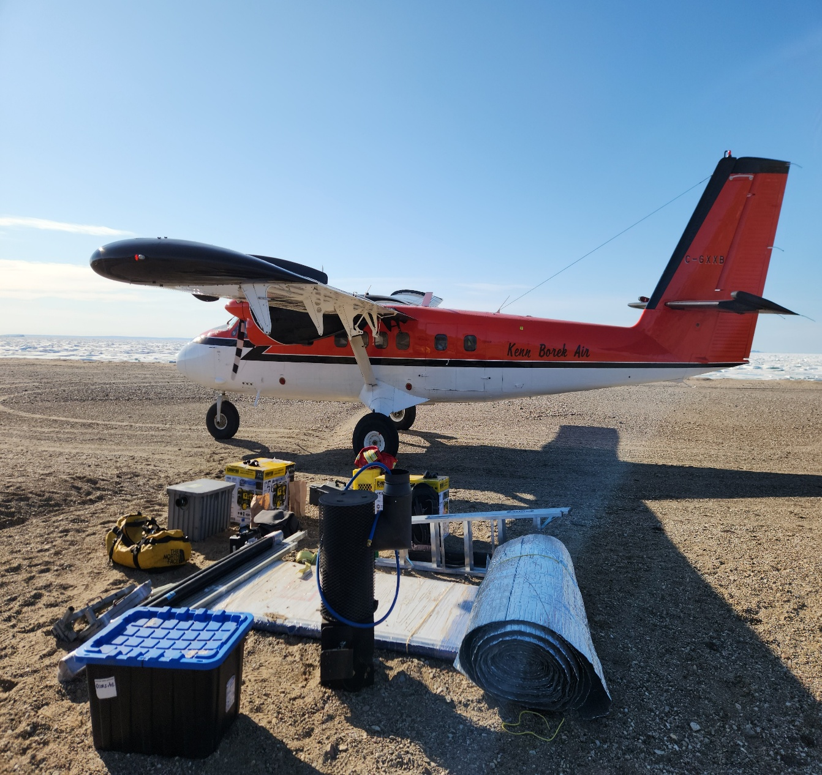
Meet Samuel
Geology is full of eureka moments. You can spend hours looking at data, making observations in the field and taking measurements, without any idea of what you’re looking at! Then, you get an idea, figure out a way to test it, and everything suddenly fits into place (or it doesn’t, and you go back to the drawing board). It’s all part of the fun and natural process of working in geology.
The biggest challenge of running exploration is managing the uncertainty, whether geological, logistical or financial. Operating in remote areas means every decision matters, with success depending on preparation, adaptability and teamwork. Things often don’t go the way you planned or expected!
© James Mungall
13 futurumcareers.com

Slide 14
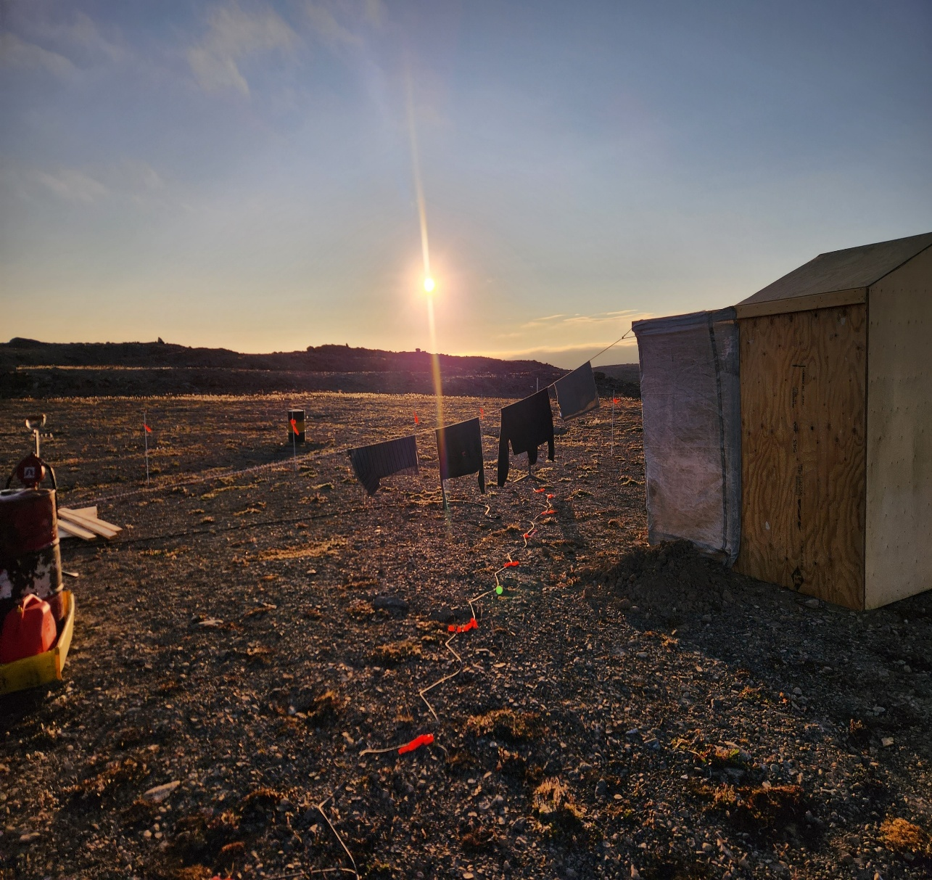
Meet Samuel
The rewards include testing new ideas, being part of new discoveries and mentoring new geologists. Building exploration programmes from the ground up, with input from local communities, is also rewarding. We’ve worked hard to establish Bronzite Exploration as a credible northern explorer, building trust with Inuit organisations, and running safe, efficient field seasons in inhospitable environments – all fulfilling achievements.
My focus is to continue advancing our exploration work at our Somerset Trough Project in Nunavut. I believe we can demonstrate that mineral exploration can be conducted responsibly and provide benefit to local communities.
© James Mungall
14 futurumcareers.com

Slide 15


Samuel’s top tips
Stay curious about the things you’re interested in; ask questions and try to figure out the answers on your own. Your curiosity will keep you excited and show your enthusiasm to everyone around you.
Be adaptable. In geology and many other fields, technology is transformative and changing the way we work. It’s important to stay on top of new methods and technologies available. That being said, don’t ever lose sight of the field. No matter how technology changes, nothing replaces boots on the ground and spending time with rocks!
Find a mentor or mentors who will challenge you to think critically, give you guidance and push you to learn things on your own.
15 futurumcareers.com

Slide 16
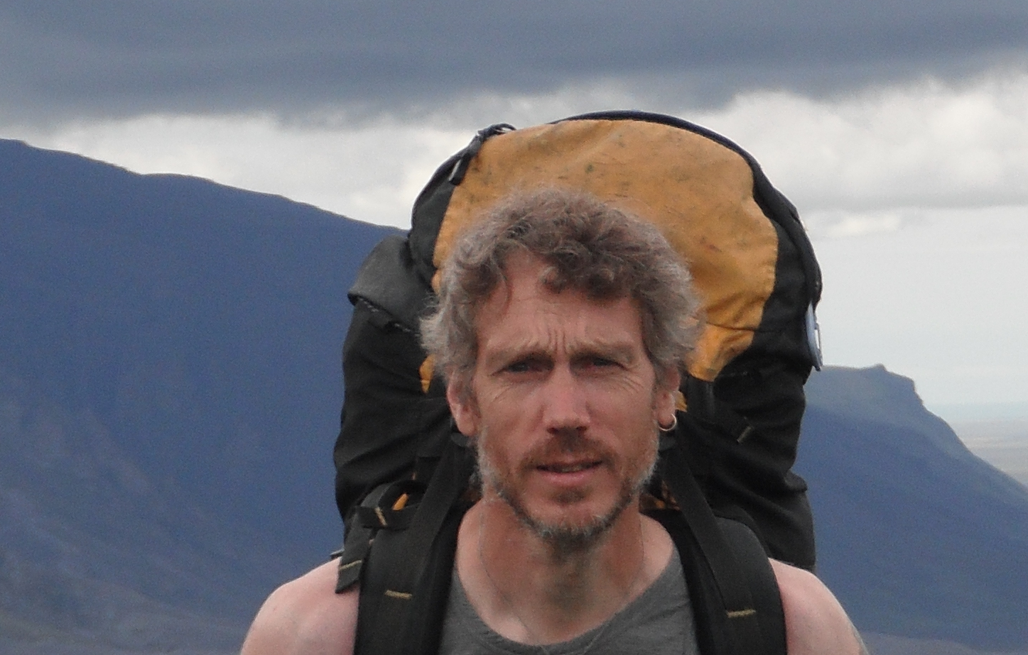
Meet James
I have always had the desire to spend time in the wilderness, testing my body and my mind against nature. As a child, I often broke open rocks, curious to know what was inside. I also loved literature and enrolled in an English programme but switched to geology because that was where my heart really lay. My first year of studies and fieldwork cemented the choice, and I’ve never regretted the decision.
Dr James Mungall
16 futurumcareers.com

Slide 17
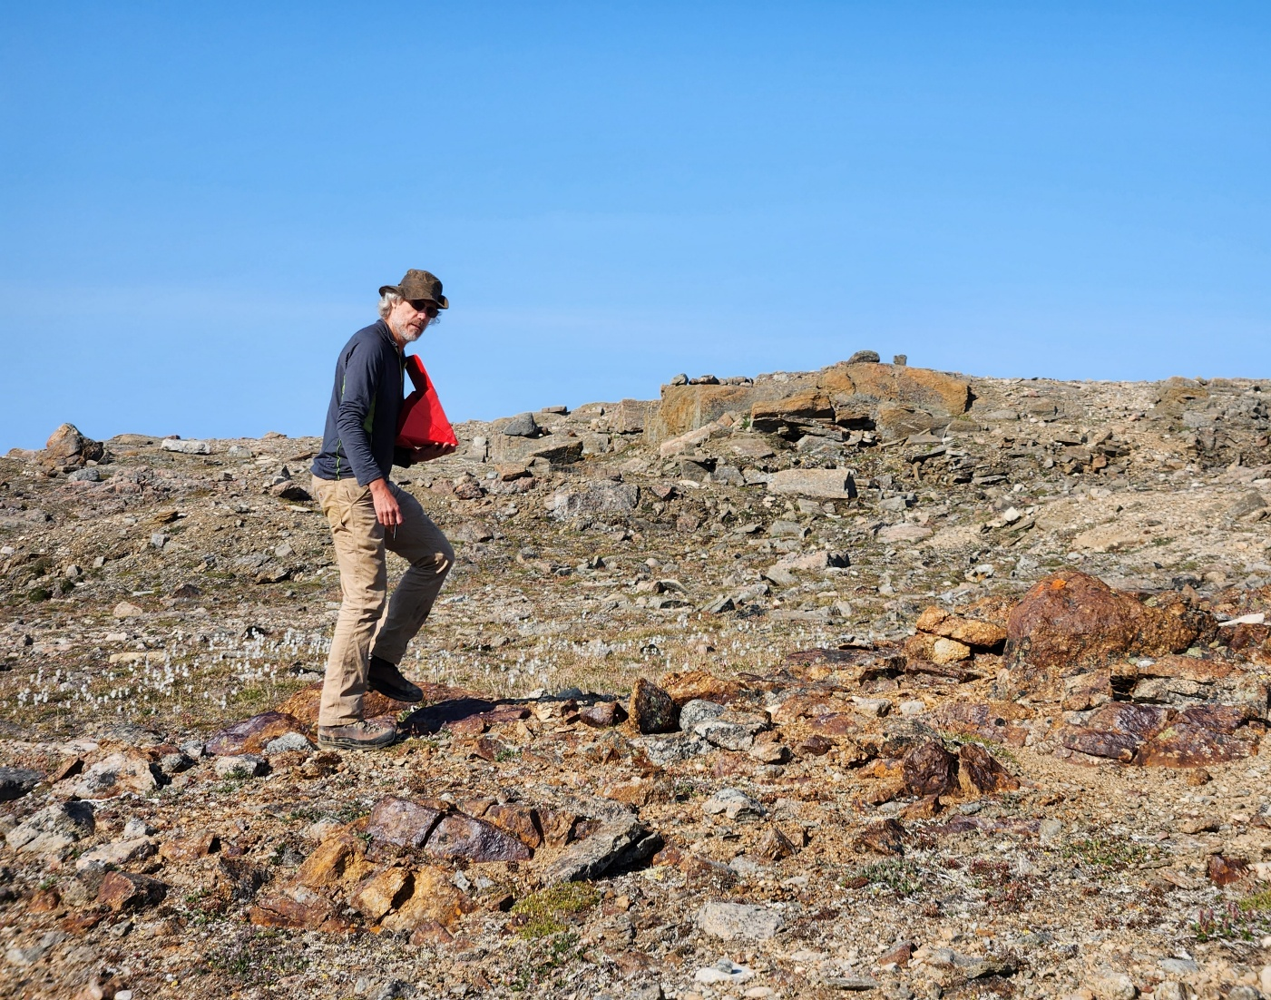
Meet James
Eureka moments have often hit when observations haven’t made sense. I’ve poked them in my mind the way you poke a sore tooth and then, suddenly, something has clicked.
For example, I was mapping rocks in northern Quebec, and nothing was making sense in terms of where nickel mineralisation was being found – we had assumed it was only in lava flows, but this didn’t match the data. One day, I realised the mineralised bodies were all part of one huge, intrusive, magmatic rock formation called a dike that cut across all the other rocks on the map. This gave us a tool to predict where the next discovery could be made. Once you step back and look at the whole picture, you wonder why it took you so long to understand!
© James Mungall
17 futurumcareers.com

Slide 18
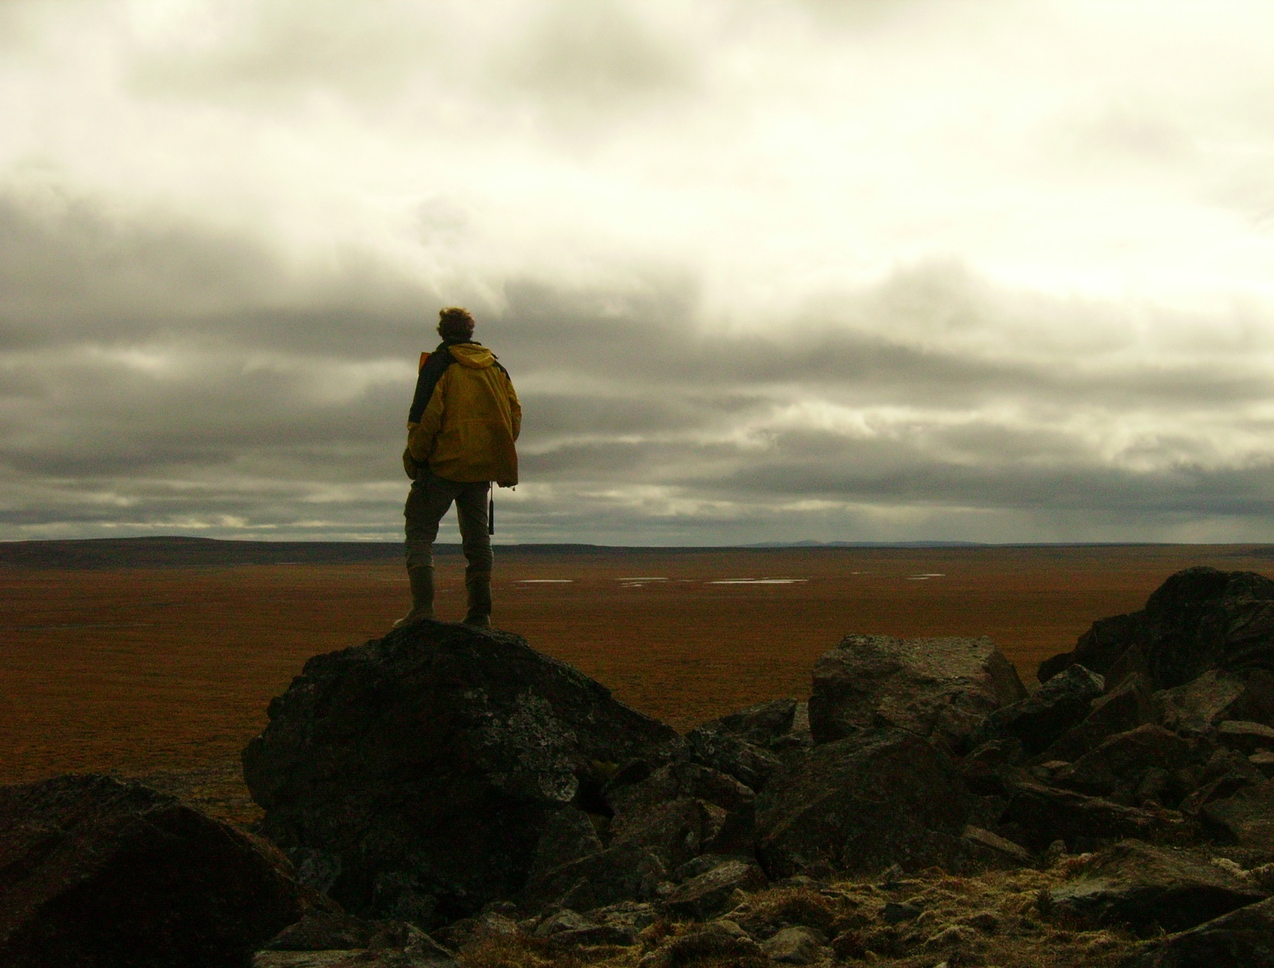
Meet James
My achievements include: publishing papers that have changed how people think about scientific processes; making geological maps that have become go-to sources of knowledge about regions of northern Canada; and building an exploration company with Samuel that, in just three years, has become one of the most ambitiously funded exploration programmes in the country.
Over the coming years, I hope to see our Somerset Trough Project selected by a major mining company for development. On the research front, I plan to publish a paper re-evaluating the composition of the Earth’s upper mantle. And, of course, I’m eager to see what Karim’s work on unconventional resources will show us about our future as a metal-producing country.
© Sophie Chung
18 futurumcareers.com

Slide 19
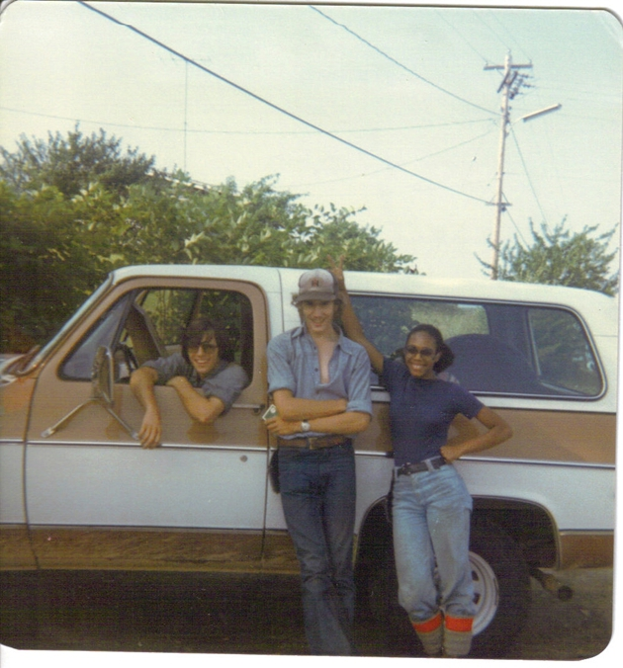
James’s top tips
Pour yourself into your work, doing it for the love of accomplishing something. Always give a little more than you were asked for and seek to constantly learn about subjects that might seem a little scary. As American physicist Richard Feynman said, when a new subject seems too complicated to understand, don’t turn away from it – that is the moment when it starts to get exciting!
© James Mungall
19 futurumcareers.com

Slide 20
Talking points
What makes geology such a varied and interesting field to work in?
What do Samuel and James do to ensure they are respectful of the environment and communities they work in?
Samuel and James mention many different aspects of their work as geologists that they find rewarding. Which of these do you think you would find especially rewarding, and why?
What have you learnt about what it means to be a scientist from meeting Samuel and James?
Which of their top tips do you find most useful, and why?
20 futurumcareers.com
© James Mungall

Slide 21
Meet Karim
I began my undergraduate studies in chemistry at the American University of Beirut in my home country, Lebanon. As part of this programme, I took a geology course that introduced me to the key minerals in rocks. I quickly became fascinated and decided to pursue a minor in geology, then a degree, and then a master’s degree. I am now pursuing my PhD in geology.
I focused my master’s research on the Tamarack Intrusive Complex, a large underground rock formation in Minnesota in the US, because it is rich in essential metals which are critical for technologies such as batteries, electric cars, renewable energy and medical devices. This research prepared me for my PhD by strengthening my research skills and sparking my interest in where our metals come from.
Karim El Ghawi
21 futurumcareers.com

Slide 22
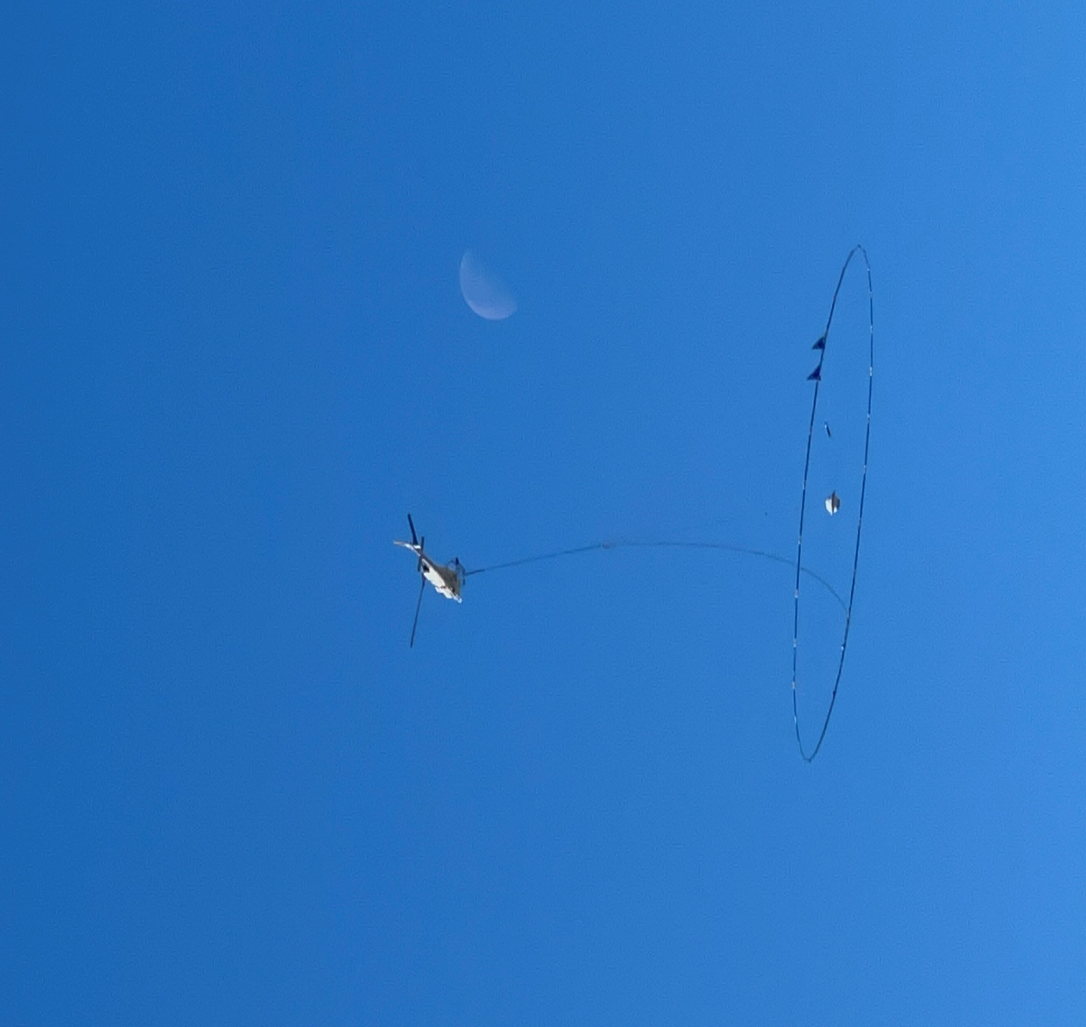
Meet Karim
For my PhD, I am investigating metals in rocks that are usually not considered to be worth mining. Although these ‘unconventional resources’ contain only small amounts of valuable metal, they have potential because they are widespread and abundant. As demand for critical metals grows, these common rocks could one day become important, new sources of supply.
To study how metals are locked in rocks and how they can be extracted, I will collect rock samples, use imaging techniques like X-ray mapping, and run lab tests to see how easily the metals can be released. These methods help predict which unconventional rocks could become future sources of metals.
© James Mungall
22 futurumcareers.com

Slide 23
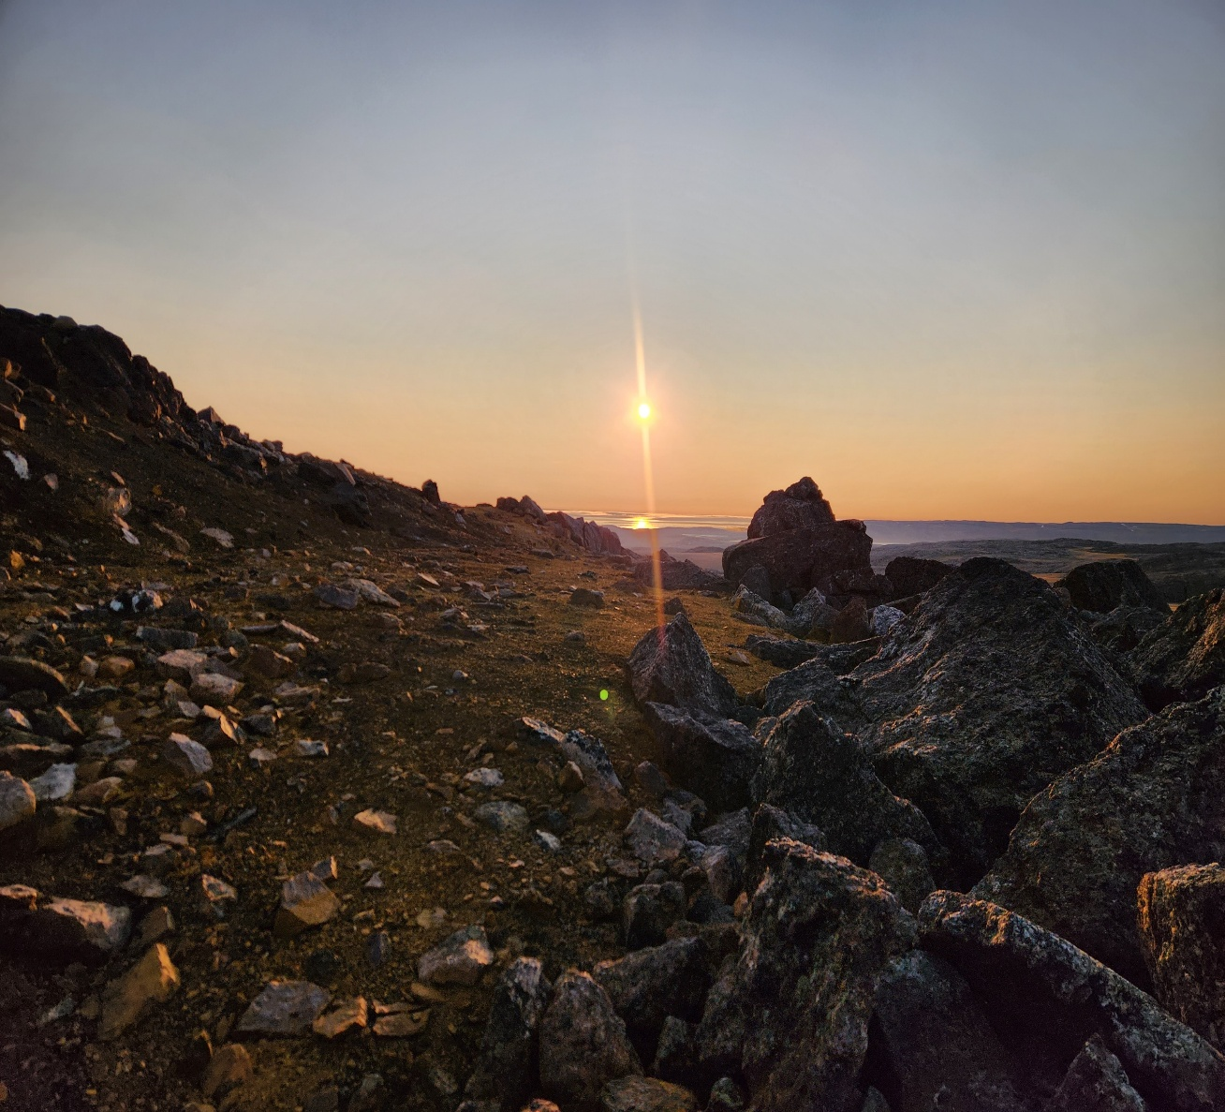
Meet Karim
I try to balance my research with activities that help me recharge. Playing soccer helps me switch off, keeps me active and lets me focus on something completely different from my studies.
I’m proud to have presented my research at several scientific conferences. These events bring together top academics and experts from around the world, so they are great opportunities to share my work, have discussions and receive feedback.
I hope my research can help guide new, sustainable ways of supplying the metals needed for technologies such as renewable energy. I want my work to play a role in supporting the transition to a greener, more sustainable future.
© James Mungall
23 futurumcareers.com

Slide 24
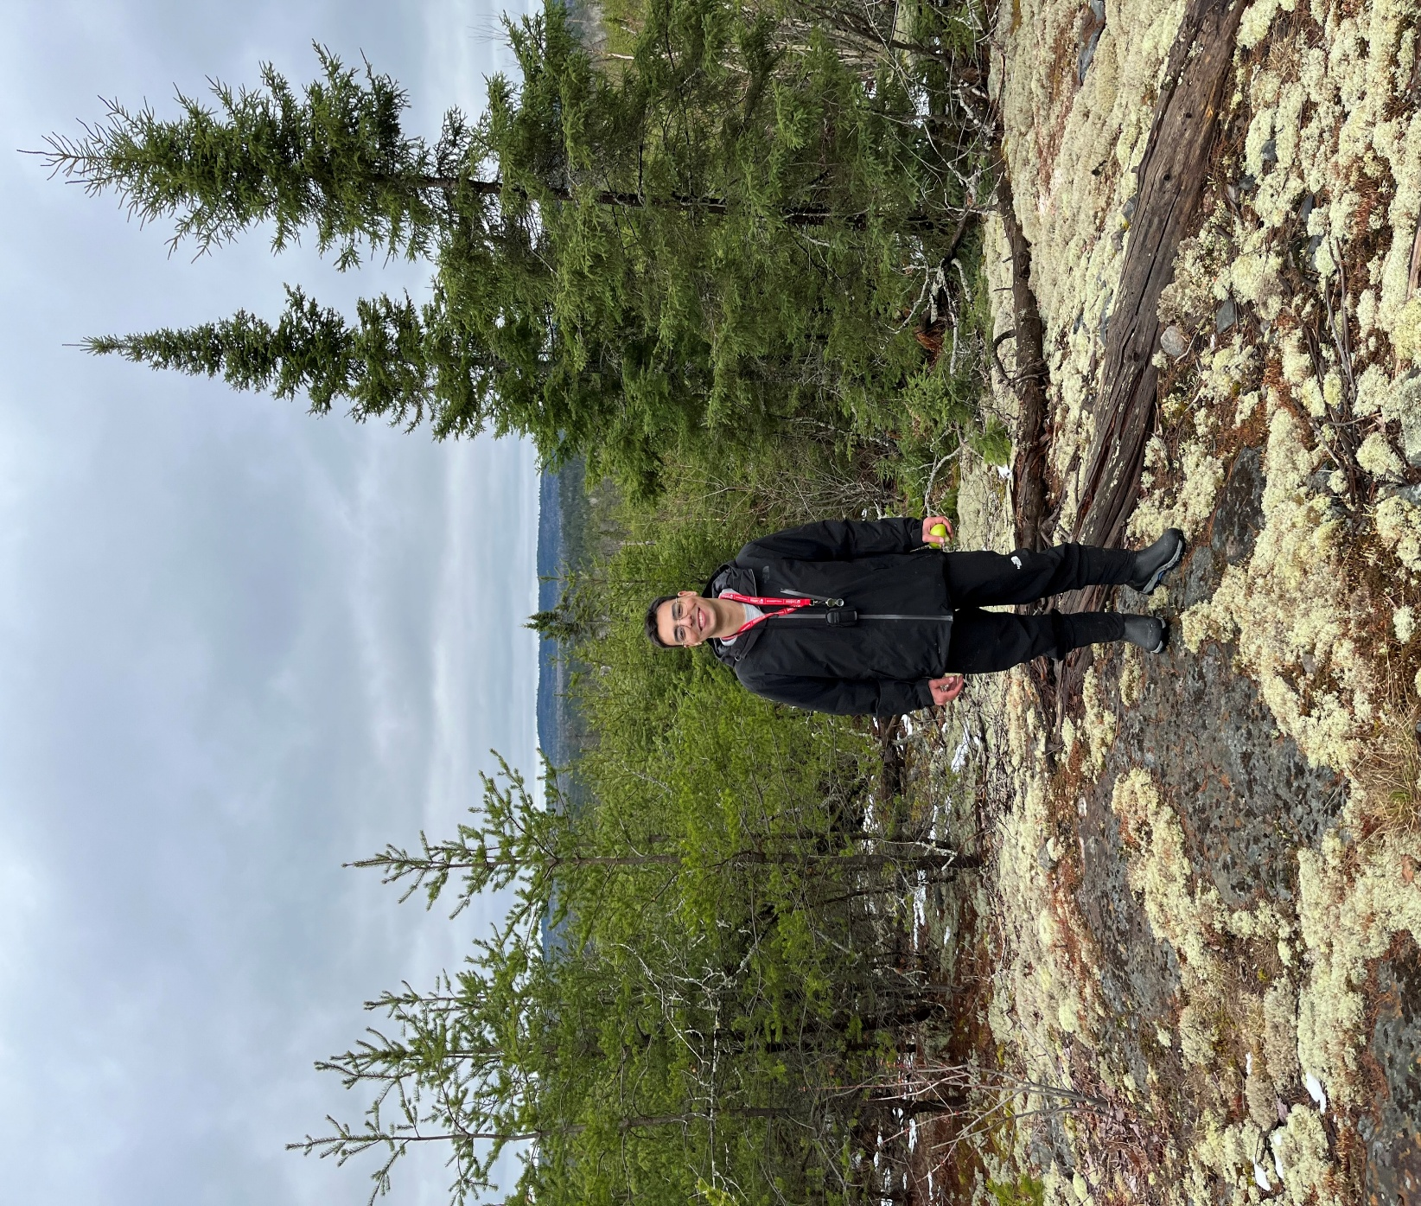
Karim’s top tips
Stay curious and spend time exploring the world around you. Geology is all about asking questions: Why does this rock look this way? How did this landscape form?
Don’t be afraid of the science; geology combines chemistry, physics and biology in exciting ways.
Most importantly, get outside when you can. The best lessons in geology happen in the field, not in the classroom.
© James Mungall
24 futurumcareers.com

Slide 25
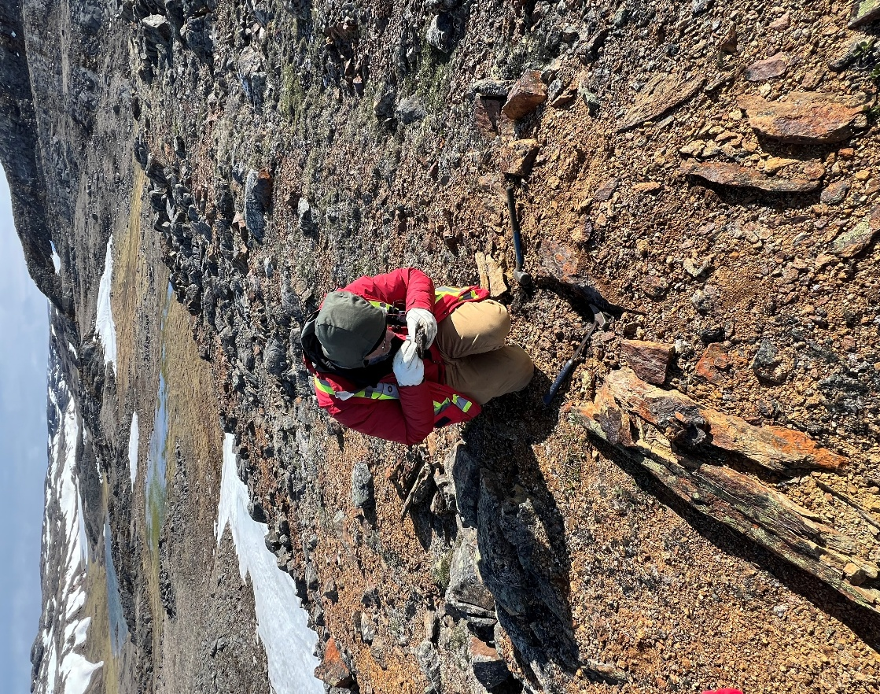
Pathway from school to geology
Developing skills in maths and science at school, especially in calculus, algebra, chemistry, physics and biology, will help build a solid foundation for geology.
Written and verbal communication skills will help with report-writing and presenting.
At university, study Earth sciences or geology, or specialise in environmental geoscience or geophysics if you can.
“To work as a geoscientist after you graduate, you will need to qualify for professional status, completing a four-year programme, followed by four years of work experience under the supervision of a professional geoscientist. You must then pass an examination of your ability to perform ethically and in compliance with the laws.” – James
“Building leadership skills can be important, so look for opportunities in sports or other extracurricular activities.” – Samuel
© James Mungall
25 futurumcareers.com

Slide 26
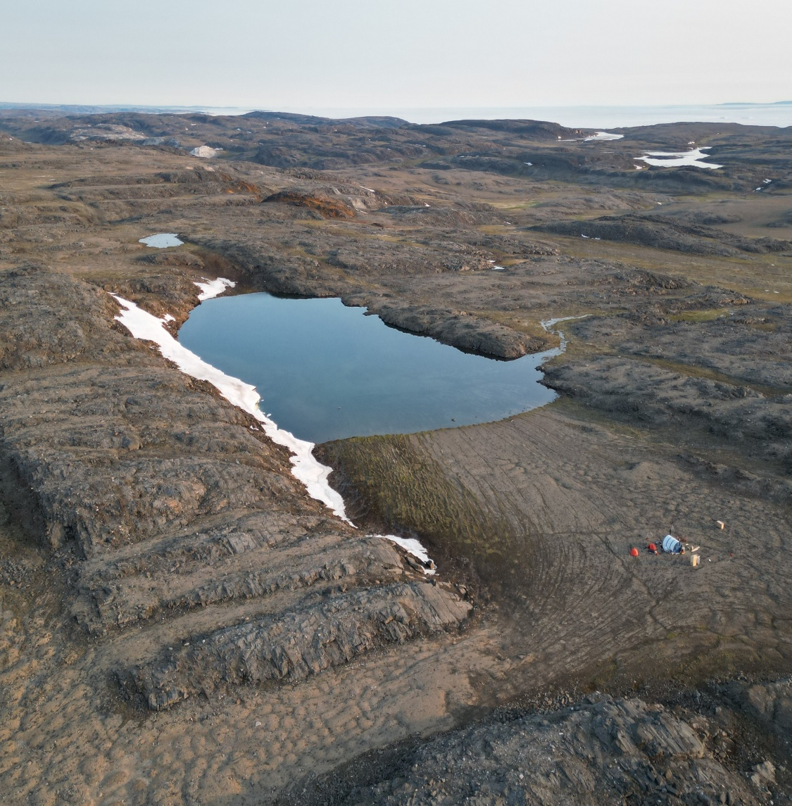
Explore careers in geology
Learn more about the work of James and his colleagues in the Department of Earth Sciences.
The Geoscientists Canada website offers advice and information about careers in geoscience. It also provides links to local professional organisations in Canada which you could join and attend events through.
Explore the website of the Mining Association of Canada which shares useful information about the mining industry and is a popular employer of geoscience graduates in Canada.
The websites of the European Geosciences Union and the Geological Society of America both contain a wealth of information about careers, the latest research and conferences networking events. You could even consider becoming a student member.
© James Mungall
26 futurumcareers.com

Slide 27
Talking points
How did studying for a master’s degree help prepare Karim for his PhD?
What is the focus of Karim’s PhD research, and what is his motivation for doing this research?
Why is it important for Karim to do activities that are not connected to his research?
How confident are you in the skills mentioned on the ‘Pathway…’ slide? How could you go about developing some of these skills further?
What have you learnt about geology that you did not know before? To what extent do you think you would enjoy a career in geology, and why?
27 futurumcareers.com
© James Mungall

Slide 28
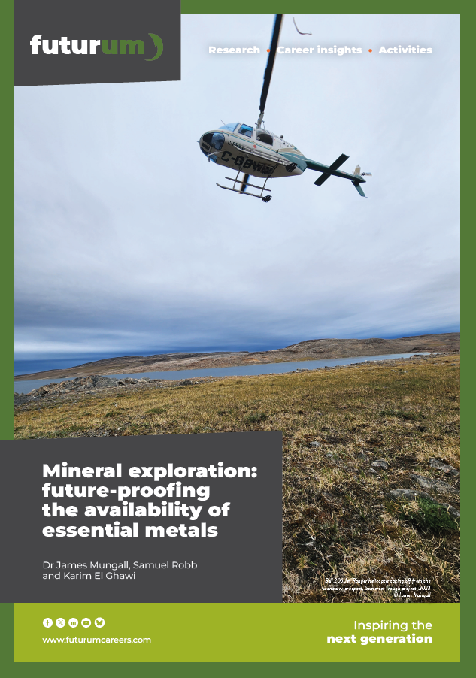
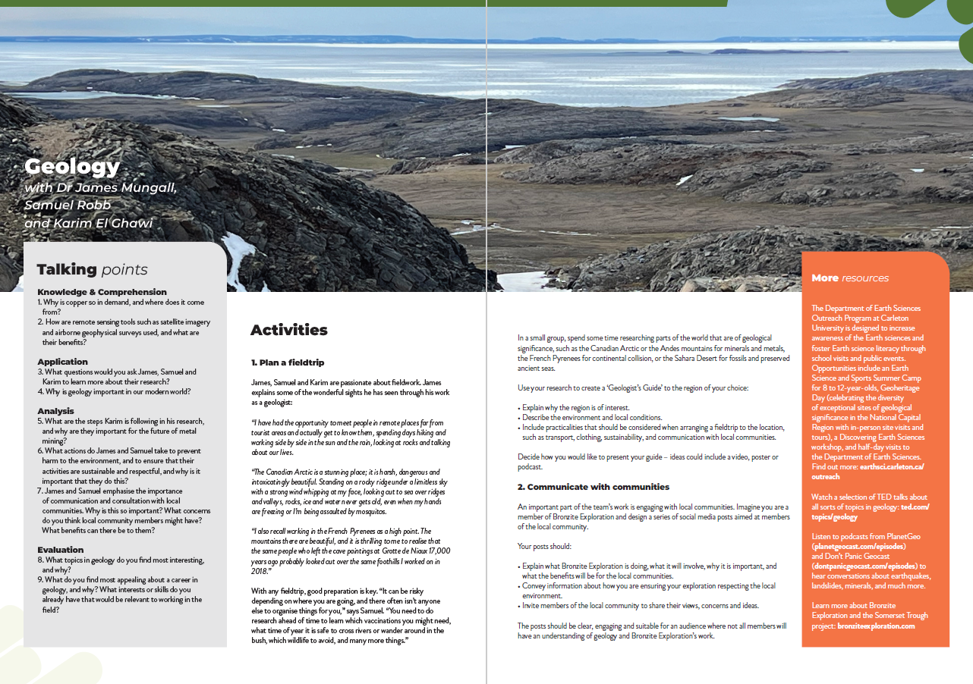
Resources
01
Download the team’s article
02
Download the activity sheet
28 futurumcareers.com
© James Mungall

Slide 29
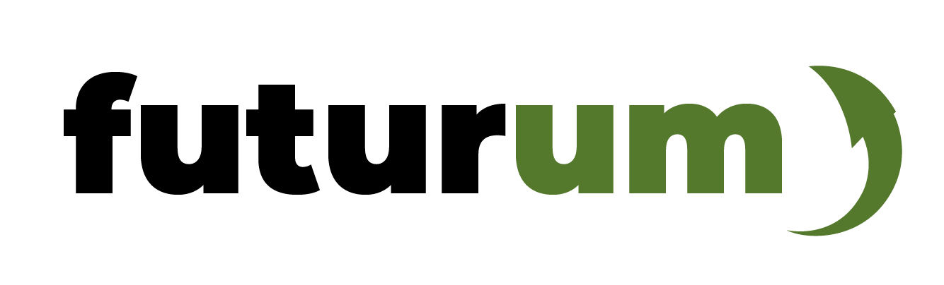
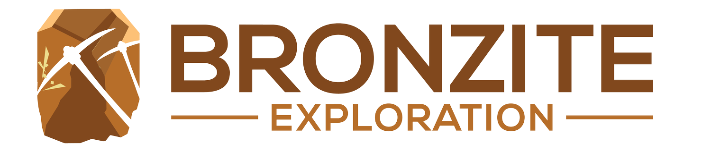
29 futurumcareers.com

