Slide 1
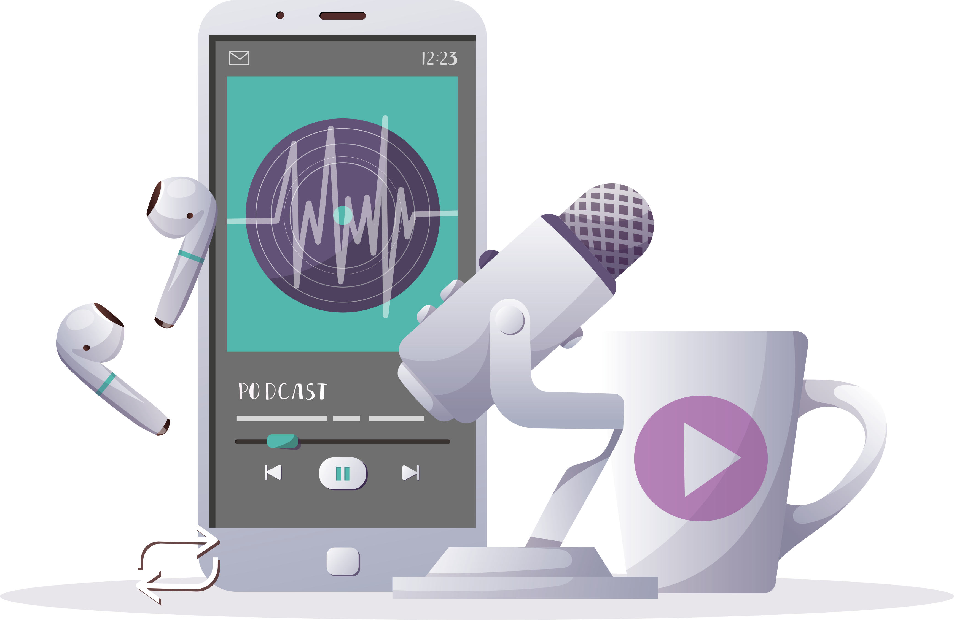
Inspiring the
next generation
FUTURUM
PODCAST
Decolonising the classroom
Dr Geraldine Balzer
Teacher CPD
ftlyip
Futurumcareers.com

Slide 2
Pre-listening | Break the down | Post-listening | Learn more podcast
Dr Geraldine Balzer
Pre-listening:
What does social justice teaching mean to you?
What does ‘decolonising the classroom’ mean to you?
To what extent have you begun implementing strategies to decolonise your classroom?
What are your current concerns about decolonising your classroom?
Department of Curriculum Studies
College of Education
University of Saskatchewan, Canada

Slide 3
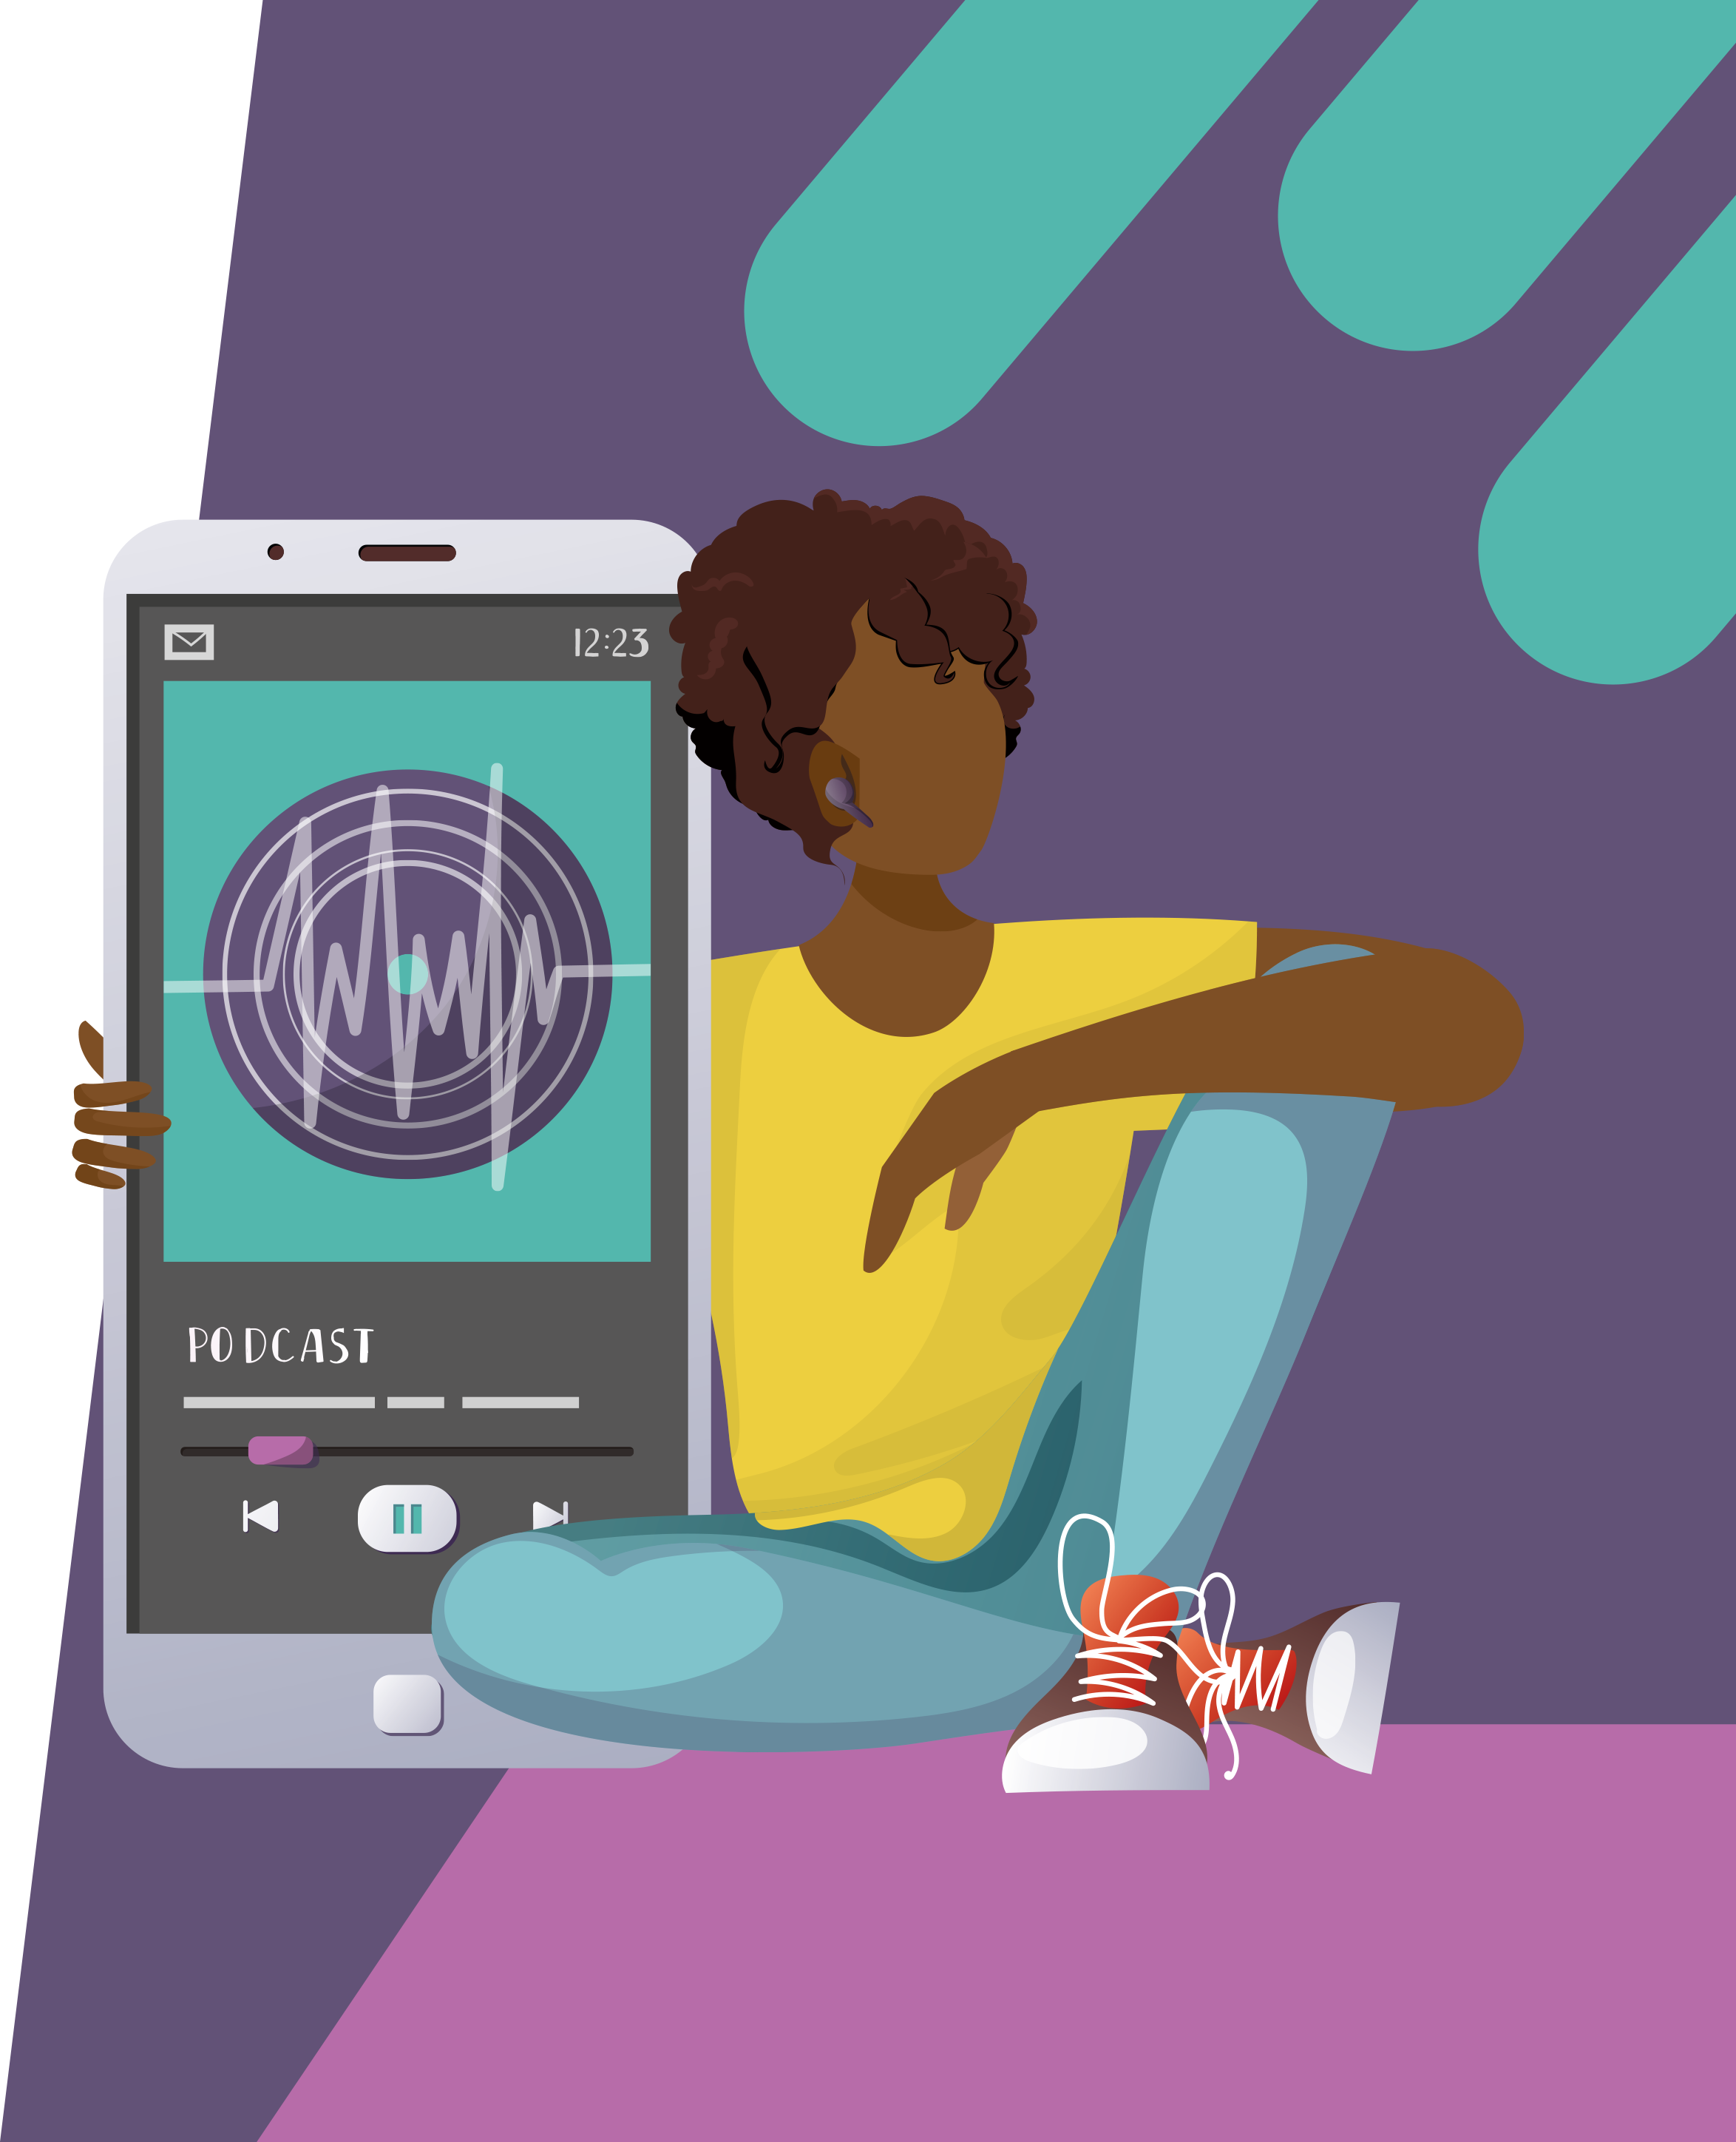
Pre-listening | Break the down | Post-listening | Learn more podcast
Break the podcast down:
00.00 – 08.00:
1. To what extent are your students represented in the literature shared in your classroom?
2. What is your experience of ‘decentralising the power’ in your classroom? What has worked well? How could you move away from a ‘hierarchal structure’ in your lessons?
3. Of the literature texts used in your classroom, which ‘mirror’ a diversity of lives, and which do not? Which new books could you explore to celebrate the joy of marginalised groups?

Slide 4
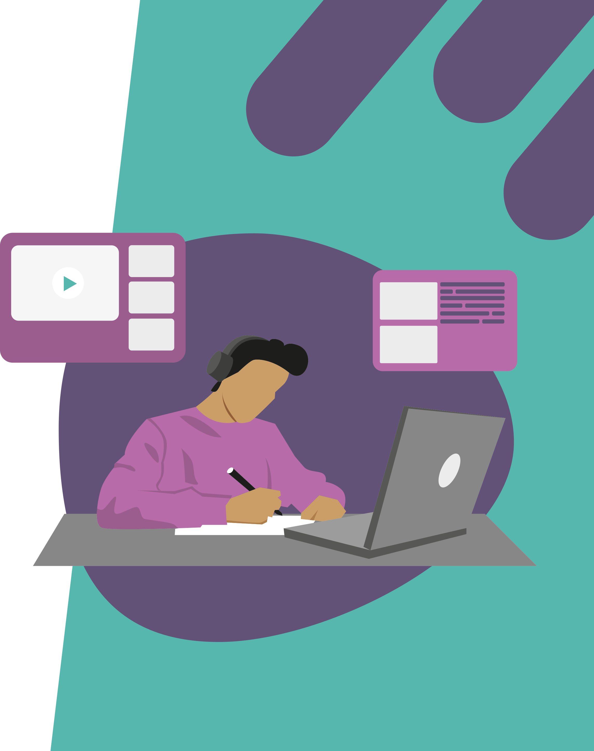
Pre-listening | Break the down | Post-listening | Learn more podcast
Break the podcast down:
08.00 – end:
5. Which resources do you need access to in order to make positive changes in your classroom?
6. What barriers might you face in implementing change/introducing new literature texts? What conversations do you foresee having with school leaders and/or parents and carers?

Slide 5
Pre-listening | Break the down | Post-listening | Learn more
Post-listening:
How confident do you feel about implementing changes in your classroom, and why?
What support would you like and from whom?
3. What are your next steps?
*Submit questions to Geraldine here.

Slide 6
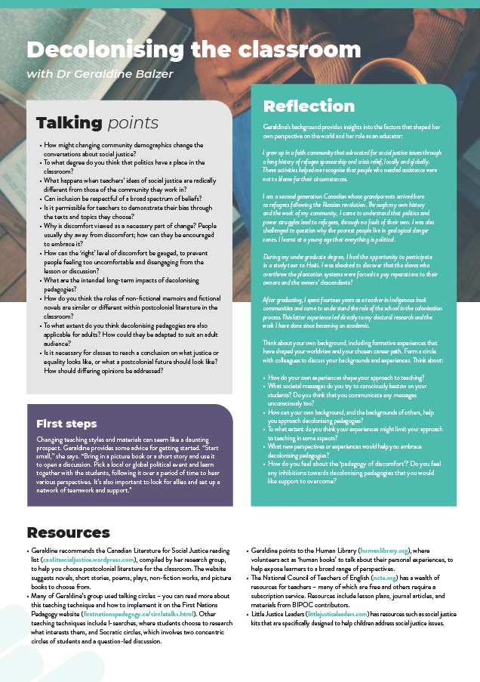
Pre-listening | Break the down | Post-listening | Learn more
Inspiring the
next generation
Learn more about
Geraldine’s work:
Read the article.
Download the activity sheet.
Teacher CPD
ftlyip
Futurumcareers.com

