Slide 1
HIGH-ENERGY-DENSITY PHYSICS
with DR VALENTIN KARASIEV and DR SUXING HU
Artsiom P - stock.adobe.com

Slide 2
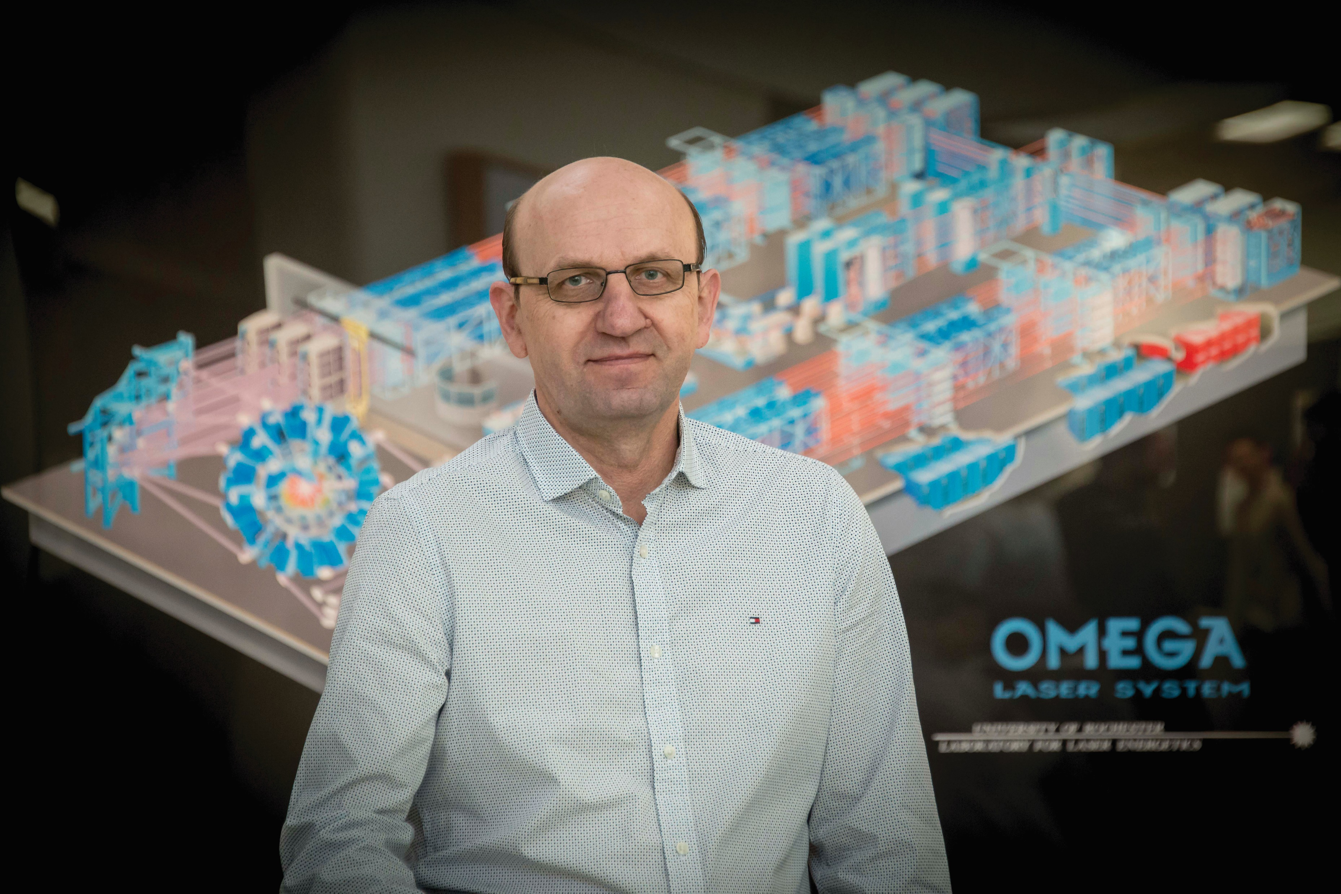
MEET VALENTIN
DR VALENTIN KARASIEV is a scientist based at the Laboratory for Laser Energetics at the University of Rochester in the USA.
He researches in the field of
high-energy-density physics.
He is developing methods for modelling processes and physics that occur in extreme environments.
© LLE

Slide 3
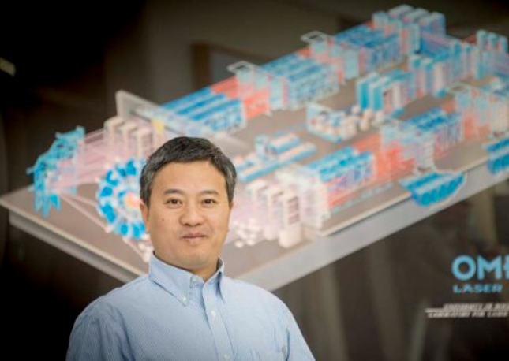
MEET SUXING
DR SUXING HU works alongside Valentin.
Suxing and Valentin are both experts in developing theoretical and computational models to describe high-energy-density processes.
Let’s read more about their work…
© LLE

Slide 4
HIGH-ENERGY-DENSITY PHYSICS
At very high temperatures and pressures, physics as we know it starts to change.
The study of such environments is known as high-energy-density physics.
These extreme environments are found at the heart of our Sun, and in the interior of giant planets and various types of stars.
These environments could hold the secret for understanding processes like nuclear fusion, which could be an incredibly important source of energy.
Roberto Sorin - stock.adobe.com

Slide 5
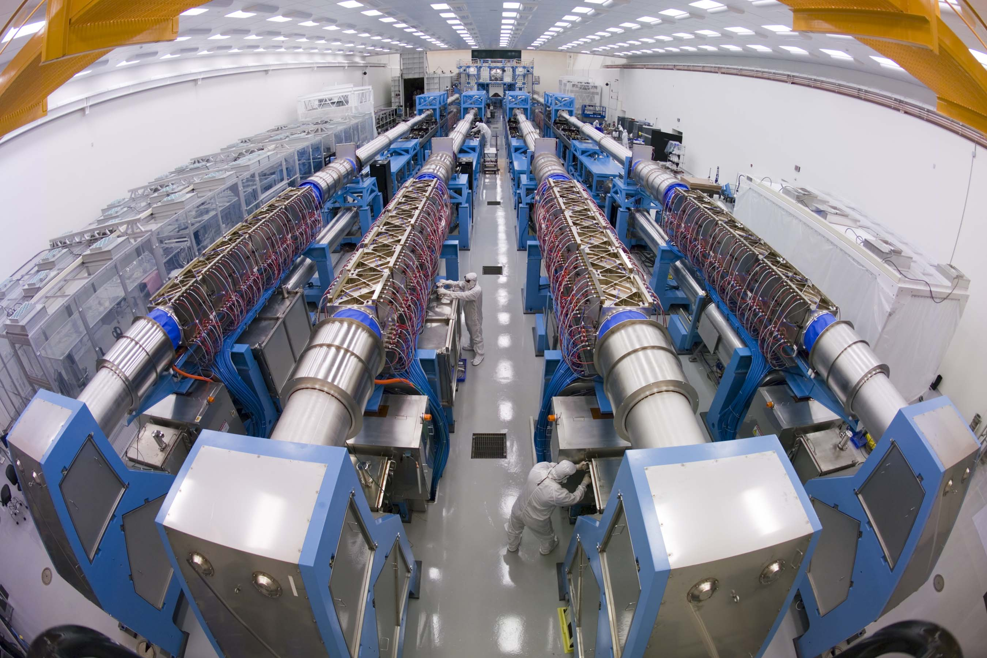
THE BIG CHALLENGE
OMEGA-EP Laser Bay, LLE.
Credit Eugene Kowaluk – © LLE
Many models which describe the physics of materials at zero to near-room temperatures stop working under such extreme conditions. Valentin and Suxing need to create new models, implement them in a computer code, and find ways to run them efficiently using high-performance computing.
Valentin works using theoretical approaches, but emphasises how important both experiments and calculations are in this area of physics. “Comparisons with experiments can validate theoretical methods used for predictions,” he says.
“Theoretical predictions, which are easier and faster to produce compared to experimental measurements, can be used to guide experiments.”

Slide 6
PHYSICS OF EXTREME ENVIRONMENTS
Valentin explains, “To create high pressures, scientists can perform diamond anvil cell experiments, when a small sample is compressed between two diamond tips, or perform gas-gun experiments, when a high-velocity projectile impacts a target to create high pressure. For high pressures and temperatures, powerful laser beams are used to heat and compress a target.”
Valentin and Suxing have been looking at hydrogen.
Hydrogen, as we know it on Earth, is a colourless, light gas. It is also the gas that acts as a fuel for nuclear fusion in stars that keeps them burning and forming heavier chemical elements.
However, under extreme pressure, hydrogen can start to behave like a metal.
Roberto Sorin - stock.adobe.com

Slide 7
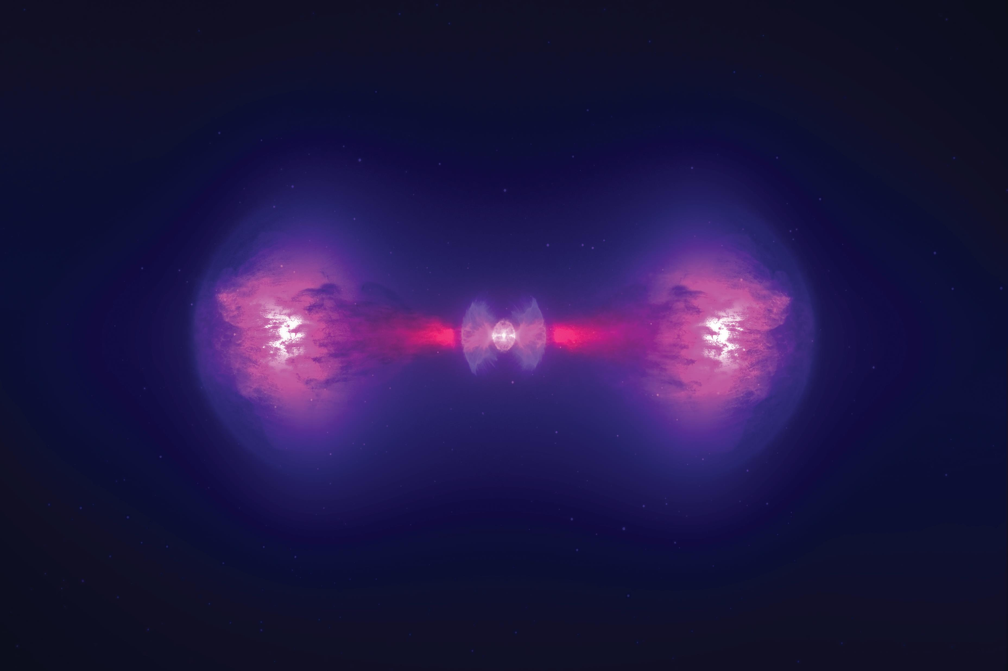
TALKING POINTS
What are Valentin and Suxing experts in?
What factors make the environments they look at ‘extreme’?
Why do Valentin and Suxing need to create new models for the work they do?
What do you think the difference is between a theoretical and experimental approach? How can these approaches work together?
How can scientists create high pressure?
What effect does extreme pressure have on hydrogen?
Artsiom P - stock.adobe.com

Slide 8
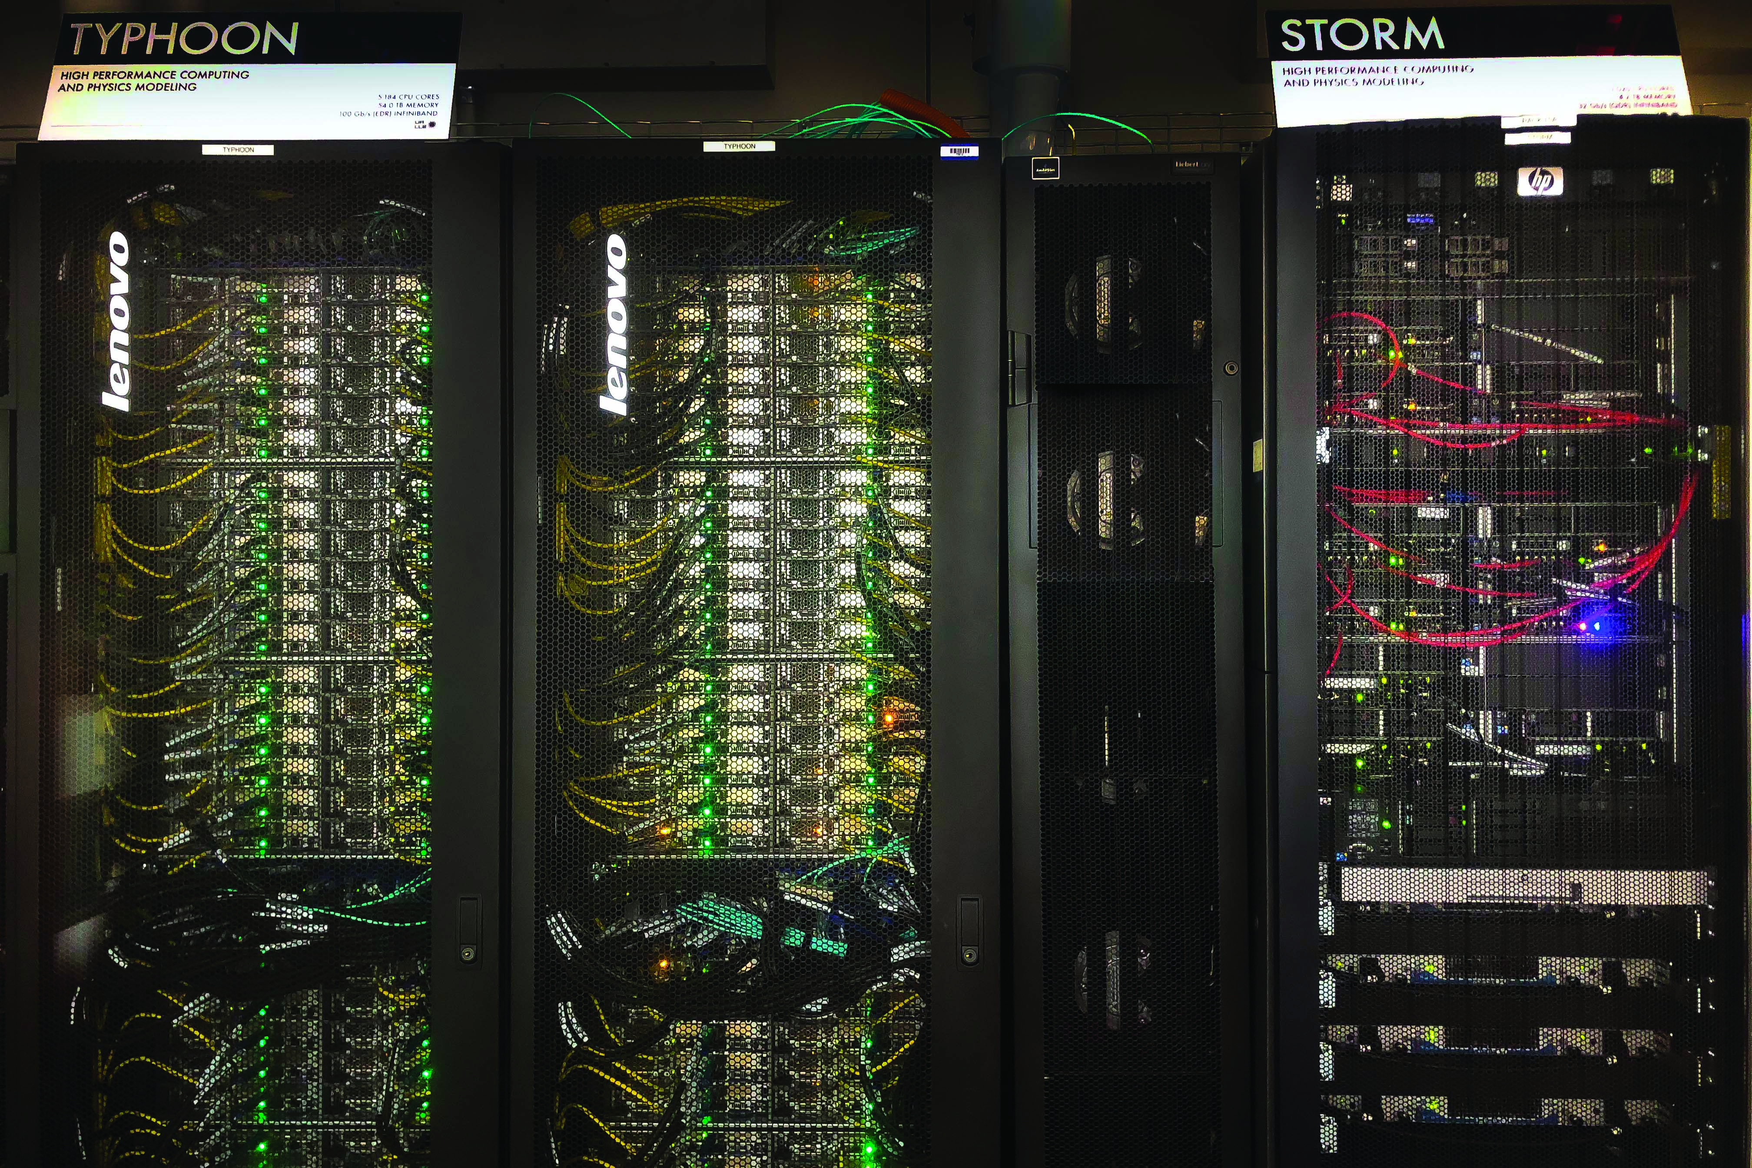
STRANGE METALS
A metal is defined by how the electrons in the material behave.
Insulating materials, like wood and gaseous hydrogen, do not conduct electricity. This is because the electrons in the material are bound and do not start to move and flow when the material becomes part of a circuit.
In metallic hydrogen, the electrons are shared between different hydrogen sites and can flow freely through the network of atoms. This means the hydrogen has become a conductor. As Valentin says, “under high pressure, hydrogen and/or some hydrogen rich materials may become room temperature superconductors.”
Typhoon and Storm HPC systems at LLE. Credit Eugene Kowaluk - © LLE

Slide 9
SUPERCONDUCTORS
A superconductor is a material that lets electrons move with no resistance.
For most normal conducting metals, an electron experiences some resistance to its movement and so generates heat as it moves.
In a superconductor, this heating does not happen and so no energy is wasted.
If a perfect superconducting device was made, the device could be on nearly forever, without ever depleting the battery.
Recently, Suxing and Valentin’s colleagues, the experimental group of Professor Ranga Dias, discovered room temperature superconductivity in carbonaceous sulphur hydride (CSH) systems and, from Suxing’s calculations, they were able to identify which structures would be the most stable room-temperature superconductors under high pressures.
Roberto Sorin - stock.adobe.com

Slide 10
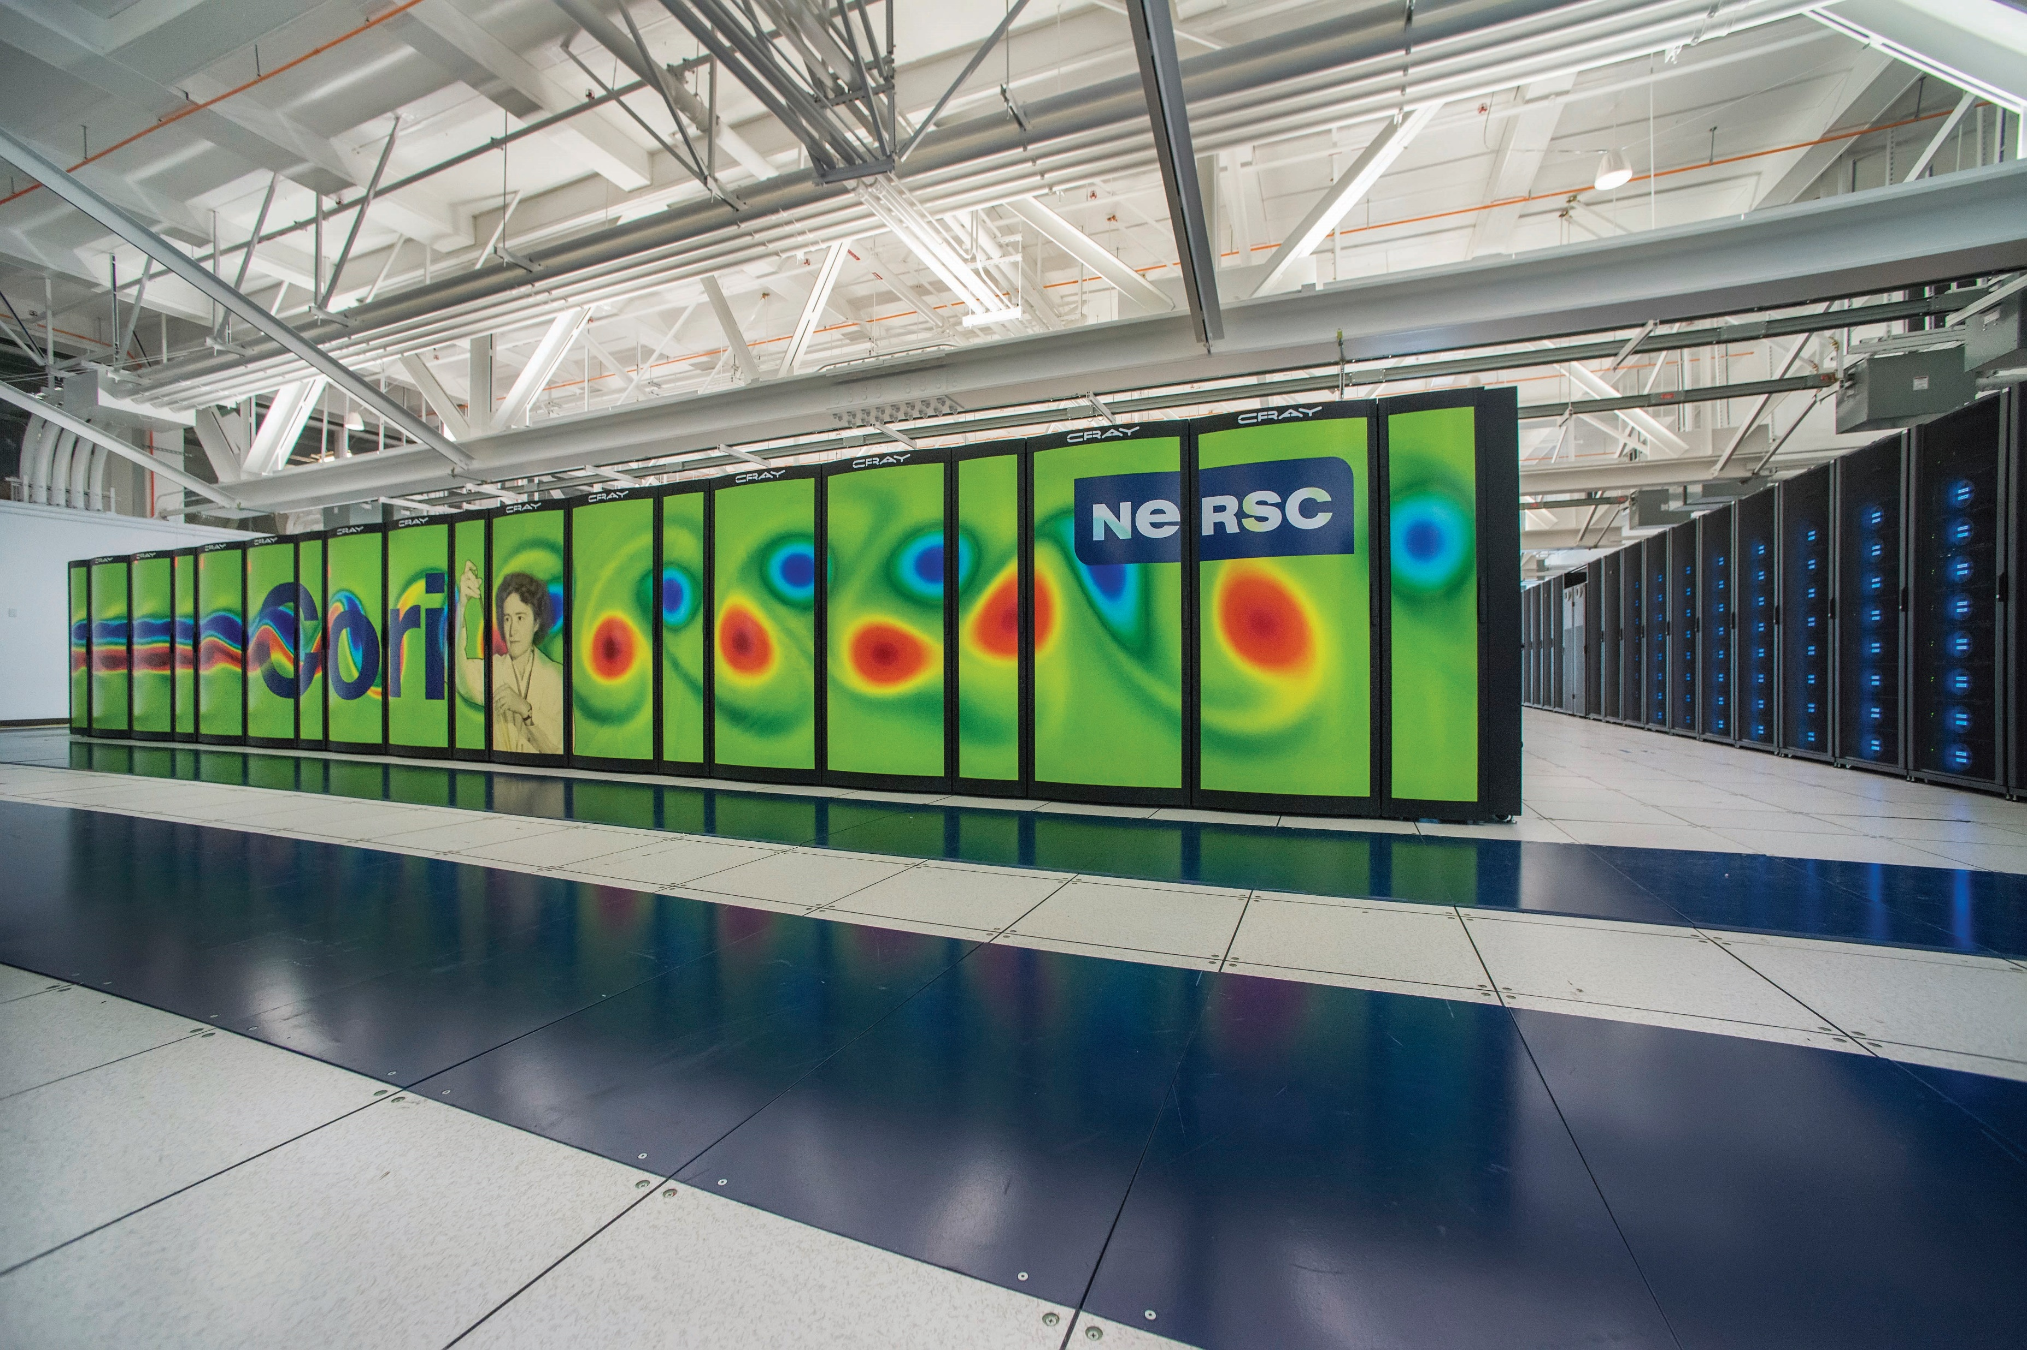
LOOKING AHEAD
Valentin has made key developments in the advancement of density functional theory-based methods for high-energy-density environments, applying them to problems such as warm dense silicon plasmas and atom interactions.
Valentin and Suxing will be looking to develop more reliable and faster ways to describe the behaviour of materials for nuclear fusion experiments.
This an exciting time to be in high-energy-density physics as it becomes increasingly involved with many other areas of science.
Researchers hope to describe even more complex and exciting systems and to really understand the wealth of physics going on in the hearts of our stars.
Cori Supercomputer at NERSC. Credit © NERSC

Slide 11
TALKING POINTS
How is a metal defined?
Why don’t insulating materials, like wood and gaseous hydrogen, conduct electricity?
What are electrons able to do in metallic hydrogen?
What is a superconductor?
What successes have Suxing and Valentin had recently?
What will they be looking at in the future?
Artsiom P - stock.adobe.com

Slide 12
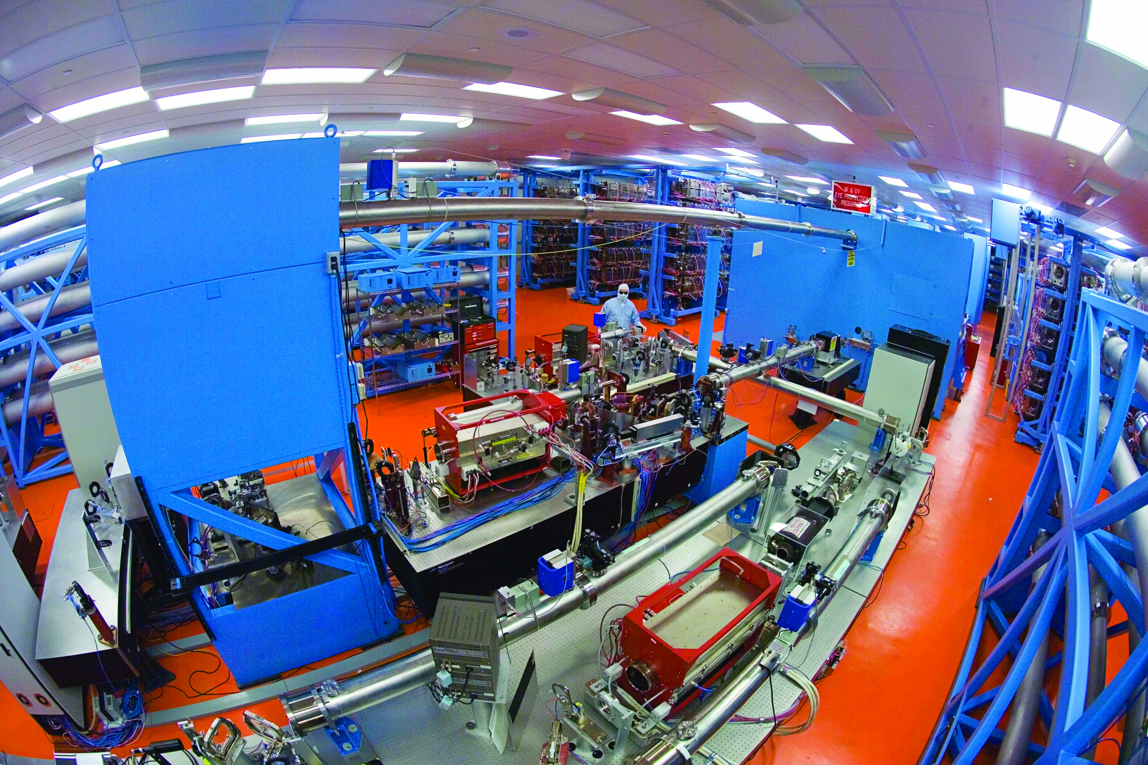
ABOUT HIGH-ENERGY-DENSITY PHYSICS
OMEGA Laser Bay, LLE. Credit Eugene Kowaluk - © LLE
This is the physics of what happens at extreme conditions and very high energy densities.
Some people specialise in laser experiments to use very powerful laser beams to generate extreme conditions in materials.
Others specialise in plasmas and understanding how they form and interact with lasers, and how the electrons behave.
These are unusual types of physics. However, we do use plasmas to help make circuit boards for electronics and we rely on our stars performing nuclear fusion to act as a source of heat and light. It was these nuclear fusion processes that formed the heavier elements that we find on Earth, such as iron.
Generally, researchers like Valentin and Suxing start with a more general degree in physics and become more specialised over time.

Slide 13
ABOUT HIGH-ENERGY-DENSITY PHYSICS
“My motivation is a passion for science as it provides a basis for understanding and discovering unknown, unusual and often counterintuitive properties of matter. I also like to develop theory and new methods, I like to write codes and run simulations and really enjoy my work.
We collaborate with theory groups at other research institutions. Modern science is complicated, and sometimes the efforts of several collaborators are required to make key advances.
The increasing multidisciplinary character of physics is one of the biggest challenges… With the increasing importance of computer simulations and development of faster and more powerful supercomputers, even specialists in materials-related topics will need to become experts with deep knowledge in computer science and mathematics.”
- Valentin
Roberto Sorin - stock.adobe.com

Slide 14
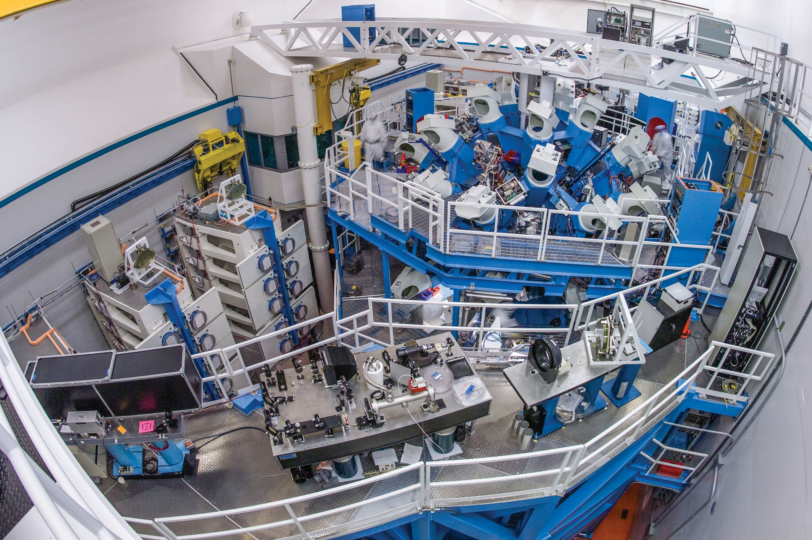
EXPLORE A CAREER IN HIGH-ENERGY-DENSITY PHYSICS
There are roles for both experimentalists and theoreticians in high-energy-density physics. In both cases, a strong general physics background is essential and good mathematical skills will also help.
National laboratories and universities are where the majority of research in high-energy-density physics is and there are a large number of sub-topics and disciplines that can be specialised in.
The Laboratory for Laser Energetics – where Valentin and Suxing are based – runs a Summer Research Program for High School Juniors.
Salaries range with experience, research institution and country, but start around $40,000 and, with experience, can be in excess of $80,000.
OMEGA Target Bay, LLE. Credit Eugene Kowaluk - © LLE

Slide 15
PATHWAY FROM SCHOOL TO HIGH-ENERGY-DENSITY PHYSICIST
Valentin recommends studying chemistry, physics and calculus/mathematics at school. At university, study physics or maths and take classes in quantum chemistry and quantum mechanics.
For theoretical physics jobs and many experimental ones, knowledge of computer programming languages and coding experience will also be beneficial. Much of Valentin’s research involves implementing new theoretical developments in new or existing codes and optimising them for high-performance computing set-ups.
Nearly all physicists will have a bachelor’s degree in physics or maths. In some areas of physics, a degree in engineering or chemistry may also be suitable. For a research position at a university, a relevant master’s and PhD is also important. If you want to specialise in high-energy-density physics, this will usually be done at master’s or PhD level.
Roberto Sorin - stock.adobe.com

Slide 16
TALKING POINTS
What might researchers in high-energy-density physics specialise in?
Why is collaboration so important in this field?
What expertise does Valentin see researchers needing more of in the future?
Are you interested in the subjects Valentin recommends? Which of these subjects would you like to further your study in?
How much experience do you have in computer programming and coding? How could you develop your skills in this area?
Artsiom P - stock.adobe.com

Slide 17
HOW DID VALENTIN BECOME A HIGH-ENERGY-DENSITY PHYSICIST?
WHO OR WHAT INSPIRED YOU TO BECOME A SCIENTIST?
“My high school physics teacher, as well as my older brother, who is also physicist. I have had a strong passion for math and physics since high school and, from 5th grade, I was interested in radio-electronics.”
WHAT ATTRIBUTES HAVE MADE YOU SUCCESSFUL?
“The key attributes for being a successful scientist include being good at abstract thinking, as well as learning how to perform a sequence of logical deductions. This involves starting with assumptions and established work and seeing what can be deduced to lead to conclusions about a problem. It takes a kind of courage and imagination to put forward new or non-standard hypotheses.”
© LLE

Slide 18
WHAT ARE YOUR PROUDEST CAREER ACHIEVEMENTS?
“One of my proudest career moments was my move to my current laboratory, the Laboratory for Laser Energetics at the University of Rochester, three and a half years ago. I have moved several times in my career, from Russia to Venezuela to the USA, and each step has presented new opportunities to learn and new challenges to overcome.”
VALENTIN’S TOP TIPS
01 Persistence is crucial to overcome many obstacles. With years of experience, I have come to realise that almost any problem can be resolved if one persists.
02 Follow what you are passionate about.
© LLE

Slide 19
TALKING POINTS
What do you think Valentin means by ‘abstract thinking’?
When did you last perform ‘logical deductions’? Which areas of your study demand this skill?
Why do you think Valentin highlights courage and imagination as important? When did you last demonstrate these traits?
What opportunities have you made the most of lately?
Which challenges have you been proud to overcome?
Artsiom P - stock.adobe.com

Slide 20
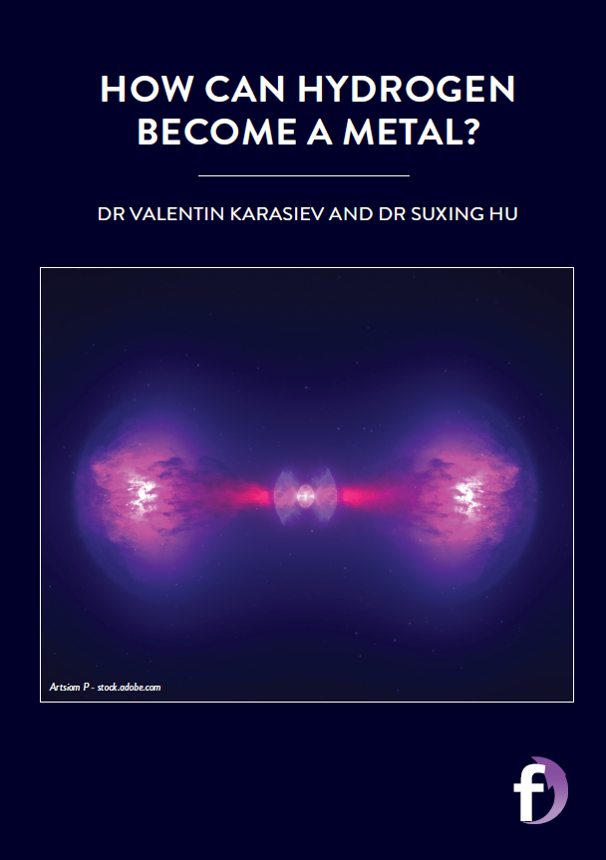
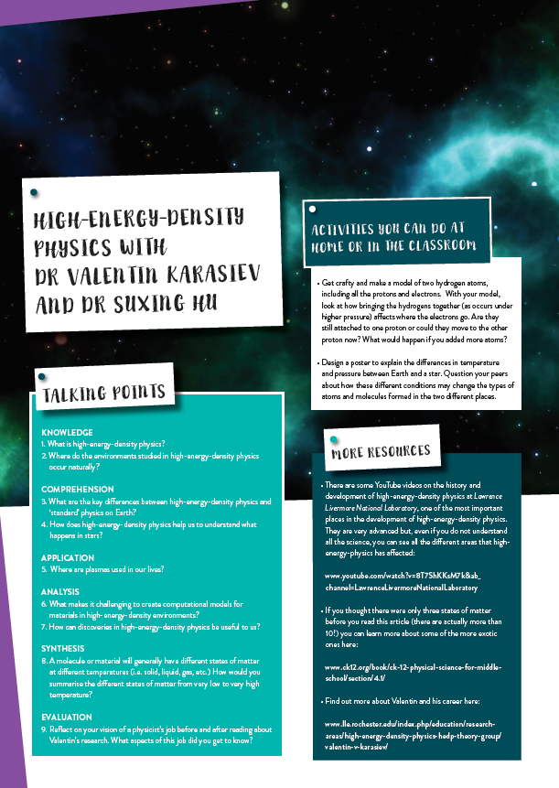
Dig deeper into Valentin and Suxing’s research.
If you have a question for them, scroll down to the end of the online article and type it in. They will reply!
Download their activity sheet.

