Slide 1
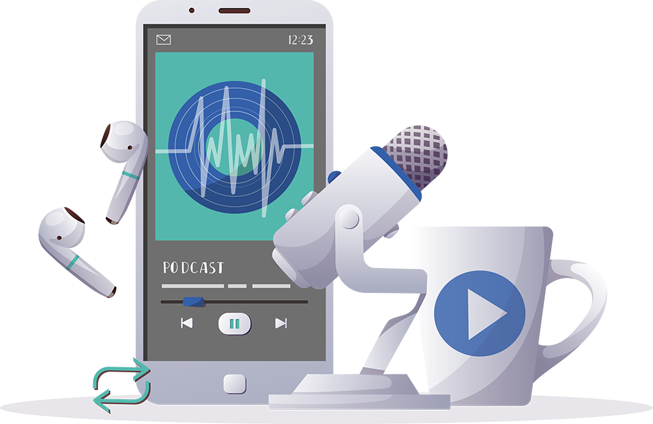
INSPIRING THE
NEXT GENERATION
FUTURUM
PODCAST
Clinical Genomics
Professor James Lupski
ftlyp
futurumcareers.com

Slide 2
Pre-listening | Break it down | Post-listening | Learn more
Meet
Professor James Lupski
Pre-listening:
James is considered a pioneer in the field of clinical genomics. Not only did he contribute to the first whole genome sequencing, but he was also one of the first people to have his genome sequenced. This resulted in his lab discovering the cause of his own genetic disease.
What do you already know about clinical genomics?
What causes genetic diseases?
How do you think the work of clinical genomicists can help people living with genetic conditions?
Profile
Baylor College of Medicine & Texas Children’s Hospital, Houston, Texas, USA
FIELD OF RESEARCH
Clinical Genomics
“You only learn science by doing science!”

Slide 3
Pre-listening | Break it down | Post-listening | Learn more
Break the podcast down:
Up to 05:00 minutes
What are James’s motivations for his clinical genomics research?
To what extent do you agree that the best way to learn science is by doing science, and why?
When has a practical application helped you understand and appreciate something more than reading theoretical knowledge?
How do you think you would benefit from getting involved with a scientific lab as a student?
How could you find opportunities to gain research experience?

Slide 4
Pre-listening | Break it down | Post-listening | Learn more
05:00 – 07:30
To what extent do you think fear of failure and the unknown holds you back?
When was the last time you faced failure? What did you learn from the experience?
Why do you think James says learning how to learn is more important than just gaining knowledge? To what extent do you agree with this?
What type of learner are you?
What skills do you think you need to become a more efficient and effective learner? How could you develop these skills?
07:30 – end
As a clinical genomicist, James discovered the gene responsible for his own genetic disease. If you were a scientist, how do you think you would feel if you discovered something that could personally help you, a friend or a family member?
How do you respond to criticism?

Slide 5
Pre-listening | Break it down | Post-listening | Learn more
Post-listening:
What excites you about the field of clinical genomics?
Why is clinical genomics important for everyone in society, not just those with genetic conditions?
What do you think you would most enjoy about a career in clinical genomics, and why?
What aspects of James’s story inspire you?
Which piece of advice from James did you find most useful, and why?
What further questions would you ask James about clinical genomics and/or his career?*
Submit questions to James here

Slide 6
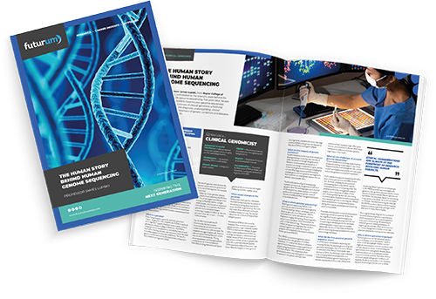
Pre-listening | Break it down | Post-listening | Learn more
Learn more about
James’s work:
A
Read the article here
A
Read the article in Spanish here
INSPIRING THE
NEXT GENERATION
ftlyp
futurumcareers.com

