Slide 1


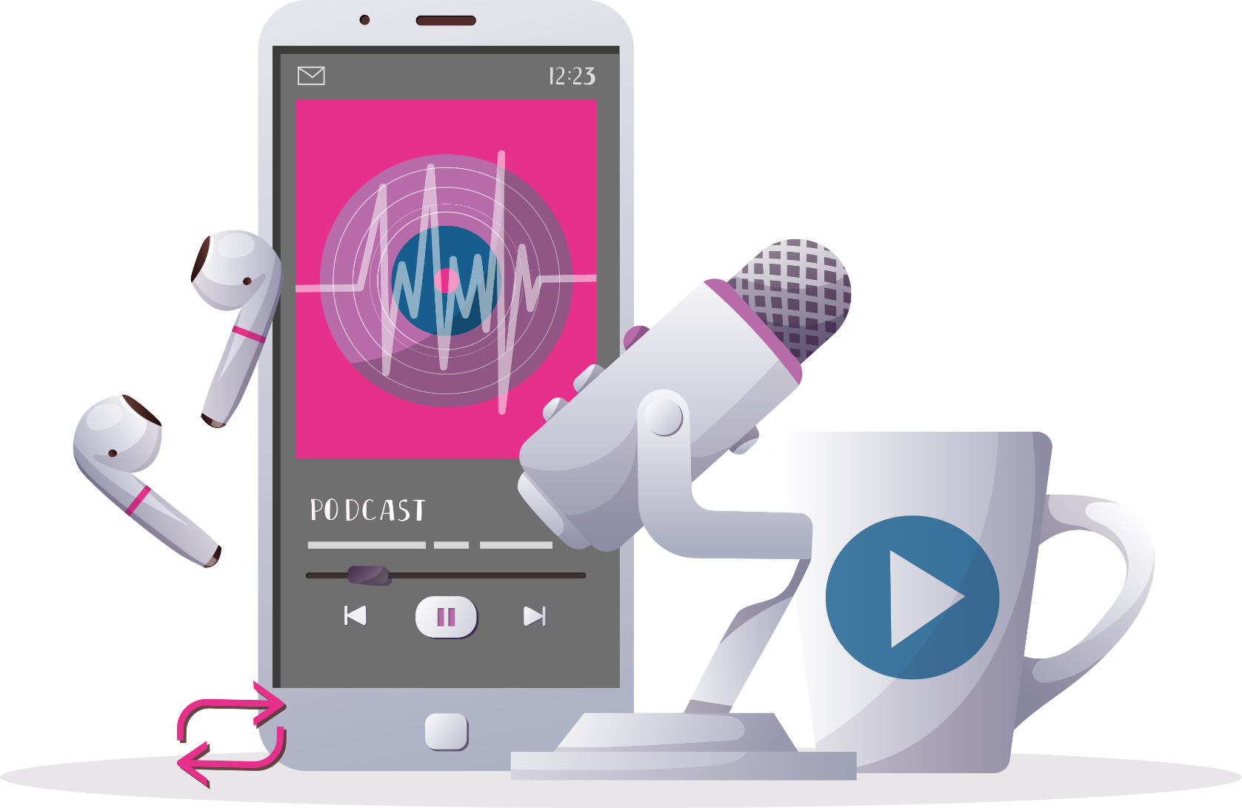
INSPIRING THE
NEXT GENERATION
FUTURUM
PODCAST
In conversation with
Dr Jennifer Quaid
ftlyp
futurumcareers.com

Slide 2

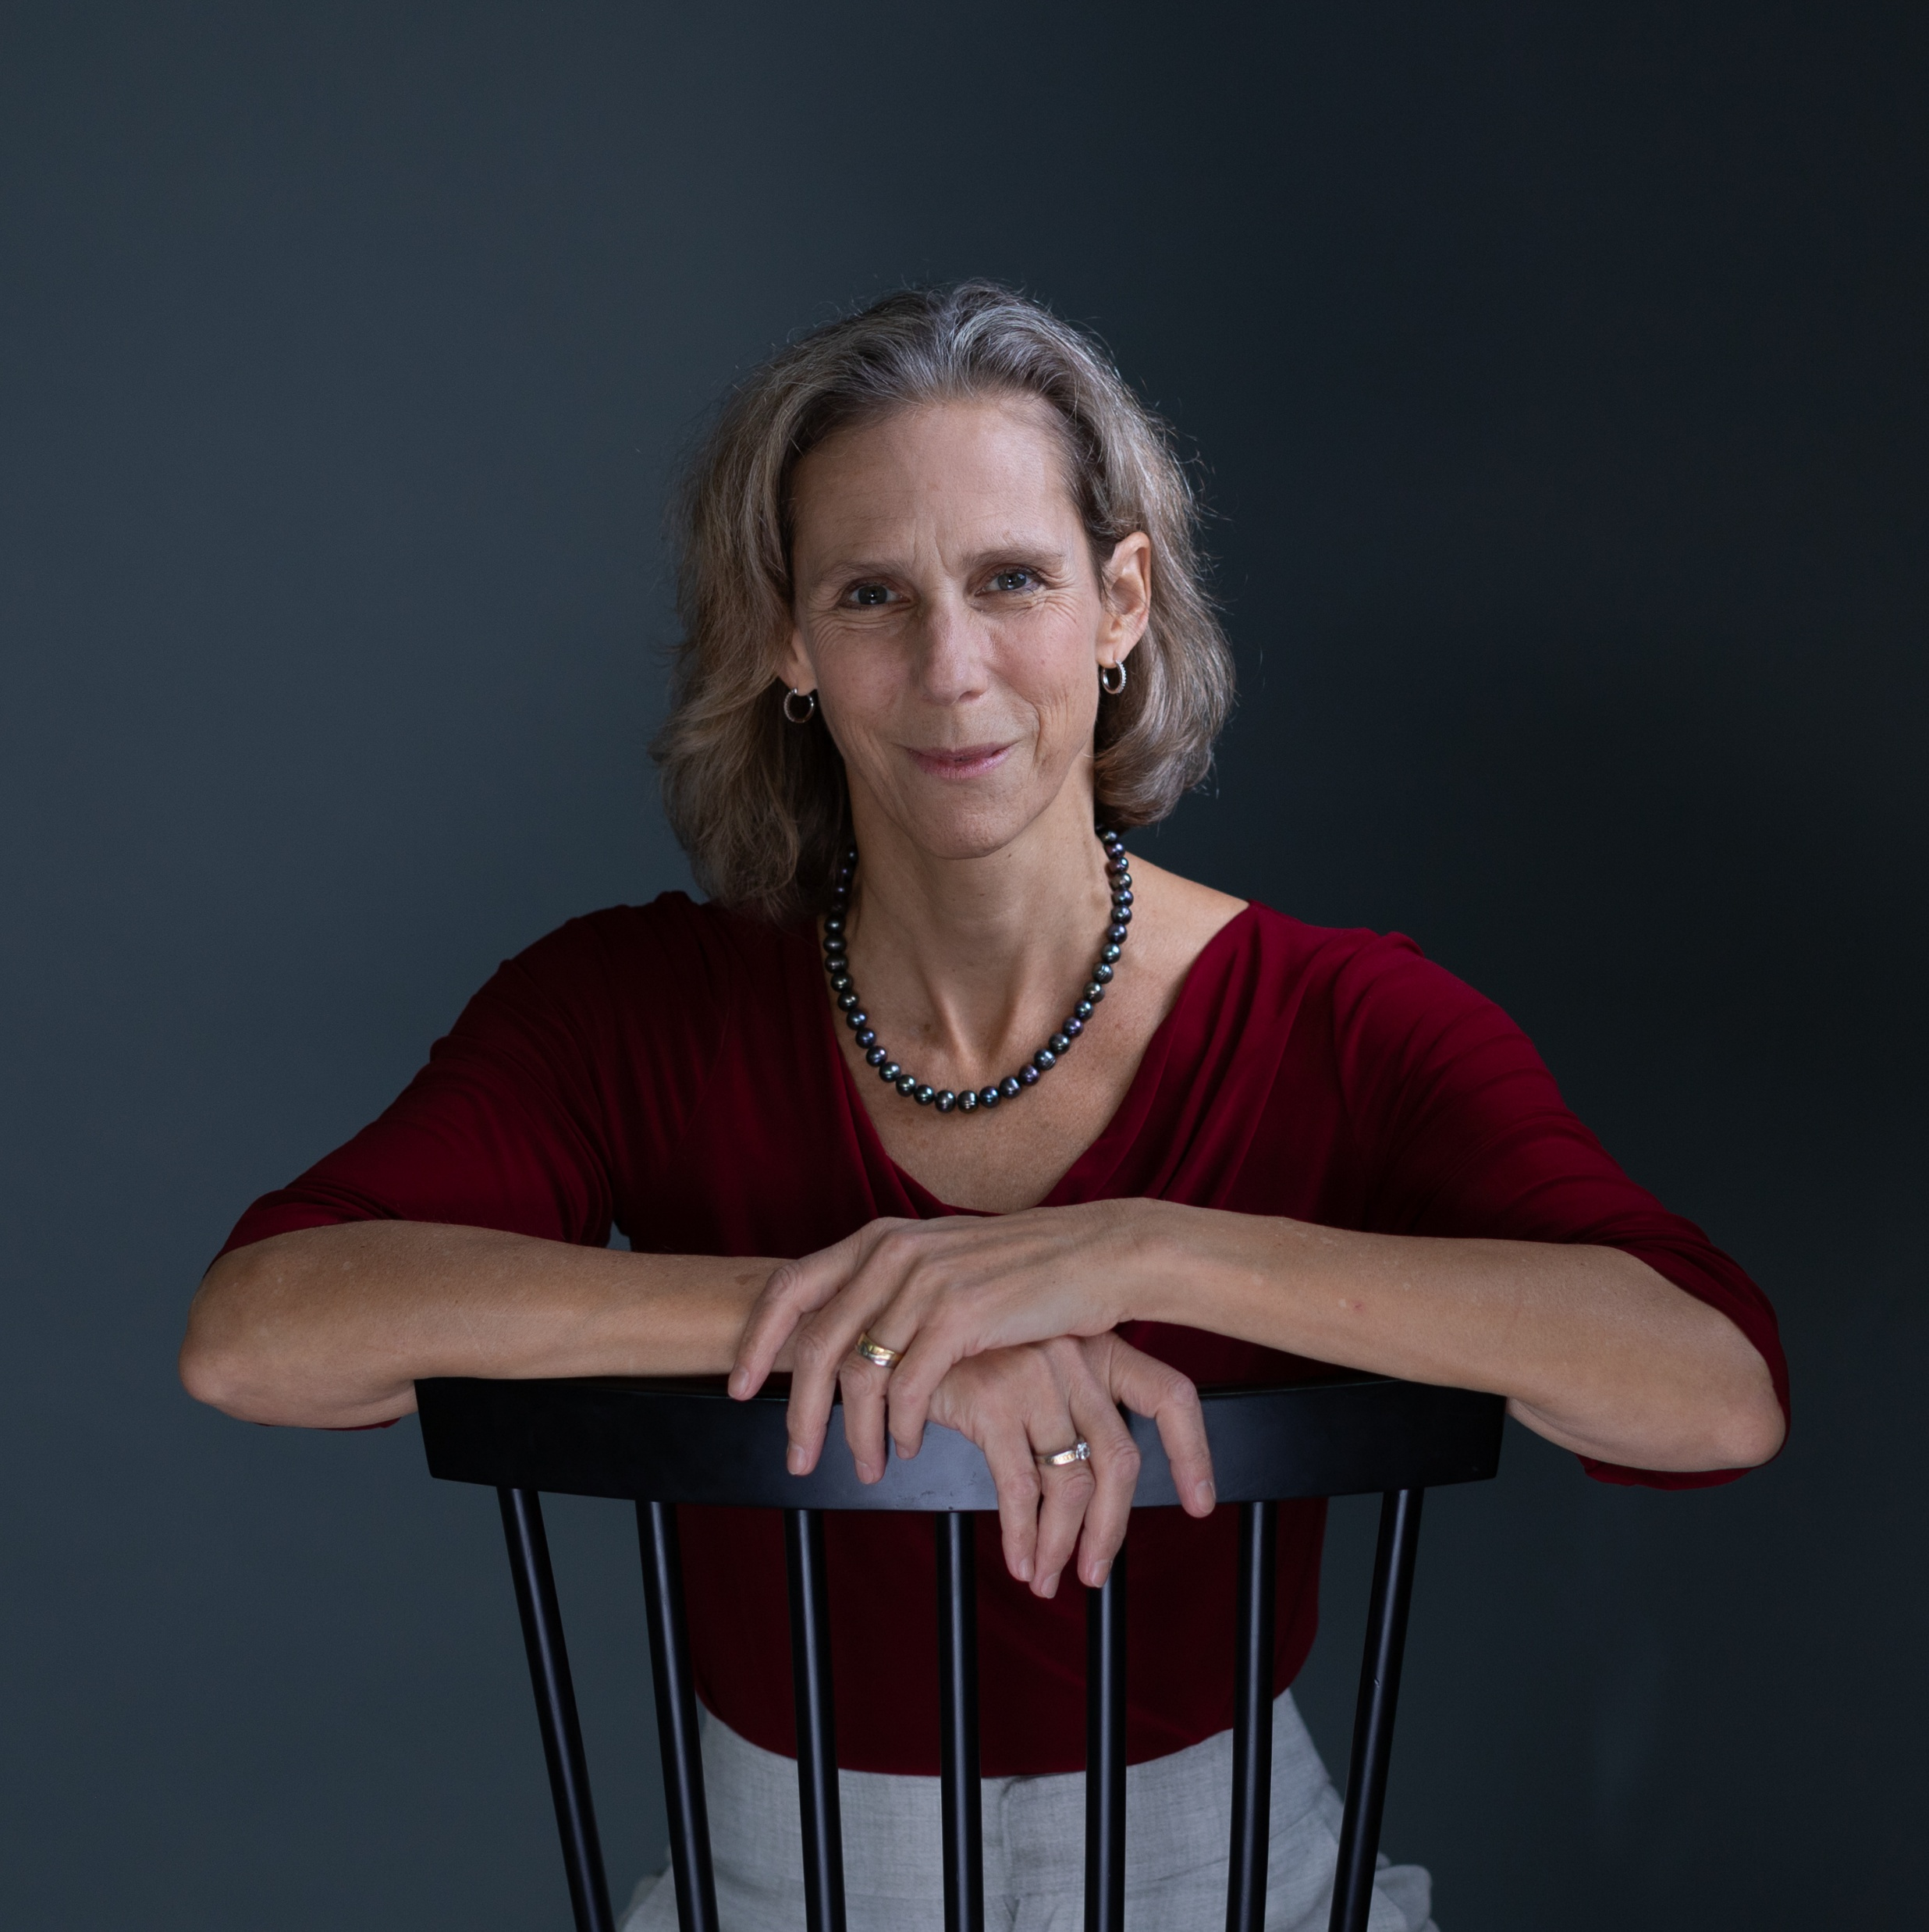
Pre-listening | Break it down | Post-listening | Learn more
Meet
Jennifer
Pre-listening:
In this podcast, Dr Jennifer Quaid, a criminal law researcher in the University of Ottawa’s Faculty of Law, discusses the importance of developing your communication skills, being open-minded and making connections with mentors.
What do you already know about criminal law?
What skills do you think students need to be successful in criminal law?
To what extent are you an open-minded person? How might this help you in a career in criminal law?
Profile
Professor, Civil Law Section, Faculty of Law, University of Ottawa, Canada
Fields of research
Criminal law; economic crime; corporate criminal law; competition law; business regulation; AI governance
“It's important to listen to what others have said, because without consensus, you don't get anything done.”

Slide 3
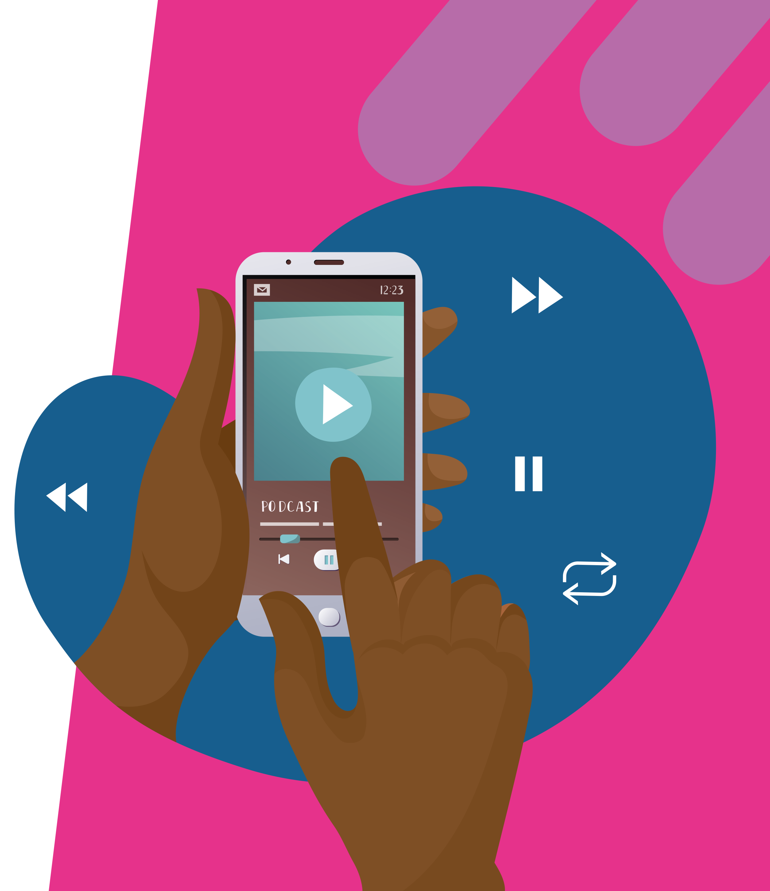

Pre-listening | Break it down | Post-listening | Learn more
Break the podcast down:
Up to 04:45 minutes
If you could use one superpower to help you with your studies, what would it be, and why? What skills could you improve to mimic this superpower?
Why are economic crimes hard to detect?
Why is it less straightforward to punish a group of people than an individual?
What makes remediation agreements such complex cases?
Why are remediation agreements a useful tool both for investigators and for organisations that have committed economic crime?

Slide 4
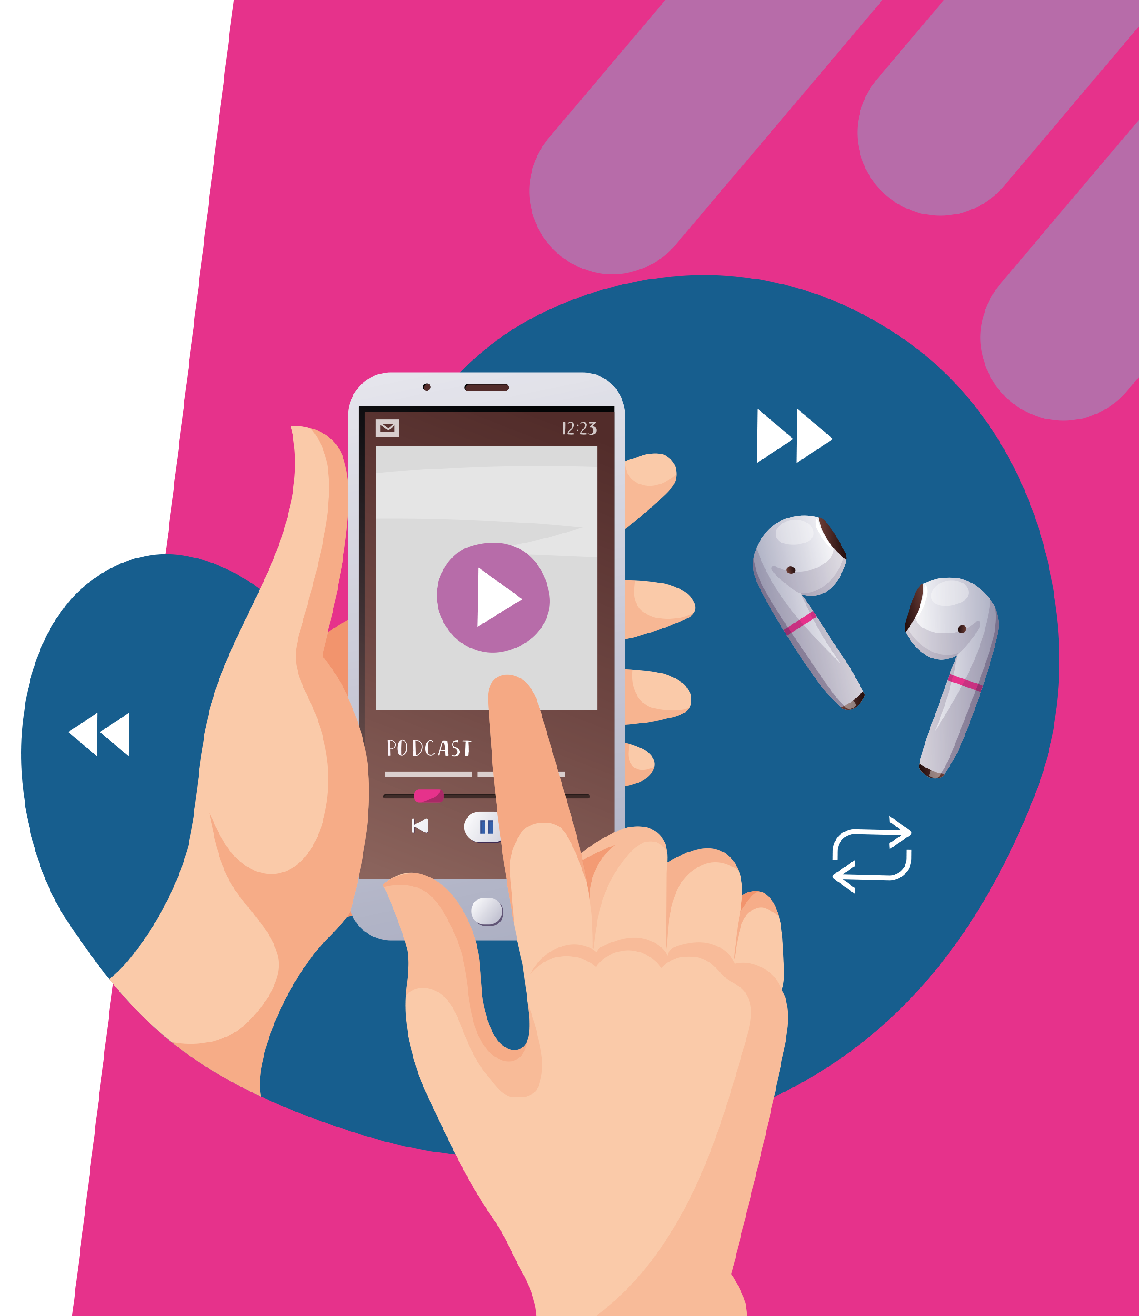
Pre-listening | Break it down | Post-listening | Learn more
Break the podcast down:
04:45 – 06:40
How often do you take the time to reflect on something that you have read or written? How could reflection help you to improve your work?
What is cognitive bias? What steps can you take to avoid succumbing to it?
Why are there fewer ‘absolute certainties’ in the humanities than there are in science? How might this change the way researchers approach questions?
How does Jennifer’s research benefit from her conversations with journalists?

Slide 5
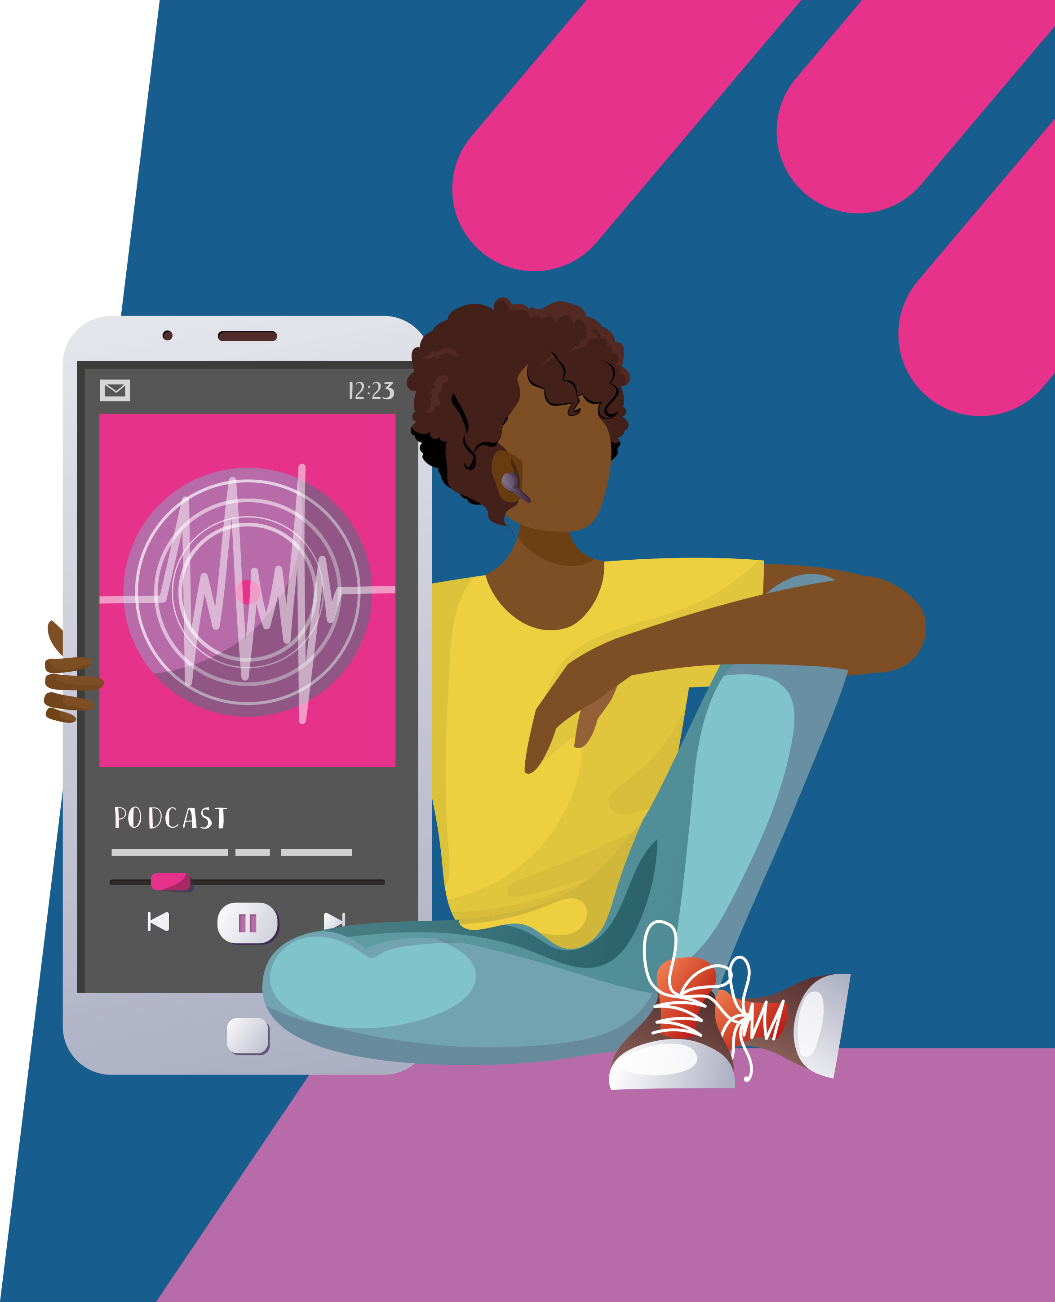
Pre-listening | Break it down | Post-listening | Learn more
Break the podcast down:
06:40 – 08:30
How good are your communication skills? What steps could you take to improve these skills?
Why is it important for an academic to be humble and open-minded?
How well do you handle criticism and constructive feedback? Why might this be important throughout your studies and career?
Jennifer says, “Without consensus, you don’t get anything done. To what extent do you agree with this statement, and why?

Slide 6
Pre-listening | Break it down | Post-listening | Learn more
Break the podcast down:
08:30 – end
Why might things that didn’t turn out so well be important for your professional and personal growth?
How have careers changed since Jennifer graduated in the early 90s?
What ideas do you have for your future career at the moment? How might these ideas change as you navigate your studies and professional life?
Why does Jennifer say that her superpower is the “Thank You Note”?
Why is it important to build relationships with mentors based on trust and mutual respect? How could you start to build these relationships?
What small thing could you do to help make the world a better place?

Slide 7


Pre-listening | Break it down | Post-listening | Learn more
Post-listening:
How would you describe remediation agreements to someone who has not listened to Jennifer’s podcast?
What skills could help you in a career as a criminal law researcher?
To what extent do you have these skills? How could you develop them further?
Which piece of Jennifer’s advice did you find most useful, and why?
How has your understanding of a career in criminal law research changed from listening to Jennifer’s podcast?
What further questions would you ask Jennifer about her research or career journey?*
Submit questions to Jennifer here

Slide 8


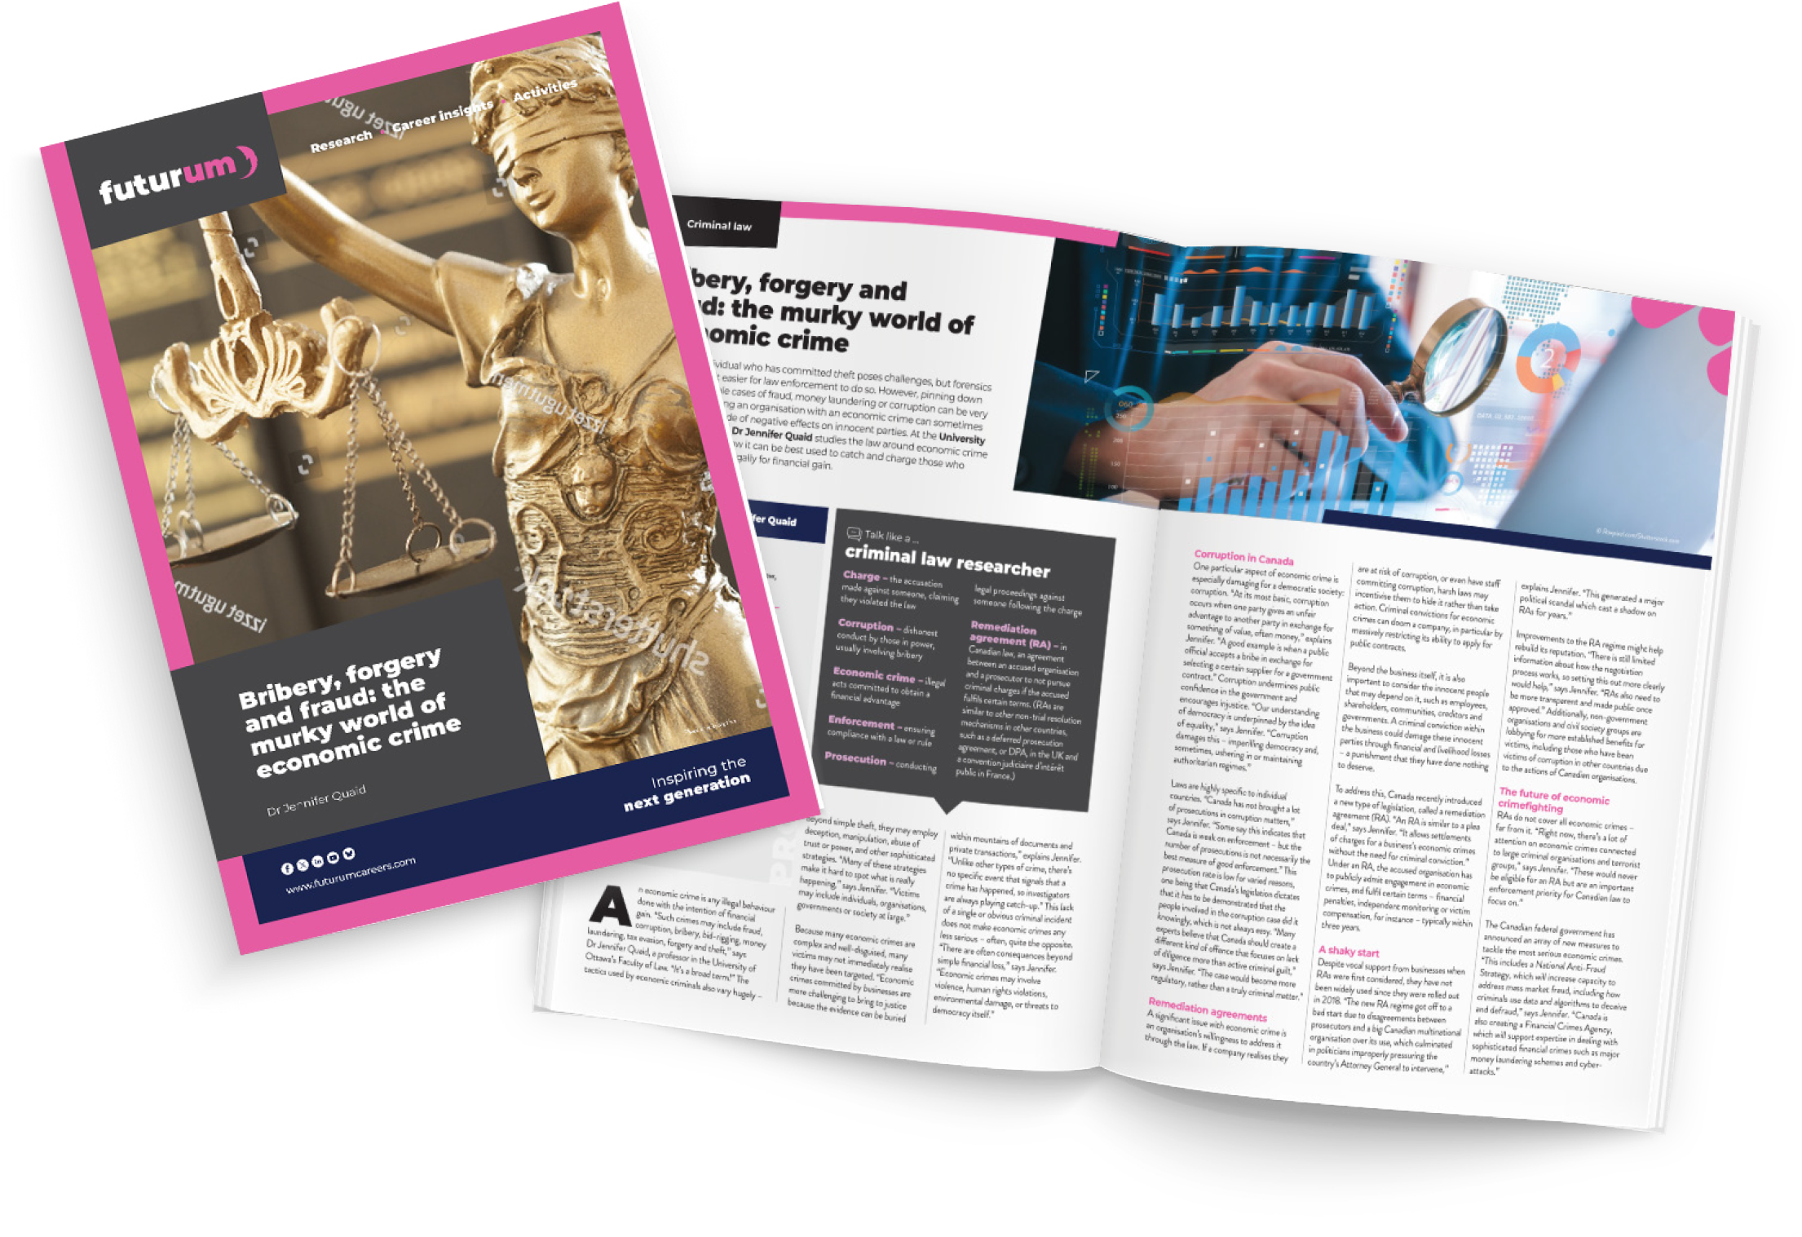
Pre-listening | Break it down | Post-listening | Learn more
Learn more about Jennifer’s work:
Read the article here
Complete the activities
A
Read the article in French here
Inspiring the
next generation
ftlyp
futurumcareers.com

