Slide 1
INSPIRING THE
NEXT GENERATION
FUTURUM
PODCAST
History and Philosophy of Science
Dr Jennifer Mensch and
Dr Michael Olson
ftlyp
futurumcareers.com

Slide 2
Meet
Jennifer and Michael
Pre-listening | Break it down | Post-listening | Learn more
Pre-listening:
Dr Jennifer Mensch and Dr Michael Olson are compiling a collection of scientific and philosophical texts from the 18th and 19th century that explore the history of the concept of race.
What comes to mind when you think about philosophy?
How many philosophers can you name? Do you know what ideas each one is famous for?
Why is it important to explore the history of the concept of race?
Dr Jennifer Mensch
Western Sydney University, Australia
Dr Michael Olson
Marquette University, USA
Field of research
History and philosophy of science

Slide 3
Pre-listening | Break it down | Post-listening | Learn more
Break the podcast down:
Up to 03:30
How did scientific and philosophical questions about reproduction lead to the formation of the concept of race?
Why are Jennifer and Michael producing their anthology?
How does society influence science?
03:30 – 07:30
Why is race a ‘cultural product’, not a natural way of categorising people?
Why is it important to understand that race is a cultural product, not a natural concept?

Slide 4
Pre-listening | Break it down | Post-listening | Learn more
07:30 – 09:35
Why do you think it is compulsory for all students at Michael’s university to take a philosophy class?
How could a knowledge of philosophy help you if you were studying engineering, biology, business, medicine, mathematics or Spanish?
How do you use philosophy in your everyday life?
In your opinion, what does a ‘good life’ look like? How could an understanding of philosophy help you achieve this?
09:35 – end
How do you reflect on situations and experiences? How could journalling help you in your reflections?
What philosophical ideas are portrayed in science fiction books, films and TV shows?

Slide 5
Pre-listening | Break it down | Post-listening | Learn more
Post-listening:
Why is it important to understand the roots of concepts of race?
How can an understanding of philosophy help you evaluate the ideas you inherit from society and the people around you? Why is this important?
If you were to try something ‘different, hard and new’, what would it be, and why? What do you think you could learn and/or achieve from the experience?
Which tips and pieces of advice from Jennifer and Michael did you find most useful, and why?
What further questions would you ask Jennifer and Michael about their research and/or studying philosophy?*
Submit questions to Jennifer and Michael here

Slide 6
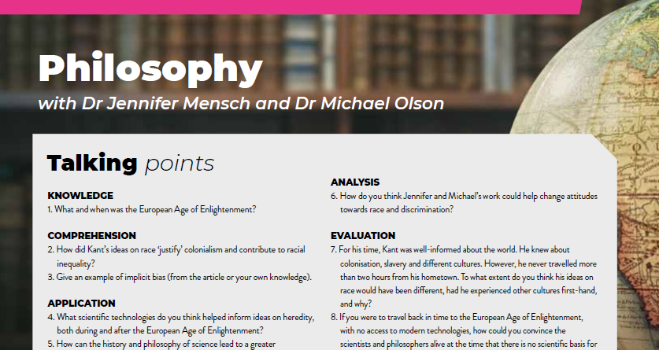
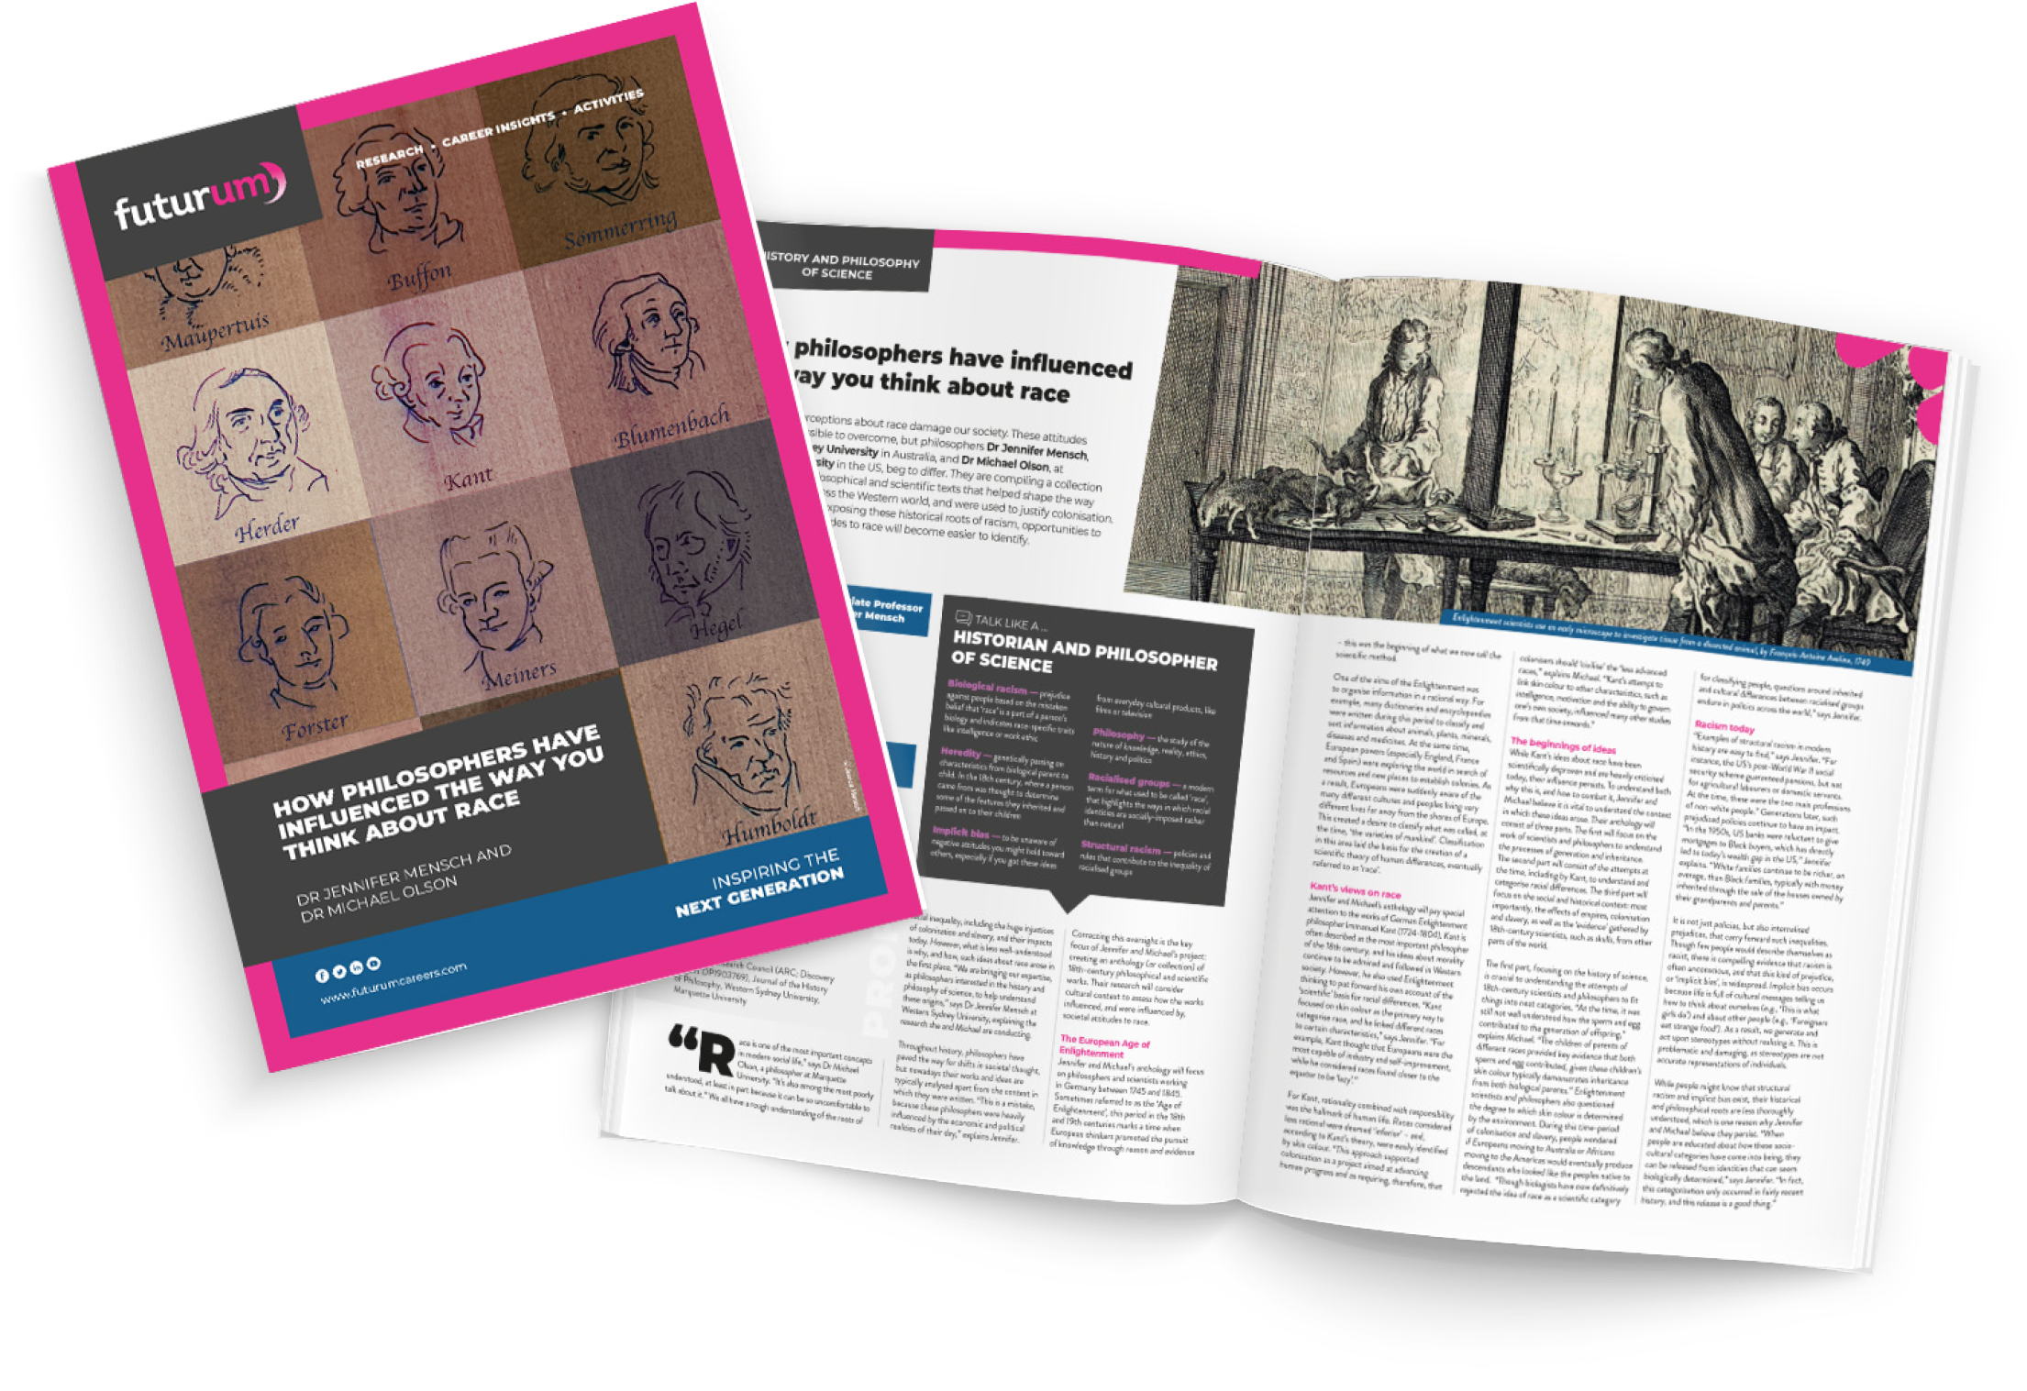
Pre-listening | Break the down | Post-listening | Learn more
Learn more about Jennifer and Michael’s work:
A
Read the article here
A
Download the activity sheet here
INSPIRING THE
NEXT GENERATION
ftlyp
futurumcareers.com

