Slide 1
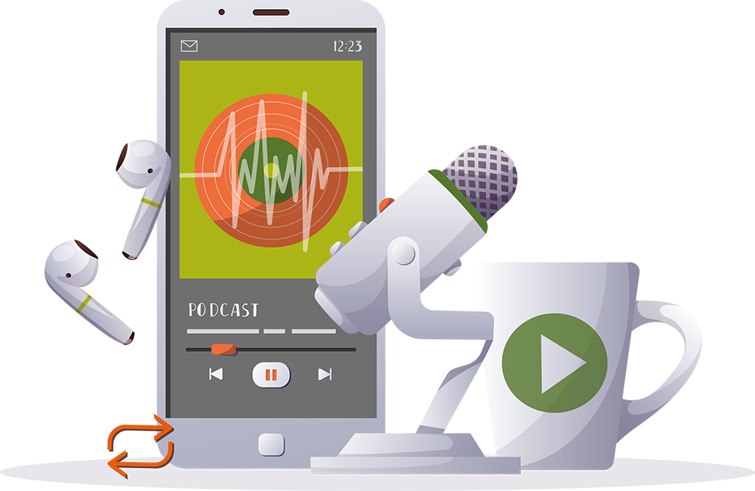
INSPIRING THE
NEXT GENERATION
FUTURUM
PODCAST
Indigenous Knowledge in Science and Education
Dr Judi Brown Clarke
ftlyp
futurumcareers.com

Slide 2
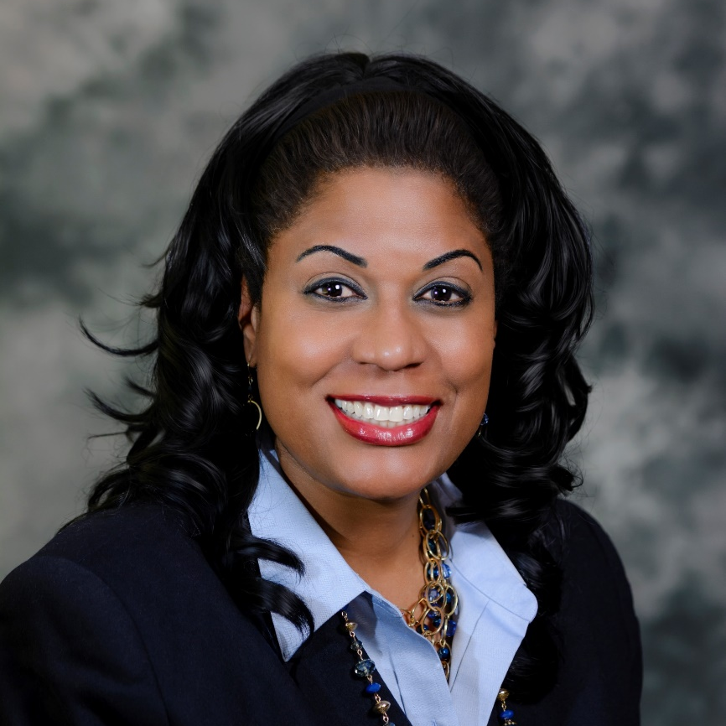
Pre-listening | Break it down | Post-listening | Learn more
Meet
Dr Judi Brown Clarke
Pre-listening:
In this podcast, Judi discusses the different ways in which Indigenous communities and western scientists view the world. She also explains the importance of diversity and inclusion in science and education, and shares her experiences as an elite athlete.
Why do you think it is important to incorporate traditional Indigenous knowledge in science education and research?
What problems arise from a lack of diversity and inclusion in science and education?
Profile
Vice President for Equity and Inclusion, Chief Diversity Officer, Stony Brook University, USA
FIELD OF RESEARCH
Inclusive Education
“It is so important that Indigenous voices are strong within research and education.”

Slide 3
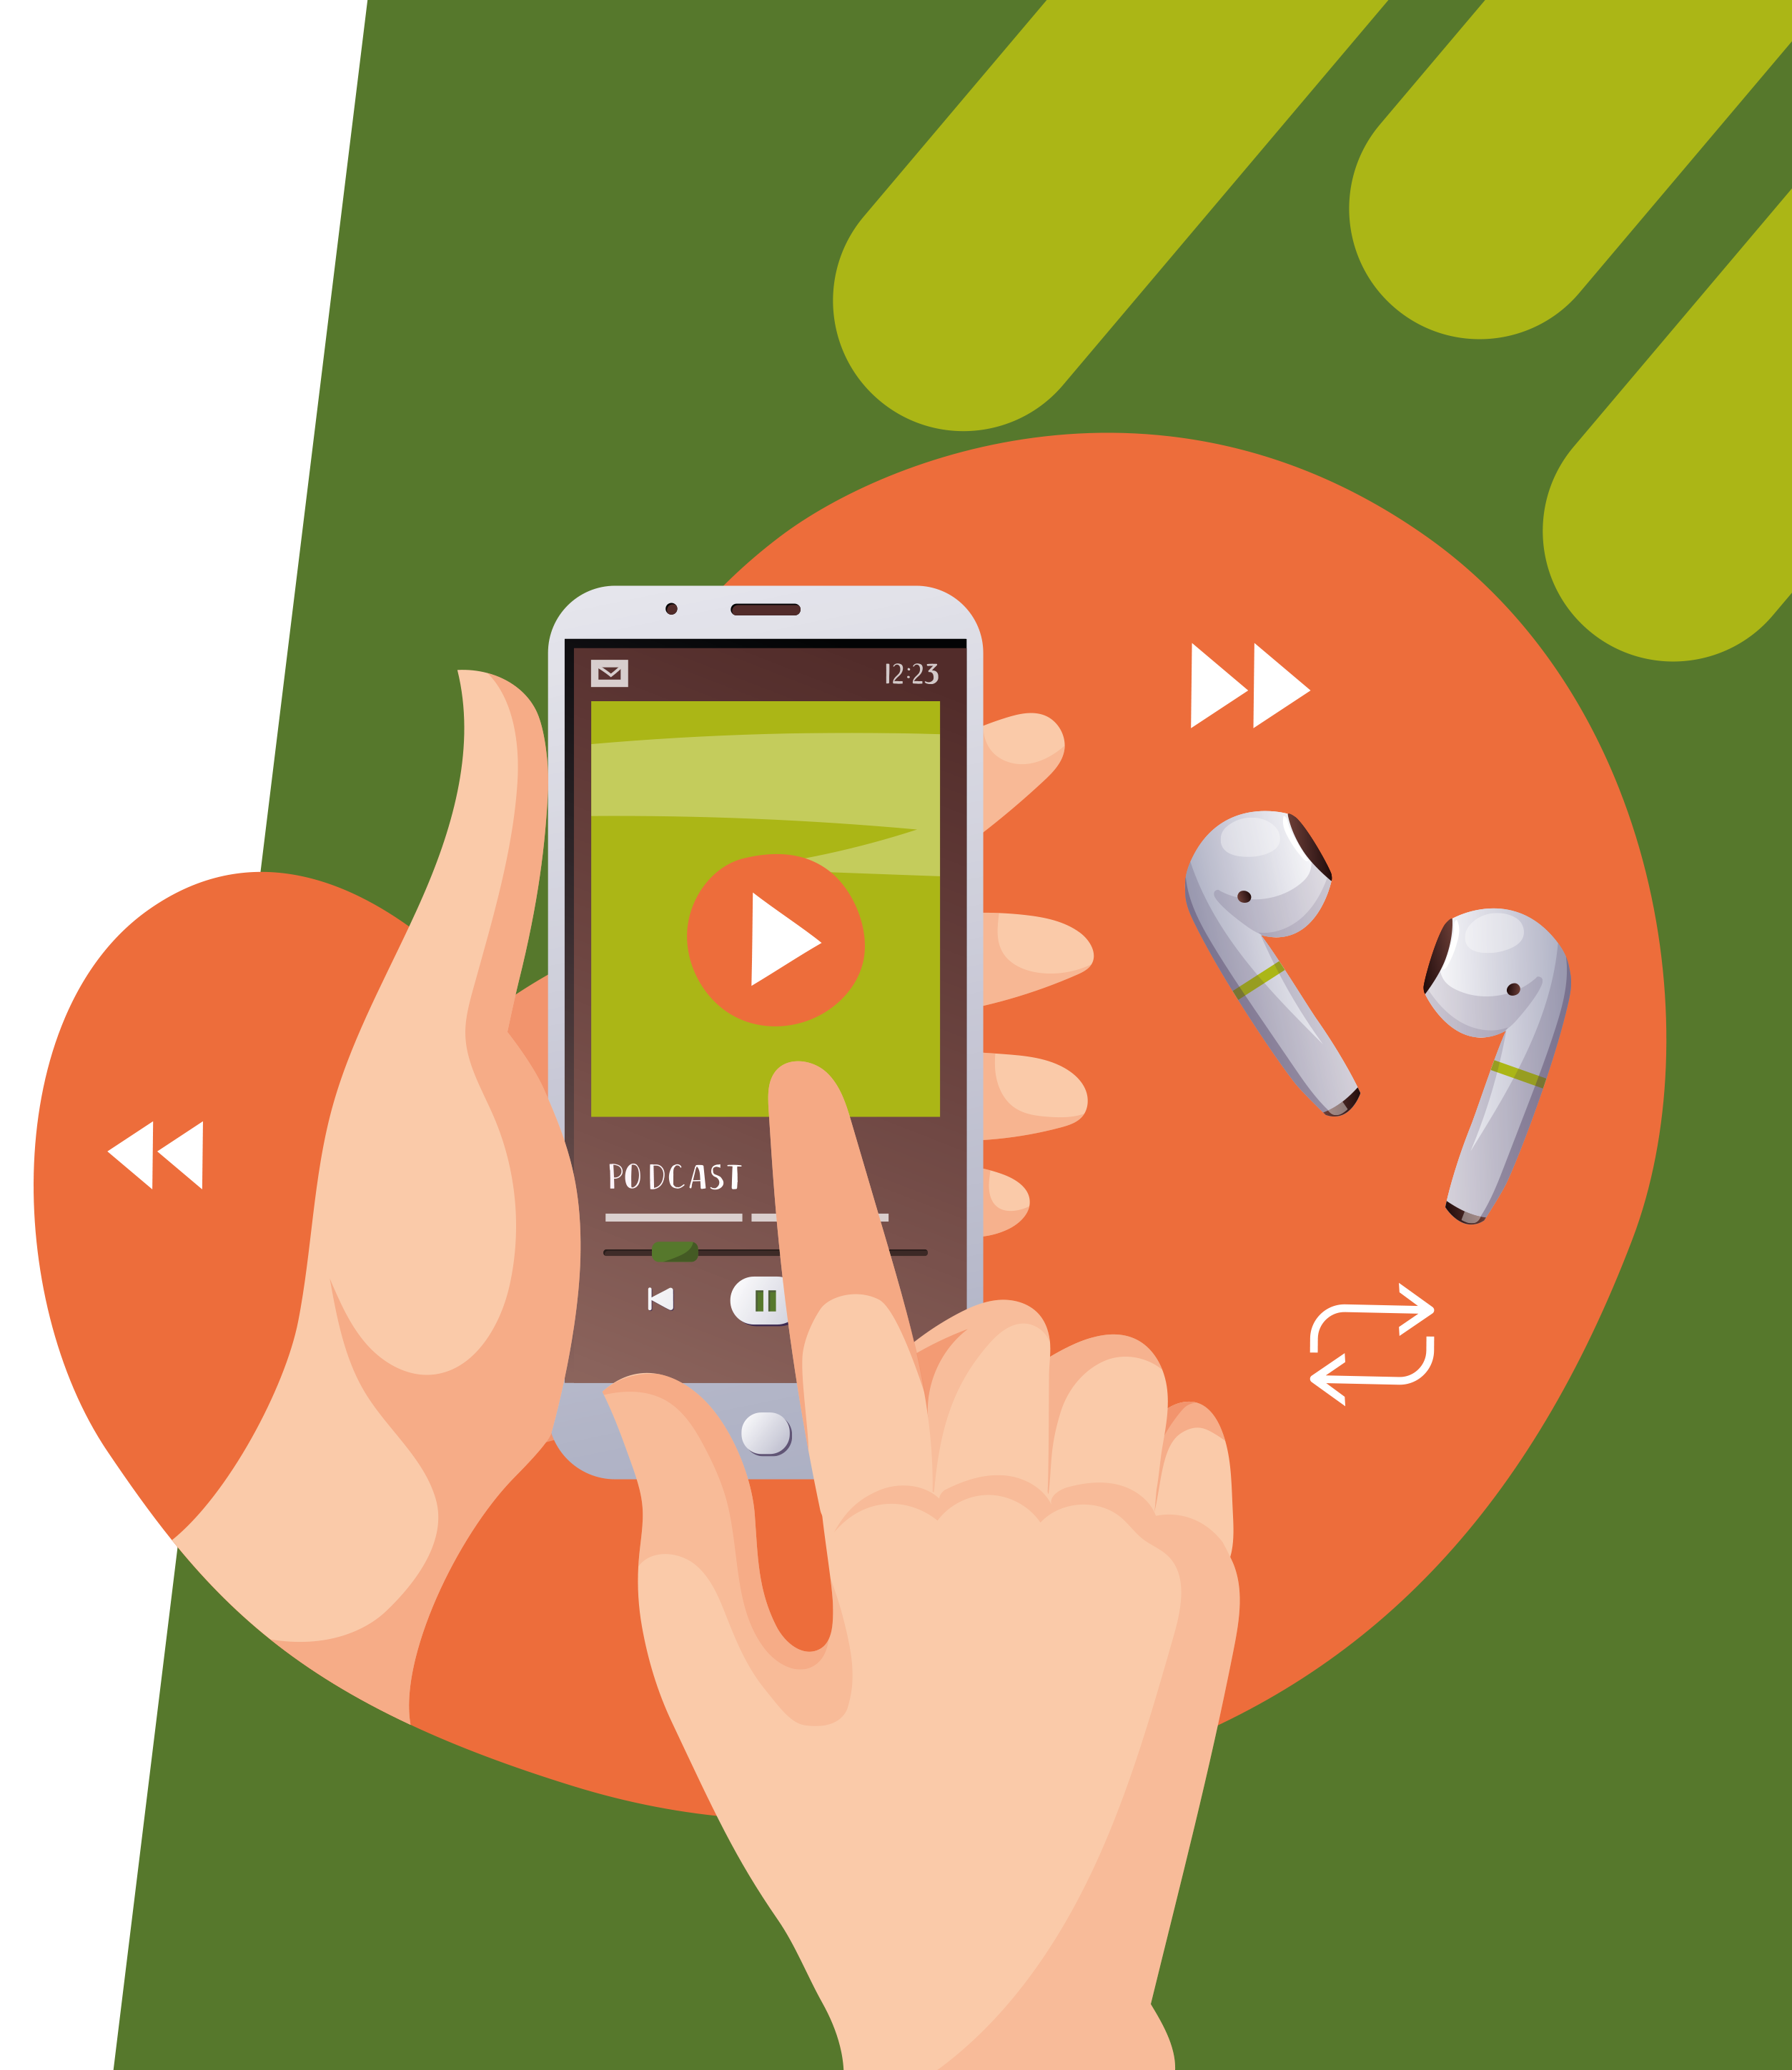
Pre-listening | Break it down | Post-listening | Learn more
Break the podcast down:
Up to 02:45 minutes
What are the differences between traditional Indigenous knowledge and western science?
What do you think it means to ‘make the table where decisions are made more inclusive, equitable and diverse’?
How will science and society benefit from a more inclusive, equitable and diverse ‘table’?
02:45 – 06:00
What should scientists consider when conducting research on or around Indigenous lands, and why?
What characteristics do you think a ‘compassionate researcher’ has?
How do you think these characteristics of compassion can benefit everyone in their lives?

Slide 4
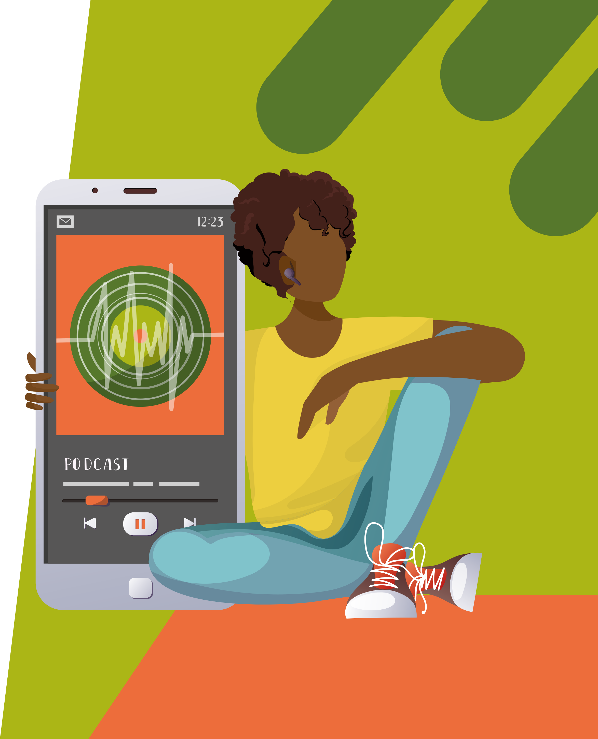
Pre-listening | Break it down | Post-listening | Learn more
06:00 – 09:00
Why do you think Judi feels responsible for using her gifts to break down barriers?
What gifts have you been blessed with? How can you use your gifts to help others?
Why are track and field sports more accessible and inclusive than many other sports?
How has Judi benefited from her experiences as an elite athlete?
If you were to travel somewhere new, how would you prefer to experience the local culture?

Slide 5
Pre-listening | Break it down | Post-listening | Learn more
09:00 – 10:30
To what extent do you agree that ‘this beautiful Earth is very small’? How can ideas about the size of the Earth influence our ideas of global connectivity?
What does the term ‘stewardship’ mean to you?
How do you think someone’s understanding of stewardship and responsibility influences their decision-making?
Why is it important for everyone to work together?
10:30 – end
What does it mean to ‘see yourself’ in a certain career or field, and why is this important?
Who are your role models and mentors? How and why do they inspire and support you?
Why is it important that Indigenous voices are included in conversations about science and education?

Slide 6
Pre-listening | Break it down | Post-listening | Learn more
Post-listening:
Which piece of Judi’s advice did you find most useful, and why?
Judi suggests interviewing someone whose career you find interesting. Who would you choose to talk to, and why?
Judi is developing teaching methods that incorporate Indigenous knowledge in geoscience education. How effective do you think this will be in leading to a more inclusive and diverse society?
Many Indigenous communities believe that we are guests on this planet. How can this view influence the way we treat the Earth?
How do you think science and society can benefit from an understanding of Indigenous knowledge?
How could you personally contribute to a more inclusive society, by ‘getting people to the table, breaking down barriers and opening doors’?
What further questions would you ask Judi about her research or career in inclusive education and/or athletics?*
Submit questions to Judi here

Slide 7
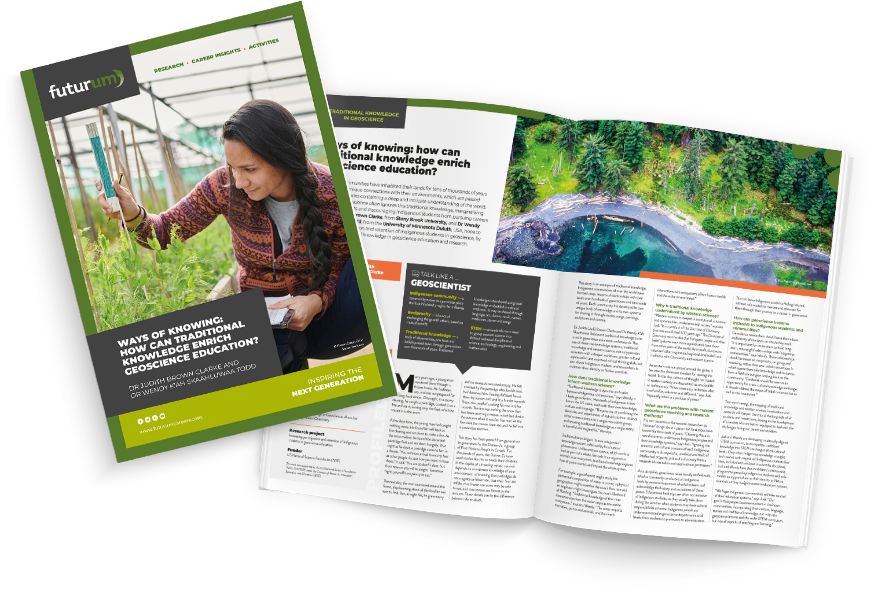
Pre-listening | Break it down | Post-listening | Learn more
Learn more about Judi’s work:
A
Read the article here
A
Download the activity sheet here
INSPIRING THE
NEXT GENERATION
ftlyp
futurumcareers.com

