Slide 1
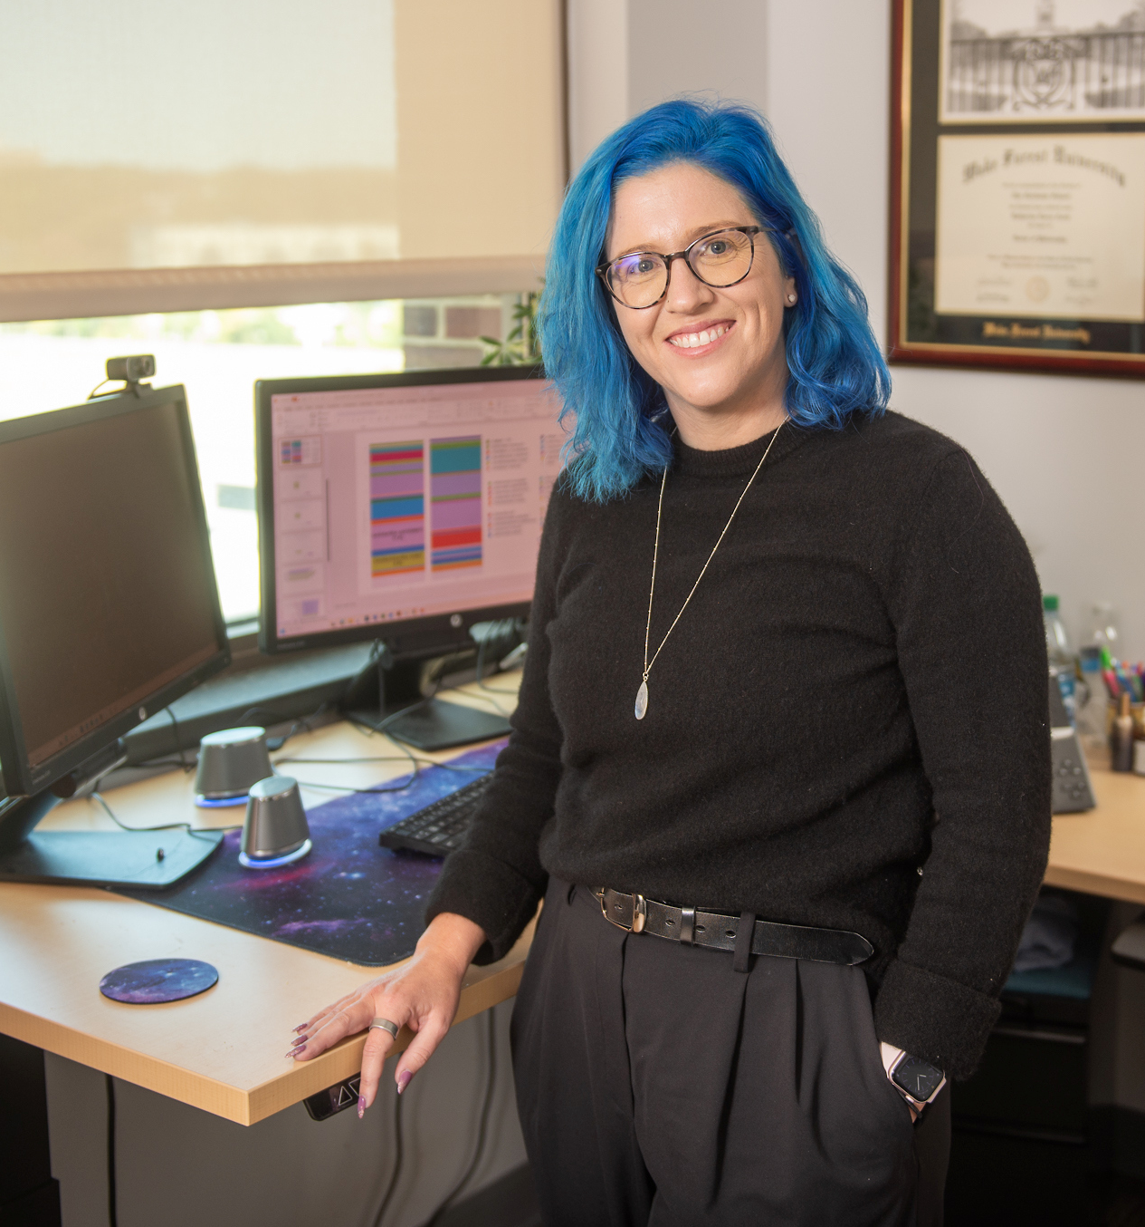

Translational Cancer Research
with
Dr. Katherine Cook
GET STARTED
© Wake Forest University School of Medicine

Slide 2
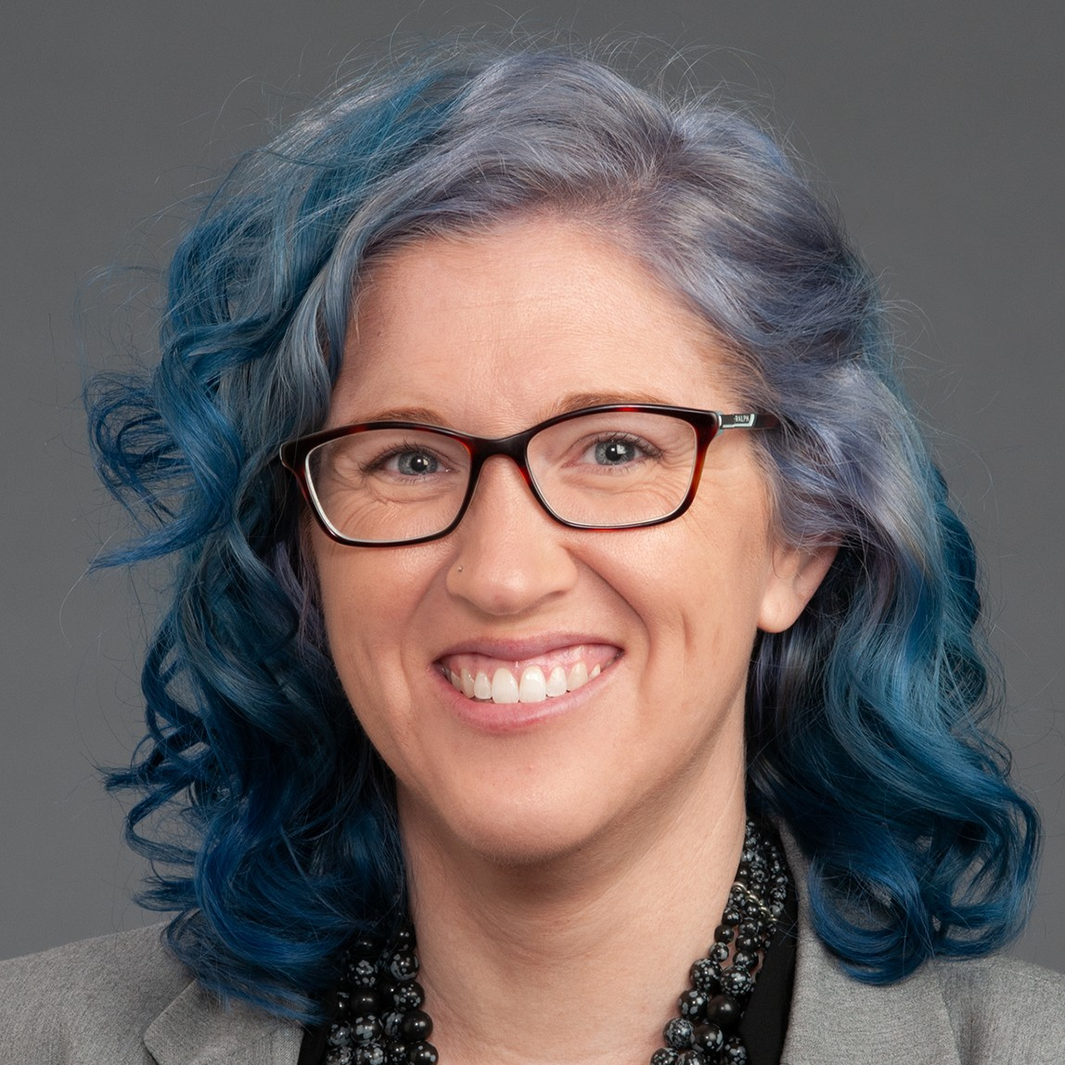
In this Presentation:
Introduction
Katherine’s Research and Career Journey
Talking Points
About Translational Cancer Research
Pathway from School to Translational Cancer Research
Careers in Translational Cancer Research
Talking Points
Meet Katherine
Talking Points
More Resources
Wake Forest University School of Medicine
02 futurumcareers.com

Slide 3
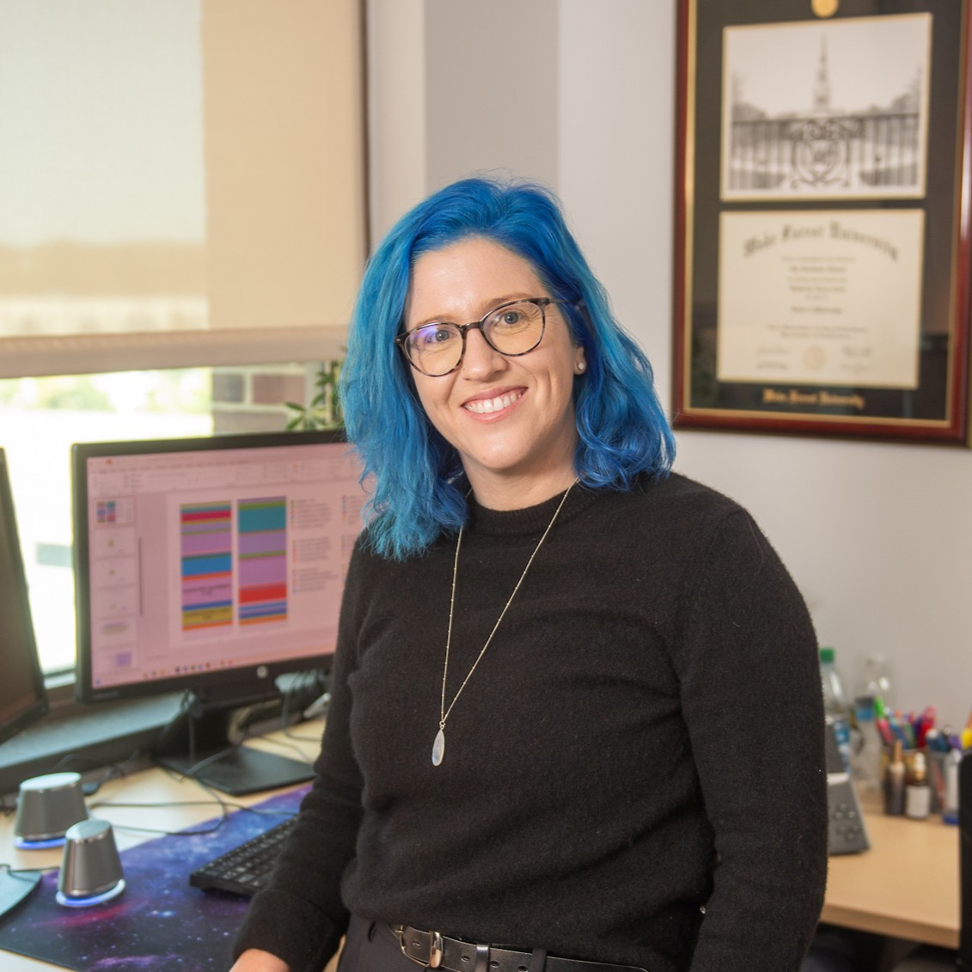
Meet Katherine
Dr. Katherine Cook is a translational cancer researcher at Wake Forest University School of Medicine in the US.
She is analyzing fecal samples from breast cancer patients and using mouse models to explore how the gut microbiome interacts with breast cancer therapies.
Dr. Katherine Cook
Wake Forest University School of Medicine
03 futurumcareers.com

Slide 4
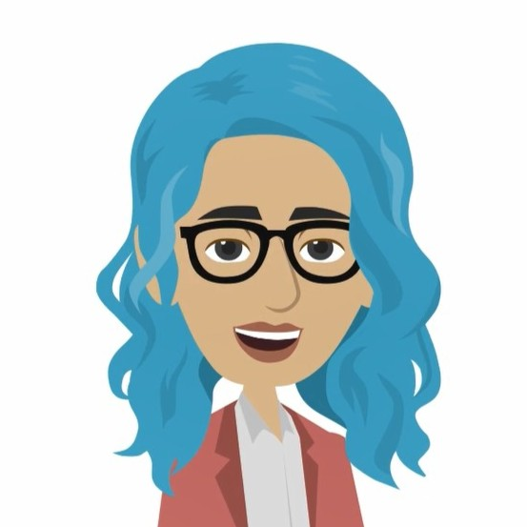
Learn about Katherine’s Research and Career Journey
The animation on the following slide will introduce you to Katherine’s research and career journey.
You can also find it on Katherine’s Futurum page: futurumcareers.com/translational-cancer-research-with-dr-katherine-cook
Or watch it on YouTube: youtube.com/watch?v=wSyup8aKsNc
04 futurumcareers.com

Slide 5


Slide 6

Animation Summary
In most countries, breast cancer is the most common form of cancer in women. And in the US, one in eight women will be diagnosed with breast cancer during their lifetime.
Katherine and her family have been impacted by breast cancer, which motived her to become a translational cancer researcher.
Katherine conducts lab-based research and leads clinical trials to study how the gut microbiome interacts with breast cancer treatments.
Your gut microbiome, which consists of the trillions of microorganisms living in your gut, can impact how well you respond to medical treatments.
06 futurumcareers.com

Slide 7
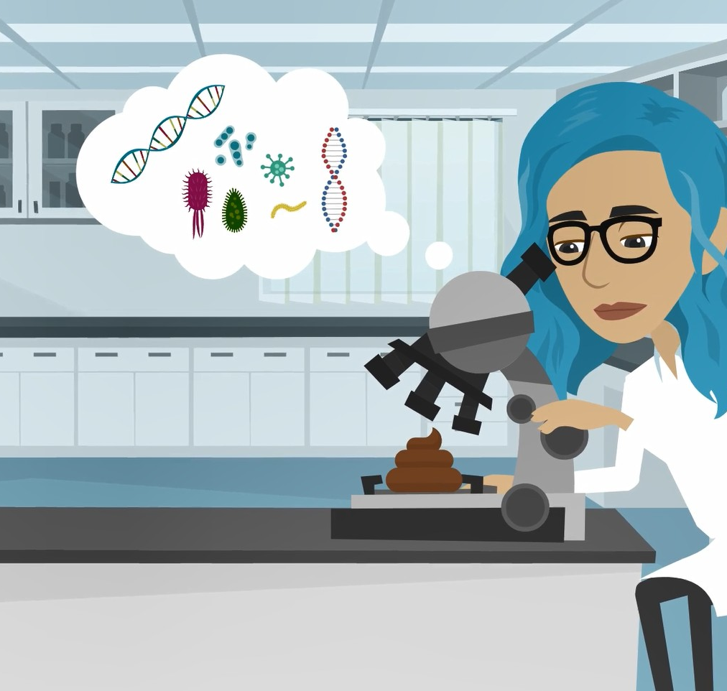
Animation Summary
In one clinical trial, Katherine is collecting fecal samples, blood samples, and diet information from breast cancer patients before and after they complete their treatment.
In the lab, Katherine is using mouse models to test how different diets and gut bacteria impact cancer treatments.
Following her initial results, Katherine is conducting another clinical trial to investigate whether women who eat more healthy fats respond better to immunotherapy.
Katherine hopes her research findings will improve outcomes for future breast cancer patients.
07 futurumcareers.com

Slide 8
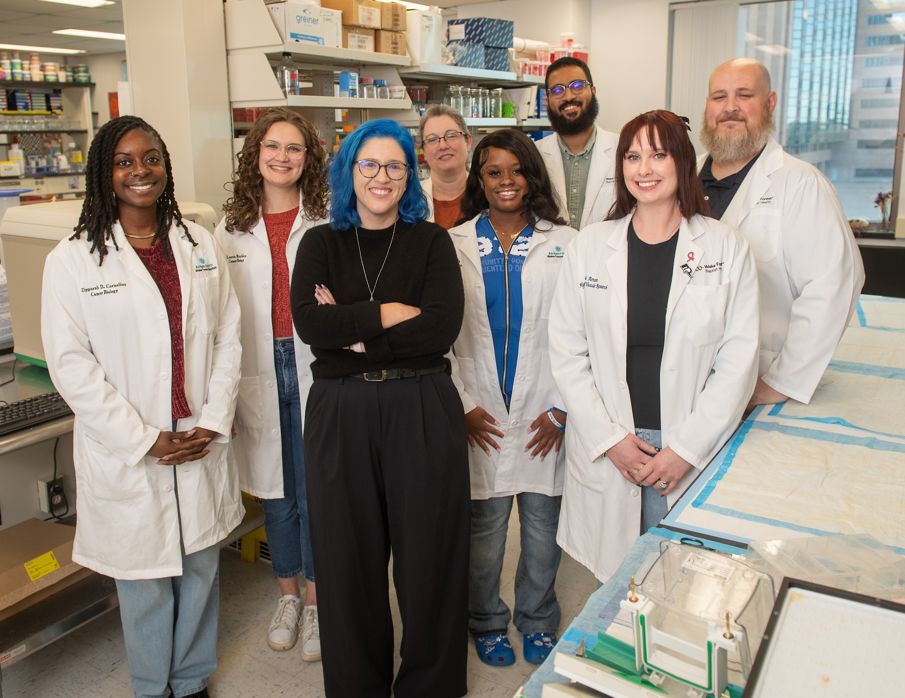
Talking Points
What proportion of women in the US are likely to develop breast cancer?
What is the gut microbiome?
What do you think Katherine can learn from analyzing fecal samples from breast cancer patients?
How and why is Katherine combining clinical trials and lab-based research?
How do you think Katherine’s research will improve treatment outcomes for future breast cancer patients?
08 futurumcareers.com
Wake Forest University School of Medicine

Slide 9
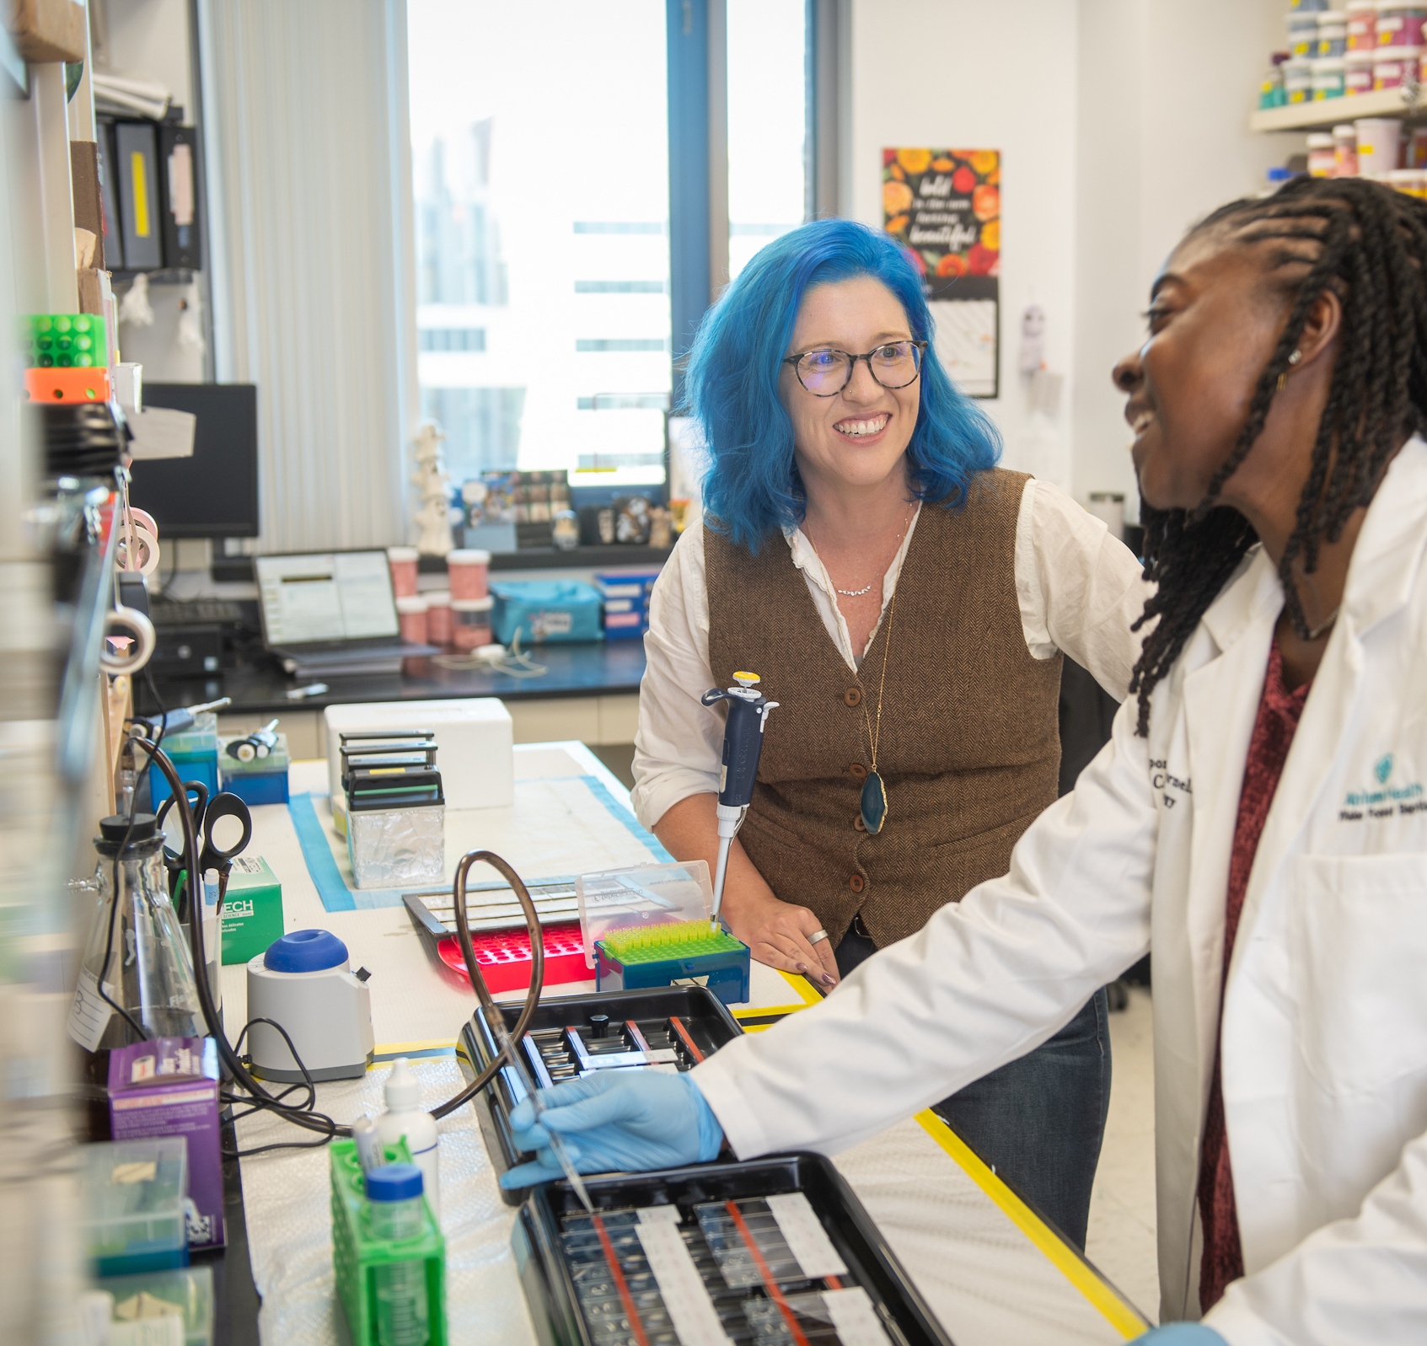
About Translational Cancer Research
“Translational research bridges the gap between basic science and clinical practice to develop practical applications that will directly benefit patients.” – Katherine
Translational cancer researchers use lab-based methods and clinical trials to explore questions such as how cancer cells grow, how the immune system reacts, and, in Katherine’s case, how the gut microbiome and diet might affect treatments.
Answering these questions will lead to more effective prevention strategies and better therapies.
Katherine discusses experiments with PhD student Zipporah Cornelius
09 futurumcareers.com
Wake Forest University School of Medicine

Slide 10
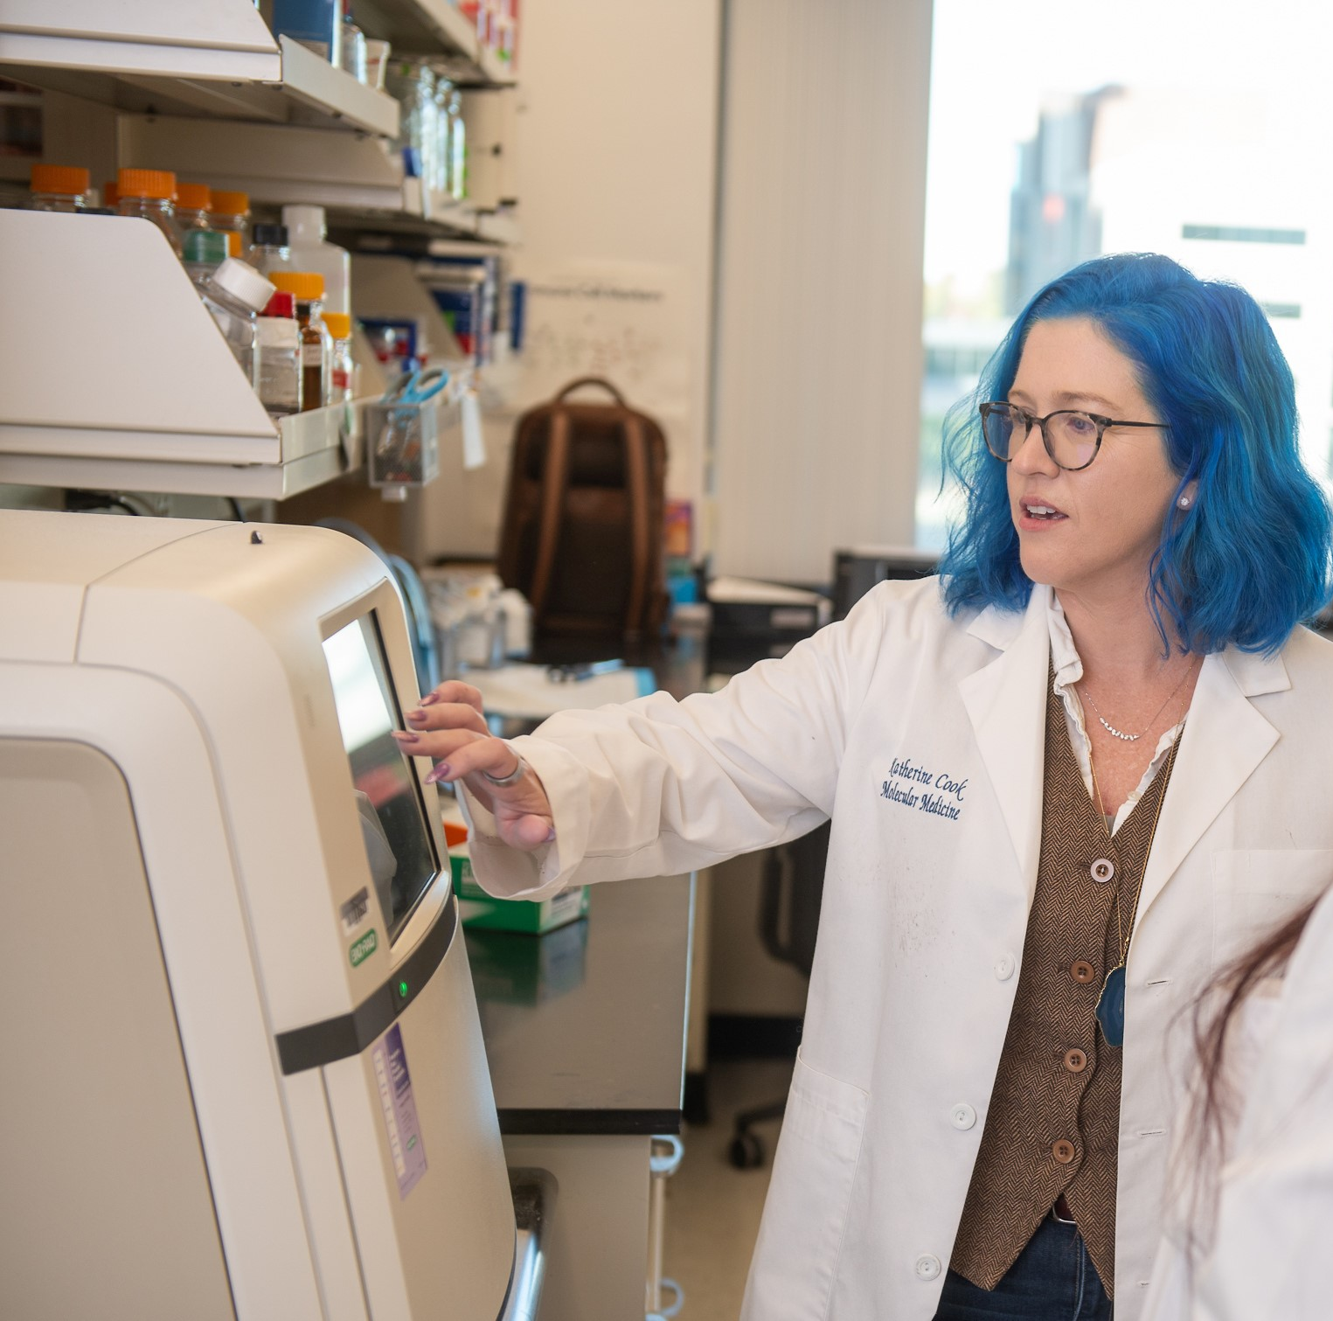
About Translational Cancer Research
“Translational research is defined as the ability to move scientific discoveries from the lab into the clinic for testing to develop real life applications.” – Katherine
This is often known as the bench-to-bedside-to-bench approach, where researchers make discoveries in the lab, then see if these apply in human testing, and then take the results of clinical trials back to the lab to build on them further.
Katherine analyzes data in the lab
10 futurumcareers.com
Wake Forest University School of Medicine

Slide 11
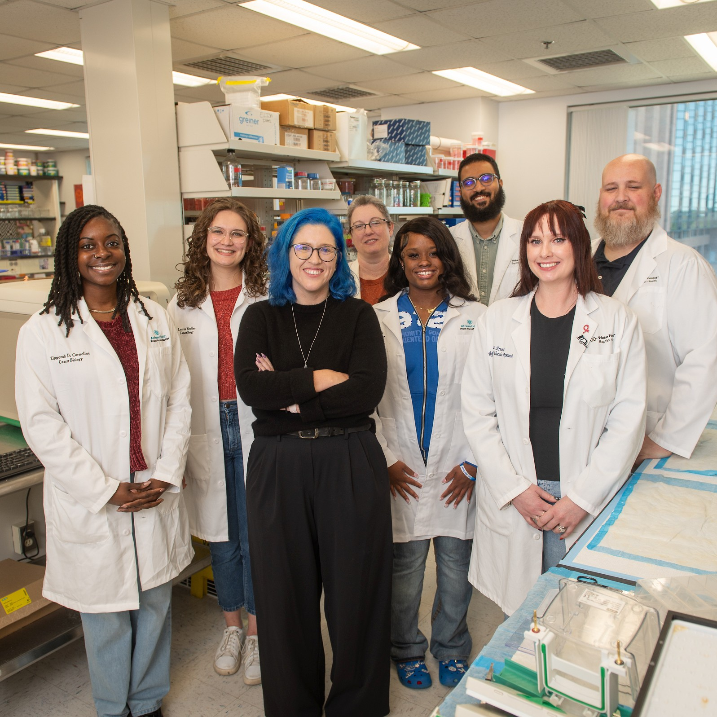
Pathway from School to Translational Cancer Research
Wake Forest University School of Medicine
At high school, study biology, chemistry, and physics, as well as mathematics (to learn about statistics for analyzing data), computing (to learn coding for processing data), and psychology (to help you relate to patients you work with during your career).
“Study anything and everything science! It’s amazing how interconnected all the science topics are to each other.”
– Katherine
At college or university, a degree in biomedical science, biology, or medicine could lead to a career in translational cancer research.
Katherine and her research team in the lab
11 futurumcareers.com

Slide 12
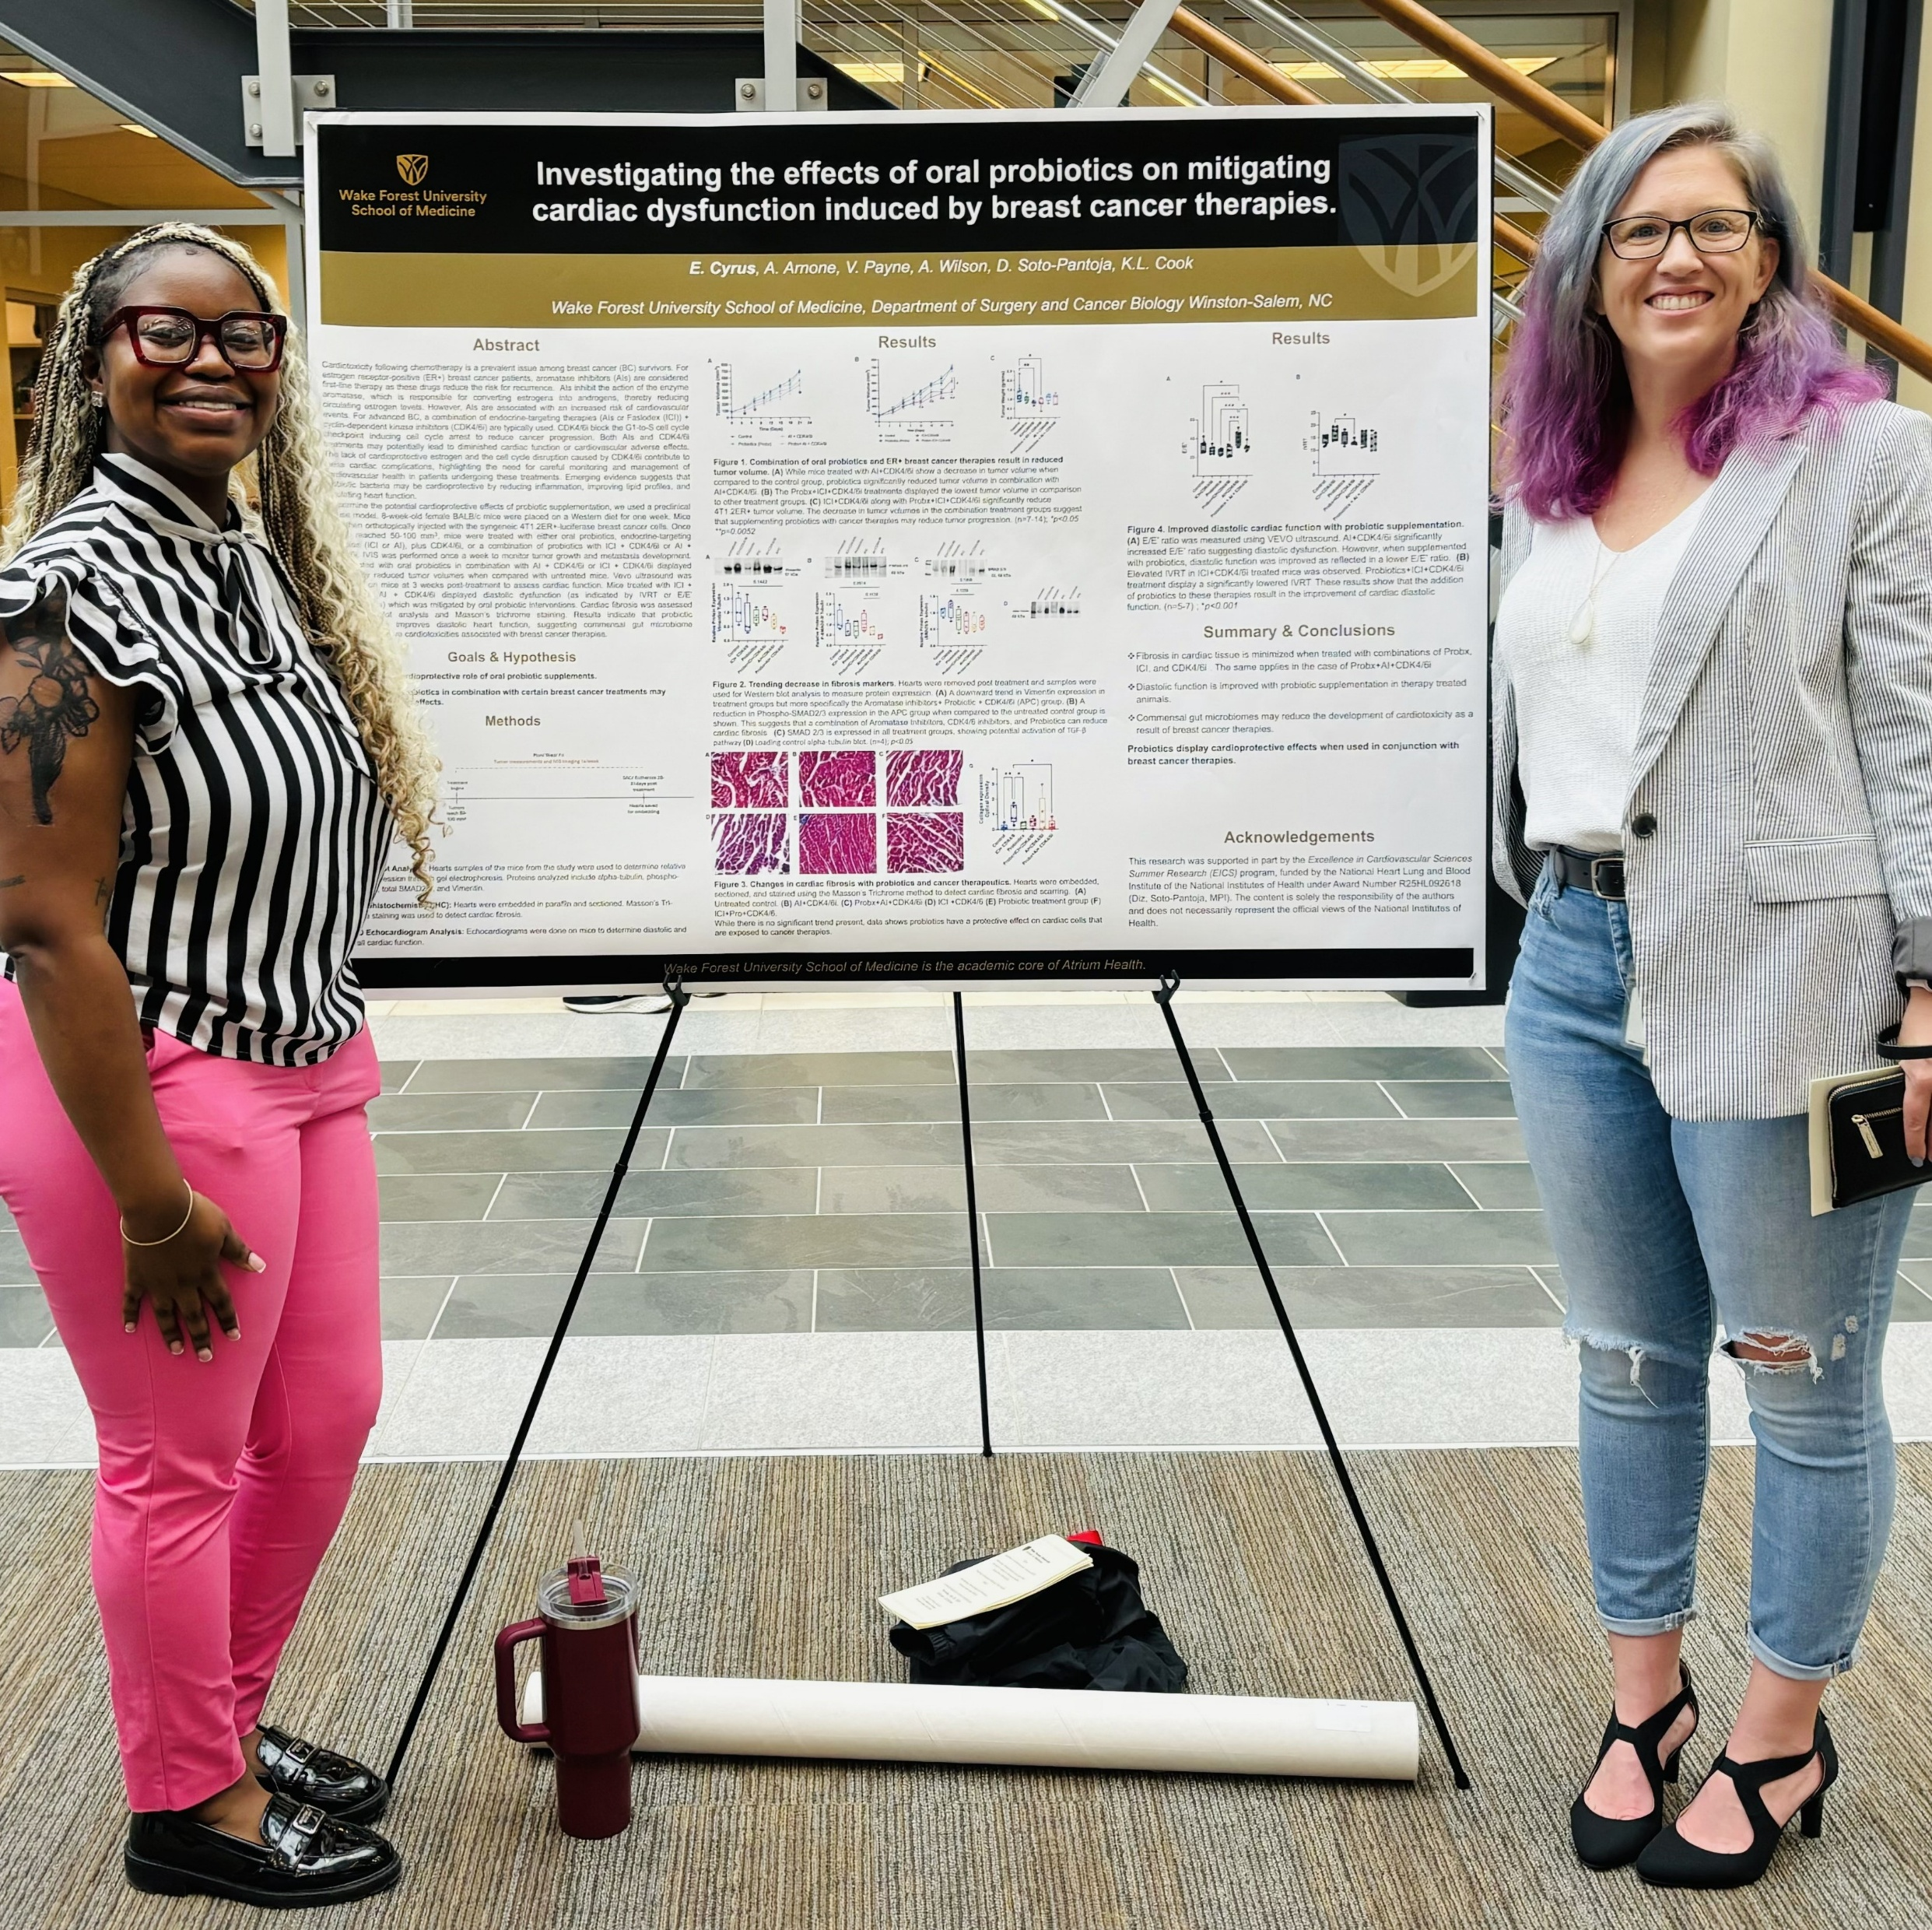
Student Opportunities
Look for opportunities to take part in scientific research to gain valuable work experience.
For example, the Department of Cancer Biology at Wake Forest University School of Medicine has summer research programs for high school and college undergraduate students.
“Participate in summer research experiences or volunteer at a science lab to find out what topics you are passionate about.” – Katherine
Undergraduate student Ellie Cyrus presents the results of her summer research project in Katherine’s lab
12 futurumcareers.com

Slide 13
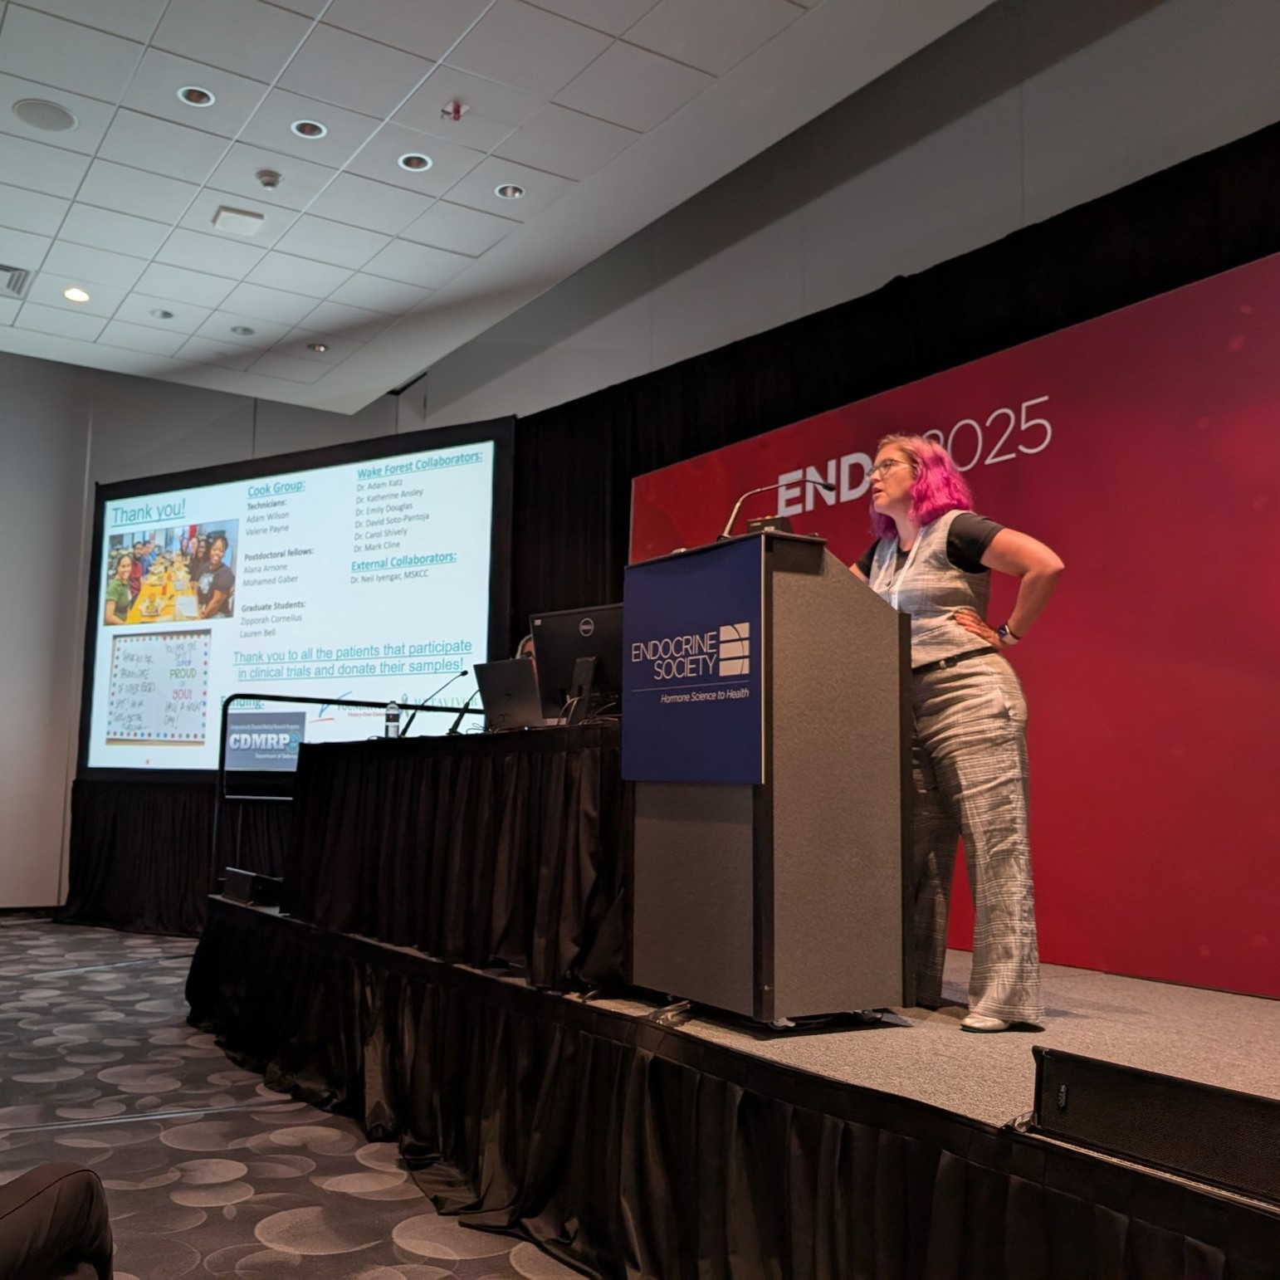
Explore Careers in Translational Cancer Research
“There are a lot of job opportunities for people with a PhD in biomedical sciences.” – Katherine
There are roles in academia (conducting research at universities), industry (working for pharmaceutical companies), and government (working for organizations such as the National Cancer Institute or Food and Drug Administration).
Learn about cancer research and careers from the American Association for Cancer Research, the American Institute for Cancer Research, the Cancer Research Institute, and the American Cancer Society.
Katherine presents her research
13 futurumcareers.com

Slide 14
Talking Points
How is translational research different from basic science research?
In what way is Katherine’s research translational?
What do you think you would most enjoy about a career in translational cancer research, and why?
How could you find opportunities to get involved in scientific research projects?
14 futurumcareers.com
Wake Forest University School of Medicine

Slide 15
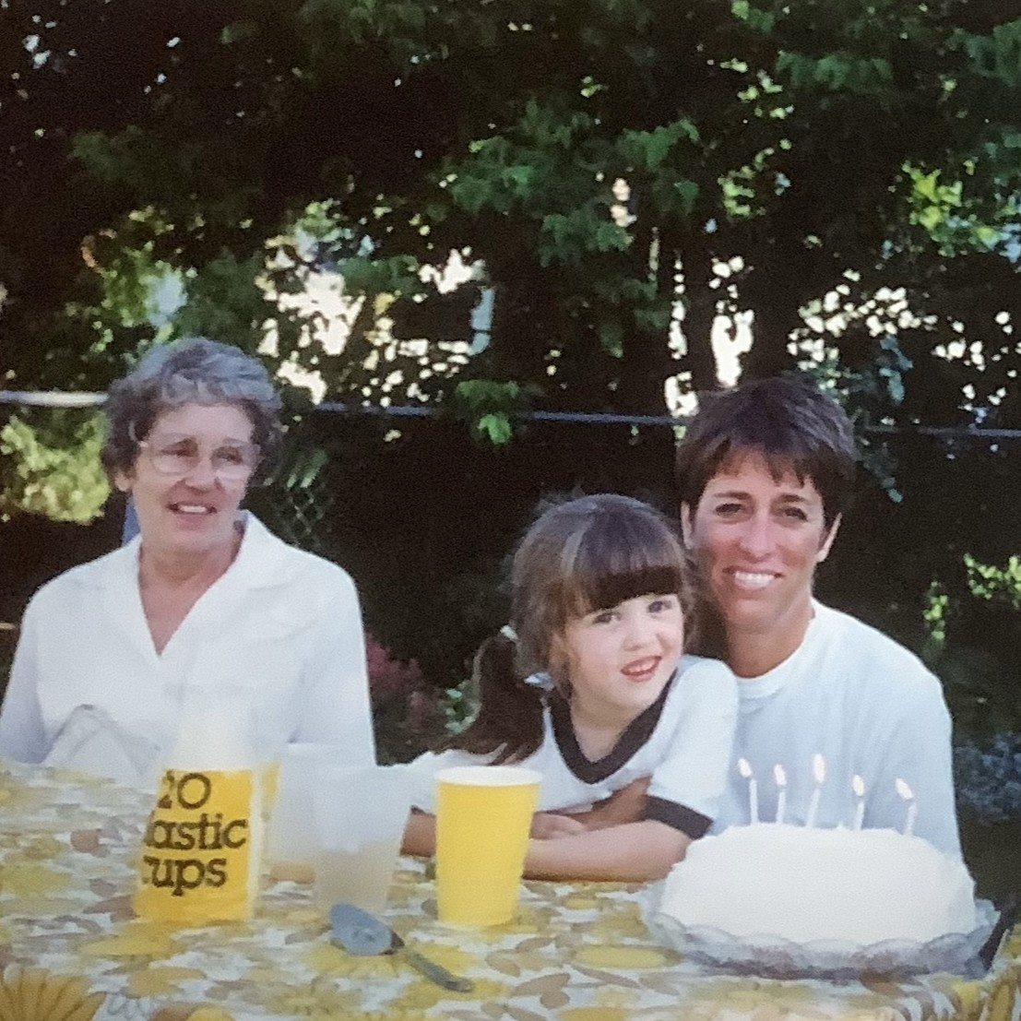
Meet Katherine
Breast cancer has profoundly impacted my family and served as a driver behind my desire to become a breast cancer researcher.
My grandmother was diagnosed with the disease when I was young and, unfortunately, passed away. My mother and aunt have each had a double mastectomy (removal of both breasts).
When I was in graduate school I found my own breast lump. I underwent surgery to remove the lump which, thankfully, was benign (not cancerous).
Katherine aged 8, with her grandmother Loree and Aunt Cindy
15 futurumcareers.com

Slide 16
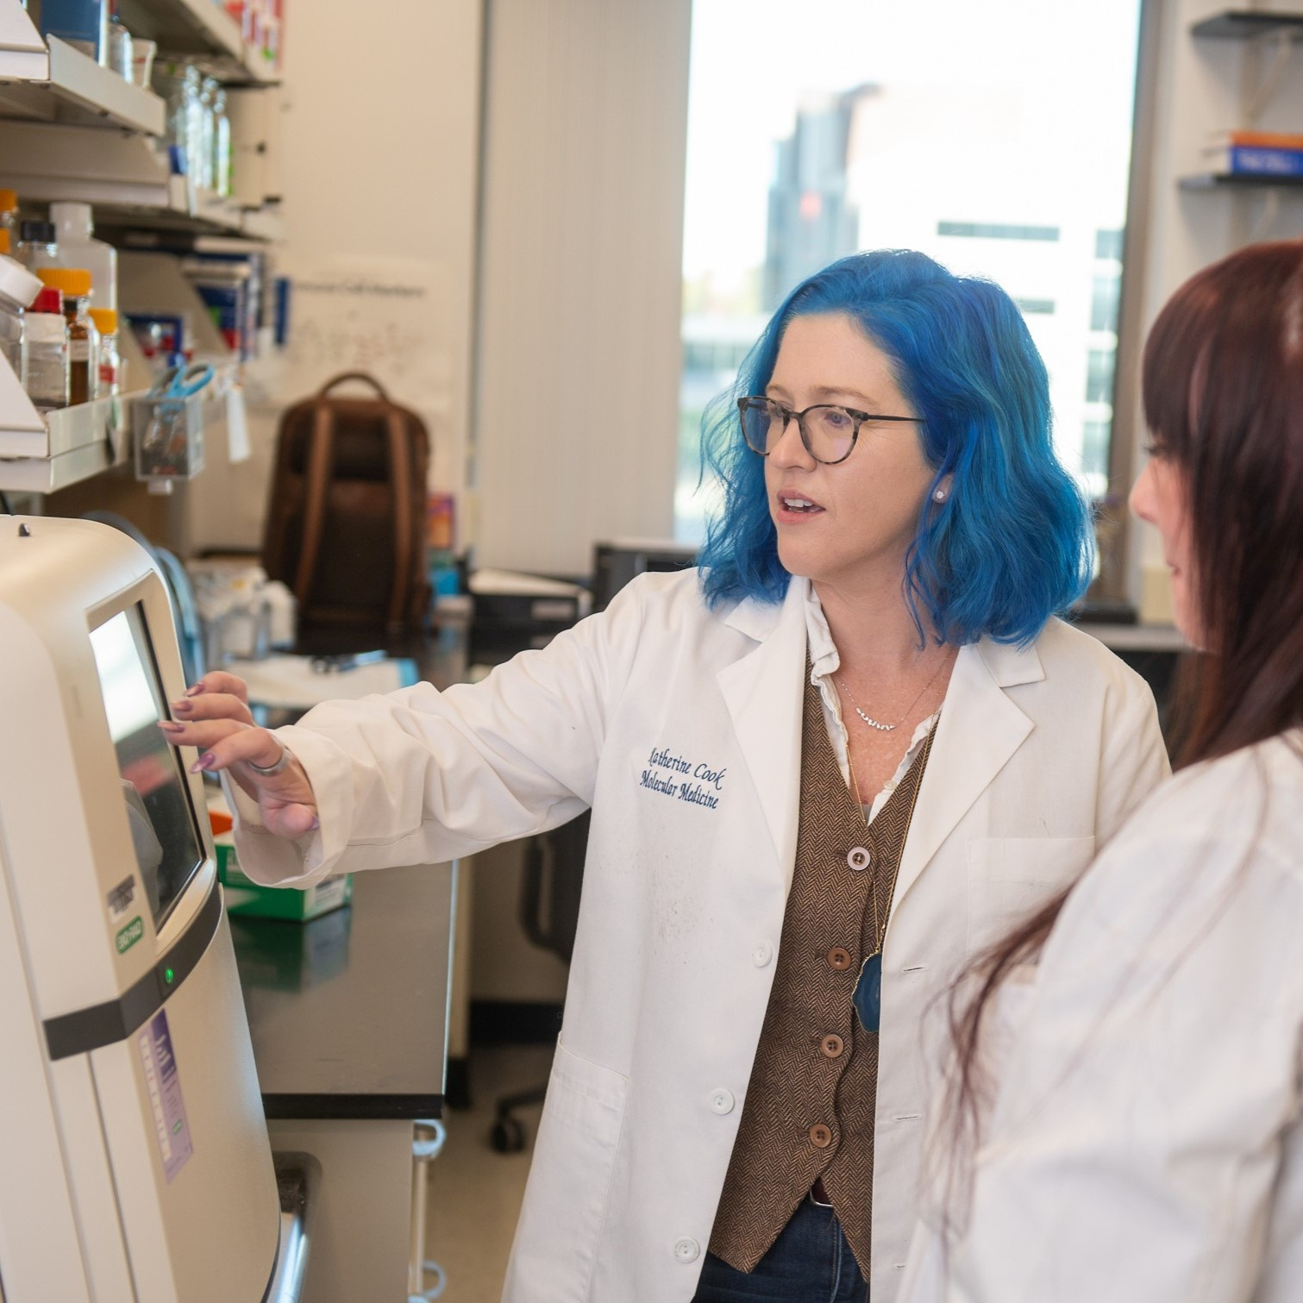
Meet Katherine
I’ve always been interested in science, taking advance placement biology and chemistry coursework during high school. I also played soccer throughout high school and for a local team.
One of the most rewarding aspects of my job as a translational breast cancer researcher is seeing our laboratory-based discoveries move into the clinic. Working on clinical trial projects means participating in real-time to improve patients’ outcomes and quality-of-life.
My hopes for the future are to continue making meaningful advances in the field and to teach the next generation of cancer researchers.
Wake Forest University School of Medicine
Katherine discusses data with Dr. Alana Arnone
16 futurumcareers.com

Slide 17
Katherine’s Top Tips
Wake Forest University School of Medicine
Be curious and don’t be afraid of asking questions.
Don’t be discouraged when things don’t work out. Keep trying. Sometimes, the experiment that doesn’t work will be the most informative and will point you in a new direction.
17 futurumcareers.com

Slide 18
Talking Points
What topic(s) are you passionate about due to a personal connection with the topic? How do you think this would influence your work if you had a career addressing the topic?
Why do you think it is rewarding to see laboratory-based discoveries move into the clinic?
How do you feel when things do not work out the way you had hoped?
18 futurumcareers.com
Wake Forest University School of Medicine

Slide 19
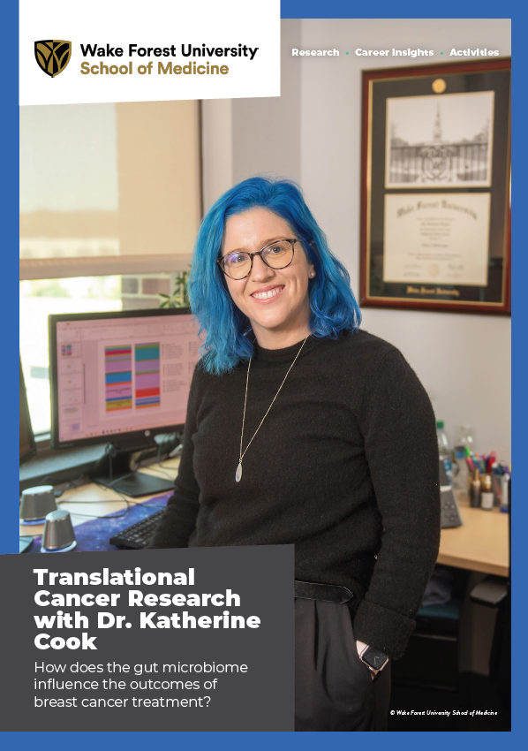
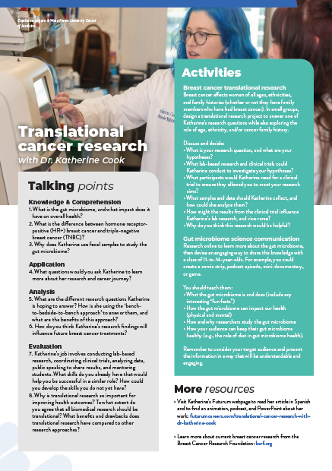
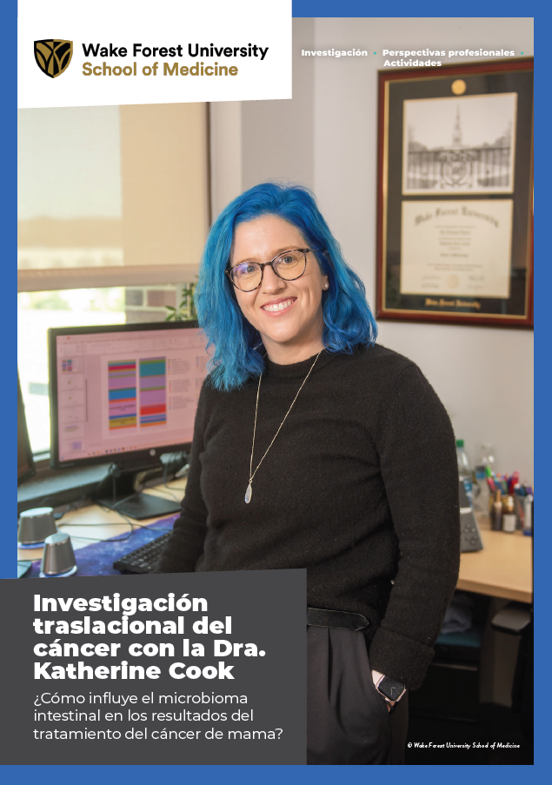


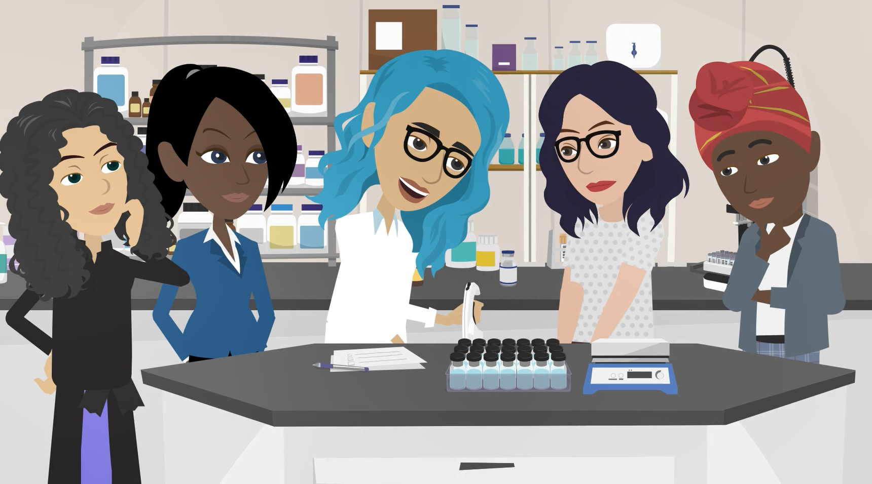
More Resources
Read the article
Complete the activities
Listen to the podcast
Watch the animation
Download the Spanish resources
19 futurumcareers.com
Wake Forest University School of Medicine

Slide 20
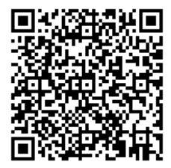



This educational material has been produced by Wake Forest University School of Medicine in partnership with Futurum and with grant support from The Duke Endowment.
The Duke Endowment is a private foundation that strengthens communities in North Carolina and South Carolina by nurturing children, promoting health, educating minds and enriching spirits.
Let us know what you think of this educational and career resource.
To provide input, simply scan the QR code or access the link below:
redcap.school.wakehealth.edu/surveys/?s=NPK347RYHCR3FNDC

