Slide 1


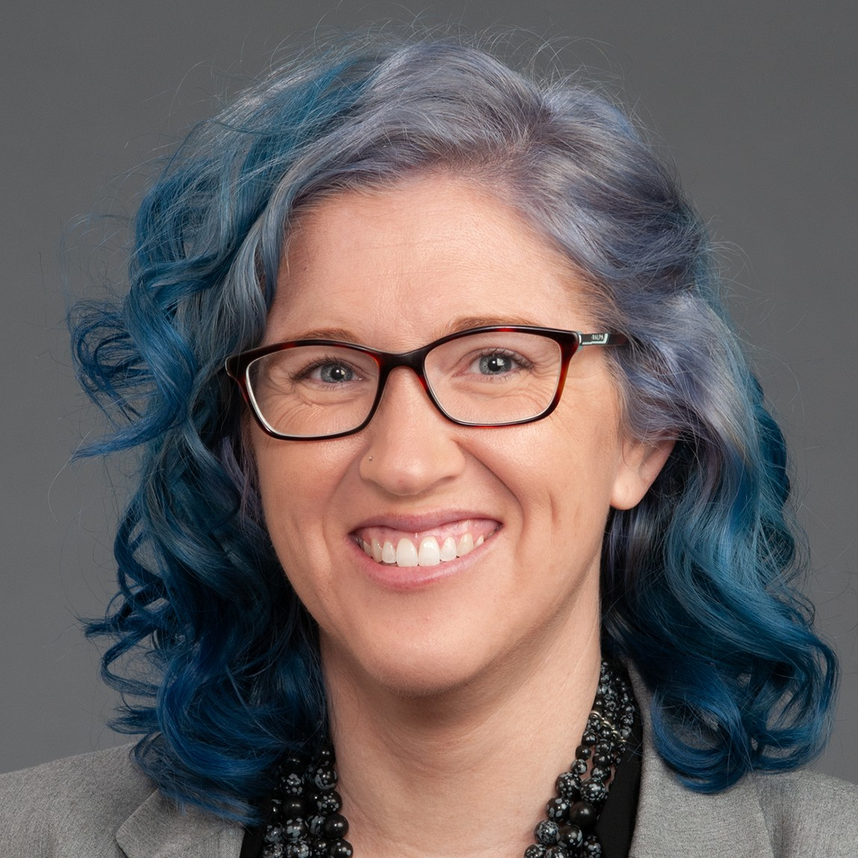


Inspiring the
Next Generation
FUTURUM
PODCAST
In Conversation with
Dr. Katherine Cook

Slide 2

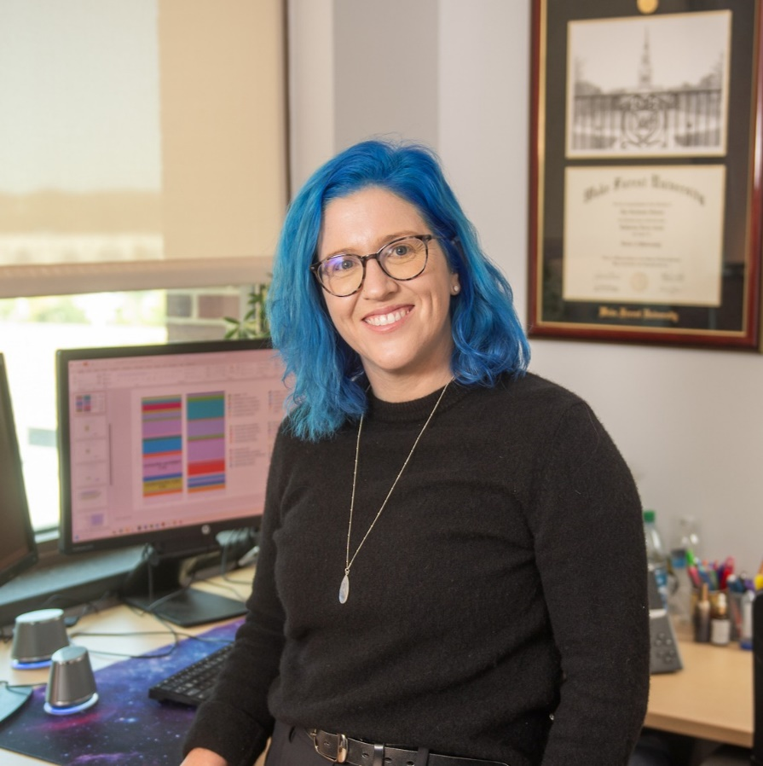
Pre-listening | Break it Down | Post-listening | Learn More
Meet
Dr. Katherine Cook
Pre-listening:
In this podcast, Dr. Katherine Cook shares how her personal experiences with breast cancer have inspired her work and talks about the importance of curiosity for scientists.
What do you think a career in translational cancer research involves?
Why do you think curiosity is so important for scientists?
Profile
Wake Forest University School of Medicine, USA
Field of Research
Translational Cancer Research
“Be curious and don't be afraid to ask questions. I think that inquisitiveness is what makes a good scientist.”

Slide 3


Pre-listening | Break it Down | Post-listening | Learn More
Break Katherine’s Conversation Down:
Up to 05:30
Why does Katherine joke that “bacterial overlords are using us as a human incubator”?
What are some functions of the gut microbiome?
How will Katherine’s research help breast cancer patients?

Slide 4

Pre-listening | Break it Down | Post-listening | Learn More
05:30 – 09:20
How have Katherine’s personal experiences with breast cancer influenced her career as a scientist?
If you were a researcher (in any field) studying a topic to which you had a strong personal connection, how do you think this would impact your work?
What motivates you when you face hard times?
Why do you think a negative result in science (when something doesn’t work) is still an important result? And how could you apply this mindset to other areas in your life?

Slide 5

Pre-listening | Break it Down | Post-listening | Learn More
09:20 – end
How do you respond to rejection and criticism? What could help you respond more constructively?
Who are your mentors who support you in your education and life? How could you find other mentors to support you?
How do you think you would benefit from practical, hands-on science experiences?
Where could you look to find practical, hands-on science experiences?

Slide 6


Pre-listening | Break it Down | Post-listening | Learn More
Post-listening:
What have you learned from Katherine about careers in biomedical science that you didn’t know before?
How curious are you? How could you develop a more questioning and inquisitive mindset?
Which piece of Katherine’s advice did you find most useful, and why?
What further questions would you ask Katherine about translational cancer research and/or her career?*
Submit questions to Katherine here

Slide 7

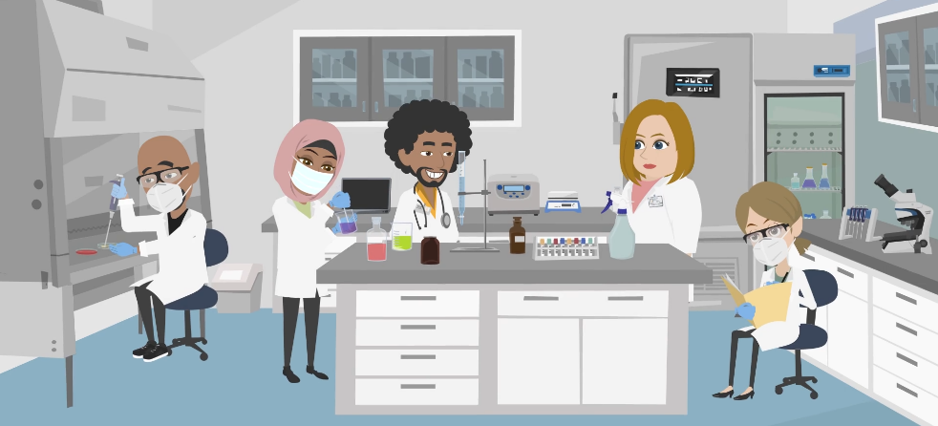
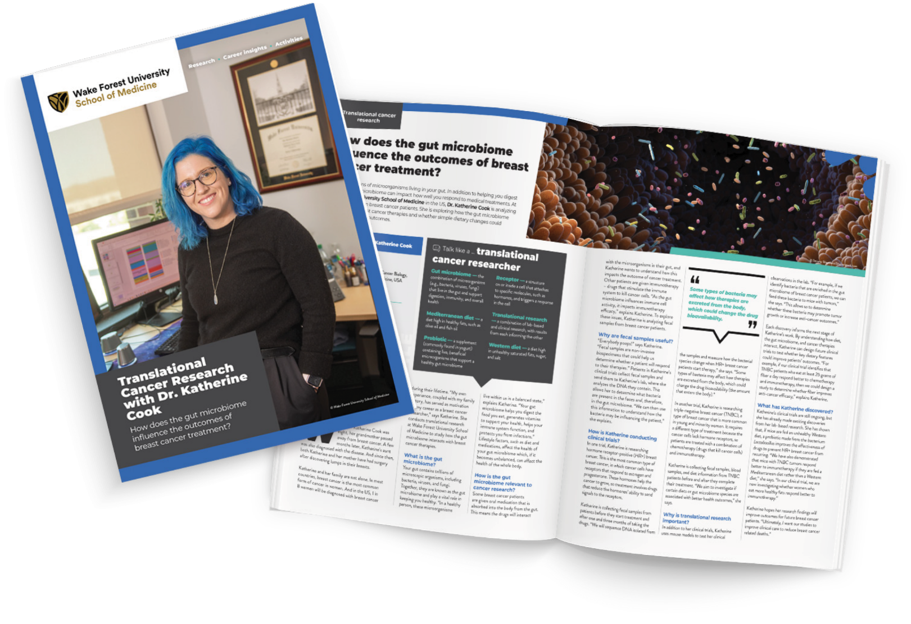
Pre-listening | Break it Down | Post-listening | Learn More
Learn More About Katherine’s Work:
Read Katherine’s article
Download Katherine’s activity sheet
Watch Katherine’s animation
Download Katherine’s careers PowerPoint
Read Katherine’s resources in Spanish
Inspiring the
Next Generation

Slide 8
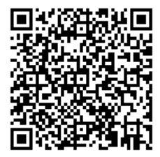



This educational material has been produced by Wake Forest University School of Medicine in partnership with Futurum and with grant support from The Duke Endowment.
The Duke Endowment is a private foundation that strengthens communities in North Carolina and South Carolina by nurturing children, promoting health, educating minds and enriching spirits.
Let us know what you think of this educational and career resource.
To provide input, simply scan the QR code or access the link below:
redcap.school.wakehealth.edu/surveys/?s=NPK347RYHCR3FNDC

