Slide 1


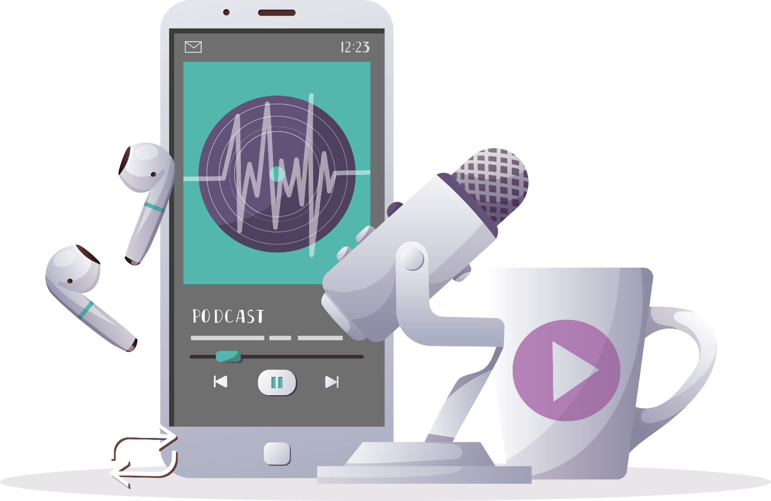

FUTURUM
PODCAST
Inspiring the
next generation
The Mobility of Objects
Engaging history: the educational impact of medieval objects
Professor Katherine Wilson
and Dr Thomas Pickles
CPD
futurumcareers.com

Slide 2

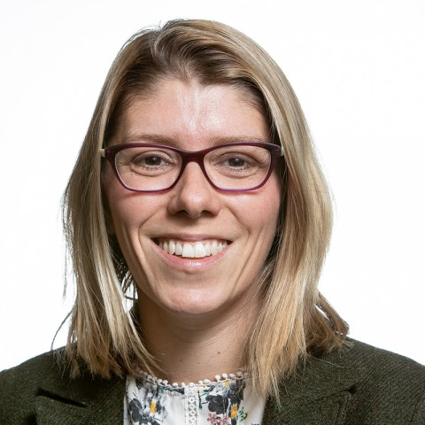
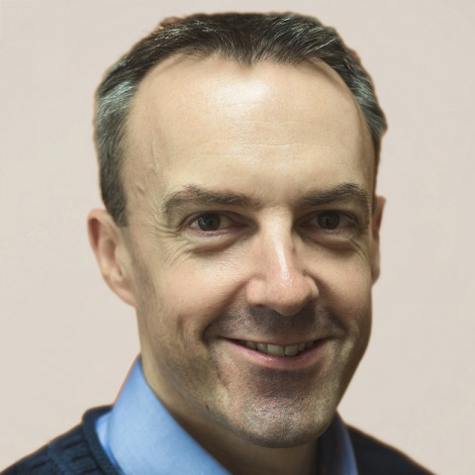
Pre-listening | Break the down | Post-listening | Learn more podcast
Professor Katherine Wilson
Professor of Later Medieval European History
Pre-listening:
Professor Katherine Wilson and Dr Thomas Pickles have developed the Mobility of Objects project, which aims to reinvigorate history education by empowering teachers and students to work with historical objects in the classroom.
What experience do you have of handling historical objects with students in your classroom? What did you and your students gain from this experience?
If you haven’t used this strategy before, how do you think handling historical objects could engage your students and aid your teaching?
Dr Thomas
Pickles
Associate Professor of Early Medieval European History
University of Chester, UK

Slide 3
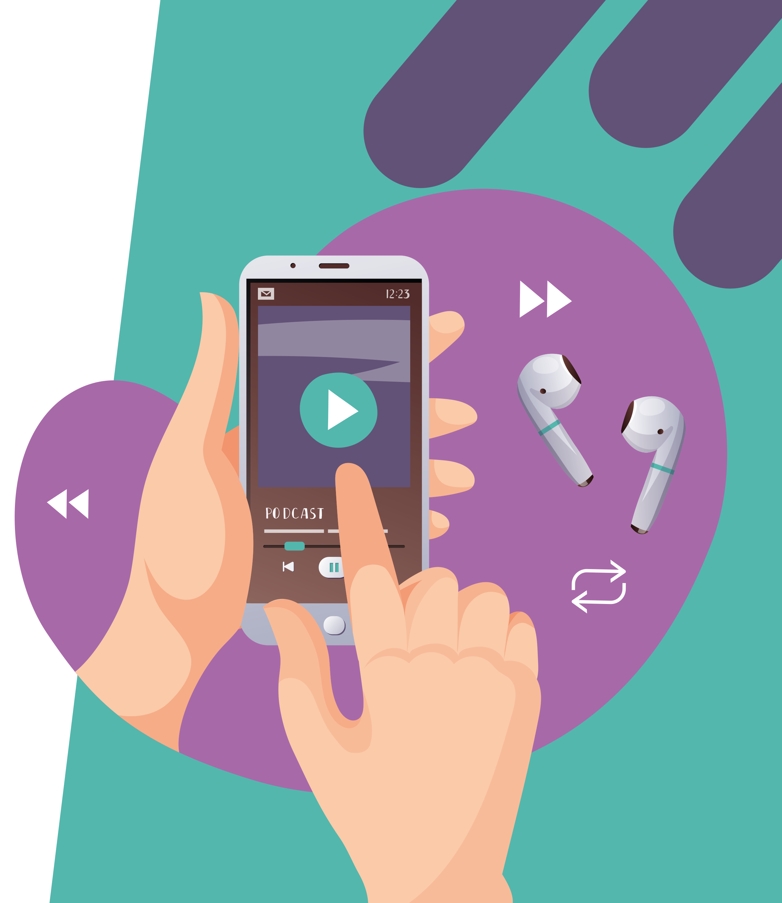

Pre-listening | Break the down | Post-listening | Learn more podcast
Break the podcast down:
Up to 04.33 minutes:
The Mobility of Objects (MOB) project focuses on everyday, rather than luxury, medieval objects. What are the educational benefits of looking at everyday objects?
A key premise of MOB is that students handle the objects and ask the questions they want to ask about them. How do you envisage your students engaging with and responding to this activity? What support would your students need to get the most out of this activity?

Slide 4
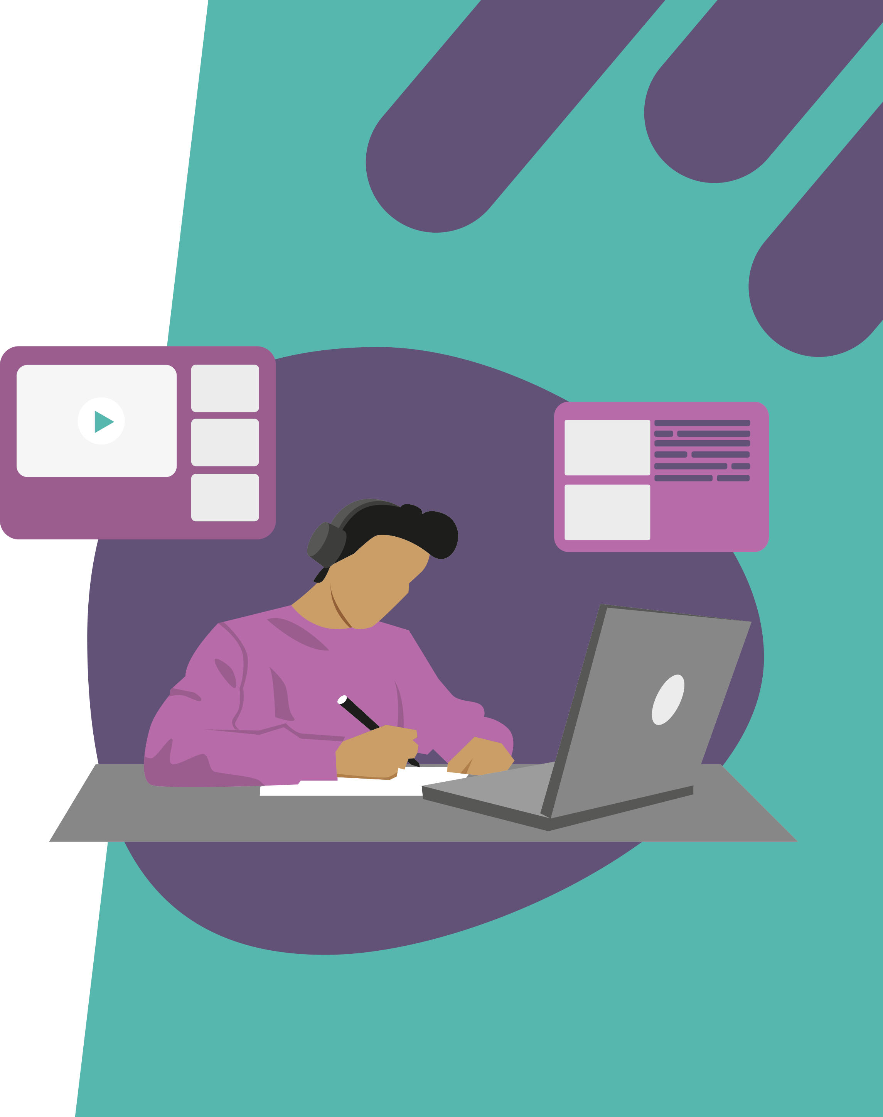
Pre-listening | Break the down | Post-listening | Learn more podcast
Break the podcast down:
04.33 – 08.24:
What do you think are the benefits of encouraging students to record their ideas in ‘non-traditional’ ways, such as writing on paper plates? What non-traditional methods do you use with your students, and what is the impact? What other methods could you use to encourage your students’ creative reflection?
The mystery of historical objects can mean that “nobody’s got the right answer”. How do your students react to having the freedom to imagine things for themselves? What support or encouragement do they need to run with their imaginations?

Slide 5
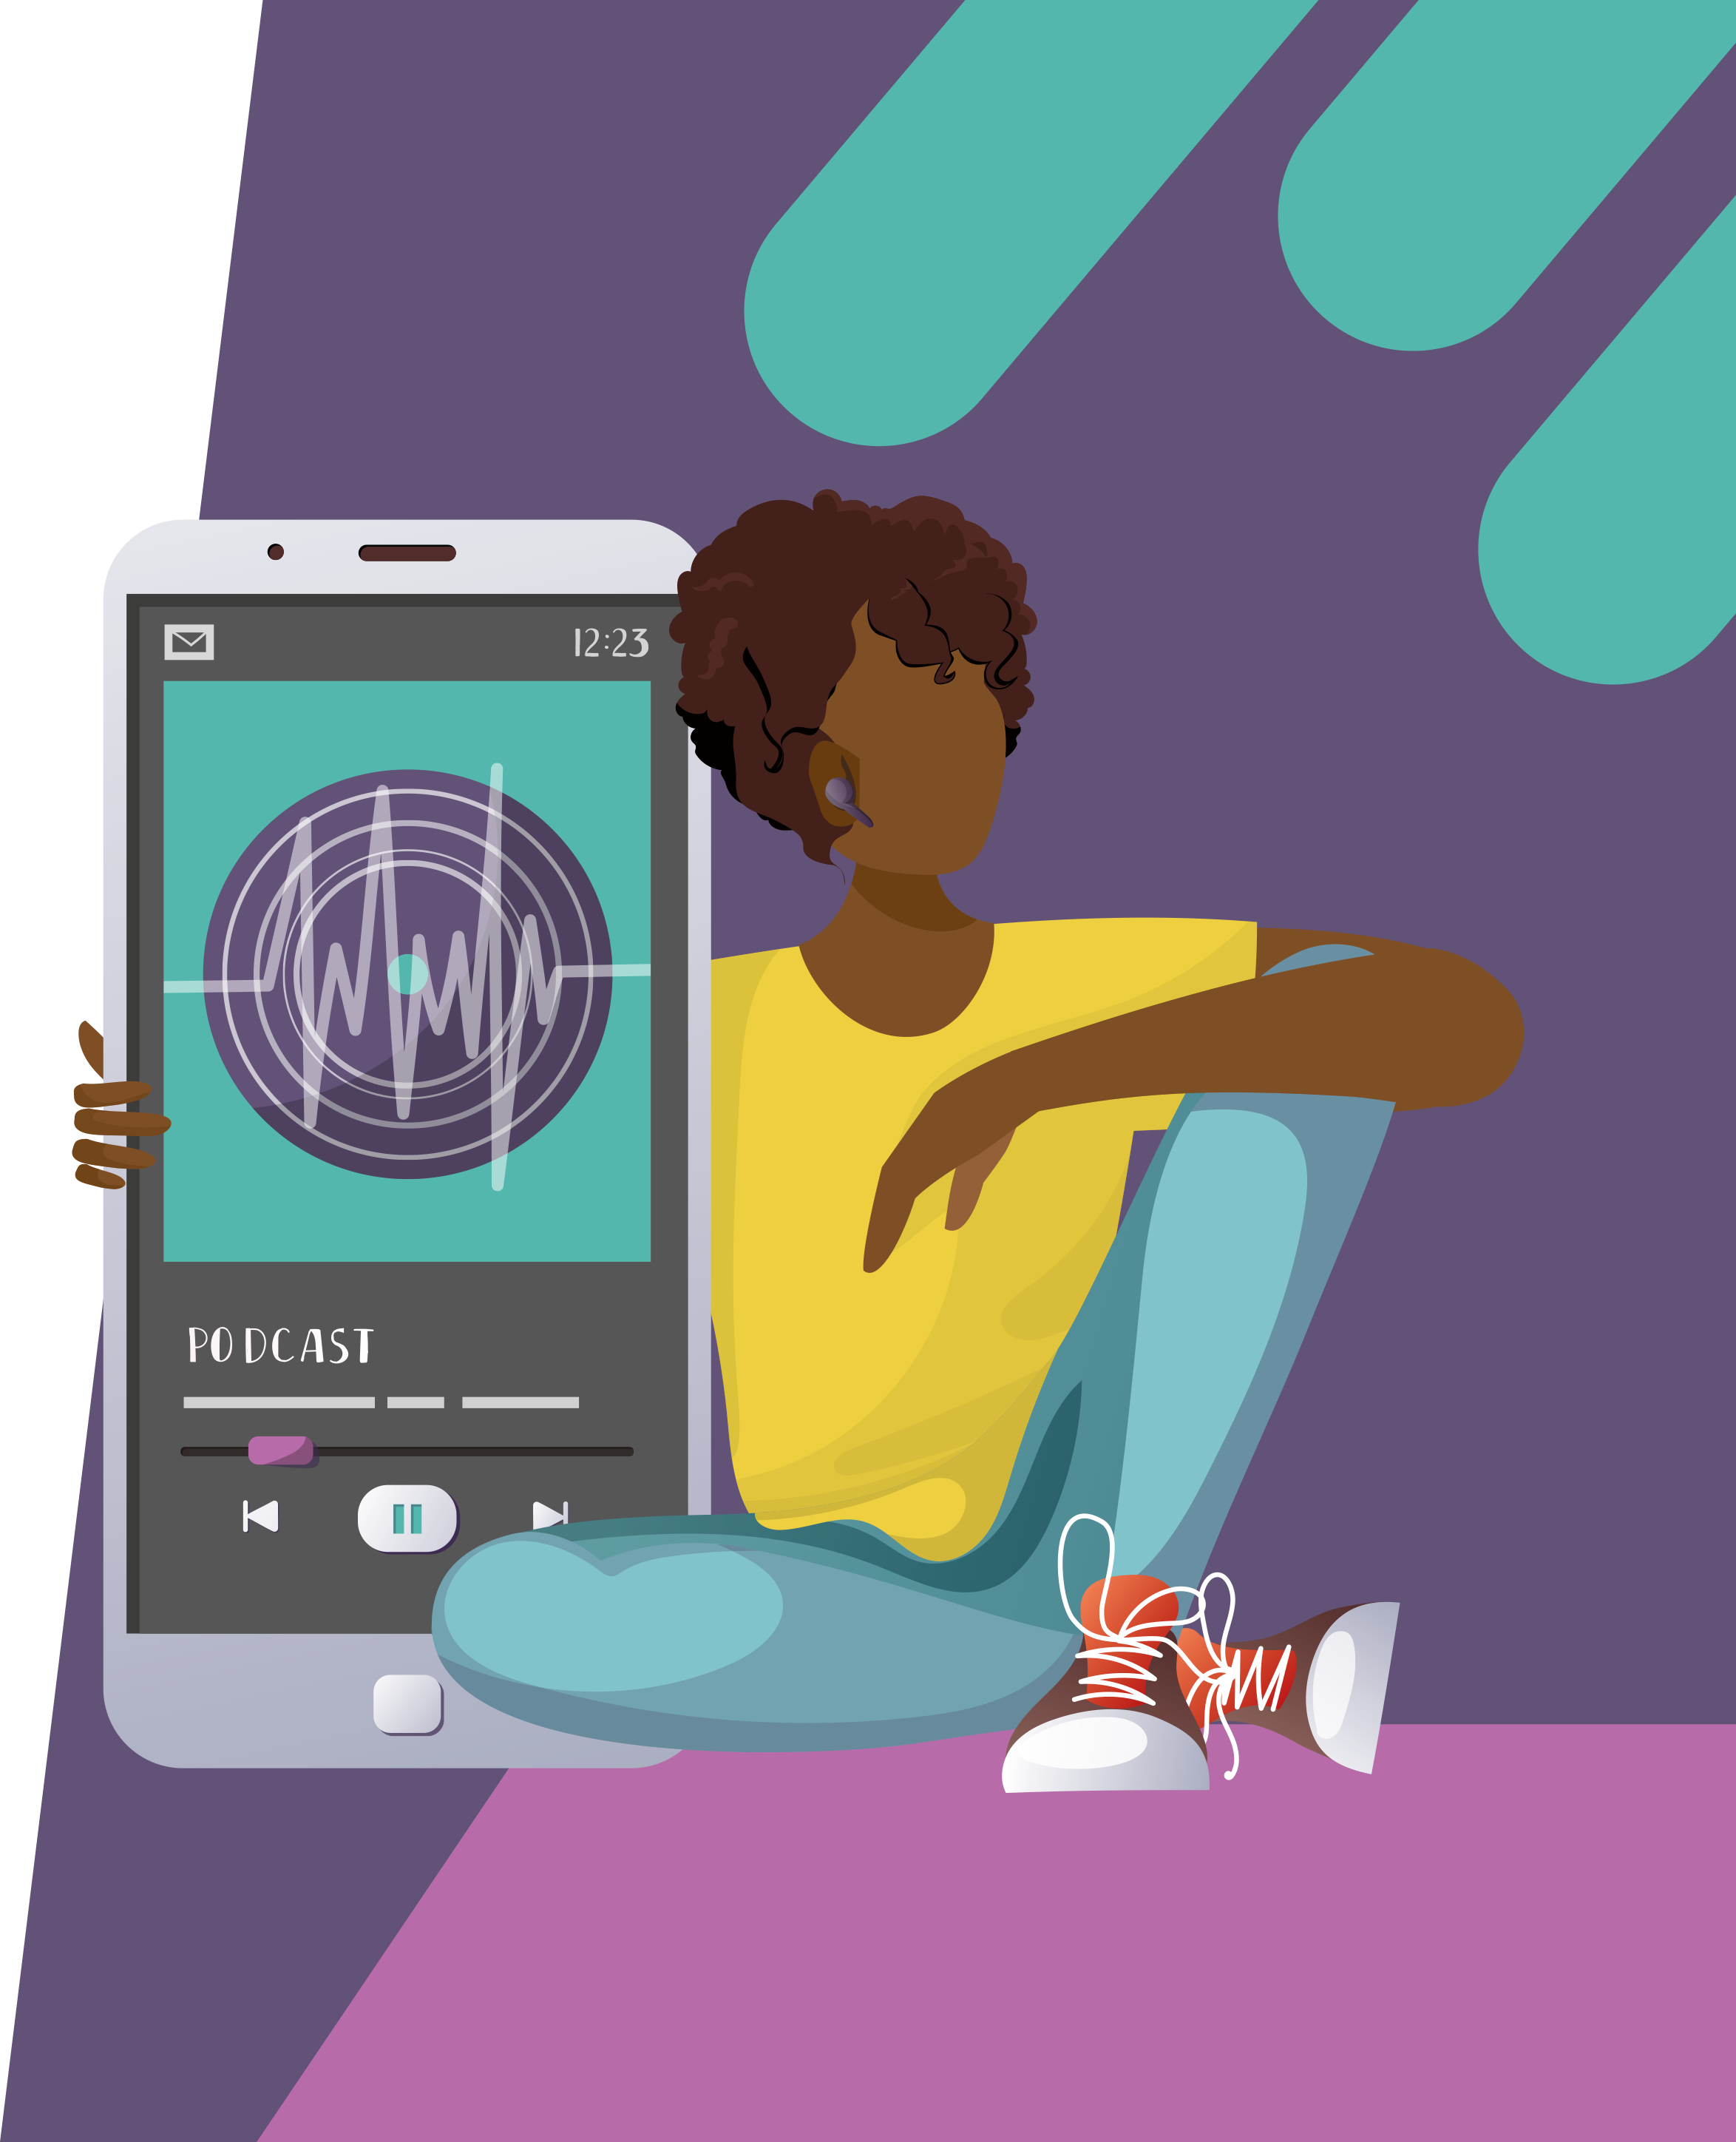
Pre-listening | Break the down | Post-listening | Learn more podcast
Break the podcast down:
08.24 – end:
What would you enjoy about exploring the ‘mobility of objects’ with your students? How do you think handling historical objects in the classroom would aid your teaching?
Which other curriculum areas can you envisage your classroom discussions about these objects leading to?
What apprehensions do you have, if any, about handling historical objects with your students? How could any concerns you have be addressed?

Slide 6


Pre-listening | Break the down | Post-listening | Learn more podcast
Post-listening:
Having listened to Katharine and Thomas, how do you feel your students would benefit from handling historical objects in the classroom?
What support would you need to feel confident in implementing this type of activity in your classroom?
How likely are you to incorporate the handling of historical objects into your classroom, and why?
What are your next steps for moving forward?
*Submit questions to Katherine and Thomas here.

Slide 7

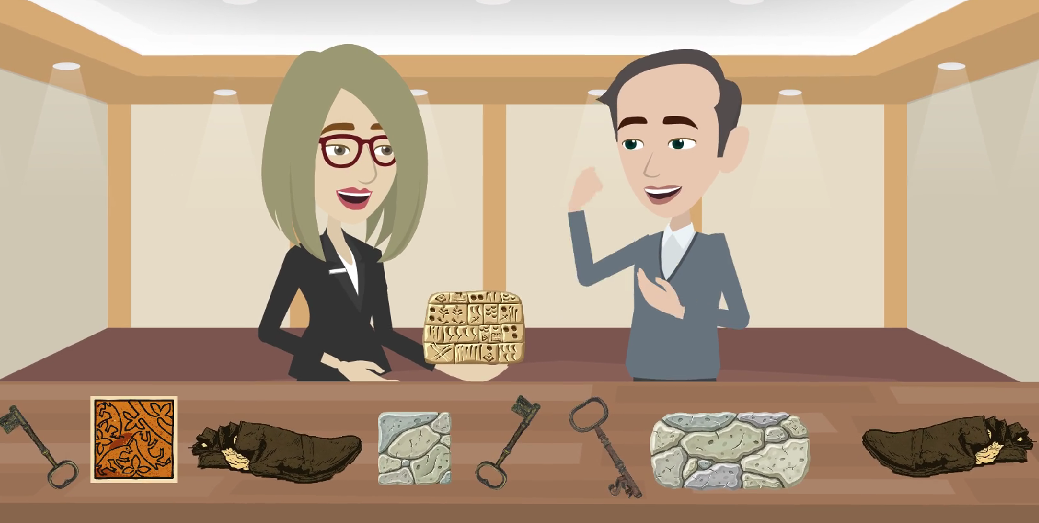
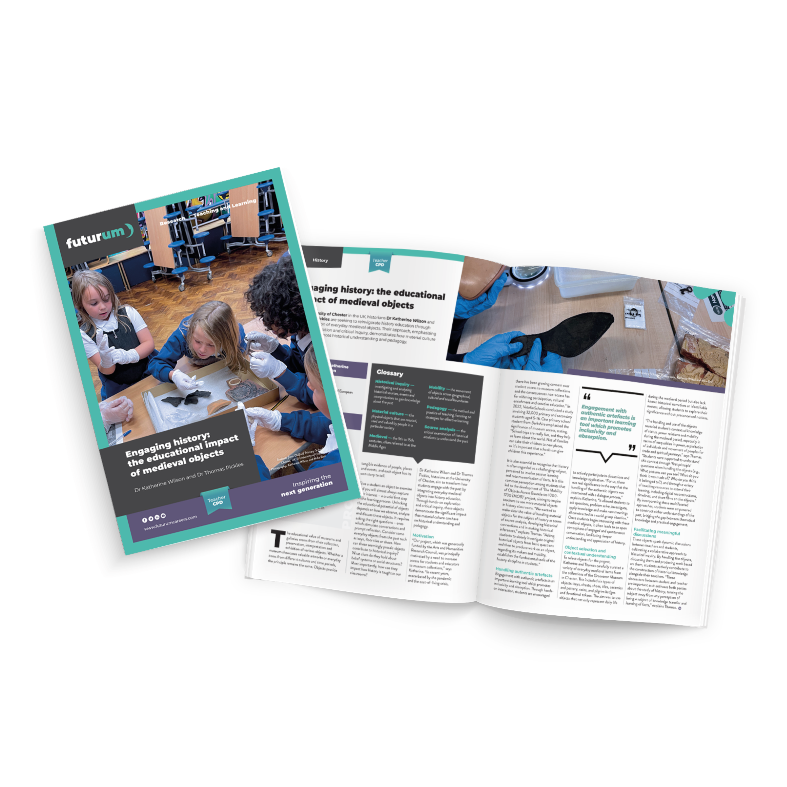
Pre-listening | Break the down | Post-listening | Learn more podcast
Learn more about
Katherine and Thomas’s work:
A
Read the article here.
A
Watch the animation here.
Inspiring the
next generation
futurumcareers.com

