Slide 1
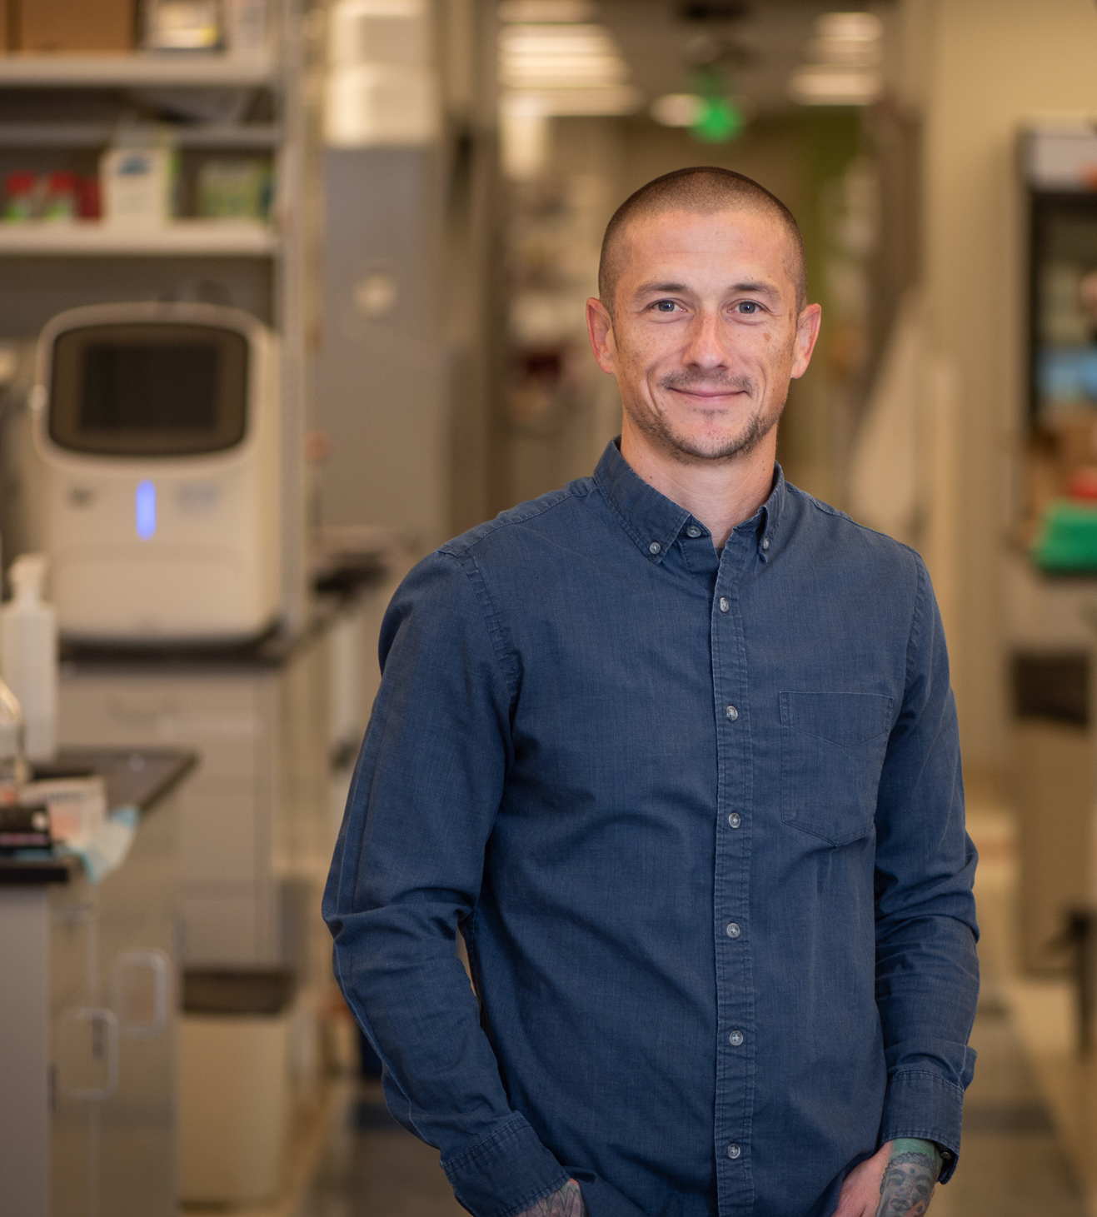


© Wake Forest University School of Medicine
Cancer Biology
with
Dr. Kelsey Fisher-Wellman
GET STARTED

Slide 2


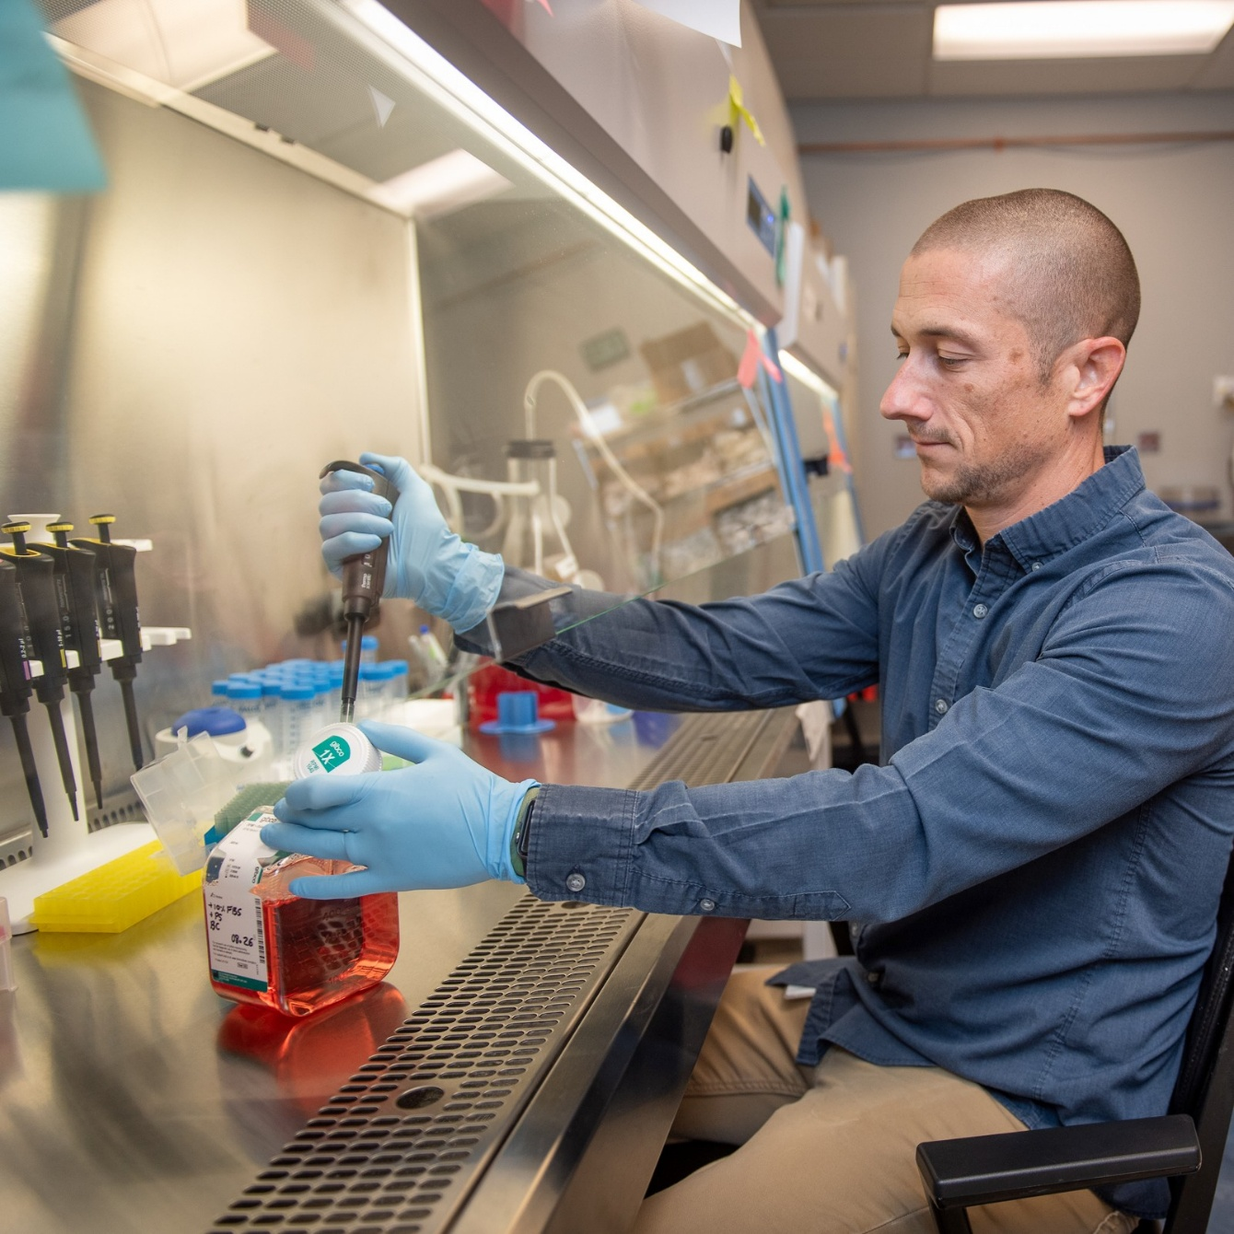
In this Presentation:
Introduction
Kelsey’s Research and Career Journey
Talking Points
About Cancer Biology
Pathway from School to Cancer Biology
Careers in Cancer Biology
Meet Kelsey
Talking Points
More Resources
Wake Forest University School of Medicine
02 futurumcareers.com

Slide 3
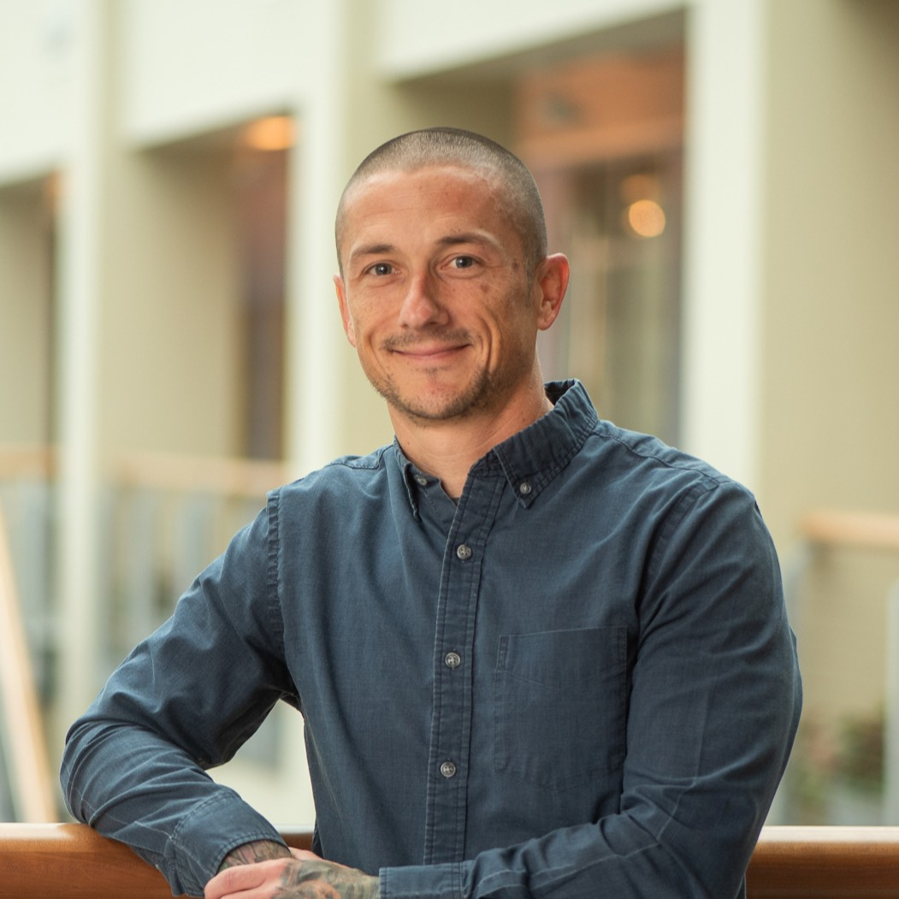
Meet Kelsey
Dr. Kelsey Fisher-Wellman is a cancer biologist at Wake Forest University School of Medicine in the US.
He is studying acute myeloid leukemia (AML), a type of blood cancer caused when stem cells fail to specialize into blood cells.
Kelsey is investigating how mitochondria in cancerous AML cells differ from those in healthy cells, as these differences could be exploited to develop new cancer treatments.
Dr. Kelsey Fisher-Wellman
Wake Forest University School of Medicine
03 futurumcareers.com

Slide 4

Learn about Kelsey’s Research and Career Journey
The animation on the following slide will introduce you to Kelsey’s research and career journey.
You can also find it on Kelsey’s Futurum page: futurumcareers.com/cancer-biology-with-dr-kelsey-fisher-wellman
Or watch it on YouTube:
www.youtube.com/watch?v=kuiXesbXdwg
04 futurumcareers.com

Slide 5


Slide 6

Animation Summary
As a teenager, Kelsey loved bodybuilding and playing baseball. At university, he studied exercise science and worked as a personal trainer.
He didn’t enjoy his internship with the university football team, so he did an internship in a research lab. There, he discovered a love for lab science and was inspired to become a biomedical scientist.
With his background in exercise science, Kelsey struggled to get into a biomedical PhD program. Then, when he did, he had to work hard to catch up with his peers.
06 futurumcareers.com

Slide 7
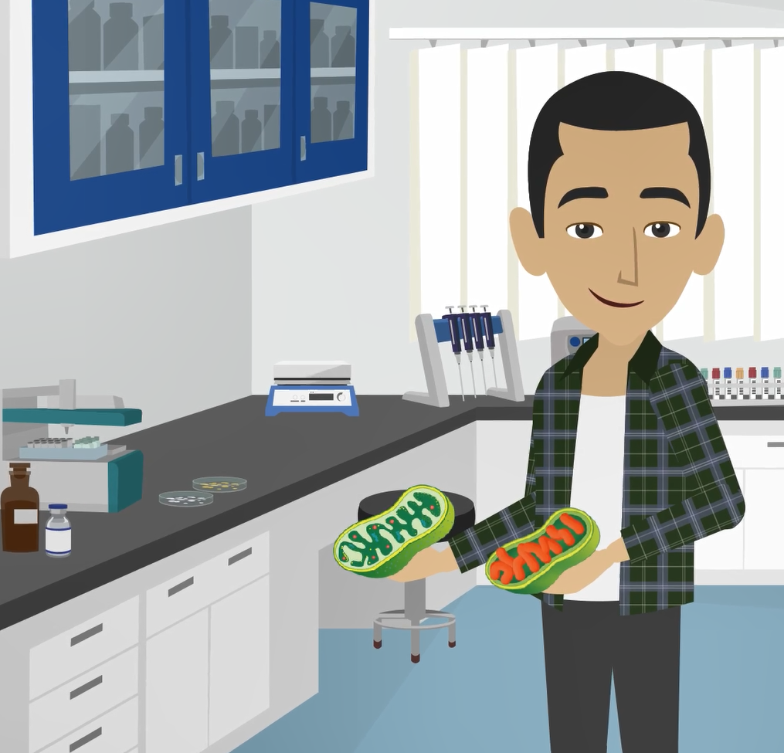
Animation Summary
Today, Kelsey studies mitochondria in AML cells. Mitochondria provide cells with energy by converting energy from food into a form that our cells can use – a molecule called ATP.
Kelsey has discovered mitochondria in AML cells run this process in reverse and consume ATP instead.
He hopes scientists will be able to use this discovery to develop new treatments for AML that destroy the mitochondria in AML cells, while leaving healthy cells unharmed.
07 futurumcareers.com

Slide 8
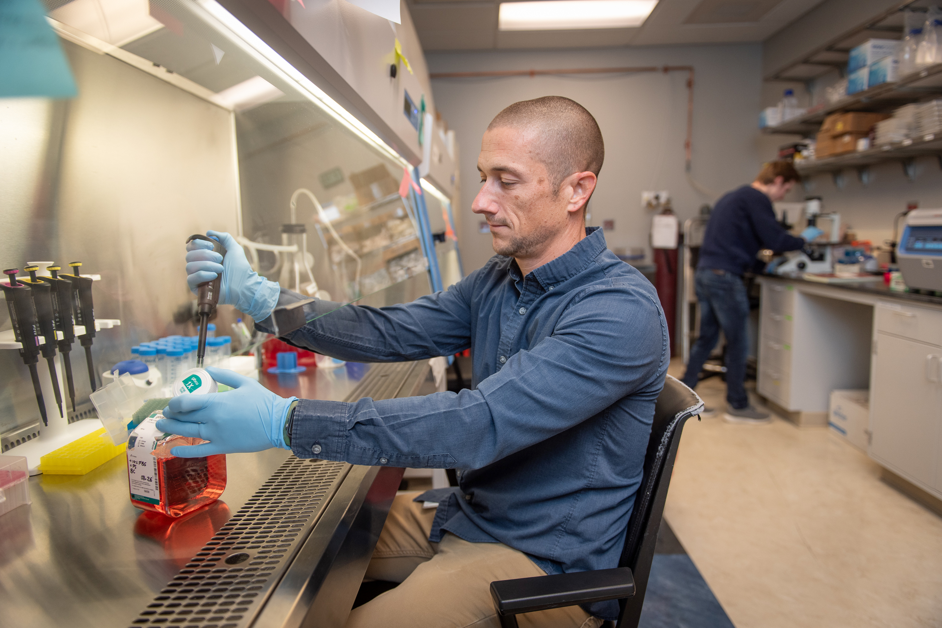

Talking Points
What causes acute myeloid leukemia (AML)?
What are mitochondria?
How did Kelsey’s teenage hobbies influence his educational journey?
How did Kelsey overcome the challenges he faced during his educational and career journey?
What has Kelsey discovered about mitochondria in AML cells?
08 futurumcareers.com
Wake Forest University School of Medicine

Slide 9
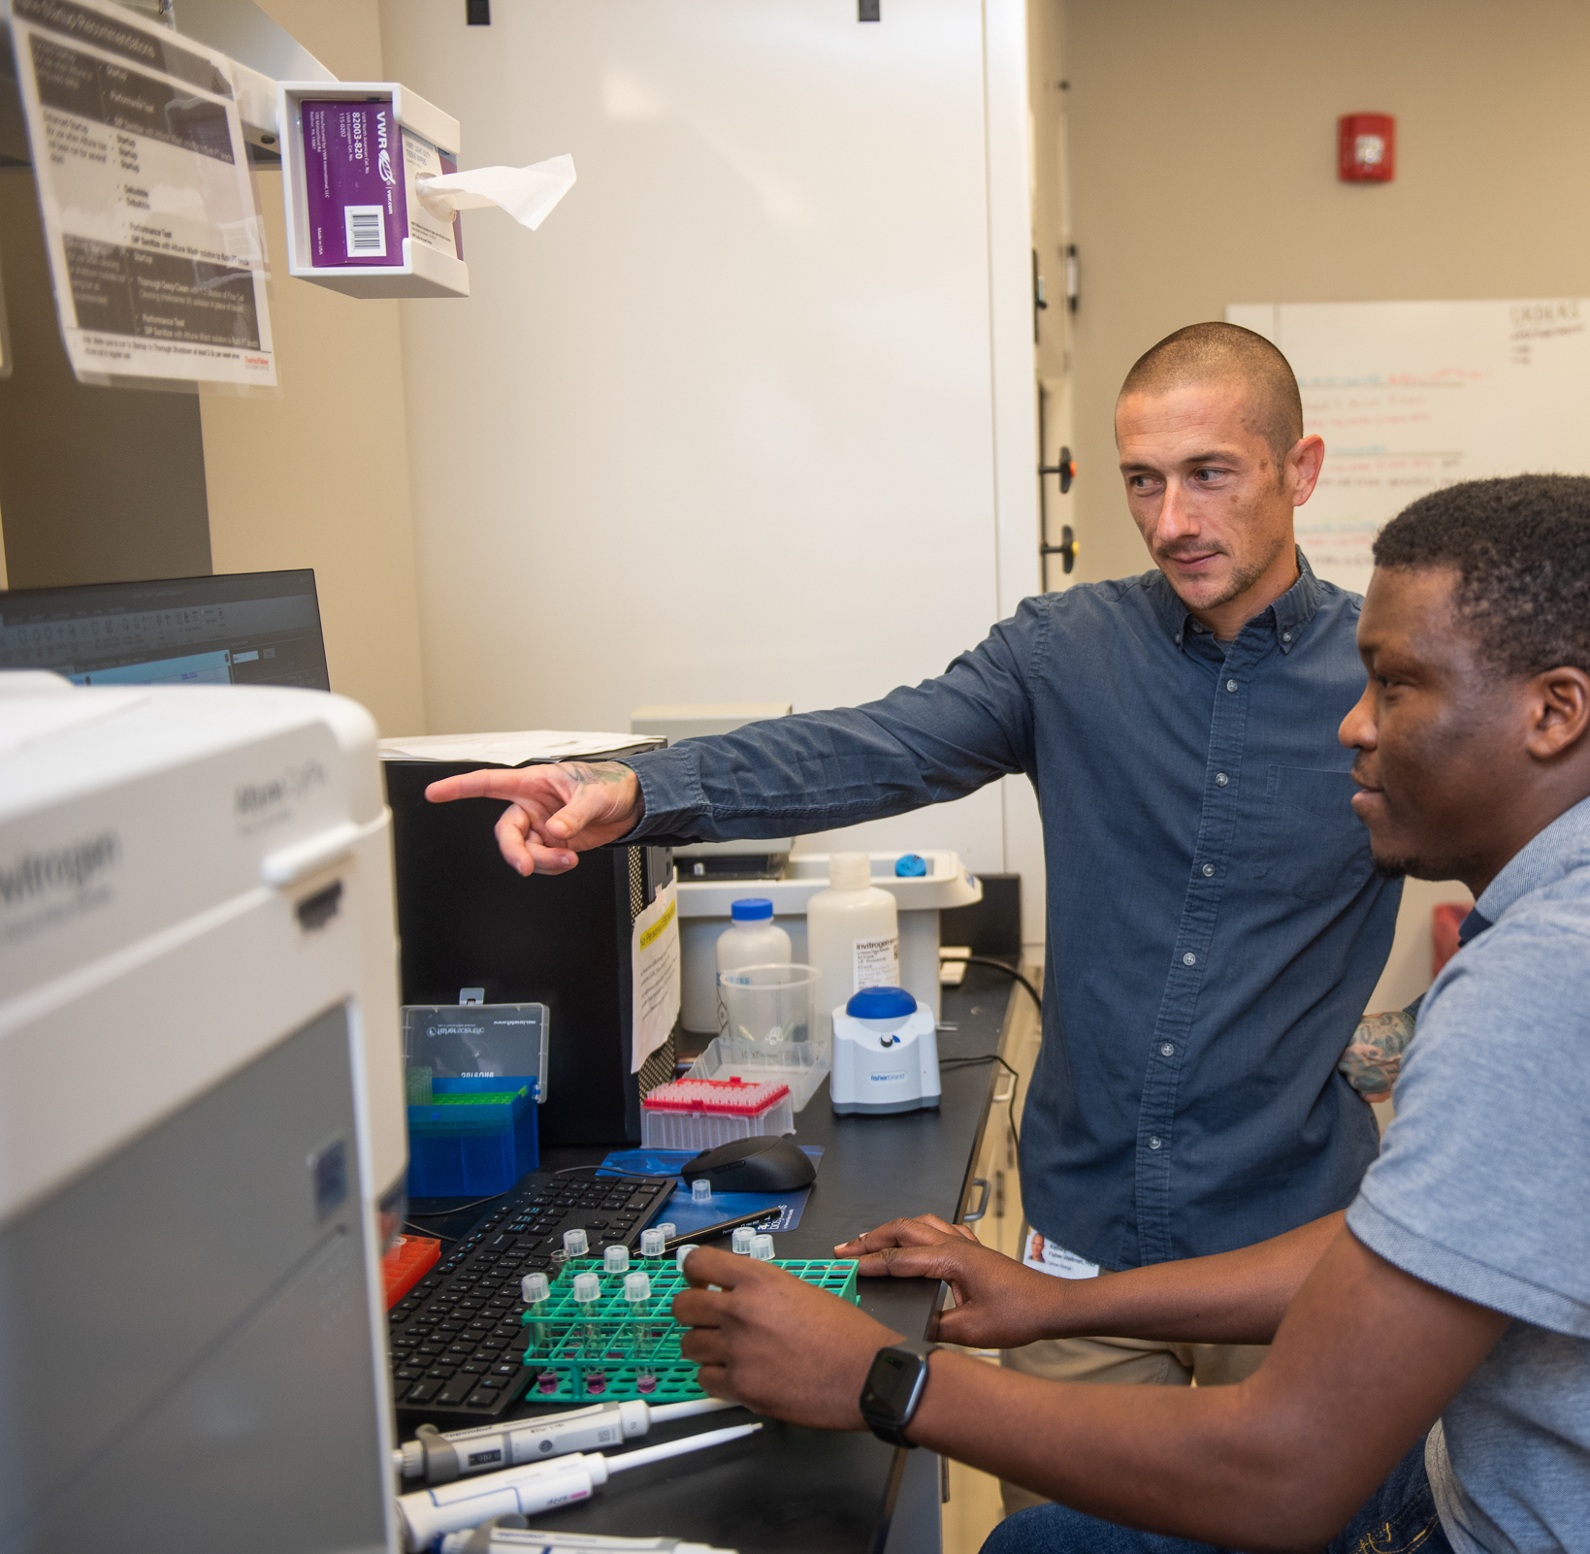
Wake Forest University School of Medicine
About Cancer Biology
Cancer biology is the study of the biological mechanisms underlying cancer development and how to address them through treatment.
“Cancer remains one of the most complex and pressing challenges facing society. Dedicating your life to understanding and treating this disease is a valuable pursuit.” – Kelsey
According to the US National Cancer Institute, two in five people in the US will develop cancer in their lifetime, so developing new and improved ways to detect and treat the disease is essential for a healthy society.
Kelsey discusses research data with staff scientist Dr. Raphael Aruleba
09 futurumcareers.com

Slide 10
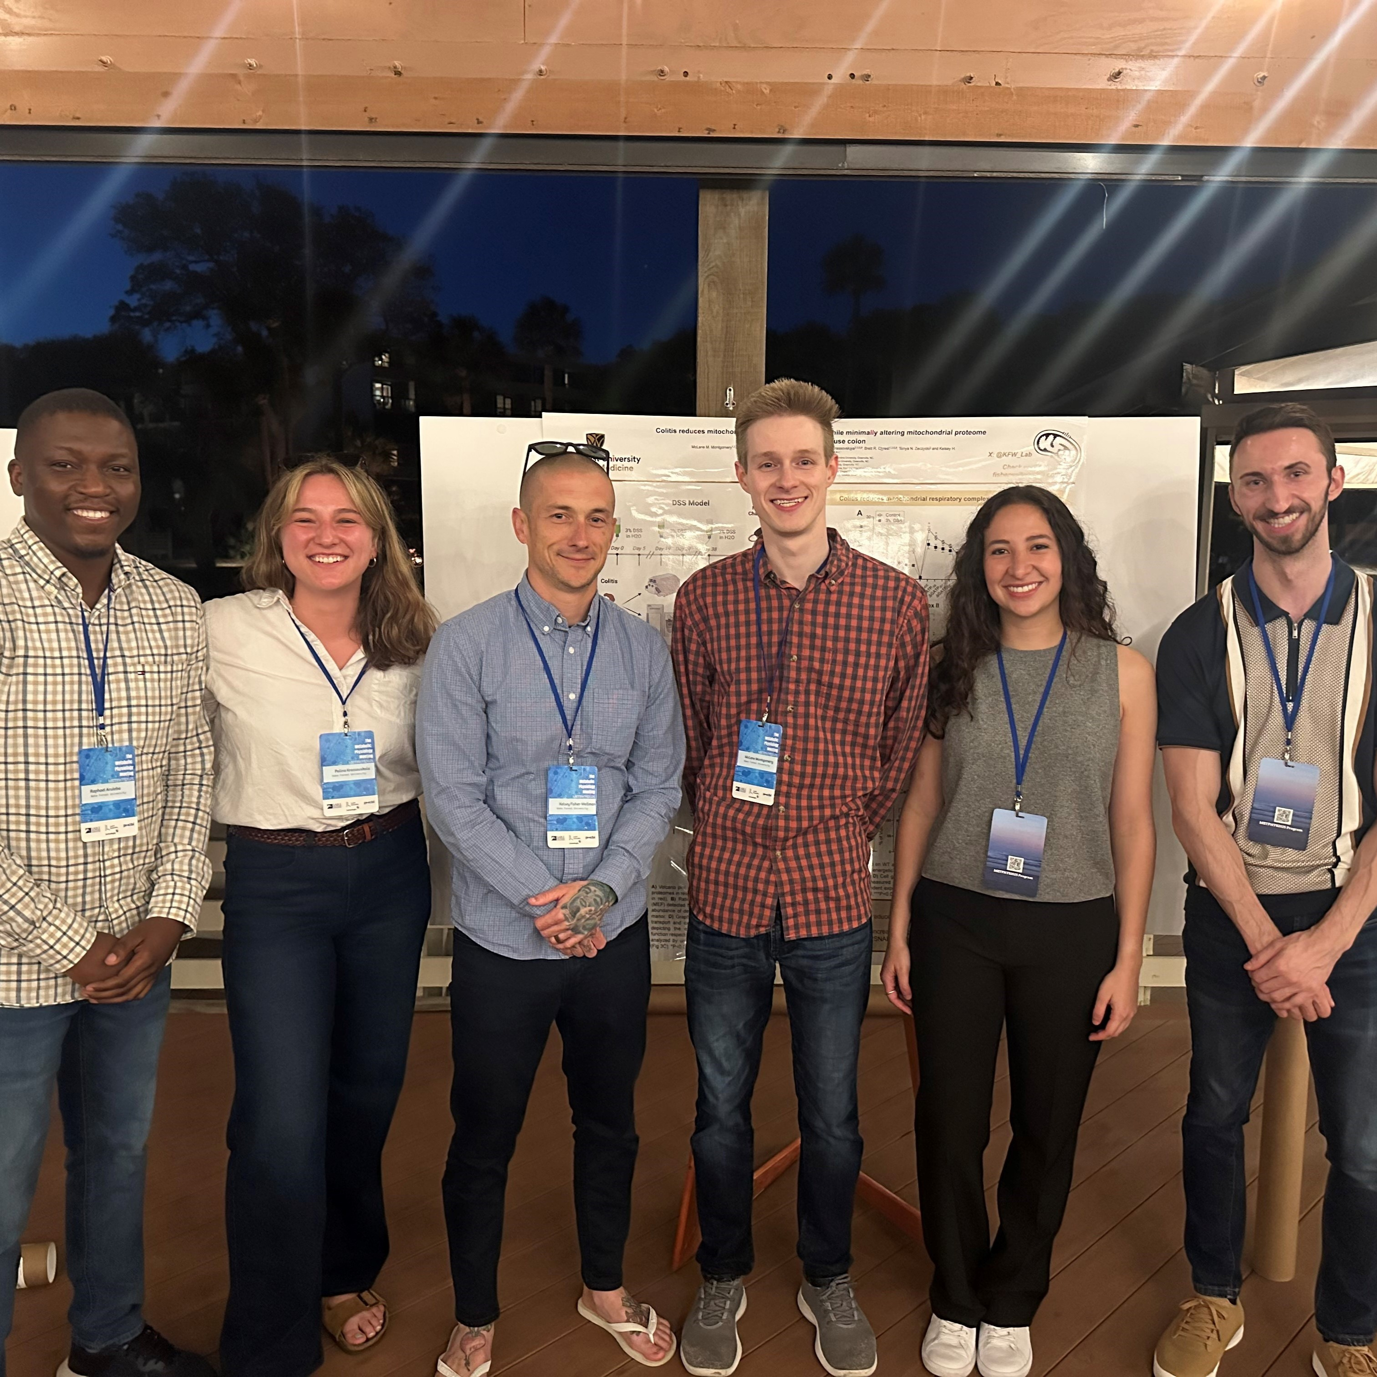
Pathway from School to Cancer Biology
At high school, it would be useful to study biology, chemistry, mathematics, physics, and computer science.
At college, a degree in biology, biomedical science, or biochemistry would provide a direct path to a career in cancer biology.
To become an academic researcher, you will need to complete a PhD – a funded form of advanced education where you get paid to learn and contribute to science.
Members of the Fisher-Wellman Lab at the 2025 Metabolic Physiology Meeting
10 futurumcareers.com

Slide 11
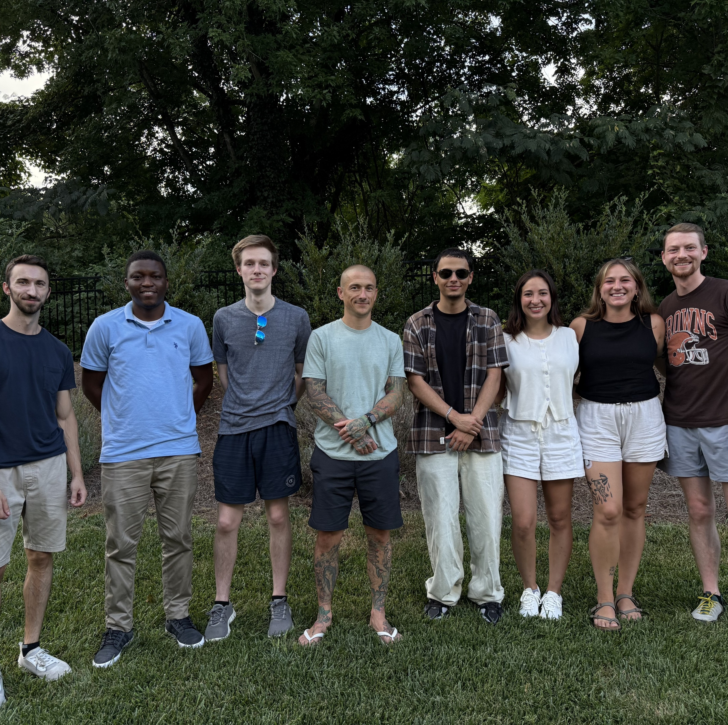
Pathway from School to Cancer Biology
Kelsey emphasizes that many innovations in cancer biology come from people who take unconventional educational and career paths.
“Instead of sticking to one field during your training, I’d encourage you to explore more broadly. Don’t limit yourself. The more diverse your knowledge base, the more creative and impactful your contributions can be.” – Kelsey
Members of the Fisher-Wellman Lab
11 futurumcareers.com

Slide 12
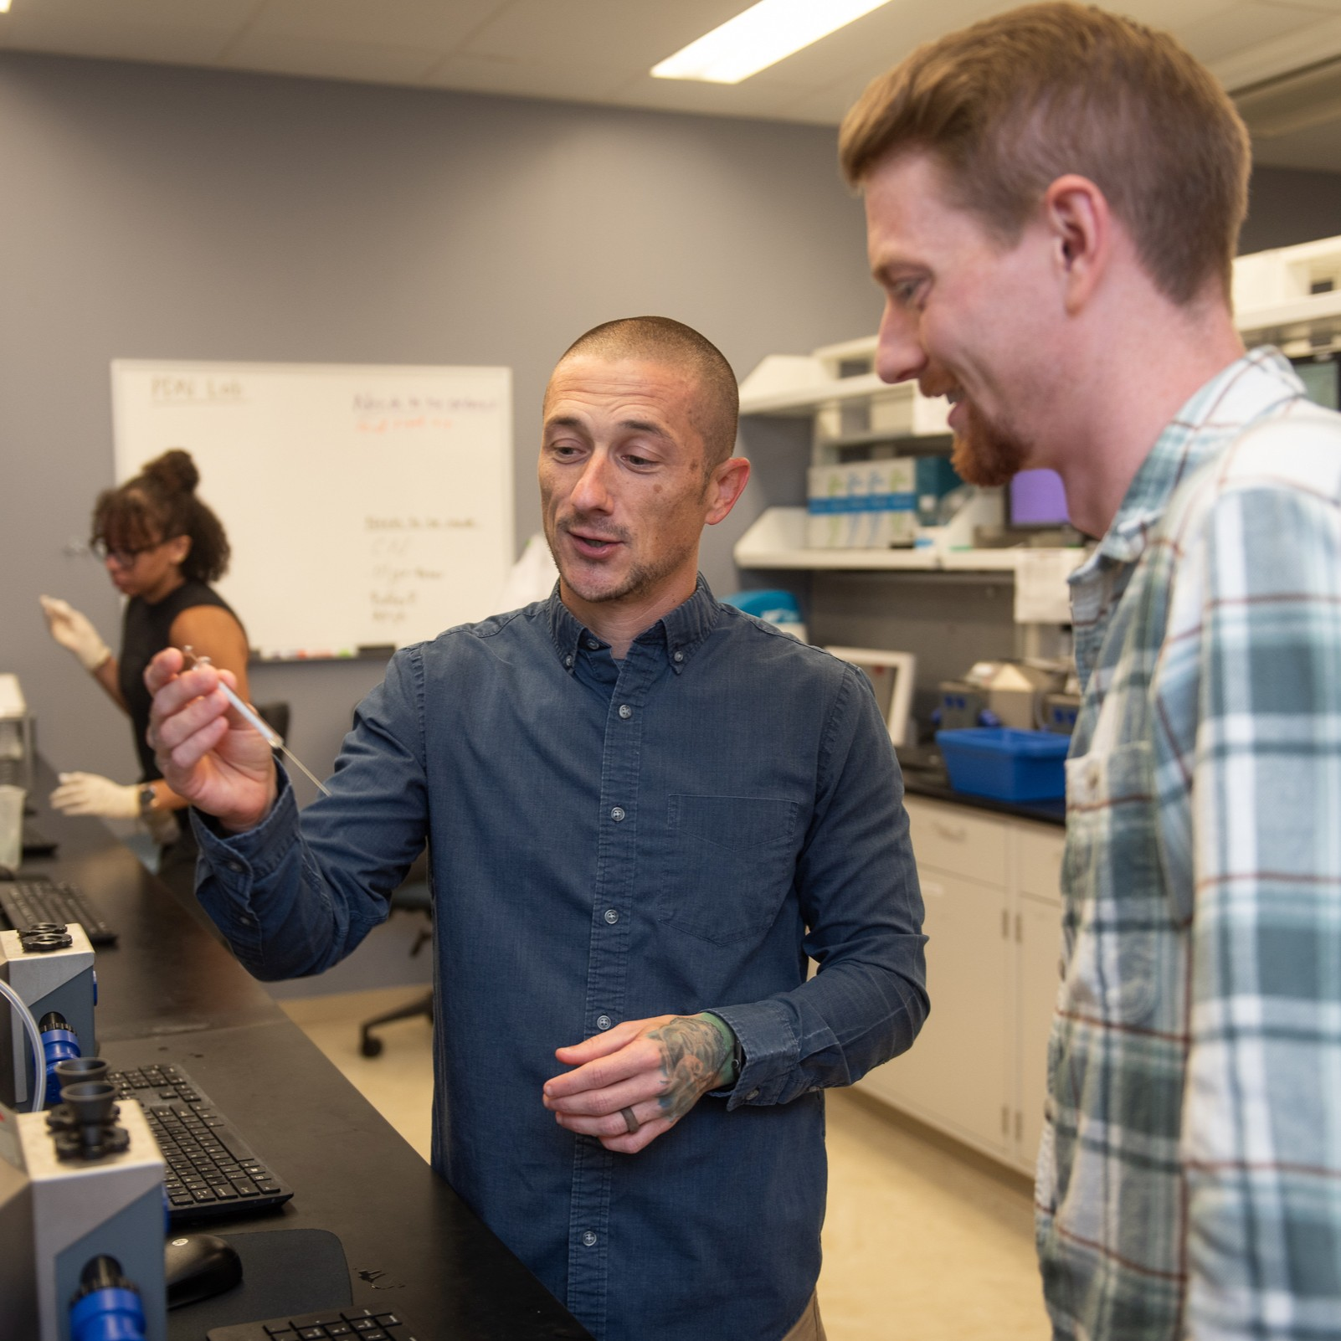
Explore Careers in Cancer Biology
Wake Forest University School of Medicine
Careers in cancer biology often involve lab-based research. This might be at a university, for a biotechnology or pharmaceutical company, or for a cancer research organization.
“It’s important to remember that scientific breakthroughs can take years, even decades, to materialize. Even though the impact of your work may not be immediately visible, that doesn’t make it any less worthwhile. There’s something deeply fulfilling about contributing to this ongoing legacy and shared endeavor.” – Kelsey
Kelsey works in the lab with postdoctoral researcher Dr. Edziu Franczak
12 futurumcareers.com

Slide 13
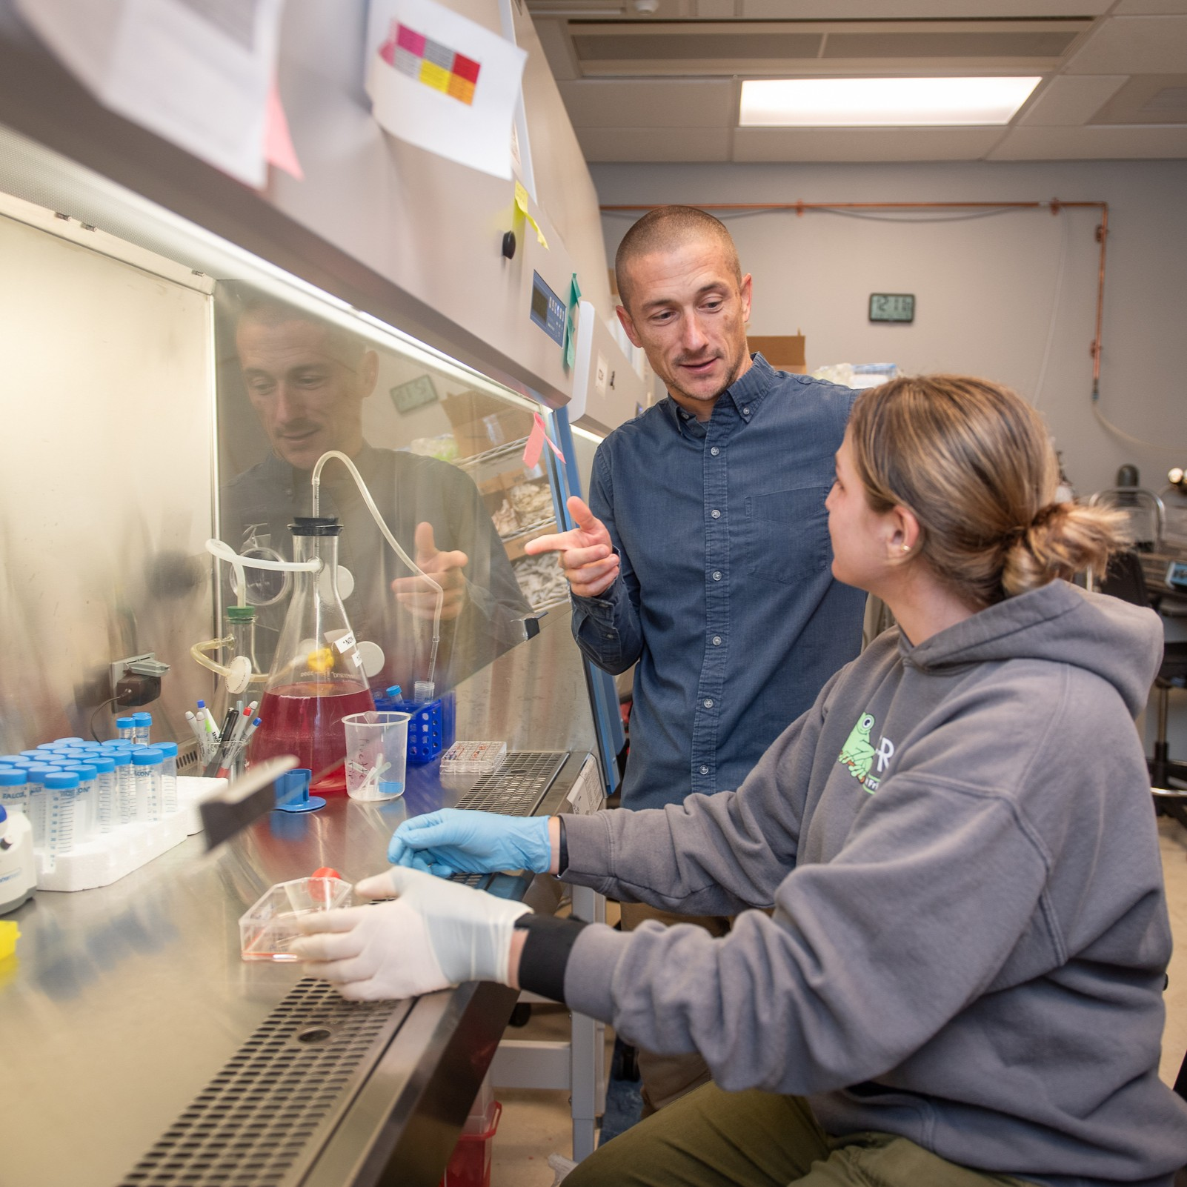
Student Opportunities
Wake Forest University School of Medicine
Kelsey recommends reaching out to biomedical scientists to seek advice and ask about opportunities to work in their lab.
“Hands-on experience, especially in a biomedical research lab, is truly invaluable. Many of the opportunities that shaped my career began with me sending a simple email asking to get involved.” – Kelsey
Many labs in the Department of Cancer Biology at Wake Forest University School of Medicine offer summer internship programs for high school and undergraduate students.
The NIH Summer Internship Program offers paid biomedical research experiences for high school students.
Kelsey works in the lab with staff scientist
Dr. Polina Krassovskaia
13 futurumcareers.com

Slide 14
Talking Points
What proportion of people in the US will develop cancer?
Why do you think many innovations in cancer biology come from those who have taken unconventional paths?
What do you think you would find most rewarding about a career in cancer biology, and why?
How could you find opportunities to gain hands-on experience in a biomedical research lab?
14 futurumcareers.com
Wake Forest University School of Medicine

Slide 15
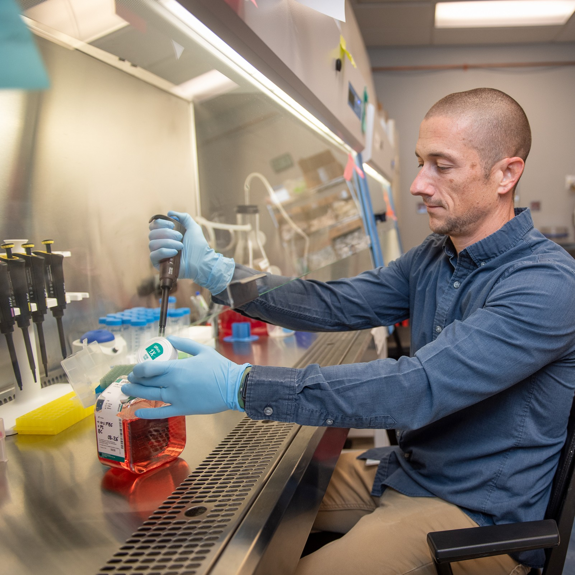
Meet Kelsey
Wake Forest University School of Medicine
As a teenager, I was interested in baseball. Team sports taught me valuable life lessons about how to recover from failure and grow from these experiences.
I went to college to study exercise science, with the goal of becoming a strength and conditioning coach. But that changed when an internship in a research lab gave me a glimpse into the life of an academic scientist.
The experience was transformative – watching my mentor work, I saw someone deeply engaged in solving complex problems that matter to the world. That internship shifted my career goals and set me on a path that I’ve been passionate about ever since.
Kelsey transfers growth media to acute myeloid leukemia cells
15 futurumcareers.com

Slide 16
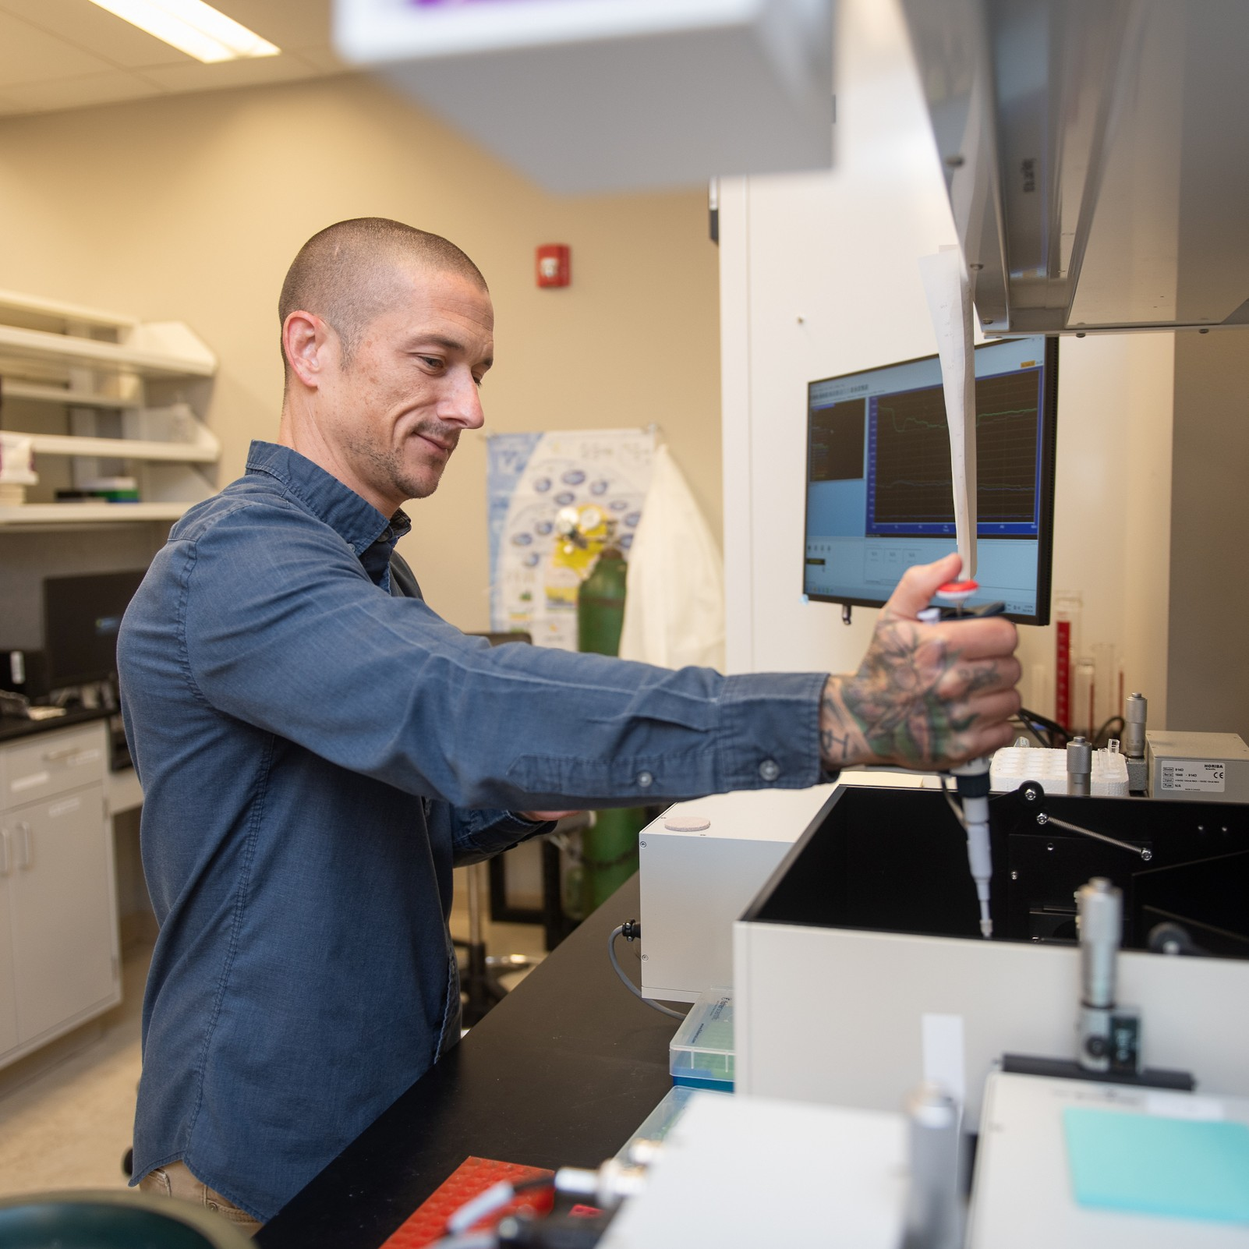
Meet Kelsey
Getting into a PhD program wasn’t easy because exercise science isn’t a typical background for biomedical research. I started behind my peers, having never studied physics or biochemistry, so I taught myself from textbooks to catch up.
After my PhD, I spent several years studying metabolic diseases in muscles. I have no formal training in cancer biology, so moving into the field was another challenge.
Each transition in my career has come with a steep learning curve. But I’ve always been drawn to non-traditional paths and willing to outwork others to succeed. This hasn’t been without challenges – I’ve had plenty of failures along the way.
Wake Forest University School of Medicine
Kelsey works in the lab
16 futurumcareers.com

Slide 17
Kelsey’s Top Tip
Wake Forest University School of Medicine
We can’t control our starting point – namely the resources we have available to us growing up – but we can control how we respond to it. In my view, academic science remains a place where doors can still open for those with talent and determination, regardless of their background. With persistence and hard work, the opportunities are real and within reach.
17 futurumcareers.com

Slide 18
Talking Points
What life lessons are you learning from your hobbies and interests?
How do you cope with challenges in your life?
To what extent are you inspired by Kelsey’s advice that, although we can’t control our starting point, we can control how we respond to it?
18 futurumcareers.com
Wake Forest University School of Medicine

Slide 19
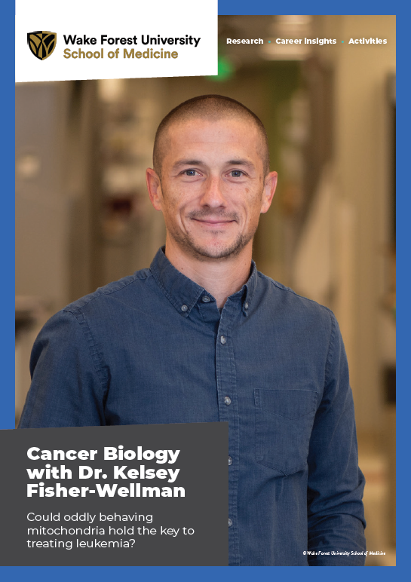
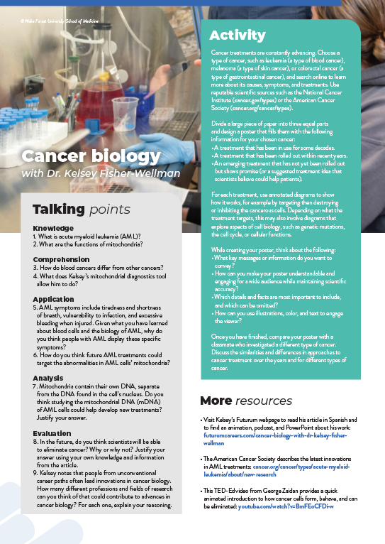



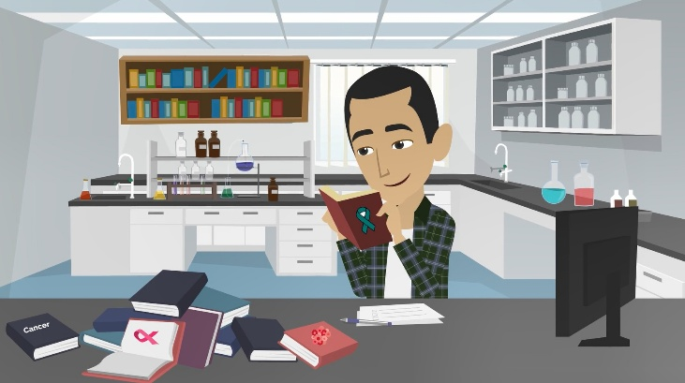
More Resources
Read the article
Complete the activities
Listen to the podcast
Watch the animation
Download the Spanish resources
19 futurumcareers.com
Wake Forest University School of Medicine

Slide 20
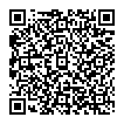



This educational material has been produced by Wake Forest University School of Medicine in partnership with Futurum and with grant support from The Duke Endowment.
The Duke Endowment is a private foundation that strengthens communities in North Carolina and South Carolina by nurturing children, promoting health, educating minds and enriching spirits.
Let us know what you think of this educational and career resource.
To provide input, simply scan the QR code or access the link below:
redcap.link/dh5j1nes

