Slide 1


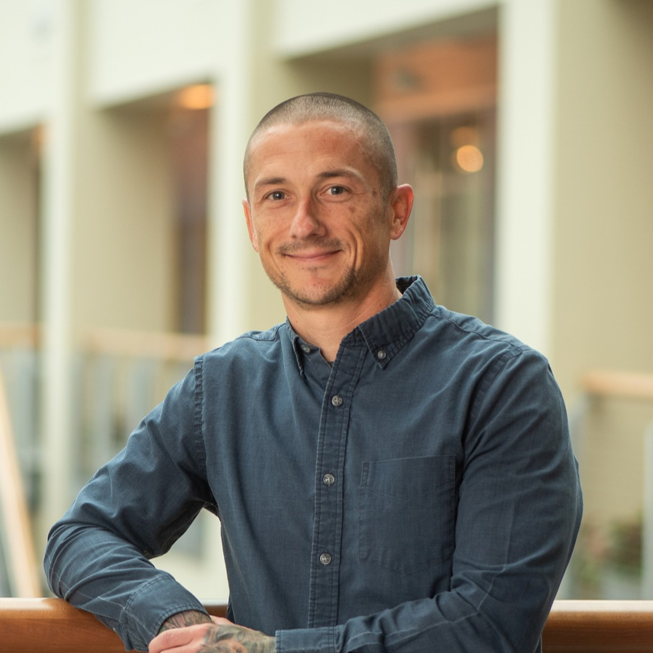


Inspiring the
Next Generation
FUTURUM
PODCAST
In Conversation with
Dr. Kelsey Fisher-Wellman

Slide 2

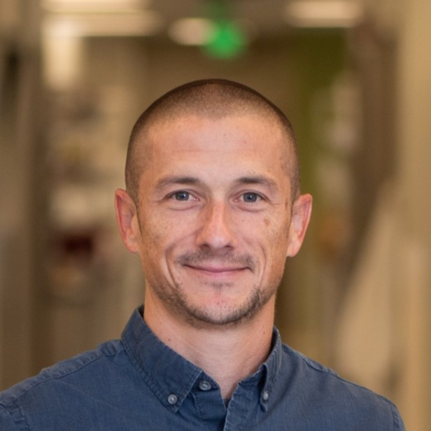
Pre-listening | Break it Down | Post-listening | Learn More
Meet
Dr. Kelsey Fisher-Wellman
Pre-listening:
In this podcast, Dr. Kelsey Fisher-Wellman shares how he has become a successful cancer biologist despite coming from an unconventional educational background and he discusses the benefits of taking a different path from everyone else.
What do you think a career in cancer biology involves?
What benefits do you think can come from taking a different path compared to everyone else?
Profile
Wake Forest University School of Medicine, USA
Field of Research
Cancer Biology
“Having a varied background is a real strength because you're bound to think about things a little bit differently.”

Slide 3


Pre-listening | Break it Down | Post-listening | Learn More
Break Kelsey’s Conversation Down:
Up to 04:15
According to Kelsey, what should the goal of every cancer biology lab be?
Why is it challenging to treat cancer?
What is Kelsey trying to identify in cancer cells?

Slide 4

Pre-listening | Break it Down | Post-listening | Learn More
04:15 – 06:00
What are your hobbies and interests? What subject(s) could you study to follow an educational path while also pursuing your interests?
If you could do an internship, what would you like to do, and why? What do you think you would gain from the experience?
Have you ever been excited to do something that then didn’t turn out as you had hoped? How did you feel, and what did you learn from the experience?

Slide 5

Pre-listening | Break it Down | Post-listening | Learn More
06:00 – end
Have you ever felt behind? How did this make you feel, and how did you respond?
To what extent are you motivated to direct your own learning, like Kelsey? What steps could you take to improve your ability to learn independently?
Why do you think Kelsey initially felt uncomfortable about having a different background from most people in biomedical science?
Why is it a strength to have a different background from those around you?

Slide 6


Pre-listening | Break it Down | Post-listening | Learn More
Post-listening:
To what extent do you think you would find a career in cancer biology to be rewarding and interesting?
How could you find mentors to support you on the next stage of your educational or career journey?
Which piece of Kelsey’s advice did you find most useful, and why?
What further questions would you ask Kelsey about cancer biology and/or his career?*
Submit questions to Kelsey here

Slide 7

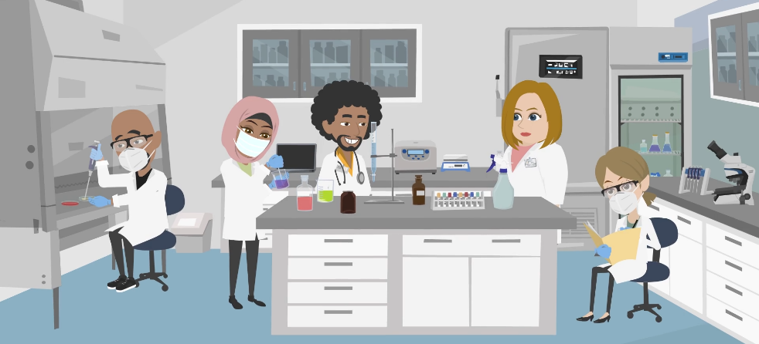
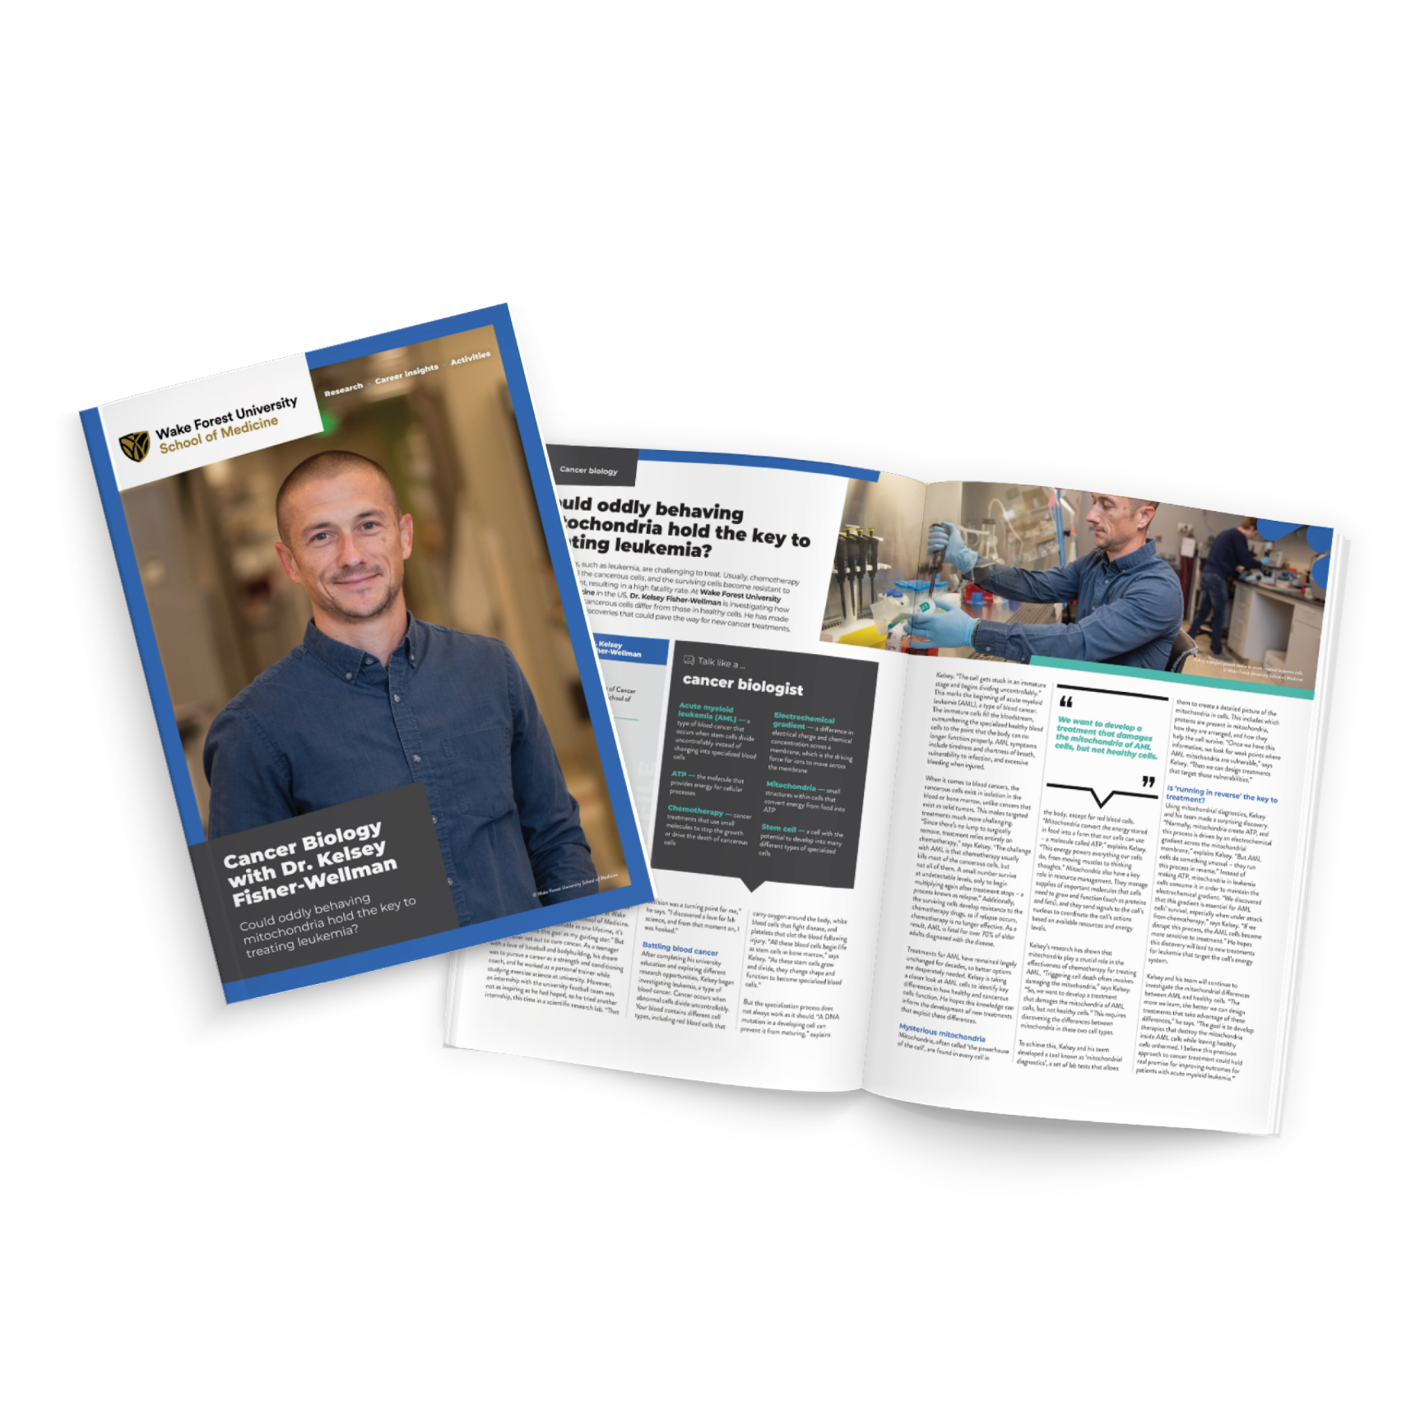
Pre-listening | Break it Down | Post-listening | Learn More
Learn More About Kelsey’s Work:
Read Kelsey’s article
Download Kelsey’s activity sheet
Watch Kelsey’s animation
Download Kelsey’s careers PowerPoint
Read Kelsey’s resources in Spanish
Inspiring the
Next Generation

Slide 8
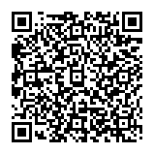



This educational material has been produced by Wake Forest University School of Medicine in partnership with Futurum and with grant support from The Duke Endowment.
The Duke Endowment is a private foundation that strengthens communities in North Carolina and South Carolina by nurturing children, promoting health, educating minds and enriching spirits.
Let us know what you think of this educational and career resource.
To provide input, simply scan the QR code or access the link below:
redcap.link/dh5j1nes

