Slide 1
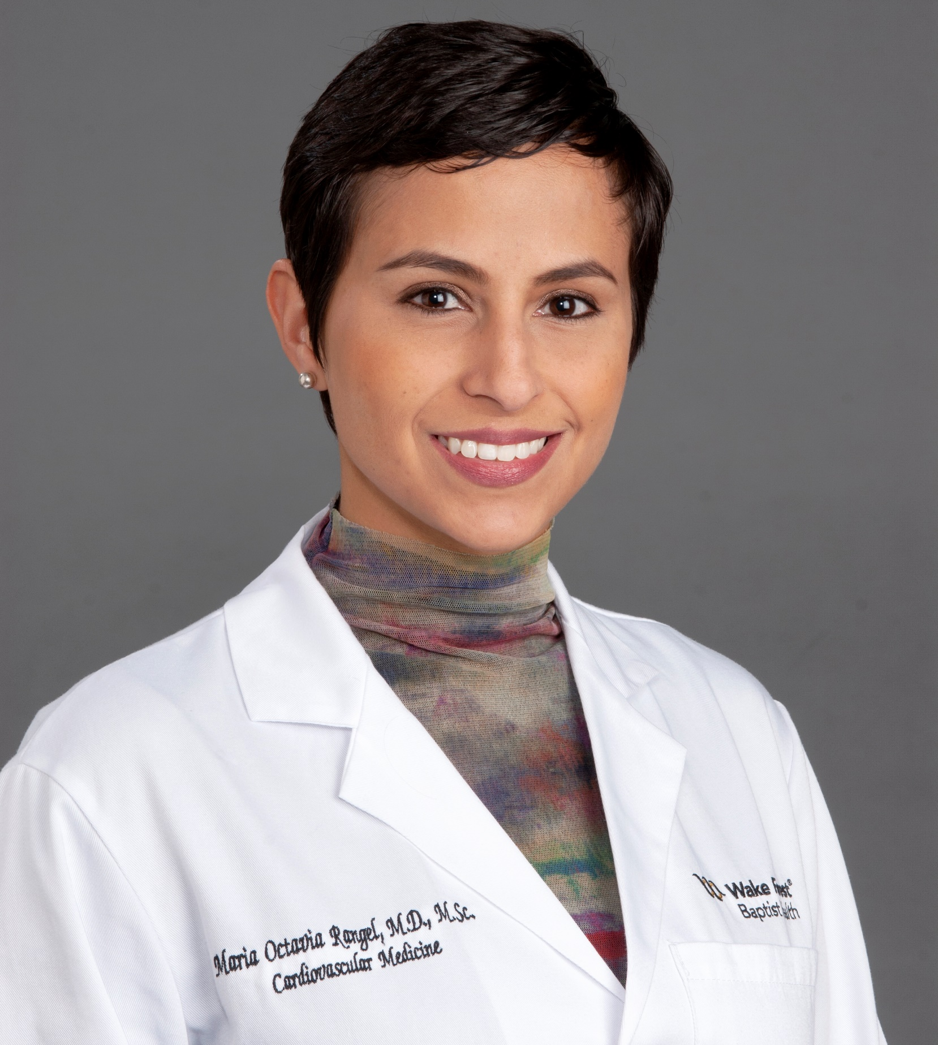


Geriatric Cardiology
with
Dr. Maria Octavia Rangel
GET STARTED

Slide 2



In this Presentation:
Introduction
Octavia’s Research and Career Journey
Talking Points
About Geriatric Cardiology
Pathway from School to Geriatric Cardiology
Careers in Geriatric Cardiology
Meet Octavia
Talking Points
More Resources
© Have a nice day Photo/Shutterstock.com
02 futurumcareers.com

Slide 3
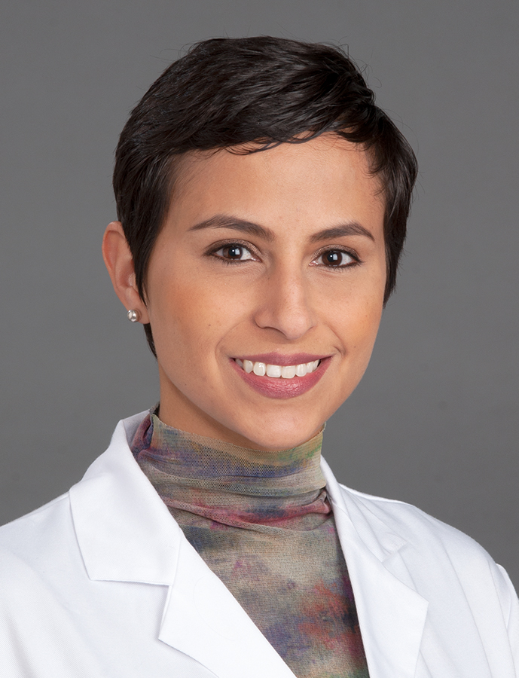
Meet Octavia
Dr. Maria Octavia Rangel is a geriatric cardiologist at Wake Forest University School of Medicine in the US.
Octavia is passionate about improving the lives of older adults living with heart problems. Her career combines clinical practice, clinical research, and teaching and mentoring the next generation of medical professionals.
Dr. Maria Octavia Rangel
03 futurumcareers.com

Slide 4
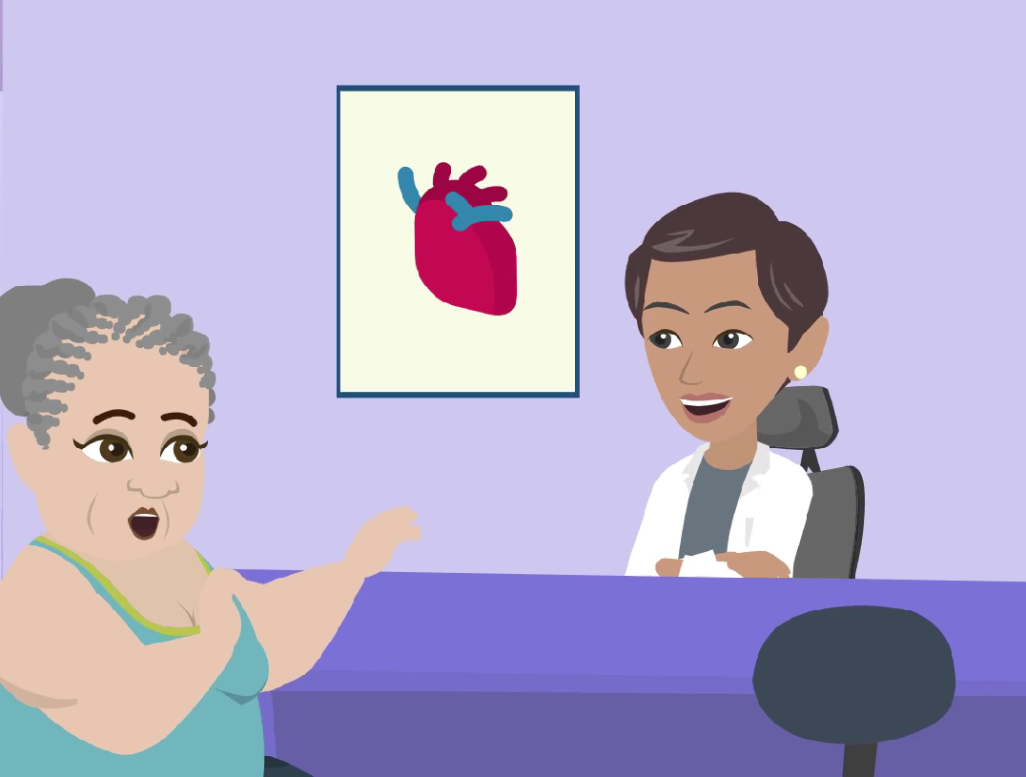
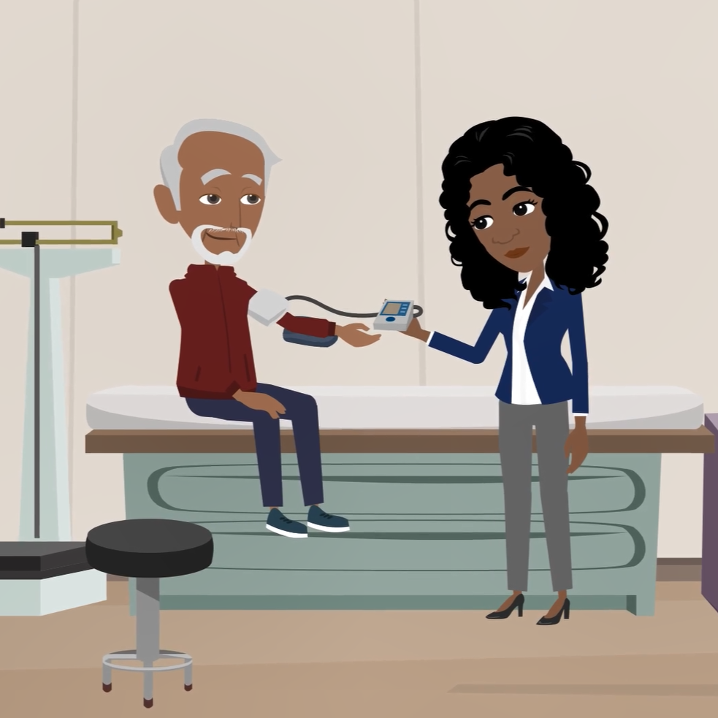
Learn about Octavia’s
Research and Career Journey
The animation on the following slide will introduce you to Octavia’s career.
You can also find it on Octavia’s Futurum page: www.futurumcareers.com/geriatric-cardiology-with-dr-m-octavia-rangel
Or watch it on YouTube: www.youtube.com/watch?v=uzEoSnQ2DCY
04 futurumcareers.com

Slide 5


Slide 6
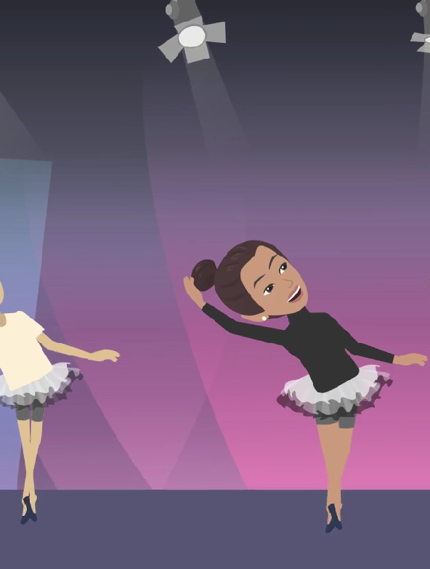
Animation Summary
As a youngster, Octavia loved learning. She practiced classic ballet for many years, which enabled self-expression and taught her discipline – something she would need when she went to medical school.
Octavia’s father inspired her to study medicine. He was a physician specializing in obstetrics – supporting patients in pregnancy and childbirth – in Venezuela, Octavia’s home country. Despite suffering from heart disease from an early age, he lived to be 74-years-old. At his funeral, Octavia met many of his patients who were very grateful for how he had helped them. Seeing the value of helping others cemented Octavia’s desire to become a doctor.
Today, Octavia is a geriatric cardiologist at Wake Forest University School of Medicine in the US. She supports older adults with cardiovascular disease and studies new ways of improving life expectancy and quality of life.
06 futurumcareers.com

Slide 7
Animation Summary
As early as her master’s degree, Octavia carried out impactful research to learn if a drug called Regadenoson was safe for individuals with a type of kidney disease to take to assess their heart health. Octavia’s study provided evidence that Regadenoson is safe to use in patients with advanced kidney disease.
Currently, Octavia is working on a research trial called REHAB-HFpEF,
exploring the impact of personalized physical rehabilitation on older adults with heart failure.
Octavia’s clinical experience inspired her to create the Geriatric Cardiology Program at Wake Forest University School of Medicine, to provide high quality, multidisciplinary care to geriatric patients. She also shares her passion and expertise by teaching and mentoring others following in her path, which she finds incredibly rewarding.
07 futurumcareers.com

Slide 8


Talking Points
What were the benefits of practicing classic ballet for Octavia? How do you think this hobby helped her when she went on to study medicine?
What hobbies do you enjoy? What are the benefits of these hobbies for you?
What inspired Octavia to pursue geriatric cardiology?
What did Octavia research for her master’s degree? What evidence did her research provide?
What research project is she currently involved with? What is Octavia’s role on this project?
08 futurumcareers.com
© Have a nice day Photo/Shutterstock.com

Slide 9
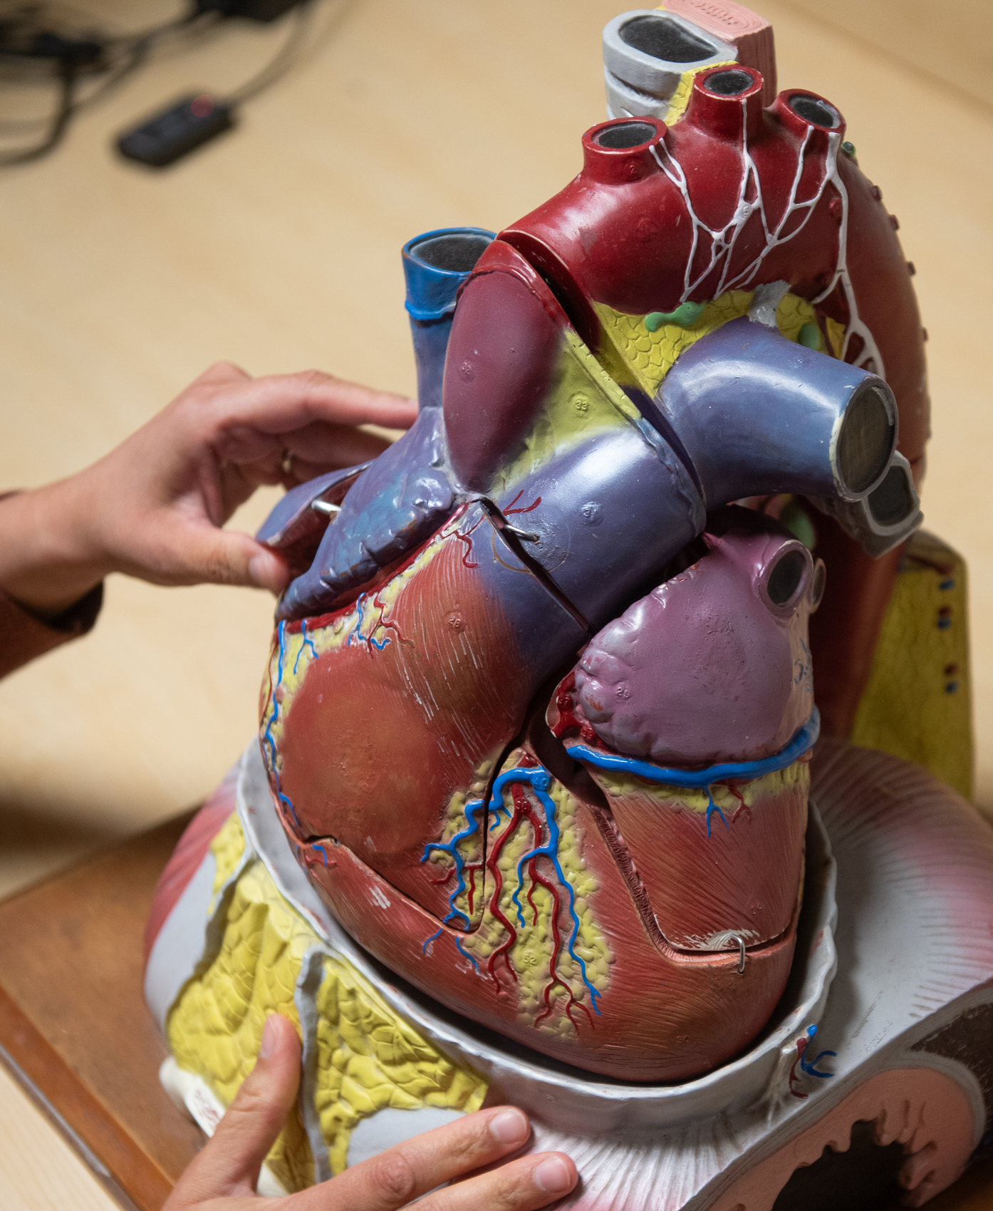
About Geriatric Cardiology
Geriatric cardiology is an exciting field to work in, with a variety
of potential ways to improve the lives of older adults living with cardiovascular disease (CVD), which is a disease of the heart, blood vessels, and circulatory system.
Geriatric cardiologists tend to work on the overall health and well-being of their patients, learning about their personal values, goals, and other medical conditions they may have, and working collaboratively with them to create their treatment plan.
Geriatric cardiologists also use tools such as cardiac stress testing, echocardiography, and blood tests to help with diagnosis, tracking progress, and treatment outcomes.
Example of a heart model used by Octavia to explain heart disease to trainees
09 futurumcareers.com

Slide 10
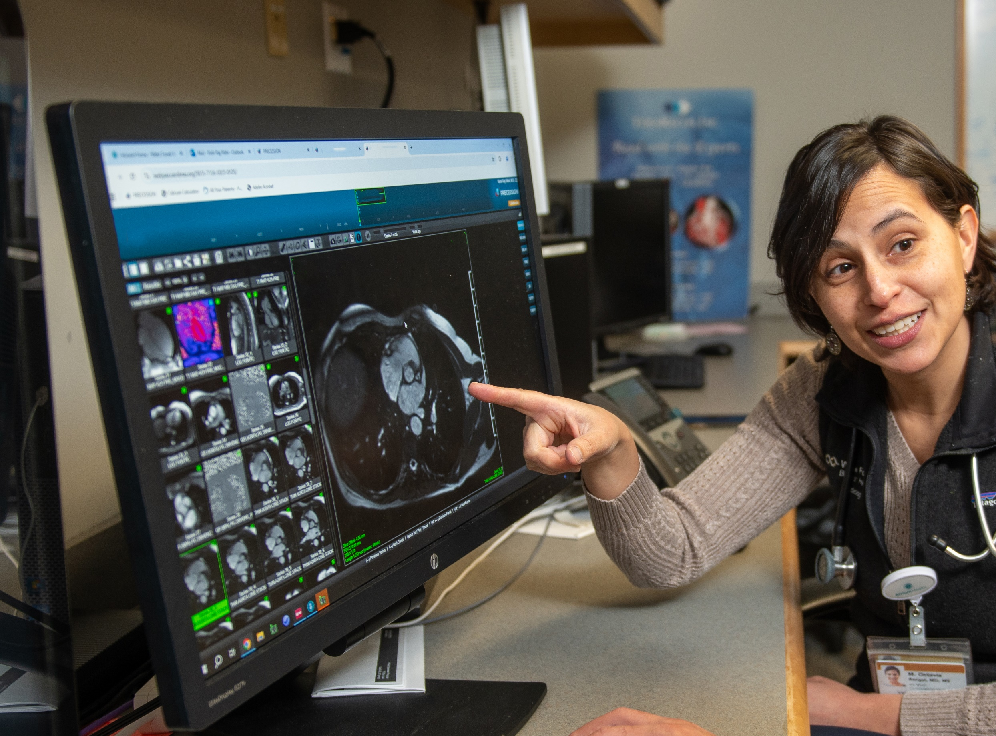
About Geriatric Cardiology
Octavia is incredibly enthusiastic about her work.
“The field of cardiology is continuously evolving in multiple aspects, from drug development, intravascular device therapies, and interventions, to preventative interventions and cardiac imaging. Since cardiovascular disease remains the number one cause of death in the US, it is also a field of great public health interest and growth.” – Octavia
Octavia teaching cardiac magnetic resonance to a cardiology fellow
10 futurumcareers.com

Slide 11
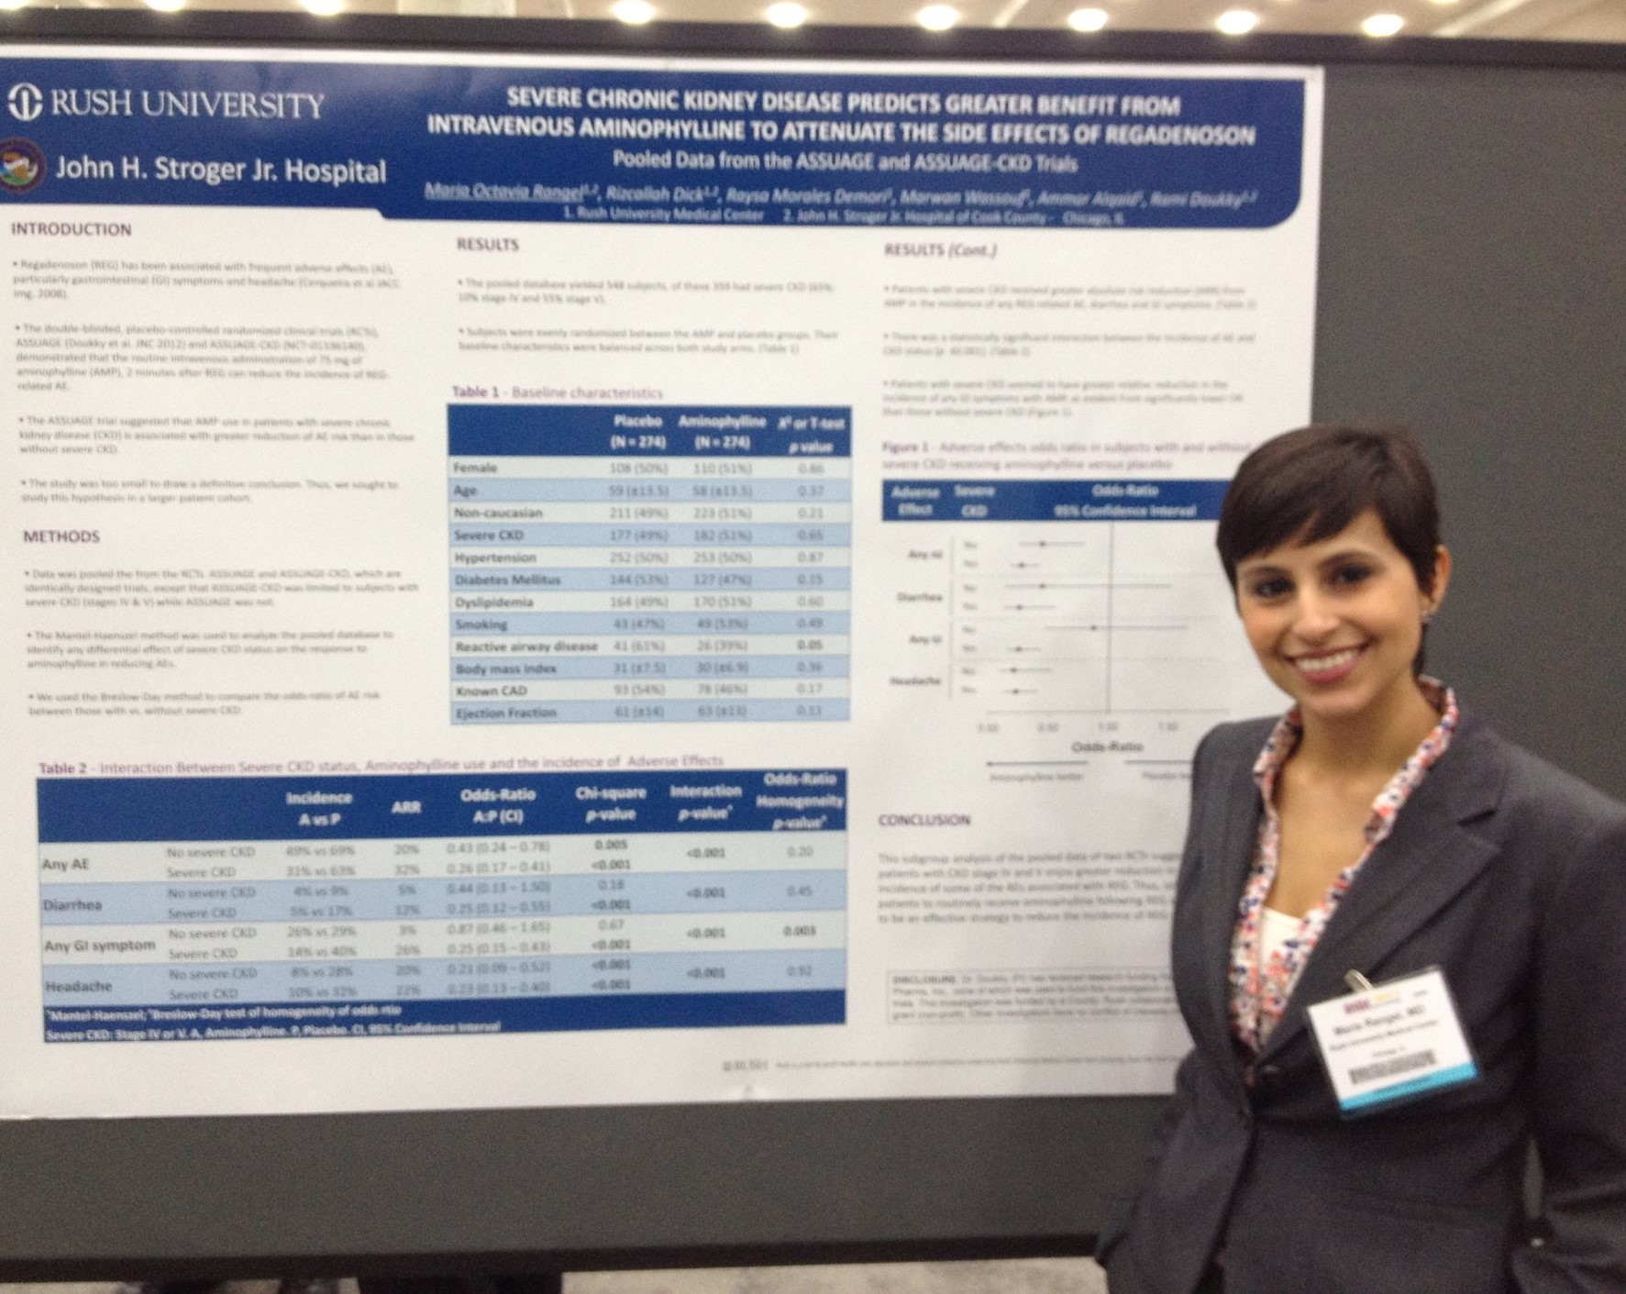
Pathway from School to Geriatric Cardiology
Octavia Rangel presents a scientific poster about her research on Regadenoson
Biology, chemistry, and physics form the foundation for an understanding of cardiology and a high competence in them is likely to be required for further study in medicine.
At college or university, topics such as biochemistry, physiology, fluid dynamics, electrophysiology, and pharmacology will all contribute to your understanding of cardiology.
“Having exposure to psychology helps you take better care of patients.” – Octavia
During your college or university studies, get involved in research projects being conducted in your department to gain direct experience of biological research.
11 futurumcareers.com

Slide 12
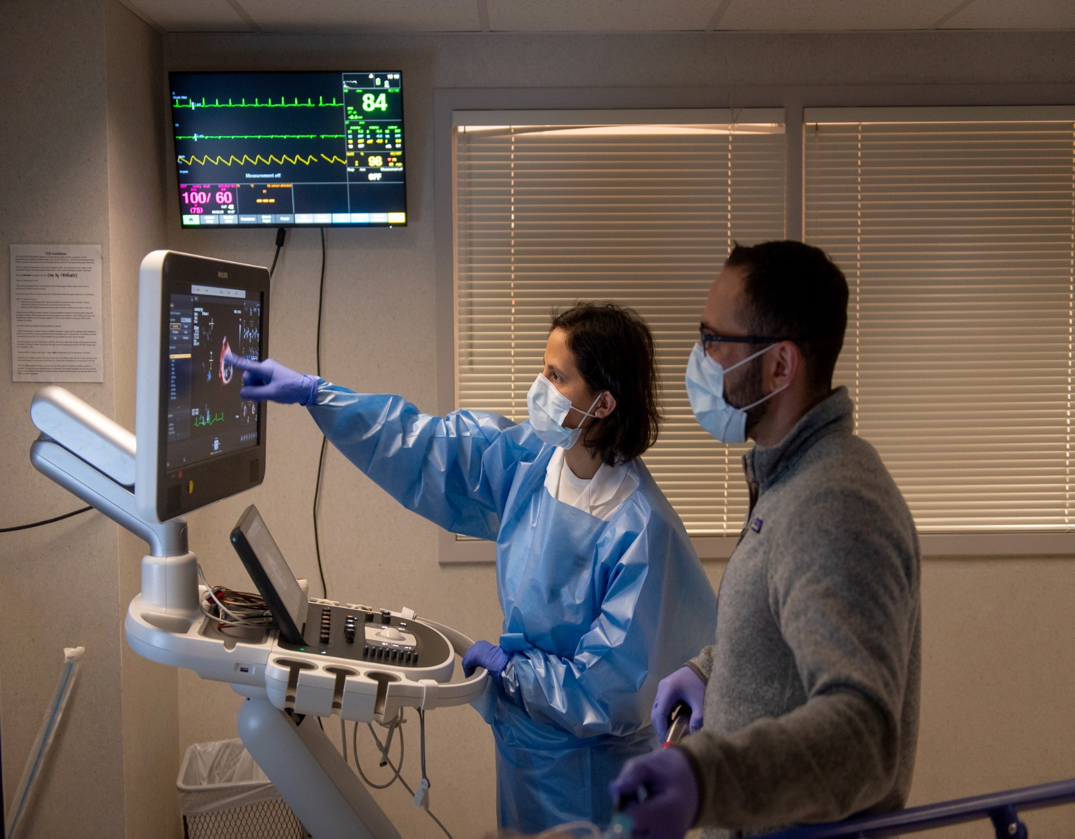
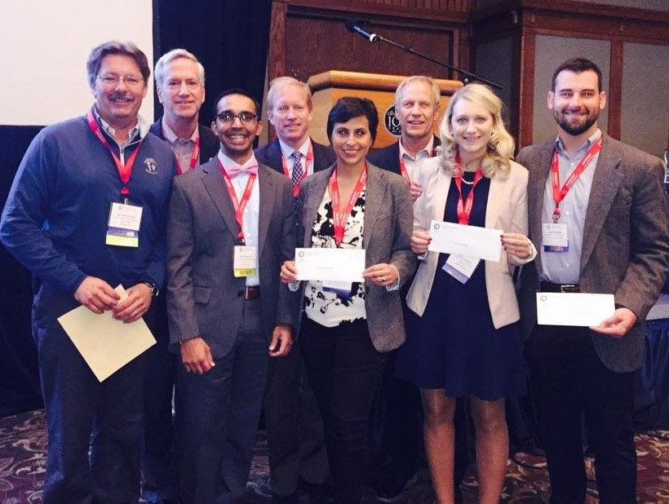
Explore Careers in
Geriatric Cardiology
Octavia performing a transesophageal echocardiogram with a cardiology fellow in training
The American Heart Association and the American College of Cardiology provide useful information, resources and volunteering opportunities. You could even consider becoming a Student Member, which gives you access to more information, meetings, conferences, and opportunities to meet professionals working in the field.
The British Medical Journal has published a helpful article about becoming a cardiologist.
Learn more about the work of Octavia and her colleagues in the Section of Cardiovascular Medicine at the Wake Forest University School of Medicine.
12 futurumcareers.com

Slide 13
Talking Points
What is cardiovascular disease (CVD)?
Who do geriatric cardiologists specialize in helping?
What do geriatric cardiologists need to learn about their patients to be able to help them effectively?
In what way is the field of cardiology evolving?
How strong are your skills in biology, chemistry, and physics? Which areas do you need to strengthen, and how could you go about doing so?
13 futurumcareers.com
© Have a nice day Photo/Shutterstock.com

Slide 14
Meet Octavia
I really liked school and learning about anything and everything! I enjoyed reading and dancing. I practiced classic ballet for many years while growing up, which equipped me with the discipline I would need in my medical school years and gave me an outlet for self-expression.
My father inspired me to study medicine. He was a physician specializing in obstetrics, supporting patients throughout pregnancy and childbirth, in Venezuela, my home country. He was deeply passionate about life and learning, and he was a philanthropist. Despite suffering from cardiovascular disease from an early age, he lived to be 74 years old, against the odds for the time.
14 futurumcareers.com

Slide 15
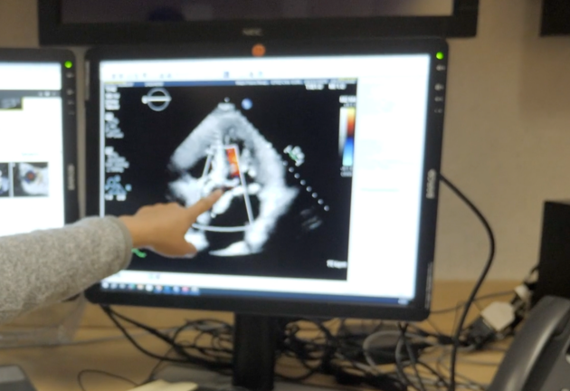
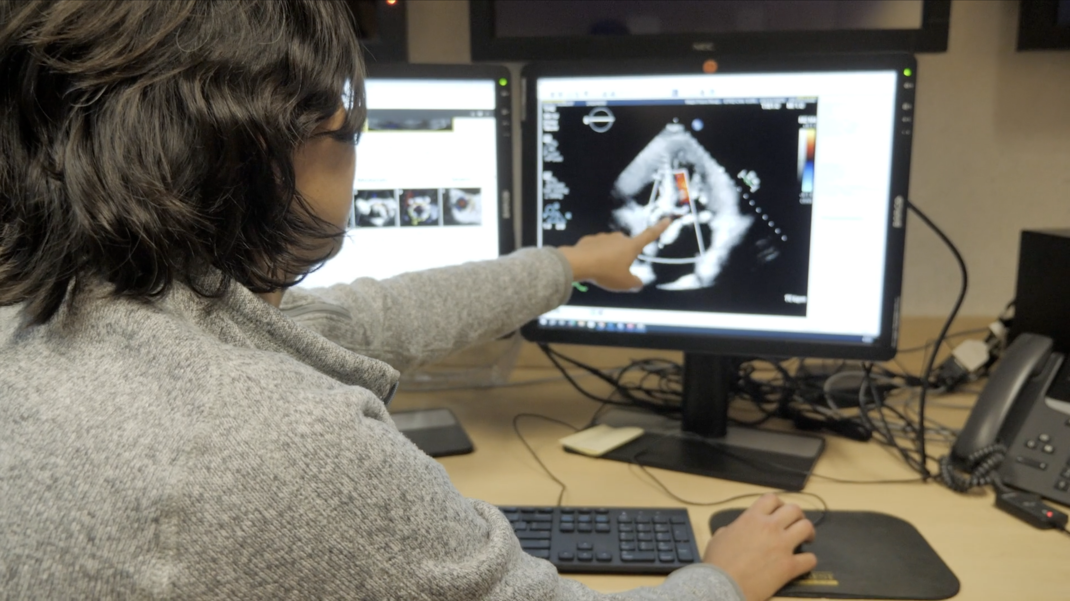
Meet Octavia
Octavia teaching in the echocardiography laboratory
When I started to get involved in clinical research, I felt the need to acquire skills to better understand and conduct clinical trials. My master’s degree equipped me with knowledge in biostatistics, bioinformatics, clinical research design, and ethics and regulatory processes.
I had contemplated studying engineering, so while in medical school, I thought that applying concepts of physics, fluid mechanics, and electricity to understanding how the heart worked was fascinating. These concepts were also fundamental to understanding the different disease processes that affected the heart and how they manifest in the body. It all just made so much sense! It was also very uplifting to learn that many heart-related conditions are treatable and that a potentially life-threatening condition could be overcome with timely intervention.
15 futurumcareers.com

Slide 16
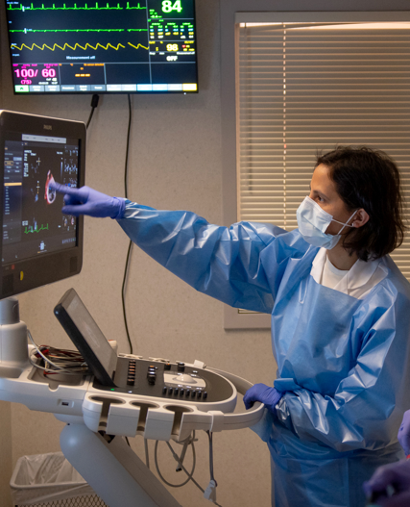
Meet Octavia
Octavia performing a
transesophageal echocardiogram
I tackle challenges by focusing on what really matters and what needs to be done to overcome the situation. I think about options and alternative scenarios, even if they are not exactly what I want. I ask myself, “If this or that happens, is this an acceptable alternative?” And I always try to find common ground when a challenge involves others.
I switch off from work by spending time outside in nature and with my family and friends. I enjoy singing and dancing, and I also like to make photo books of cherished memories from trips, special occasions, and day-to-day events.
I aim to keep learning and adapting to deliver the best care possible to my patients. I hope I continue to experience the joy of teaching. I aim to continue to help close knowledge gaps in the care of older adults with cardiovascular disease through my participation in clinical trials.
16 futurumcareers.com

Slide 17
Octavia’s Top Tips
Stay open to learning and exploring. Keep a mindset of ingenuity, wonder, and curiosity.
Be humble. Honor the trust that people put in you.
Life happens, and it is not linear. You can do and achieve anything you put your mind to, but it is okay if it does not happen all at once!
17 futurumcareers.com

Slide 18
Talking Points
From what you have read about him, why do you think Octavia’s father was such an inspiration to her?
How does Octavia relate her interest in engineering to cardiology? What does this reveal about a scientific mind and scientific curiosity?
Octavia tackles challenges by focusing on what really matters and alternative scenarios. How do you overcome challenges?
How do you switch off from your work? Why is it important to do so?
Which of Octavia’s top tips do you find most useful, and why?
18 futurumcareers.com
© Have a nice day Photo/Shutterstock.com

Slide 19
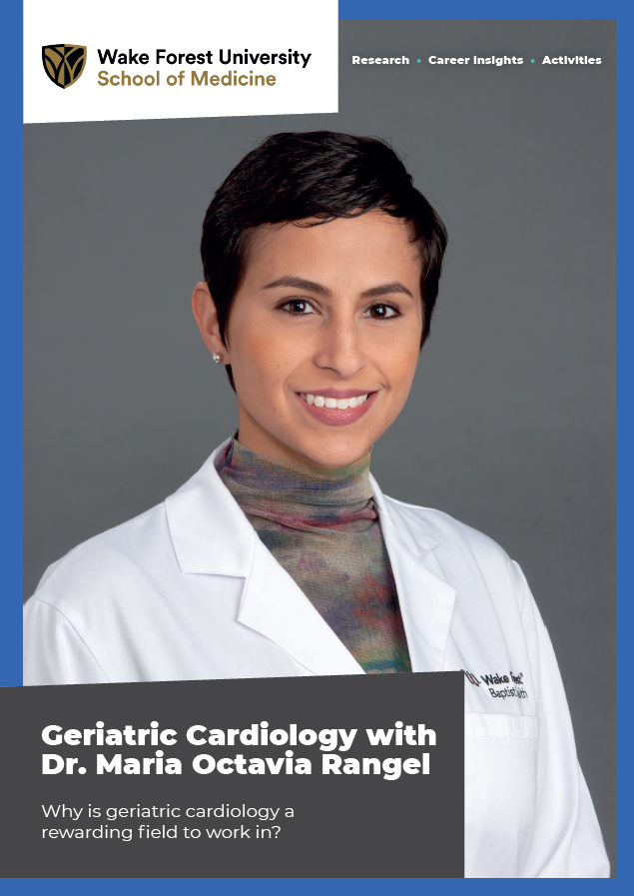
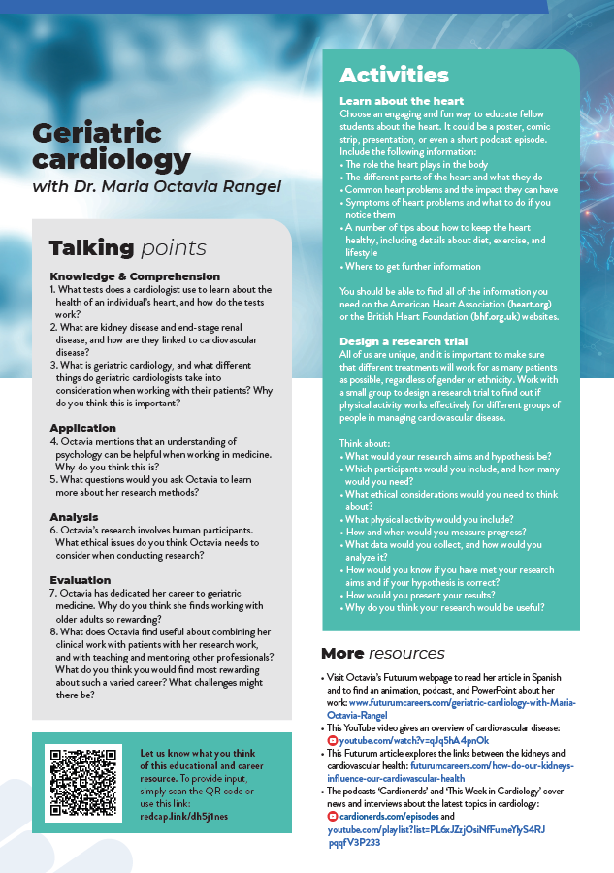

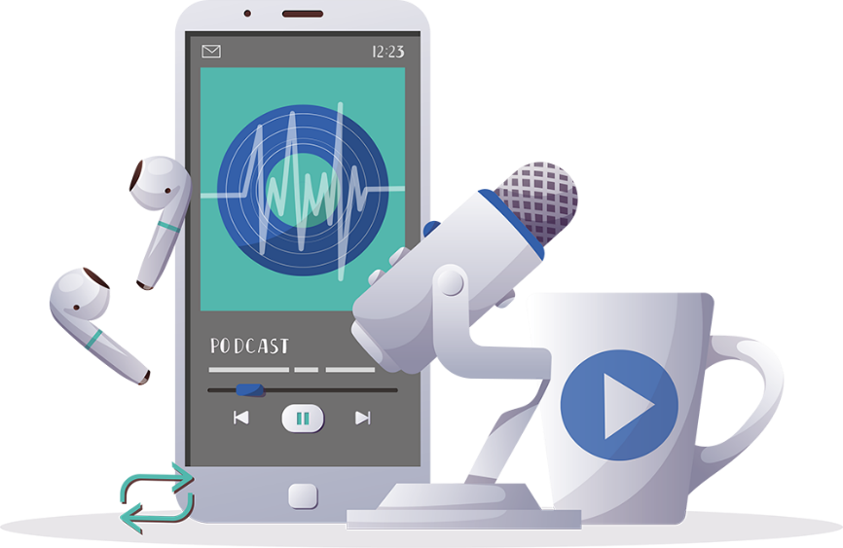

More resources
Read the article
Complete the activities
Listen to the podcast
Watch the animation
Download the Spanish resources
19 futurumcareers.com
© Have a nice day Photo/Shutterstock.com

Slide 20
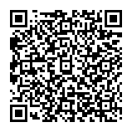
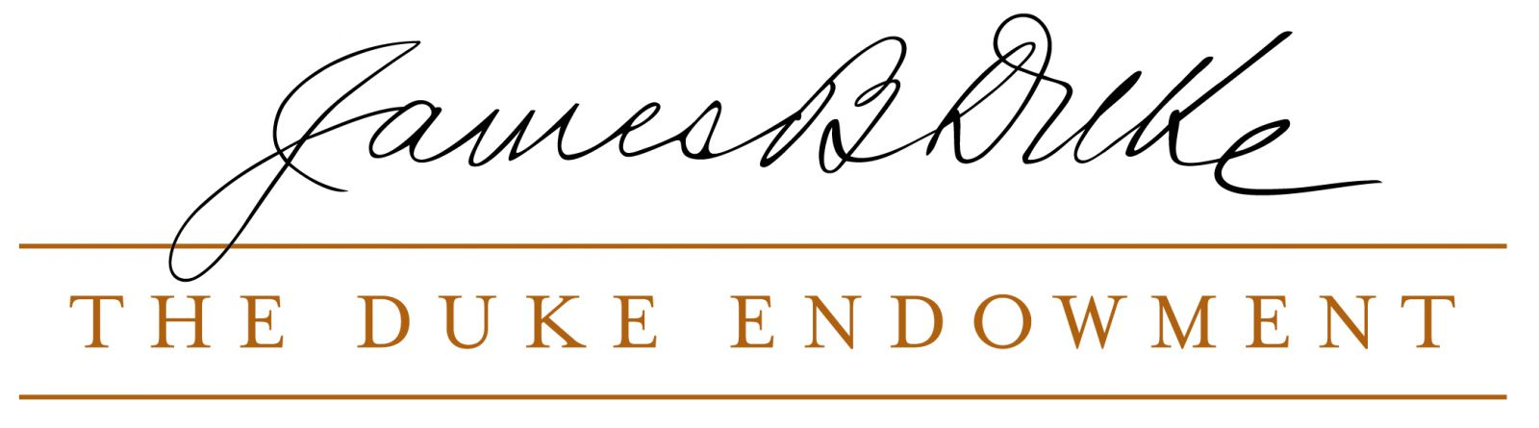

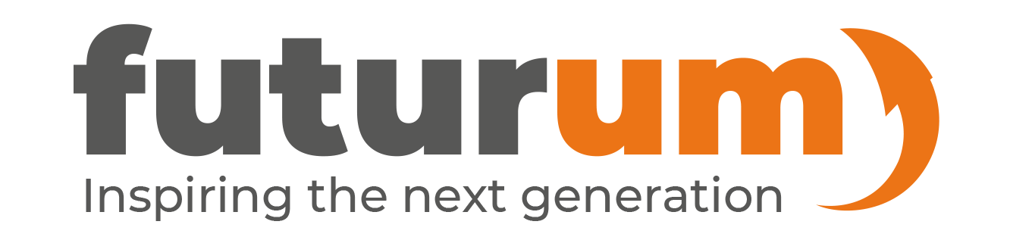
This educational material has been produced by Wake Forest University School of Medicine in partnership with Futurum and with grant support from The Duke Endowment.
The Duke Endowment is a private foundation that strengthens communities in North Carolina and South Carolina by nurturing children, promoting health, educating minds and enriching spirits.
Let us know what you think of this educational and career resource.
To provide input, simply scan the QR code or access the link below:
redcap.link/dh5j1nes

