Slide 1


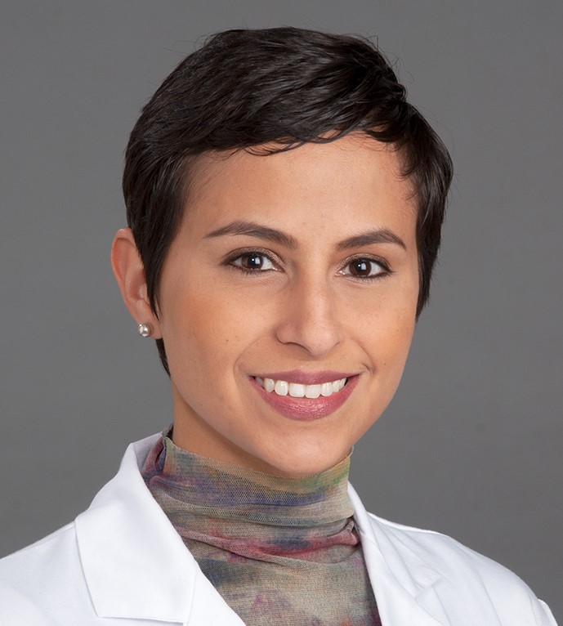


Inspiring the
Next Generation
FUTURUM
PODCAST
In Conversation with
Dr. Maria Octavia Rangel

Slide 2

Pre-listening | Break it Down | Post-Listening | Learn More
Meet
Dr. Maria Octavia Rangel
Pre-listening:
In this podcast, Dr. Maria Octavia Rangel speaks about how to create supportive and reciprocal relationships with your mentors, and the importance of pushing yourself out of your comfort zone.
What do you think a career in geriatric cardiology involves?
Why do you think it is important to have mentors to support you through life?
How do you feel about stepping out of your comfort zone? When have you had to do so, and how did you cope with the challenge?
Profile
Wake Forest University School of Medicine, USA
Field of Research
Geriatric Cardiology
“Have that openness to see opportunity in everything that comes your way.”

Slide 3


Pre-listening | Break it Down | Post-listening | Learn More
Break Octavia’s Conversation Down:
Up to 05:45
What does Octavia say is unique about working with the geriatric age group?
What do you think it means to be a co-investigator on a clinical trial? What responsibilities do you think this role includes?
Has there been a time when you have had to adapt to change? How did you find this experience? What enabled you to meet the challenge of adapting?
When did you last ask for help, and how easy did you find doing so? What was the result of asking for this help?

Slide 4

Pre-listening | Break it Down | Post-listening | Learn More
05:45 – 08.50
Why do you think Octavia believes it is important for a mentee to be mentored by a variety of people, rather than one long-term mentor?
Why do you think Octavia finds it so rewarding to be a mentor?
When did you last have a real sense of wonder? When did you last explore and really question something? What did you learn from this experience?

Slide 5

Pre-listening | Break it Down | Post-listening | Learn More
08:50 – end
In what way can life’s path be ‘curvy’? What detours have you experienced in life, and what did you gain from these detours? What unexpected opportunities did they provide?
What advice does Octavia give about hearing ‘no’ as an answer? How can we respond to ‘no’ in a constructive, positive way?

Slide 6


Pre-listening | Break it Down | Post-listening | Learn More
Post-listening:
To what extent do you think you would find a career in geriatric cardiology to be rewarding and interesting, and why?
Have you ever had a mentor? What support did they give you? What did you gain from being their mentee? If you have not had a mentor before, is there someone you admire? What do you think you could gain – and offer – by being their mentee?
Where could you look to seek out opportunities such as mentoring and shadowing?
Which piece of Octavia’s advice did you find most useful, and why?
What further questions would you ask Octavia about geriatric cardiology and/or her career?*
Submit questions to Octavia here

Slide 7

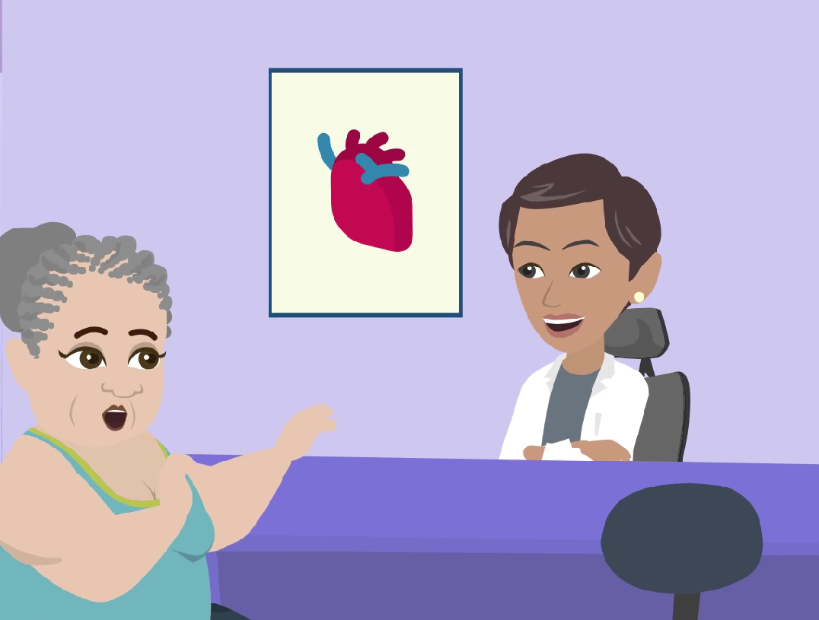
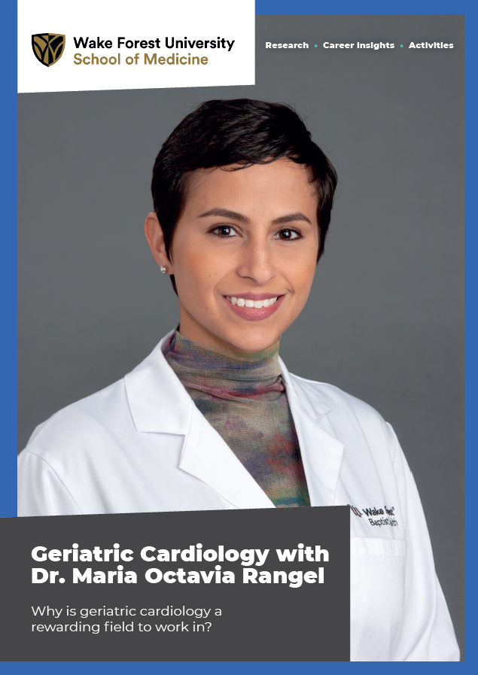
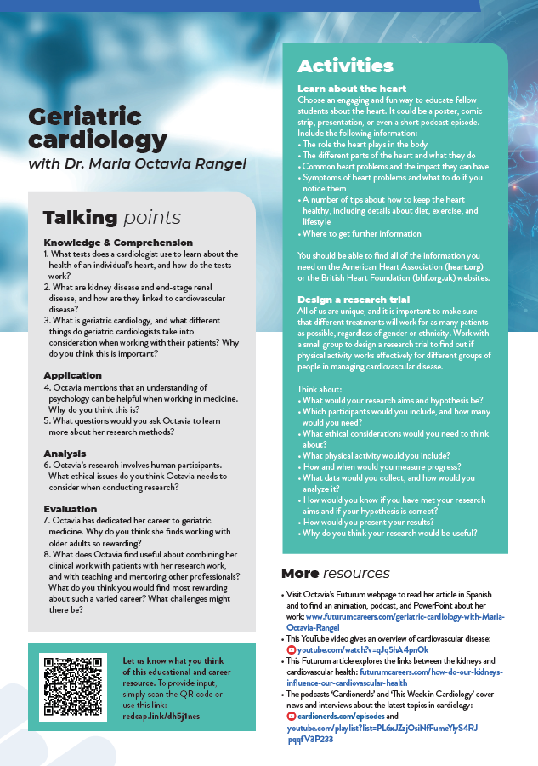
Pre-listening | Break it Down | Post-listening | Learn More
Learn More About Octavia’s Work:
Read Octavia’s article
Download Octavia’s activity sheet
Watch Octavia’s animation
Download Octavia’s careers PowerPoint
Read Octavia’s resources in Spanish
Inspiring the
Next Generation

Slide 8
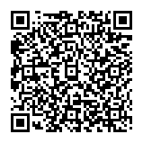



This educational material has been produced by Wake Forest University School of Medicine in partnership with Futurum and with grant support from The Duke Endowment.
The Duke Endowment is a private foundation that strengthens communities in North Carolina and South Carolina by nurturing children, promoting health, educating minds and enriching spirits.
Let us know what you think of this educational and career resource.
To provide input, simply scan the QR code or access the link below:
redcap.link/dh5j1nes

