Slide 1
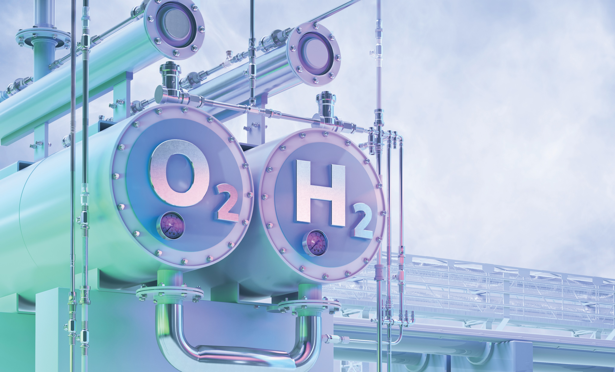
MATERIALS CHEMISTRY
WITH DR NICOLAS BOSCHER
Green Hydrogen, future energy h2 fuel 3D illustration. Green hydrogen production by electrolysis technology, renewable electricity, alternative eco way of getting hydrogen H2, cut industry emissions. By Corona Borealis

Slide 2
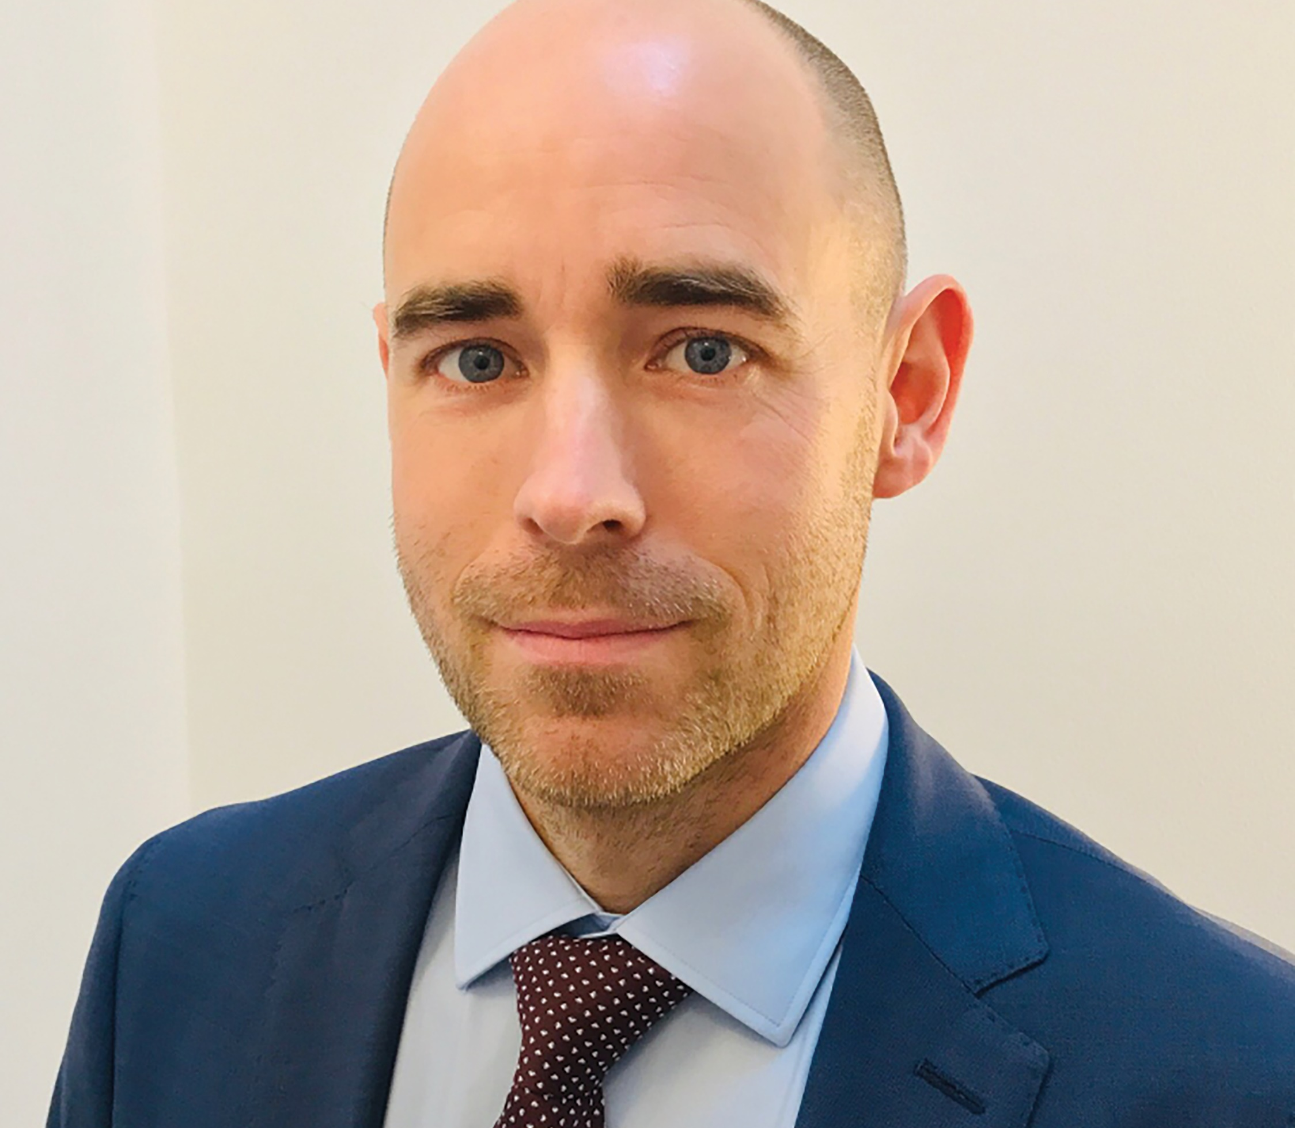
MEET NICOLAS
DR NICOLAS BOSCHER is Lead Researcher at the Luxembourg Institute of Science and Technology in Luxembourg.
Leading the CLEANH2, TODAM & POLYPORPH research projects, he is developing materials chemistry techniques for the clean production of hydrogen fuels, reducing greenhouse gas emissions.
Let’s learn more about his research…

Slide 3
Burning hydrogen does not produce greenhouse gases, which means that it has the potential to be a clean fuel powering cars, planes and other processes currently dependent on fossil fuels.
However, the production of hydrogen fuels usually generates greenhouse gas emissions. Around 95% of hydrogen is currently produced from fossil fuels, limiting its potential to be a truly clean energy source.
Nicolas and his international team are perfecting methods to clean up hydrogen production to help the world to reduce greenhouse gas emissions and tackle climate change.
Photocatalytic polymers assembled from different chlorophyll-like molecules.

Slide 4
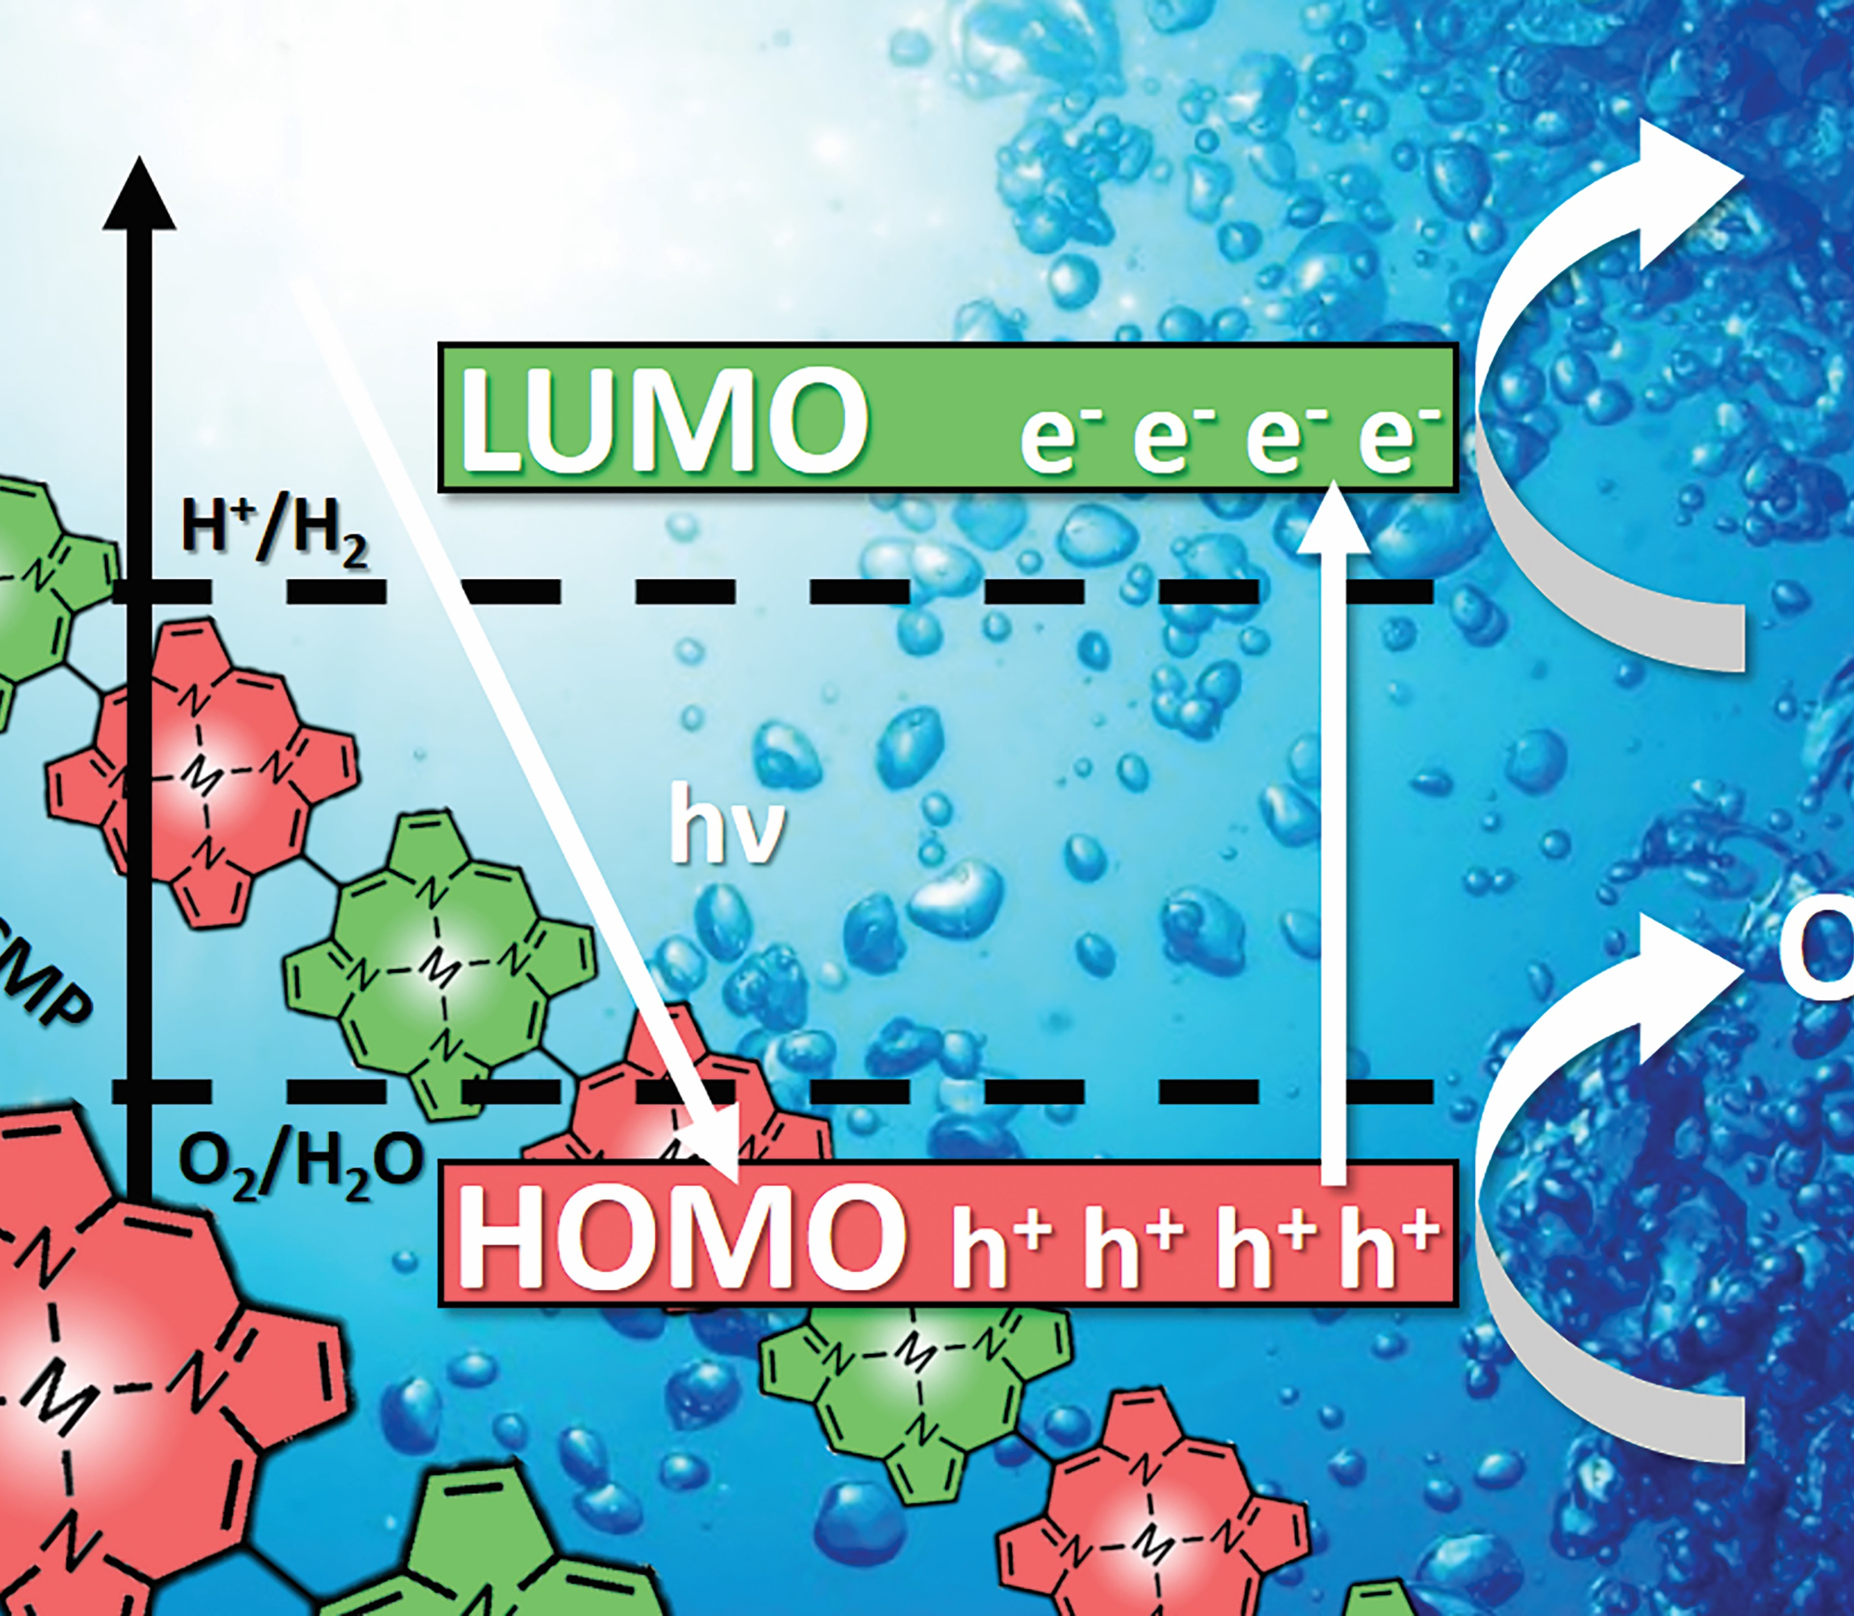
A CLEAN FUEL
Most hydrogen is currently produced from methane or natural gas, in a process that generates carbon dioxide.
Nicolas’ alternative method involves a process called photocatalytic water splitting.
This method mimics part of the process of photosynthesis whereby plants use energy from the sun to transform water (H₂O) and carbon dioxide (CO₂) into oxygen (O₂) and sugar (C₆H₁₂O₂).
Nicolas explains, “For over three billion years, nature has been implementing water splitting using sunlight.” Photocatalytic water splitting is artificial photosynthesis that uses light to split H₂O molecules into H₂ and O₂.
Sunlight is used to form electron-hole pairs to oxidise water and produce hydrogen.

Slide 5
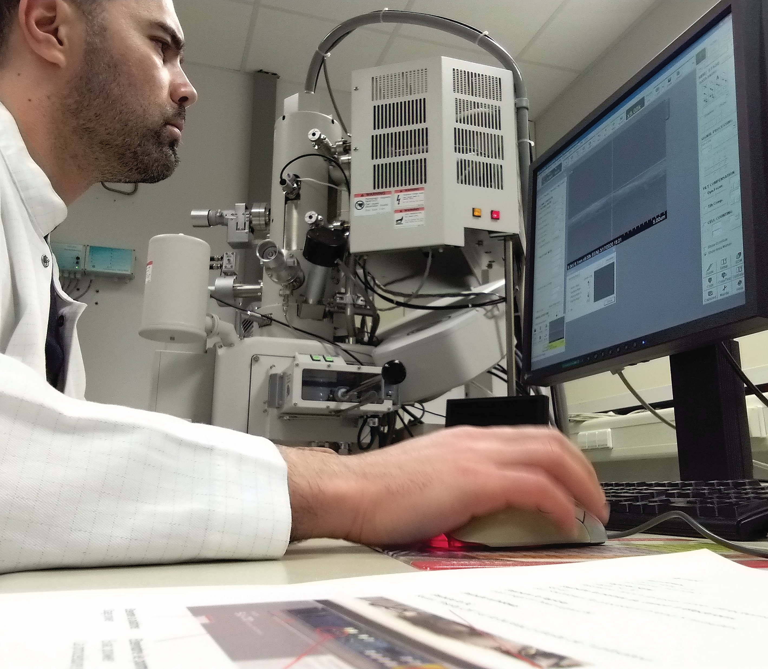
MIMICKING PHOTOSYNTHESIS
Nicolas and his team create new polymer photocatalysts by joining together smaller chlorophyll-like molecules or other strongly coloured molecules.
The resulting photocatalyst must have two key properties:
1) It can absorb light and turn it into energy.
2) It is microporous with active sites that molecules can bind to so that chemical reactions can take place.
Nicolas says, “Imagine an intensely coloured polymer foil on which hydrogen and oxygen bubbles form when immersed in water, under sunlight.”
Kamal operating a scanning electron microscope.

Slide 6
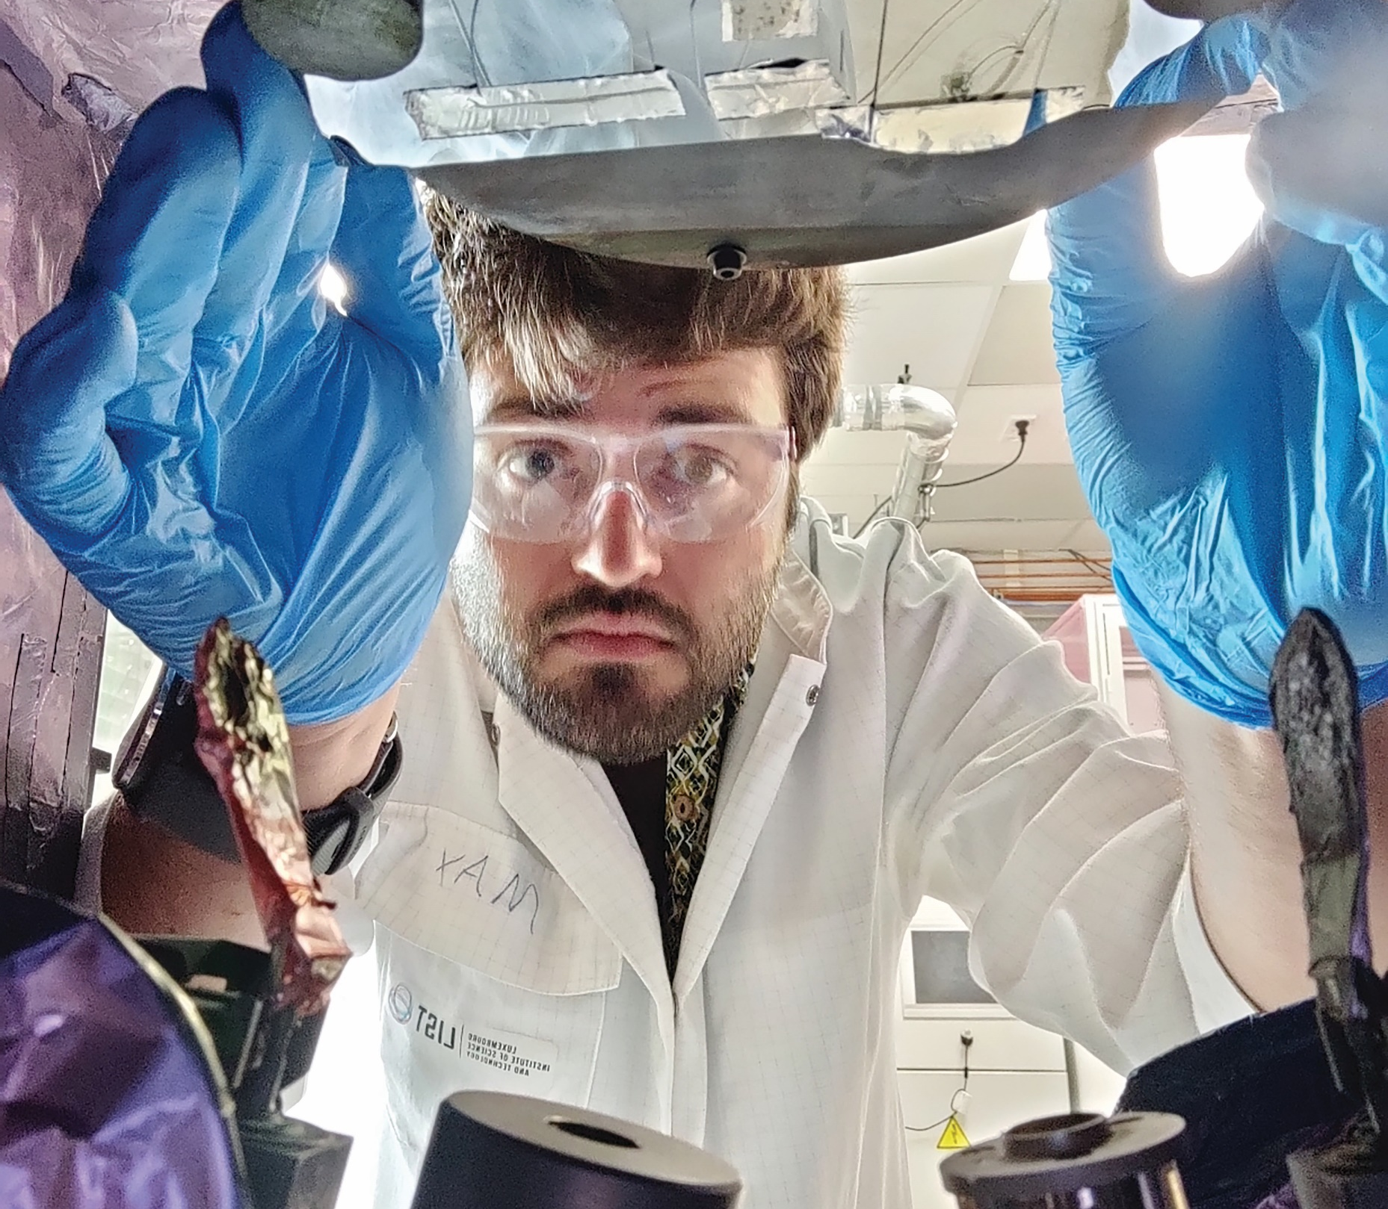
SYNTHESISING NEW POLYMERS
“The synthesis of our photocatalytic polymers is not straightforward,” says Nicolas. Some of the molecules used have poor solubility, which means that it is difficult to synthesise usable polymer photocatalysts using a traditional ‘wet chemistry’ approach.
To overcome this, Nicolas and his team use molecules in a gas state to synthesise their polymers while modifying them to be useful.
This gas phase approach opens the doors to other opportunities, like trying different molecules as polymer subunits and engineering polymers in new ways.
Max changing the substrates in the chemical vapor deposition reactor.

Slide 7
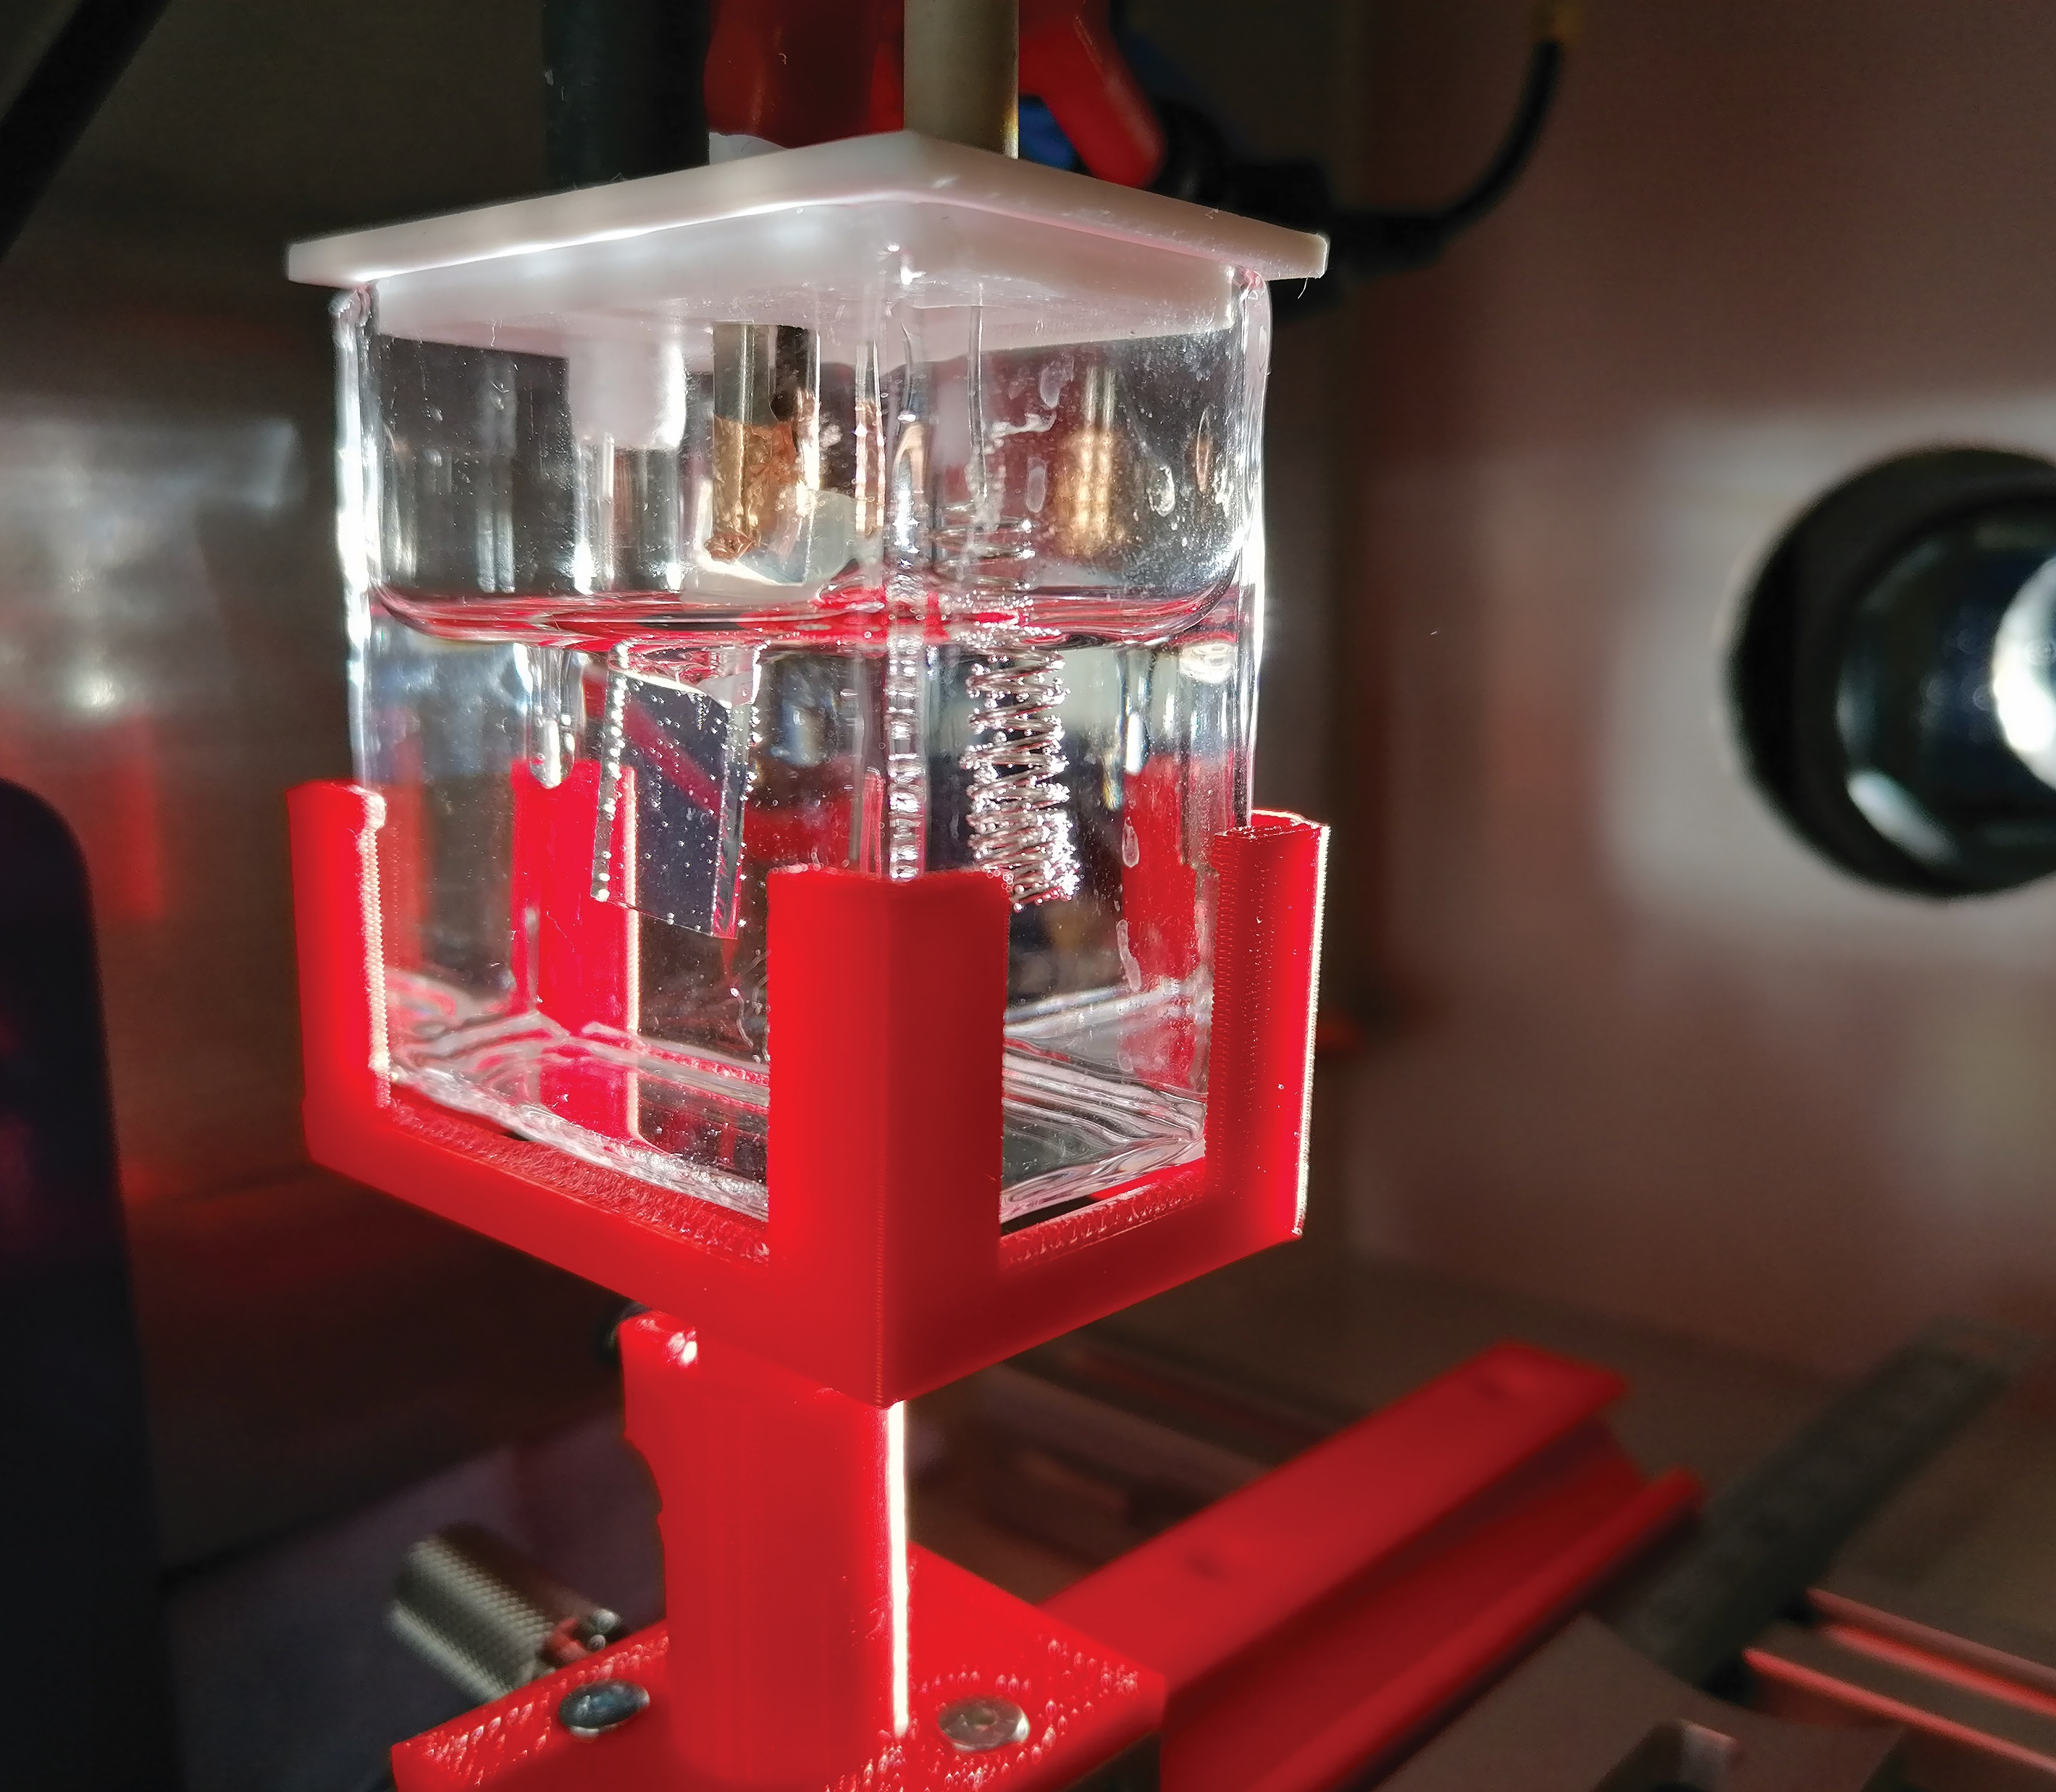
THE BENEFITS
Electric cars could be an important way of reducing greenhouse gas emissions, but clean hydrogen could be used to fuel larger vehicles like buses, trains, trucks, ships and planes, which would require prohibitively heavy batteries (~1500 kg) to be powered by electricity. Hydrogen can also be used for clean heat and power generation.
The team’s research shows that photocatalysts could be engineered to mimic other biological processes and power chemical reactions, such as producing plastics from carbon dioxide. This would be a huge step forward in ‘green chemistry’.
Photoelectrochemical cell used for the evaluation of the hydrogen production performances.

Slide 8
TALKING POINTS
What percentage of hydrogen fuel is currently produced from fossil fuels?
What is photocatalytic water splitting, and why is Nicolas’ team using this approach?
What properties must the new polymer photocatalysts that the team is producing have?
How is the team overcoming the issue of the poor solubility of some molecules?
What could be the long-term impacts of the team’s research?
Green Hydrogen, future energy h2 fuel 3D illustration. Green hydrogen production by electrolysis technology, renewable electricity, alternative eco way of getting hydrogen H2, cut industry emissions. By Corona Borealis

Slide 9
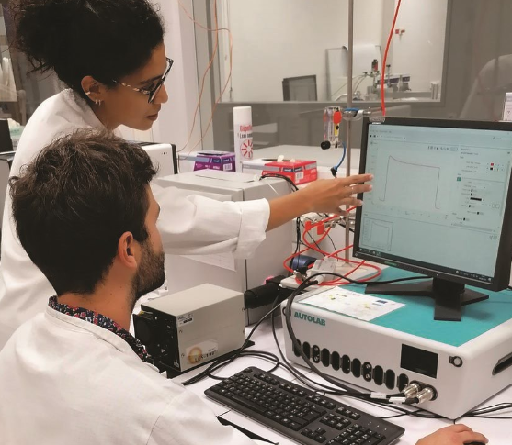
EXPLORE A CAREER IN MATERIALS CHEMISTRY
Materials chemists use chemistry techniques to understand how materials work, and to design and synthesise new materials which will be applied for useful purposes.
It is common for materials chemists to work as part of a team with a mixture of expertise, such as engineers and physicists.
The Luxembourg National Research Fund has lots of useful information on its site.
Salaries vary depending on where you work, for example in a university or another organisation. According to Glassdoor, the national average salary for a researcher in Luxembourg is €61,000 per year.
Drialys and Max discussing results of the photoelectrochemical cell.

Slide 10
NICOLAS’ TOP TIPS
01 Be determined and methodical. Developing a rational and structured approach will provide you with the courage to go to unexplored fields and tackle challenges.
02 Complement your skills. Do not stick with what you already know or what you have done in the past. Learn from your colleagues, develop new skills and merge them with your expertise to explore things from a new perspective.
03 Keep an open mind and learn from your mistakes. Consider every opinion, especially criticisms, which are often excellent opportunities to improve yourself. Do not let failures and mistakes stop you. Analyse them, learn from them and adapt your approach to succeed next time.

Slide 11
TALKING POINTS
Material Chemists like Nicolas work with a range of experts. When did you last collaborate with others on a team project? How successful were you? What did you contribute and what did you learn from others?
Nicolas highlights the need to be determined and methodical. When have you had to tackle a challenge in this way? In what way could you develop these strengths further?
When did you last make a mistake, and how did you deal with it? What did you learn from it? How might you deal with failures and mistakes in the future?
Green Hydrogen, future energy h2 fuel 3D illustration. Green hydrogen production by electrolysis technology, renewable electricity, alternative eco way of getting hydrogen H2, cut industry emissions. By Corona Borealis

Slide 12
MEET NICOLAS’ TEAM…
Photocatalytic polymers assembled from different chlorophyll-like molecules.

Slide 13
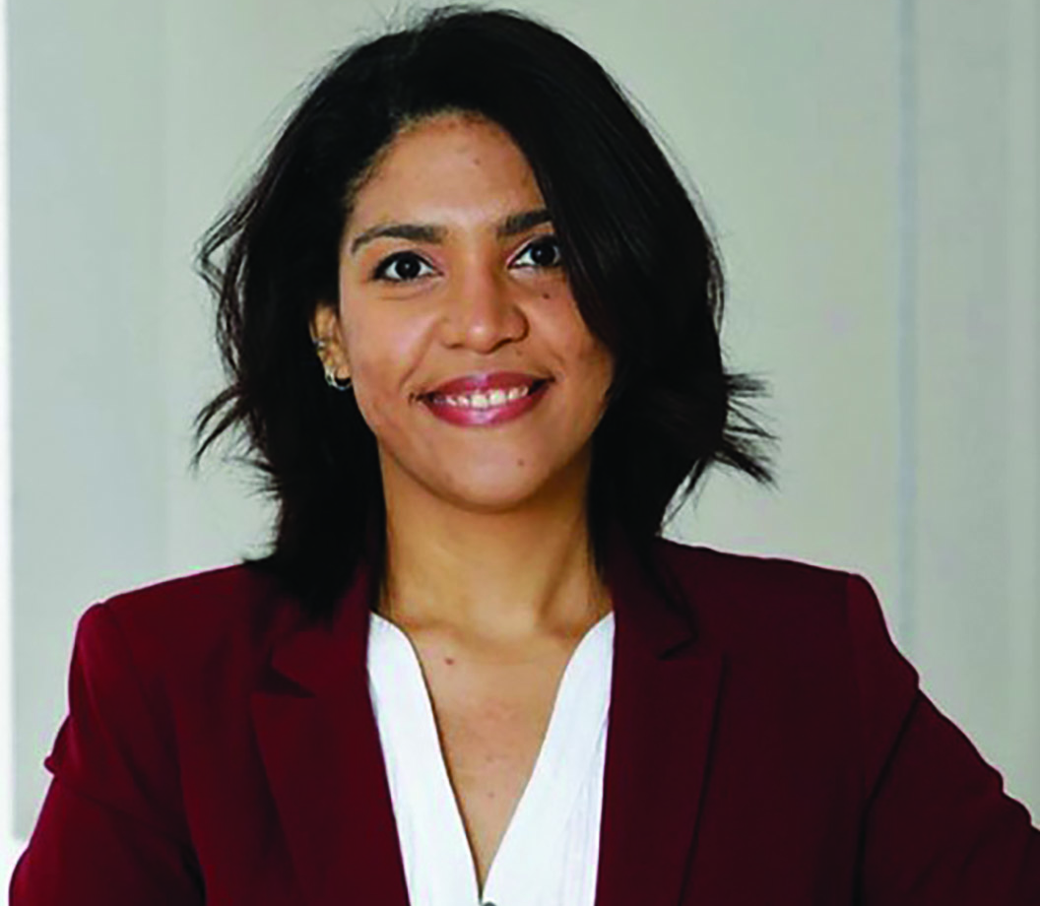
DR DRIALYS CARDENAS-MORCOSO
NATIONALITY: CUBAN
AREAS OF RESEARCH: RADIOCHEMISTRY, APPLIED PHYSICS

Slide 14
I joined CLEANH2 to contribute to understanding the structure and properties of the molecules used in the project.
Since childhood, I have been curious and keen to understand nature’s processes. As I grew up, I participated in science projects at school. During my master’s and PhD, I focused on the synthesis and characterisation of materials for the development of efficient light-powered devices and particularly solar fuels production. Now, I am bringing what I have learned to CLEANH2, helping to understand and develop solar hydrogen production systems.
Growing up in Cuba, I was impressed by the scientific advances in my country, particularly in biotechnology and in the development of materials, despite limited resources. I believe that the investment in technical-scientific development in Cuba over recent decades motivated many people of my generation to lean towards scientific careers.
I am also very concerned about environmental issues and their consequences, especially for future generations. I decided, as far as possible, to gear my scientific career towards developing approaches that can contribute to a sustainable future.
I feel very proud of contributing to projects aiming to develop practical devices for producing clean fuels from abundant and feasible materials. My future goal is to lead a research project developing new materials and approaches that can help to meet, in a safe and environmentally friendly way, current energy demands.

Slide 15
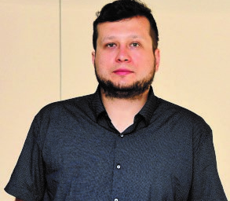
DR MAREK KRZYSZTOF CHARYTON
NATIONALITY: POLISH
AREAS OF RESEARCH: ORGANIC CHEMISTRY (FUNCTIONAL DYES), MATERIAL SCIENCES

Slide 16
In the TODAM project, I am responsible for designing, synthesising and understanding basic properties of synthetic organic (carbon-based) dyes.
I was raised in a region known as ‘the Green Lungs of Poland’ because of its vast forest, post-glacial lakes, basins and river valleys. I used to spend a lot of time in woods learning about wildlife, different environments and how ecology relates to modern society.
As child, I often watched documentaries and read books related to botany and zoology. I found the most fascinating parts were related to discovering a new functionality of a known species. This led me towards nature-inspired organic chemistry and bio-based materials.
For me, the most rewarding thing in the field of synthesis of organic dyes is when non-coloured compounds (simple and small molecules) react to form products with intense colours (larger molecules with more complex structure). The challenge is that even small differences in the reaction conditions or traces of impurity in the substances used can lead to results that can’t be reproduced. However, sometimes an unfortunate mistake leads to a very fortunate discovery. A scientist should always try their best to understand what has happened in the reaction flask!

Slide 17
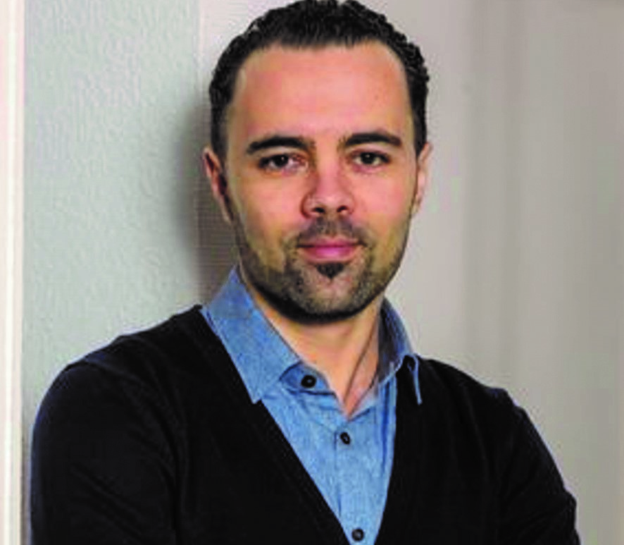
DR KAMAL BABA
NATIONALITY: ALGERIAN
AREAS OF RESEARCH: CHEMICAL AND PROCESS ENGINEERING

Slide 18
As a kid, I was always curious about how things work. I wanted to understand the workings of artificial things such as an electric toy car, a home radio, the dynamo of a bike, but also natural phenomena such as day and night, seasons, rain, and snow. I learned lots at school, but also learned by watching TV and through life experience – when something broke at home, I was always happy trying to fix it!
I came to in the field of science very late and by chance. When I decided to study chemical engineering, I was dreaming of being an engineer in the oil and gas industry, which is one of the best sectors to work in in Algeria. However, after finishing my first degree I decided to continue my studies and live abroad. During my master’s in France, I had several opportunities to visit the research lab where many of the lecturers were working. It was very interesting to see how scientists and their students, engineers and technicians work. At the end of my master’s, I was convinced by one of my lecturers to do a research internship in the lab with them. It was a very exciting and motivating experience, and it felt natural to continue the experience as a PhD researcher.

Slide 19
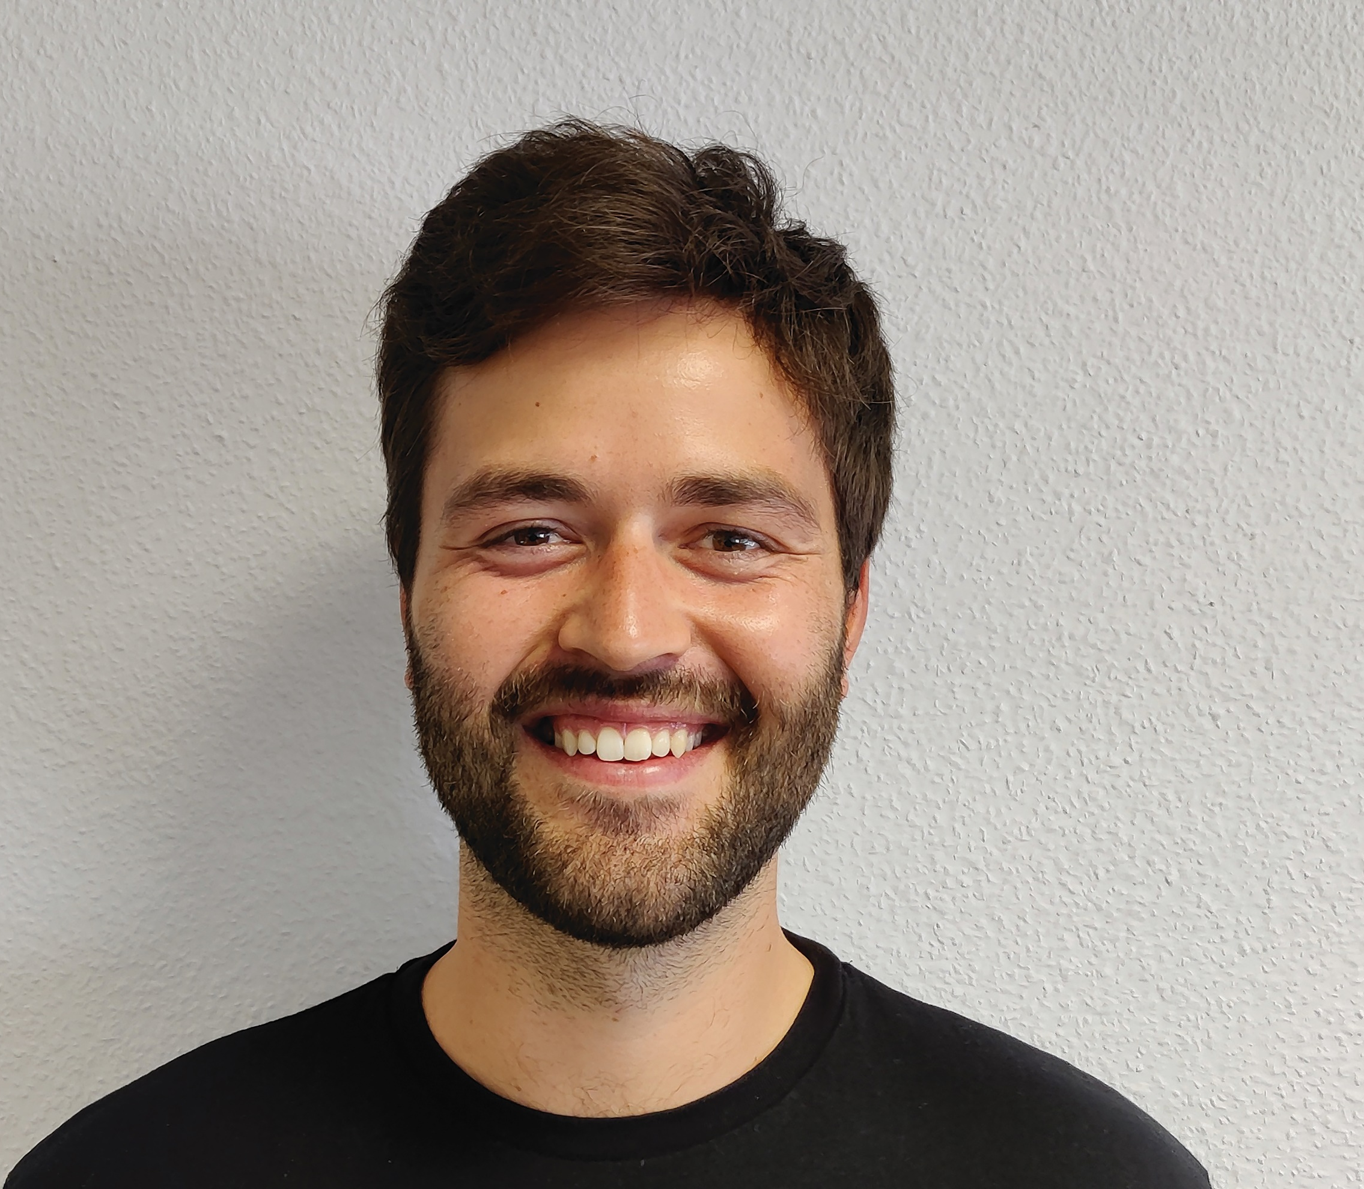
MAX HEIDERSCHEID, MSC
NATIONALITY: LUXEMBOURGISH
AREAS OF RESEARCH: INORGANIC AND ORGANIC CHEMISTRY

Slide 20
During my PhD, I will be involved in the development, characterisation and investigation of the influence of different molecules on the generation and properties of photocatalysts.
Growing up in the countryside in Luxembourg, I have always been interested in natural phenomena. High school awakened my interest in natural sciences, especially chemistry. I did my bachelor’s degree in inorganic chemistry where I took part in a project, synthesising catalysts that are able to produce hydrogen by artificial photosynthesis. I continued with my master’s in bio-organic chemistry with focus on synthesising modified building blocks for DNA and RNA. My PhD research combines all my fields of interest, focusing on the goal of clean fuels for future.
The most exhausting and rewarding thing about chemistry is that it consists of several fields and is very broad! It is quite challenging to build up basic knowledge at first, but when you can connect all the knowledge it allows you to understand many natural phenomena. A big advantage of natural sciences and especially chemistry and materials science is that you can apply what you have learned and obtain physical proof of the applied knowledge.
Although I am still at the very beginning of my scientific career, I am very proud of the fact that I have a bachelor’s degree in inorganic chemistry, a master’s degree in bio-organic chemistry and am now doing a doctorate in materials science. At each of these stages, I have ventured into new waters to pursue my current areas of interest. I am also very proud to be involved in a project that aims to produce renewable energy to help make the world a more sustainable place.

Slide 21
PATHWAY FROM SCHOOL TO MATERIALS CHEMISTRY
The members of Nicolas’ team have varied backgrounds and have bachelor’s and postgraduate degrees in different fields related to chemistry, physics and chemical engineering. However, they all pursued their passions and interests, which lead them to bring their individual skillsets to the team’s research activities.
Being involved in a project like CLEANH2 requires an undergraduate degree (usually followed by a postgraduate degree) in a related field – so it is worth researching different types of chemistry and materials science courses to see what sparks your interest.
Max explains, “It is important to have a good general knowledge of chemistry, as well as physics and mathematics. By gaining this basic knowledge, you quickly realise what you are most interested in and which path and specialisations you will take.”
Drialys highlights the importance of networking, meeting and talking to people when exploring a career in this field. She advises, “Don’t miss the chance to participate in science festivals or young scientist conferences usually held by the universities. In addition, you can look for opportunities of internships in laboratories.”
Photoelectrochemical cell used for the evaluation of the hydrogen production performances.

Slide 22
THE TEAM’S TOP TIPS
01 Be disciplined and tenacious – in scientific research, you sometimes have to keep working hard even when you don’t see immediate success. But if you persevere, the outcomes can be very rewarding.
02 Be curious, and don’t shy away from exploring challenging questions as they may be the most important ones to answer.
03 Be passionate! As Steve Jobs said, “The only way to do great work, is to love what you do”.
Kamal operating a scanning electron microscope.

Slide 23
TALKING POINTS
The team members were inspired by nature and wildlife as children. How do you think this interest has inspired their careers? To what extent do you share this interest?
Several of the team members have relocated to another country to study and conduct their research. How would you feel about such a big life change?
What do you think motivates the team to do the work they do?
Whose profile interests you the most and why? Who do you feel you have most in common with and why?
Which piece of advice has been most useful for you and why? How could you put this advice into action?
Green Hydrogen, future energy h2 fuel 3D illustration. Green hydrogen production by electrolysis technology, renewable electricity, alternative eco way of getting hydrogen H2, cut industry emissions. By Corona Borealis

Slide 24
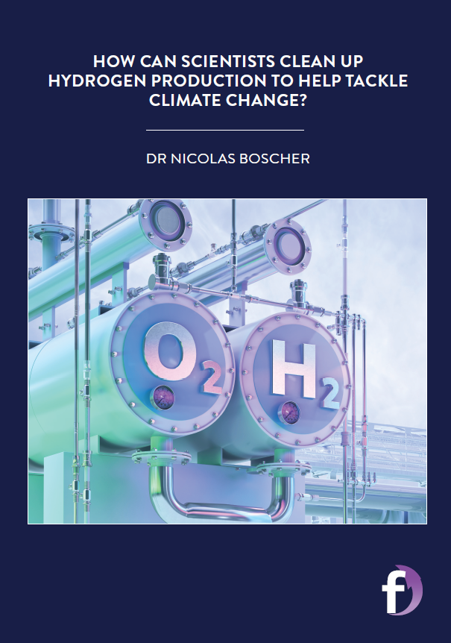
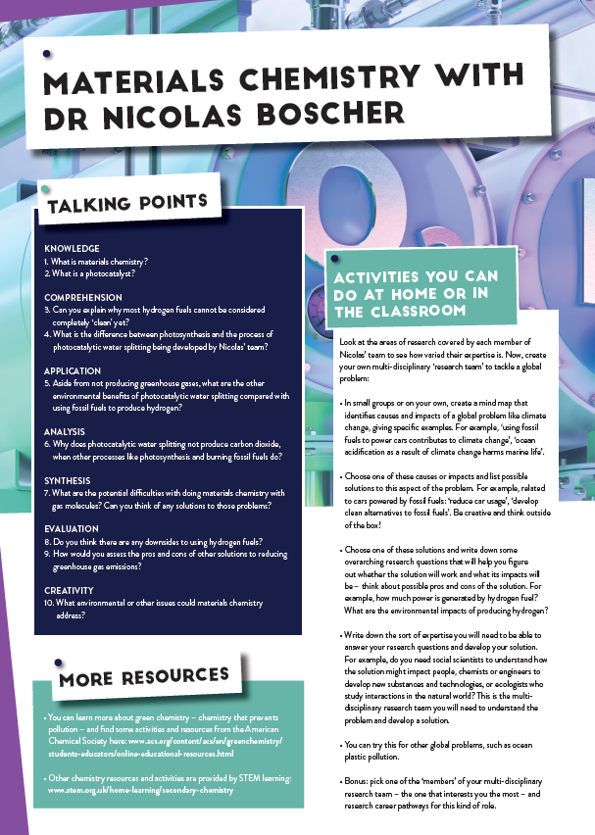
Dig deeper into Nicolas and the team’s research
Down the activity sheet

Slide 25
