Slide 1
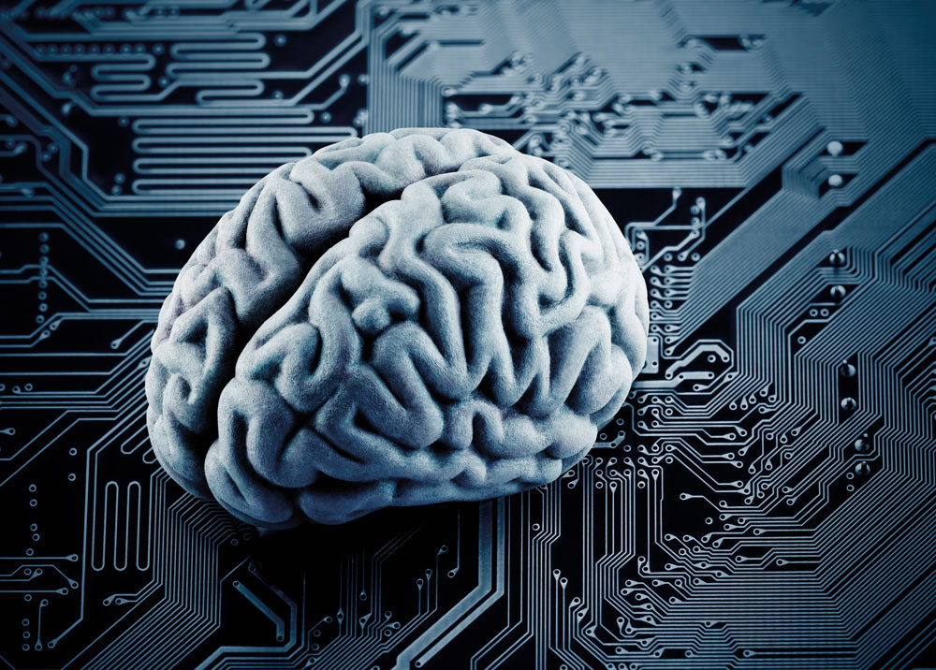
Computational cognitive neuroscience
Neuroscience of Cognitive Control Lab
Princeton University, USA
Get started
www.futurumcareers.com

Slide 2
In this presentation:
What is human intelligence?
What are computational models?
Can computational models reproduce human intelligence?
What is computational cognitive neuroscience?
Talking points
Pathway from school to computational cognitive neuroscience
Meet members of the Neuroscience of Cognitive Control Lab
Talking points
More resources
02 www.futurumcareers.com

Slide 3
The human brain is often referred to as the most complex device known in the Universe.
It gives rise to the amazing abilities of the human mind, including our capacity for intelligence.
03 www.futurumcareers.com

Slide 4
What is intelligence?
Intelligence is the ability to acquire and flexibly apply knowledge and skills to solve new problems.
As humans, we have the unique ability to make connections between things we have previously learnt and use those to solve challenges in new situations.
Understanding how the human brain functions so efficiently and flexibly remains one of the greatest mysteries of science.
04 www.futurumcareers.com

Slide 5
For many years, psychologists and neuroscientists have sought to uncover how the mind functions, while computer scientists have attempted to reproduce human-like capabilities in machines.
Collaborations between these disciplines have resulted in computational models that are helping scientists to uncover the secrets of the mind and impart this intelligence to computers.
05 www.futurumcareers.com

Slide 6
Computational models
A mathematical function transforms an input to an output:
The function +10 transforms the inputs [1, 2, 90] to the outputs [11, 12, 100], by adding 10 to each input.
An algorithm links multiple functions together in a rule-based sequence:
The algorithm +10, ×2 is a different algorithm than ×2, +10 (because 1 + 10 = 11, 11 × 2 = 22; while 1 × 2 = 2, 2 + 10 = 12).
A variable is an element of a function that can be assigned different parametric values:
If the function is +b, then the variable can be set to b = 1 (the parametric value is 1, transforming [1, 2, 90] to [2, 3, 91]) or b = 314 (the parametric value is 314, transforming [1, 2, 90] to [315, 316, 404]).
06 www.futurumcareers.com

Slide 7
Computational models
Computational models are built from functions linked together into algorithms with specific parametric variables.
Models can be used to explore how the assignment of different inputs to its variables affect the model’s behaviour.
Psychologists, neuroscientists and computer scientists hope to uncover the mysteries of human intelligence with the help of computational models of the brain.
07 www.futurumcareers.com

Slide 8
Modelling minds
Computational models of the human brain are composed of algorithms designed and trained with the goal of reproducing intelligent human behaviour.
Scientists aim to create computational models that reproduce the patterns of behaviour exhibited by humans performing the same cognitive task.
Computational modelling has helped scientists understand how the brain carries out different functions, and what happens when these functions are disrupted, for example through brain injury or psychiatric conditions.
08 www.futurumcareers.com

Slide 9
Computational cognitive neuroscience
Computational cognitive neuroscience seeks to understand human cognition (the mental process of acquiring, evaluating and/or using knowledge) by building computational models that express theories of how the brain gives rise to cognition.
To test whether these models operate in a similar way to the human mind, scientists compare the models’ performance with findings about human performance from cognitive psychology.
09 www.futurumcareers.com

Slide 10
Psychologists conduct experiments to characterise the mental functions people use when solving tasks.
Neuroscientists uncover the structural organisation of the brain to characterise the functions that different brain structures perform in different tasks.
Computer scientists combine these data to build computational models of the human brain.
These models enable scientists to test how the operation of different brain mechanisms gives rise to different psychological functions. Understanding this relationship will provide insights into how disruptions to brain functions can be corrected and will help scientists understand how to implement intelligence in machines.
10 www.futurumcareers.com

Slide 11
Talking points
What is intelligence?
What is the difference between a function and an algorithm?
How do scientists build computational models of the human mind?
What are the motivations for building computational models of the human mind?
To what extent do you believe that a human mind can truly be replicated in a computer?
15 www.futurumcareers.com

Slide 12
Pathway from school to computational cognitive neuroscience
Computational cognitive neuroscience is an interdisciplinary field combining psychology, neuroscience and computer science. A degree in any of these subjects could lead to a career in the field.
A wide range of other subjects is also relevant for uncovering the mechanisms behind intelligence, including machine learning, data science, electrical engineering, medicine, physics and philosophy.
Coding and computer programming are key skills for developing computational models, so look for free online tutorials where you can learn, such as Code Academy.
11 www.futurumcareers.com

Slide 13
Meet members of the Neuroscience of Cognitive Control Lab
Tyler Giallanza
Dr Javier Masís
Dr Harrison Ritz
Role: Graduate student
Field of research:
Cognitive Psychology
Role: Postdoctoral Researcher
Fields of research:
Neuroscience, Cognitive Science
Role: Postdoctoral Researcher
Field of research:
Computational Cognitive
Neuroscience
12 www.futurumcareers.com

Slide 14
Tyler Giallanza
I enjoy uncovering the ‘algorithms’ humans use to learn and make decisions. The human brain is good at reusing algorithms for different purposes. However, this causes issues if we try to simultaneously do different activities that use the same algorithms. I think this theory is interesting as it connects common experiences (such as the inability to drive safely while texting) to underlying principles.
13 www.futurumcareers.com

Slide 15
Dr Javier Masís
You don’t have to actually study brains to ‘study the brain’. Research is so vast that there are many different ways to contribute to the field of neuroscience. For example, while I am technically a brain scientist, I hardly ever deal with specific brain regions. Instead, I study the problems the brain solves, which generates important findings for other scientists who study the brain itself.
14 www.futurumcareers.com

Slide 16
Dr Harrison Ritz
I think it’s incredible that we can now decode the contents of the mind. By measuring someone’s brain activity, we can now reconstruct simple aspects of their thoughts. For example, imagine you are shown an X or an O, then asked to think about which shape you were looking at. By analysing images of your brain activity, scientists can tell (with high accuracy) whether you are thinking of an X or an O. It’s like mind-reading!
15 www.futurumcareers.com

Slide 17
Talking points
Do you have computer coding skills? How could you improve these?
Why is it not possible to drive safely while texting?
How do you think scientists can reconstruct aspects of people’s thoughts? What data do you think they need to achieve this, and what experiments might they have conducted to collect these data?
Name three ways in which scientists could study the brain without actually studying brains.
Which aspect of computational cognitive neuroscience most interests you, and why?
15 www.futurumcareers.com

Slide 18
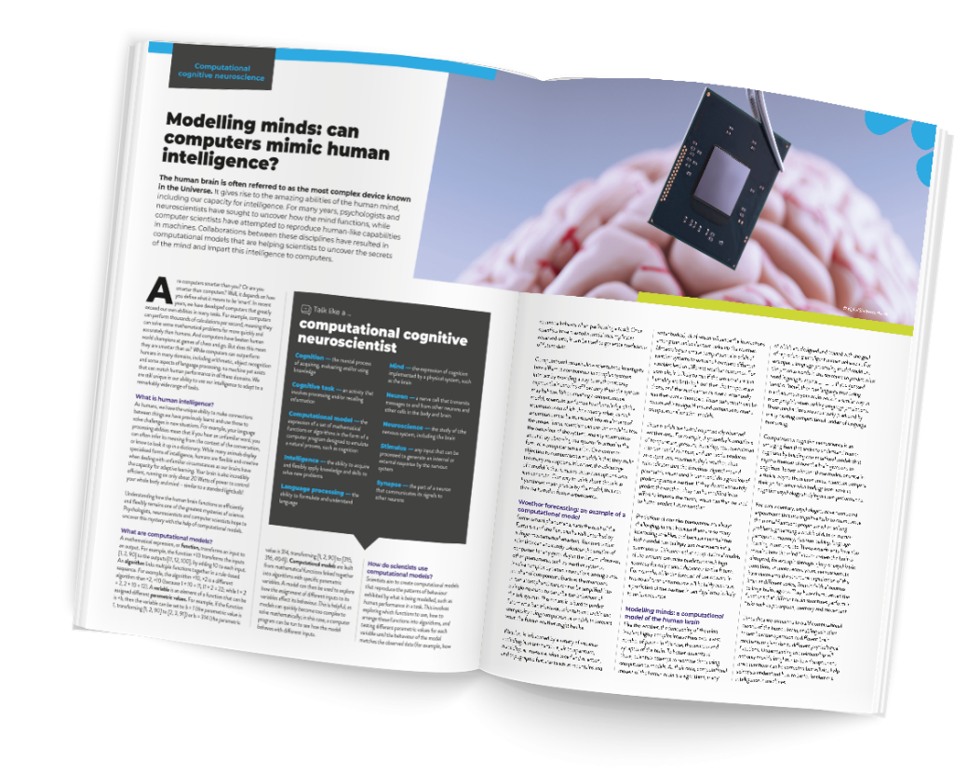
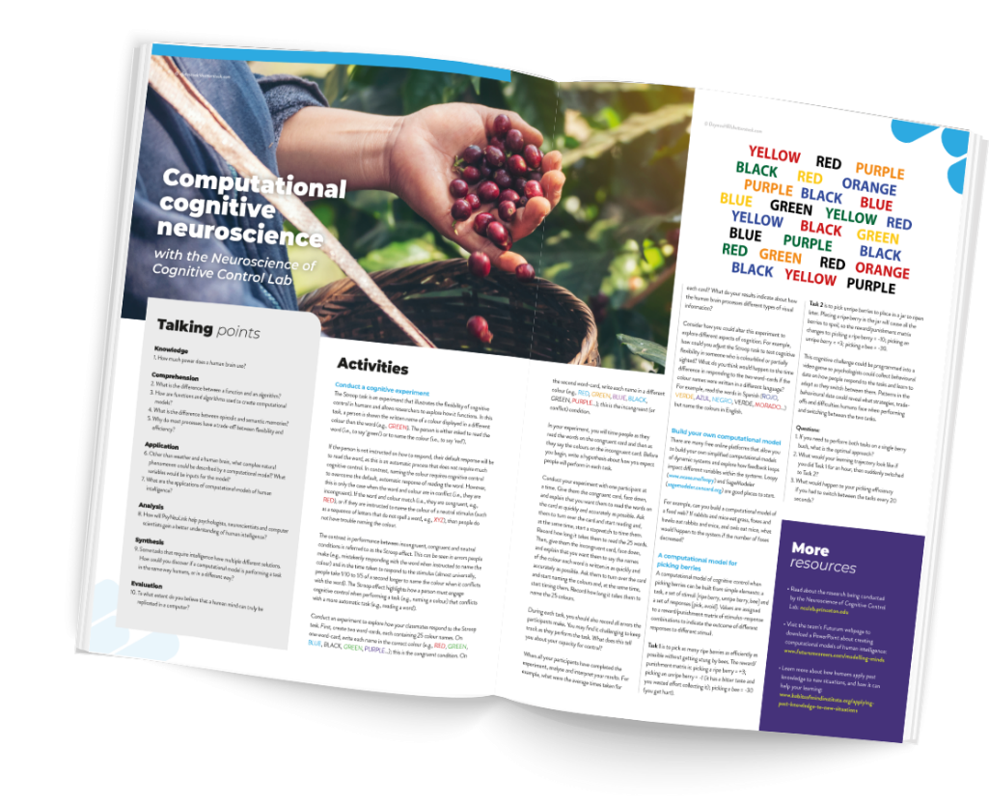
Resources
Download the article to learn more about modelling minds
Download the activity sheet to conduct your own psychology experiment
01
02
016 www.futurumcareers.com

