Slide 1
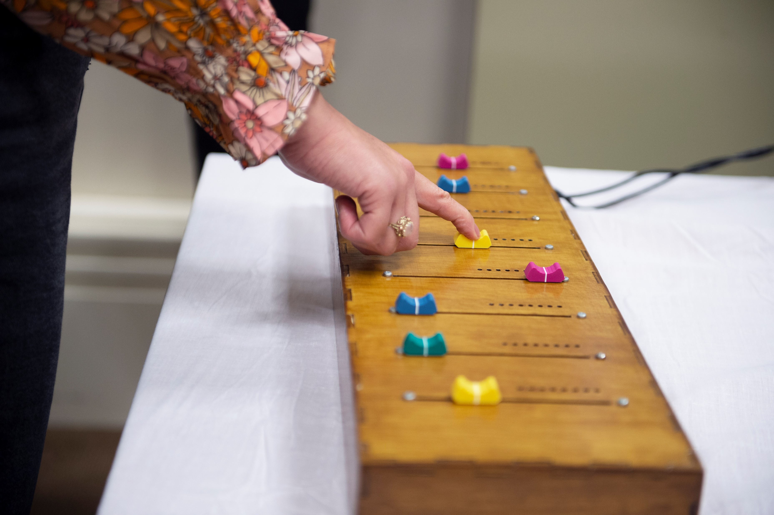
Music Technology
Dr Jennifer MacRitchie,
Dr Justin Christensen and
Jon Pigrem
GET STARTED
www.futurumcareers.com
© Jennifer MacRitchie (CC BY-NC-ND)

Slide 2
In this presentation
we will cover:
Meet the team
Dementia and music
The team’s digital musical instruments
Talking points
About music technology
Pathway from school to music technology
Careers in music technology
Thoughts from the team
Talking points
02 futurumcareers.com

Slide 3
Meet Jenni
Jenni is a musician and electronic engineer at the University of Sheffield in the UK.
She is leading a project to develop new digital musical technologies to improve music accessibility for people living with dementia.
“Music is an activity that is multi-faceted in nature. It engages with our emotions, makes us want to move, helps us relate to others and contributes to our personal identity.”
– Jenni
Dr Jennifer MacRitchie
03 futurumcareers.com

Slide 4
Meet Justin and Jon
Jenni is collaborating with Justin and Jon, who are both musicians and researchers.
Justin has expertise in psychology, and Jon has expertise in digital lutherie (the creation of digital musical instruments).
Dr Justin Christensen
Jon Pigrem
04 futurumcareers.com

Slide 5
Dementia and music
The term ‘dementia’ covers over 200 different conditions that have symptoms including memory loss, difficulty communicating and impairments to other cognitive abilities.
Alzheimer’s disease is the most common cause of dementia, accounting for 60-80% of cases.
“Music is highly communicative, but does not rely on words, allowing people living with dementia to connect through music.”
– Justin
Jon introduces workshop participants to the team’s instruments
© Jennifer MacRitchie (CC BY-NC-ND)
05 futurumcareers.com

Slide 6
“Imagine you are playing a violin. Think about all the brain functions you need to play a single note. You need the ability to read (or remember) the music to know which note to play, then to know the correct hand position to produce that note. You need the motor skills to press your fingers on the strings and to move the bow so it hits the string at the correct angle and pressure.”
– Jenni
As dementia can cause a loss of memory and motor skills, technology can reduce the complexity of the actions needed to produce music.
Playing the violin requires memory and motor skills
© Henleverlag (CC BY 3.0)
02 futurumcareers.com
06 futurumcareers.com

Slide 7
Digital musical instruments
Few music technologies have been designed specifically for people living with dementia. Jenni, Justin and Jon hope to change this by creating dementia-friendly digital musical instruments (DMIs).
Digital music is produced electronically by computers. By partnering with a music technology platform, the team can develop digital interfaces that allow people living with dementia to interact with music and to have musical experiences.
The electronics behind one of the team’s digital musical instruments
© Jennifer MacRitchie (CC BY-NC-ND)
07 futurumcareers.com

Slide 8
The importance of co-creation
The team organises workshops where people living with dementia and their carers can share how they want to interact with music, discuss the barriers they face, and try out and provide feedback on the DMIs.
“This project relies on us collaborating with people living with dementia and their carers. They are the experts on their experience. Together we can co-design DMIs that reflect what individuals want to do with these technologies.”
– Jenni
Justin talks with workshop participants © Jennifer MacRitchie (CC BY-NC-ND)
08 futurumcareers.com

Slide 9
The Slider Box
The Slider Box* is like a mixing desk, where users can move levers up and down to combine pre-recorded pieces of music to produce new compositions.
The pre-recorded tunes uploaded to the instrument can be chosen to be pieces that are familiar to the user, allowing the Slider Box to be used in reminiscence therapy.
“The active process of selecting familiar music from the past can help people living with dementia to access memories.”
– Jon
The Slider Box
© Jennifer MacRitchie (CC BY-NC-ND)
09
Pigrem J, MacRitchie J, & McPherson AP (2023). Instructions Not Included: Dementia-Friendly approaches to DMI Design. In: Proceedings of the International Conference on New Interfaces for Musical Expression (NIME), Mexico City, Mexico

Slide 10
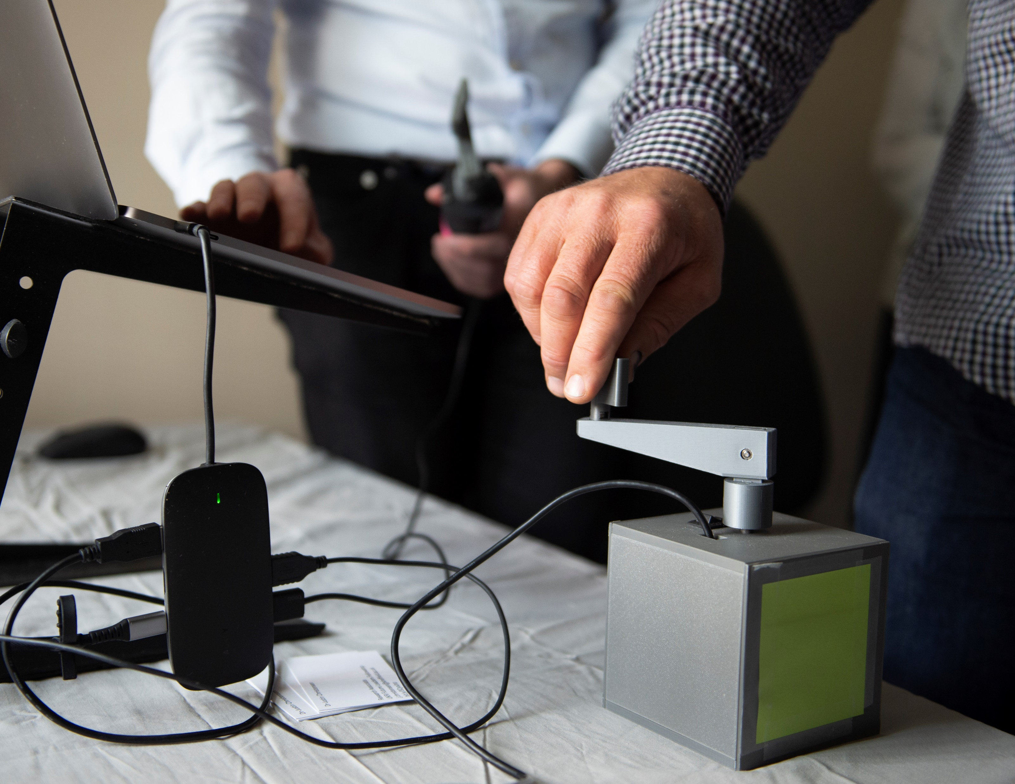
The Music Memory Makers duet system
The Music Memory Makers* duet system is an electronic version of the mechanical music box that was popular in the 19th century. It allows two people to create music together by spinning the handles on the box.
“The aim of the duet system is to provide a meaningful way for couples to continue interacting together as one of them experiences dementia, through the power of music.”
– Justin
The Music Memory Maker
© Jennifer MacRitchie (CC BY-NC-ND)
10
Christensen J, Kauenhofen S, Loehr J, Lang J, Peacock S, & Nicol J (2023). MMM Duet System: New accessible musical technology for people living with dementia. In: Proceedings of the 18th International Audio Mostly Conference (AM ‘23), Edinburgh, UK

Slide 11
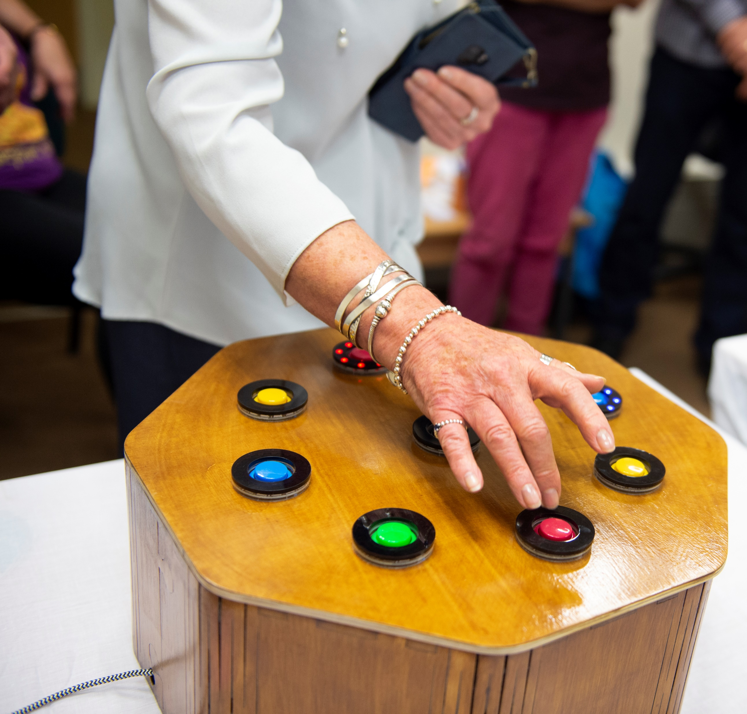
The In C Box
The In C Box* is like an arcade machine. It is covered with coloured buttons, each of which produces a different sound and lights up when pressed.
“The In C Box explores notions of agency in the composition process for those with no musical training, or with cognitive or physical barriers to musical performance.”
– Jon
The In C Box
© Jennifer MacRitchie (CC BY-NC-ND)
11
Pigrem J, MacRitchie J, & McPherson AP (2023). Instructions Not Included: Dementia-Friendly approaches to DMI Design. In: Proceedings of the International Conference on New Interfaces for Musical Expression (NIME), Mexico City, Mexico

Slide 12
Talking points
Why are musical experiences beneficial for people living with dementia, and why might they struggle to interact with them?
How are people living with dementia contributing to the creation of the team’s digital musical instruments (DMIs), and why is their input important?
What challenges do you think the team has faced when designing and creating dementia-friendly DMIs?
How are the Slider Box, Music Memory Makers duet system and In C Box used by people living with dementia?
If you were to design a new DMI for the team’s project, what would it be? How would it be used, and what features would it have?
12 futurumcareers.com
© Jennifer MacRitchie (CC BY-NC-ND)

Slide 13
About music technology
Music technology involves applying technology, such as computers and software, to the musical arts. It covers everything from designing accessible instruments for people with physical or cognitive disabilities, to being a music producer at a record label.
“From gramophones and player pianos to Spotify and Guitar Hero, technology has long supported the musical experience!”
– Jon
A person living with dementia interacts with the In C Box
© Jennifer MacRitchie (CC BY-NC-ND)
13 futurumcareers.com

Slide 14
© MCStock
Pathway from school to music technology
If you play an instrument, join your school band or a local youth orchestra. Why not start your own band with your friends?
At school, studying music, design, technology and physics will all be useful.
Some universities offer degrees in music technology or engineering with music. You could also study electrical or electronic engineering and apply your skills to music-related challenges, or you could study music production if you are interested in the technology of modern music production.
The Department of Music at the University of Sheffield has an outreach programme for schools and offers several music degrees, including courses that specialise in music technology.
14 futurumcareers.com

Slide 15
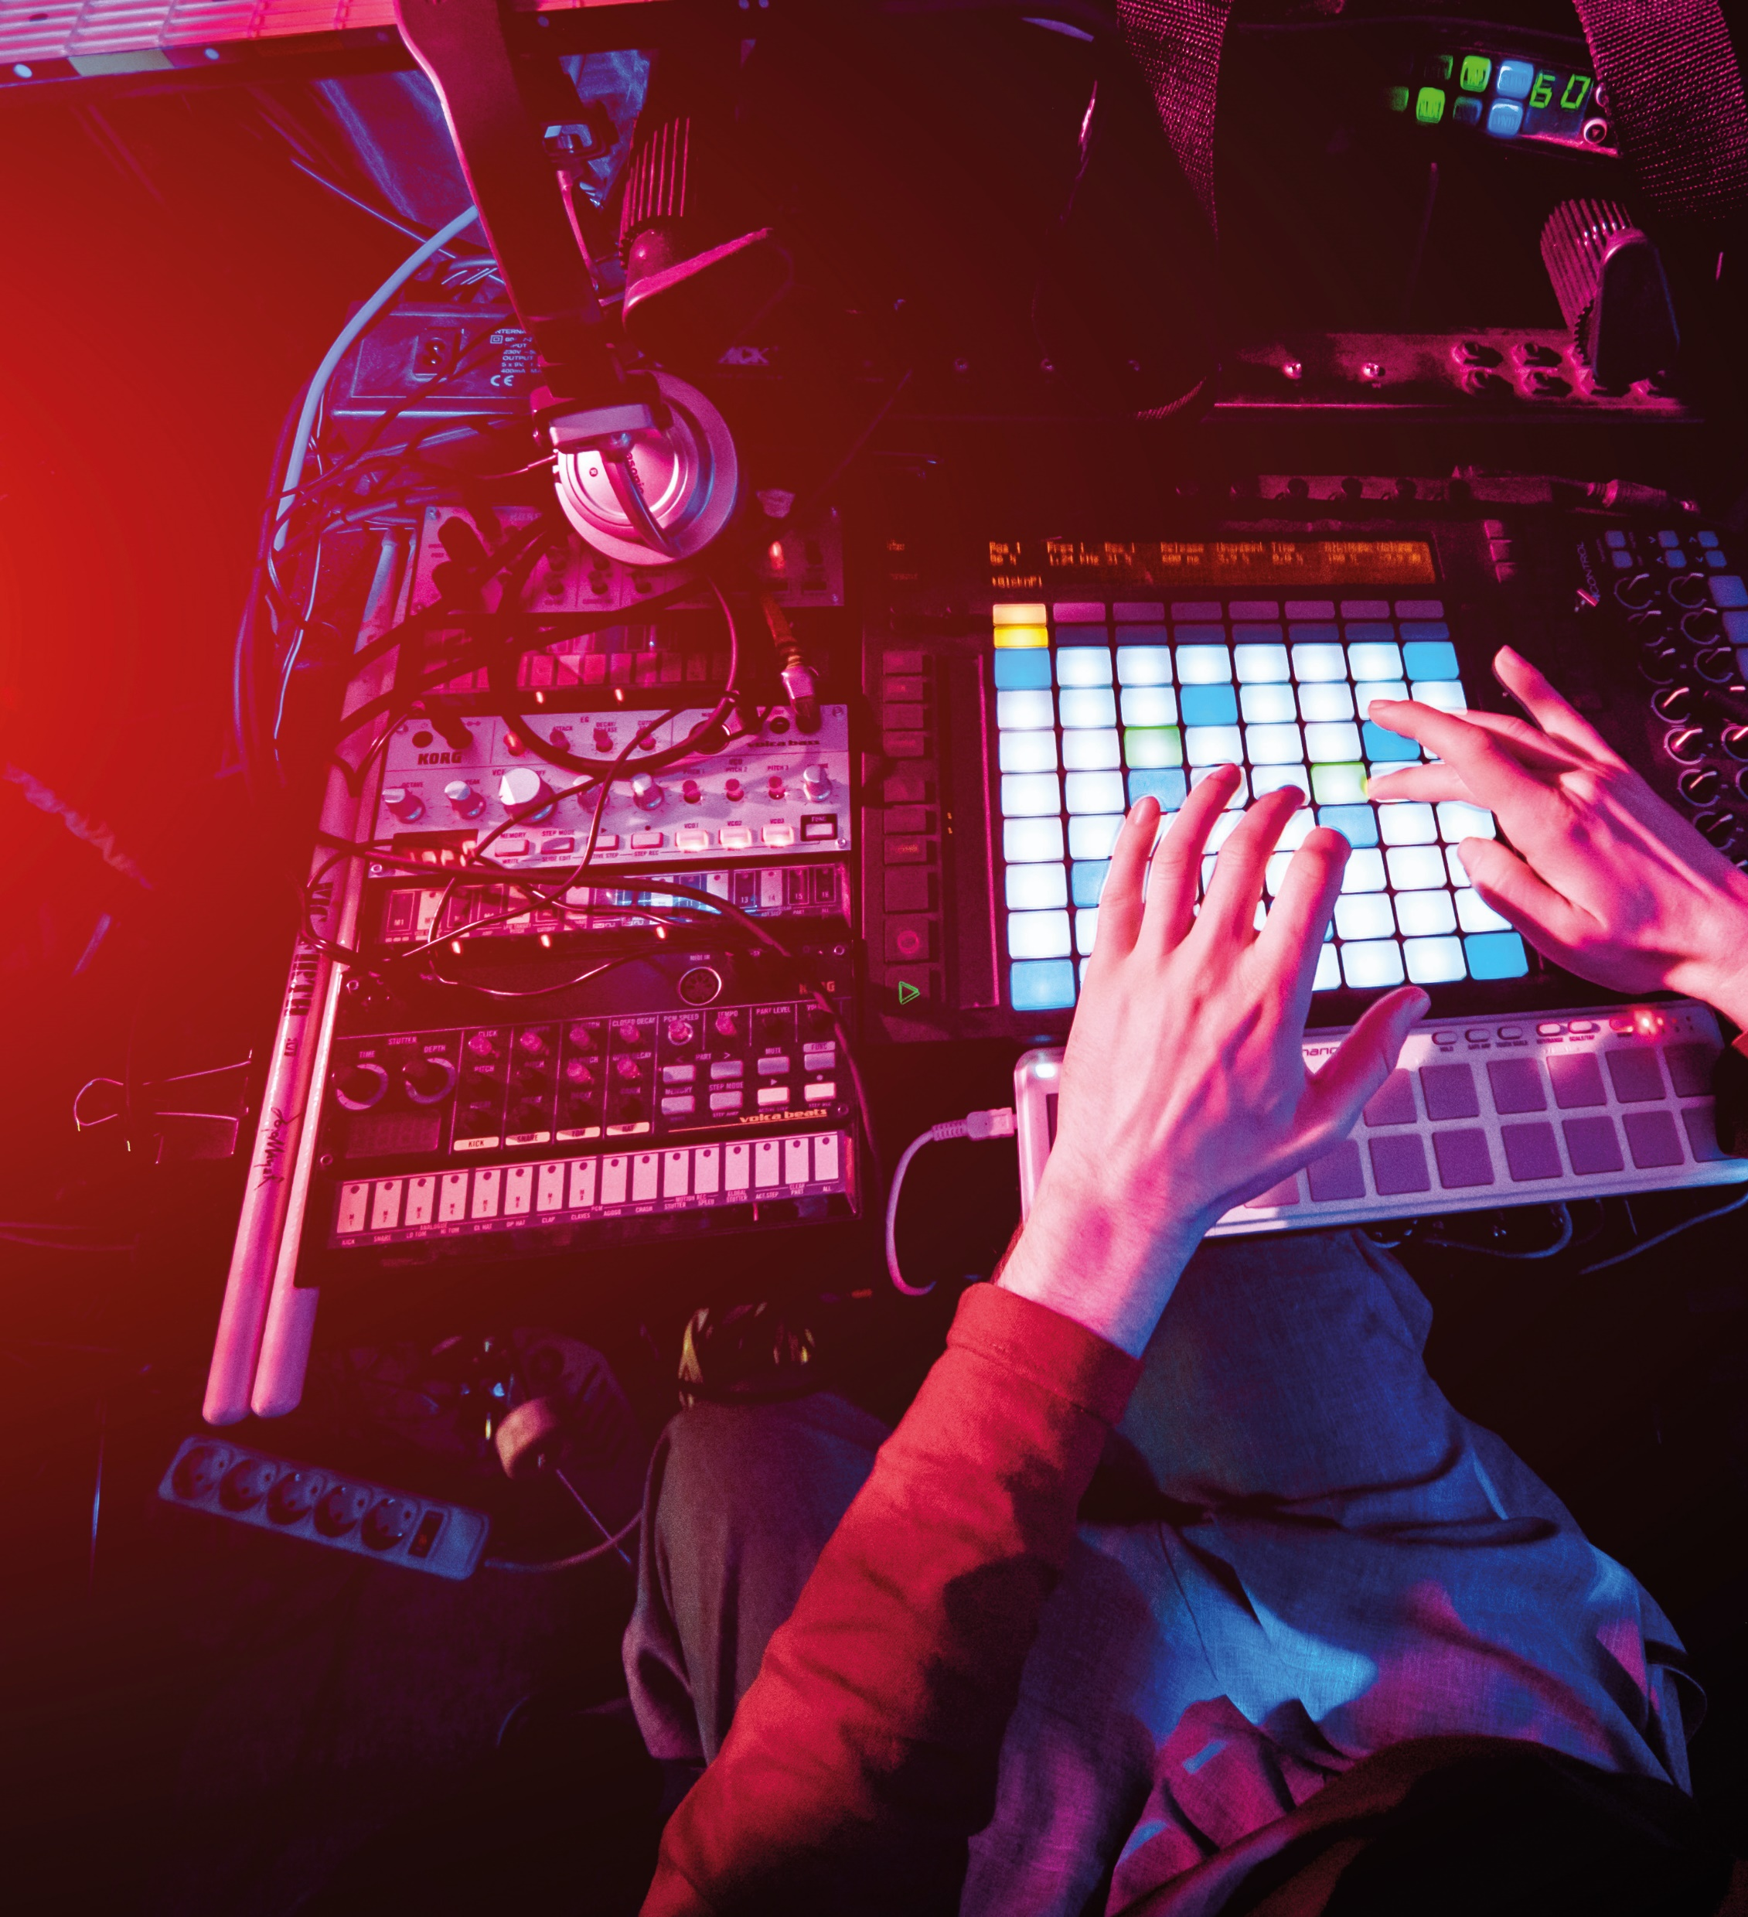
© romaset
Explore careers in music technology
There are many career options in the field of music technology. Most aspects of modern music production require technology, so you could find yourself working as a music producer, director, sound engineer or technician. If you enjoy performing, you could work as an electronic musician or DJ.
“Today, everything has some role for music technology,” says Jon. “As an industry, it is at the forefront of cultural and technical invention and overlaps the worlds of science and the arts.”
Careers in Music has a wealth of information about different careers in music and what they involve.
MusicTechMag has an article about the role of technology in music.
15 futurumcareers.com

Slide 16
© Jennifer MacRitchie (CC BY-NC-ND)
I have been privileged to have had access to music lessons from a young age. Growing up, I played music for my own enjoyment and in local youth orchestras. For me, music has always been a way of connecting with other people, making new friends, and having fun experiences playing and performing.
I could never choose between the sciences and arts, which is why I studied a joint degree of electronics with music at university. Music had always been my passion, but I also really loved doing experiments in physics and thinking about how things worked. I was delighted to discover a degree programme that combined my interests.
Jenni
16 futurumcareers.com

Slide 17
© Jennifer MacRitchie (CC BY-NC-ND)
I play the trumpet in a contemporary classical ensemble, and I write my own musical compositions to express myself in ways that I can’t quite seem to manage in words.
I’m interested in how music can affect our perception of time. The passage of time is constant, but I think we all have feelings that time is passing faster at some moments and slower at others. For me, music, and how immersed I get into it, can really affect my sense of time. I’m also fascinated by how, when people play music together, they can feel they are joined together into something bigger than themselves.
Justin
17 futurumcareers.com

Slide 18
© Jennifer MacRitchie (CC BY-NC-ND)
Music has given me the freedom to explore the world through touring and performing, as well as providing stability to grow and develop at home.
Digital lutherie involves the creation of digital musical instruments. It is as much about artistic design and engineering research as it is about making the instruments themselves.
In this project, I am a technical research officer, and my role is to build the instruments that we are using in our research.
Jon
18 futurumcareers.com

Slide 19
Talking points
Which of the careers in music technology mentioned in this presentation most appeals to you, and why?
Would you prefer to enter the field of music technology from the music or technology side? What would be the advantages of each direction, and how might you benefit from a course that combines both?
How have the musical arts benefited from advances in technology?
How have Jenni, Justin and Jon’s personal backgrounds influenced their involvement in this project?
What does music mean to you? How has music impacted your life?
12 futurumcareers.com
© Jennifer MacRitchie (CC BY-NC-ND)

Slide 20
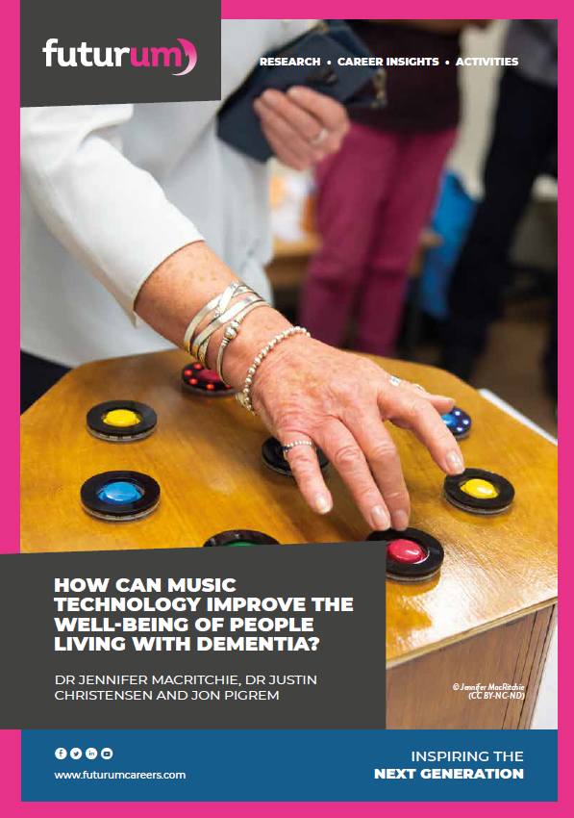
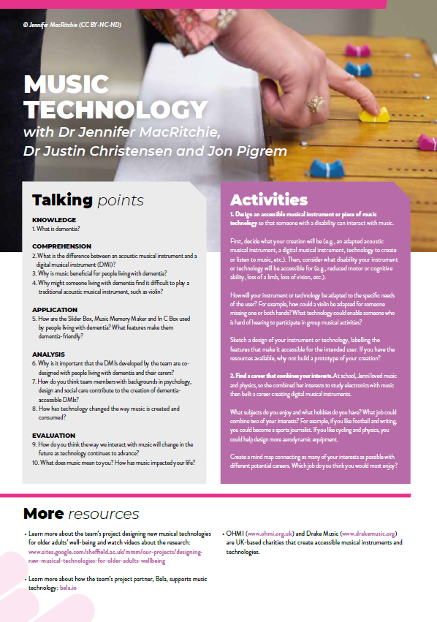
Resources
01
Download the article
02
Download the activity sheet
20 futurumcareers.com

