Slide 1


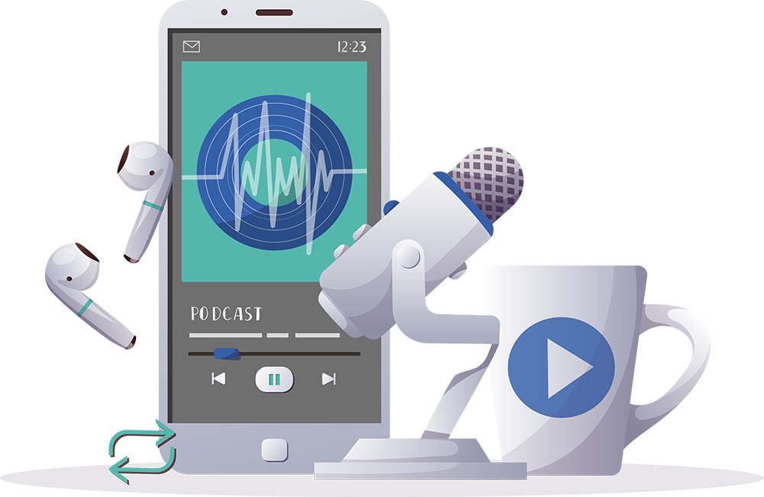
Inspiring the
next generation
FUTURUM
PODCAST
In conversation with
Nancy Tahmo
ftlyp
futurumcareers.com

Slide 2

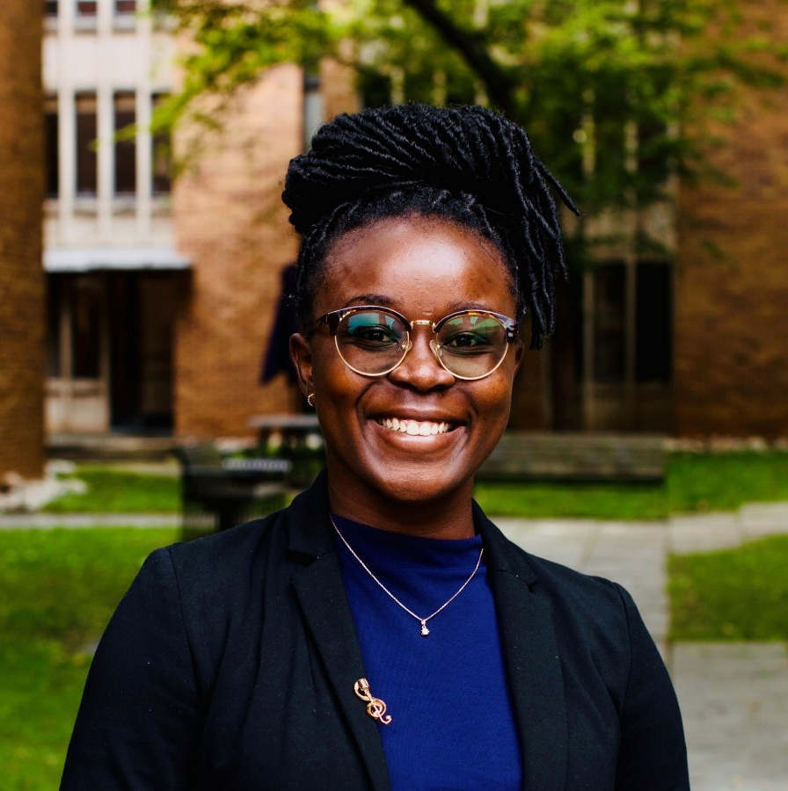
Pre-listening | Break it down | Post-listening | Learn more
Meet
Nancy Tahmo
Pre-listening:
In this podcast, Nancy Tahmo discusses the importance of involving communities in epidemiology research and shares how a setback at the start of her career ended up pointing her in the right direction.
What do you already know about epidemiology?
Why do you think it is important to involve communities in epidemiology research?
Profile
PhD Candidate
University of Toronto, Canada
Field of research
Epidemiology
“When communities are involved [in research], it allows us to democratise how knowledge is created.”

Slide 3


Pre-listening | Break it down | Post-listening | Learn more
Break the podcast down:
Up to 06:40
How does HIV impact the body?
Why is it important that communities impacted by HIV are involved in creating mathematical models of HIV?
What do you think Kenyan communities impacted by HIV teach Nancy and her colleagues?
How does the field of epidemiology combine health science and data science?

Slide 4
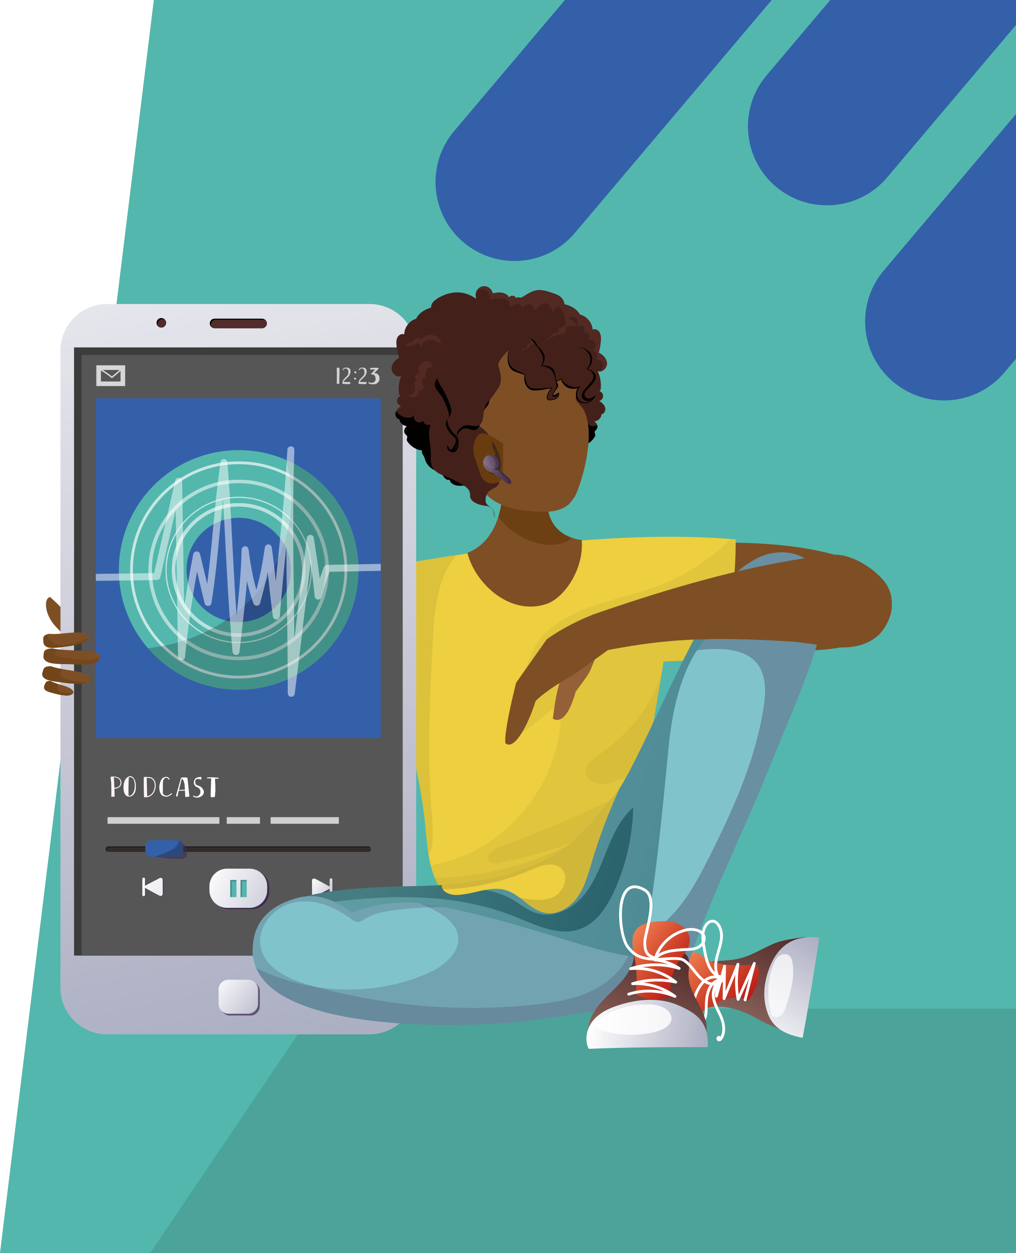
Pre-listening | Break it down | Post-listening | Learn more
06:40 – end
Think of a time when you failed at something. How did it make you feel? And what did you learn from the experience?
What do you think you could learn from Nancy’s reaction to failing her medical entrance exam?
What does ‘community’ mean to you? What are your communities, and how do they support you in different aspects of your life?
“If science is not contributing to the public good, I don’t think it’s worth pursuing,” says Nancy. “I think everything that we do needs to contribute to something more than just our curiosity.” To what extent do you agree with this statement, and why?

Slide 5


Pre-listening | Break it down | Post-listening | Learn more
Post-listening:
How resilient are you? When have you shown resilience? How could you adopt a resilient mindset to help you face setbacks?
Nancy’s work is shaped by her belief that helping others makes the world a better place. What philosophy do you live your life by?
Which piece of Nancy’s advice did you find most useful, and why?
What further questions would you ask Nancy about epidemiology and/or her career?*
Submit questions to Nancy here

Slide 6

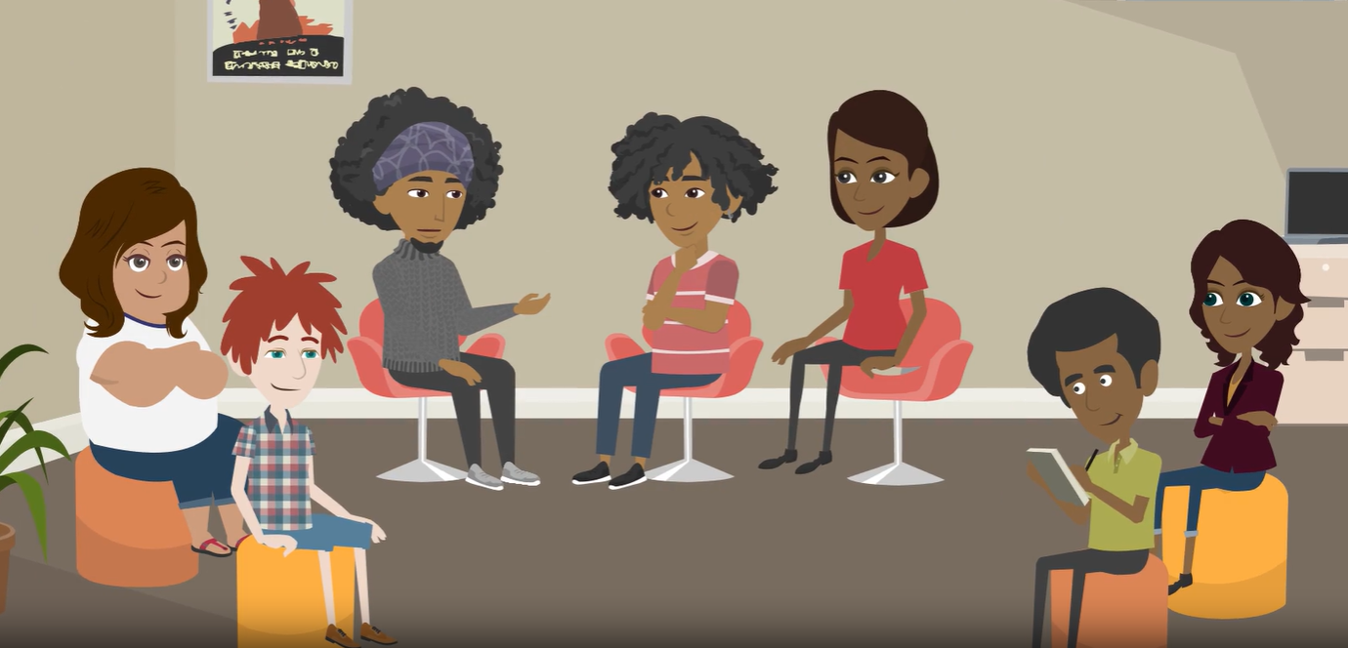
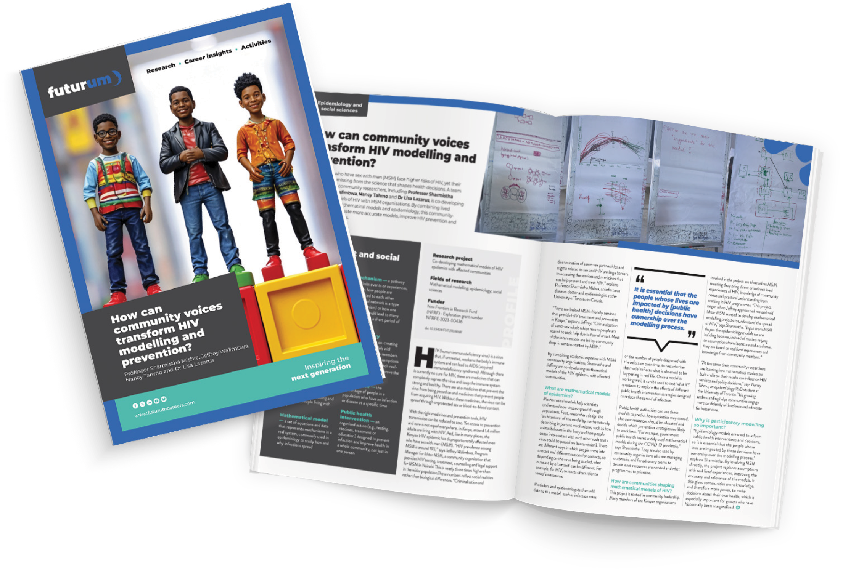
Pre-listening | Break it down | Post-listening | Learn more
Learn more about the work of Nancy and her colleagues:
Read the article
Complete the activities
Watch the animation
Download the PowerPoint
Read the article in Swahili, French and Spanish
Inspiring the
next generation
ftlyp
futurumcareers.com

