Slide 1
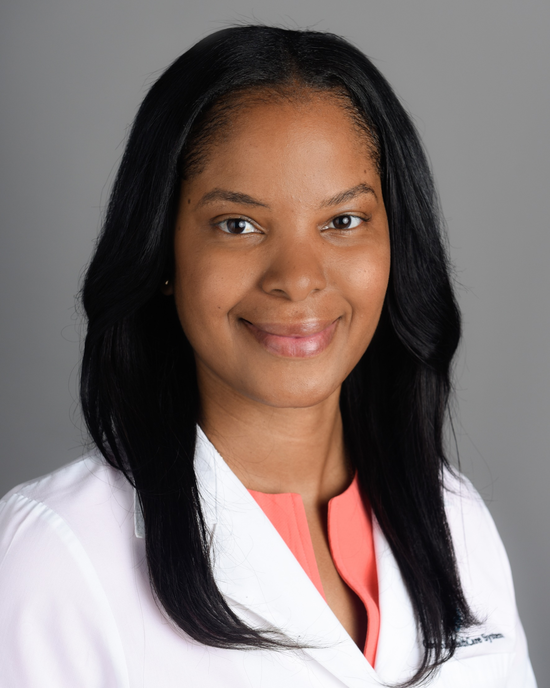


Cardiology
with
Dr. Nicole B. Cyrille-Superville
GET STARTED

Slide 2



In this Presentation:
Introduction
Nicole’s Research and Career Journey
Talking Points
About Cardiology
Pathway from School to Cardiology
Careers in Cardiology
Meet Nicole
Talking Points
More Resources
© everything possible/Shutterstock.com
02 futurumcareers.com

Slide 3
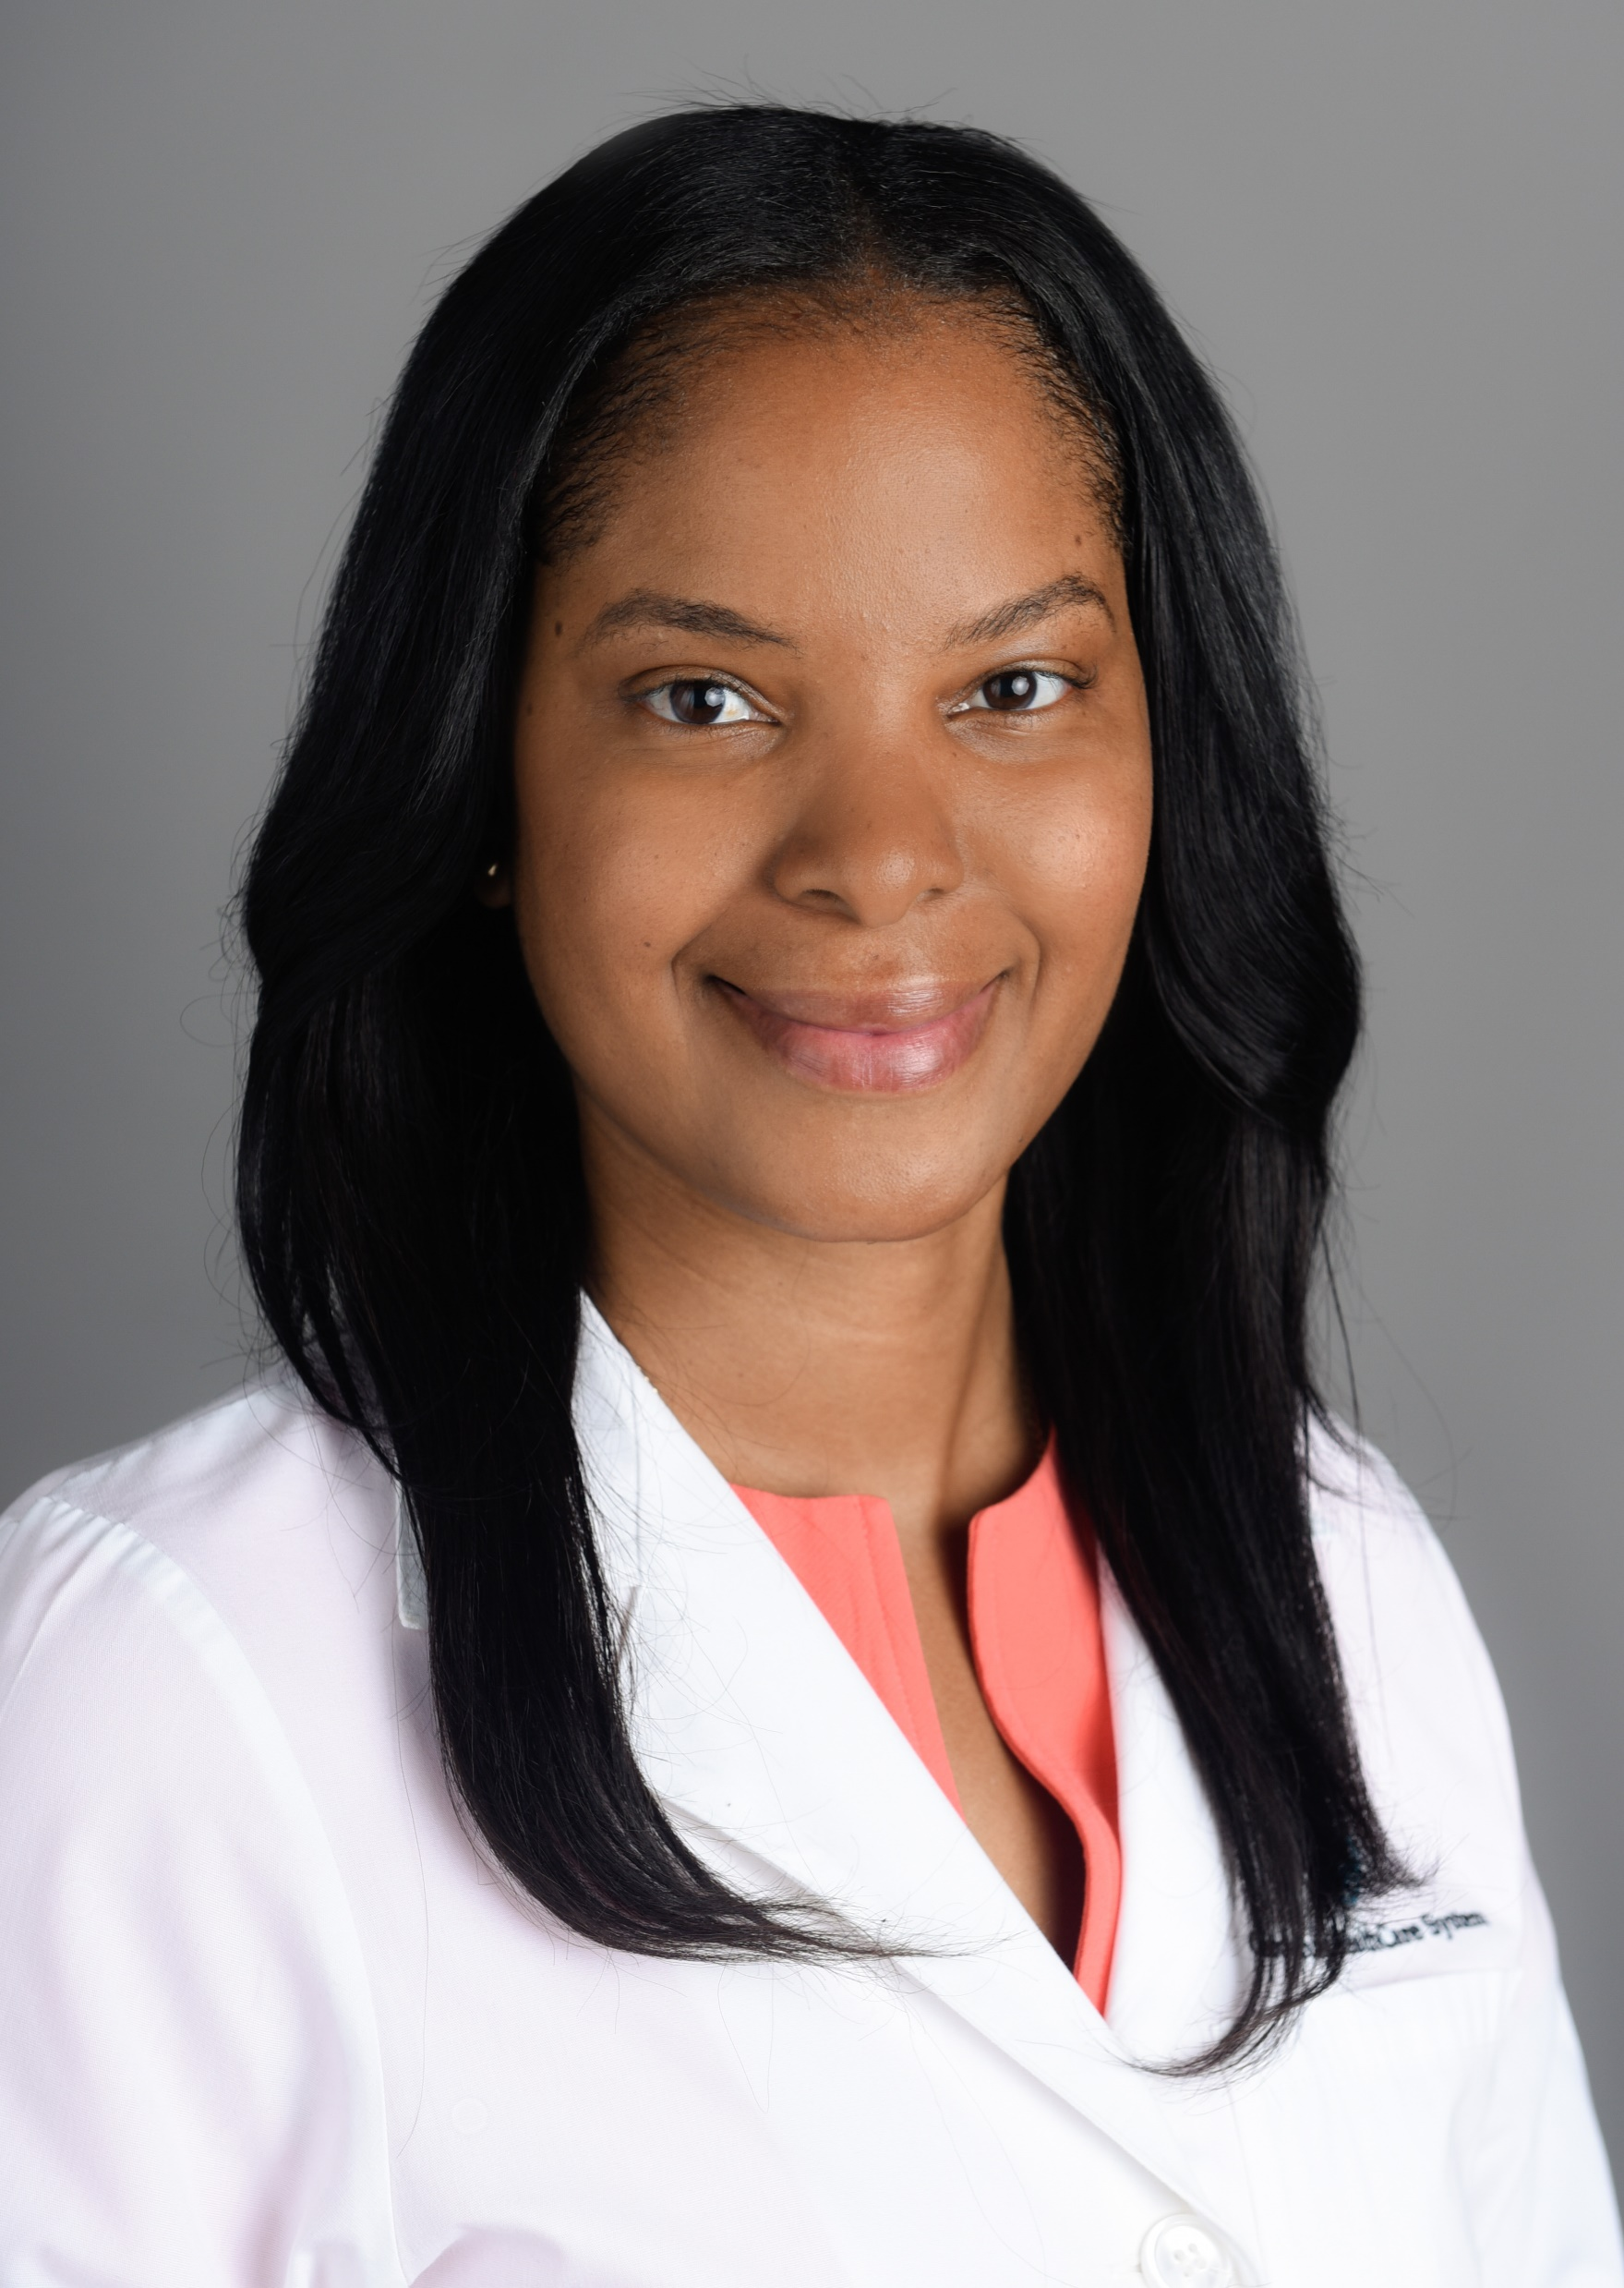
Meet Nicole
Dr. Nicole B. Cyrille-Superville is a cardiologist at Atrium Health Sanger Heart & Vascular Institute Kenilworth and Wake Forest University School of Medicine in the US.
Nicole studies heart failure with preserved ejection fraction (HFpEF) and social determinants of health. With patient care at the forefront of her mind, Nicole’s work can involve a range of roles at any one time.
Dr. Nicole B.
Cyrille-Superville
03 futurumcareers.com

Slide 4
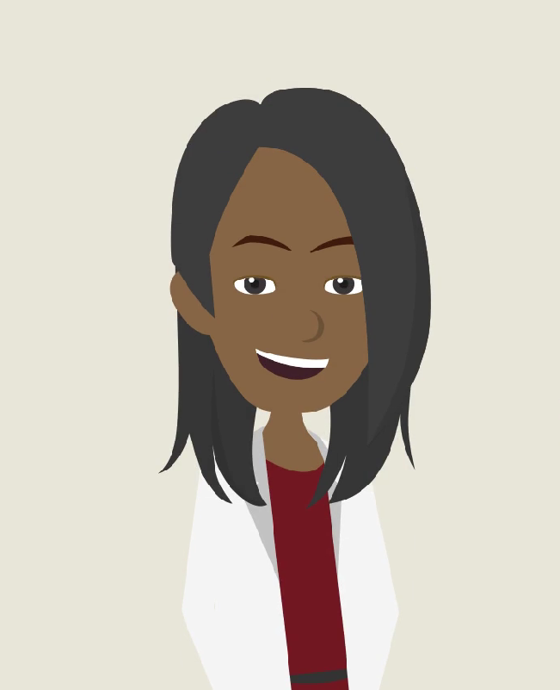
Learn about Nicole’s
Research and Career Journey
The animation on the following slide will introduce you to Nicole’s research and career journey.
You can also find it on Nicole’s Futurum page: futurumcareers.com/cardiology-with-dr-nicole-b-cyrille-superville
Or watch it on YouTube: youtube.com/watch?v=GE8xAdB3mpQ
04 futurumcareers.com

Slide 5


Slide 6
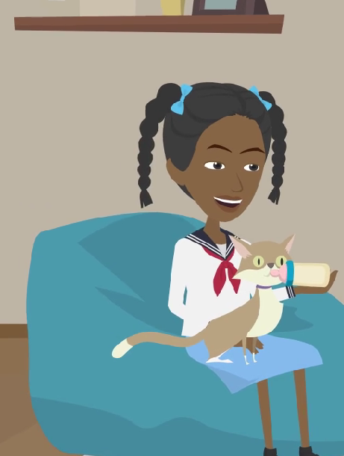
Animation Summary
As a child, Nicole was a natural caretaker. She loved animals and once took care of a litter of six kittens after their mother died.
Nicole’s parents instilled in her the importance of education and a strong work ethic. They were unable to complete high school, so when Nicole had the opportunity to move from Dominica to Texas, she was determined to succeed.
Today, Nicole is a cardiologist at Atrium Health Sanger Heart & Vascular Institute Kenilworth and Wake Forest University School of Medicine, in the US, focusing on conditions which affect the heart and blood vessels.
There are many physical factors that can impact our health, such as age, genetics, and physical mobility. Social, educational, and economic factors can also play a part. Combining clinical practice with research, Nicole has dedicated her career to improving our understanding of how all these factors can affect health outcomes for patients with heart failure.
06 futurumcareers.com

Slide 7
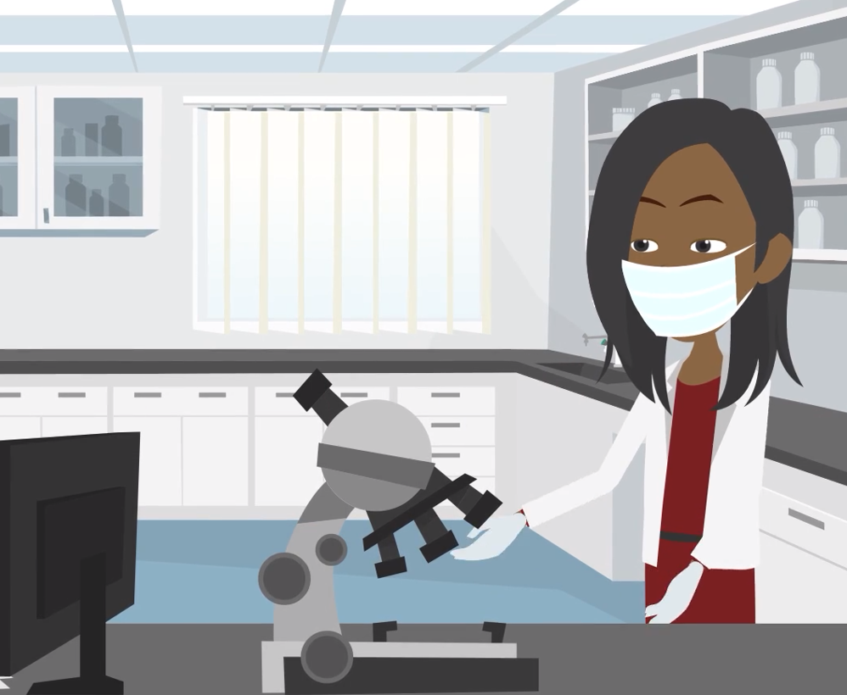
Animation Summary
Currently, Nicole is a co-investigator for REHAB–HFpEF, a clinical trial looking at the impact of a novel physical rehabilitation program on outcomes in patients hospitalized with decompensated heart failure with preserved ejection fraction, or HFpEF.
In addition to medical data, Nicole collects data about her patients’ social determinants of health. This helps her to develop a clearer understanding of what impacts the outcomes for HFpEF patients.
Nicole is also working on HeartShare, a study analyzing the phenotypes, or traits, of HFpEF patients. The project aims to build a large biorepository to explore pathophysiology and future therapeutic targets.
Nicole's work can involve a variety of professional tasks and can involve a few different research projects at any one time. For example, she is also a Champion for HeartShare, playing a leading role in increasing the enrollment of representative participants.
07 futurumcareers.com

Slide 8


Talking Points
What inspired Nicole’s strong work ethic? What motivates you to work hard?
What physical factors can impact someone’s health?
What are social determinants of health?
What has Nicole’s story taught you about a career in cardiology that you did not know before?
What do you think you would enjoy about being a cardiologist, and why?
08 futurumcareers.com
© everything possible/Shutterstock.com

Slide 9

About Cardiology
Working in cardiology can lead to a rewarding and multifaceted career, with cardiologists specializing in understanding conditions that affect the heart and blood vessels. A cardiologist may specialize as a clinician, working directly with patients to diagnose and treat conditions.
As Nicole’s story shows, clinicians will often take time to understand both the physical factors and the social determinants of health impacting their patients, to be able to support them in the best ways possible.
Cardiologists may also work in research, in the laboratory, or as educators and mentors, and some cardiologists do a combination of these.
09 futurumcareers.com
Hananeko_Studio/Shutterstock.com

Slide 10
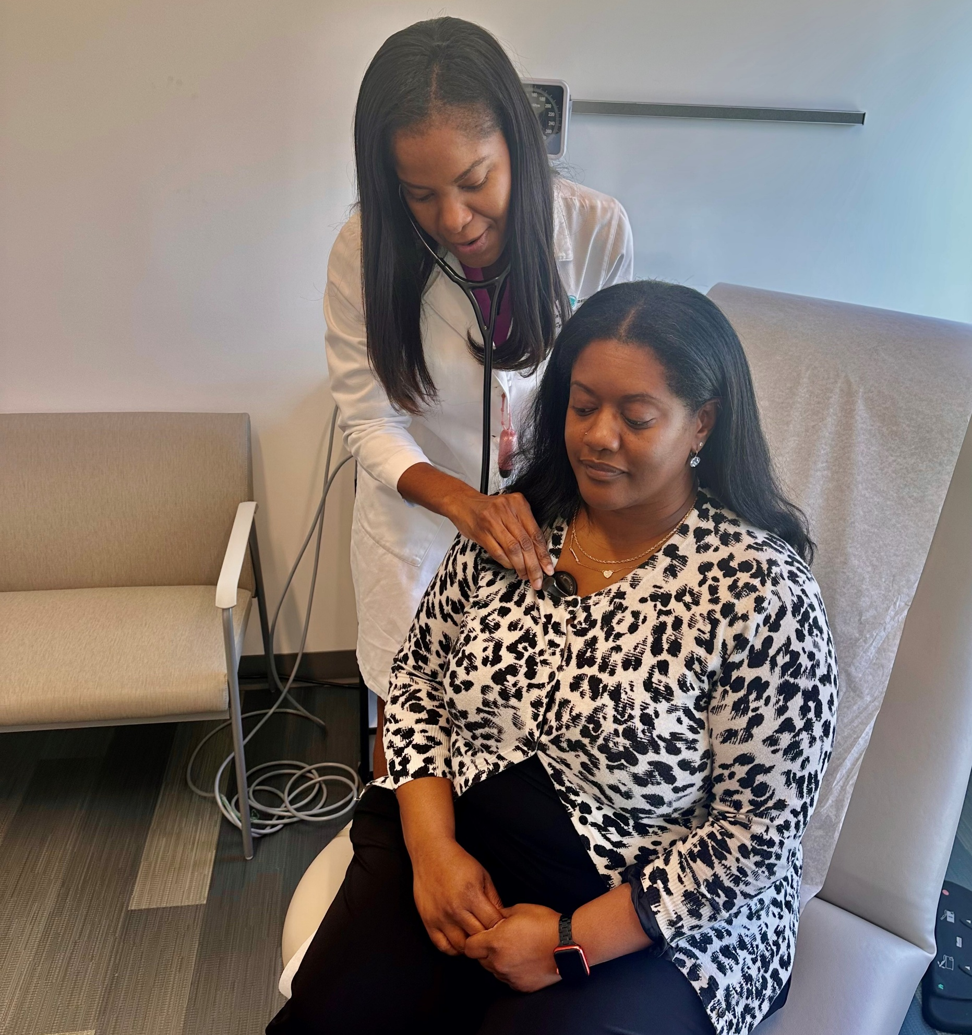
About Cardiology
Nicole enjoys the varied and multidisciplinary nature of cardiology. From pharmaceutical treatments to mechanical devices which support the heart in pumping blood, to transplant surgery for patients with more advanced heart failure, there are many different approaches cardiologists can take to help their patients.
“There is so much more to be explored in this dynamic field. This includes treatments and technologies, as well as areas in which we can impact health policy.” – Nicole
Nicole performing cardiac auscultation on HeartShare participant, Diane Holmes
10 futurumcareers.com

Slide 11

About Cardiology
Cardiology can be a challenging field to work in because heart failure is serious and complex. However, cardiologists can make a huge difference in the lives of the individuals they work with, their loved ones and wider communities. For Nicole, one of the most important and rewarding parts of her role is carrying out research to support the patients she works with.
“It truly gives me a chance to connect with patients and the community on a deeper level. I do a lot of outreach work with churches and at community events that allows me to build a better understanding of the challenges that my patients face, as well as the things they are eager to embrace and be a part of.” – Nicole
11 futurumcareers.com
©Drazen Zigic/Shutterstock.com

Slide 12
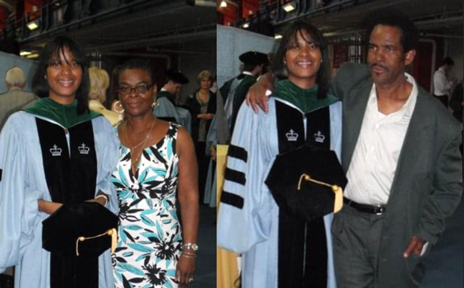
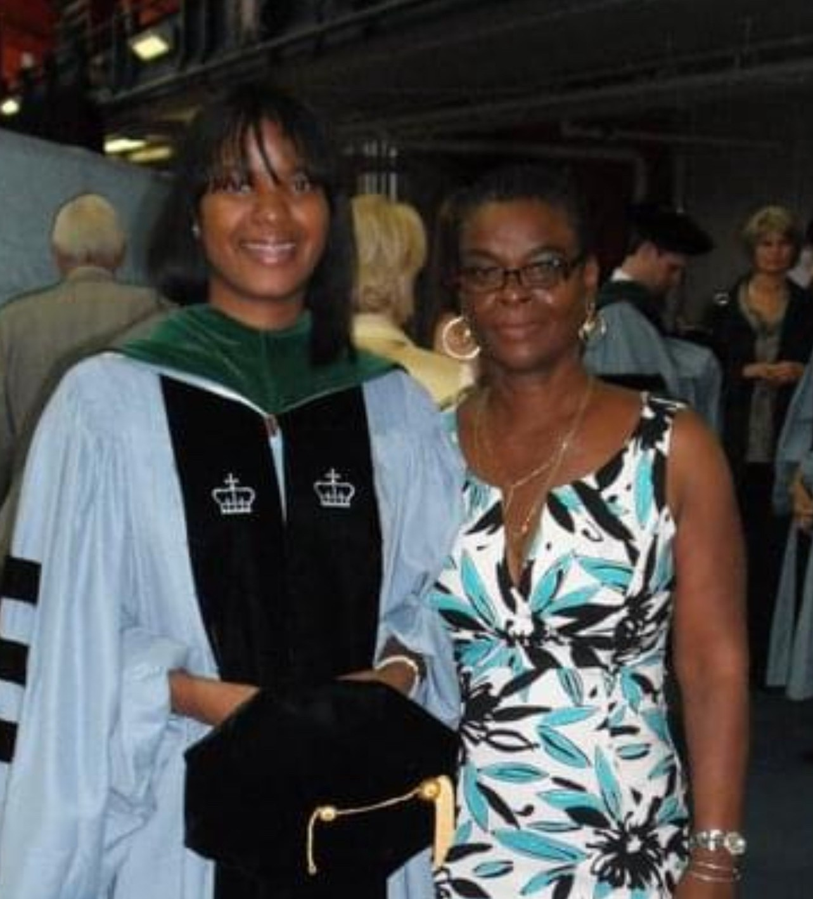
Nicole with her mom, Patricia Bruney, and her dad, Norman Cyrille, at her graduation from Columbia University College of Physicians and Surgeons
Pathway from School to Cardiology
Subjects such as biology, chemistry, and physics are required to study medicine and to form a solid foundation for understanding cardiology.
“I encourage you to explore areas that may allow you to integrate your other interests with patient care in unique ways. I had peers who studied literature, and there was a course called narrative medicine which involved bringing art and storytelling to patients. Another friend studied architecture and did a project focused on how the layout of the intensive care unit affected patients’ mental health. You never know where your passions and interest could take you – and how they might help patients.” – Nicole
12 futurumcareers.com

Slide 13
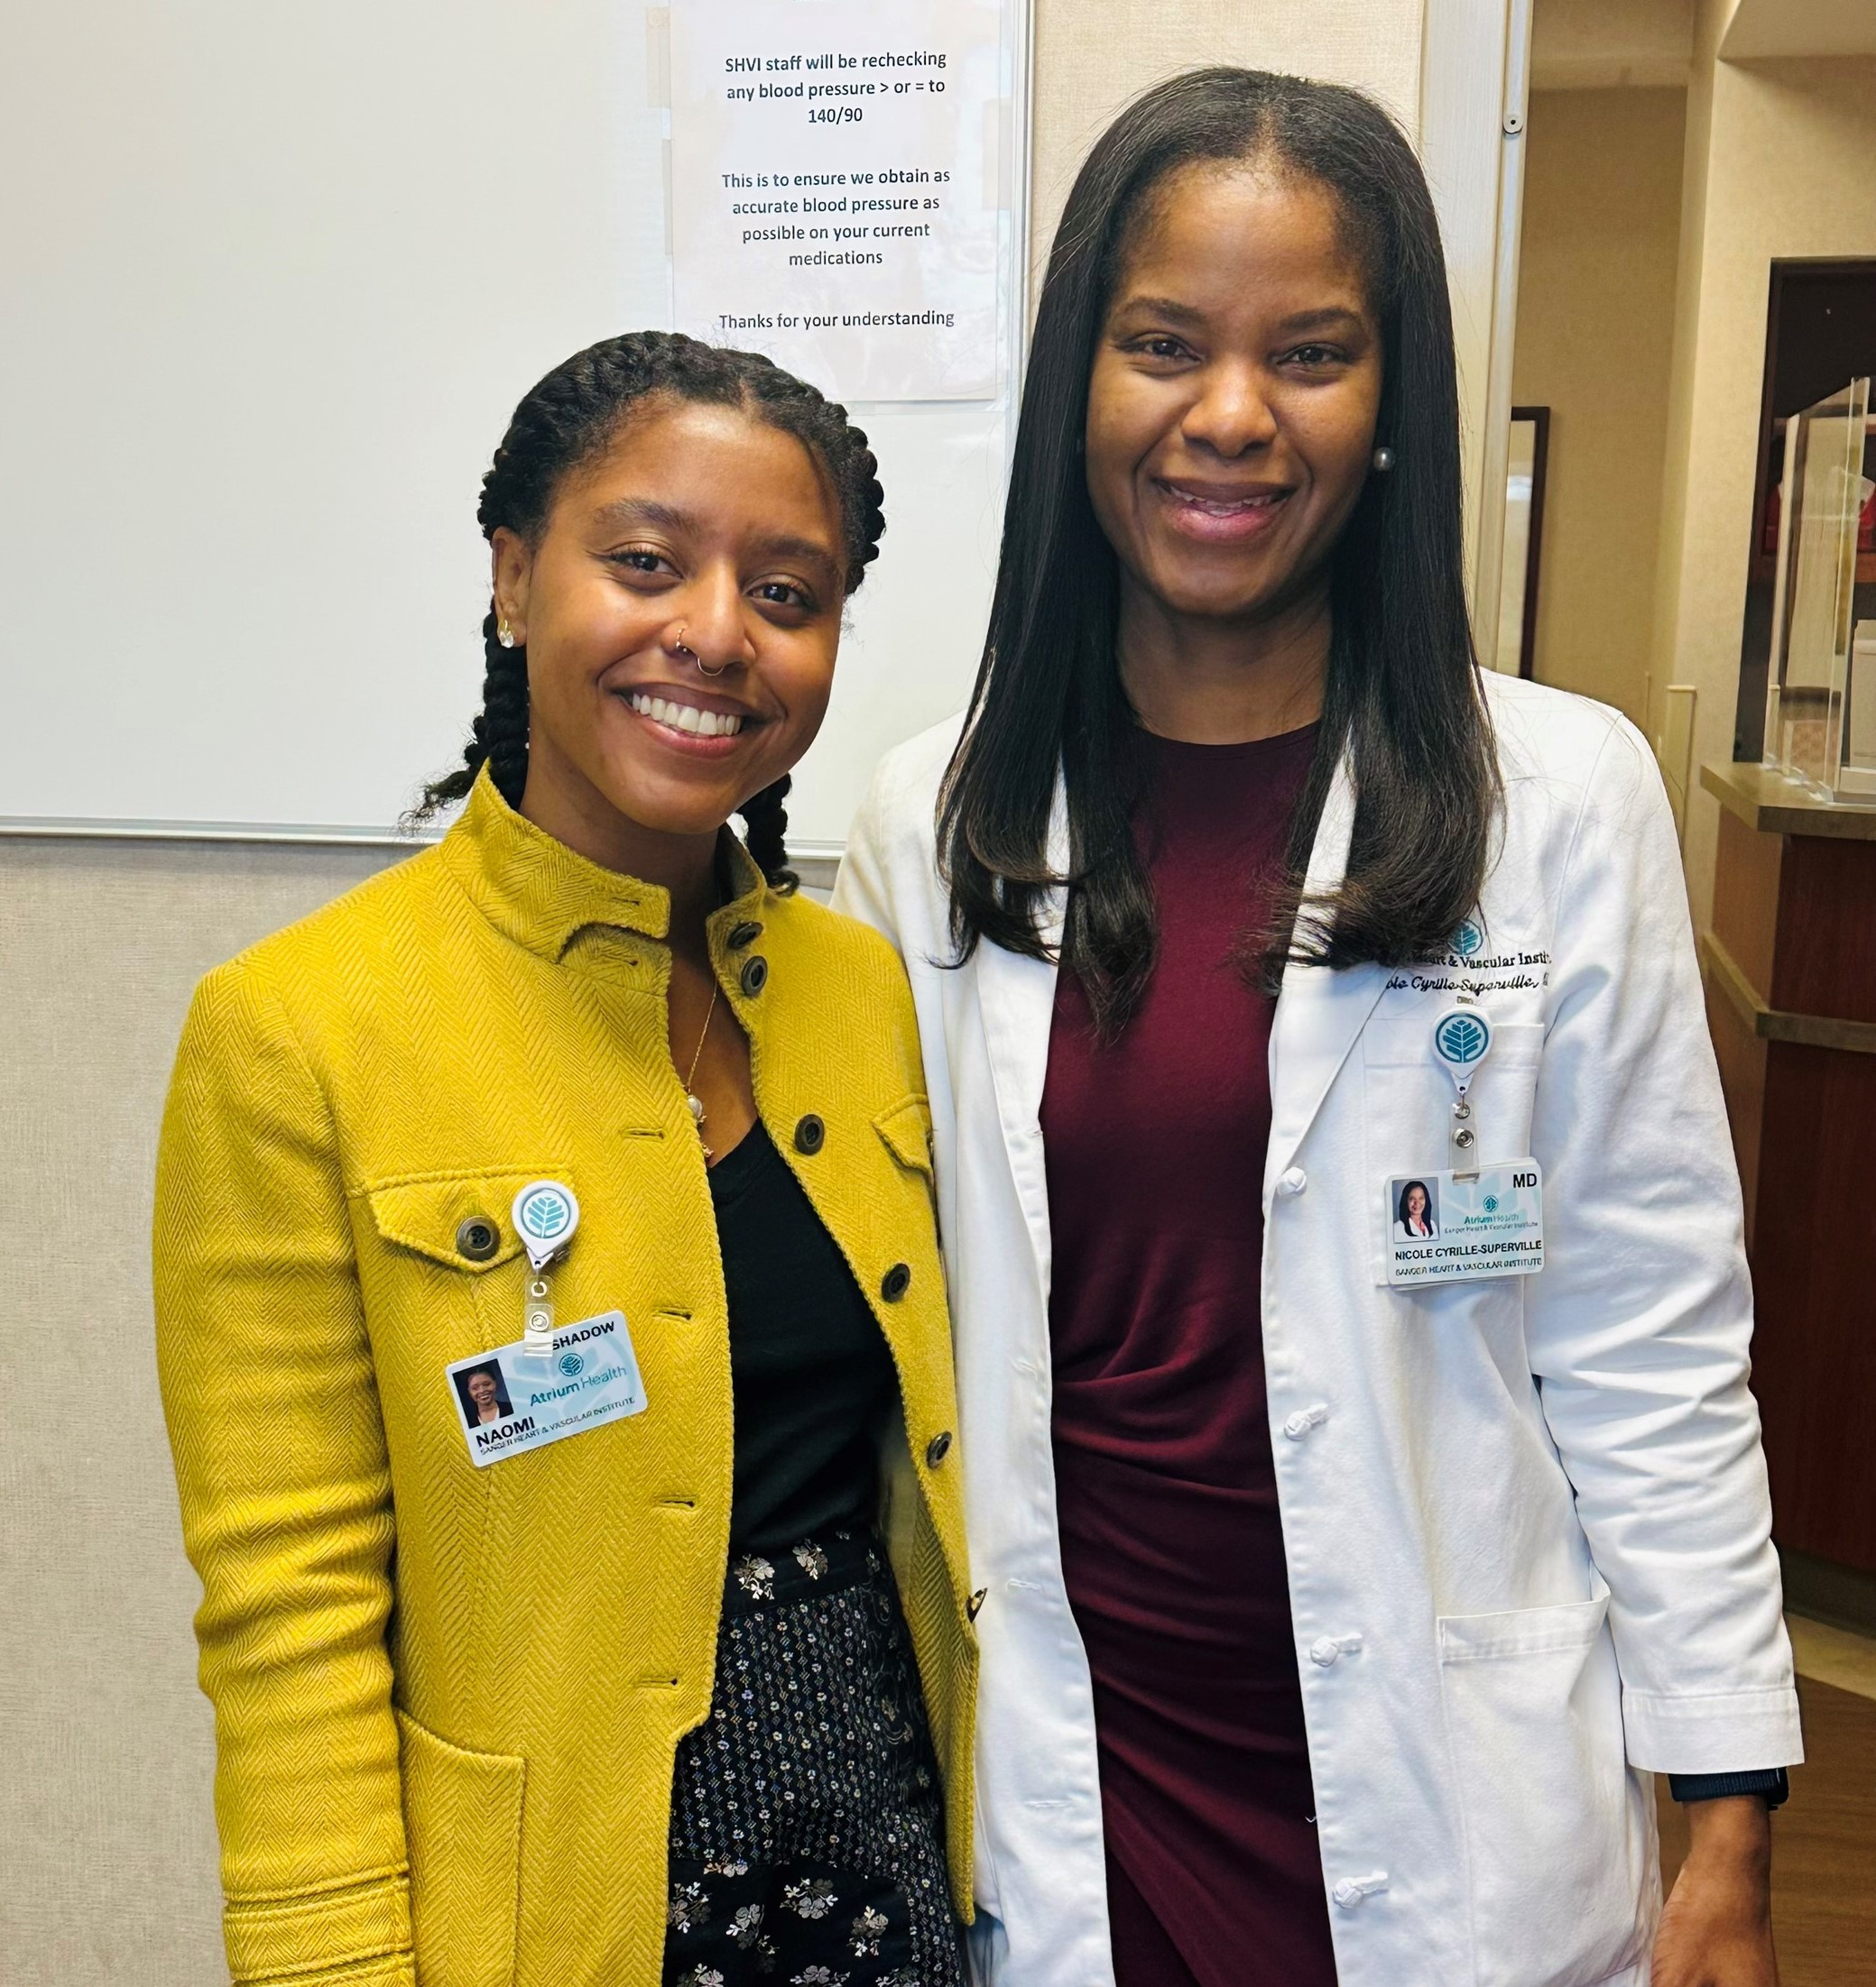
Explore Careers in Cardiology
Nicole with her mentee, Naomi Kemp, enjoying a day of shadowing in the heart failure clinic
“I encourage you to gain experience through shadowing a professional and volunteering outside of your classroom studies.”
– Nicole.
Nicole highlights the summer internship programs and observation opportunities offered by her employer, Atrium Health.
The American College of Cardiology has a wealth of information about different careers in cardiology and the opportunities the field offers.
The American Heart Association provides resources and volunteering opportunities. You can also become a Student Member, giving you access to meetings, conferences, and networking opportunities.
13 futurumcareers.com

Slide 14
Talking Points
Why is it important for cardiologists to understand social determinants of health, as well as physical factors?
Why do you think Nicole describes cardiology as a “dynamic” field?
Nicole finds it rewarding to connect with and understand her patients. To what extent would you enjoy working closely with patients, and why?
How confident are you in biology, chemistry, and physics? How could you go about developing your skills and knowledge in these areas?
How can different subject areas help cardiologists to support patients in unique and unexpected ways?
14 futurumcareers.com
© everything possible/Shutterstock.com

Slide 15
Meet Nicole
Neither of my parents completed high school, and my mom always stressed the importance of education above all else. I get a lot of my work ethic from my parents, especially my mom. I think a lot about how much she had to overcome being orphaned at 12 years old and becoming a mom at 17, and how, despite these challenges, she ensured that we always had what we needed.
My parents sacrificed a lot and missed out on so many opportunities given the circumstances they were born into, so I knew I had to succeed. I strongly believe in seeing things through to the end and always putting your best foot forward, leaving no room for regret.
15 futurumcareers.com

Slide 16
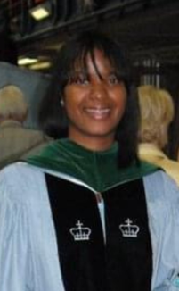
Meet Nicole
Nicole at her graduation from
Columbia University College of Physicians and Surgeons
I think being a caretaker comes naturally to me. As a child, I loved animals, and when one of my cats passed away after giving birth to a litter of six kittens, I got up early every morning to feed them milk with a syringe before school.
I yearned for more opportunities for myself and my family, so I took advantage of a chance to go to college in the US. It was a culture shock moving from Dominica to Texas and living on my own for the first time. I had to learn to balance work and study, budgeting, and paying bills. I worked hard, getting numerous scholarships, and was fortunate to meet a lot of good people who helped me along the way. The kindness I received cemented in me the need to pay it forward.
16 futurumcareers.com

Slide 17
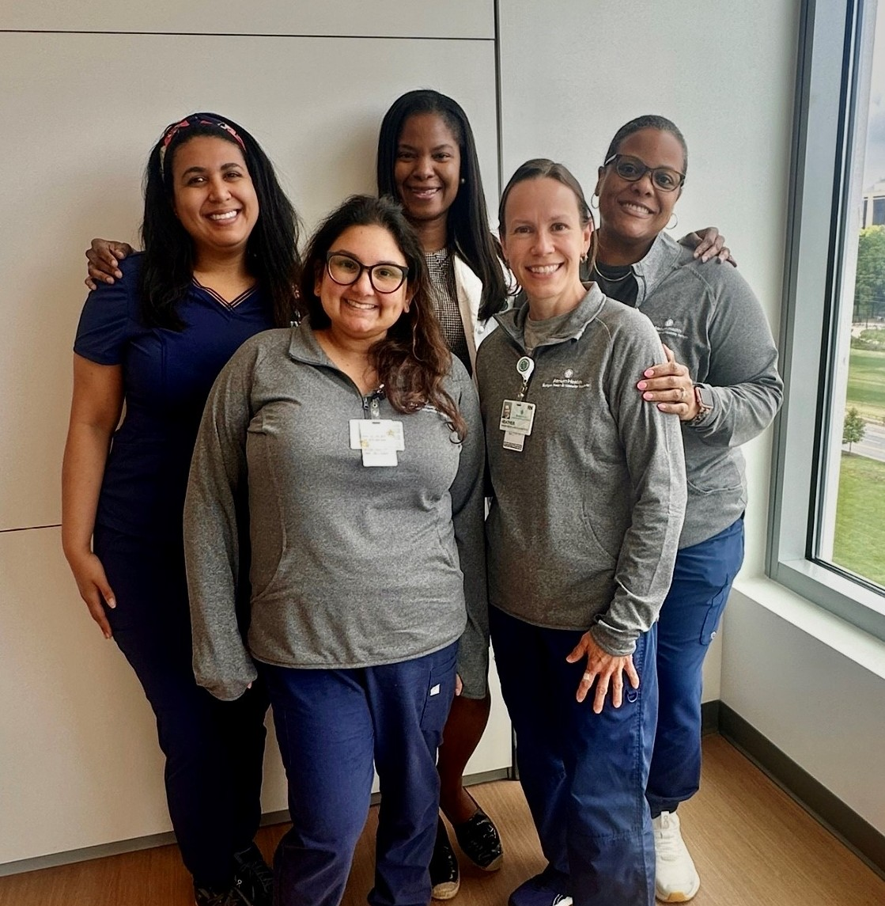
Meet Nicole
Nicole with members of the Atrium Health Research team
My proudest career achievements include being one of the top graduates in my class at Midwestern University and receiving the President Excellency Award for perfect grades.
I was the first university graduate on my mom’s side of the family, and it gave me the confidence and determination to push further.
I found my voice during my time at the Columbia College of Physicians and Surgeons, where I started my medical career, and have achieved numerous grants and accolades, including the Top Principal Investigator award by the Heart Failure Collaboratory in association with the American Heart Association in 2024.
17 futurumcareers.com

Slide 18

Meet Nicole
Nicole with her husband (Marvin), son (Jaden), and daughter (Nailah)
Career-wise, I am always striving to find the right balance between my clinical and research time to serve patients in the best way possible. Mentoring and community outreach is my way of giving back, and I want to continue to expand on that.
From a personal standpoint, my aims for the future are to be a great wife and mom. I switch off from work by spending time traveling with my family and creating new experiences for my kids. I think there is so much to navigate as a teenager, especially in the age of social media, so instilling good values and a strong work ethic is essential to help young people find their way in life. My children’s success and happiness are truly how I measure my own success.
18 futurumcareers.com

Slide 19
Nicole’s Top Tips
Be intentional. Once you have decided on what you wish to pursue or become an active participant in, figure out how to get there and know that sometimes the journey comes with sacrifices.
Embrace what makes you unique. It is okay to be different or unconventional. Our varied experiences and backgrounds bring so much more to the field of medicine and the ways in which we care for and impact patients.
Don’t get discouraged by failure. What matters the most is being humble enough to learn from failure and doing better the next time.
19 futurumcareers.com

Slide 20
Talking Points
How good are you at “seeing things through”? What can make that difficult to do? What helps you to stay focused and determined?
What experience have you had in balancing study with other responsibilities, such as work and day-to-day chores? How do you think this “balancing act” has helped you to develop useful skills?
How much do you know about scholarships? How could you find out more about scholarships that you could benefit from in the future?
Which of Nicole’s top tips do you find most useful, and why?
20 futurumcareers.com
© everything possible/Shutterstock.com

Slide 21
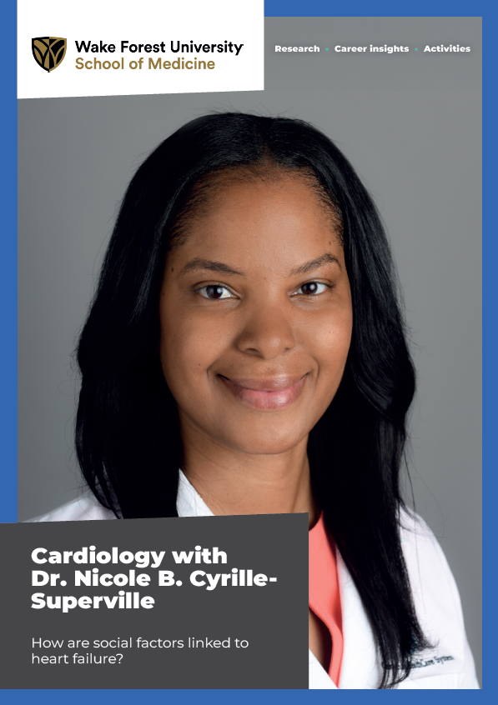
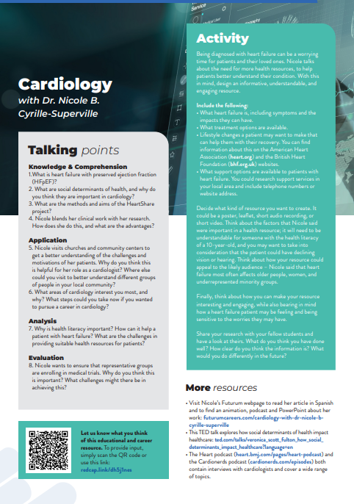
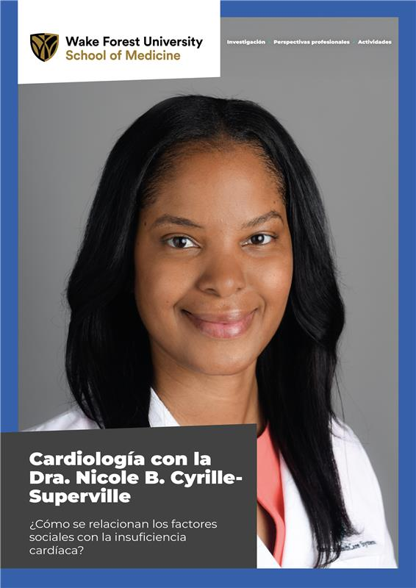

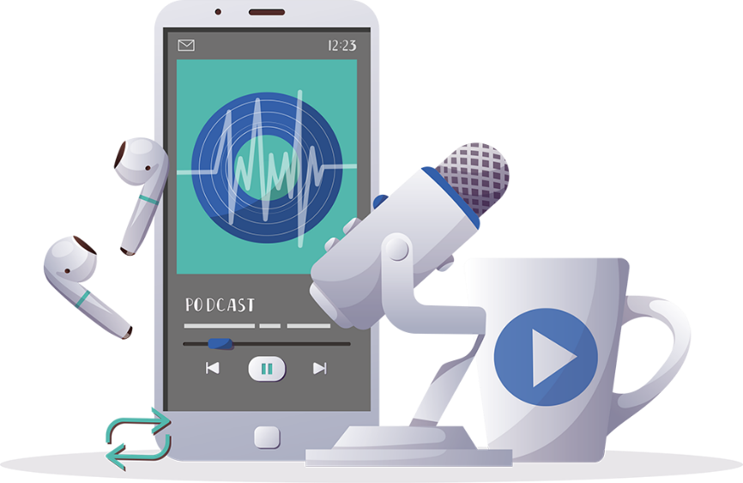

More resources
Read the article
Complete the activities
Listen to the podcast
Watch the animation
Download the Spanish resources
21 futurumcareers.com
© everything possible/Shutterstock.com

Slide 22
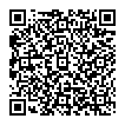



This educational material has been produced by Wake Forest University School of Medicine in partnership with Futurum and with grant support from The Duke Endowment.
The Duke Endowment is a private foundation that strengthens communities in North Carolina and South Carolina by nurturing children, promoting health, educating minds and enriching spirits.
Let us know what you think of this educational and career resource.
To provide input, simply scan the QR code or access the link below:
redcap.link/dh5j1nes

