Slide 1


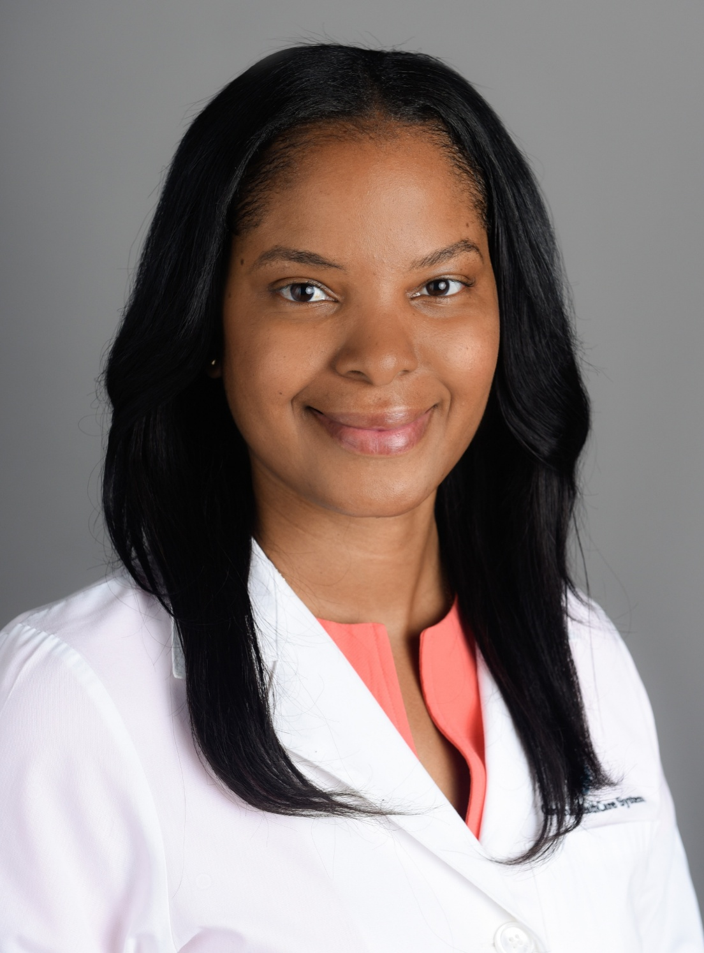
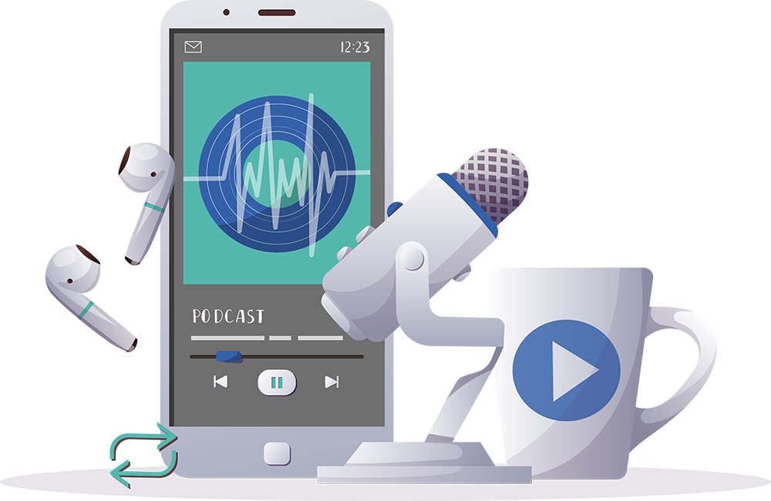

Inspiring the
Next Generation
FUTURUM
PODCAST
In Conversation with
Dr. Nicole B. Cyrille-Superville

Slide 2

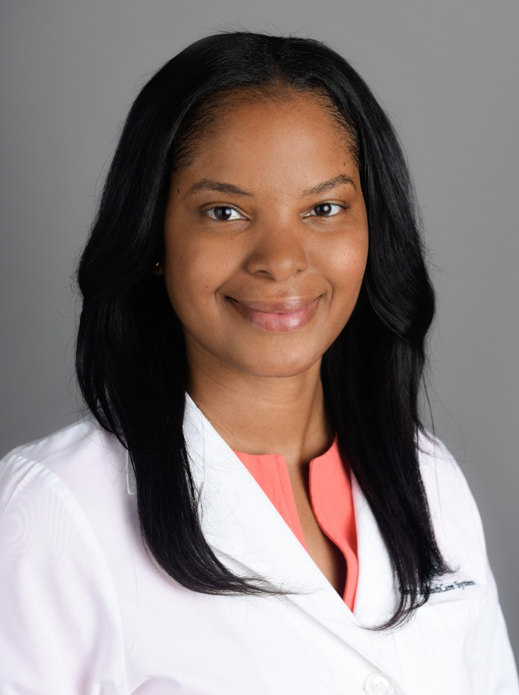
Pre-listening | Break it Down | Post-Listening | Learn More
Meet
Dr. Nicole B. Cyrille-Superville
Pre-listening:
In this podcast, Dr. Nicole B. Cyrille-Superville speaks about the importance of trusting your team, her experience of moving from the Caribbean to the US, and about being thankful for the people who have helped her throughout her life.
When have you worked as part of a team? What did this teamwork enable you to achieve?
Who offers you support and guidance in life? Who could you talk to if you needed help?
What do you think Nicole’s job as a cardiologist involves?
Profile
Atrium Health Sanger Heart & Vascular Institute and Wake Forest University School of Medicine, USA
Field of Research
Cardiology
“When opportunities come your way, always put your best foot forward.”

Slide 3


Pre-listening | Break it Down | Post-listening | Learn More
Break Nicole’s Conversation Down:
Up to 04.00
What is the REHAB-HFpEF trial that Nicole is working on aiming to understand?
What are some examples of social determinants of health?
How do you think these social determinants of health impact patients?
What do you think it means to have good health literacy? How do you think experts like Nicole can support patients with their health literacy?

Slide 4

Pre-listening | Break it Down | Post-listening | Learn More
04.00 – 07.27
What traits do you think enabled Nicole to cope with moving to and studying in another country? How do you think you would cope with a similar experience, and why?
What experience confirmed Nicole’s desire to work with patients in cardiology?
Why is it important to lean on your team to ‘stay afloat’ in challenging situations?

Slide 5

Pre-listening | Break it Down | Post-listening | Learn More
07.27 – 12.08
Why is it important to know that you are not going to be right all the time? When have you had to consider different opinions, and how did this broaden your understanding of a situation?
What do you think it means to be a ‘forever learner’? To what extent do you agree it is important to be a ‘forever learner’, and why?
Who gives you the push to keep moving forward in life?

Slide 6
Pre-listening | Break it Down | Post-listening | Learn More
12.08 – end
How good are you at making the most of opportunities that come your way? Does anything hold you back from putting your ‘best foot forward’ and, if so, how could you change this?
When did you last fail at something? What did you learn from the experience?
Have you ever had to make a sacrifice to achieve a goal? Making a sacrifice is not easy – how did you keep yourself motivated? How could you keep yourself motivated in the future?

Slide 7


Pre-listening | Break it Down | Post-listening | Learn More
Post-listening:
To what extent do you think you would find a career in cardiology to be rewarding and interesting, and why?
Where could you look to seek out opportunities such as mentoring?
Which piece of Nicole’s advice did you find most useful, and why?
What further questions would you ask Nicole about cardiology and/or her career?*
Submit questions to Nicole here

Slide 8

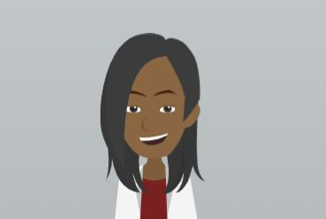
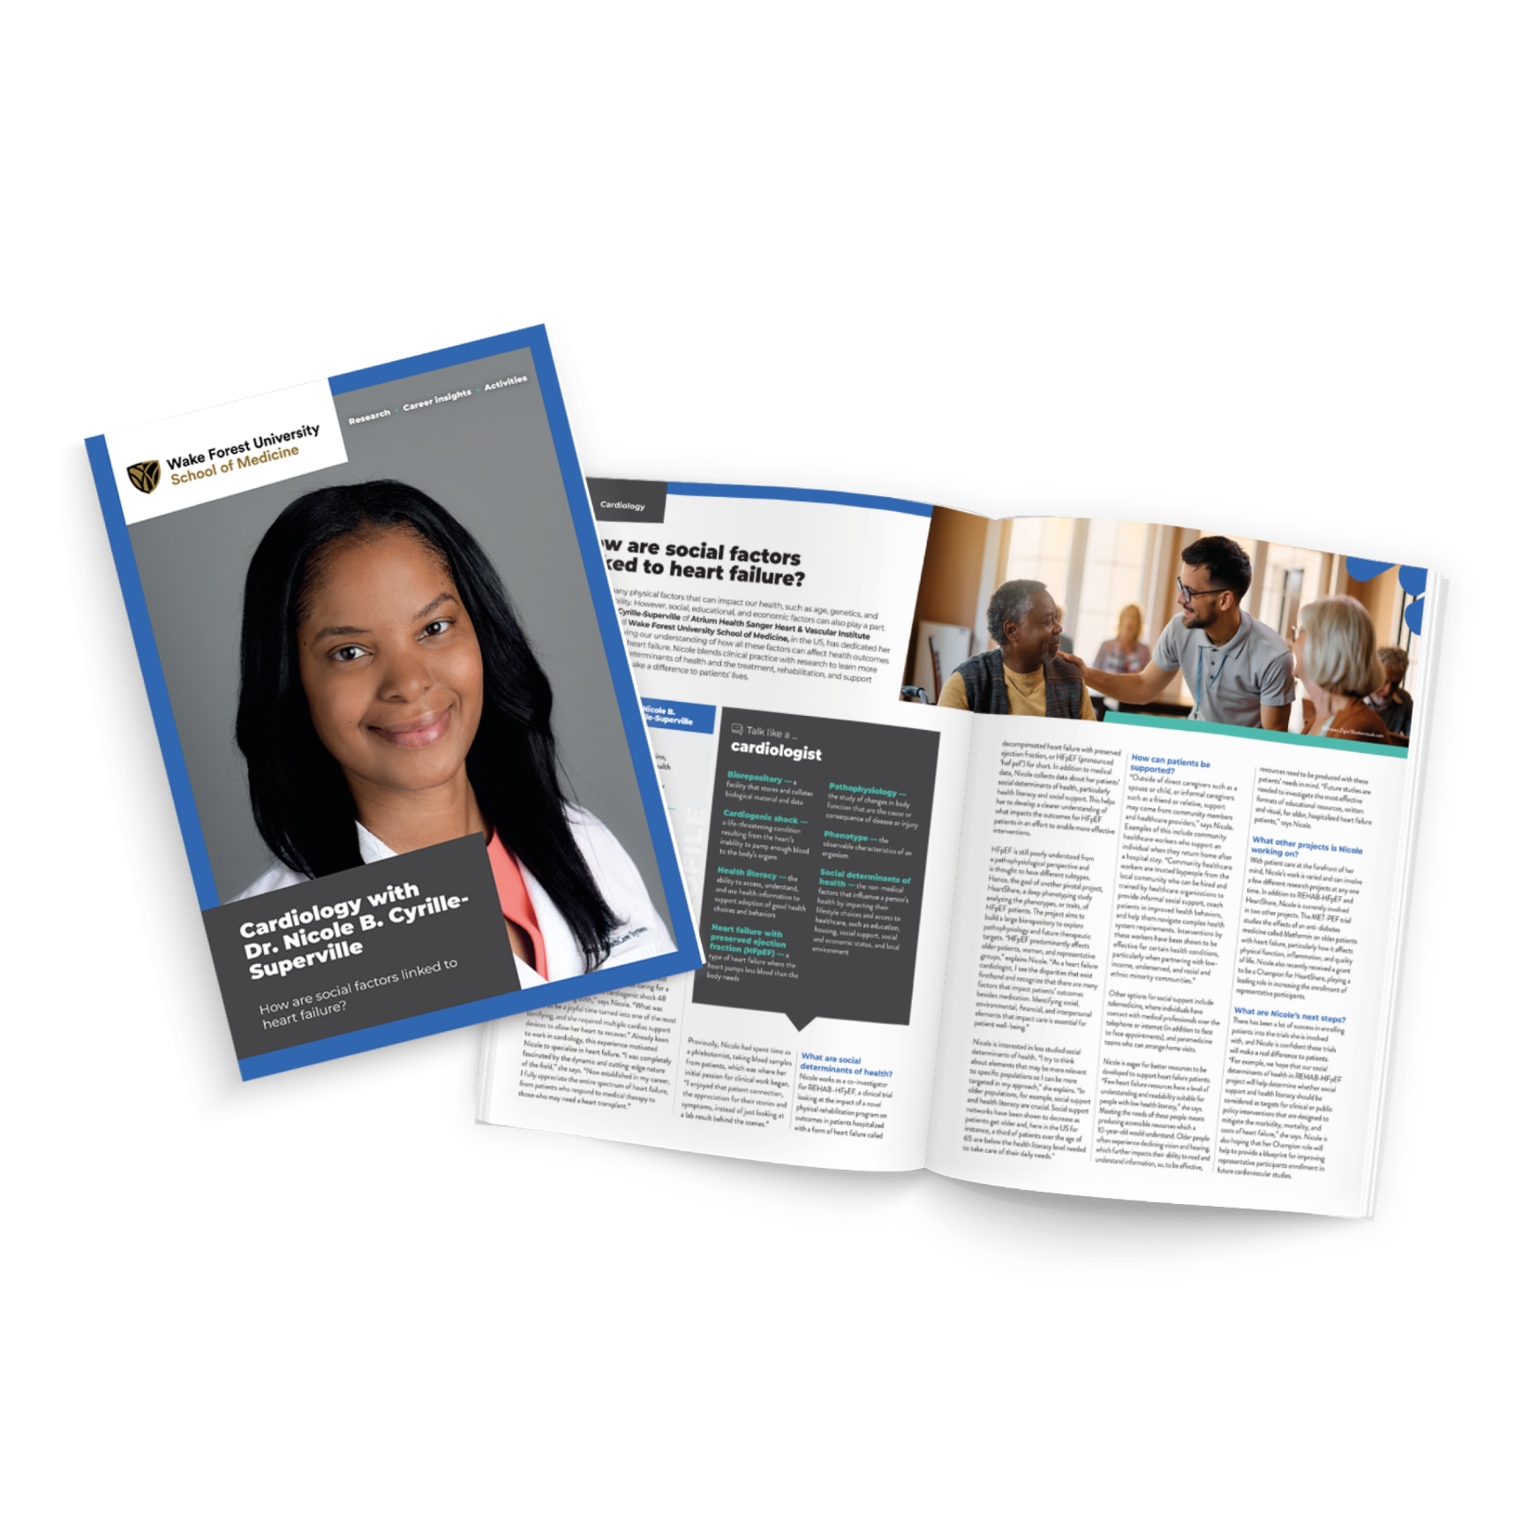
Pre-listening | Break it Down | Post-listening | Learn More
Learn More About Nicole’s Work:
Read Nicole’s article
Download Nicole’s activity sheet
Watch Nicole’s animation
Download Nicole’s careers PowerPoint
Read Nicole’s resources in Spanish
Inspiring the
Next Generation

Slide 9
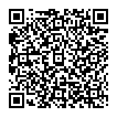



This educational material has been produced by Wake Forest University School of Medicine in partnership with Futurum and with grant support from The Duke Endowment.
The Duke Endowment is a private foundation that strengthens communities in North Carolina and South Carolina by nurturing children, promoting health, educating minds and enriching spirits.
Let us know what you think of this educational and career resource.
To provide input, simply scan the QR code or access the link below:
redcap.link/dh5j1nes

