Slide 1
OPHTHALMOLOGY
PROFESSOR TUNDE PETO
AND THE REACH-DR TEAM

Slide 2
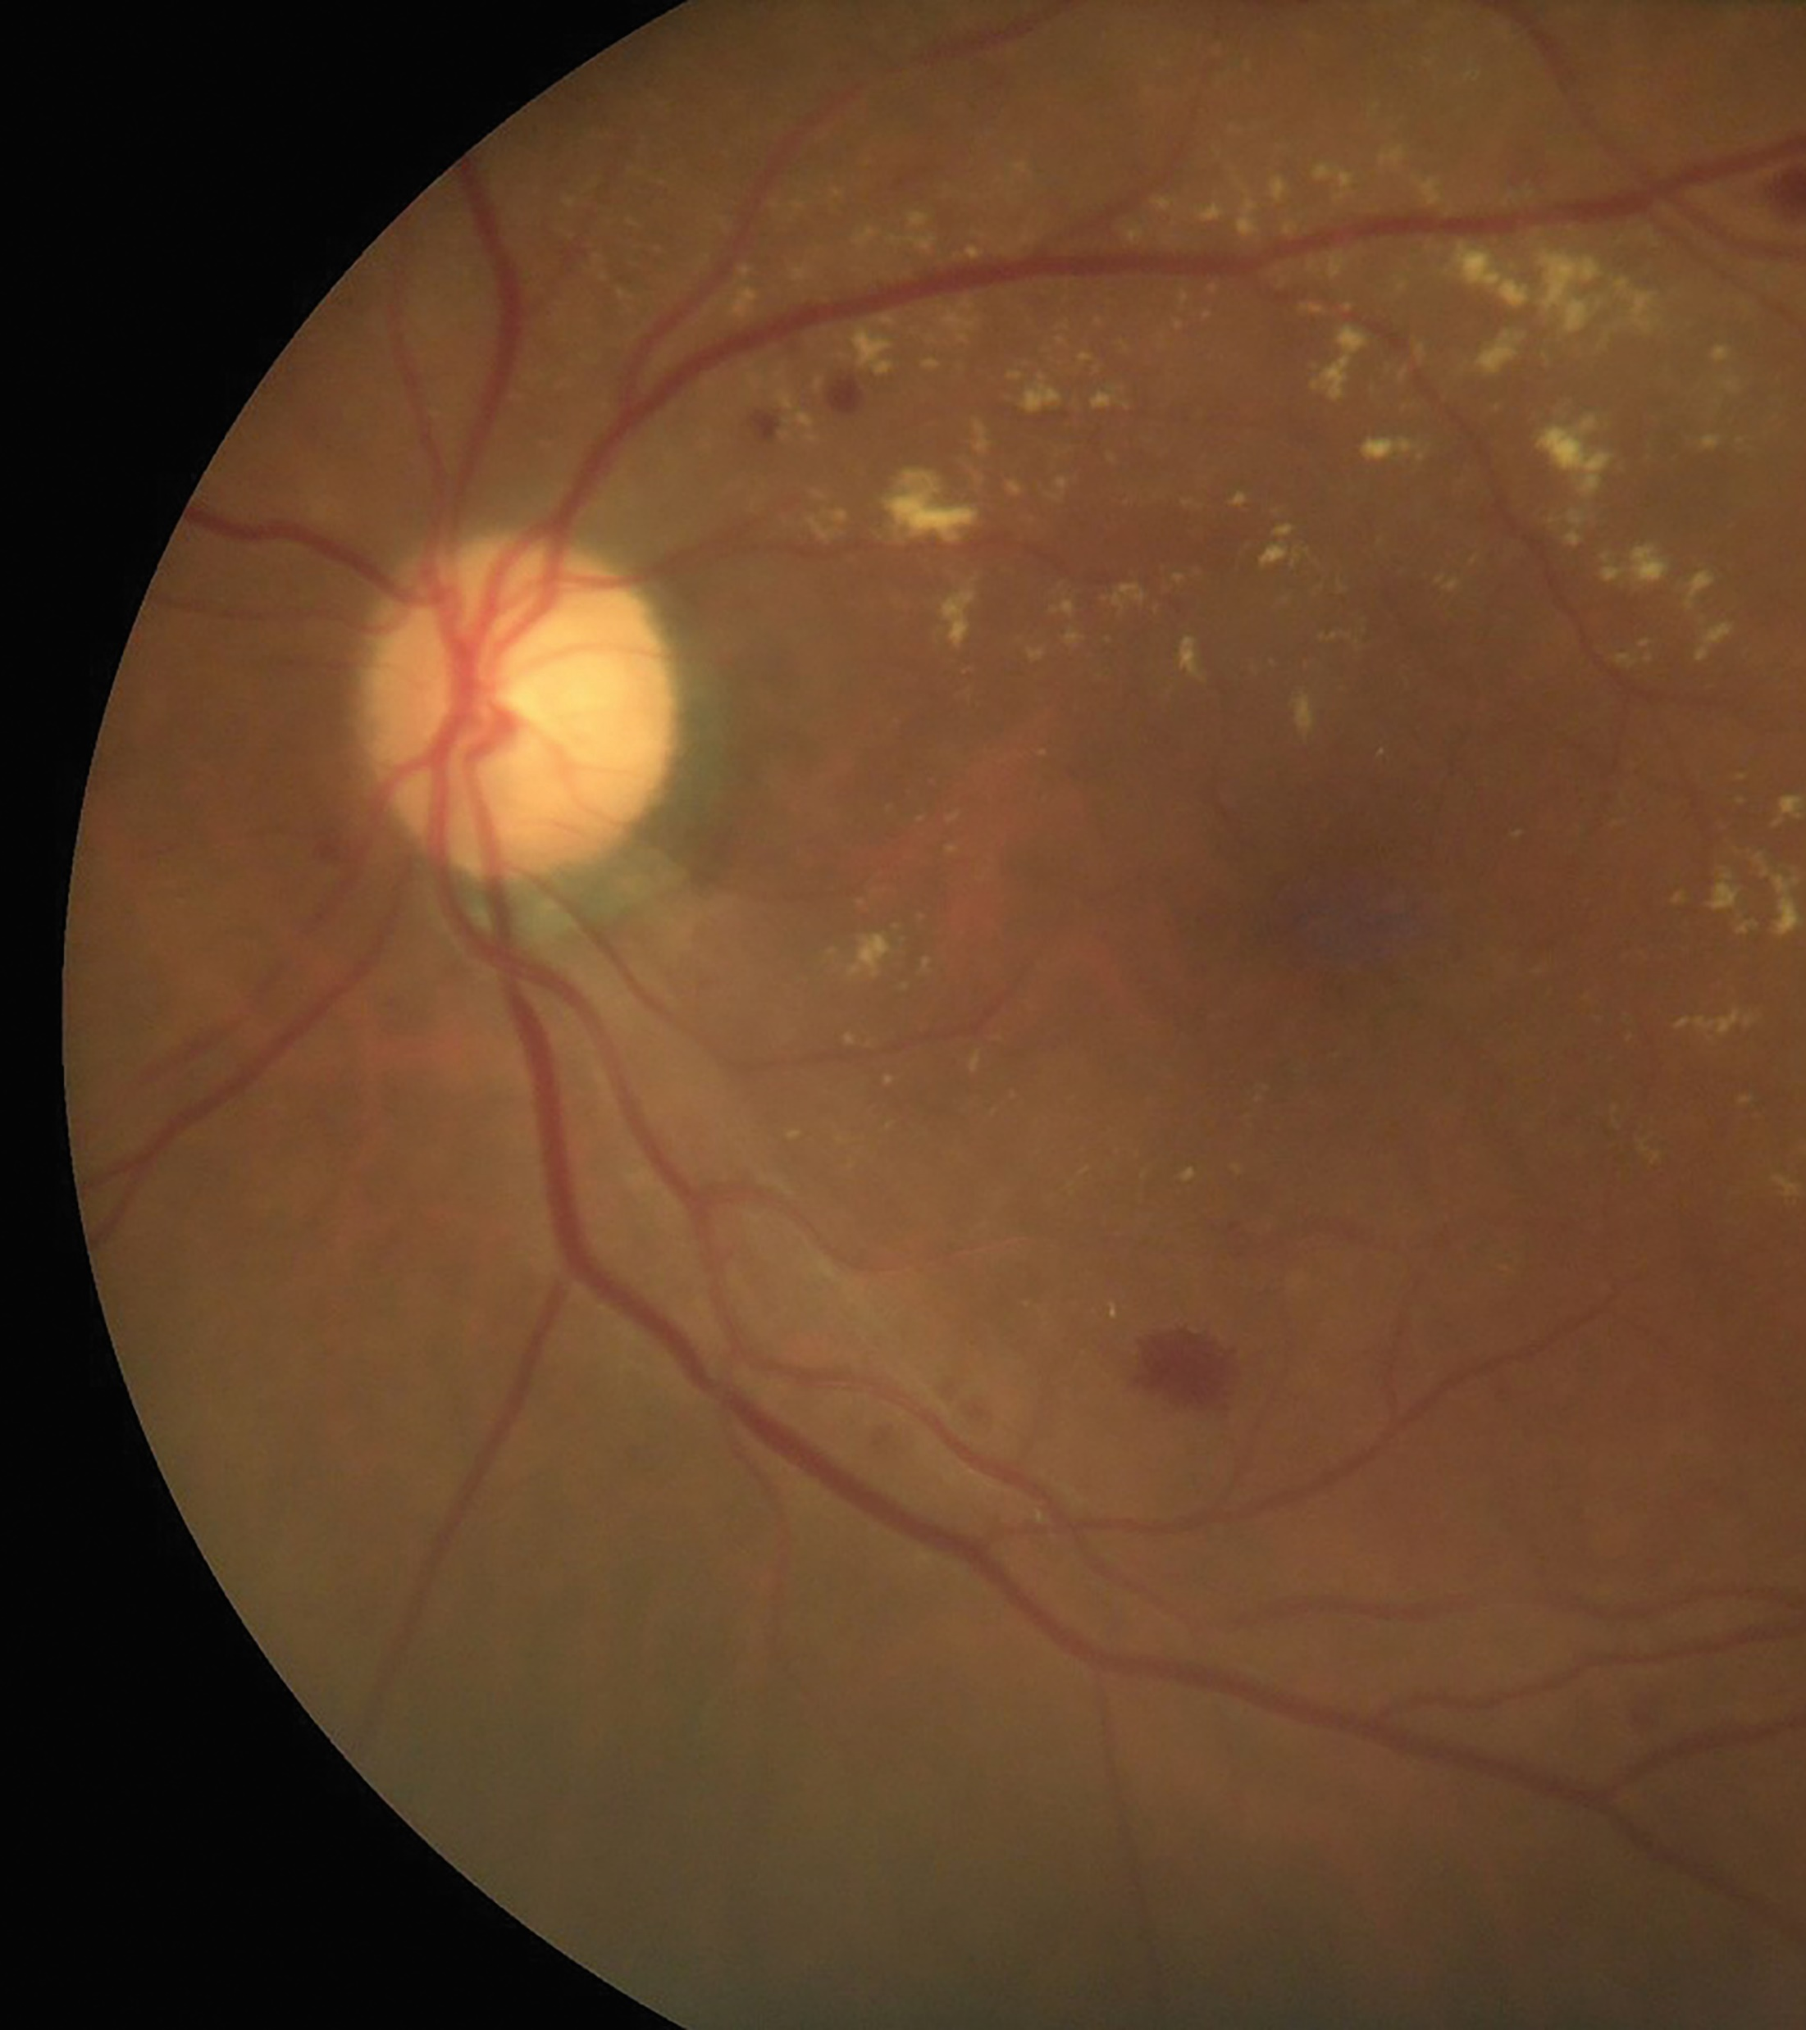
DIABETES AND EYE HEALTH
Diabetes can lead to a wide range of complications, many of which affect blood vessels around the body.
For instance, retinopathy happens when diabetes damages the blood vessels inside the eyes. This can lead to diabetic maculopathy, a severe condition where patients may experience impaired vision such as blurring and image distortion.
However, in the majority of cases, there are no visual symptoms until it is too late. Diabetic eye screening is of great importance – the earlier changes are identified, the better the chance of saving a person’s sight.
A photo of the retina showing changes related to diabetes. Note the red spots (haemorrhages) and yellowish dots (exudates) due to diabetic eye disease.

Slide 3
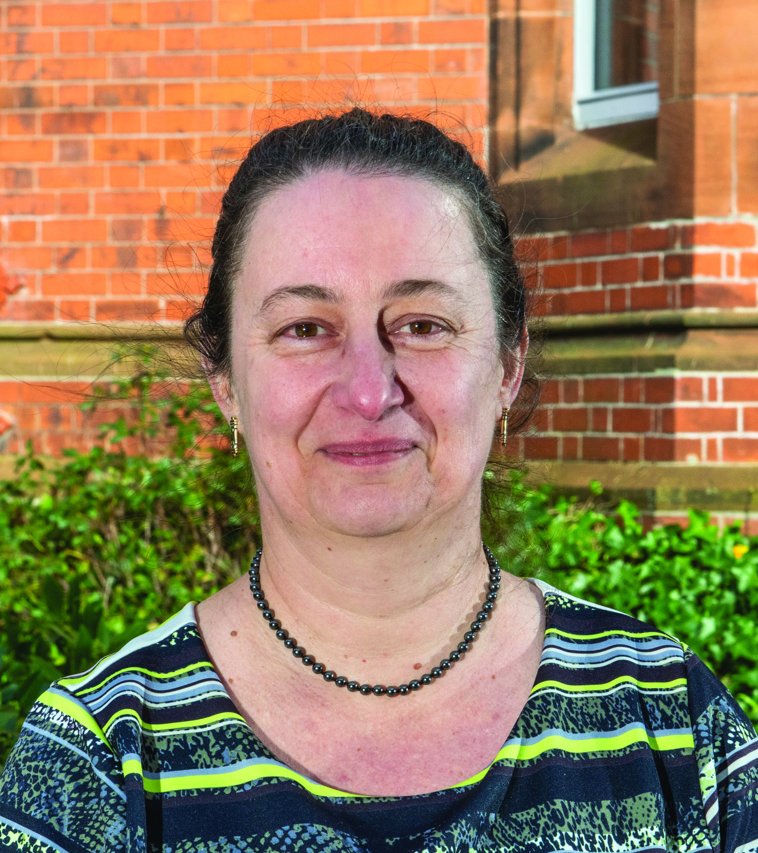
MEET TUNDE
Professor Tunde Peto and a team of researchers based at Queen’s University Belfast (QUB) in the UK are working on the UK-Philippines Remote Retinal Evaluation Collaboration in Health: Diabetic Retinopathy (REACH-DR) project.
Diabetic eye screening programmes (DESP) in the UK are among the most successful in the world, particularly with the advent of teleophthalmology eye evaluations, and Tunde and her team want to ensure the REACH-DR project enables the Philippines to achieve a similar level of care.
Let’s learn more about their work…

Slide 4
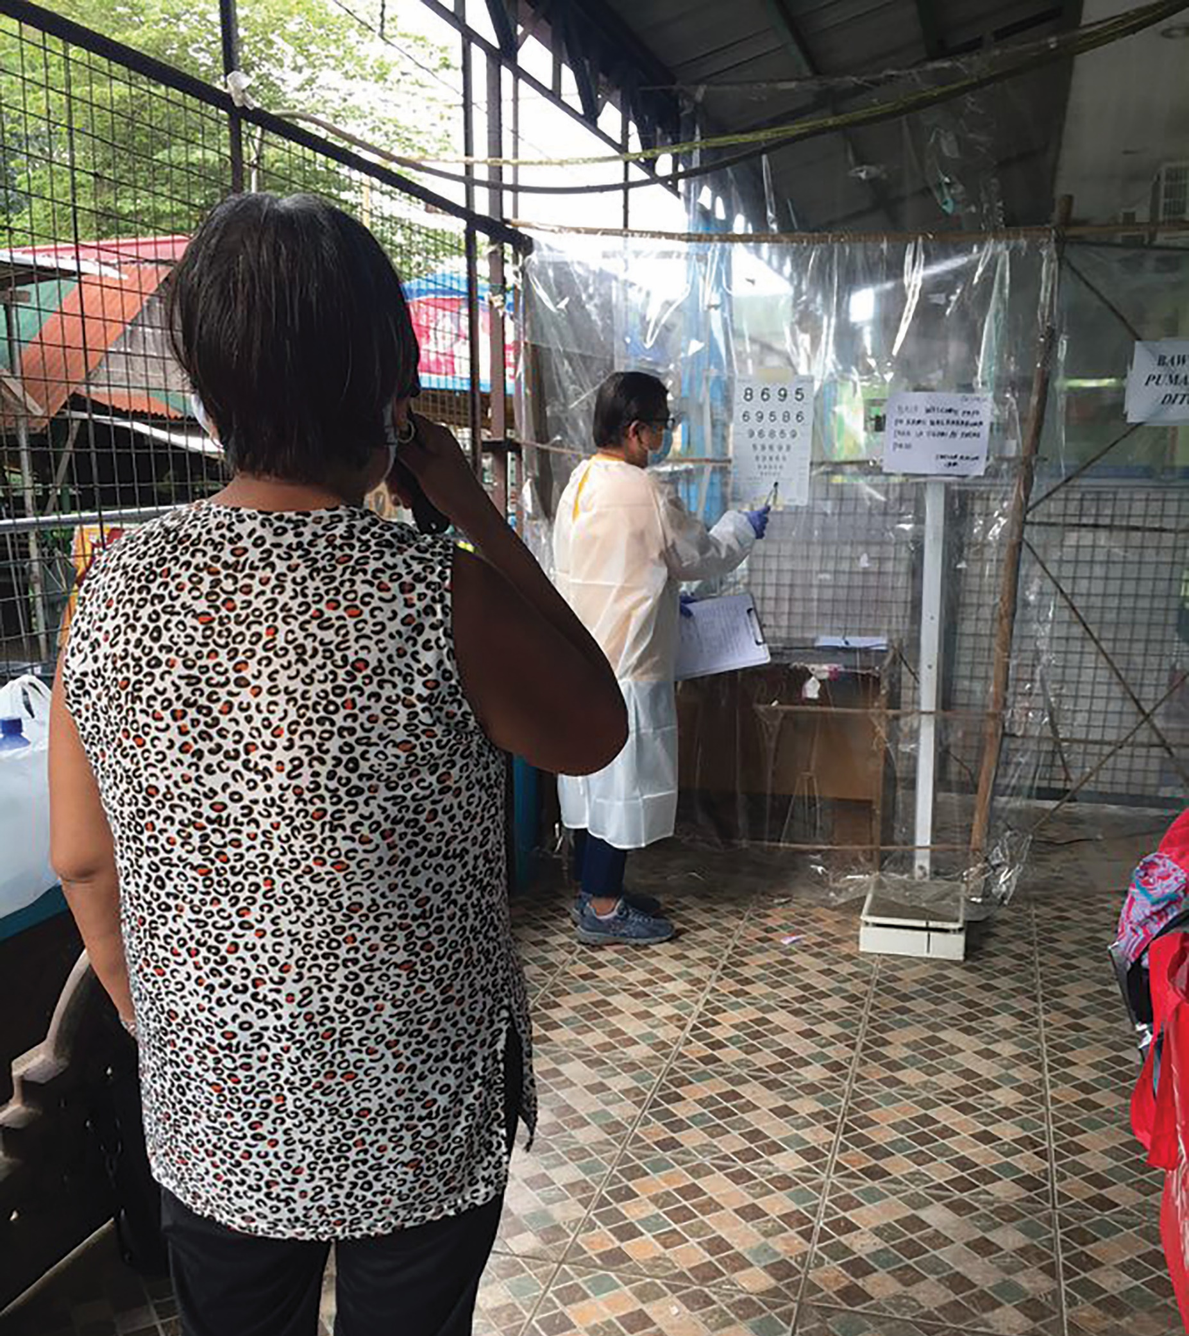
THE CHALLENGES
The Philippines has 7,641 islands and more than 100 million people which makes evaluation of diabetic eye disease very challenging.
“Not all areas have the necessary equipment for eye examinations and the transportation of machines and specialists is challenging if a DESP it to be deployed on a national scale,” says Tunde.
“Then there is the lack of trained eye health professionals; there are only about 1,600 ophthalmologists in the country where around 4 to 5 million people are estimated to have diabetes.”
REACH-DR staff in the Philippines test the visual acuity of a patient during community screening

Slide 5
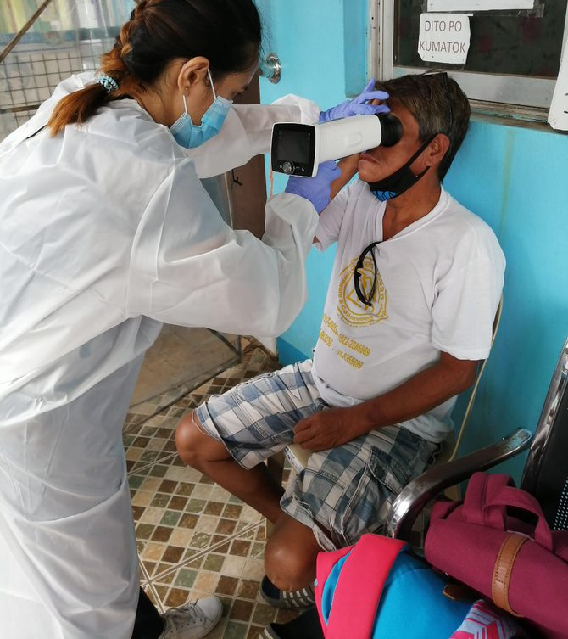
THE SOLUTIONS
A teleophthalmology eye evaluation involves taking photographs of the patient’s eyes in different community-based locations and sending these images to a central database.
The images are evaluated remotely at a reading centre by trained image graders who send the results back to the patient and their doctors.
If the team can perform teleophthalmology eye evaluations using mobile retinal cameras, they can overcome the geographical and practical challenges that exist in the Philippines.
REACH-DR staff taking retinal images using a mobile handheld camera

Slide 6
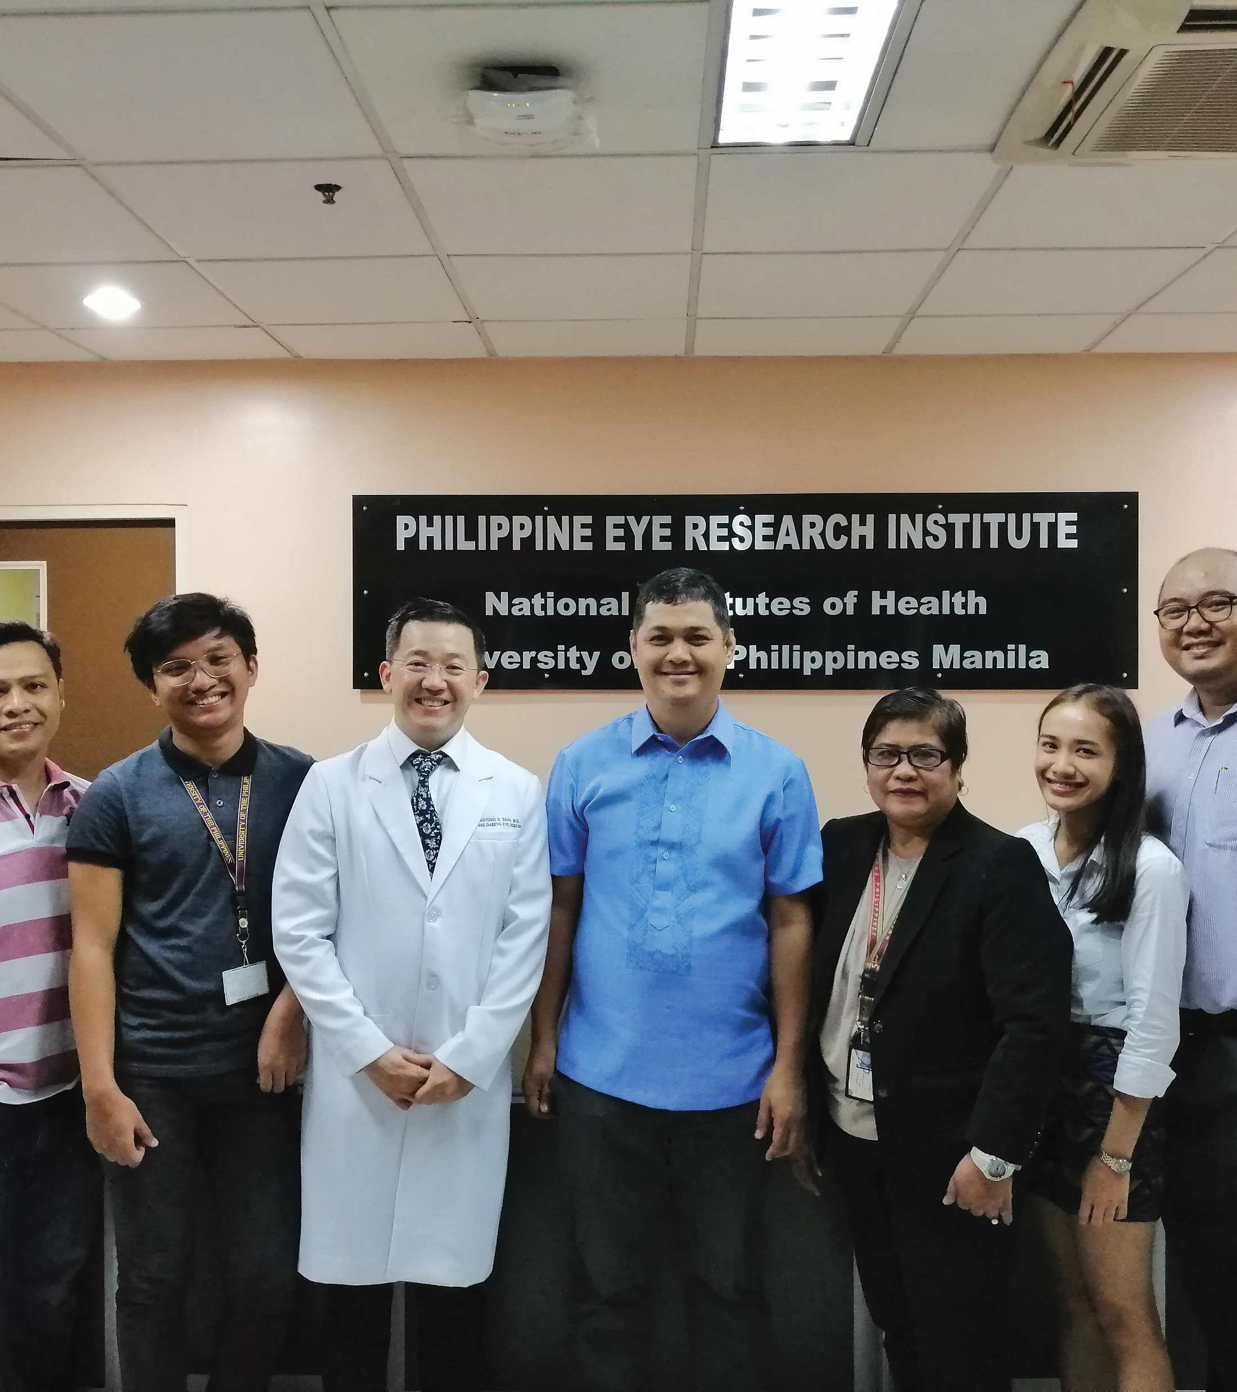
COLLABORATION
The UK national DESP is one of the most successful globally; the UK team now wants to share this success with the Philippines.
“The framework for the pilot DESP in the Philippines was developed using UK standards and best practices,” explains Tunde.
The UK team’s colleagues from the Philippine Eye Research Institute have been involved in the planning and delivery of all aspects of the project from the very beginning.
The two teams have been working together on the design of the programme, the delivery of the training and quality assurance, and thinking about how to include artificial intelligence in the screening programme.
The REACH-DR team from the Philippine Eye Research Institute including Dr Paolo Silva (in white blazer), the Philippine lead

Slide 7
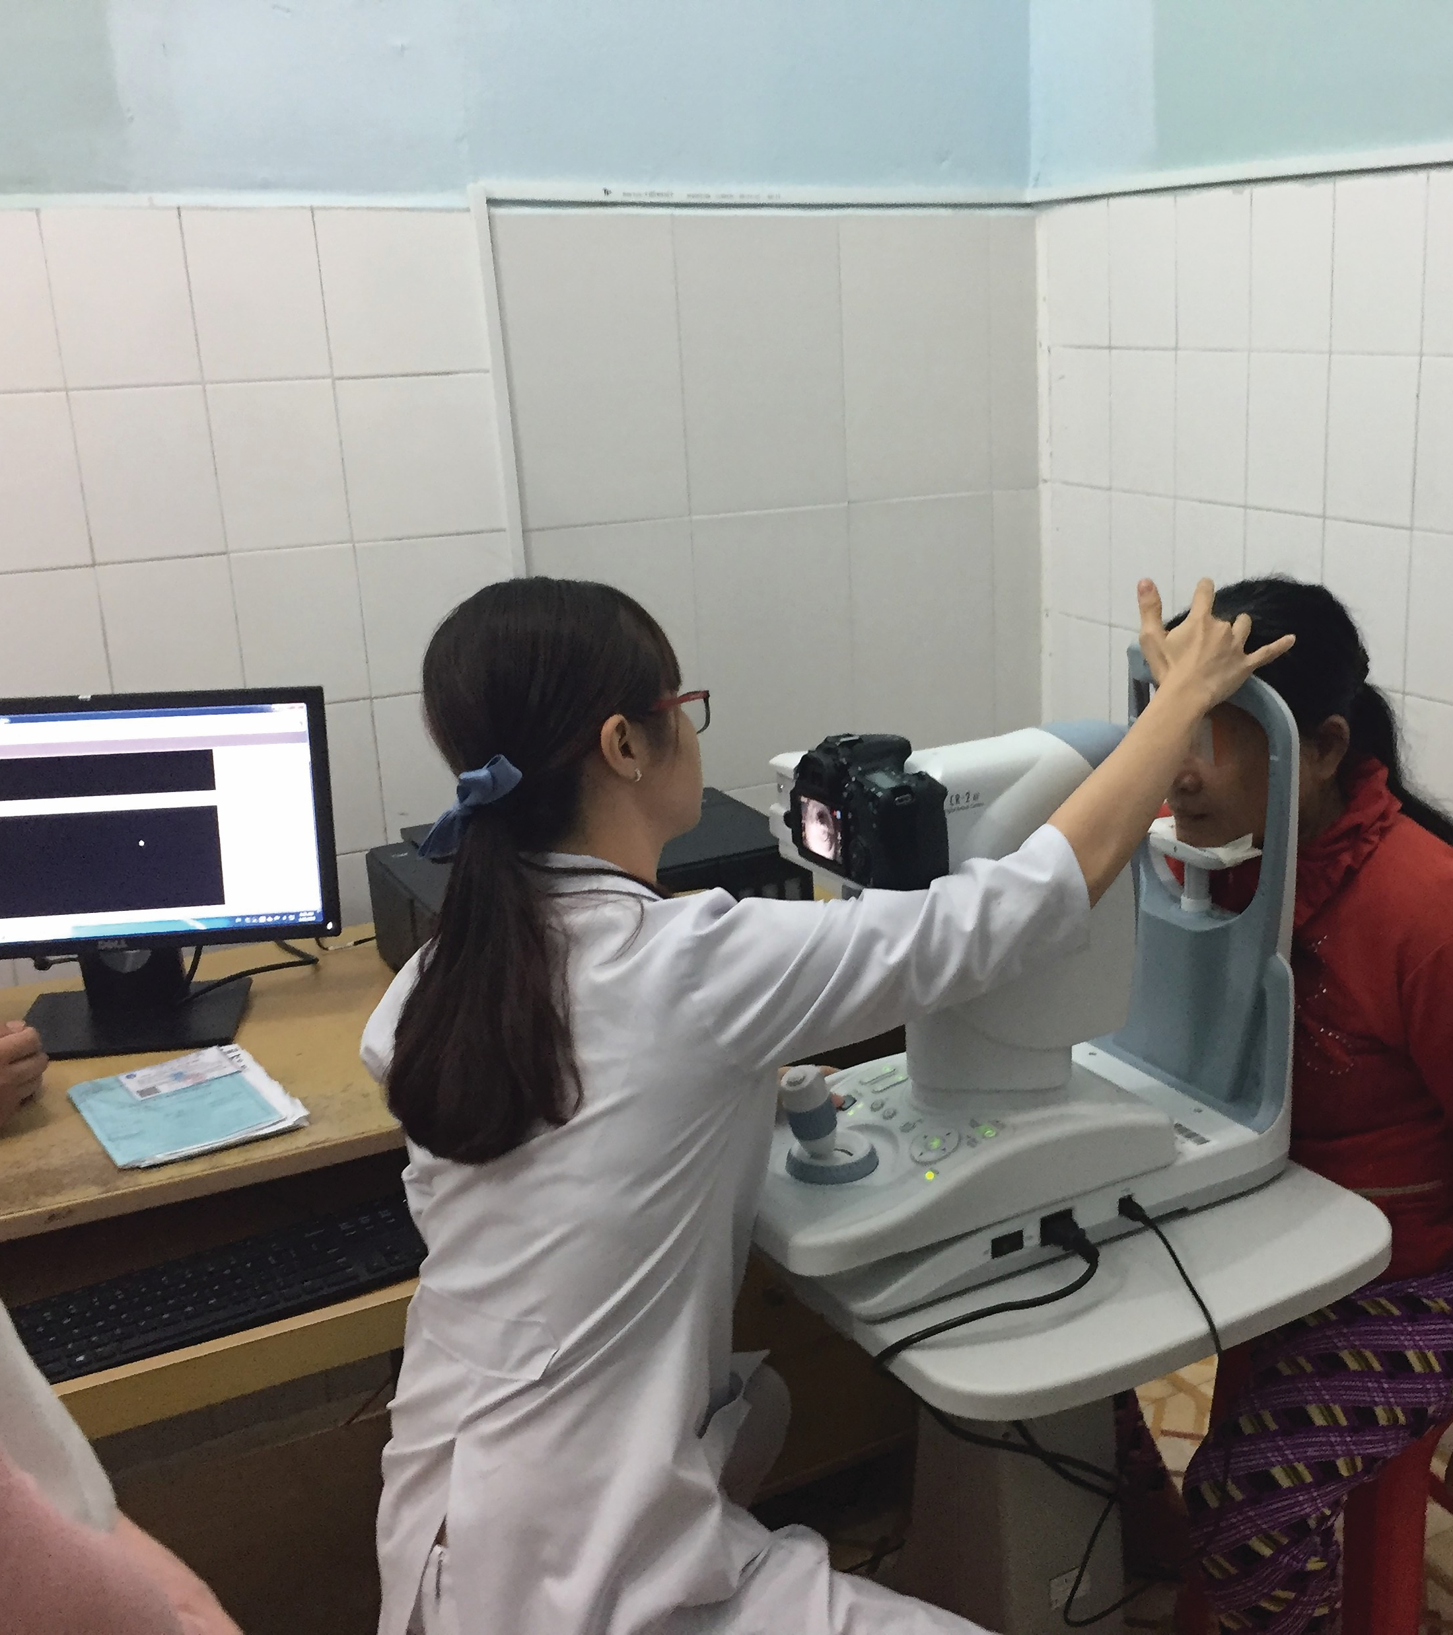
THE LONG-TERM
The goal of the REACH-DR project is that relevant decision makers in the Philippines will have policies in place to enable long-term funding of the DESP.
The Philippines is aiming to achieve a reduction of blindness from diabetic eye disease, mirroring the UK results.
The next steps of the project include presenting the results to the relevant stakeholders and applying for further funding.
The team will also need to train administrators, policymakers, AI-specialists and quality assurance personnel.
REACH-DR staff taking retinal images using a mobile handheld camera

Slide 8
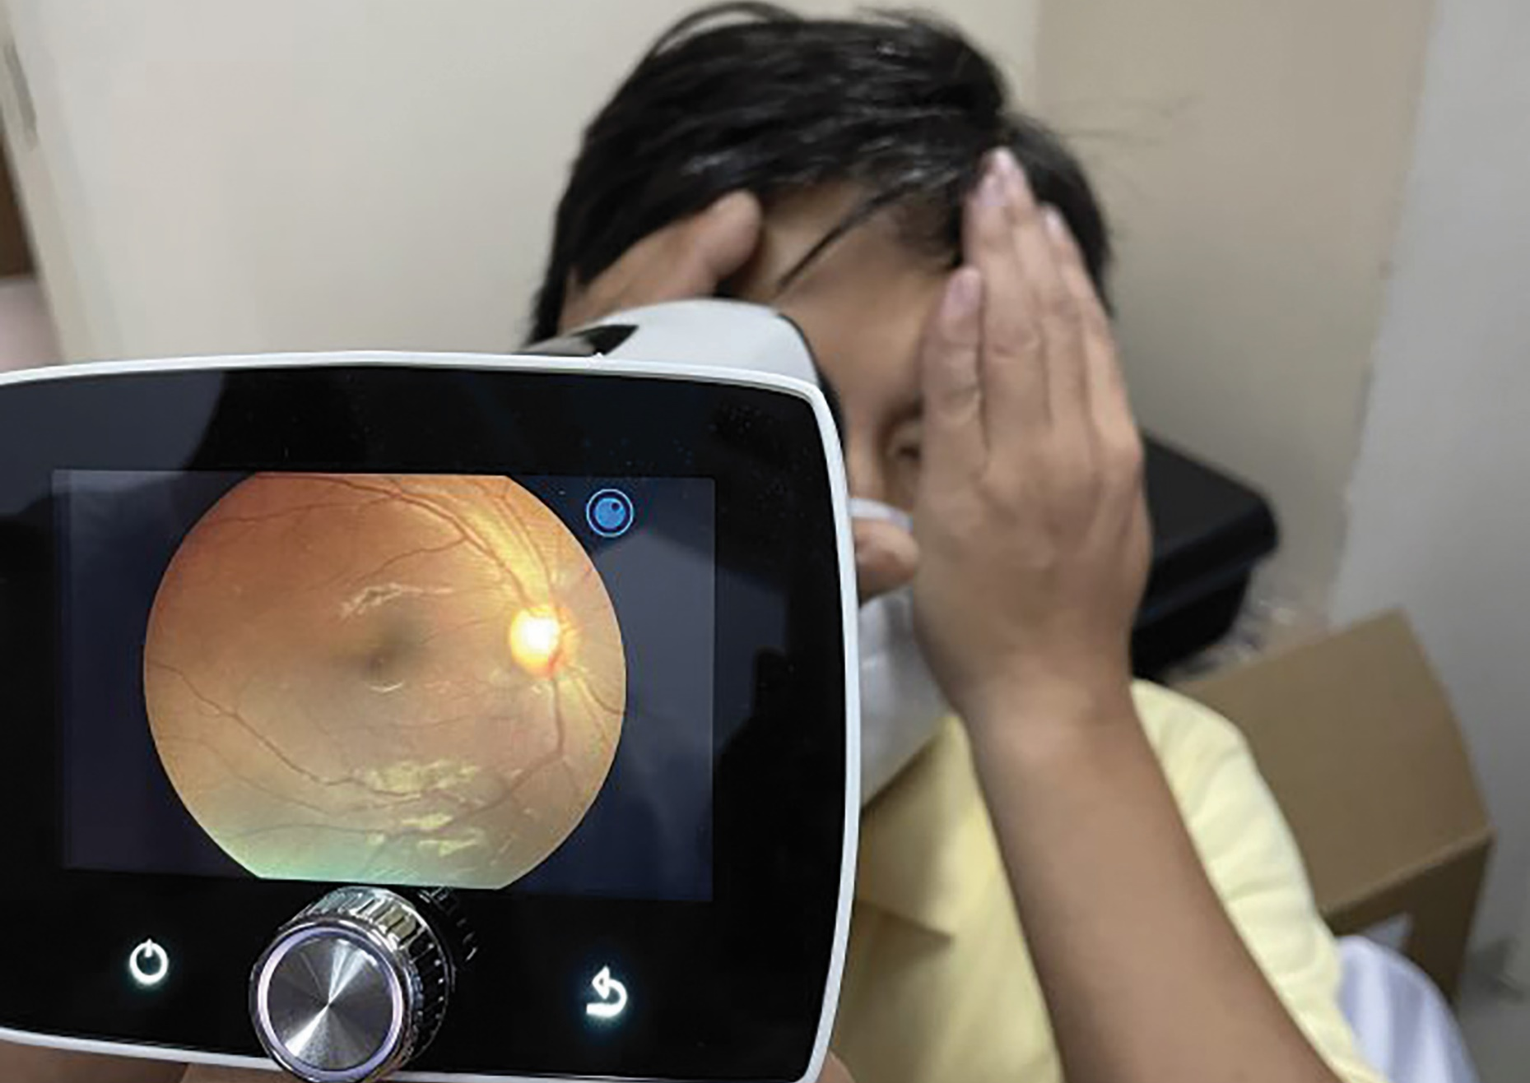
TALKING POINTS
How can diabetes lead to impaired vision?
Why are diabetic eye screening programmes (DESP) so important?
Why does the Philippines pose such a challenge for a national DESP?
How is teleophthalmology able to provide the solution?
Why is collaboration vital for the REACH-DR project? What does this collaboration involve?

Slide 9
ABOUT OPHTHALMOLOGY
Ophthalmology is a branch of medicine concerned with the diagnosis, treatment and prevention of diseases that affect the eyes and vision.
A vast number of people from medical and non-medical backgrounds work in ophthalmology – it is a diverse field that offers job opportunities for people with varying interests and capabilities.
For example, clinical professionals are involved in detecting and managing ocular disease.
Non-medical staff may be involved in screening for ocular pathology, capturing ocular images using different imaging modalities, and working with people with visual loss.
A photo of the retina showing changes related to diabetes. Note the red spots (haemorrhages) and yellowish dots (exudates) due to diabetic eye disease.

Slide 10
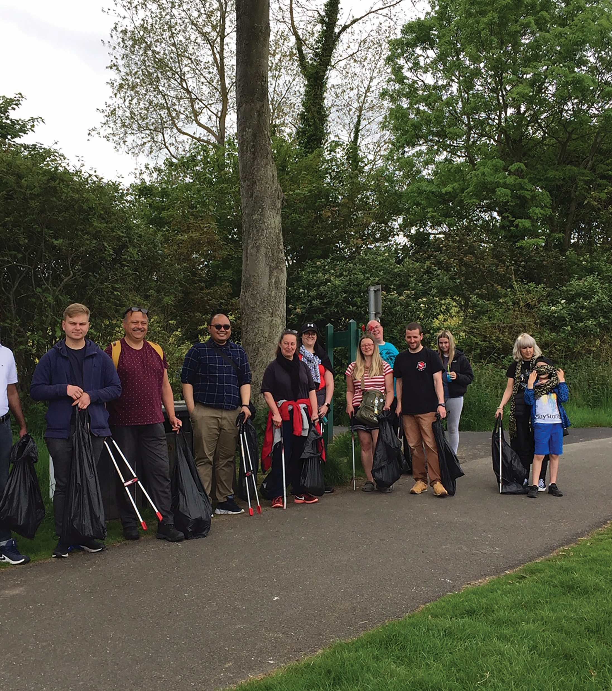
The next generation of ophthalmologists will face the challenge of examining and treating people with diabetic eye disease and other conditions such as age-related macular degeneration and refractive errors such as short and long-sightedness.
Good communication and interaction with patients are crucial. In the future, virtual clinics and artificial intelligence may mean that there is less in-person contact. A challenge will be how to use these technological advances while remaining empathic and communicating well with patients.
The teams involved in ophthalmology are varied – from administrators to IT personnel and technicians, and optometrists, nurses and doctors.
Being a good team-player will be vital for anyone entering the field.
Professor Tunde Peto and colleagues from Belfast during a team-building activity

Slide 11
EXPLORE CAREERS IN OPHTHALMOLOGY
• Tunde suggests you reach out to your local eye care professionals so you can personally discuss your ideas or questions about the field. It can also be very helpful to volunteer at an eye clinic to get a glimpse of what working in this field entails.
• The Royal College of Ophthalmologists’ website is an excellent resource for learning more about the subject.
• According to Prospects, the basic starting salary for junior hospital doctor trainees at foundation training level is £27,000 in the first year, rising to £32,000 in the second year.
REACH-DR staff in the Philippines test the visual acuity of a patient during community screening

Slide 12
PATHWAY FROM SCHOOL TO OPHTHALMOLOGY
Tunde recommends biomedical sciences, mathematics, statistics and data science in preparation for a career in ophthalmology.
“In the era of computerisation, big data and artificial intelligence, these subjects are very important,” she says. “However, we cannot forget that we work closely with people, many of them elderly and visually impaired, so being a good communicator is vitally important.”
You will also find people with backgrounds in social sciences, psychology and languages working in ophthalmology teams.
REACH-DR staff taking retinal images using a mobile handheld camera

Slide 13
TALKING POINTS
How would you explain ophthalmology to someone who had never heard of it?
What are some of the medical and non-medical roles in this field?
Why do you think ophthalmology involves such a huge range of roles?
What questions would you ask an eye care professional? Is there a clinic near you that you could ask about volunteering opportunities?
Of the subjects that Tunde mentions, which are you most confident in? Which areas do you need to focus your learning on?

Slide 14
MEET THE REACH-DR TEAM
As you read about each team member’s role, think about what you would enjoy about what they do, what interests you share with them and how you could develop the knowledge, skills and attributes they have.
What could you contribute to the field of ophthalmology?
Professor Tunde Peto and colleagues from Belfast during a team-building activity

Slide 15
PROFESSOR TUNDE PETO PRINCIPAL INVESTIGATOR
My role is to lead and manage the programme, enabling the Philippines to set up a sustainable model for diabetic eye screening programmes (DESPs). This will ensure knowledge transfer on all levels: from administration to the screening process, to providing treatment.
I have been committed to studying and treating chronic eye disease since completing my medical degree. After finishing my PhD and ophthalmology training, I moved to Moorfields Eye Hospital in London, focusing on diabetes-related complications. I am now Professor of Clinical Ophthalmology at Queen’s University Belfast (QUB) and have worked on many large population studies and multi-centre clinical trials while remaining a practicing ophthalmologist.
As the clinical lead for the Diabetic Eye Screening Programme in Northern Ireland, I have been involved with the UK’s National Diabetic Retinopathy Screening Programme. Finding and treating patients early in the disease process reduces the rate of diabetes-related visual loss, but is expensive, which is where telemedicine can step in.

Slide 16
I always wanted to pursue science and I loved both the regular human contact and long-term relationships with patients with chronic diseases. This, along with the surgical challenge, makes ophthalmology perfect for me. I love that it involves maths, science, technology, statistics, surgery and lots of communication with patients, their family and their carers.
One of my main motivations is the importance of collaboration and a joined-up approach to research. I work with large teams involving not only those working in eye-care, but also in healthy ageing and dementia care. These are new frontiers and I never stop learning.
Not giving up and being open minded have made me successful. It is important to never look down on anyone and to be appreciative of help.
I have been involved in a number of international developmental activities, such as being part of the team for the Queen’s Diamond Jubilee Trust Fund’s Diabetic Eye Screening in the Commonwealth. Our work will leave a lasting legacy in the countries involved.
TUNDE’S TOP TIPS
1. Always listen, know yourself and your limitations but use your skills to the best of your ability.
2. Sometimes life presents opportunities you never knew existed, so keep your eyes open!
3. Be pro-active in learning and work in different teams and cultures if you can; these experiences will always teach you something new.

Slide 17
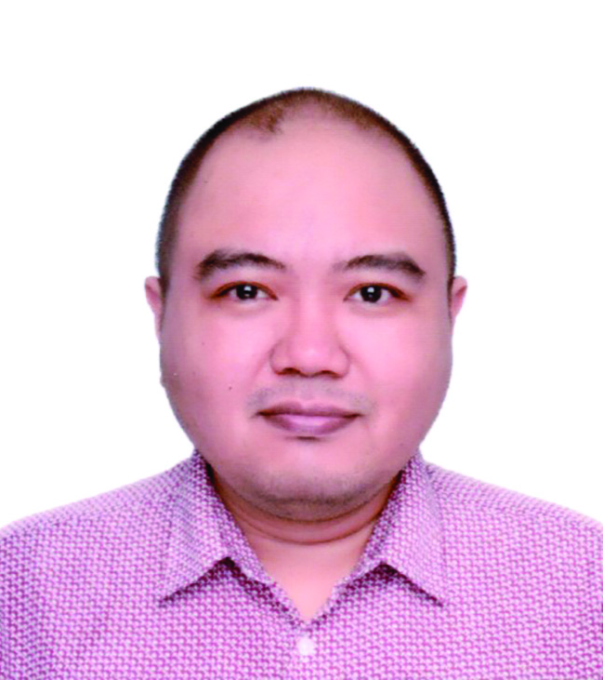
DR RECIVALL SALONGCAY RESEARCH OPHTHALMOLOGIST
I am responsible for the planning and delivery of REACH-DR related research activities so the objectives of the project are met including liaising between the UK and the Philippine teams. I also assist Tunde with preparing reports for scientific journals, conferences and funders.
In Manila, I was a consultant ophthalmologist, specialising in retinal diseases, and a research scientist, where most of my work revolved around retinal imaging for diabetic retinopathy. I knew a research fellowship at QUB would be a good opportunity for me to learn from and collaborate with renowned experts in my field.
I always wanted to become a medical doctor; growing up I was always interested in the biological sciences. My other interests included music, books and anime.
As a trainee in ophthalmology, I realised I also wanted to pursue a career in research; I would often have questions about how we can better diagnose and treat patients with eye conditions, and how these potentially blinding diseases can be prevented.

Slide 18
I worked with some amazing mentors and collaborators who inspired me to pursue this career path. I learned more about teleophthalmology and diabetic retinopathy screening while working at the Philippine Eye Research Institute, and I realised that something needed to be done on a national level.
I am motivated by helping people who suffer from blinding retinal diseases and by being around individuals who share the same passion for ophthalmology and vision science as I have.
Resilience has really helped me in my career. In a clinician-scientist’s career, we encounter many setbacks and rejections – from unsuccessful study grant applications to a research experiment not producing the desired outcome – but we cannot let these derail us or make us lose focus on our goals. We need to accept these setbacks and move on, using them to inform our future decisions.
Being offered my current post at QUB is one of my proudest achievements, not only because of the wealth of opportunities that this has brought me but because I know that the work we are doing is meaningful and will make an impact on the millions of people with diabetes in my home country.
RECIVALL’S TOP TIPS
1. It is never too late or too early to become involved in science.
2. It will take time to gain expertise in your chosen scientific field, so keep that in mind when you start out and remain patient!
3. Ask questions and start searching for the answers.

Slide 19
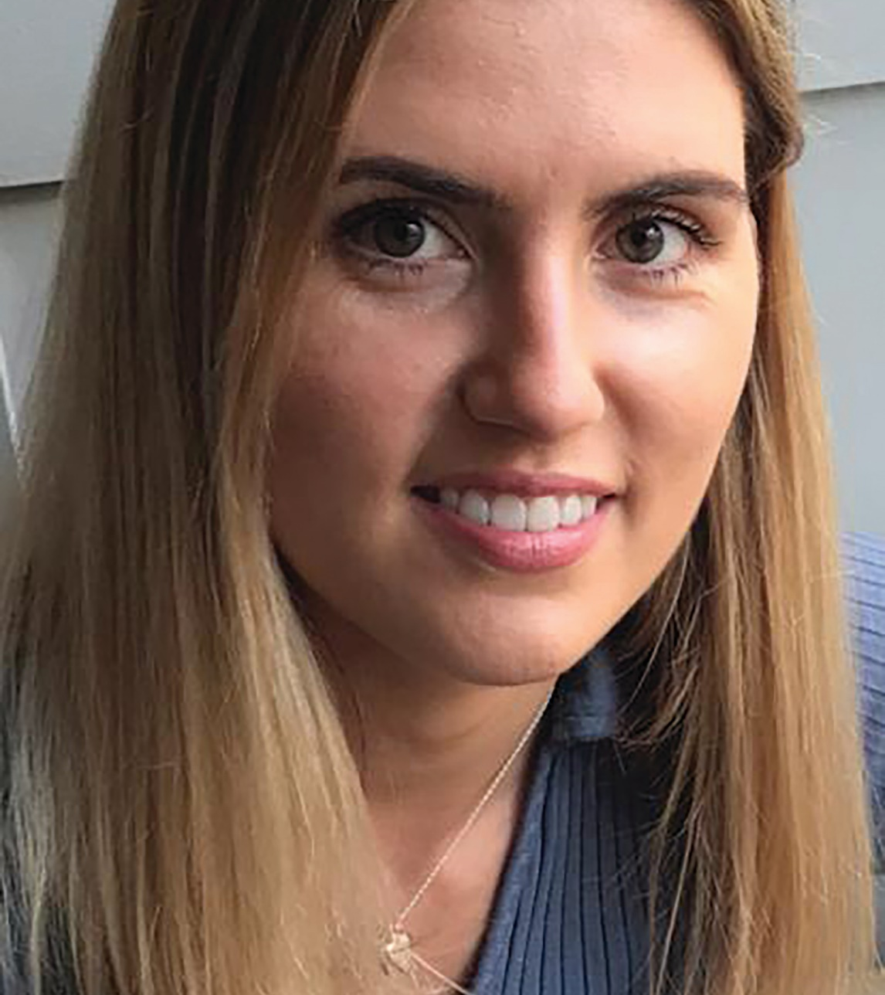
DR KATIE CURRAN RESEARCH OPTOMETRIST
Part of my role in the Queen’s University Belfast team is to ensure transfer of learning. I am delighted to help strengthen the REACH-DR programme with my expertise.
During my PhD, I worked in Vietnam and Bangladesh where most of my work focused on strengthening diabetic retinopathy services. I recently embarked in a role as a Wellcome Trust research fellow at QUB and continue to work on retinal diseases.
I always had a keen interest in science subjects in school and always wanted to work as a healthcare professional. My uncle lost his sight at a young age, and I completed my work experience in an optician’s when I was 16. Following my work experience, I was keen to pursue a career in optometry.
After four years working as an optometrist, I decided to take a career break to explore South-East Asia. Although I enjoyed working as an optometrist, I wanted a career that would offer some flexibility and allow me to be involved in eye care research. I completed a master’s in public health and a PhD at QUB which gave the opportunity to pursue a career in academia, whilst maintaining my role as an optometrist on a part-time basis. This enables me to interact with patients and conduct research in my area of interest.

Slide 20
I have been extremely lucky to work with successful and motivational people throughout my career. Tunde provides guidance and support to me to become a successful academic whilst building on my experience as an optometrist. Her expertise as a professor and ophthalmologist is invaluable for me.
One of my main attributes that has helped me is my dedication to work. If I set out to achieve a goal, I work hard to ensure I reach that goal.
My proudest career achievement so far is completing my PhD and having the opportunity to work with international collaborators, particularly in low-middle income countries.
KATIE’S TOP TIPS
1. Developing a career that you are happy and satisfied with can take time, so be patient.
2. Many job opportunities are available, and it is important to research these carefully and seek advice from the right people.
3. We will all encounter rejections at some point in our careers and it is crucial to learn and develop from these.

Slide 21
TALKING POINTS
What motivates Tunde, Recivall and Katie in their work?
Tunde mentions she has worked on a range of international projects. How do you think it feels to contribute to such development?
Recivall explains why resilience is so important. When did you last have to be resilient? How could you develop this trait further?
Katie refers to working with motivational people. Who motivates you? How could you help motivate others?
Which of the team’s top tips are most useful for you and why?

Slide 22
Dig deeper into the team’s research.
Download their activity sheet.

