Slide 1
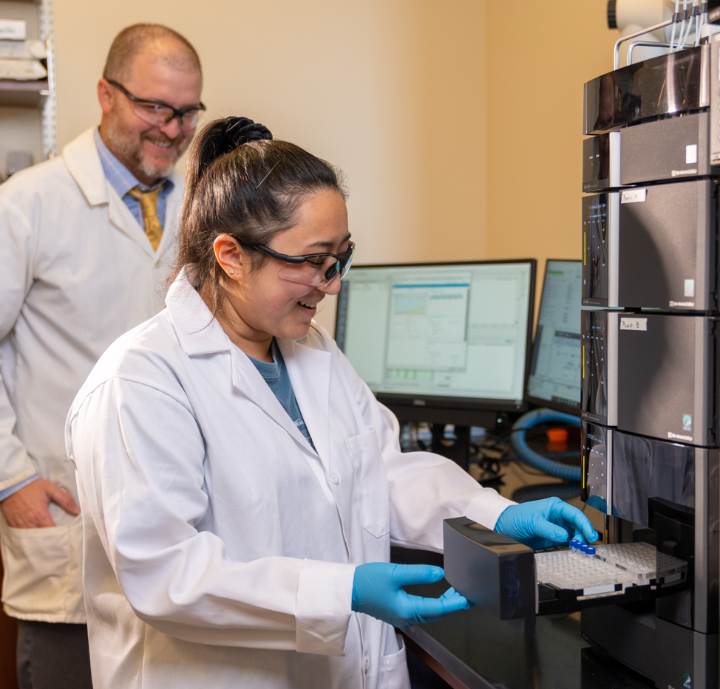
Analytical Chemistry
Dr Ron Quinlan
GET STARTED
www.futurumcareers.com

Slide 2
In this presentation:
Meet Ron
The chemistry of beer
Talking points
About analytical chemistry
Careers in analytical chemistry
Ron’s story
Talking points
More resources
02 futurumcareers.com

Slide 3
Meet Ron
Dr Ron Quinlan is an analytical chemist at Christopher Newport University in the US.
Along with a team of students and local brewers, he is using analytical techniques to uncover the chemistry of beer.
Ron hopes to demonstrate the real-world applications of analytical chemistry by helping brewers create the perfect pint!
Dr Ron Quinlan
03 futurumcareers.com

Slide 4
What is beer made from?
Beer contains four key ingredients: malt, hops, yeast and water.
Malt creates the beer’s colour and provides the sugars (glucose) which the yeast converts into alcohol (ethanol) and carbon dioxide during fermentation:
C₆H₁₂O₆ → 2C₂H₅OH + 2CO₂
Malt and hops contribute to the beer’s flavour. They also contain vitamins, essential oils and acids which provide health benefits.
“Different combinations of these compounds can lead to designed changes in the beer’s bitterness, aroma and taste.”
– Kevin Kingsbury, Head Brewer at Tradition Brewing
04 futurumcareers.com

Slide 5
The impacts of climate change
A beer’s flavour depends on the chemistry of the malt, hops and water used to produce it, and the chemical changes that occur during fermentation.
The specific chemical compounds in malt and hops depend on the environment in which they are grown. As climate change changes the growing conditions of malt and hops, the flavours of beers are also changing.
“Changing the environmental conditions changes the chemical ratios within the same plant species. And changing the ratios of the chemicals in beer results in changes in the flavour.”
– Ron
05 futurumcareers.com

Slide 6
Chemical analysis of beer
Ron and the team are combining two analytical techniques, liquid chromatography and mass spectrometry, to determine the chemical composition of beer and beer ingredients.
Liquid chromatography separates a liquid sample into its chemical components, then mass spectrometry analyses each individual component and identifies what chemical compounds it contains.
The team uses these techniques to determine which compounds are produced by the hops and malt before they go into the beer, then tracks how the compounds change through the brewing process.
Celina loads hop samples into the liquid chromatograph
06 futurumcareers.com

Slide 7
“When we put the two techniques of liquid chromatography and mass spectrometry together, we can determine which compounds are present in the beer with very high accuracy and precision.”
– Celina Paoletta, student
“Tracking the compounds through the brewing process and into the finished beer allows us to discover previously unidentified chemical reactions taking place during the brewing process.”
– Chris Balog, student
Jameson analyses data collected using the liquid chromatography mass spectrometer
07 futurumcareers.com

Slide 8
“This research is exciting because we’re just beginning to understand how the growing environment of malt and hops influences the flavour of beer.”
– Ron
“What we do know is that growing the same species of hop in different environments, then brewing them with the same recipe into beer, will result in slightly different beer chemistry and, therefore, different tastes.”
– Kevin
The team is now trying to determine how chemical reactions during the brewing process cause these changes.
Kevin works with students Bryan and
Jameson in the brewery
08 futurumcareers.com

Slide 9
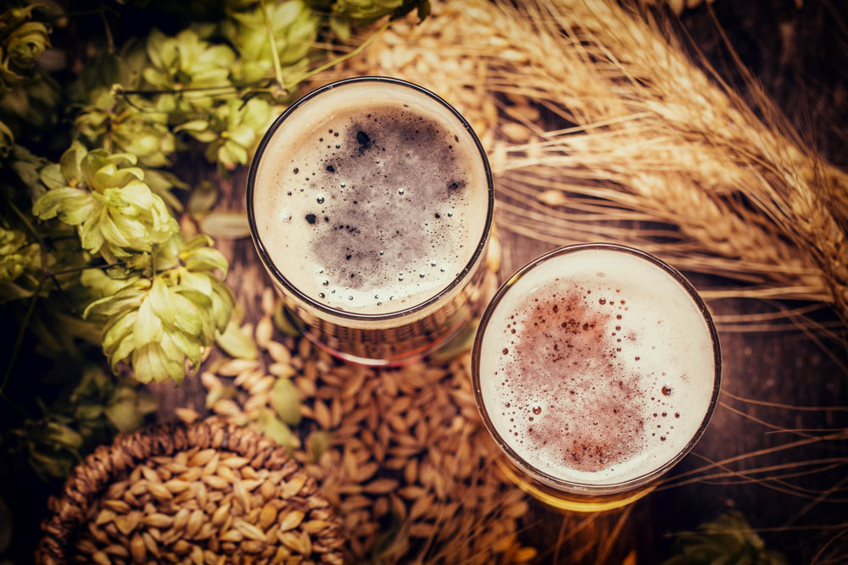
Talking points
What role does malt play in beer?
What chemical reaction occurs during fermentation?
How does the combination of liquid chromatography and mass spectrometry help Ron’s team investigate the chemistry of beer?
Why is climate change causing the flavour of beers to change?
As climate change continues, how could this research help malt and hop farmers?
As climate change continues, how could this research help brewers, such as Kevin?
09 futurumcareers.com

Slide 10
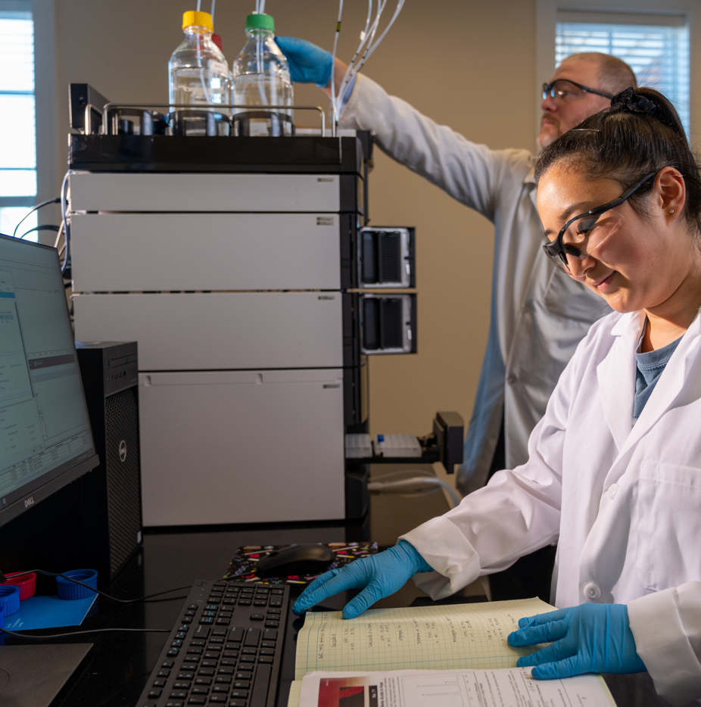
About analytical chemistry
Analytical chemistry is the study of how matter interacts and behaves as it undergoes chemical analysis.
While chemical analysis aims to determine what matter is made up of, analytical chemistry is focused on the methods that are used to do this, such as liquid chromatography and mass spectrometry.
10 futurumcareers.com
Ron and Celina use liquid chromatography and mass spectrometry to analyse samples of hops

Slide 11
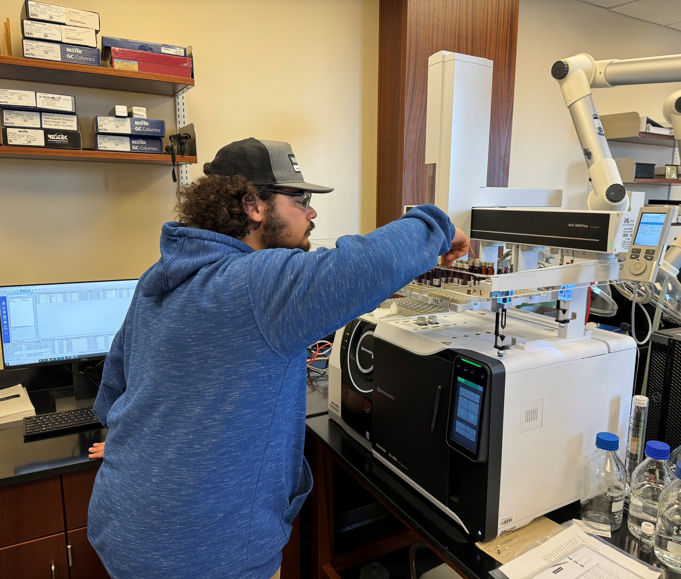
What do analytical chemists do?
“Analytical chemists seek to find and correct errors in current methods of analysing chemical compounds, and to discover new analytical chemistry techniques.
– Ron
Analytical chemists often repeat an analysis multiple times with slightly different volumes of the sample to discover how this impacts the results. Or they might perform the same analysis again and again to calculate the reproducibility of the method.
Therefore, analytical chemists must have patience, good attention to detail and an ability to work precisely and accurately.
Bryan loads samples into a gas chromatography mass spectrometer, which separates gases into their chemical components
11 futurumcareers.com

Slide 12
Applications of analytical chemistry
Through his beer chemistry research project, Ron is keen to highlight the real-world applications of analytical chemistry.
Collaborating with Tradition Brewing, a local brewery, means students gain practical experience of applying their analytical chemistry knowledge to address real-world challenges facing the beer industry.
“Analytical chemistry is applicable to every other science. Do you want to study organic chemistry, pharmaceuticals, cellular metabolism or neurological disorders? For all of these, you need an analytical chemist to make your measurements.”
– Ron
12 futurumcareers.com
Ron and Chris celebrate the successful defence of Chris’ master’s thesis

Slide 13
Pathway from school to analytical chemistry
At school and beyond, studying chemistry is crucial for learning the theory behind chemical compounds and reactions and the practical methods of chemical analysis.
A strong background in mathematics is also important for statistically analysing data.
Biology and physics will provide background knowledge for many applications of analytical chemistry.
13 futurumcareers.com

Slide 14
Take part in chemistry events and competitions, such as science fairs and chemistry olympiads, to gain hands-on chemistry experience.
Practical experience in a chemistry laboratory will be incredibly valuable. Look for internships with chemistry-based industries and for opportunities to volunteer in research labs.
When studying chemistry at university, take as many laboratory classes as you can.
“Studying analytical chemistry fosters critical thinking and problem-solving skills. It also teaches you how to ask better questions and how to fail forward, and you get to learn more about the world in the process.”
– Celina
14 futurumcareers.com

Slide 15
Explore careers in analytical chemistry
“The career opportunities as an analytical chemist are endless.”
– Ron
In addition to helping brewers develop tastier beer, you could apply your skills in fields such as water quality monitoring, environmental assessment, pharmaceutical development, chemical production and food science.
The American Chemical Society and the Royal Society of Chemists have a wealth of educational and careers resources for students.
15 futurumcareers.com

Slide 16
Meet Ron
My father is a chemist, so I spent a lot of time in a lab when I was growing up. We were always having fun with science projects.
For many years, I dreamt of being a medical doctor, but after just a couple of weeks in college, I changed my mind and switched my focus to chemistry.
During my undergraduate degree, I participated in a summer research project with one of my professors, which is when I decided I wanted to become a chemist. Once I got the research bug, I was hooked!
16 futurumcareers.com

Slide 17
After finishing my PhD, I spent four years working in research and development for the US Navy, where I helped develop lithium-ion batteries. I characterised the chemistry of the materials used to make the battery electrodes and examined whether they degraded over time as the battery was repeatedly used and recharged.
I started the beer research because I wanted an engaging project to get my chemistry undergraduate students interested in analytical chemistry. Studying beer is a great way to learn about and apply analytical chemistry. And, of course, beer makes the research taste better!
17 futurumcareers.com

Slide 18
Talking points
What is the difference between chemical analysis and analytical chemistry?
What applications do you think analytical chemistry has in water quality monitoring, pharmaceutical production and food science?
What other industries do you think analytical chemists work in, and why?
To what extent do you have the skills needed by analytical chemists? How could you develop these skills further?
How could you gain practical chemistry experience? What chemistry events could you participate in? Are there any research facilities or chemistry-based industries near you that offer outreach opportunities?
18 futurumcareers.com

Slide 19
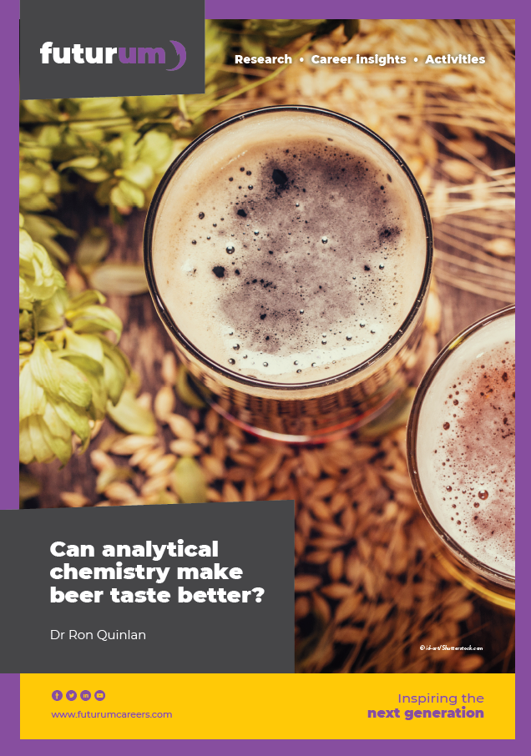
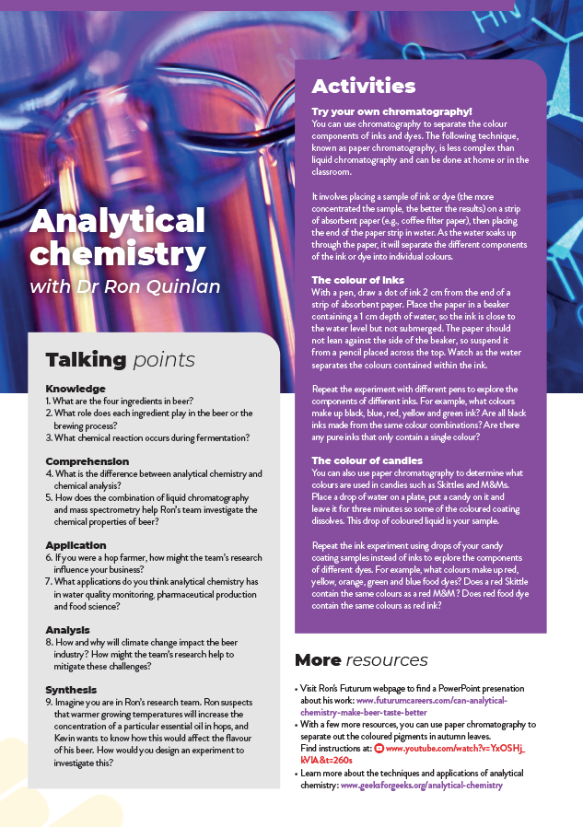
Resources
Try your own chromatography experiment!
Download Ron’s article
02
Download the activity sheet
01
19 futurumcareers.com

