Slide 1
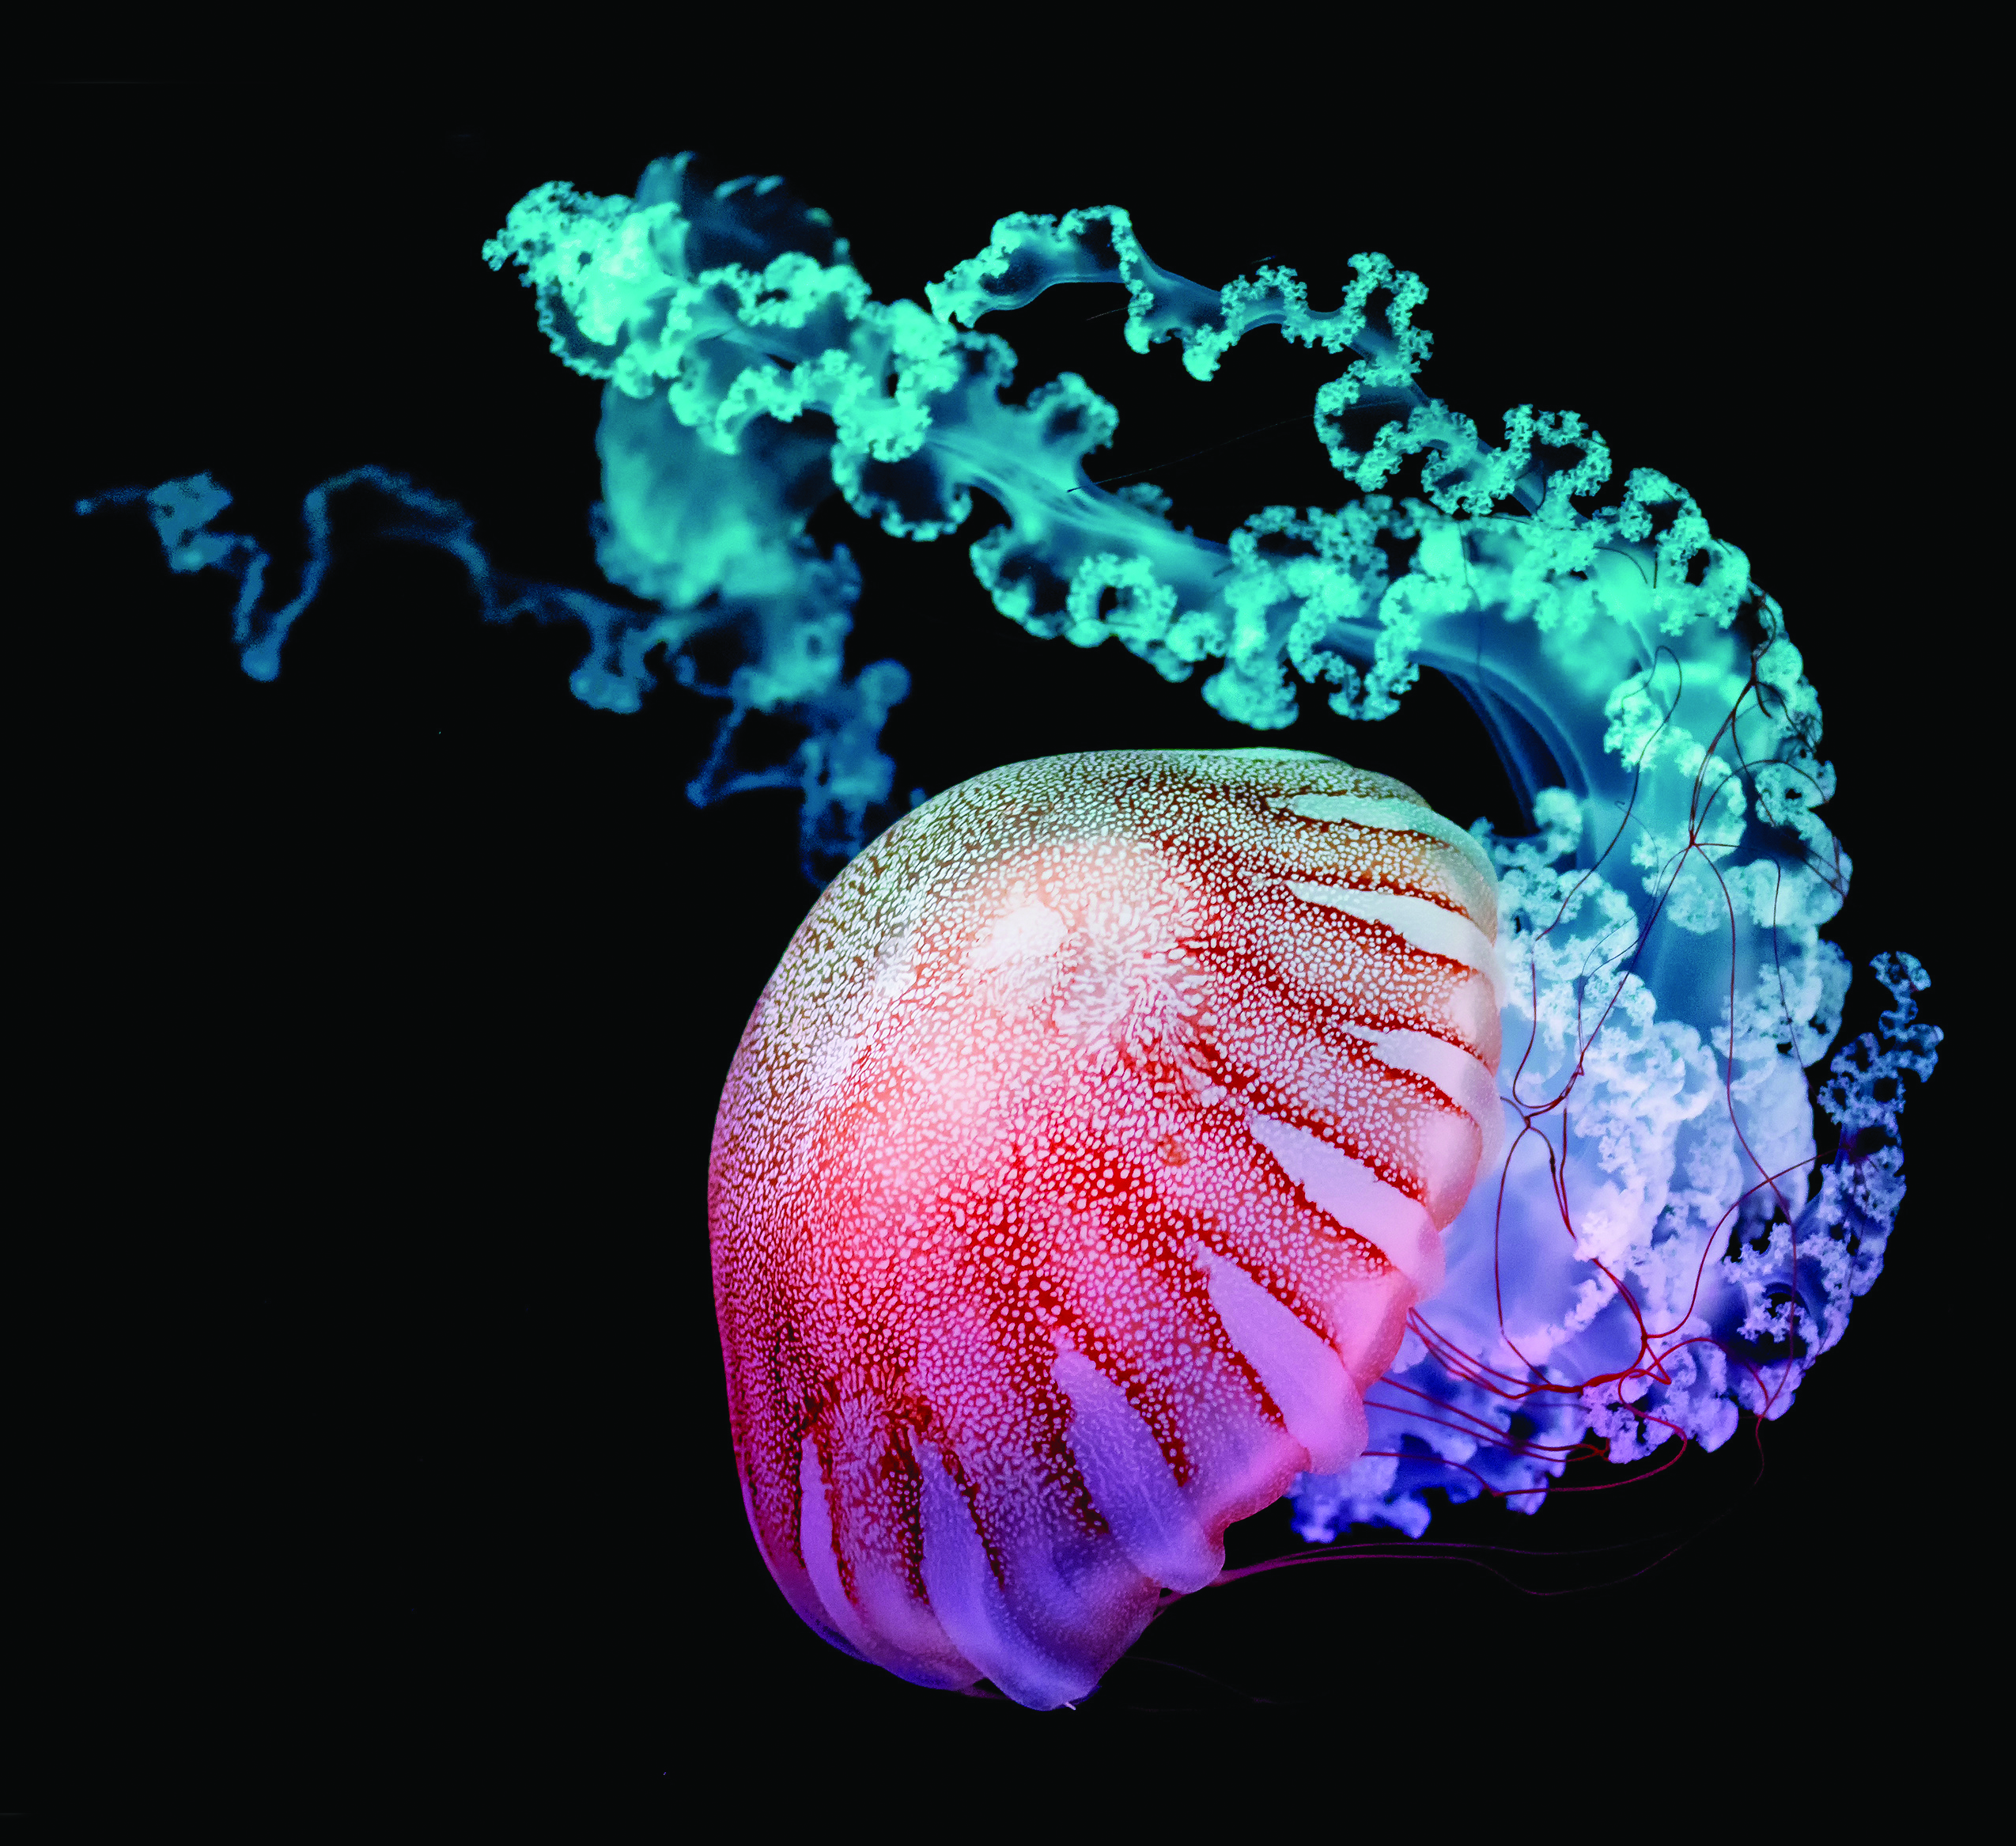
MARINE BIOLOGY
WITH DR SEAN COLIN

Slide 2
MEET SEAN
DR SEAN COLIN is a marine biologist working at the Roger Williams University in Rhode Island, US.
He has been investigating the mechanisms that jellyfish and ctenophores use to propel themselves through the water, and how this influences their feeding behaviour.
Let’s find out more about his research…

Slide 3
JELLYFISH AND CTENOPHORES
Among all of the creatures in our oceans, few are more ancient or mysterious than jellyfish and ctenophores.
First appearing over 500 million years ago, ctenophores swim through water by waving tiny, hair-like protrusions on their cells, named ‘cilia.’
Jellyfish, also called ‘jellies,’ evolved at around the same time, but use completely different strategies to move around; in fact, they were the first animals to move using muscle-powered swimming.
Incredibly, the muscle layer they use to swim is just one cell thick, making them extremely weak. Because of this, jellies needed to evolve highly efficient ways to propel themselves through water.

Slide 4
HOW DO JELLYFISH SWIM?
Fluorescein dye around a swimming Aurelia sp. showing the vortices created in the wake of the swimming jellyfish
Jellyfish propel themselves by contracting their umbrella-shaped bells.
In small jellies, this causes water to rapidly squirt out of the bell, generating enough force for them to dart around using jet propulsion.
Previously, biologists thought that all jellyfish swam in this way. However, for animals with bells larger than 5 centimetres in diameter, the water volumes they hold become far too heavy for weak jellyfish muscles to expel them quickly.
Sean was first faced with this biomechanical mystery early on in his career and he has studied it extensively ever since.

Slide 5
HOW DID SEAN SOLVE THIS BIOMECHANICAL MYSTERY?
Biomechanics is the study of the physical motions and structures used by living organisms.
To study jellyfish and ctenophore motion and feeding, Sean and his team used:
Videos of jellyfish and ctenophores in captivity to see how they interacted with water and prey
Cutting-edge techniques in SCUBA diving to capture the behaviour of wild jellies and ctenophores
Remotely-operated submarines in deeper water
A robotic jellyfish that they designed with a team of engineers. By tweaking the design of its bell to efficiently propel itself forwards, they could learn a lot about the biomechanics used by real jellyfish.
The particles in a red laser sheet show the flow around a ctenophore

Slide 6
JELLYFISH SHAPES
The shapes of jellyfish bells can vary widely, depending on their sizes.
Small jellyfish have more elongated, torpedo-shaped ‘prolate’ bells, which help them to jet through water.
Larger jellyfish have flatter, plate-shaped ‘oblate’ bells.
As Sean’s team has discovered, these animals have evolved a completely different way of moving.
The scyphomedusae Aurelia aurita that can be found all around the world

Slide 7
SWIMMING MECHANISMS
An oblate jellyfish will start by slowly contracting its bell. This causes the flexible circular margin at the bottom of the bell to suddenly flair out, like the skirt of a twirling dancer. This margin acts like a flappy oar, pushing water away from the outer edge of the bell, creating a large region of negative pressure in front of the jellyfish. The bell will move to compensate for this pressure deficit, and the entire jellyfish is propelled forwards.
Sean and his colleagues have dubbed this behaviour ‘rowing propulsion.’ The speed it provides may be slow, but since the motion requires such little muscle power, the researchers have shown it to be one of the most efficient swimming mechanisms in the animal kingdom.

Slide 8
FEEDING MECHANISMS – SMALL JELLYFISH
Sean’s work has revealed that jellyfish use jetting and rowing for completely different processes.
For smaller jellies with prolate bells, an effective hunting strategy is to sit still inside a nutritious water current, with their stinging tentacles extended. When a predator comes along, or if the current becomes depleted of food options, the jellyfish can then rapidly dart away and reposition itself, allowing it to maximise the time spent feeding.
This behaviour has had a big impact on the evolution of their tentacles. The size and type of their prey depends on the spacing between their tentacles, and the number and type of stinging cells they contain.

Slide 9
FEEDING MECHANISMS – LARGE JELLYFISH
In contrast, larger oblate-shaped rowing jellies are moving constantly. They use their own swimming motions to generate nutritious water currents, which they pull and circulate through their tentacles.
The capture surfaces have a significant impact on how these jellies interact with the surrounding water.
In Semaeostomes (an order including Lion’s Mane and Sea Nettle jellyfish) long, frilly tentacles are used to capture large plankton and fish larvae.
Rhizostomes (an order including Cannonball and Barrel jellyfish) do not have tentacles at all. Instead, they use oral feeding disks featuring large clusters of cilia, allowing them to filter for far smaller prey.

Slide 10
FEEDING MECHANISMS – CTENOPHORES
Ctenophores may have evolved at around the same time as jellyfish, but they use completely different strategies to capture prey.
By waving the fused cilia on their bodies, they move water slowly past their sensory structures. This allows them to scan the surrounding water and divert any nutrients towards their tentacles.
The ctenophore Mnemiopsis leidyi, found all around the Atlantic ocean

Slide 11
Talking points
When did jellyfish and ctenophores first evolve?
Why do jellyfish swimming motions need to be so efficient?
What methods did Sean use to study jellyfish biomechanics?
What impact does a jellyfish’s size and shape have on its swimming mechanism?
Can you describe and explain the differences in swimming mechanisms between small jellyfish, large jellyfish and ctenophores?
How do these differences in swimming mechanism result in differences in feeding mechanisms?

Slide 12
ABOUT MARINE BIOLOGY
Marine biologists have a passion for the natural world and the mysteries it holds. They use a broad range of problem-solving skills to understand how organisms and ocean-based ecosystems function.
Researchers collect and analyse data, and then communicate their findings. If a scientist is truly passionate about their work, each of these steps can be fun and rewarding.
Sean’s job allows him to develop a diverse variety of skillsets, including teaching, SCUBA diving, videography, computer analysis, and writing.
Perhaps most importantly, marine biologists are at the front line of efforts to solve the many problems now facing the natural world.
Sean, diving with an in situ video system used to examine the feeding behaviour of ctenophores and jellyfish

Slide 13
EXPLORE A CAREER IN MARINE BIOLOGY
The Roger Williams University offers several outreach schemes. These include a week-long Marine Biology Camp each summer, which gives high school students opportunities to experience research both in the lab and the field.
Look here for more information about how to start a career in environmental science, and several university courses currently available in the US.
Elsewhere, university courses in many subjects related to marine biology and environmental science are widely available worldwide.
The average annual salary of an environmental scientist in the US is around $64,000.

Slide 14
PATHWAY FROM SCHOOL TO MARINE BIOLOGY
Sean recommends that students should gain a strong foundation in the sciences as a whole.
Branching into a specific area of environmental science like marine biology would not necessarily involve studying marine biology at college or university. If a student has a strong background in biology, they will be able to specialise more easily in graduate school.

Slide 15
Talking points
If you were a marine biologist, which aspect of ocean-based ecosystems would you most like to study? Why?
Which of the skills required for Sean’s job would you most like to have?
How do you think high school students benefit from attending the Marine Biology Camp at Roger Williams University?
If you want to become a marine biologist, why do you think it is not necessary to initially specialise in marine biology when you start at college or university?

Slide 16
HOW DID SEAN BECOME A MARINE BIOLOGIST?
What were your interests as a youngster?
I enjoyed sports, being on the water and the outdoors. I always had a particular interest in animals and the water.
Who or what inspired you to become a scientist?
I was first inspired to become a scientist on a trip I made to the Bahamas as a child. On that trip, I snorkelled through the coral reefs just off the beach where we were visiting. I think it was that trip that initiated my desire to become a marine scientist.
Since then, working with scientists who truly love doing science and discovering things about animals has been a continual inspiration throughout my career.

Slide 17
HOW DID SEAN BECOME A MARINE BIOLOGIST?
What attributes have made you successful as a scientist?
I think being observant (the basis of scientific discovery), persistent and creative (needed to translate observations into quantitative scientific knowledge), and having a strong intuition about how things work have all been important attributes that have contributed to my success.
How do you overcome obstacles in your work?
Persistence and creativity are critical to overcome challenges and obstacles. But collaborating with great scientists also helps a lot.

Slide 18
SEAN’S TOP TIPS
Pursue areas of study that you are truly interested in and enjoy.
Achieving necessary degrees and having a career in the sciences requires students to endure tough courses and experiences, which are not always fun.
Achieving success and getting a job requires persistence – and that is much easier to have when you are working for something that you really enjoy.

Slide 19
Talking points
How did Sean’s childhood experiences contribute to his career path?
Sean gains inspiration from scientists working around him. Who do you know who inspires you?
Which of Sean’s personal attributes do you have, and how could you develop those you do not have?
What do you enjoy? How could you develop your interest into a career path?

Slide 20
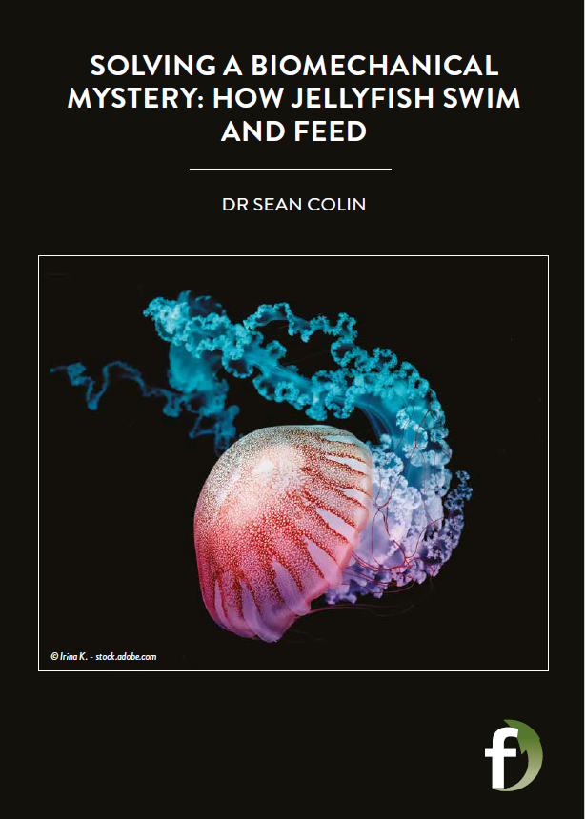
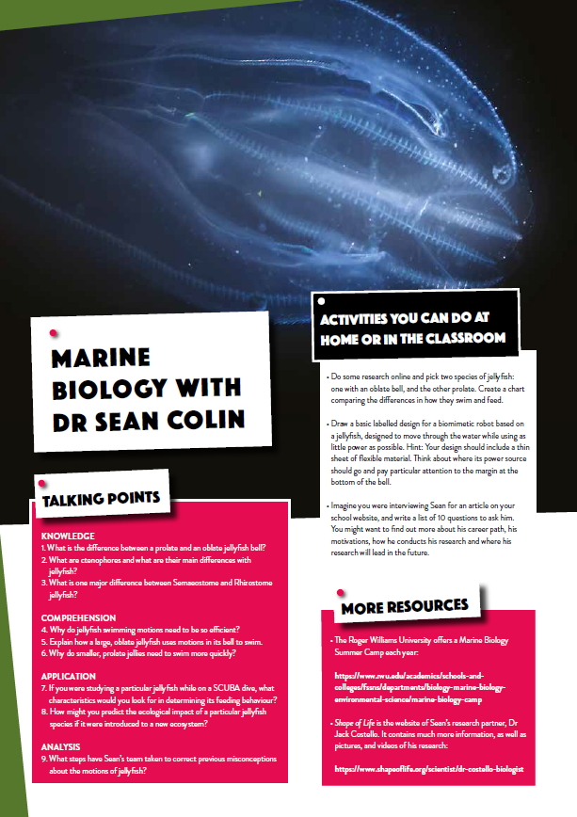
Dig deeper into Sean’s research
If you want to ask Sean a question, scroll down to the end of his online article and type it in. He will reply!
Download his activity sheet

