Slide 1
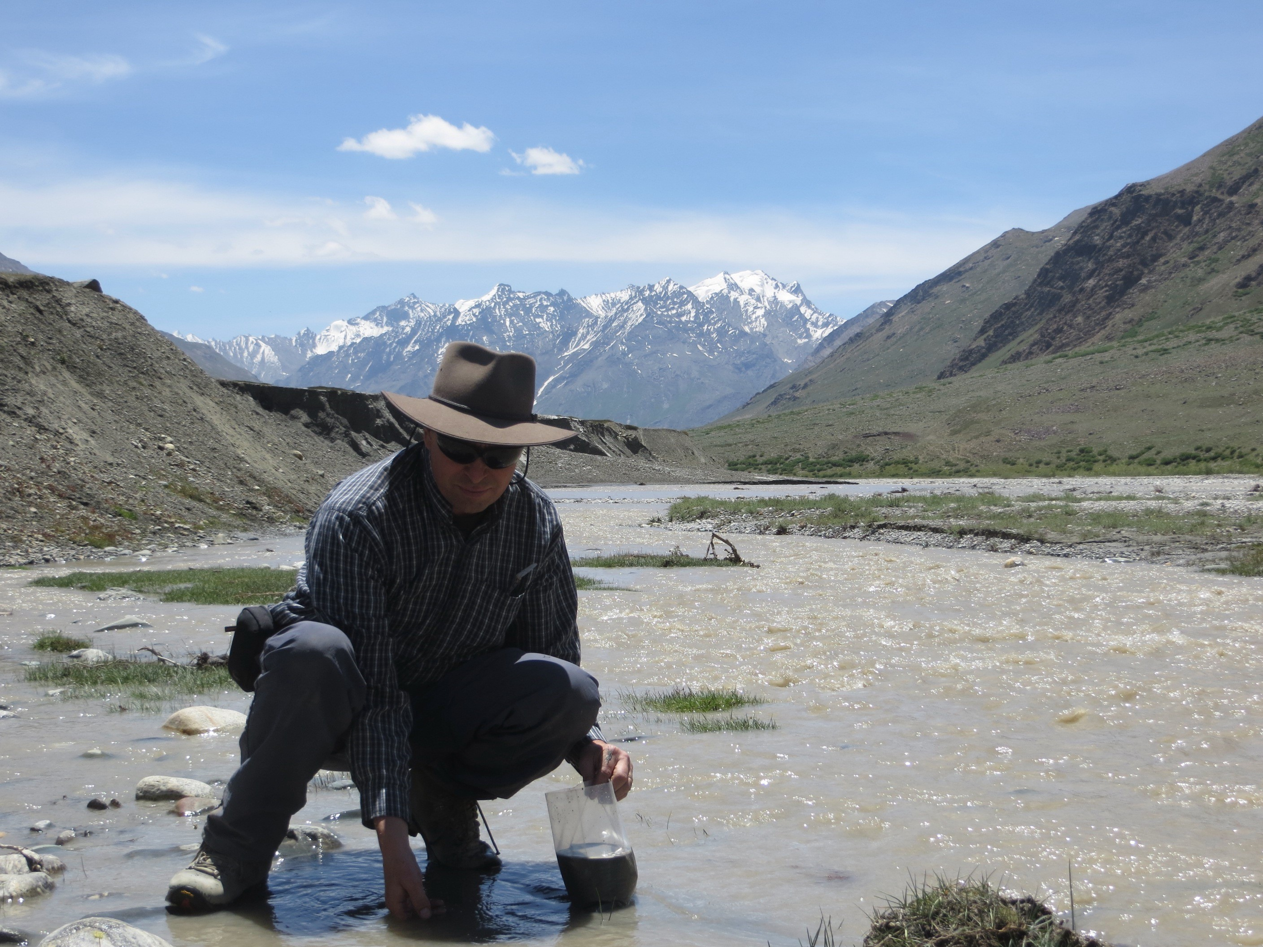
SEDIMENTARY GEOLOGY
WITH
PROFESSOR PETER CLIFT

Slide 2
MEET PETER
Professor Peter Clift is a sedimentary geologist at Louisiana State University in the USA.
He is investigating how the Asian monsoon has influenced the Himalayan mountains, and how ancient civilisations have been affected by past changes in the monsoon.
Let’s learn more about his research…
Peter at Siccar Point, a famous geological site in Scotland, UK

Slide 3
MONSOONS
“Monsoons are climatic systems that occur on all the major continents,” says Peter. “They reflect seasonal changes in wind patterns, driven by temperature differences between the ocean and land, which bring rain deep into the continental interior.”
The shape and scale of the Himalayas and the Tibetan Plateau make the Asian monsoon the largest in the world. “The rain of the Asian monsoon is responsible for sustaining the agricultural systems that feed the majority of the world’s population,” explains Peter.
Storm clouds gather over the Himalayan town of Leh, India

Slide 4
MARINE EXPEDITIONS
To investigate past changes in the Asian monsoon, Peter takes part in marine expeditions. Modified oil drilling ships are used to penetrate hundreds of metres into the sea floor to extract long sediment cores that provide a vertical record of the Earth’s geological history.
These expeditions are long and intense. “We spend eight weeks at sea, working 12-hour shifts with no days off,” says Peter. Each expedition will contain a variety of scientists on board. Some will describe the sediment cores as they are brought onto the ship, some will measure the chemical properties of the cores, and some will identify fossils in the sediment. “The pace of work ensures it is never boring as there are always things to do.”
Peter on a research ship during a marine drilling expedition

Slide 5
ANALYSING SEDIMENT
Peter and the team analyse the sediment extracted in these cores to reconstruct how the environment and climate have changed in the past. The cores provide clues about the rate of continent erosion and the chemical breakdown of sediments, which indicate the strength of monsoons in the geological past.
For many years, scientists thought the Asian monsoon strengthened about 8 million years ago, but Peter’s analysis of sediment cores from the South China Sea indicates it is much older, strengthening by at least 24 million years ago, if not before.
Peter collecting sediment for analysis in Ladakh, India

Slide 6
THE ASIAN MONSOON AND HIMALAYAS
The Tibetan Plateau formed when the Indian subcontinent collided with Asia around 50 million years ago. However, the landscape looked very different to the mountains we are familiar with today – until the monsoon gathered strength.
Peter has revealed the Himalayas were formed from the Tibetan Plateau due to the monsoon’s erosive power. “Stronger rains removed sedimentary rocks at the surface, allowing deep-buried rocks to rise to the Earth’s surface,” he explains. The peaks and valleys of the Himalayas are the result of this erosive process.
“In the future, I aim to decipher why the monsoon got stronger only 24 million years ago, rather than immediately after the collision of India and Asia,” says Peter.
Monsoon clouds and horses at Rohtang Pass, India

Slide 7
ANCIENT CIVILISATIONS
The Indus delta and flood plains in Pakistan, though arid today, were one of the most fertile regions in the world back in the Bronze Age. By analysing sediment cores from the region, Peter has been unpicking how this fertility, and the benefits it brought for early civilisations, are connected to the monsoon.
Around 4,000 years ago, the Indus civilisation collapsed. Peter believes his sediment cores shed light on why this happened. “We conclude the collapse of these early urban societies was linked to the weakening of the monsoon,” he explains.
This weakening led to reduced rainfall and diminishing agricultural productivity, forcing the population to migrate to the more fertile regions of what is now northern India.
Storm clouds gather over the Himalayan town of Leh, India

Slide 8
IMPLICATIONS FOR THE PRESENT
These findings have implications for the modern world. “The sensitivity of human society to changes in monsoons is quite striking,” says Peter. Today, global climate change is affecting monsoon patterns. As billions of people rely on the Asian monsoon, this is troubling.
“Climate change will mostly make monsoons stronger, but will also make them less reliable and stormier,” says Peter. This will threaten crop viability and bring risks to people’s lives and livelihoods through flooding and storms.
Understanding what drives monsoons and using this information to predict their future behaviour will help society mitigate these risks.
Monsoon clouds gather near Guilin, China

Slide 9
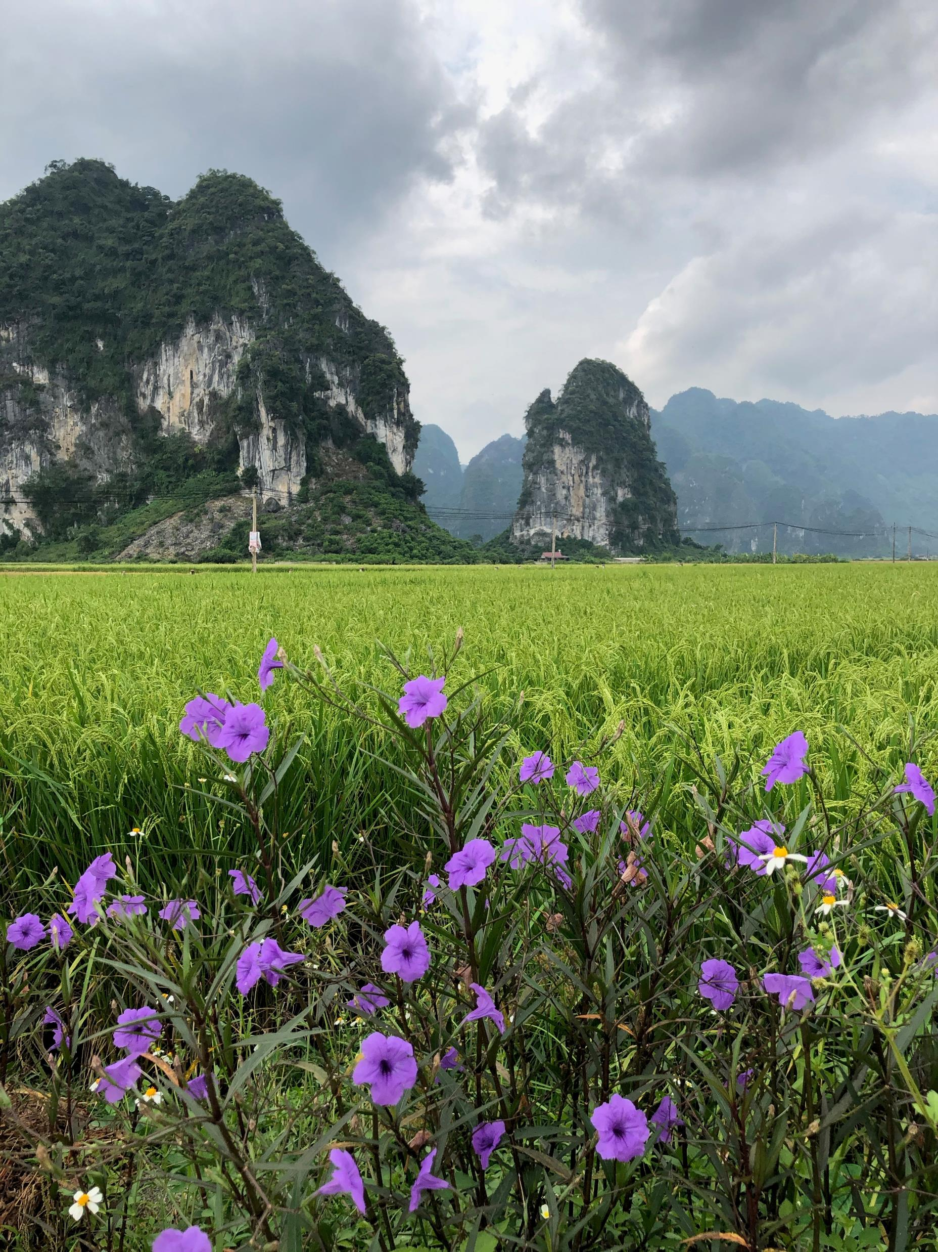
TALKING POINTS
When did the Asian monsoon increase in strength?
How has the Asian monsoon influenced the Himalayas?
Why did the Indus civilisation collapse?
How is knowledge of Bronze Age civilisation collapse relevant for societies today?
How will the Asian monsoon change in the future? What impacts will this have on modern Asian societies?
Would you like to take part in a marine expedition? What do you think you would enjoy about the experience, and what would you find challenging?

Slide 10
EXPLORE A CAREER IN SEDIMENTARY GEOLOGY
Historically, many sedimentary geologists worked in the oil and gas industries, using their skills to locate new reservoirs of fossil fuels.
Today, sedimentary geologists are using these same skills in the carbon capture industry, locating subsurface rock units that can store carbon dioxide, thereby reducing atmospheric carbon dioxide levels.
Sedimentary geologists can also be found working in environmental consultancy, engineering geology, marine geology and even in forensic investigations.
Peter on a research ship during a marine drilling expedition

Slide 11
EXPLORE A CAREER IN SEDIMENTARY GEOLOGY
Peter recommends joining local or national geological societies, which often organise fieldwork opportunities and scientific meetings, and provide educational resources and information about geology careers. Examples include The Geological Society of America and The Geological Society.
Work experience, internships and summer schools will provide you with invaluable experience. The US Geological Survey has a Summer Fellowship Program that sponsors interns.
The Department of Geology and Geophysics at Louisiana State University offers many outreach opportunities for high school students (e.g. EnvironMentors) and members of the public (e.g. The Science Café).
Peter collecting sediment from the Zanskar River, India

Slide 12
PATHWAY FROM SCHOOL TO SEDIMENTARY GEOLOGY
There are many pathways to becoming a sedimentary geologist, but a grounding in basic sciences is essential. Peter studied maths, physics and chemistry at high school, but suggests that geography and biology would also be useful.
Many universities offer degrees in geology or Earth sciences, which will include courses in sedimentary geology. Peter advises maintaining a broad scientific understanding rather than focusing on a specialised area too early in your studies, as geologists draw on many different methods to solve complex problems.
Winter fieldwork in Yunnan Province, China

Slide 13
TALKING POINTS
Why do you think many sedimentary geologists are now using their skills in the carbon capture industry, instead of the oil and gas industry?
What would you gain from conducting geological work experience or an internship?
Why do you think Peter advises you to maintain a broad scientific understanding, rather than specialising early in your studies?
Are there any geological societies or institutions near you which offer outreach activities? If you are not sure, how could you find out? How could you get involved with their programmes?

Slide 14
HOW DID PETER BECOME A SEDIMENTARY GEOLOGIST?
WHAT WERE YOUR INTERESTS GROWING UP?
I was always interested in the natural world and being outside, coupled with an academic interest in physics. I loved camping with friends and with the school cadet force, and the notion of travelling around the world and witnessing different environments and cultures appealed to me. I’ve always loved ships too, which perhaps influenced my choice to pursue marine geology.
WHAT INSPIRED YOU TO BECOME A GEOLOGIST?
My love of mountain landscapes. They seemed very exotic compared to the rather flat landscape of southern England where I grew up.
Peter at Siccar Point, a famous geological site in Scotland, UK

Slide 15
WHAT HAVE BEEN YOUR FIELDWORK HIGHLIGHTS?
I’ve had the good fortune to work in many interesting places, but perhaps my favourite is Vietnam. The country has fascinating geology, friendly people and delicious food. I have also had wonderful experiences hiking and camping in the Indian Himalayas. It’s incredible to wake up to see snow-capped mountains from your tent.
DOES YOUR LOVE OF GEOLOGY SPILL OVER INTO YOUR FREE TIME?
For me, geology is more of a lifestyle than a career. I am a complete fanatic! Most of my friends are also geologists, my house is full of interesting rock specimens and my holidays involve seeing rocks in exotic places! Some people might think I spend all my time working, but for me it feels like being paid to pursue my hobby.
Peter collecting sediment from the Zanskar River, India

Slide 16
PETER’S TOP TIPS
Get a good, solid foundation in the physical sciences. Don’t give up maths and physics just because they are difficult – they are important for the modern scientific world.
Make sure you work on something that inspires you. Success depends on being excited and passionate about your career.
Peter examines ancient lake sediments in Ladakh, India

Slide 17
TALKING POINTS
How have Peter’s interests shaped his career?
What are your interests? How could you combine these into a career?
Why is maths fundamental to the modern scientific world? What examples can you think of where maths skills are necessary to answer scientific questions?
To what extent would you like a career that allows you to travel the world? What do you think are the benefits and drawbacks of a fieldwork-related job?

Slide 18
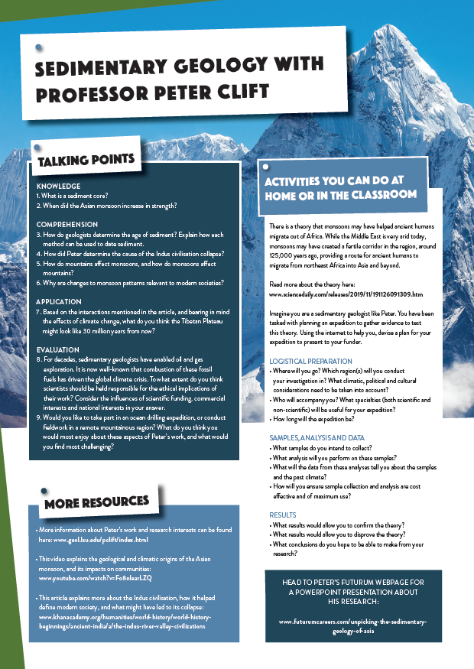
Dig deeper into Peter’s research
Read his article
Download his activity sheet

Slide 19
