Slide 1
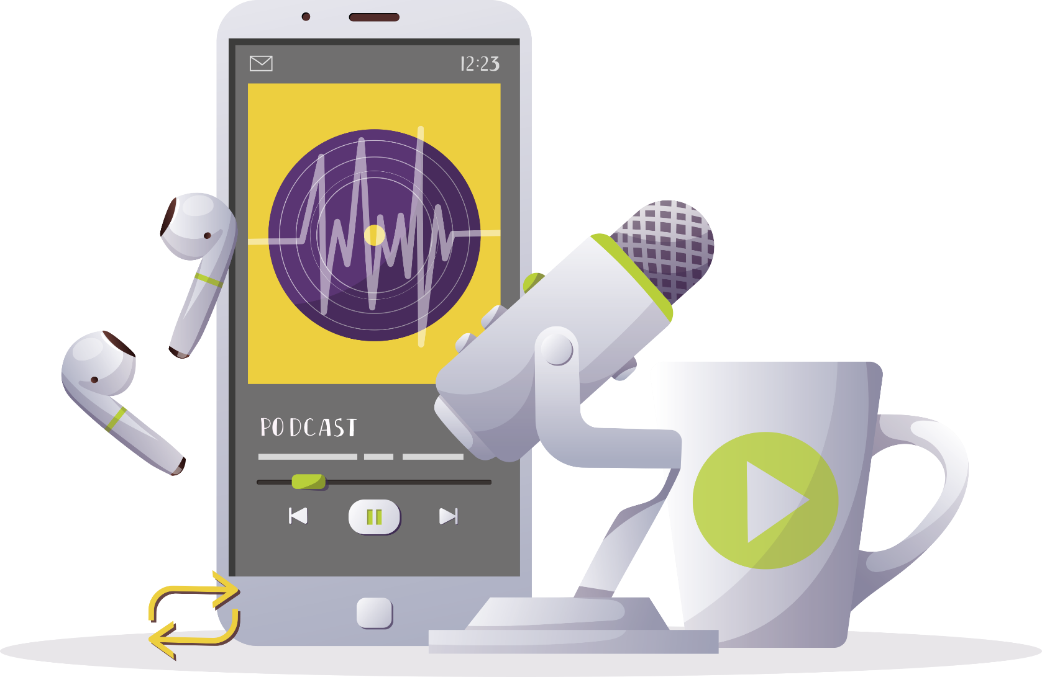
INSPIRING THE
NEXT GENERATION
FUTURUM
PODCAST
Medical physics
Professor Simon Cherry
ftlyip
Futurumcareers.com

Slide 2
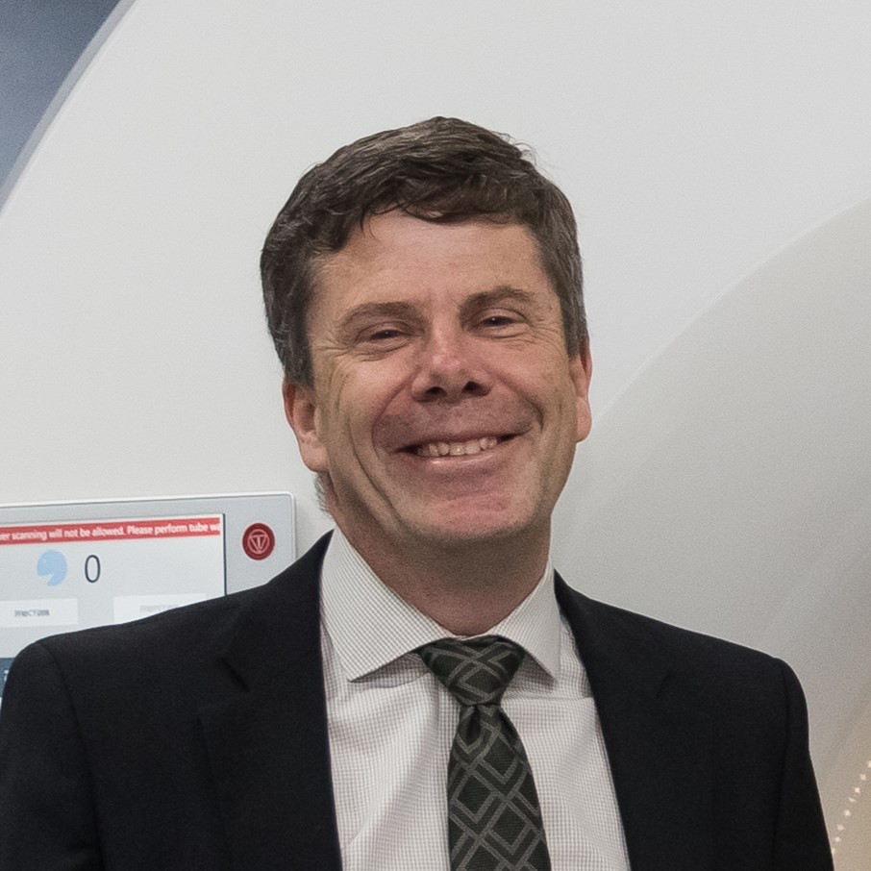
Pre-listening | Break it down | Post-listening | Learn more
Meet
Professor Simon Cherry
Pre-listening:
Professor Simon Cherry has developed the world’s first full-body medical imaging scanner. In this podcast, he discusses how the discoveries of past physicists have influenced his work, the importance of teamwork for success in science, and how to build confidence in yourself.
What do you think the field of medical physics involves?
Why do you think scientific discoveries and inventions rely on teamwork?
How confident are you in your own abilities? How do you think you could increase your confidence?
Profile
Department of Biomedical Engineering, University of California Davis, USA
FIELDS OF RESEARCH
Biomedical engineering, medical physics
“Don't be afraid of aiming high,
don't be afraid of pursuing your dreams.”

Slide 3
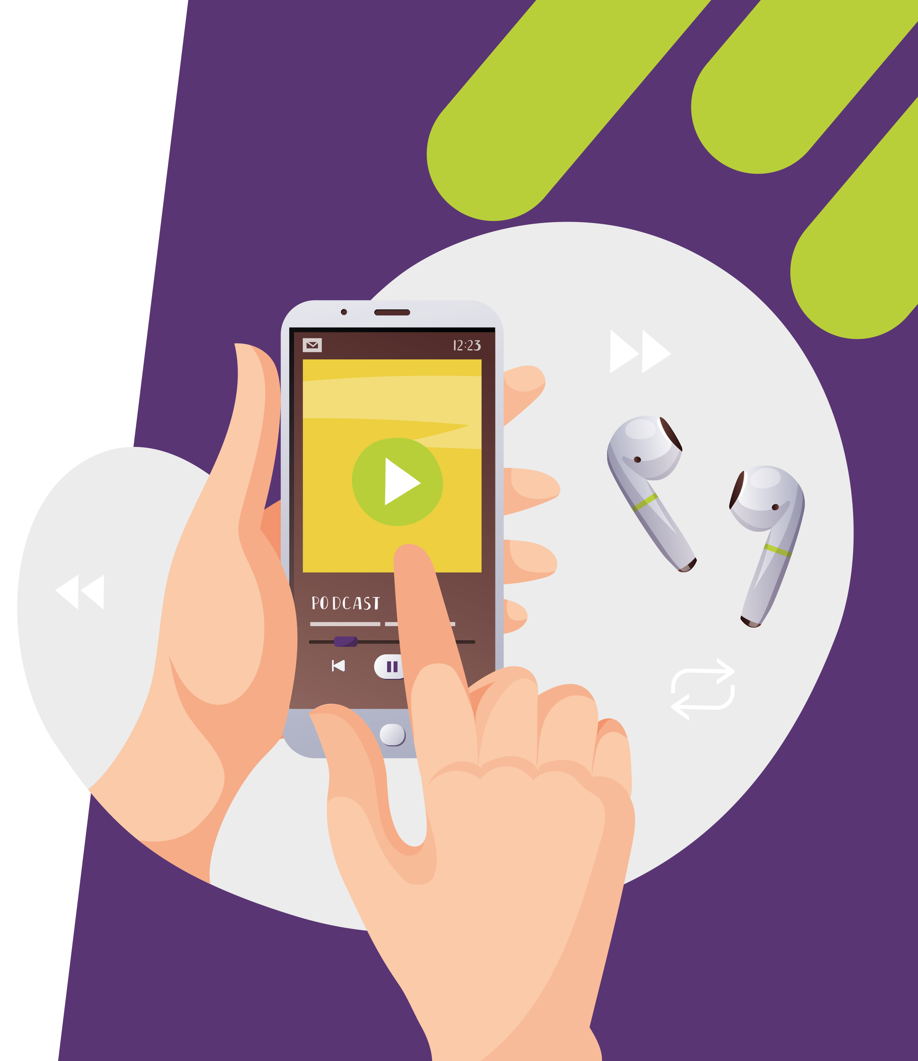
Pre-listening | Break it down | Post-listening | Learn more
Break the podcast down:
Up to 03:00 minutes
What happens when radioactive materials decay?
How have the discoveries of Marie Curie and Albert Einstein influenced Simon’s work?
03:00 – 04:00
Which field of physics most interests you, and why?
Why was Simon attracted to the field of medical physics?
What joys and challenges do you think you would face when starting work in a field that is new to you?

Slide 4
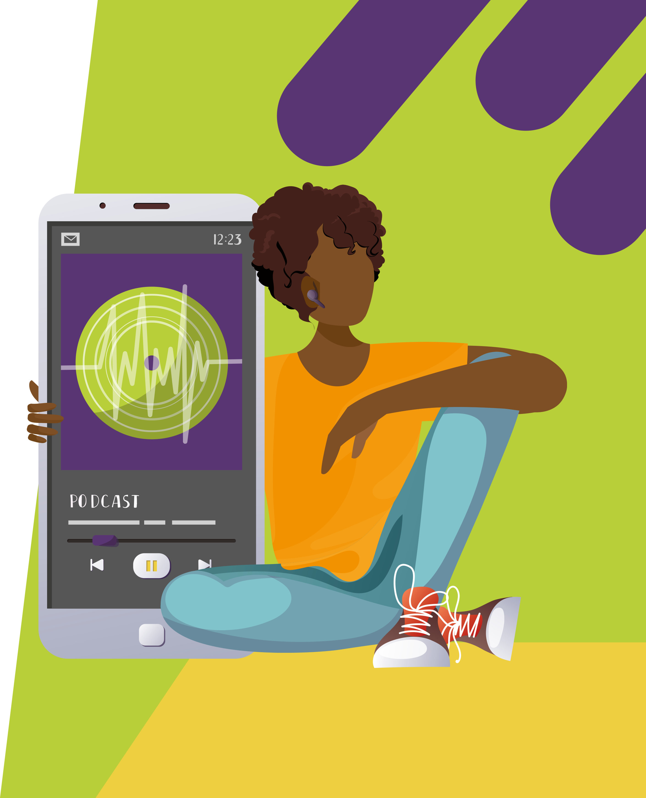
Pre-listening | Break it down | Post-listening | Learn more
04:00 – 07:10
What are your current hopes for your future career? How could asking questions open doors to help you achieve these dreams?
Why is teamwork essential for success in science?
When was the last time you worked in a team? What did you contribute to the team, and how did you ensure all team members felt valued?
07:10 – end
What do you think the next steps on your education or career journey will be?
What do you find most exciting and daunting about these next steps? How do you think you could overcome any challenges you will face?
How could you make connections with people who may be able to help you get started on your chosen career?

Slide 5
Pre-listening | Break it down | Post-listening | Learn more
Post-listening:
When was the last time you faced a setback? How did you respond to it? What did you learn from the experience?
What areas of your life do you lack confidence in? How could you increase your confidence in yourself and your abilities?
Simon recommends that you ‘pursue what you love’. How could you build a career from your interests and hobbies?
Which piece(s) of Simon’s advice did you find most useful, and why?
What further questions would you ask Simon about medical physics and/or his career?*
*Submit questions to Simon here

Slide 6
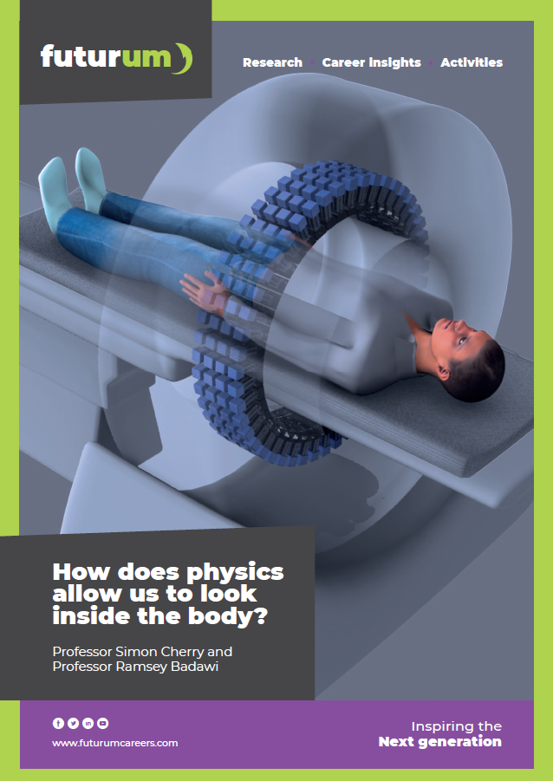
Pre-listening | Break it down | Post-listening | Learn more
Learn more about
Simon’s work:
A
Read the article here
A
Download the PowerPoint here
Download the activity sheet here
A
ftlyip
Futurumcareers.com

