Slide 1
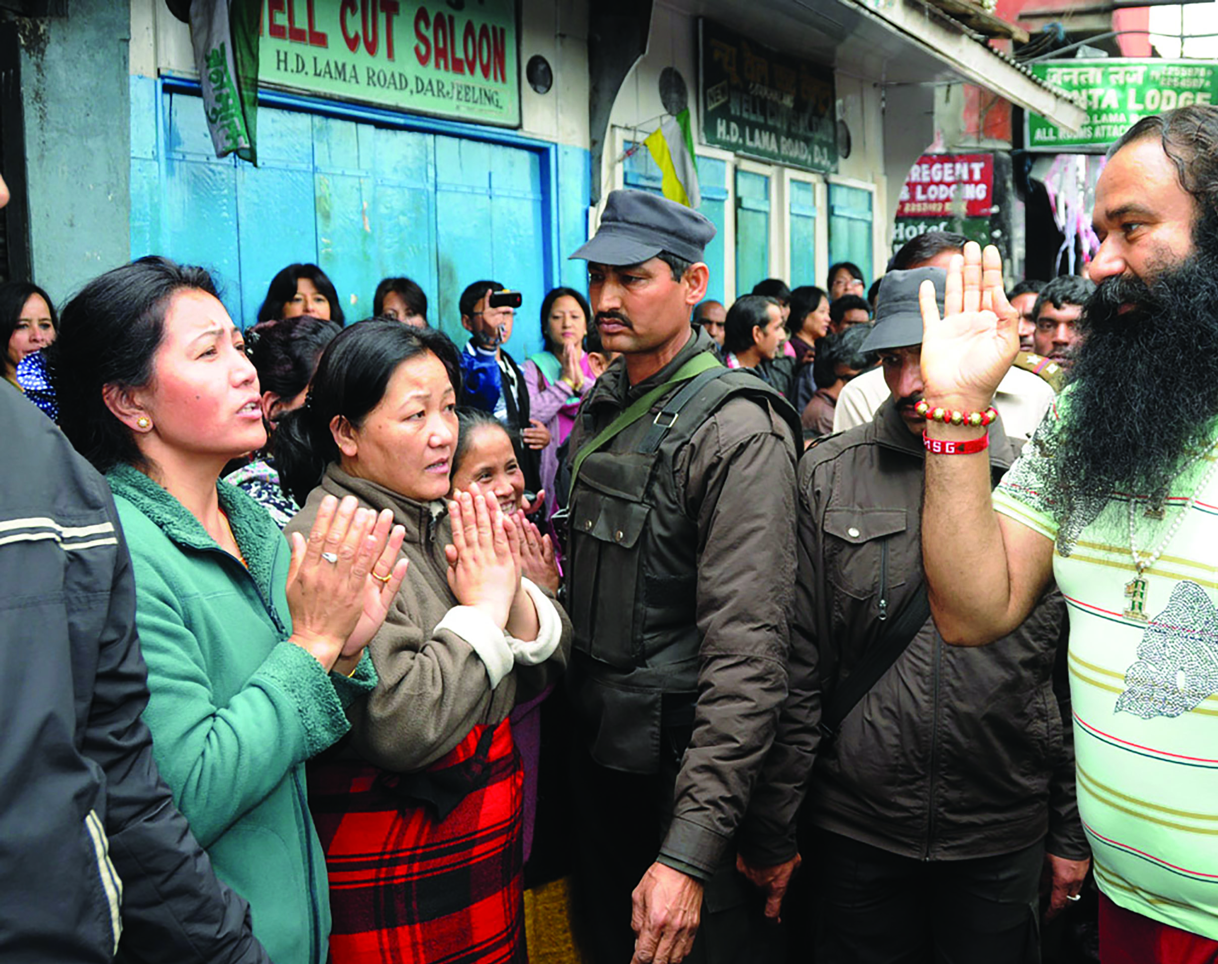
Social Anthropology
with Professor Jacob Copeman
Gurmeet Ram Rahim Singh Ji Insan, a guru. Photo credit: Auroaaddy, Wikimedia Commons

Slide 2
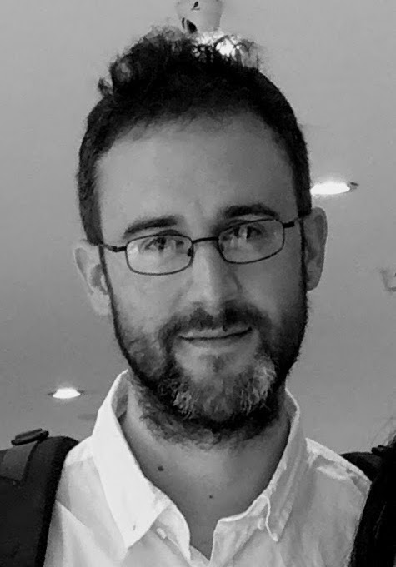
MEET JACOB
Professor Jacob Copeman is a social anthropologist at the University of Santiago de Compostela in Spain and Distinguished Investigator at the Galician Innovation Agency.
Jacob is investigating the political and religious elements of voluntary blood donation, particularly in India.
Let’s learn more about his work…

Slide 3
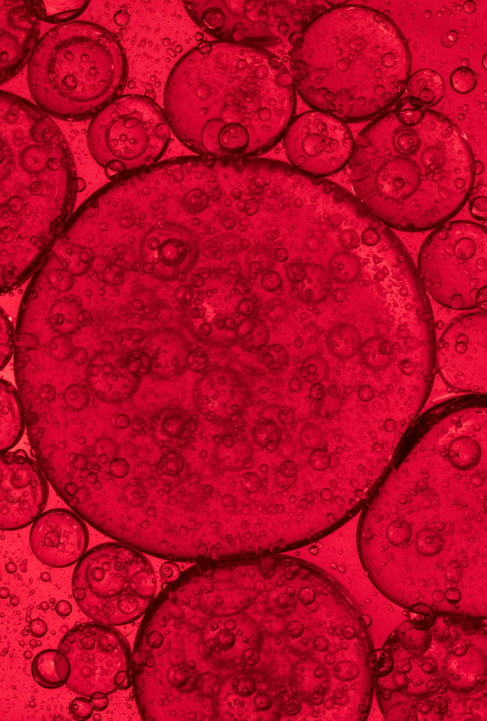
WHAT IS VOLUNTARY BLOOD DONATION?
Voluntary blood donation is where somebody gives their blood to be used by whoever might need it, without getting any payment in return.
There are other forms of blood donation:
Replacement donation – where a donor gives their blood to a central blood bank because they have a relative who needs a blood transfusion.
Commercial donation – where the donor receives a payment.
Voluntary donation is considered the safest method for patients and is strongly encouraged by the World Health Organization (WHO).

Slide 4
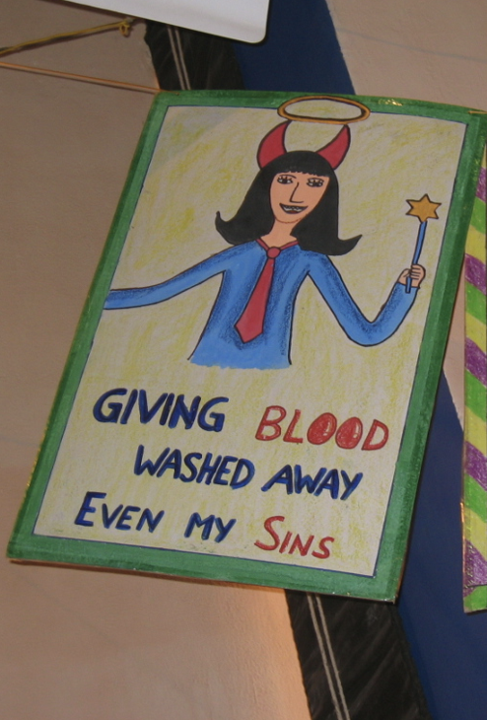
WHAT HAS BLOOD DONATION GOT TO DO WITH ANTHROPOLOGY?
In your biology classes, you will have learned that blood is a bodily fluid made up of plasma, red blood cells, white blood cells and platelets. But is this the first thing that comes to mind when you hear the word ‘blood’?
Depending on your beliefs and culture, you might associate blood with family connections, Christ on the cross, halal meat, war, sacrifice, or any number of other things.
Blood donation, therefore, means different things to different people, and this is what anthropologists such as Jacob are interested in.
Poster designed by the pupils at Modern School, New Delhi in India.
Image supplied by Jacob.

Slide 5
BLOOD DONATION IN INDIA
Before the 1980s, many people in India were sceptical about giving blood.
They had their own cultural understanding of medicine and blood, and many were suspicious of new western medicine.
People in India believed that giving blood would lead to permanent weakness (in fact, your body regenerates completely in 4-8 weeks). As a result, few people came forward to donate.

Slide 6
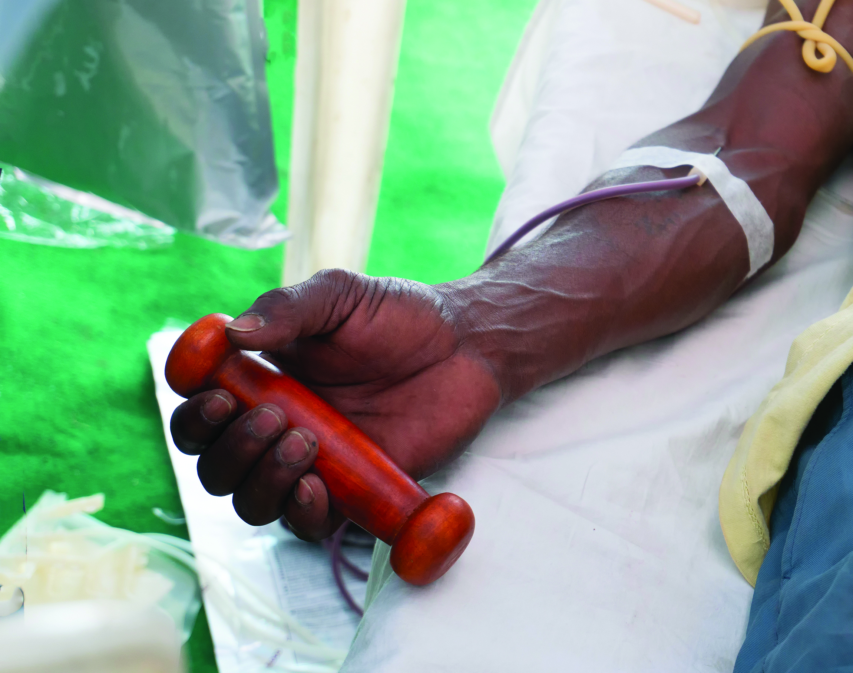
TALKING POINTS
What are the three forms of blood donation?
When you think of blood and blood donation, what comes to your mind? Do your friends have different images/ideas to you?
How do you feel about giving blood? Who would influence you to donate your blood?
Why do you think it’s important to study people’s reasons for donating blood?

Slide 7
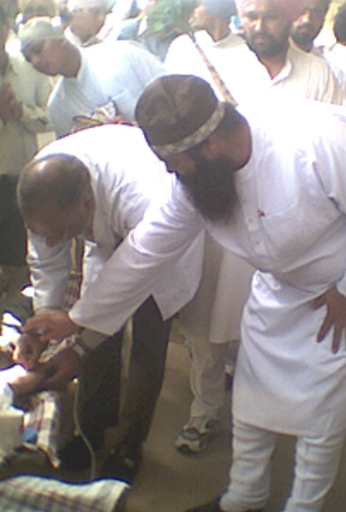
BLOOD DONATION IN INDIA: A RELIGIOUS PRACTICE
A religious guru is a teacher or master of spiritual and religious knowledge. In India, some of the most influential people are Hindu and Sikh gurus.
Doctors realised that gurus had the power to change the attitudes of their devotees. If a guru endorsed blood donation, their devotees then saw it as a way of expressing their religion and showing their respect for the guru.
For many devotees, giving blood transformed from a strange new medical practice into a sacred ritual, and donations sky-rocketed.
Hazoor Maharaj ji blesses the hand of a doctor inserting the needle into a devotee-donor. Image supplied by Jacob

Slide 8
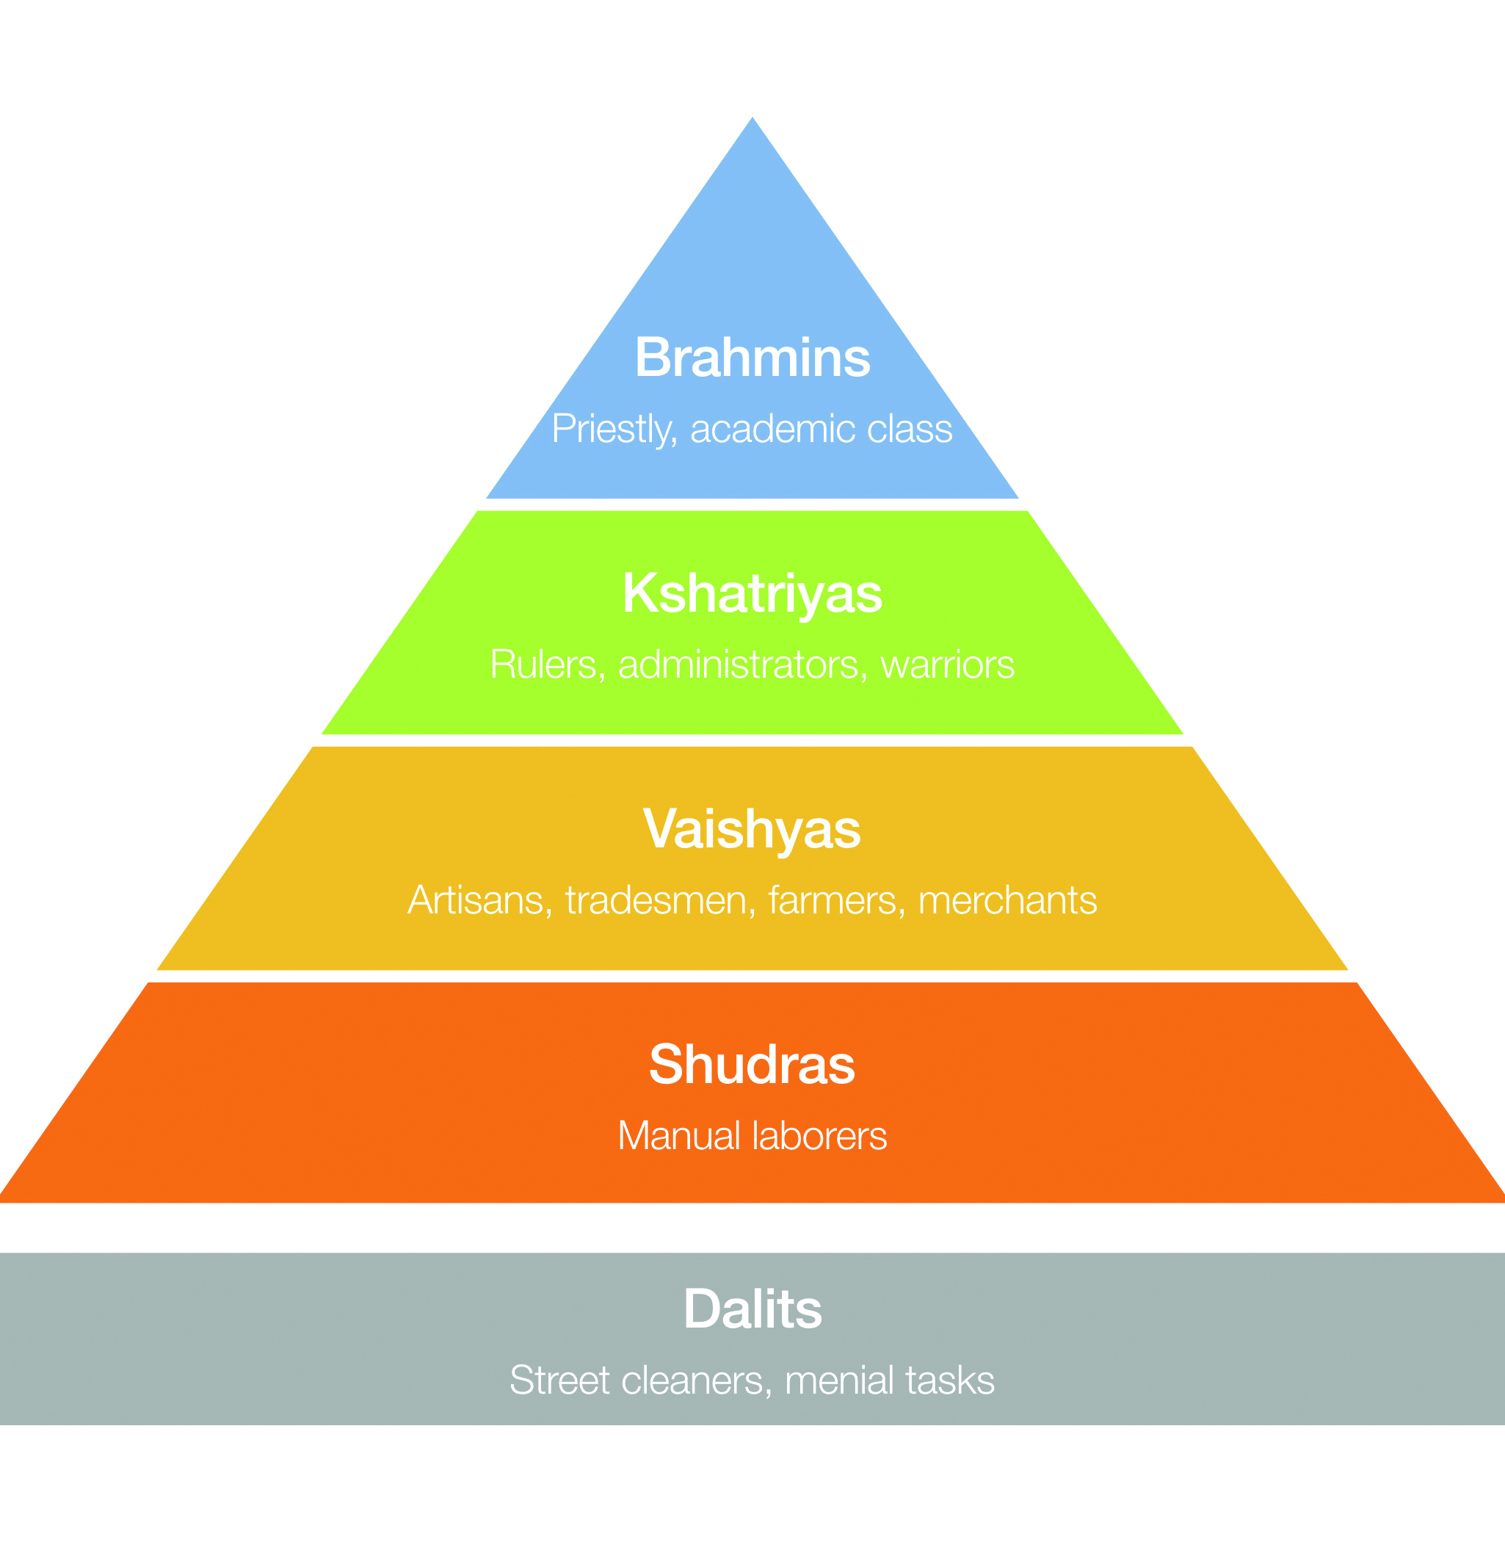
BLOOD DONATION IN INDIA: CHALLENGING THE CASTE SYSTEM
The Indian caste system is a traditional division of society, in which people in the upper castes are considered superior to those in lower castes.
Often, the differences between castes are thought to be biological in nature. Many people might believe that there is something contained in a person’s blood that indicates which caste they belong to.
Blood donation has shown people from different castes can have the same blood type (called A, B and O).

Slide 9
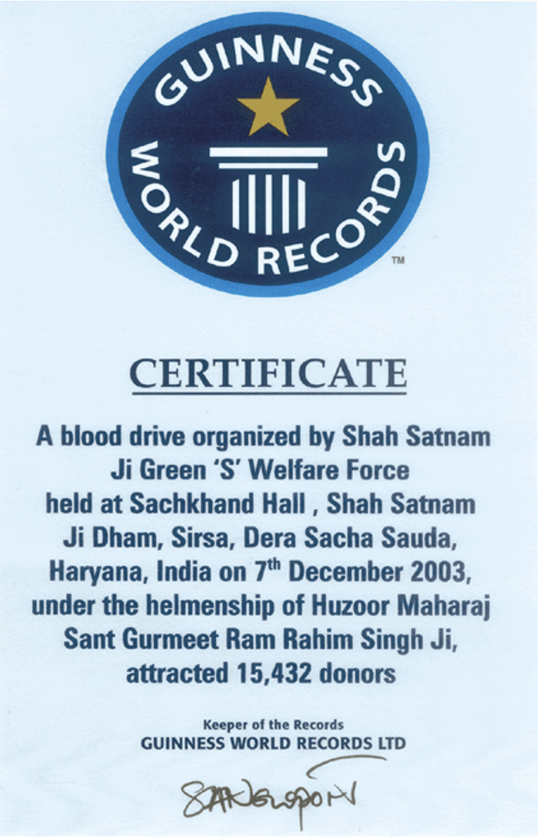
BLOOD DONATION IN INDIA: POLITICS
When India fought to become independent from British colonial rule, people spilt their blood for the sake of their country. India became a free country in 1947, but was later invaded in 1962 by China.
During the war, many who were not fighting donated their blood to treat injured soldiers. These memories, in addition to the way blood crosses the caste boundaries, make giving blood a symbol of national pride.
As a result, political campaigns often involve blood donation events, with some political parties competing to donate the most blood.

Slide 10
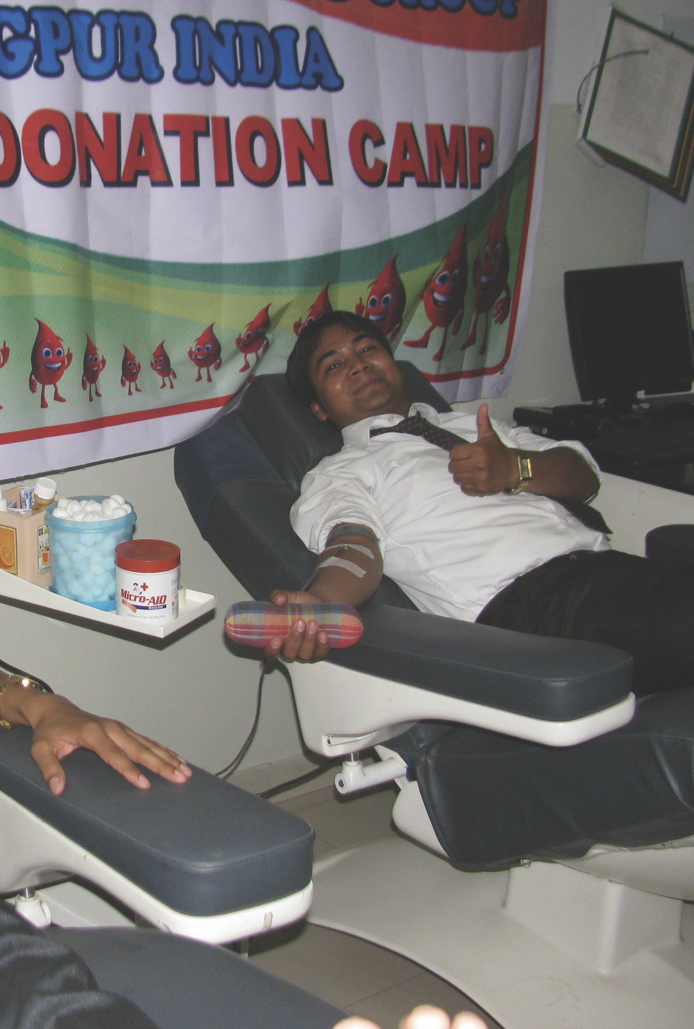
BLOOD DONATION IN INDIA: ANTHROPOLOGY
A key message of Jacob’s work is that if we want to change people’s behaviour, then we must first understand their culture.
In the case of Indian blood donation, people often were not persuaded by doctors; many, instead, put their trust in religious gurus.
If this had not happened, Indian blood banks might still be trying, unsuccessfully, to persuade large swathes of the population that donating blood is safe and effective.
Blood donation at Jeevan Jyoti, Rotary Club of Nagpur

Slide 11
TALKING POINTS
What are gurus?
How is our modern understanding of blood incompatible with the traditional view of the Indian caste system?
Why is blood donation associated with national duty in India?
Think of a time when people had to be persuaded to change their behaviour for medical reasons. Was the campaign effective? Why, or why not?

Slide 12
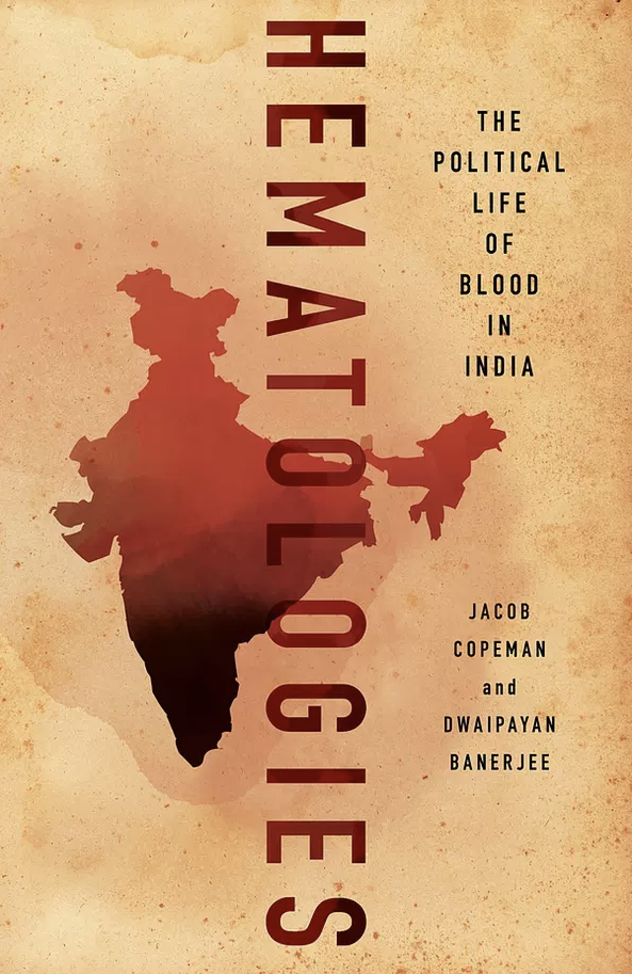
ABOUT SOCIAL ANTHROPOLOGY
How do social structures and practices differ, and how are they the same? What defines culture, and what is universally human?
These are the questions that anthropologists try to answer. They do so by studying peoples’ lives in detail, often by living alongside communities for extended periods of time.
Social anthropology is often associated with the study of small, isolated communities. While this is sometimes the case, anthropologists are interested in much more.
The cover of one of Jacob’s books on blood in India: Hematologies: The Political Life of Blood in India

Slide 13
WHY IS SOCIAL ANTHROPOLOGY IMPORTANT IN MEDICINE?
Advances in medicine are useless unless they are accepted by a society.
The last time you swallowed a pill, did you stop to check the ingredients and find out how it works? Probably not, because you trust the pharmacy or doctor who gave you the pill. Building that trust between medicine and society is vital, and that is where anthropology can help.
Medical anthropologists explore belief systems, power structures and motivations in different medical contexts.
This can help the medical profession to communicate effectively with different populations. Jacob’s work on blood donation in India is just one example of this type of anthropology.

Slide 14
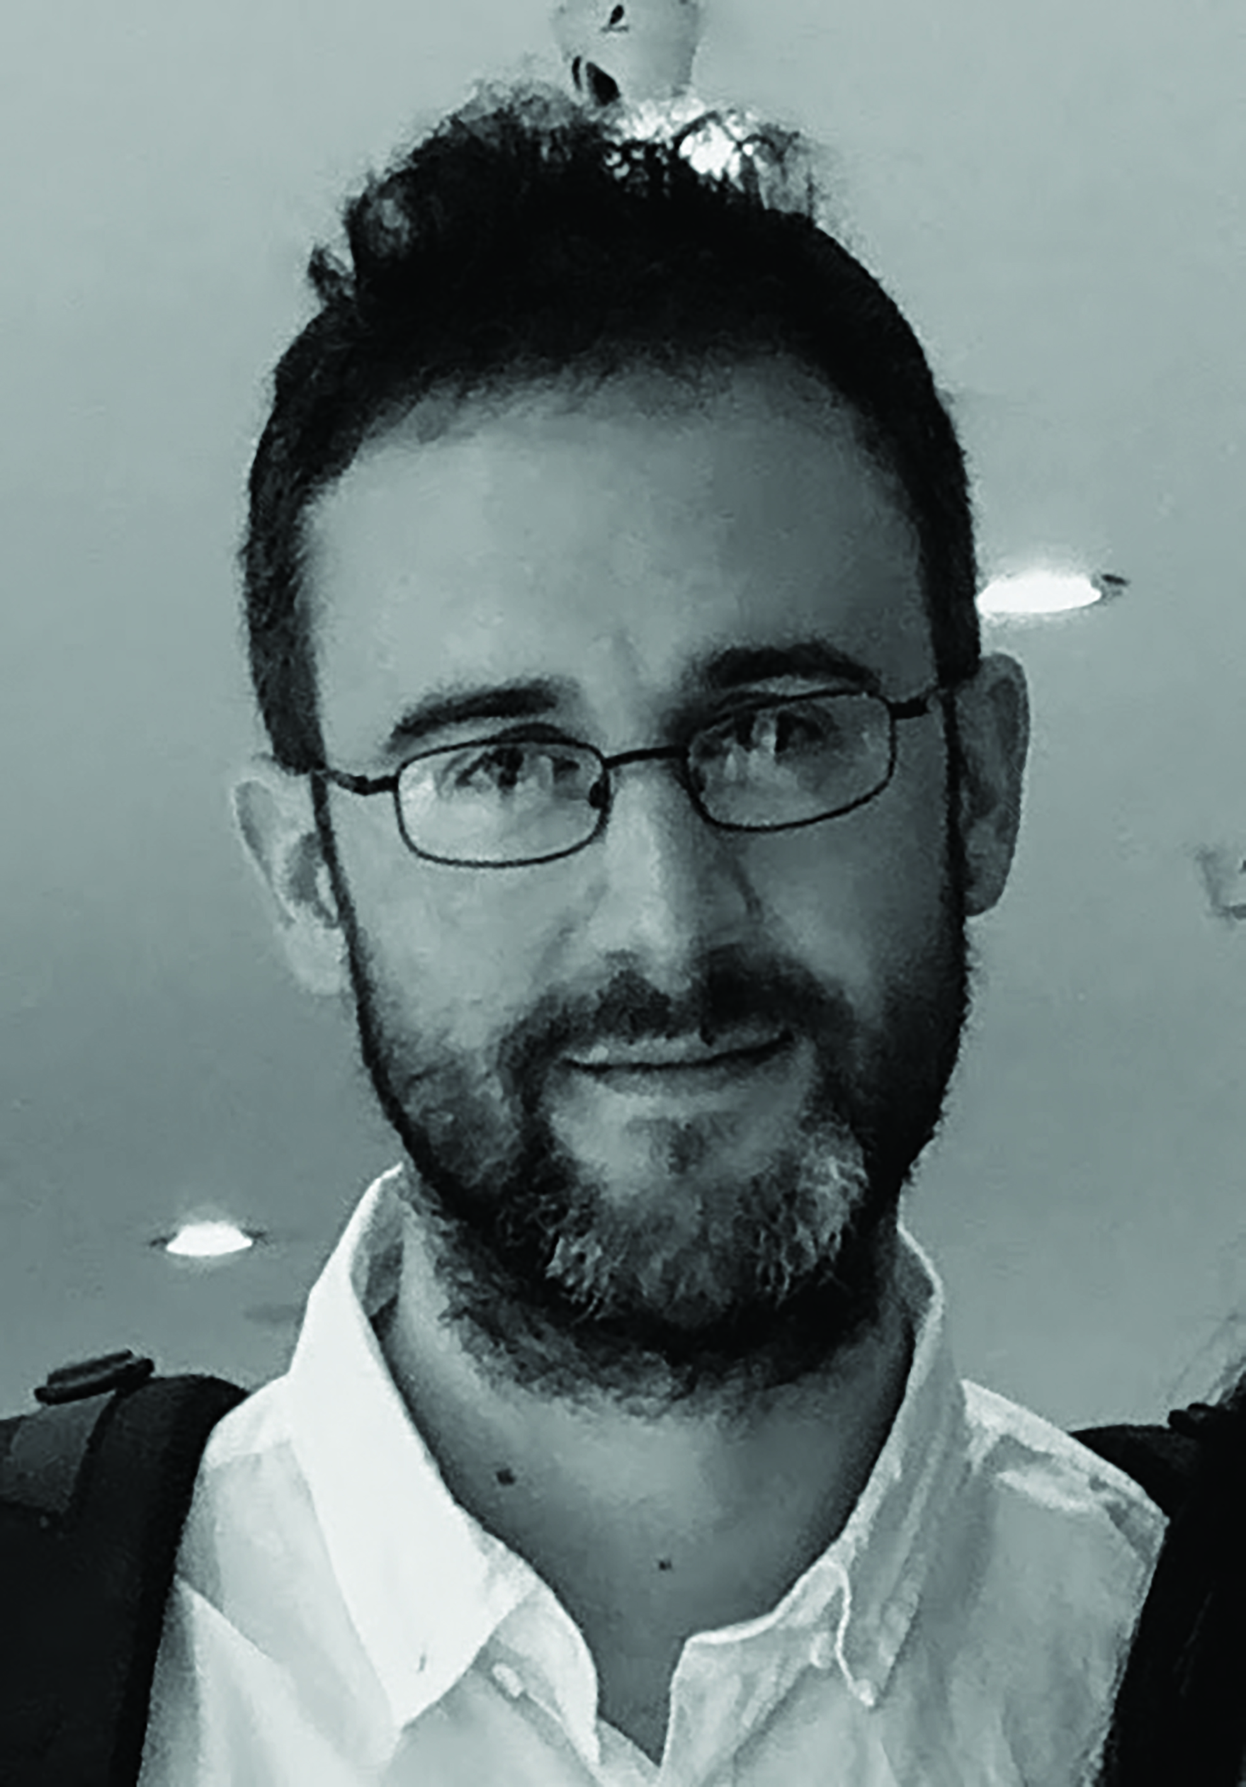
HOW DID JACOB BECOME A SOCIAL ANTHROPOLOGIST?
“I was unaware of anthropology as a subject until I was in my late teens, so I certainly didn’t grow up thinking I’d be an anthropologist – I don’t think many people do!
However, in my early teens, I developed keen interests in politics, religion and culture. When I discovered anthropology as a discipline, I realised these interests were an excellent basis for anthropology.
In my time, I’ve also wanted to run an independent arts venue, and be a writer on music and sport.”

Slide 15
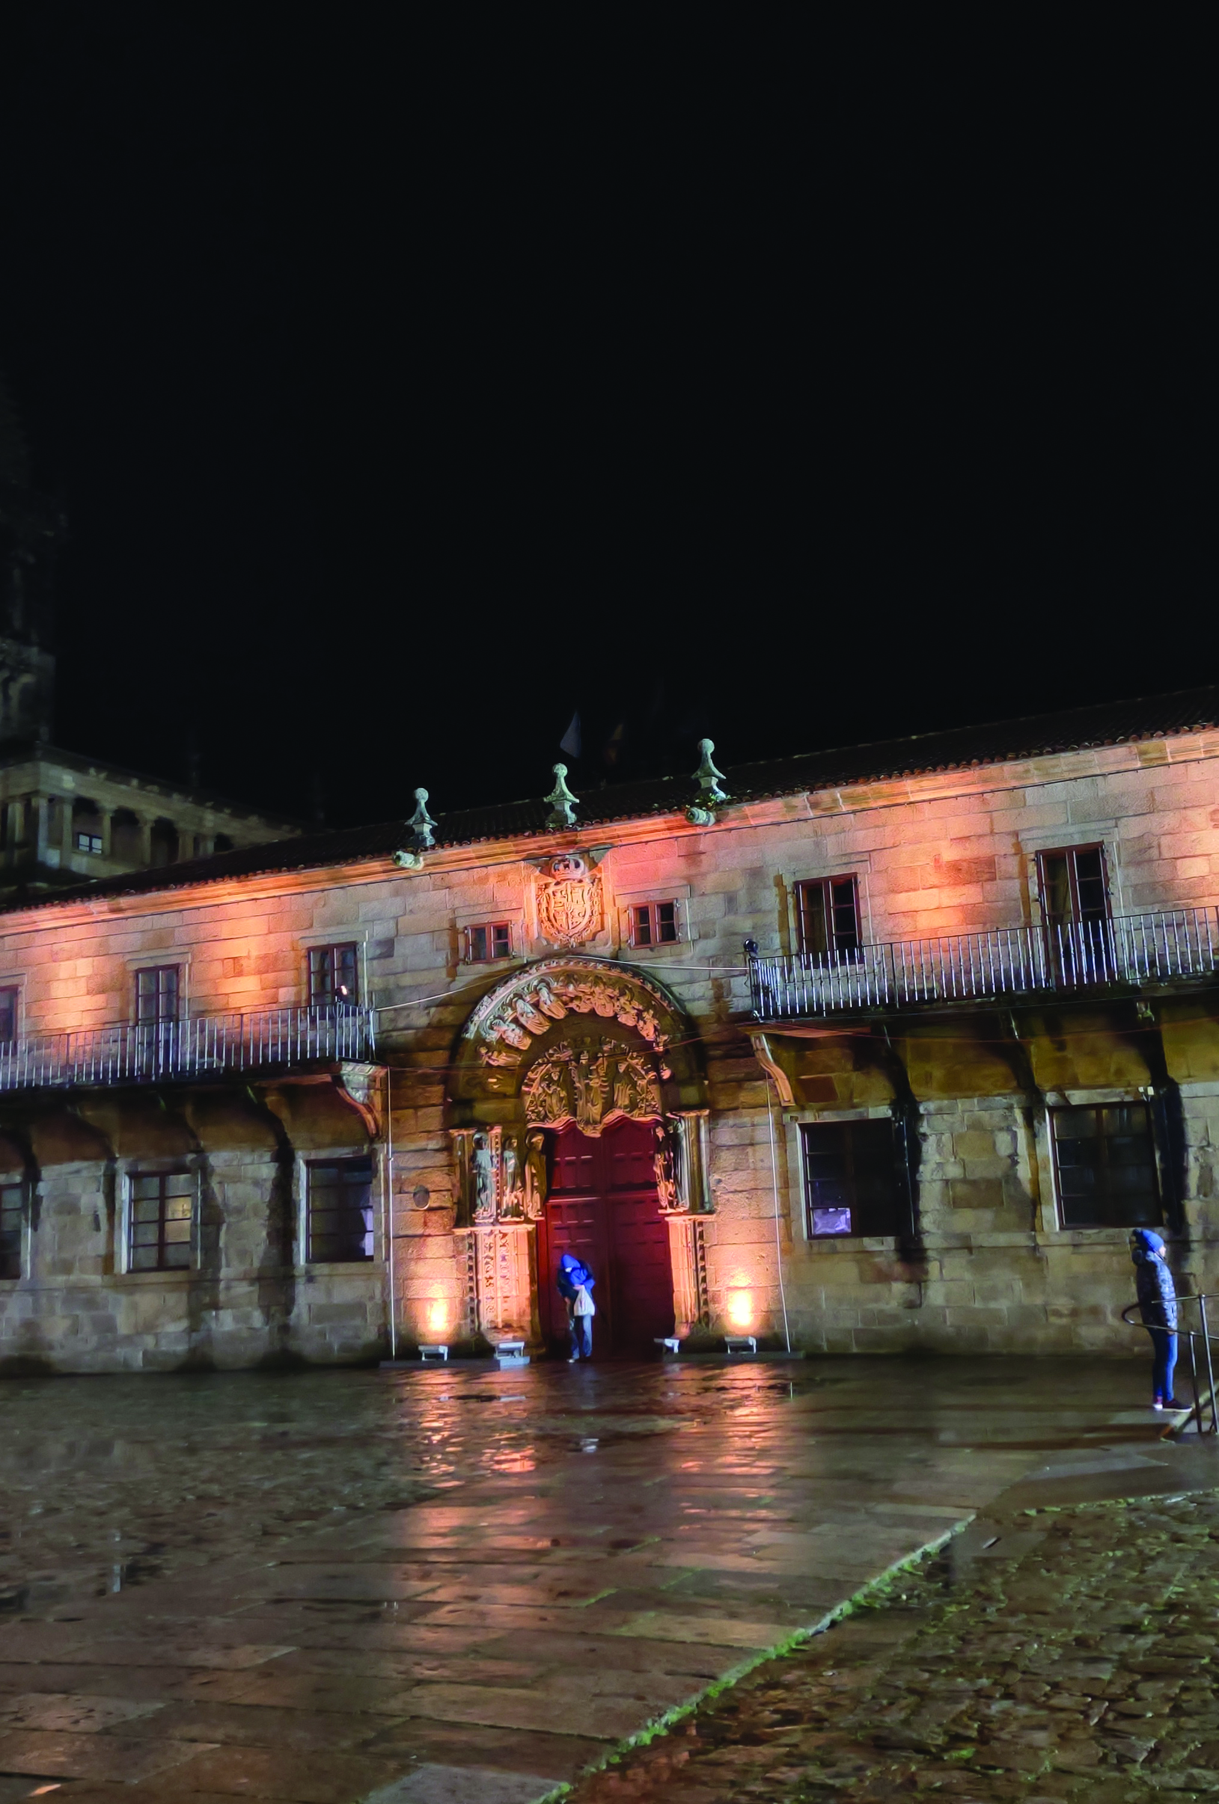
WHAT DOES JACOB LOVE ABOUT HIS WORK?
“I have always been curious about how societies work, and the differences and similarities between different societies and cultures.
I love the fact that I can follow my curiosities and explore these in such depth. I meet interesting people all over the world, and have the opportunity to be part of events I would otherwise know nothing about, from mass blood donation camps in India to spectacular religious ceremonies.”
A photo taken by Jacob of the University of Santiago de Compostela at night. Imagine this being your place of work!

Slide 16
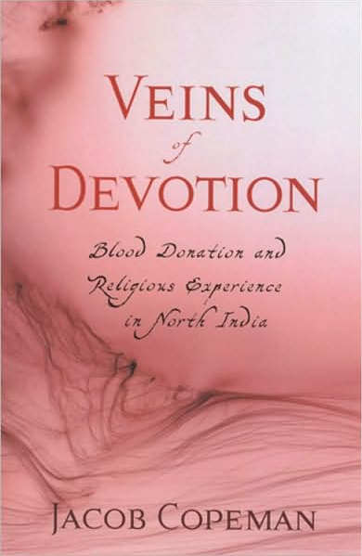
CAREERS IN SOCIAL ANTHROPOLOGY
To study anthropology at university, you will need to show an interest in how different societies work, and the people who make up these different societies.
Religious studies, geography and history will all stand you in good stead as an anthropologist. However, most universities do not require specific subjects.
Some anthropologists come to the field after studying another arts or humanities subjects. Jacob, for example, studied English for his first degree.
You could work in academia, policy, development, social work, business and in many other sectors. Salaries for academic anthropologists in the UK range from £32,000 to £82,000.

Slide 17
TALKING POINTS
What did you know about social anthropology before this lesson?
How might the school subjects that interest you lead to a career in social anthropology?
If you could ask Jacob a question, what would it be?

Slide 18
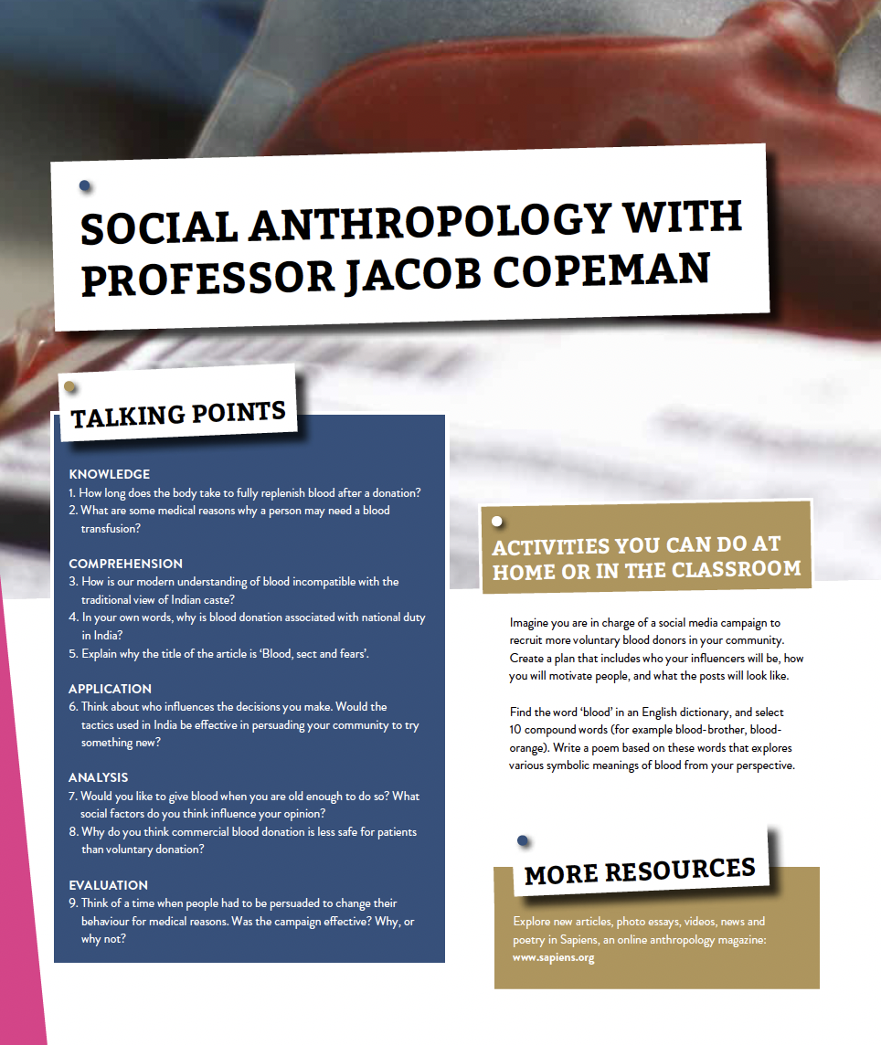
Dig deeper into Jacob’s research and head to his article online: https://futurumcareers.com/blood-sect-and-fears
If you want an answer to your question to Jacob, scroll down to the end of Jacob’s article and type it in.
Download Jacob’s activity sheet for even more anthropology activities: https://futurumcareers.com/Jacob-Copeman_activity-sheet.pdf

