Slide 1
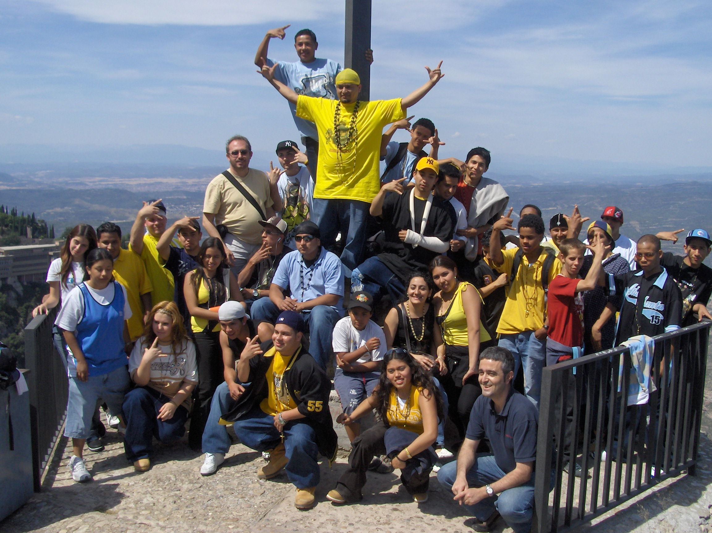
CAREERS IN ANTHROPOLOGY
DID YOU KNOW THAT GANGS ARE NOT ALL ABOUT CRIME AND VIOLENCE?

Slide 2
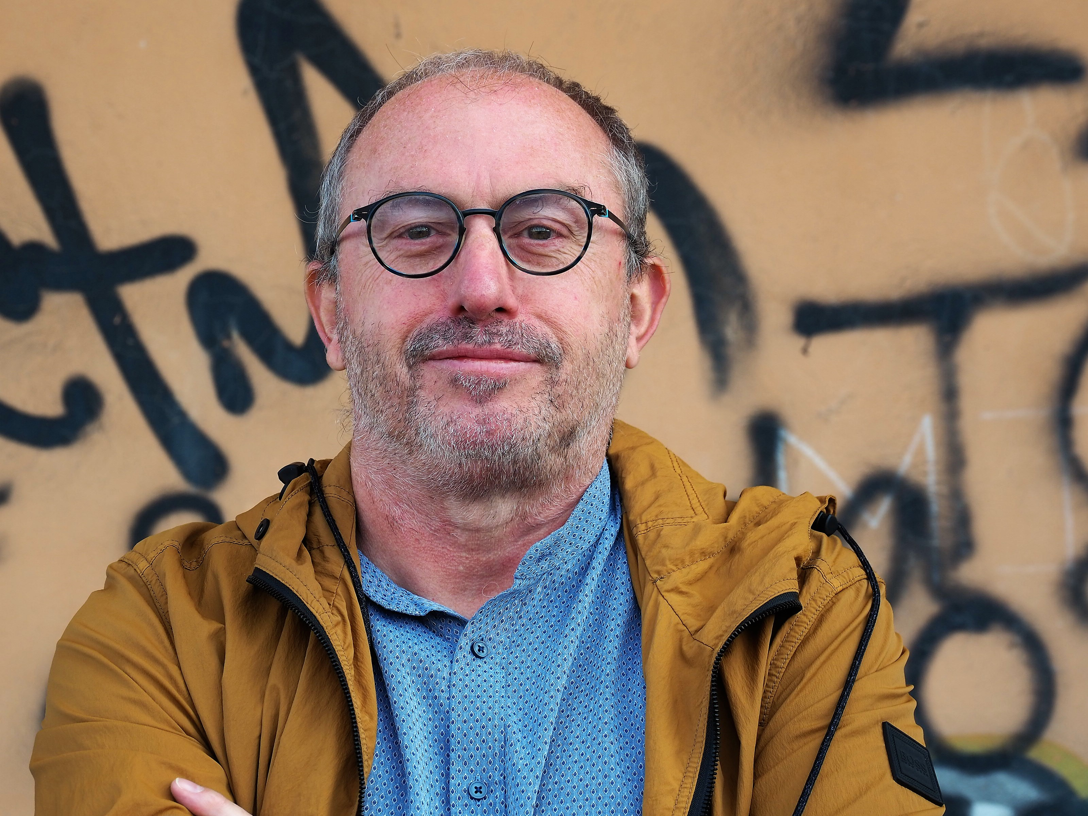
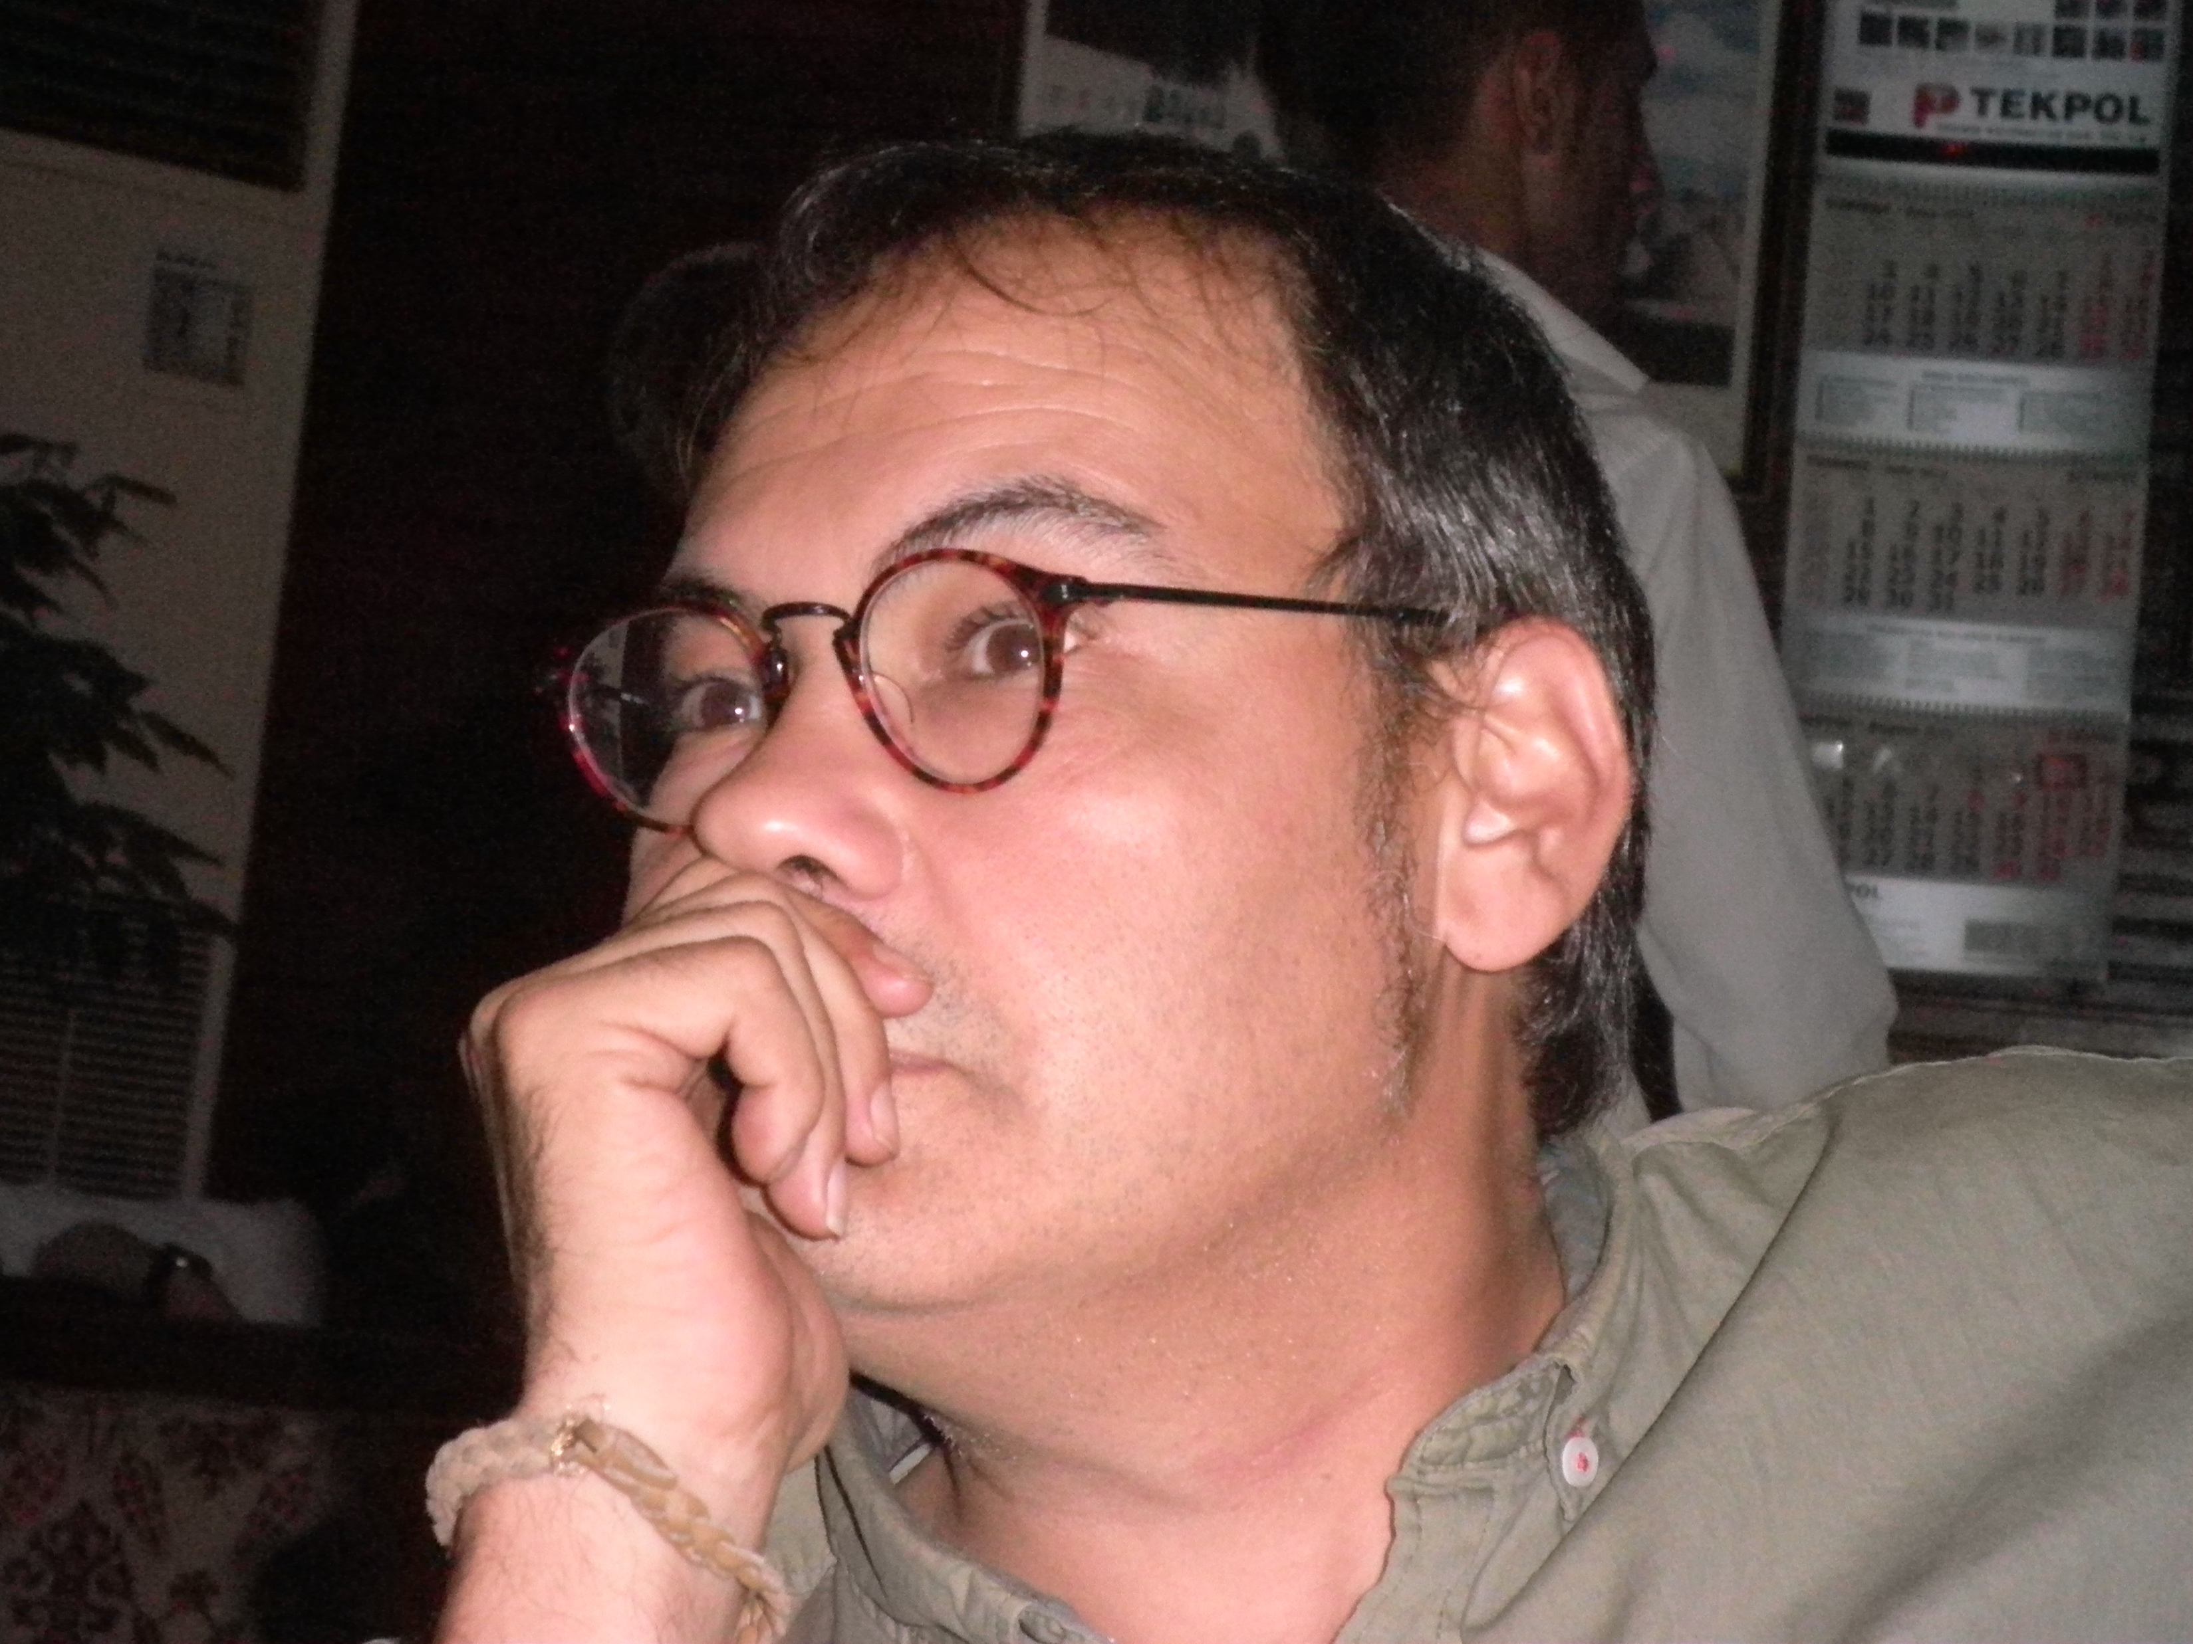
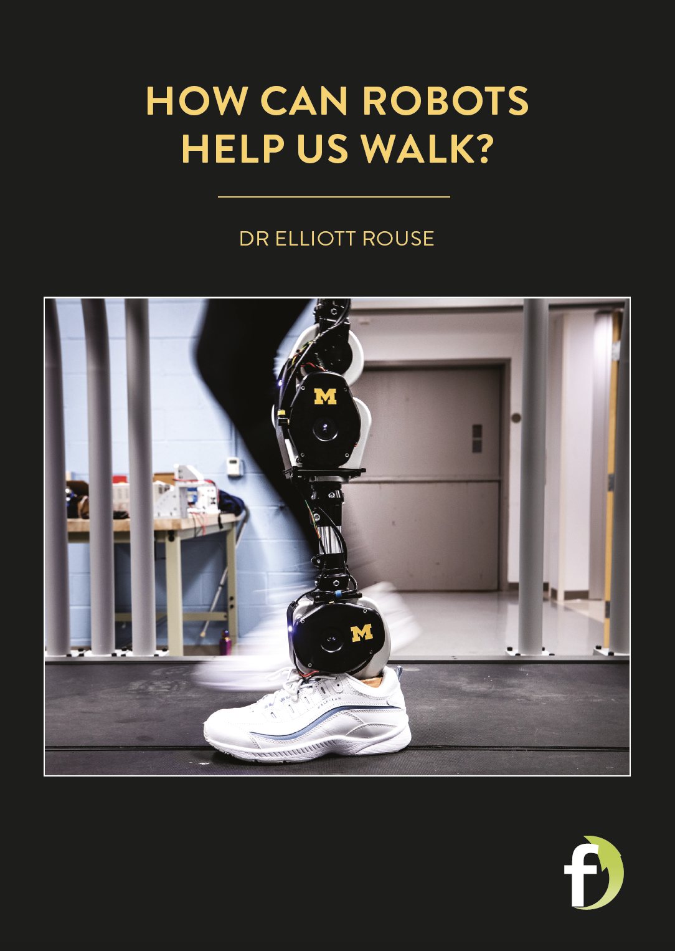
DR JOSÉ SÁNCHEZ GARCÍA
DR CARLES FEIXA PÀMPOLS
Based: Department of Communication, Pompeu Fabra University Barcelona, Spain
Research Field: Anthropology
Research Project: Transnational Gangs as Agents of Mediation: Experiences of Conflict Resolution in Street Youth Organisations in Southern Europe, North Africa and the Americas (TRANSGANG)

Slide 3
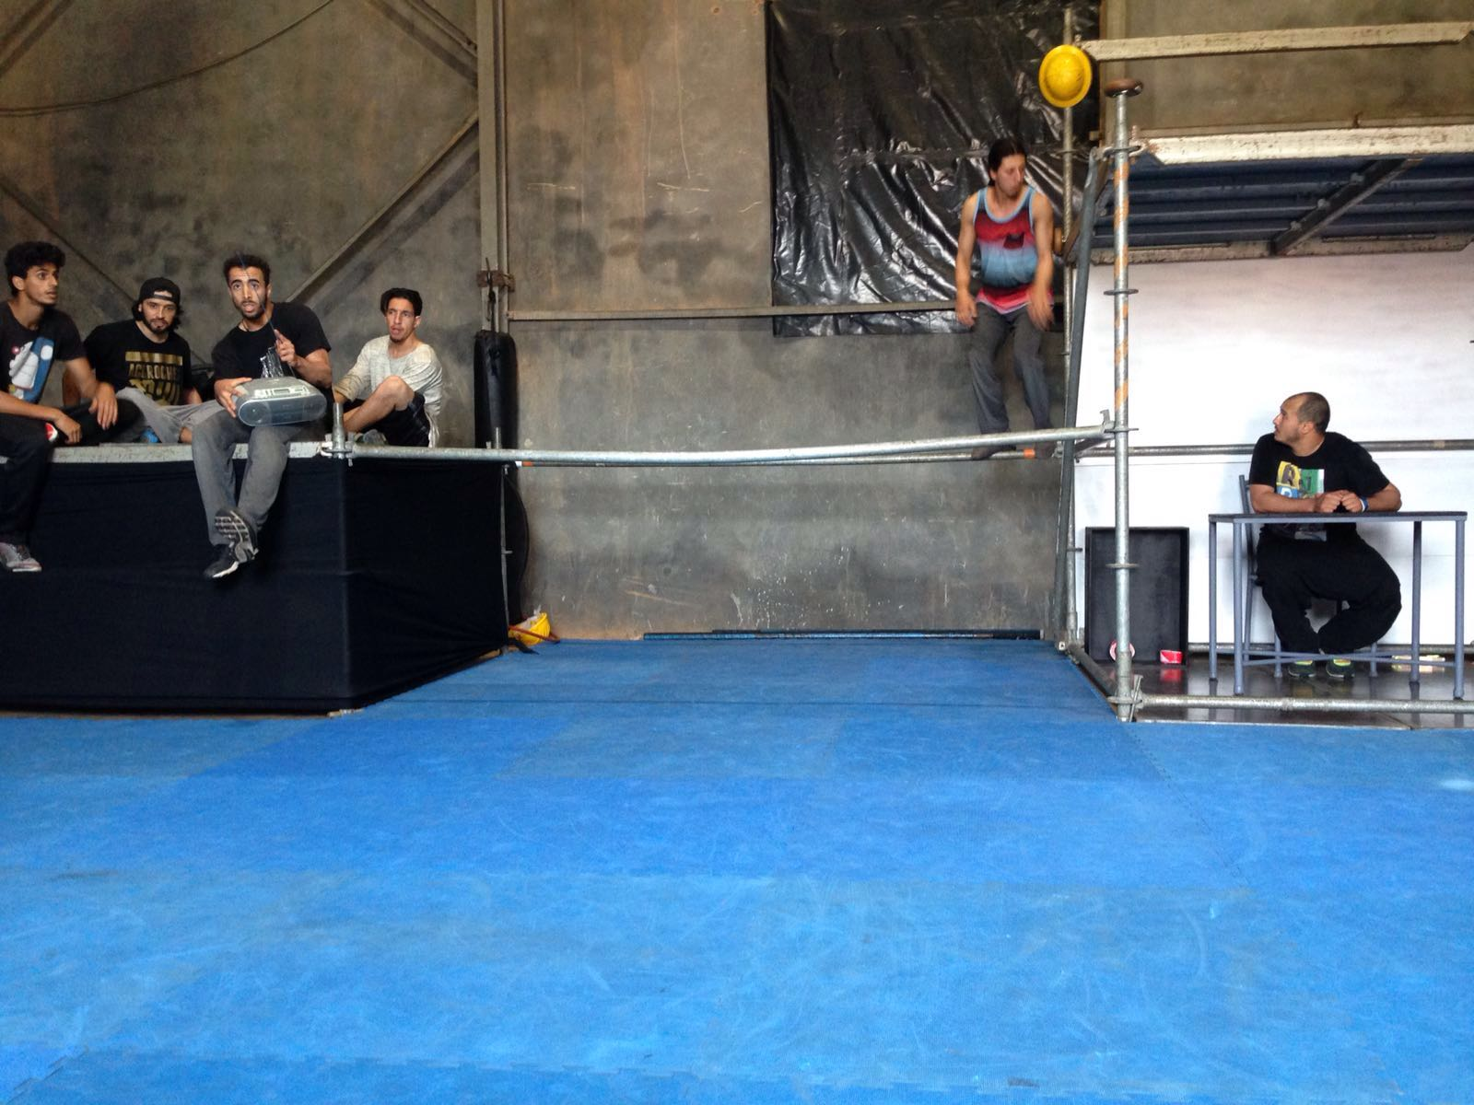
The TRANSGANG project
What comes to mind when you think of ‘gangs’?
In many cases, the word ‘gang’ is used to describe the evils of youth culture, and all the violence and crime associated with a strong street presence. However, young men and women are not born violent gang members. Instead, a history of family breakdown, poor education, unemployment and poverty forces them to join youth street groups. Similarly, it is often thought that the only way gangs know how to solve a conflict is through violence.
Dr Carles Feixa Pàmpols and Dr José Sánchez García, based at Pompeu Fabra University in Barcelona, Spain, want to offer a different perspective, however. They are
keen to learn how these groups can use mediation to
address their issues internally and with other groups.

Slide 4
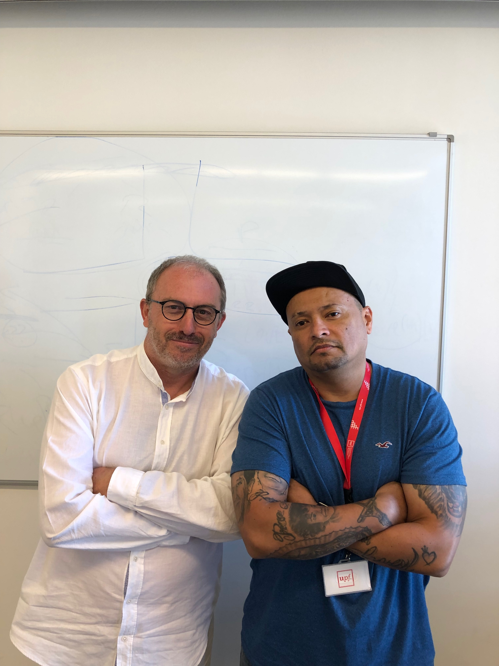
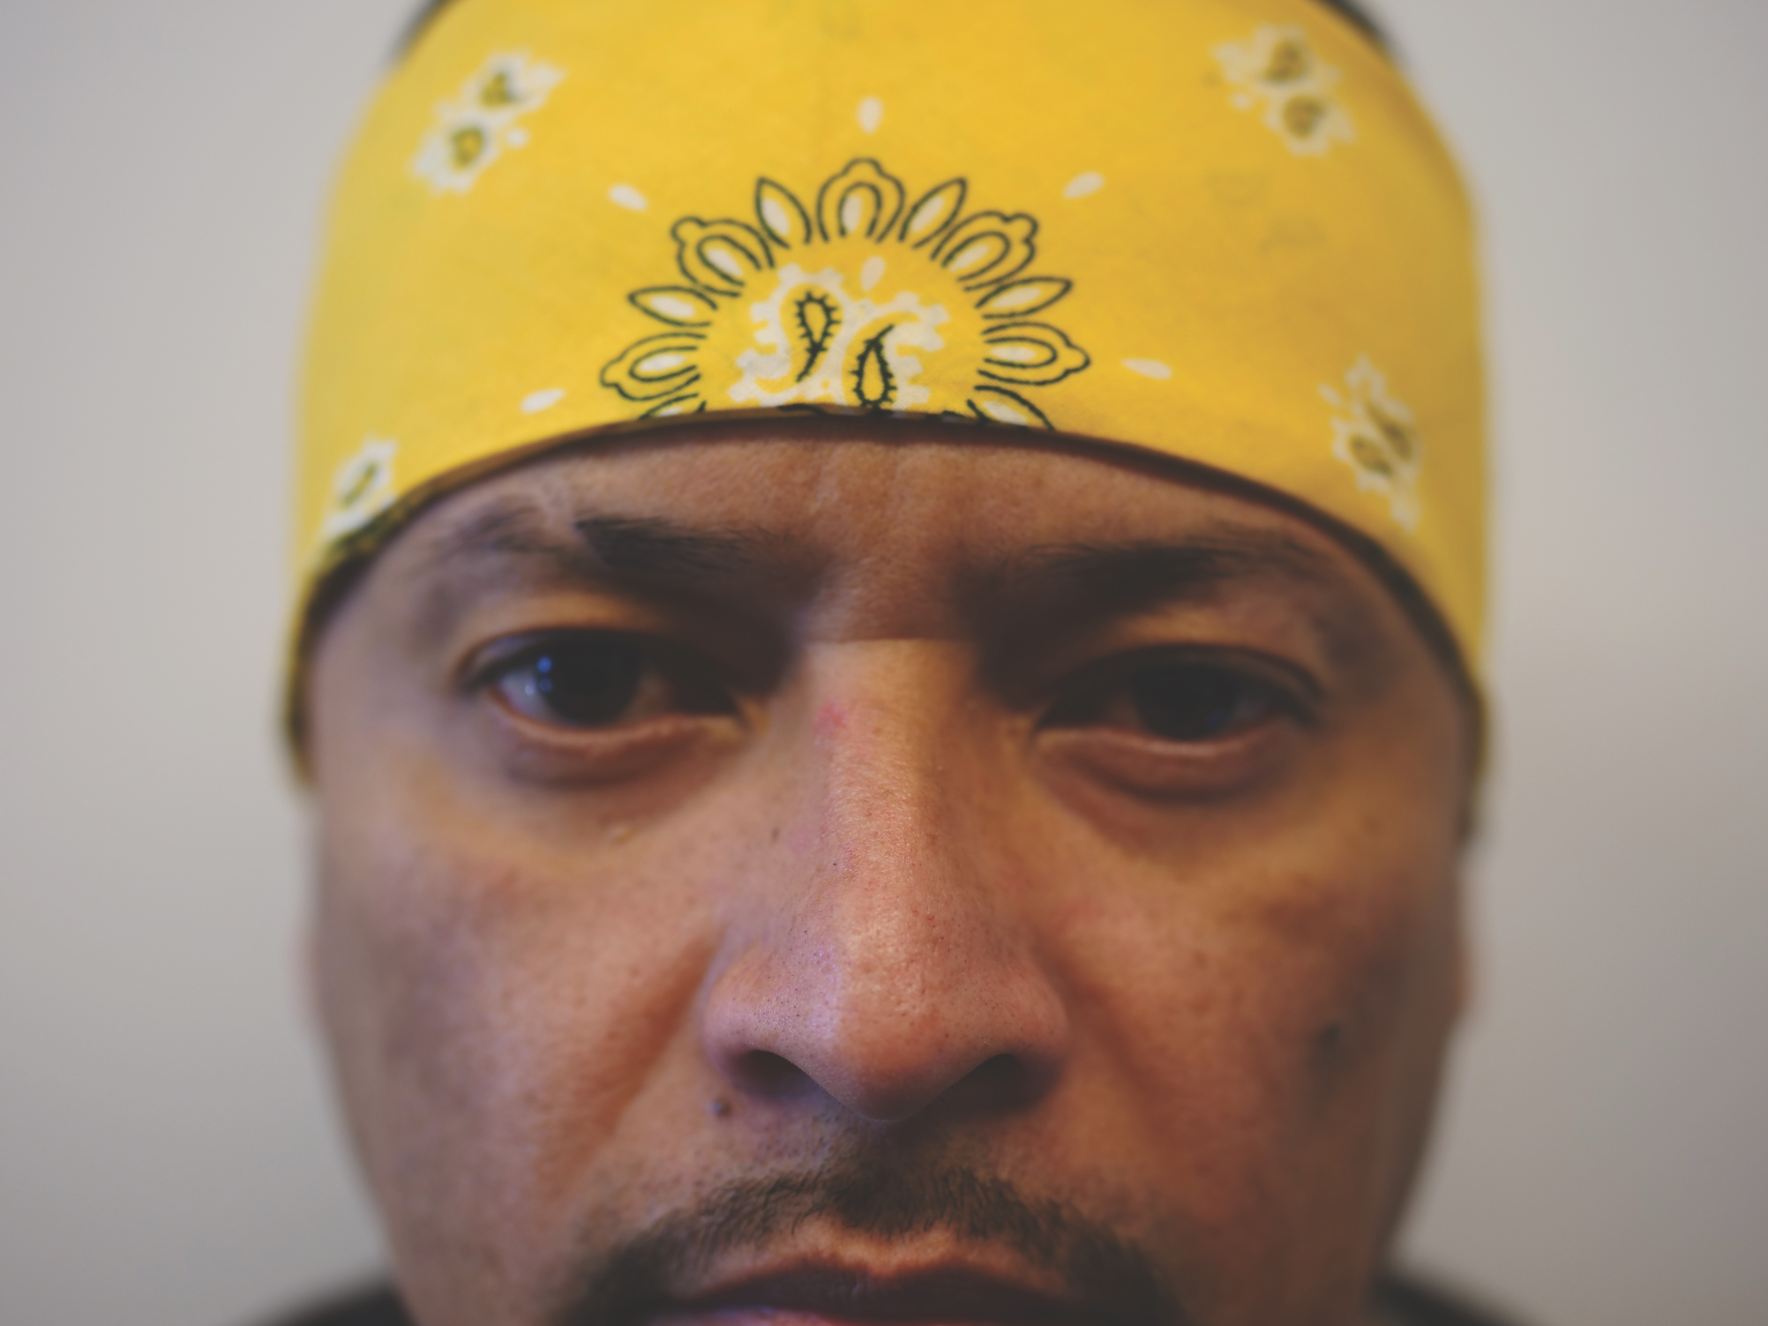
The TRANSGANG project
There is a lot of research into gang culture, but for all these years, the focus has been on criminal activities and violent behaviour. Few people have considered how gangs can have a positive influence. This includes, for example, forming a welcoming place for new members migrating from a different country or being the first on the scene to help the community, such as in 2017 when a massive earthquake hit Mexico.
“In short, we need new ways of talking about youth gangs in the global era and this project sets out to fill this gap.”
Carles, José and their international team are looking at successful cases of youth gangs and social inclusion. Their TRANSGANG project focuses on Latino and Arab youth gangs from several locations in the Americas, Southern Europe and North Africa, and across different gang cultures, including pandillas, clicas, combos and maras – words to describe gangs or street groups.
“Our aim is to help these populations integrate in society, acknowledging their circumstances and youth culture.”
For the researchers, mediation is key.
Carles with César Andrade
Arteaga, a member of the Latin Kings gang and assistant researcher.

Slide 5
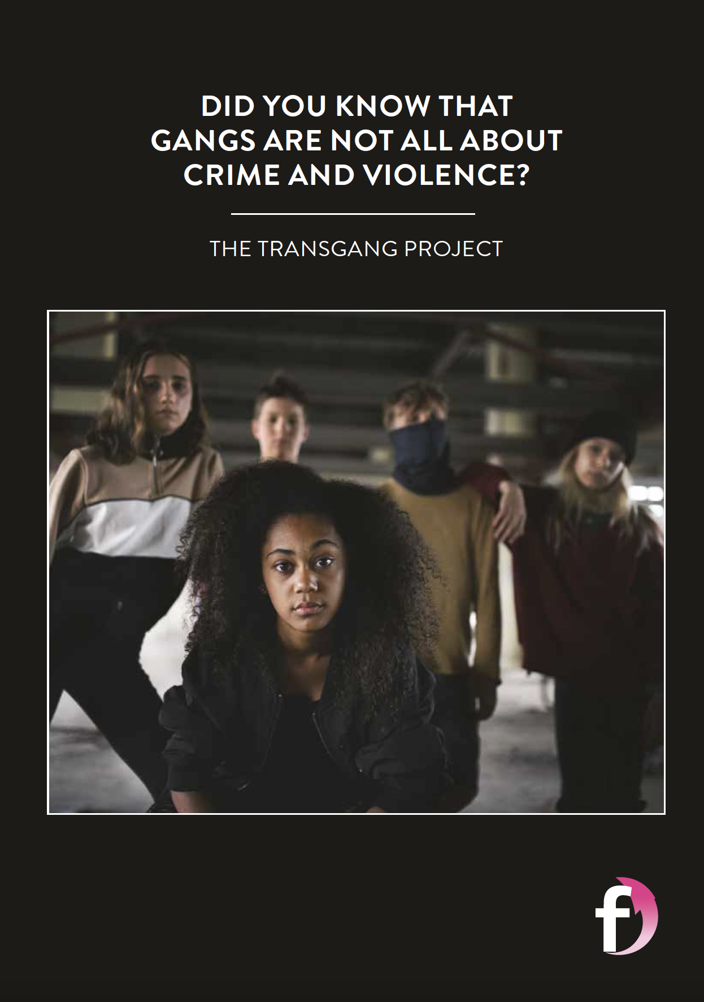
What does mediation mean?
Why are we focusing on mediation?
We have given two examples of gangs having a positive impact on society. What other examples can you come up with?
To learn more about the TRANSGANG project, read his Futurum article.
For discussion points and activities you can do at home or in the classroom,
visit his activity sheet.

Slide 6
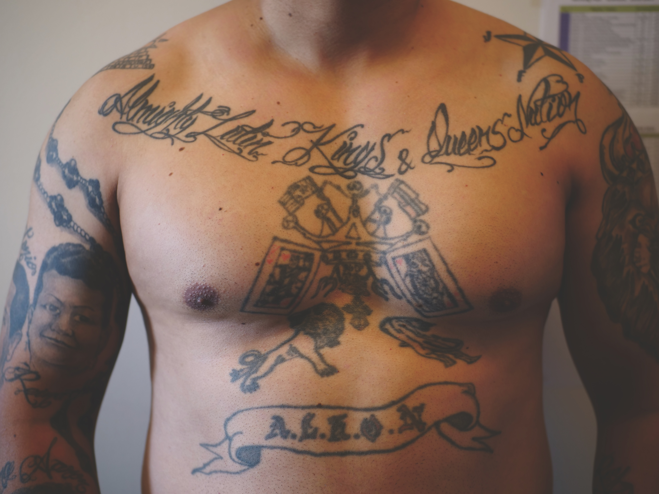
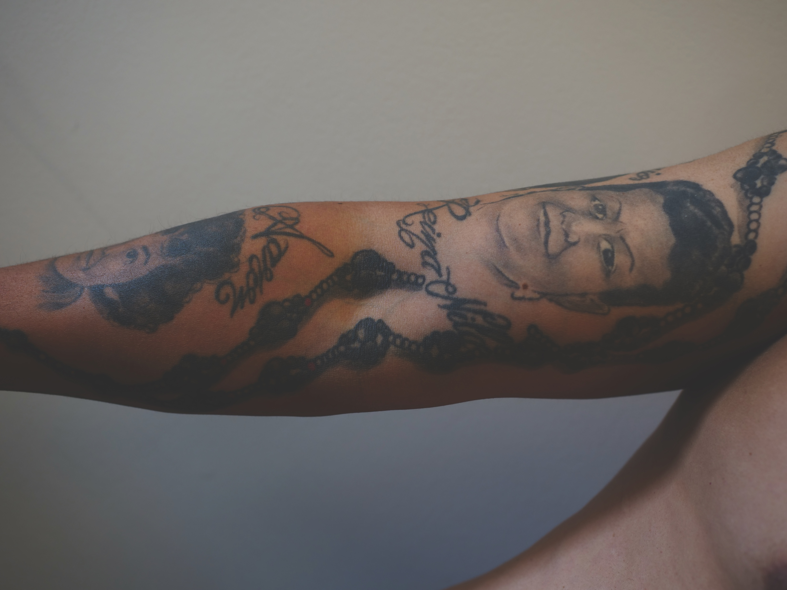
About anthropology
In very general terms, anthropologists ask questions about people, their culture and environment.
A popular misconception is that anthropologists only study remote tribes. While this is true for some researchers, many others – like Carles and José – carry out their work in a city environment and seek to understand how people behave in different, everyday scenarios.
The TRANSGANG project looks at ways to resolve conflicts within gangs, between gangs, and between gangs and their social environment. Social environment means the culture that an individual is educated or lives in, and the people and institutions with whom they interact.
“Anthropology
gives you tools to be a better person and
develop true empathy towards others. As an
anthropologist, you can improve your critical
thinking and respect for cultural diversity, and set up development projects to help people”.
- José
Notes:
Intro to subject ‘About…’

Slide 7
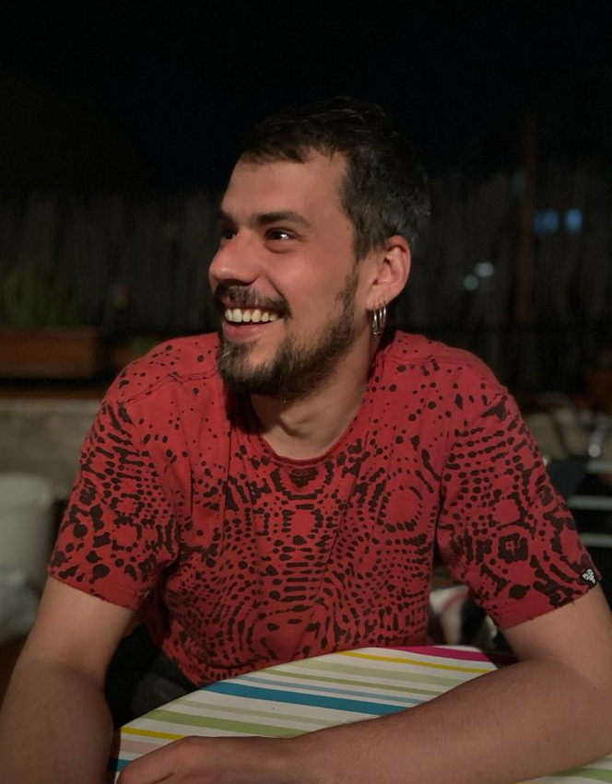
MEET DR EDUARD BALLESTE, AN ANTHROPOLOGIST WORKING ON THE TRANSGANG PROJECT IN BARCELONA, SPAIN
Do you have critical thinking skills? What about empathy and respect for cultural diversity?
WHAT DID YOU WANT TO BE WHEN YOU WERE YOUNGER?
I was not sure what I wanted to be. It was difficult to imagine a trade or a career to which I would like to dedicate myself. Even so, I have always liked everything related to history (movies, books, museums, etc.).
HOW DID YOU END UP STUDYING SOCIAL ANTHROPOLOGY?
It was a mix between chance and opportunities that opened up. I like the search to understand meanings, cultures and worlds that, although geographically close, could be unknown to me. Finally, fate gave rise to an opportunity (both economic and academic infrastructure) to do a PhD in social anthropology and be able to fully enter this field.
WHAT CAN YOUNG PEOPLE WHO ARE NOT GANG MEMBERS LEARN FROM THIS PROJECT?
The project itself goes beyond gang members. Understanding the experience of living
in the margins of society, whether through gangs or other groups, allows us to
understand how exclusion and stigmatisation affect specific groups.
Notes:
Pathway

Slide 8
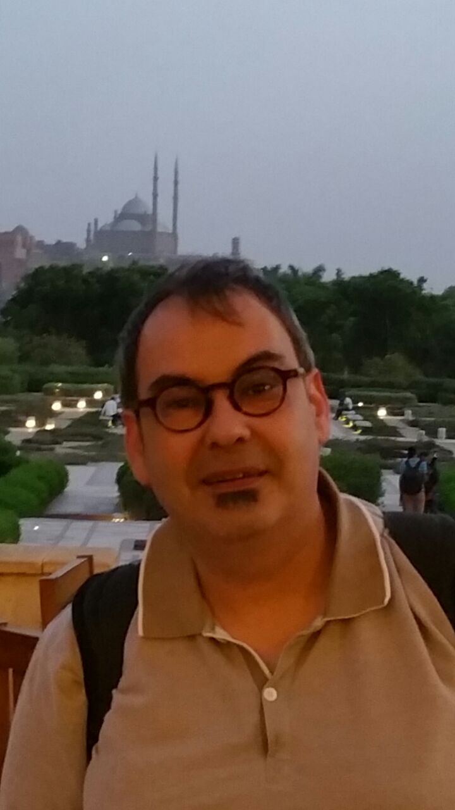
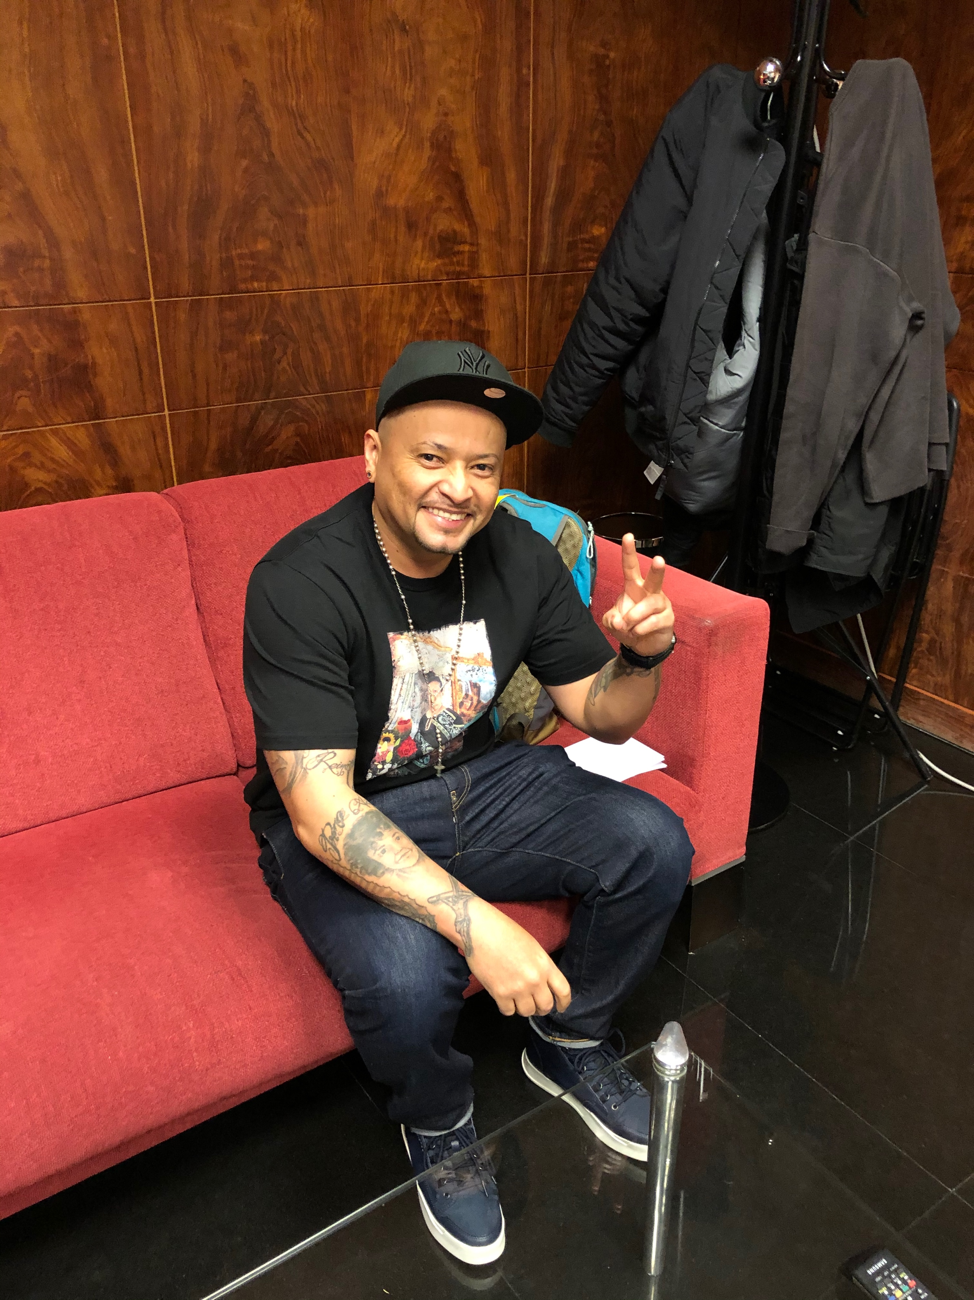
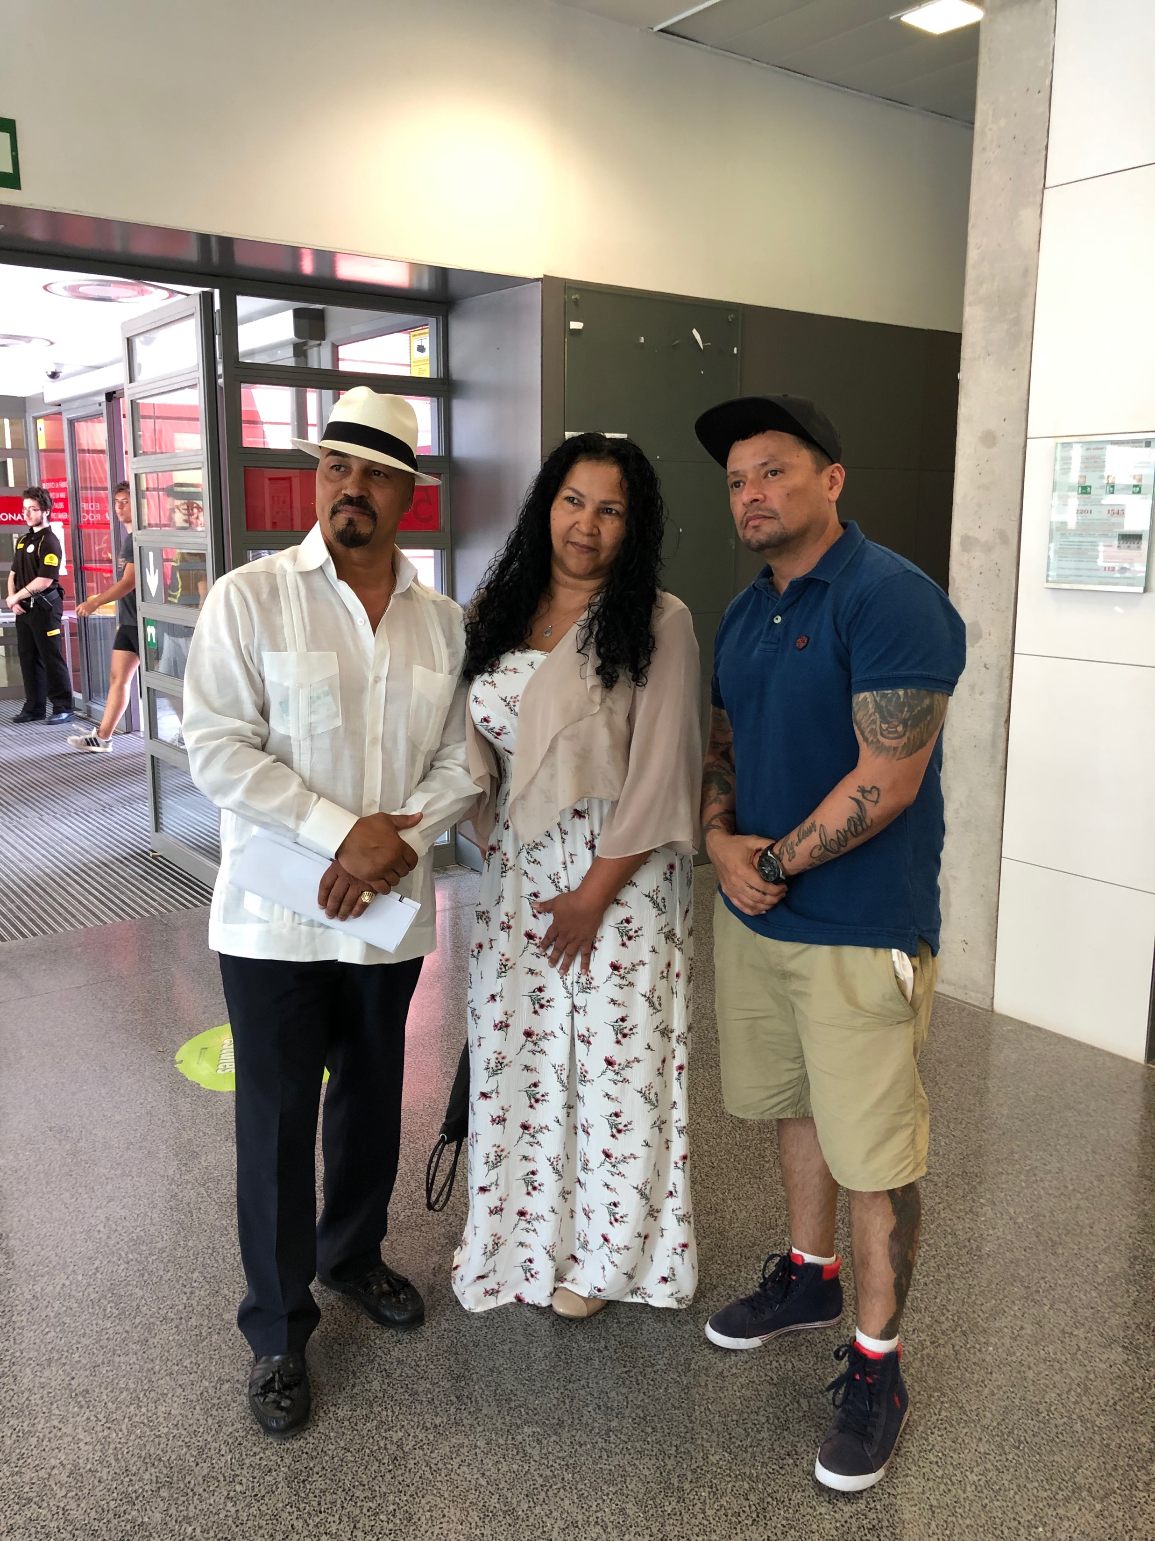
Pathway to anthropology
If you are interested in people, human behaviour, culture and social relationships, anthropology may be the subject for you. Carles and José recommend studying social sciences or humanities such as geography, history, sociology and psychology.
At degree level, anthropology, social anthropology or biological anthropology are good options.
Many honours courses combine other social sciences or vocational subjects such as law:
https://www.topuniversities.com/courses/anthropology/guide
Many courses have the option to study abroad for a year. This is the best way to develop your understanding of anthropology across the world.
Anthropology gives you skills that
can be applied in different
environments, such as problem solving,
communication, presentation and reasoning –
all of which are highly valued by employers.

Slide 9
What does stigmatisation mean?
How do you think exclusion and stigmatisation affect people?
Why do employers need people to have problem solving, communication, presentation and reasoning skills?
Which skills do you need to develop? How could you develop them?
Notes:
Talking points

Slide 10
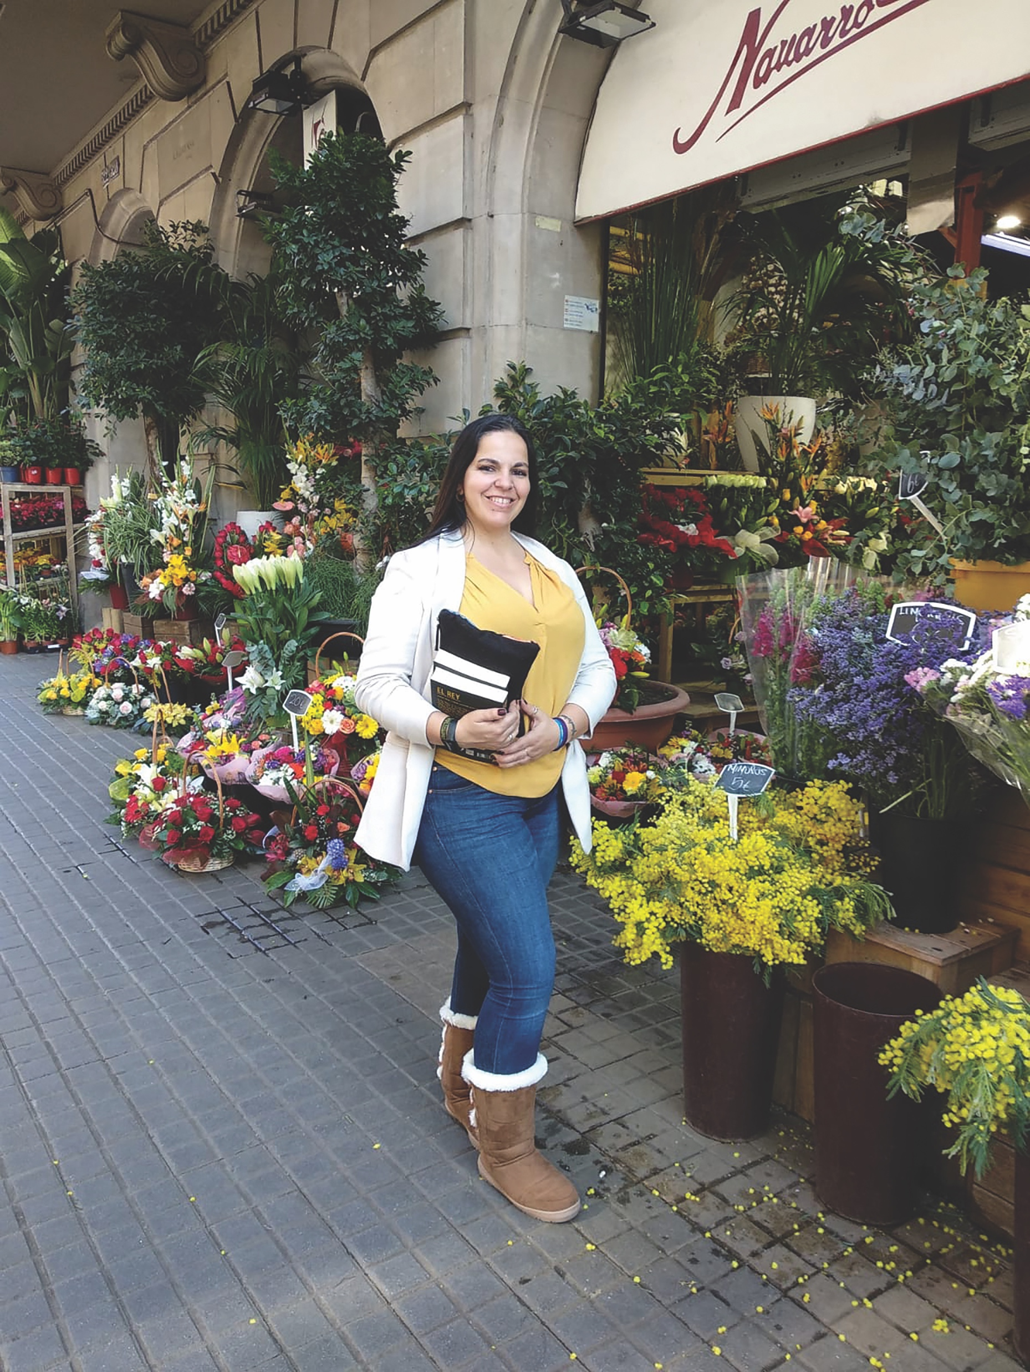
MEET MARÍA OLIVER TORRES, TRANSGANG RESEARCHER IN MADRID, SPAIN, AND EX-MEMBER OF THE LATIN QUEENS
“I had some Latino friends from Ecuador who proposed to create a group of the Latin Kings & Queens Nation in my hometown, so I decided to join. I was the only female in this group when it started in Madrid in 2000. I joined the group because I was tired of witnessing Latinos being abused, physically and verbally, in the streets, in their jobs and in their free time. I have always been someone who seeks social justice; I’m an anti-racist and a fighter for equality, values that are at the core of the Latin Kings & Queens Nation.
When more girls started to show up from Ecuador, or to join the group in Spain, the Latin Queens group took shape and I eventually joined them. I found a community of sisters that provided mutual support and that became more and more independent from the group of men as time passed. I found sisterhood there, even before I knew the word existed.
My experience with the Latin Queens has brought empathy and sorority. For us women, we are raised in a world that tells us we have to be enemies, to fight for male attention, to be pretty, to be nice, to wear uncomfortable clothes to look good, etc. The Queens’ standards told us to help and support each other, grow together, be independent, strong, and have self-worth, without male validation. We promoted collaboration instead of competition. These values are good for any teenager in the Western world who feels that her actions, body and even her feelings are being constantly monitored.
Notes:
Pathway

Slide 11
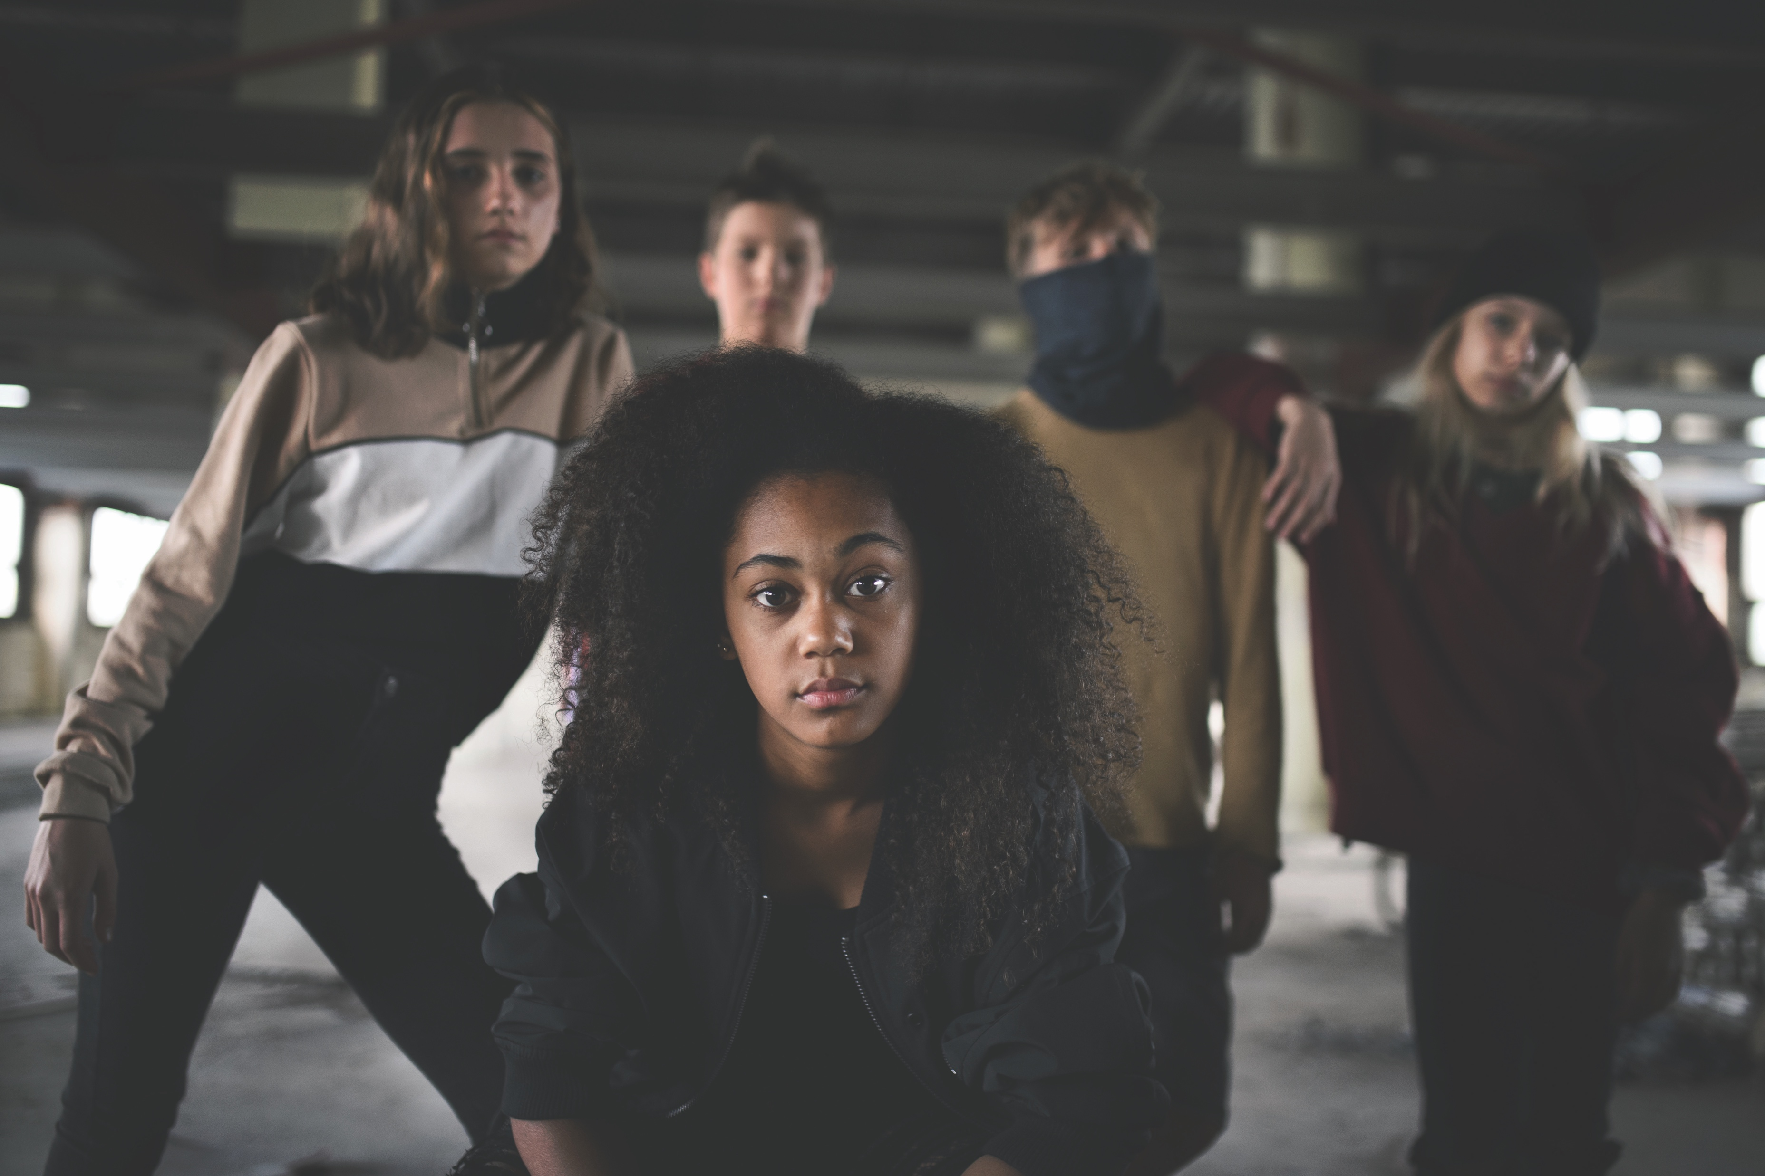
MARÍA OLIVER TORRES
“I also learned the value of diversity, different cultures and community. The sentence “it takes a village to raise a child” is one that comes to my mind when I reflect over these issues now.”
Do you feel that your actions, body and feelings are constantly being monitored?
What does ‘it takes a village to raise a child’ mean?
Notes:
Top Tips

Slide 12
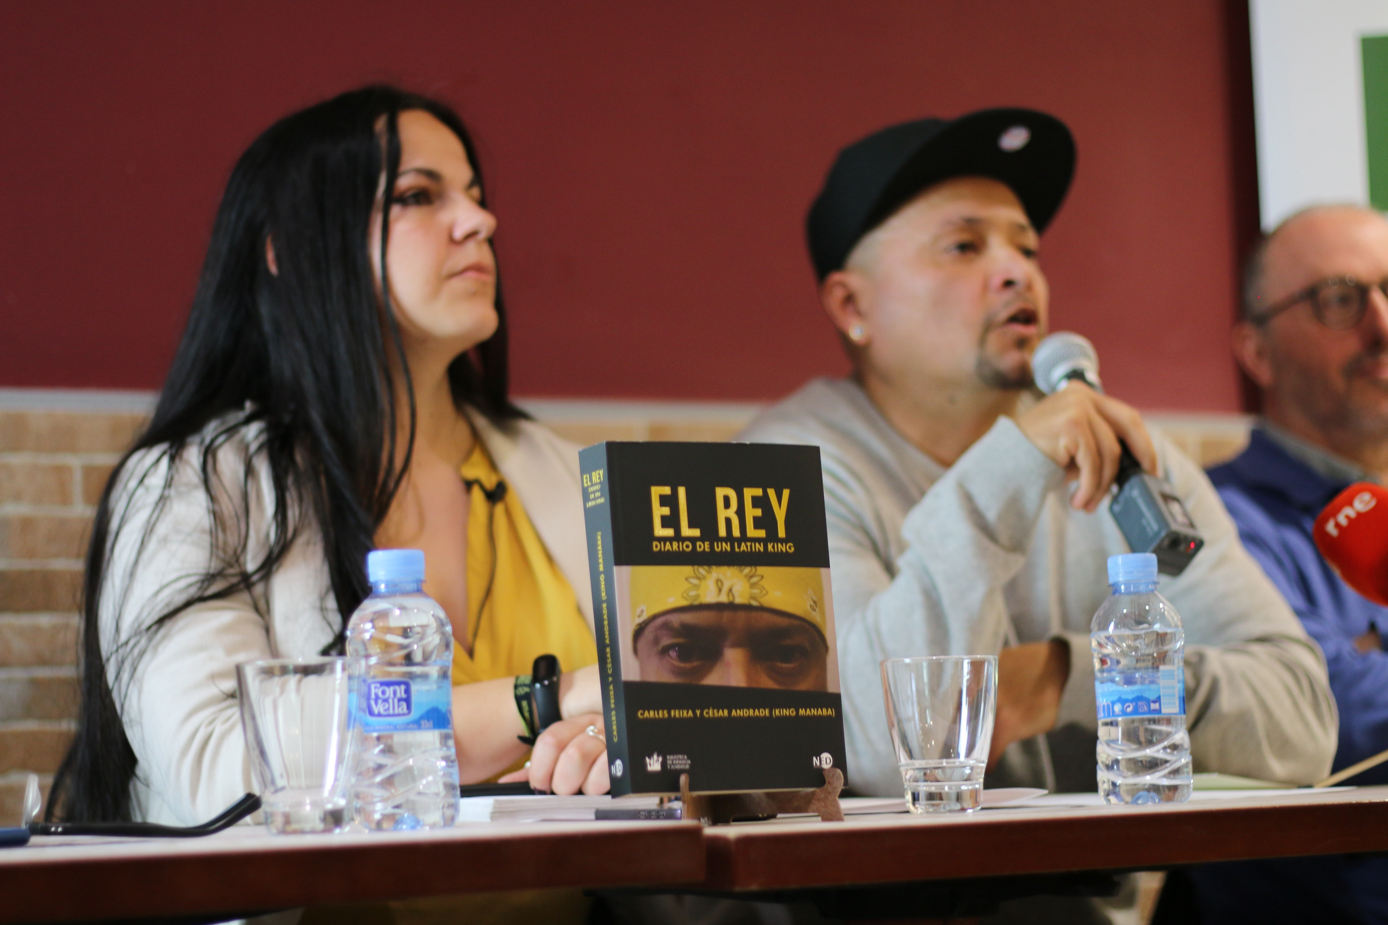
What is clear is that gangs themselves are not the problem. Indeed, they can be active agents in the search for solutions. Young people, especially those from a deprived background or another country, join these groups for solidarity and as a part of growing up.
If gangs are formed under strong moral codes of conduct and rely on mediation rather than violence to solve their conflicts, these groups can be a very positive force in society. In this scenario, senior members are ideally placed to support newcomers and steer them into responsible adulthood.
Notes:
Talking points/Evaluation

Slide 13
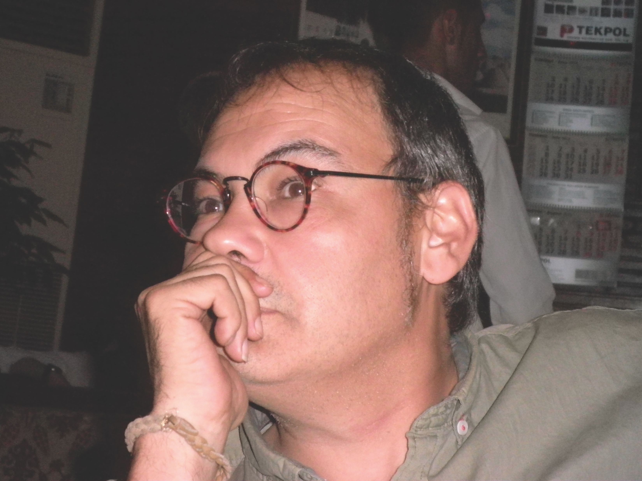
FINALLY…. an ethical dilemma
Researchers on the TRANSGANG project have to follow a strict code of ethics. They are studying members of youth street gangs, many of whom may be teenagers and therefore considered minors. Carles, José and the TRANSGANG team have to ask themselves a lot of ethical questions.
For example, only teenagers aged 14 and over were invited to take part in the project, but are 14-year-olds experienced enough to understand what it means to be involved?
Do their parents or legal guardians need to be informed?
What if by telling parents or legal guardians, the child is at risk from harm?
If a gang member admits to taking part in a criminal activity, should the police be informed?
What do you think?

