Slide 1
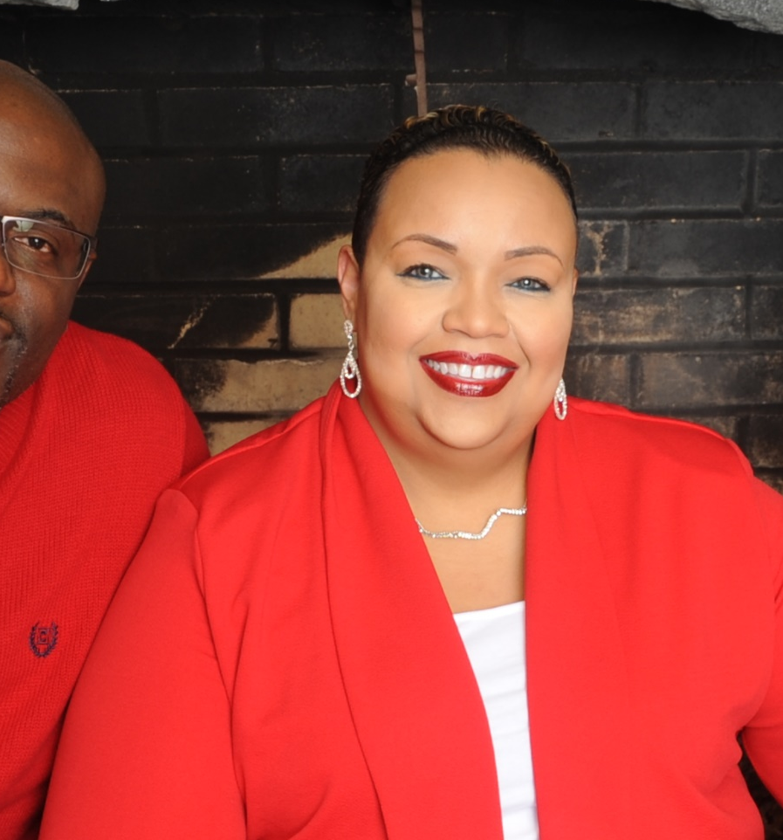


Health Promotion
with
Dr. TanYa Gwathmey
GET STARTED

Slide 2



In this Presentation:
Introduction
TanYa’s Research and Career Journey
Talking Points
About Health Promotion
Pathway from School to Health Promotion
Careers in Health Promotion
Meet TanYa
Talking Points
More Resources
© pixelheadphoto/Shutterstock.com
02 futurumcareers.com

Slide 3
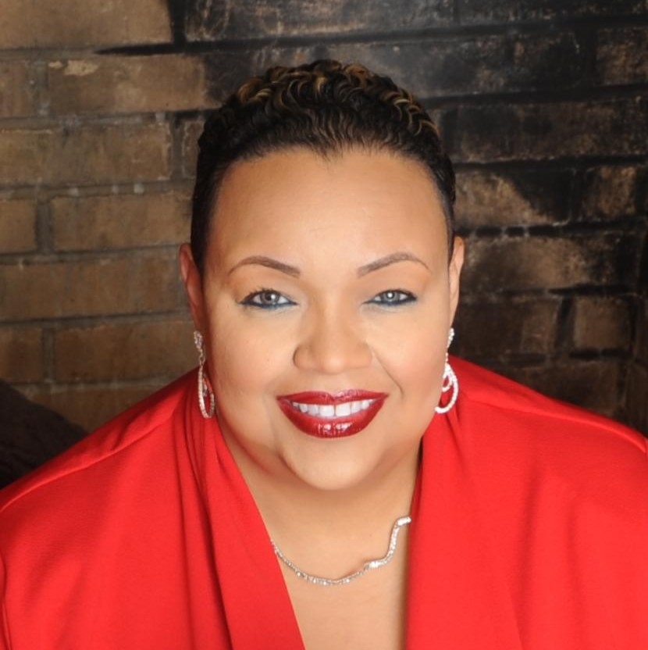
Meet TanYa
Dr. TanYa Gwathmey is a health promoter at Wake Forest University School of Medicine in the US.
She co-leads the Triad Pastors Network, a partnership between churches in North Carolina and the Maya Angelou Research Center for Healthy Communities (MARCH).
She believes that health education is better received by African American communities when it is delivered by trusted faith leaders.
Dr. TanYa Gwathmey
03 futurumcareers.com

Slide 4
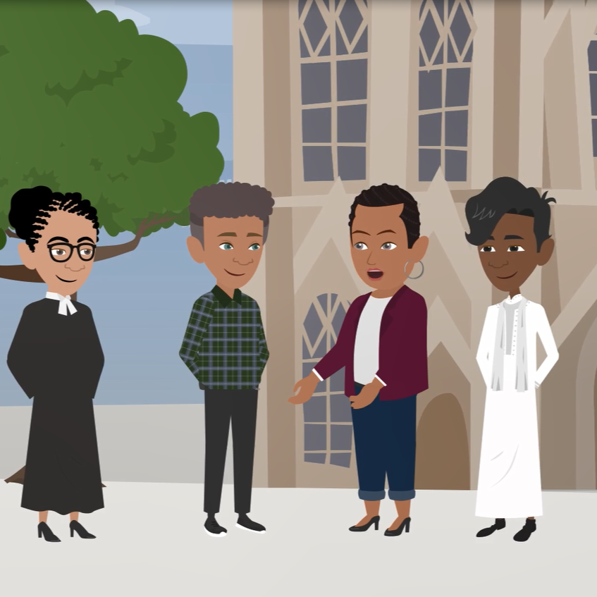
Learn about TanYa’s Research and Career Journey
The animation on the following slide will introduce you to TanYa’s research and career journey.
You can also find it on TanYa’s Futurum page: www.futurumcareers.com/health-promotion-with-dr-tanya-gwathmey
Or watch it on YouTube:
youtu.be/fiKkGrrUL_E
04 futurumcareers.com

Slide 5


Slide 6
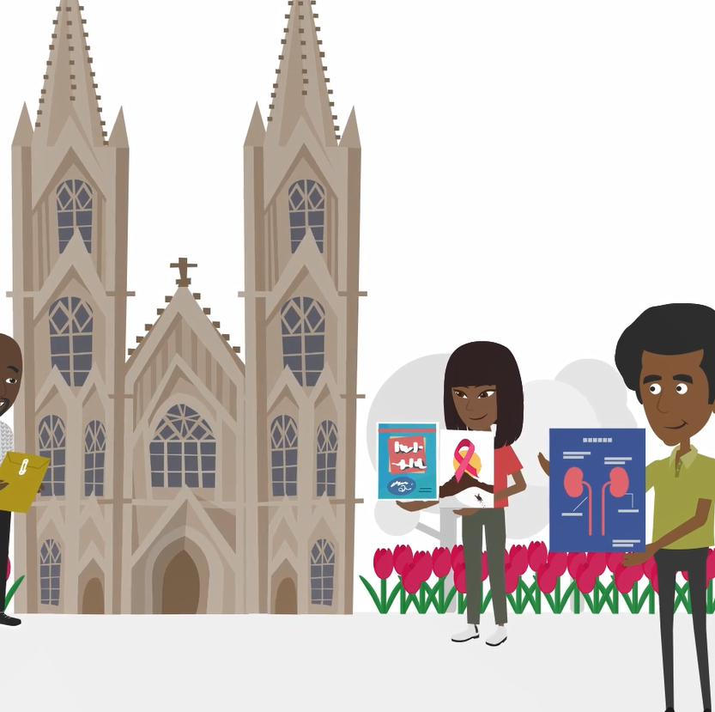
Animation Summary
TanYa’s childhood experiences of watching her mother care for sick family members inspired TanYa to improve health outcomes in communities with limited access to healthcare.
Evidence shows that people are more likely to trust healthcare information if it is provided through groups that they have a connection with.
The Triad Pastors Network (TPN) is a partnership between health researchers and Christian faith leaders from African American communities in North Carolina.
As a health promotor with the TPN, TanYa creates educational resources about health issues impacting different church congregations, and she trains church members to educate others about how to prevent and manage health conditions.
06 futurumcareers.com

Slide 7


Talking Points
How have TanYa’s life experiences influenced her career journey?
Why do you think health education is better received by African American communities if it is delivered by local churches rather than by healthcare organizations?
Why is it important that health education is adapted to the specific needs of a community?
How does the Triad Pastors Network take a community-driven approach to health promotion?
07 futurumcareers.com
© Zamrznuti tonovi/Shutterstock.com

Slide 8
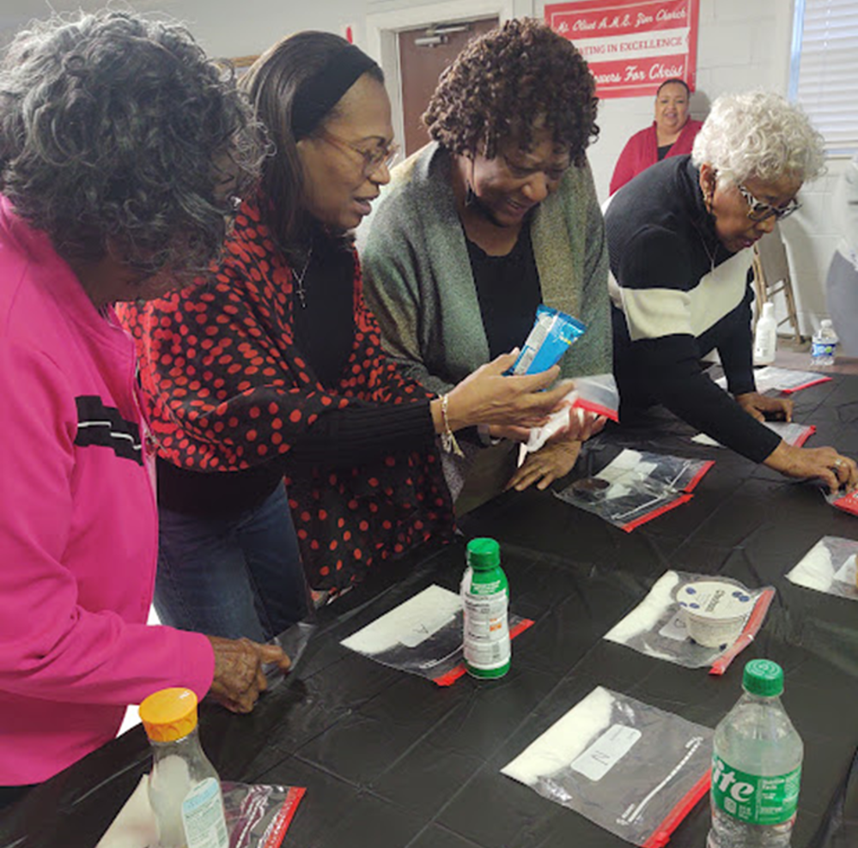
About Health Promotion
Health promotion focuses on health education and disease prevention.
Health education involves raising awareness of health issues. This includes normalizing conversations about health and illness.
Disease prevention involves encouraging people to take preventative action before illness strikes.
Health promotion aims to improve health and overall well-being. This is particularly important in communities where access to healthcare is limited, and communities may not be engaged with the health care systems for several reasons.
During a TPN activity, congregation members learn about the nutritional composition of common foods
08 futurumcareers.com

Slide 9
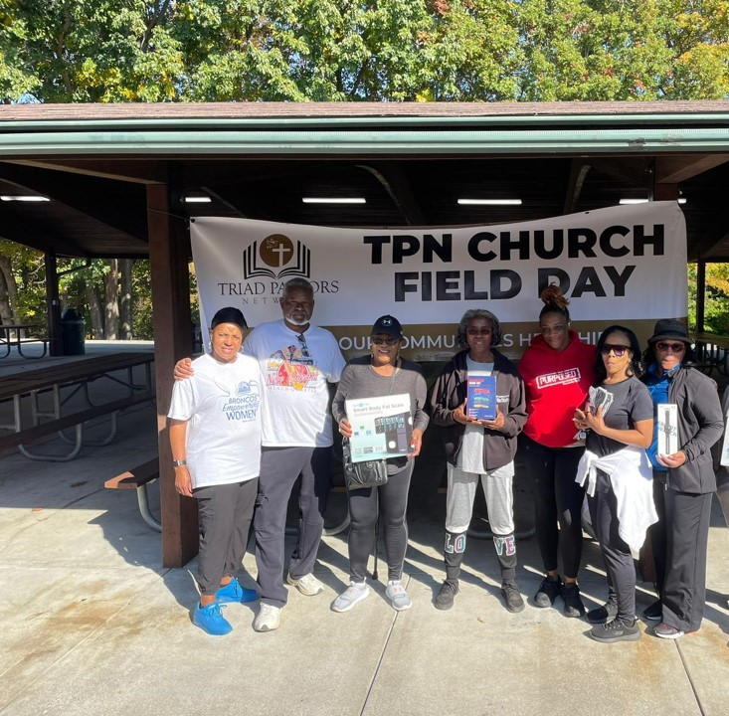
About Health Promotion
“I spent much of my childhood watching my mother take care of family members who needed medical care. It wasn’t until I was about 11 that I realized she was not actually a nurse. Many of my
family members did not have access to healthcare or did not trust healthcare professionals and consequently, I saw many of them die at young ages.” – TanYa
This motivated TanYa to dedicate her career to improving health outcomes in communities with limited access to healthcare. Now, as a researcher and health promoter, she focuses on addressing the factors that prevent people from getting the care they need.
During the TPN Church Field Day, churches gather to promote physical activity among their members
09 futurumcareers.com

Slide 10
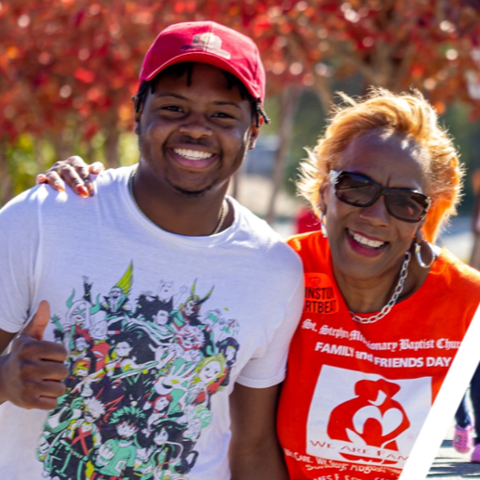
Pathway from School to Health Promotion
There are many pathways to a career in health promotion, depending on the role that most interests you.
“This means that health promotion is open to everyone who has an interest and commitment.” – TanYa
At school, you could study biology, chemistry, math, social studies or psychology. At college or university, you could study biomedical science, molecular biology, biochemistry, public health, biostatistics or epidemiology.
Many community health worker roles do not require a university degree. Look for internships where you can train while working.
TPN members participate in the American Heart Association Heart and Stroke Walk
10 futurumcareers.com

Slide 11
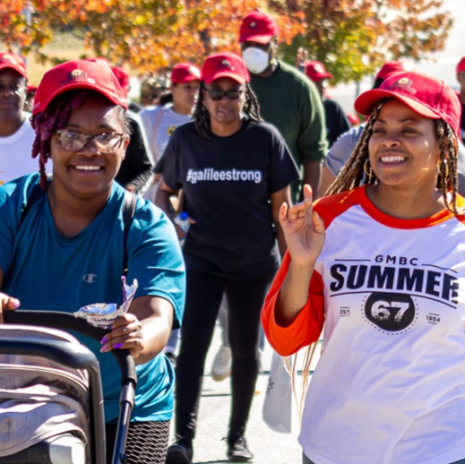
Pathway from School to Health Promotion
Look for opportunities to gain practical experience in healthcare settings. For example, the Maya Angelou Research Center for Healthly Communities offers internships for students to explore health promotion work.
“There is no better way to find out what appeals to you than simply trying it!” – TanYa
Explore organizations such as the Office of Disease Prevention and Health Promotion, the Global Health Council, and the World Health Organization to find articles, educational resources and careers advice about health outcomes, public health and health promotion.
TPN members participate in the American Heart Association Heart and Stroke Walk
11 futurumcareers.com

Slide 12
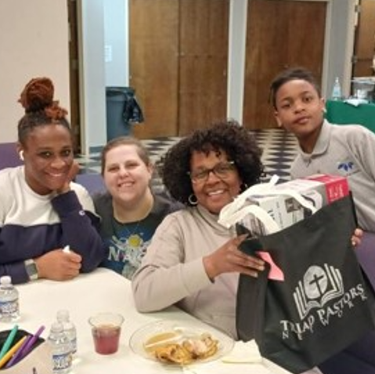
Explore Careers in Health Promotion
Careers in health promotion include clinical roles (providing healthcare to patients), teaching roles (providing health education), academic roles (conducting research to improve health outcomes), and community health worker roles.
“Whether you are outgoing and enjoy interacting with others, analytical and prefer studying and analyzing research, passionate about working with data to track trends and outcomes, or creative and enjoy designing materials to communicate health information, there is a role for you in health promotion.” – TanYa
TPN health ambassadors receive blood pressure equipment
12 futurumcareers.com

Slide 13
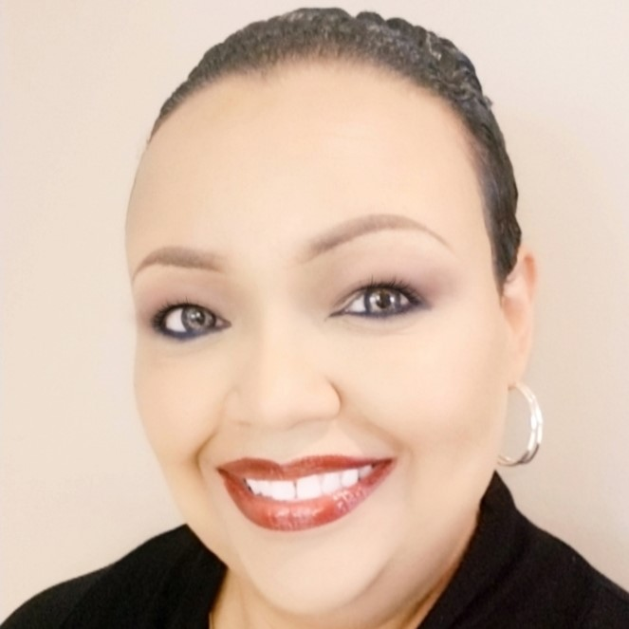
Meet TanYa
As a teenager, I was very interested in reproduction and wanted to become an obstetrician (someone who delivers babies).
In college, I was exposed to the concept of research and had the opportunity to work with a neonatologist (a doctor who cares for babies who are born early or with medical problems) who studied hypertension (high blood pressure) in newborn babies. We also explored hypertension in sheep, as an animal model.
This translational research was mind-blowing to me and solidified my interest in becoming a biomedical researcher.
13 futurumcareers.com

Slide 14
Meet TanYa
My oldest sister, who worked as a nurse for many years, inspired my interests in science and healthcare. While my original intent was to become a clinician, my involvement in research quickly became important to me and caused me to shift my career aspirations.
As I recognized opportunities to apply my research experience to communities that resembled my family and loved ones, it became clear that I needed to serve as an advocate for those who didn’t have a good understanding of health or the ability to access it.
14 futurumcareers.com

Slide 15
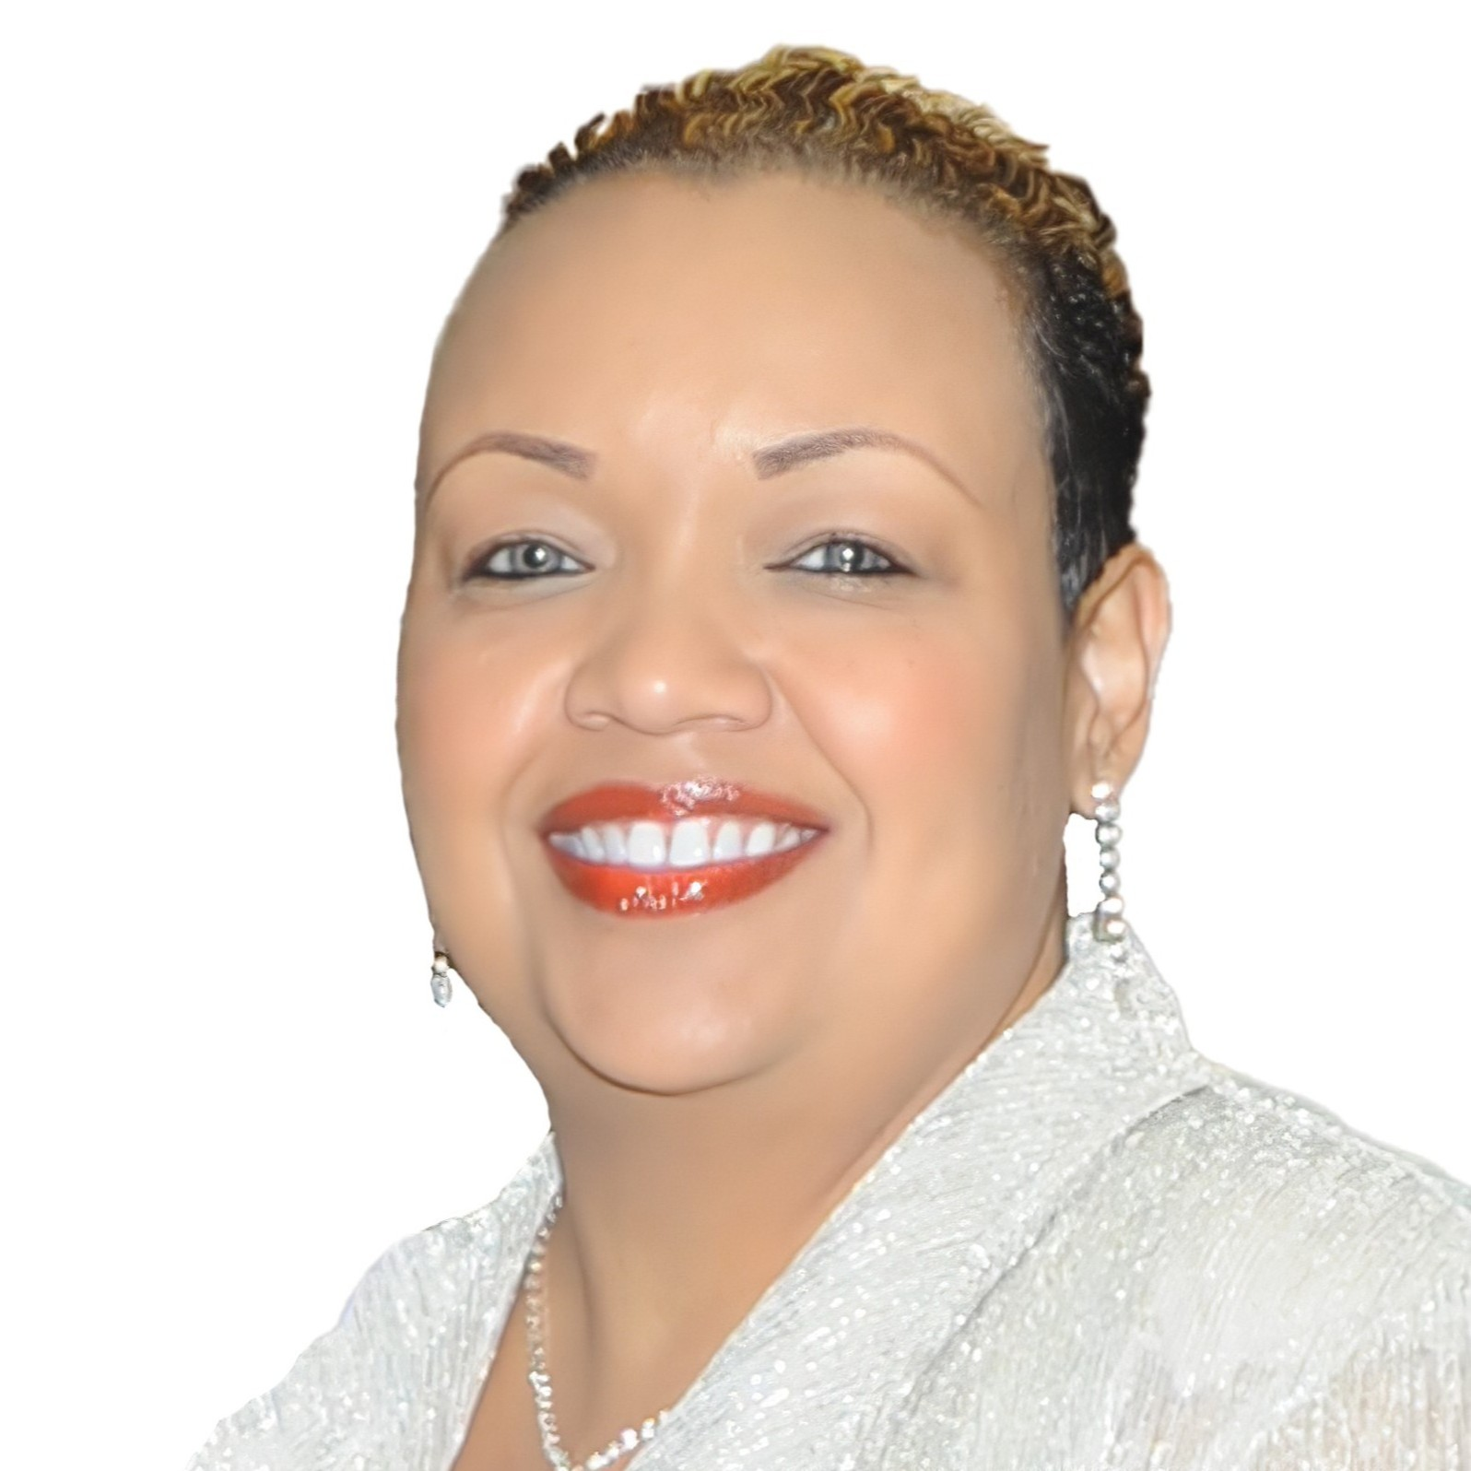
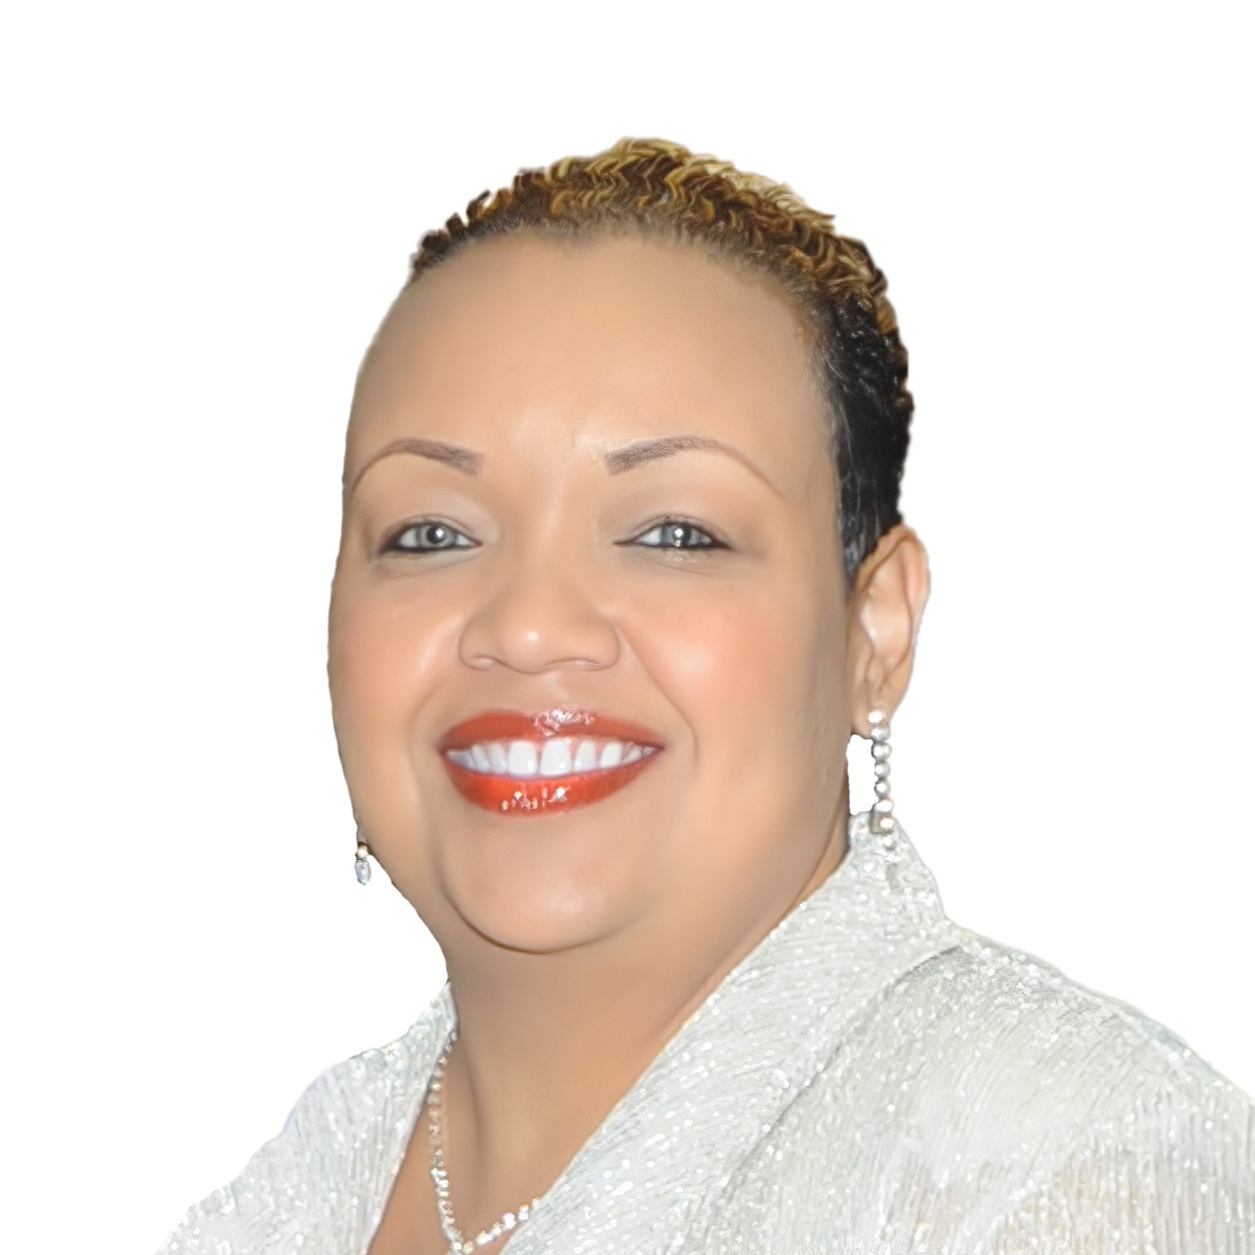
TanYa’s Top Tips
Find good mentors. I have learned so much from my mentors throughout my career. There is not one person who can teach you everything, but you can learn many things from those who have been where you would like to go. You may find advocates in places that you least expect.
Stand firm when you find something you enjoy doing. There will be plenty of obstacles that you encounter along the way. Make up your mind to stay the course, even when things get challenging, or others begin to doubt you. Anything worth having is worth working for!
15 futurumcareers.com

Slide 16
Talking Points
Why is it important to normalize conversations about health and illness?
Which career in health promotion most interests you, and why?
How could you contribute to improving health outcomes through your chosen career in health promotion?
What personal qualities do you have, and how could these align with a career in health promotion?
16 futurumcareers.com
© Zamrznuti tonovi/Shutterstock.com

Slide 17
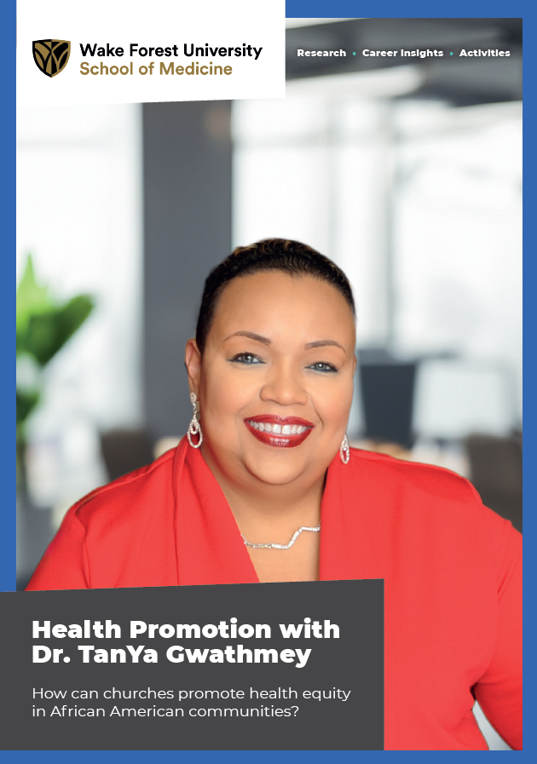
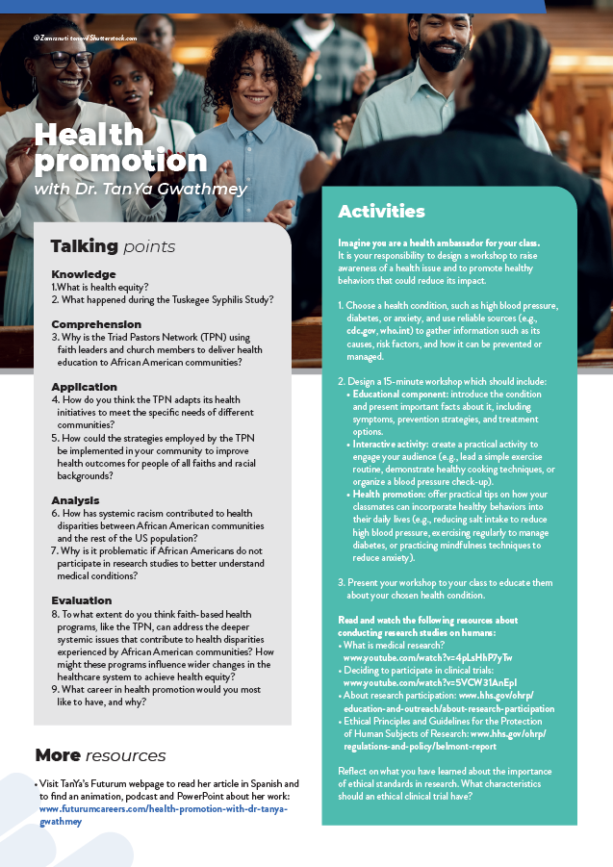
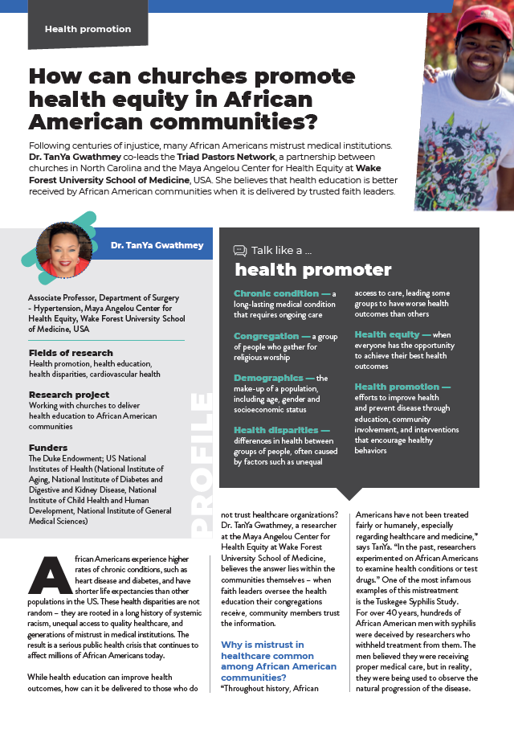



More Resources
UPDATE IMAGE WHEN COMPLETED
Read the article
Complete the activities
Listen to the podcast
Watch the animation
Download the Spanish resources
17 futurumcareers.com
© Zamrznuti tonovi/Shutterstock.com

Slide 18
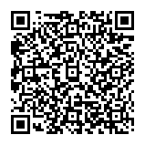



This educational material has been produced by Wake Forest University School of Medicine in partnership with Futurum and with grant support from The Duke Endowment.
The Duke Endowment is a private foundation that strengthens communities in North Carolina and South Carolina by nurturing children, promoting health, educating minds and enriching spirits.
Let us know what you think of this educational and career resource.
To provide input, simply scan the QR code or access the link below:
redcap.link/dh5j1nes

