Slide 1
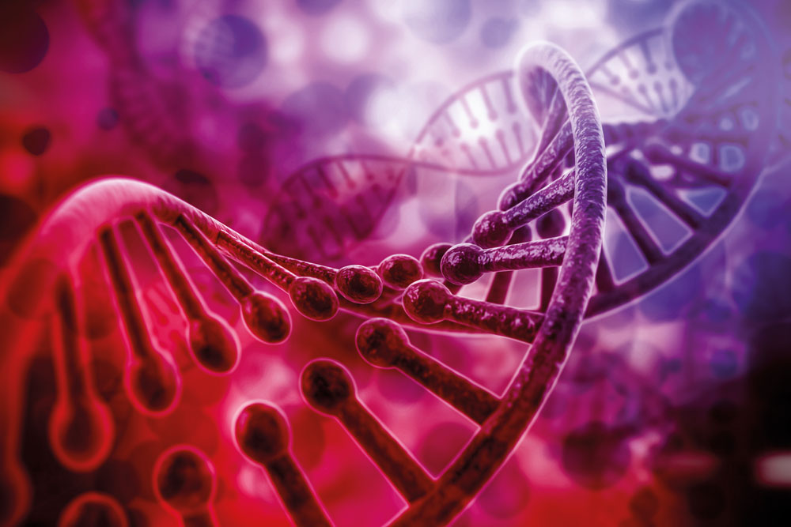
THE APPLICATION OF DNA IN THE REAL WORLD
DR KRISTINA AMES
GET STARTED
www.futurumcareers.com
© xsense/Shutterstock.com

Slide 2
In this presentation:
Meet Kristina
The ‘central dogma’
Pitstop plenary
What is DNA?
Pitstop plenary
Ethical questions
Research challenges
More resources
© Yurchanka Siarhei/Shutterstock.com
02 futurumcareers.com

Slide 3
Meet Kristina
Dr Kristina Ames is the Assistant Director for Cancer Research Training and Education Coordination (CRTEC) of the Montefiore Einstein Cancer Center at the Albert Einstein College of Medicine in New York, USA.
Before we think about the applications of DNA in the real world, Kristina will talk us through the ‘central dogma’ of biology and explain what DNA is…
Dr Kristina Ames
03 futurumcareers.com

Slide 4
Kristina explains the ‘central dogma’
“The central dogma of molecular biology was formulated by Dr Francis Crick, a British scientist, in 1958.
It has been viewed as a fundamental principle of biology and explains the flow of genetic information: DNA specifies RNA and RNA specifies protein.
As the starting principle for understanding the basic information flow in biological organisms, it provides a solid foundation for life sciences.
Understanding this concept will give you a deeper appreciation of molecular biology and how cellular processes are interconnected.
The central dogma can be used to understand DNA structure and function, transcription and translation, gene expression, and molecular genetics.”
04 futurumcareers.com
The ‘Central Dogma’ – from DNA to protein (created with Biorender.com)

Slide 5
How has understanding of the dogma changed in recent years?
“In most cases, genetic information is transferred in the direction from DNA to RNA to protein – but there are exceptions.
There are factors other than DNA that specify proteins, and the flow of the information does not always go in the direction from DNA to proteins.
Since the dogma was first formulated, scientists have learnt that DNA specification of RNA can be reversed.
There is a group of viruses called retroviruses, including the human T-cell lymphotropic virus type 1 (HTLV-1) and the human immunodeficiency virus (HIV), that reverse transcribing strands of RNA to DNA using an enzyme called reverse transcriptase.
Series of proteins are responsible for modifying the DNA segment – reverse transcriptase transcribes RNA into DNA, and integrase incorporates the new DNA segment into the existing DNA, demonstrating how proteins can specify DNA.”
05 futurumcareers.com

Slide 6
“Another interesting exception to Crick’s central dogma is the unique prion example.
Prion diseases are rare, degenerative and fatal neurological disorders such as Creutzfeldt-Jakob disease CJD) and fatal familial insomnia (FFI).
Prions are abnormal agents that are infectious and produce atypical folding of normal cellular proteins. In the case of prions, abnormal proteins infect and change normal proteins, rather than reproduce.
Prions do not contain genetic material in the form of nucleic acids and they do not multiply, but they affect similar proteins – often in the brain – by behaving as templates to convert other naturally occurring proteins into their abnormal shape.
Exceptions to the rules, like these exceptions to the central dogma, are one of the reasons why I love exploring cell biology. To be a scientist is to continuously engage in exploration without ever stopping.”
06 futurumcareers.com

Slide 7
Pitstop plenary
What does the central dogma explain?
What does the concept of the central dogma help us to understand?
What have scientists learnt about DNA specification since the dogma was formulated?
What are prions, and what do they do?
What does Kristina love about being a scientist?
07 futurumcareers.com
© xsense/Shutterstock.com

Slide 8
What is DNA, and what does it do?
“DNA is the molecule inside cells that contains the genetic instructions for the cells’ development and function. DNA has a language of nucleotides that it uses to ‘write’ an organism’s instruction manual.
The language of DNA is composed of only four chemical bases: adenine (A), cytosine (C), guanine (G) and thymine (T).
DNA is structured in the form of a double helix, consisting of two intertwined strands resembling a twisted ladder. Each of the DNA strands has a ‘backbone’ made of alternating sugar (deoxyribose) and phosphate groups with one of the four bases (A, C, T, or G) attached to each sugar. The bases on the two strands link together, connecting the two strands of DNA. These four bases arrange themselves in different sequences to create genes that carry different instructions for the organism.
“In a human body, there are approximately 3 billion DNA bases packed into the chromosomes in the nuclei of the cells. About 99% of those bases are the same in every person; the remaining 1% is what makes you unique!
08 futurumcareers.com

Slide 9
Why is the structure of DNA significant?
“The structure of DNA enables genetic information storage, replication and transmission, as well as genetic mutations and diversity. DNA’s double-helix structure allows it to store and transmit genetic information, replicate (make a copy of itself) during cell division and provide the basis for evolution.
The sequence of nucleotides in DNA determines the genetic code that directs protein synthesis, which is essential for cellular function. Thus, DNA’s structure is crucial for understanding the basis of heredity, evolution and biology.”
© Yurchanka Siarhei/Shutterstock.com
09 futurumcareers.com

Slide 10
What is the process of DNA replication?
“DNA replication is the process by which a cell creates an identical copy of its DNA before cell division. The process begins with the unwinding of the double helix structure, creating a replication ‘fork’.
DNA polymerase then adds complementary nucleotides to each strand, creating two new double-stranded DNA molecules. This ensures that each daughter cell (resulting from the division of a single cell) receives an accurate copy of the genetic material.”
© CLIPAREA l Custom media/Shutterstock.com
10 futurumcareers.com

Slide 11
How has the understanding of DNA impacted science?
“The Human Genome Project (1990-2003) generated the first sequence of the human genome. This project provided fundamental information about human genetic makeup and accelerated the study of human biology, drastically improving the practice of medicine.
The Human Genome Project provided three surprising findings:
1. Most of the genome is non-protein coding. Out of 3.2 billion bases, only 1.5% code for specific proteins.
2. Humans have a small number of protein coding genes compared to other species. For example, 46 human chromosomes carry 21,000 protein coding genes, while 12 chromosomes of the rice plant carry 37,000 protein coding genes.
© RFBSIP/stock.adobe.com
11 futurumcareers.com

Slide 12
3. Humans and chimpanzees share 98% of their DNA sequence, and each human on the planet is 99.5% similar to every other human!
DNA is central to our knowledge of biological processes. Errors or mutations in DNA can lead to genetic disorders and evolutionary changes. DNA replication allows timely repair of damaged DNA which is critical for the maintenance and transmission of genetic information.
Not only does DNA serve as the fundamental blueprint for all living organisms, but it also dictates the functioning of our body under normal circumstances, as well as the development and progression of diseases. The more details scientists understand about the structure and function of DNA, the more they can investigate disease pathways, evaluate genetic predisposition to specific diseases, diagnose genetic disorders, formulate new drugs and bring them to the clinic to treat patients.”
© Sashkin/stock.adobe.com
12 futurumcareers.com

Slide 13
Pitstop plenary
1. What is DNA?
2. In what way is DNA similar to an instruction manual?
3. What key findings did the Human Genome Project make? Which of these findings surprises you the most, and why?
4. Which research areas does an understanding of DNA allow scientists to explore?
5. Which of the real-life applications of DNA knowledge that Kristina highlights interests you the most, and why?
13 futurumcareers.com
© xsense/Shutterstock.com

Slide 14
“Now that we know what DNA is, we need to consider some of the controversies and ethical questions related to how our understanding of DNA is applied in the real world.
As technology advances, it is crucial to have ongoing discussions and ethical frameworks in place to navigate these complex issues responsibly.
Read the next few slides and discuss…”
14 futurumcareers.com

Slide 15
Talking points
Ethical questions
Genetic Testing and Privacy
With advancements in DNA sequencing technology, individuals have greater access to genetic testing, which can provide valuable insights into their health risks, ancestry and more. However, concerns arise regarding the privacy and security of genetic information.
Questions to discuss:
Who should have access to this data?
How should it be stored and protected?
What potential does this have for discrimination based on genetic predispositions?
© JLStock/Shutterstock.com
15 futurumcareers.com

Slide 16
Talking points
Ethical questions
2. Genetic Engineering and Gene Editing
Techniques like CRISPR-Cas9 have revolutionised gene editing and have the potential to treat genetic diseases and enhance desirable traits. However, the ability to manipulate the genetic code raises ethical questions.
Questions to discuss:
What should the boundaries of genetic enhancement be?
What is the potential for unintended consequences?
What would be the implications of creating genetically modified organisms (GMOs) without fully understanding the long-term effects?
© peterschrieber.nedia/Shutterstock
16 futurumcareers.com

Slide 17
Talking points
Ethical questions
3. Genetic Discrimination
Genetic information can provide insights into an individual's predisposition to certain diseases or conditions. Ethical concerns revolve around the use of genetic data, as well as protecting individuals from discrimination based on their genetic makeup.
Questions to discuss:
How could this knowledge lead to discrimination in areas such as employment, insurance coverage, and access to healthcare?
How could genetic data be used fairly and responsibly?
© Who is Danny/Shutterstock.com
17 futurumcareers.com

Slide 18
Talking points
Ethical questions
4. Ownership and Patenting of Genetic Material
The question of who owns genetic material, particularly human genes, has sparked debates. Patents on genes have been granted in the past, which raises several concerns.
Questions to discuss:
Who do you think could – and should – own genetic information?
How problematic would it be if one organisation owned and sold this genetic information?
How would this impact access to medical treatments?
To what extent could this hinder scientific research and innovation?
“© Gorondenkoff/Shutterstock.com
18 futurumcareers.com

Slide 19
Talking points
Ethical questions
5. Cloning and Human Reproductive Technologies
The concept of cloning and the use of reproductive technologies to create genetically identical individuals raise ethical questions about the sanctity of life, individuality and the potential for exploitation.
Questions to discuss:
What are the ethical concerns of humans being able to raise ‘designer babies’?
How could reproductive technologies create social inequalities?
How important do you think individuality is to human existence?
© Bluebay/Shutterstock.com
19 futurumcareers.com

Slide 20
Talking points
Ethical questions
6. Forensic DNA Databases
DNA databases used for criminal investigations and identification purposes can raise ethical questions related to privacy, consent and the potential for misuse or false matches. Balancing the need for effective law enforcement with safeguarding individual rights is a significant concern.
Questions to discuss:
What do you think is more important, and why: law enforcement or individual rights?
How can we achieve a balance between effective law enforcement and safeguarding individual rights?
How could forensic DNA databases affect that balance?
“© Gorodenkoff/Shutterstock.com
20 futurumcareers.com

Slide 21
“Scientists in the field of DNA research face several challenges that they need to overcome to advance their understanding and applications.
Addressing these challenges requires sustained research efforts, interdisciplinary collaboration, technological advancements, and ethical considerations.
Overcoming these hurdles will pave the way for deeper insights into DNA and its applications, leading to improved healthcare, personalized medicine, and scientific breakthroughs.
Which challenge would you like to help solve?”
21 futurumcareers.com

Slide 22
Research points
Research challenges
Understanding the Functional Genome
While the human genome has been sequenced, much of DNA's functionality remains unknown. Scientists need to unravel the complexities of the non-coding regions of the genome, such as regulatory elements and non-coding RNAs, to understand their role in gene expression and disease.
Find out more
From the UK’s NHS Genomics Education Programme:
What is genomics?
What is functional genomics?
From the EMBL's European Bioinformatics Institute (EMBL EBI):
What is functional genomics?
Functional genomics case studies
“© Giovanni Cancemi/Shutterstock.com
22 futurumcareers.com

Slide 23
Research points
Research challenges
2. Decoding Epigenetic Modifications
Epigenetic modifications, such as DNA methylation and histone modifications, play a crucial role in gene regulation and cellular identity. However, decoding the epigenome and deciphering how it interacts with the genome remains a significant challenge for researchers.
Find out more
The UK NHS Genomics Education Programme:
What is epigenetics?
From the US NIH National Human Genome Research Institute:
Epigenetics
© Christoph Burgstedt/Shutterstock.com
23 futurumcareers.com

Slide 24
Research points
Research challenges
3. Unravelling Complex Genetic Interactions
Many diseases and traits are influenced by complex interactions among multiple genes and environmental factors. Understanding and untangling these interactions pose challenges due to the complexity and variability of genetic networks.
Find out more
What are complex or multifactorial disorders?
What is an environmental factor?
Gene and Environment Interaction
Gene-Environment Interaction
Interactions between genetics and the environment can explain variability seen in common neuropsychiatric disorders
© Ground Picture/Shutterstock
24 futurumcareers.com

Slide 25
Research points
Research challenges
4. Ethical Considerations and Public Perception
As scientific advancements in DNA research raise ethical questions, researchers must navigate the ethical landscape and public perception. Engaging in responsible research practices, ensuring informed consent, and addressing societal concerns are crucial challenges.
Find out more
From The Conversation:
Human genome editing offers tantalizing possibilities – but without clear guidelines, many ethical questions still remain
Videos:
The Realities of Gene Editing with CRISPR I NOVA I PBS
Genetic Engineering Will Change Everything Forever – CRISPR by Kurzgesagt – In a Nutshell
“© Gorondenkoff/Shutterstock.com
25 futurumcareers.com

Slide 26
Research points
Research challenges
5. Translating Research into Clinical Applications
While DNA research holds great promise for personalised medicine and disease prevention, translating research findings into practical clinical applications faces obstacles. Developing effective therapies, addressing regulatory hurdles, and ensuring the affordability and accessibility of genetic tests and treatments are significant challenges.
Find out more
Learn about the clinical implications of Kristina’s own research:
What happens when our blood production system fails?
Watch her animation.
Also from Futurum:
Can we create viruses and use them to treat cancer?
How do cells control protein levels?
© everything possible/Shutterstock.com
26 futurumcareers.com

Slide 27
Research points
Research challenges
6. Data Management and Analysis
DNA research generates massive amounts of data, requiring sophisticated computational and analytical tools. Overcoming challenges in data management, integration, and analysis, including developing robust algorithms and computational models, is essential to extract meaningful insights from genomic data.
Find out more:
Computer engineering and gene sequencing:
How can we read genetic codes in a single piece of DNA… quickly?
© archy13/Shutterstock.com
27 futurumcareers.com

Slide 28
Research points
Research challenges
7. Interdisciplinary Collaboration
DNA research often requires collaboration across various disciplines, including genetics, bioinformatics, medicine, and ethics. Fostering effective interdisciplinary collaboration and communication poses challenges due to the diversity of expertise and the need to bridge gaps between different fields.
Find out more
Learn about the Transdisciplinary Research Programs conducted at the Montefiore Einstein Cancer Center where Kristina works.
© Rawpixel.com/Shutterstock.com
28 futurumcareers.com

Slide 29
Research points
Research challenges
8. Standardisation and Reproducibility
Ensuring the reproducibility of research findings and establishing standards for experimental protocols, data sharing, and analysis methods are ongoing challenges in DNA research. Enhancing transparency and rigor is crucial for the advancement of the field.
Find out more
From Nature:
Six factors affecting reproducibility in life science research and how to handle them
© Davizro Photography/Shutterstock.com
29 futurumcareers.com

Slide 30
“Our knowledge of DNA has paved the way for incredible research. How could you help advance our understanding?
What research would you conduct?
Stay curious and keep asking questions.
Look for opportunities to participate in summer research programmes and internships to gain experience of working in a cell biology lab.
For example, the Albert Einstein College of Medicine has a summer research programme for high school students.
And I helped establish BEYOND ALBERT (Bronx Einstein Youth Oncology Network Dedicated to Academic Learning, Biomedical Education and Research Training), a summer programme that allows high school students in the Bronx to undertake lab-based biology research projects.
Whichever path you take, good luck and enjoy the exploration!”
30 futurumcareers.com

Slide 31
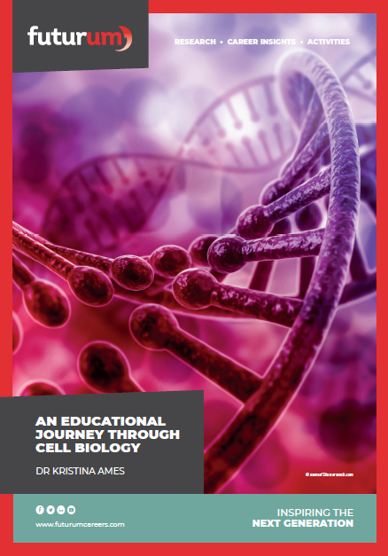
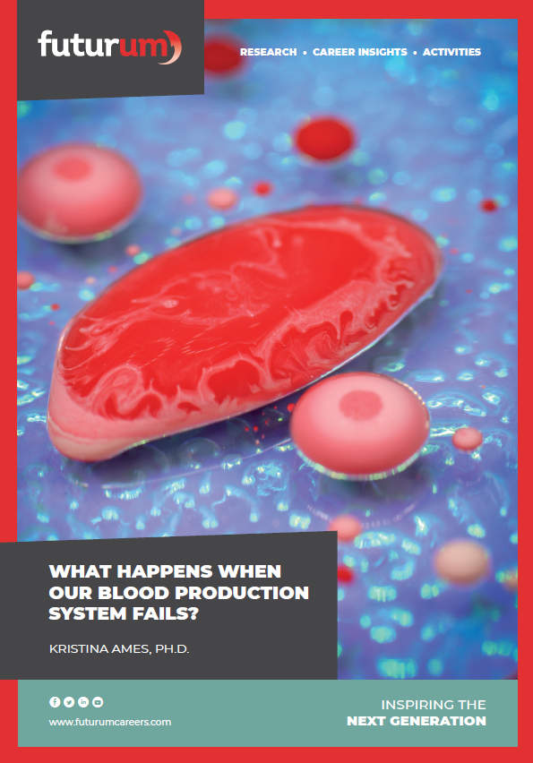
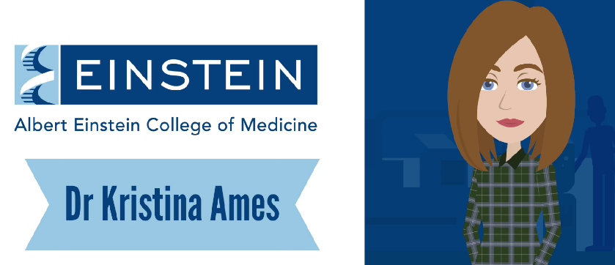
More resources
Download Kristina’s cell biology article
Download Kristina’s research article
03
Download Kristina’s animation
01
02
31 futurumcareers.com
© xsense/Shutterstock.com

Slide 32
32 futurumcareers.com

