Slide 1
What is this object?
What is it made of?
Who did it belong to?
What story can it tell us?
© University of Chester Photography, Katherine Wilson and Mike Bird
01 futurumcareers.com

Slide 2
Engaging history:
the educational impact
of medieval objects
Dr Katherine Wilson &
Dr Thomas Pickles
www.futurumcareers.com
© University of Chester Photography, Katherine Wilson and Mike Bird

Slide 3
In this presentation:
‘The Mobility of Objects Across Boundaries 1000 - 1700 (MOB)’
Motivation
Talking points
Handling authentic artefacts
Object selection and contextual understanding
Facilitating meaningful discussions
Talking points
Impact on students
Impact on teachers
Advice for teachers
Talking points
© University of Chester Photography, Katherine Wilson and Mike Bird
03 futurumcareers.com

Slide 4
‘The Mobility of Objects Across Boundaries 1000 - 1700 (MOB)’
At the University of Chester in the UK, historians Dr Katherine Wilson and Dr Thomas Pickles are seeking to reinvigorate history education through the incorporation of everyday medieval objects.
Their approach, emphasising hands-on exploration and critical inquiry, demonstrates how material culture profoundly enhances historical understanding and pedagogy.
Dr Katherine Wilson
Dr Thomas Pickles
04 futurumcareers.com

Slide 5
Motivation
“Our project was principally motivated by a need to increase access for students and educators to museum collections. In recent years, exacerbated by the pandemic and the cost-of-living crisis, there has been growing concern over student access to museum collections and the consequences non-access has for widening participation, cultural enrichment and creative education.”
Katherine
“Asking students to closely investigate original historical objects from basic questions and then to produce work on an object, regarding its makers and mobility, establishes the fundamental tools of the history discipline in students.”
Thomas
05 futurumcareers.com
© University of Chester Photography, Katherine Wilson and Mike Bird

Slide 6
Handling authentic artefacts
Objects provide tangible evidence of people, places and events, and each object has its own story to tell.
Give a student an object to examine and you will almost always capture their interest.
Unlocking the educational potential of objects depends on how we observe, analyse and discuss those objects.
How can these seemingly prosaic objects contribute to historical inquiry?
What clues do they hold about belief systems or social structures?
How can they impact how history is taught in our classrooms?
© University of Chester Photography, Katherine Wilson and Mike Bird
06 futurumcareers.com

Slide 7
Handling authentic artefacts
Through hands-on interaction, students are encouraged to actively participate in discussions and knowledge application.
The handling of authentic objects:
is intertwined with a dialogue process
allows students to ask questions, problem solve, investigate, apply knowledge and make new meanings
leads to an open atmosphere of engaged and spontaneous conversation, facilitating deeper understanding and appreciation of history.
© University of Chester Photography, Katherine Wilson and Mike Bird
07 futurumcareers.com

Slide 8
Talking points
How can you challenge traditional perceptions of history as a subject primarily focused on memorisation of facts and dates?
Reflecting on your teaching experience, what are some alternative methods you have used to engage students with historical content beyond textbooks and lectures?
How might incorporating material culture into your lessons enhance inclusivity and accessibility, considering the diverse backgrounds and experiences of your students?
08 futurumcareers.com
© University of Chester Photography, Katherine Wilson and Mike Bird

Slide 9
Object selection and contextual understanding
Katherine and Thomas curated a variety of everyday medieval items from the collections of the Grosvenor Museum in Chester. This included six types of objects: keys, chests, shoes, tiles, ceramics and pottery, coins, and pilgrim badges and devotional tokens.
The aim was to use objects that not only represent daily life during the medieval period but also lack known historical narratives or identifiable owners, allowing students to explore their significance without preconceived notions.
© University of Chester Photography, Katherine Wilson and Mike Bird
02 futurumcareers.com
09 futurumcareers.com

Slide 10
Object selection and contextual understanding
“The handling and use of the objects revealed student’s contextual knowledge of status, power relations and mobility during the medieval period, especially in terms of inequalities in power, exploitation of individuals and movement of peoples for trade and spiritual journeys.”
Thomas
© University of Chester Photography, Katherine Wilson and Mike Bird
10 futurumcareers.com

Slide 11
Facilitating meaningful discussions
Alongside digital reconstructions, timelines and short films on the objects, students’ responses were stimulated through ‘first principle’ questions:
What pictures can you see?
What do you think it was made of?
Who do you think it belonged to?
Students were empowered to construct richer understandings of the past, bridging the gap between theoretical knowledge and practical engagement.
By handling the objects, discussing them and producing work based on them, students actively contribute to the construction of historical knowledge alongside their teachers.
© University of Chester Photography, Katherine Wilson and Mike Bird
11 futurumcareers.com

Slide 12
Facilitating meaningful discussions
“These discussions between student and teacher are important as it enthuses both parties about the study of history, turning the subject away from any perception of being a subject of knowledge transfer and learning of facts.”
Thomas
© University of Chester Photography, Katherine Wilson and Mike Bird
12 futurumcareers.com

Slide 13
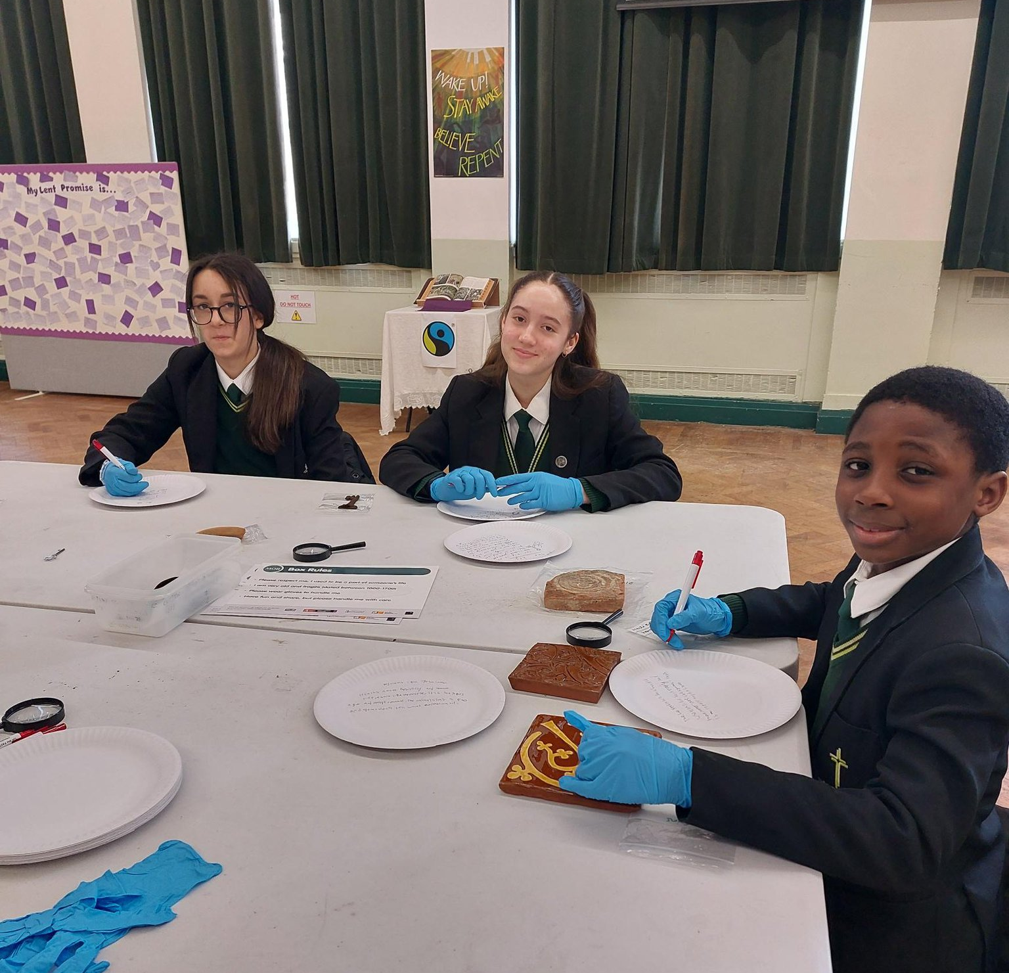
Impact on students
The objects sparked students’ curiosity and imagination.
“Their imaginations evocatively set the objects into very human contexts, full of meaning, when asked to write about their makers, production processes and movements. In the work undertaken by the students, they wrote about tilers wanting to spread enlightenment and revelation through the beauty of their decorated tiles… pilgrimage badges representing long and arduous journeys, for both showing off and anxious safekeeping…”
Katherine
Students’ responses went beyond mere descriptions; they were infused with critical historical inquiry and meaningful discussion.
13 futurumcareers.com
© University of Chester Photography, Katherine Wilson and Mike Bird

Slide 14
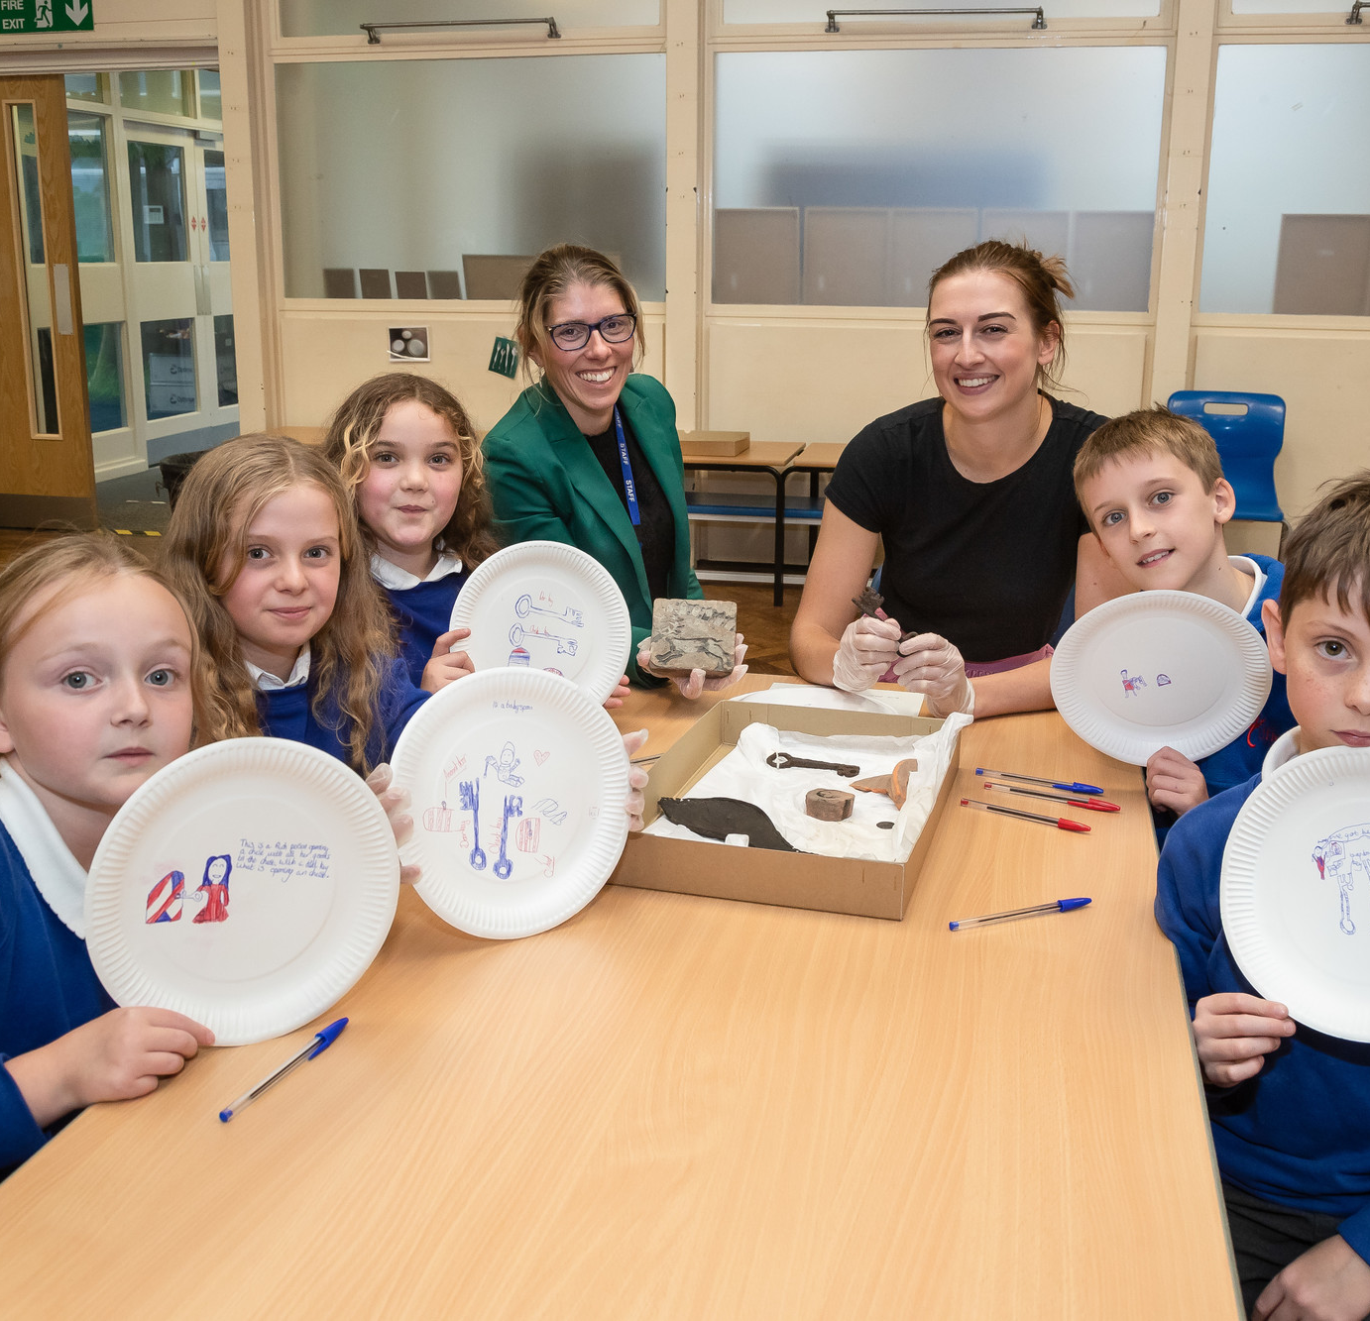
Impact on teachers
The MOB project prompted educators to fundamentally reconsider their approach to historical sources and teaching methods.
Many teachers commented on how handling authentic objects provided a new lens through which to engage with historical material, allowing students to make historical inferences without extensive prior contextual knowledge.
It deepened teachers’ appreciation for the care and respect students inherently possess for history when provided with meaningful opportunities for interaction.
14 futurumcareers.com
© University of Chester Photography, Katherine Wilson and Mike Bird

Slide 15
Impact on teachers
Trainee teachers benefitted significantly from their involvement in the project, gaining first-hand experience in implementing object-based learning across diverse classroom settings.
“I was able to plan the same experience for students in both placement schools during my training. The artefacts were met with the same level of interest and respect, no matter the age, ability or gender of the students.”
Trainee teacher
© University of Chester Photography, Katherine Wilson and Mike Bird
15 futurumcareers.com

Slide 16
Advice for teachers
Start with everyday objects that offer rich historical insights.
“We would recommend approaching your local museums or collections to see which artefacts they might be able to loan to you for handling sessions with students. We found non-elite, everyday objects without known historical narratives or owners were the most engaging and useful for students to handle and question.”
Katherine
Many museum collections offer loan boxes of artefacts that educators can apply to access.
The Mobility of Objects website provides free downloadable resources.
© University of Chester Photography, Katherine Wilson and Mike Bird
16 futurumcareers.com

Slide 17
Talking points
What are the potential interdisciplinary connections between history and other subjects, such as art, science or English? How can object-based teaching facilitate cross-disciplinary learning?
How might engaging with material culture in the classroom contribute to developing students’ empathy, cultural awareness and global citizenship?
How can you approach teaching with sensitivity and respect for diverse cultural perspectives, considering the ethical considerations surrounding the acquisition and display of historical objects?
17 futurumcareers.com
© University of Chester Photography, Katherine Wilson and Mike Bird

Slide 18
Talking points
How might you empower students to take ownership of their learning through object exploration, considering your role as a facilitator of historical inquiry?
As you consider incorporating object exploration into your teaching, reflect on your questioning techniques. How open-ended are the questions you ask? To what extent do your questioning techniques encourage critical thinking and discussion? What questions would you ask to facilitate deeper engagement with material culture?
18 futurumcareers.com
© University of Chester Photography, Katherine Wilson and Mike Bird

Slide 19
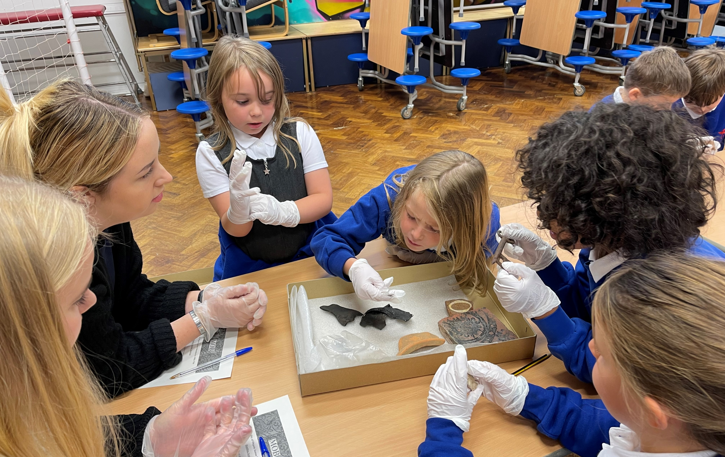
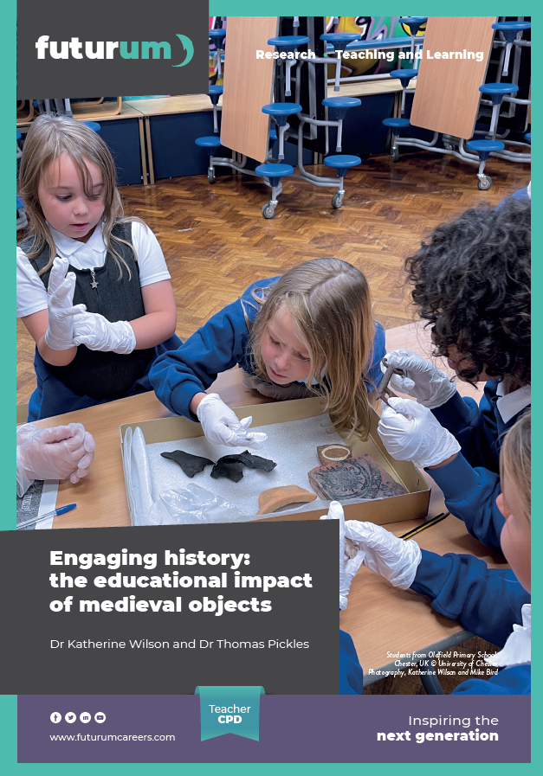
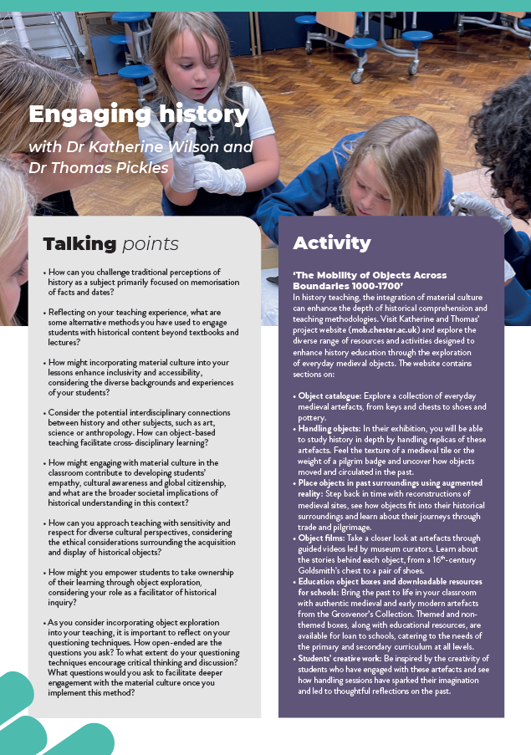
More resources
Download Katherine and Thomas’ article
Download the activity sheet
01
02
19 futurumcareers.com
© University of Chester Photography, Katherine Wilson and Mike Bird

Slide 20
20 futurumcareers.com

