Slide 1


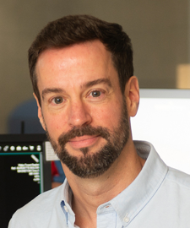
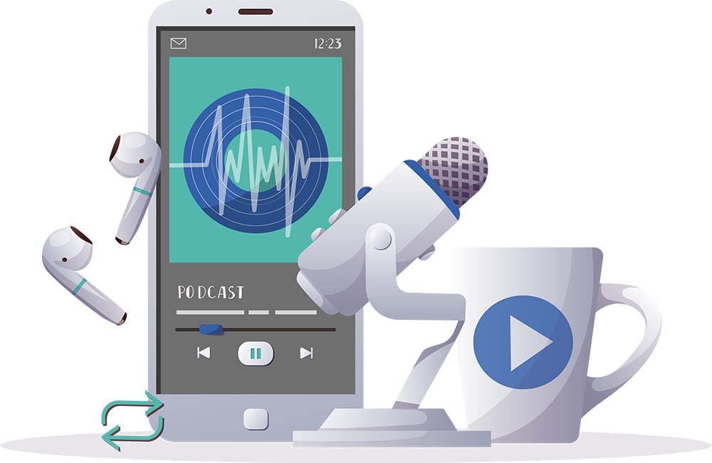

Inspiring the
Next Generation
FUTURUM
PODCAST
In Conversation with
Dr. Timothy Hughes

Slide 2

Pre-listening | Break it Down | Post-Listening | Learn More
Meet
Dr. Timothy Hughes
Pre-listening:
In this podcast, Dr. Timothy Hughes discusses his love of drawing and how he uses creativity in his research. He speaks about how his meditation practice helps him to think clearly and how getting experience in a lab can be a great way to figure out what kind of research is right for you.
Profile
In what ways are you creative? How does creativity help with your learning?
What helps you to think clearly?
What experience of lab work do you have?
Wake Forest University
School of Medicine, USA
Field of Research
Neurovascular Epidemiology
“Be curious. Ask the questions. See where it takes you.”

Slide 3


Pre-listening | Break it Down | Post-listening | Learn More
Break Tim’s Conversation Down:
Up to 05:00
What do epidemiologists study?
As a neurovascular epidemiologist, what does Tim focus his research on?
In learning about epidemiology, what did Tim learn about his career options?
What profound realization did Tim have about heart and brain health? Why do you think this was an exciting revelation for him?

Slide 4

Pre-listening | Break it Down | Post-listening | Learn More
05:00 – 08:20
Which parts of school and learning do you find easy, and why? Which do you find challenging, and why?
What strategies do you use to overcome struggles in school and with your learning?
What was Tim’s strategy to overcome the challenges he faced at school? To what extent do you think Tim’s strategy could help you, and why? How could you go about implementing it?
What are your skills and interests? What types of opportunities do you think these could lead to for you?

Slide 5

Pre-listening | Break it Down | Post-listening | Learn More
08:20 – 11:10
In what way has meditation been a “secret weapon” for Tim?
What has neuroscience shown Tim about how the brain – and meditation – works?
What mechanisms do you use for coping with worry and stress?
Have you ever meditated? If so, how did you find the experience? If not, how likely are you to try it now, having listened to Tim, and why?

Slide 6
Pre-listening | Break it Down | Post-listening | Learn More
11:10 – end
Which local universities or researchers could you reach out to for STEM opportunities? If you don’t know any, how could you go about investigating possible contacts?
If you did reach out to a scientist, what would you ask them about, and why?
How confident are you in your writing skills? What areas of your writing do you think you need to develop further, and how might you go about this?
How curious are you? What sparks your curiosity? What could you do to nurture your curiosity?

Slide 7


Pre-listening | Break it Down | Post-listening | Learn More
Post-listening:
To what extent do you think you would find a career in neurovascular epidemiology rewarding, and why?
What surprised you when you listened to Tim talk about his interests and experiences?
Which piece of Tim’s advice did you find most useful, and why?
What further questions would you ask Tim about neurovascular epidemiology and/or his career?*
Submit questions to Tim here

Slide 8

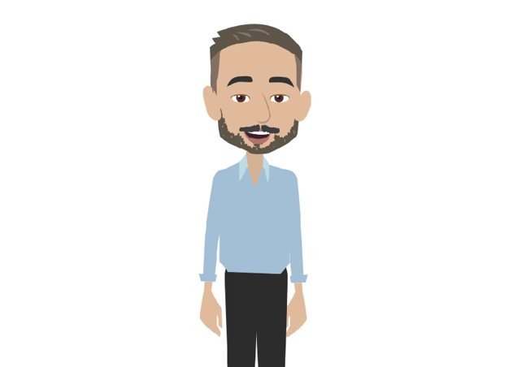
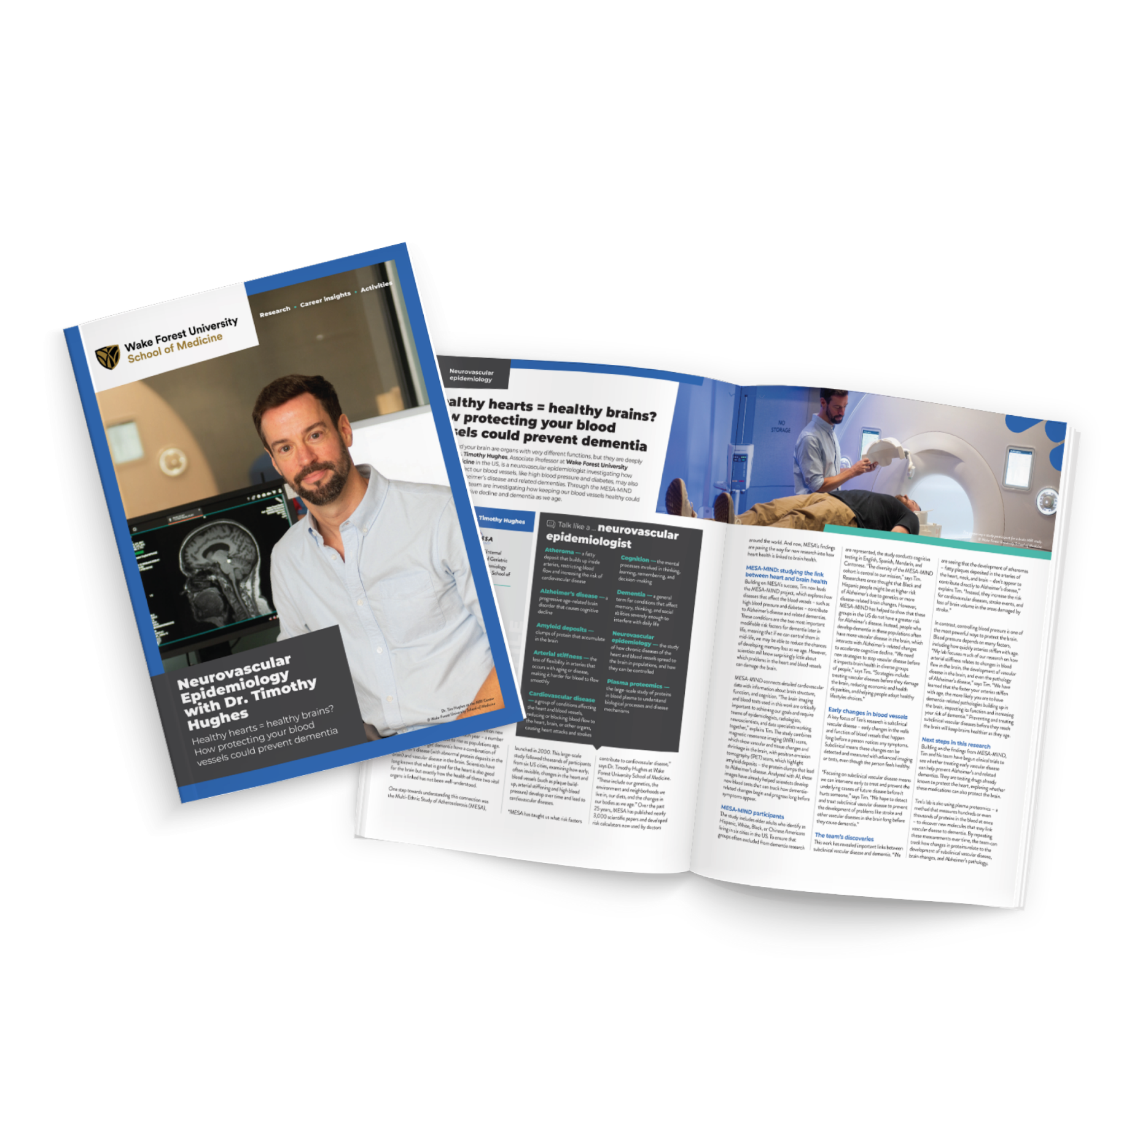
Pre-listening | Break it Down | Post-listening | Learn More
Learn More About Tim’s Work:
Read Tim’s article
Download Tim’s activity sheet
Watch Tim’s animation
Download Tim’s careers PowerPoint
Read Tim’s resources in Spanish
Inspiring the
Next Generation

Slide 9
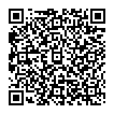



This educational material has been produced by Wake Forest University School of Medicine in partnership with Futurum and with grant support from The Duke Endowment.
The Duke Endowment is a private foundation that strengthens communities in North Carolina and South Carolina by nurturing children, promoting health, educating minds and enriching spirits.
Let us know what you think of this educational and career resource.
To provide input, simply scan the QR code or access the link below:
redcap.link/dh5j1nes

