Slide 1
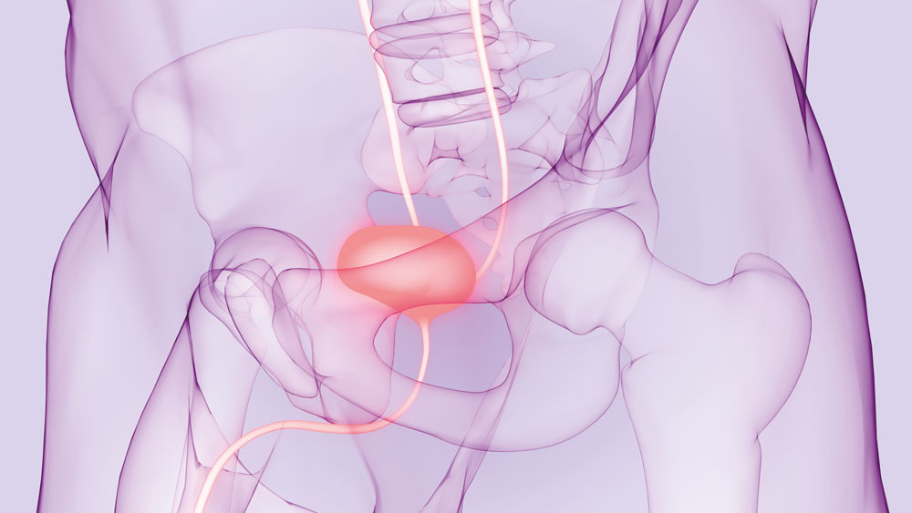
UROGYNAECOLOGY
with
PROFESSOR CINDY L. AMUNDSEN, MD
GET STARTED
© Magic mine/Shutterstock.com
www.futurumcareers.com

Slide 2
Unless stated otherwise, all images © Cindy L. Amundsen @Duke Ob/Gyn Communications
In this presentation
Meet Cindy
Cindy’s research
Talking Points
About gynaecology
Pathway from school gynaecology
Explore careers in gynaecology
Cindy’s career & top tips
Talking points
Meet Cassandra
Meet Eric
Meet Byron
Talking points
More resources
Cindy teaching in the operating room (OR)
02 futurumcareers.com

Slide 3
Meet Cindy
Based at Duke University Department of Obstetrics and Gynecology (Duke University School of Medicine) in the US, Professor Cindy L. Amundsen is studying lower urinary tract dysfunction (LUTD) with the goal of developing better treatment options for people struggling with this condition.
Learn more about her work…
Professor Cindy L. Amundsen, MD
03 futurumcareers.com

Slide 4
The urinary tract
The urinary tract involves all the organs that work together to make urine and remove it from our bodies.
This includes the kidneys, where urine is made; the ureters, which carries urine to the bladder; the bladder, where urine is stored; and the urethra, through which urine exits the body.
The upper urinary tract includes the kidneys and ureters, and the lower urinary tract includes the bladder and urethra.
© ploypilin/Shutterstock.com
04 futurumcareers.com

Slide 5
LUTD
When the lower urinary tract is not working properly, someone might have lower urinary tract dysfunction (LUTD).
Both males and females can experience LUTD, as can children of any age.
LUTD encompasses a broad range of different problems, and symptoms can include leaking urine, having sudden urges to pee, urinating at night, having a slow stream.
There are many therapies which can treat the symptoms of LUTD.
However, there are limitations to these treatments, and it can be difficult to diagnose exactly why someone is experiencing symptoms, which can reduce the effectiveness of the treatment.
Gynaecologic trainees in the suture laboratory practise suturing (sewing biological tissue)
05 futurumcareers.com

Slide 6
LURN
Cindy is part of a team of surgeons, biological scientists, computational scientists and medical research professionals who have come together from six different universities across the US to study the lower urinary tract and improve treatments for LUTD.
The network was formed in 2012 and named ‘LURN: the Symptoms of Lower Urinary Tract Dysfunction Research Network’.
Cindy teaching in the operating room (OR)
06 futurumcareers.com

Slide 7
The initial research that has come out of LURN shows that not only are there different symptoms among patients, but also differences in demographics, medical conditions and biological variables between patients.
Cindy and the LURN team used advanced statistics to group individuals together into subtypes according to the similarity of their symptoms.
They found that symptom improvement varied by subtype, meaning that some subtypes responded better to therapies than others.
To learn more about the research that Cindy and the LURN team are conducting, read her Futurum article: What causes problems with the lower urinary tract?
07 futurumcareers.com

Slide 8
Talking points
What are the two different sections of the urinary tract? Which organs does each part contain?
What are some of the symptoms of lower urinary tract dysfunction (LUTD)?
What can decrease the effectiveness of LUTD treatments?
Who is involved with the LURN network, and what are they aiming to achieve?
How has the LURN team used advanced statistics? How do you think analysis of these statistics will inform patient treatments?
08 futurumcareers.com
© Magic mine/Shutterstock.com

Slide 9
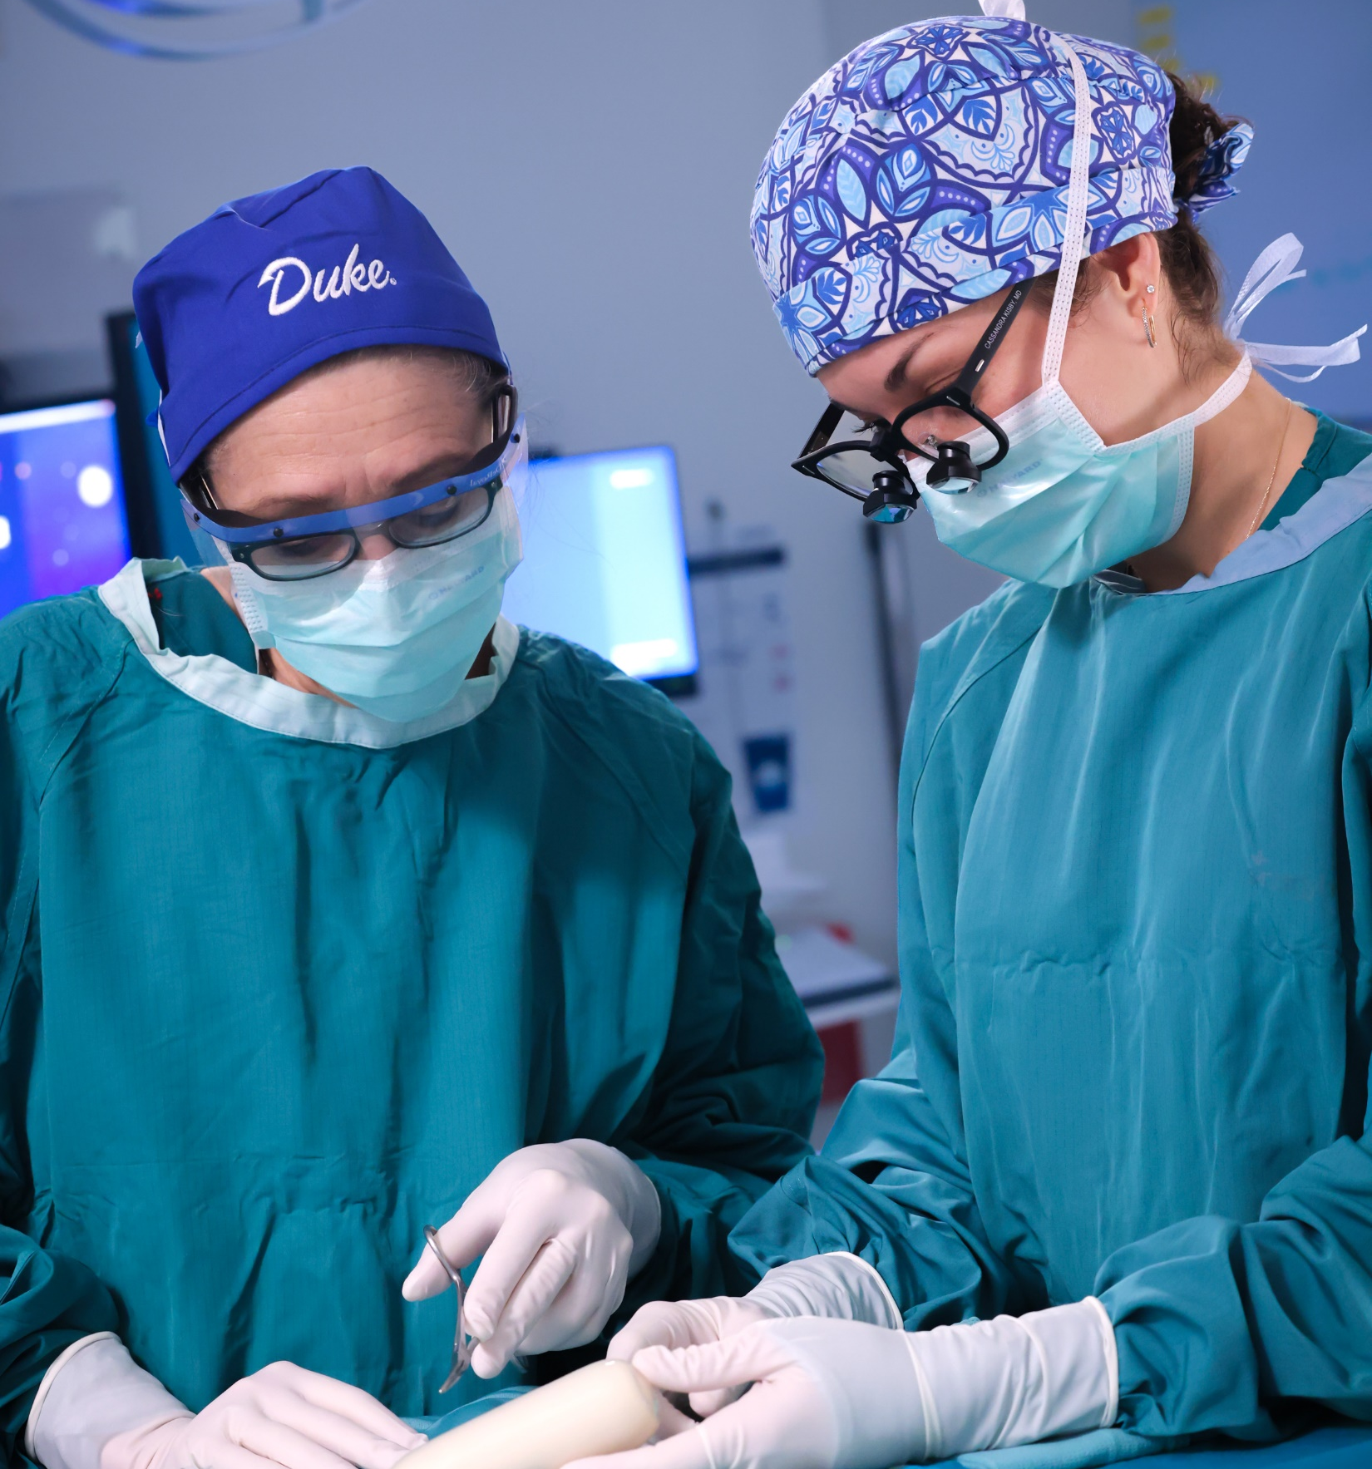
About gynaecology
Gynaecologists are medical doctors who perform surgery and who have undergone specialised training to become experts in the female reproductive system.
They might work in a clinical environment, engaging daily with patients experiencing health problems and/or work in a research setting, conducting experiments or surveys to better understand medical problems and develop new, innovative treatments.
Gynaecology is often combined with obstetrics to create the field of obstetrics and gynaecology, referred to by the acronym OB/GYN. Having a strong knowledge of both areas will make you more able to solve problems related to women’s health.
.
09 futurumcareers.com
Cassandra performing pelvic surgery

Slide 10
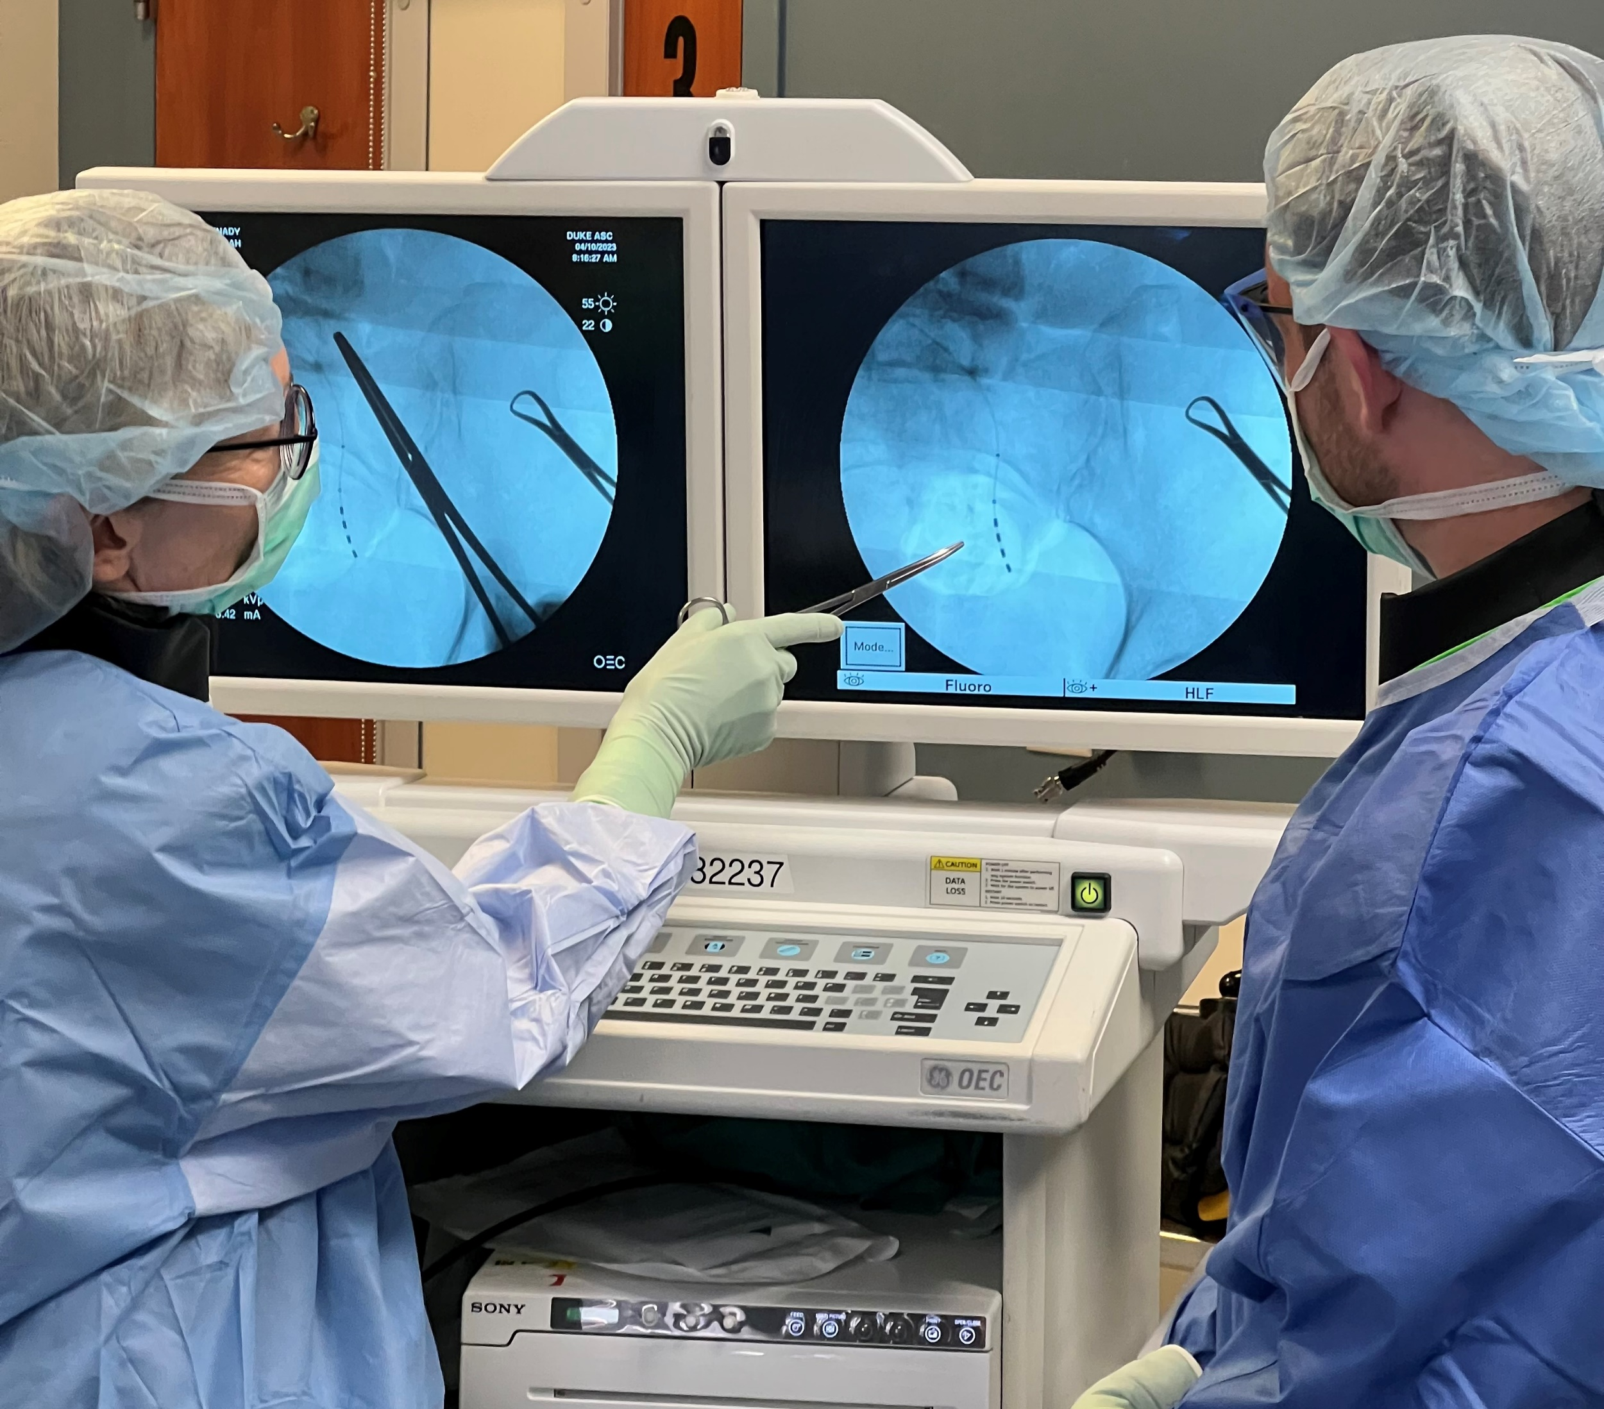
About gynaecology
You must be curious about women’s health issues to work in this field, as there is still so much to be discovered.
“We still don’t understand why women get many of the gynaecologic conditions such as endometriosis, recurrent urinary tract infections, chronic pelvic pain, fibroids, infertility, gynaecologic cancer, menstrual irregularities, pelvic support problems, urinary incontinence, and many more conditions.”
– Cindy
Future gynaecologists will pursue research questions to understand what contributes to the onsets of these conditions and diseases, as well as how they progress and what treatments might be possible. Gynaecologists also need to be able to disseminate their findings to the wider scientific community and use their results to improve advice for patients.
10 futurumcareers.com

Slide 11
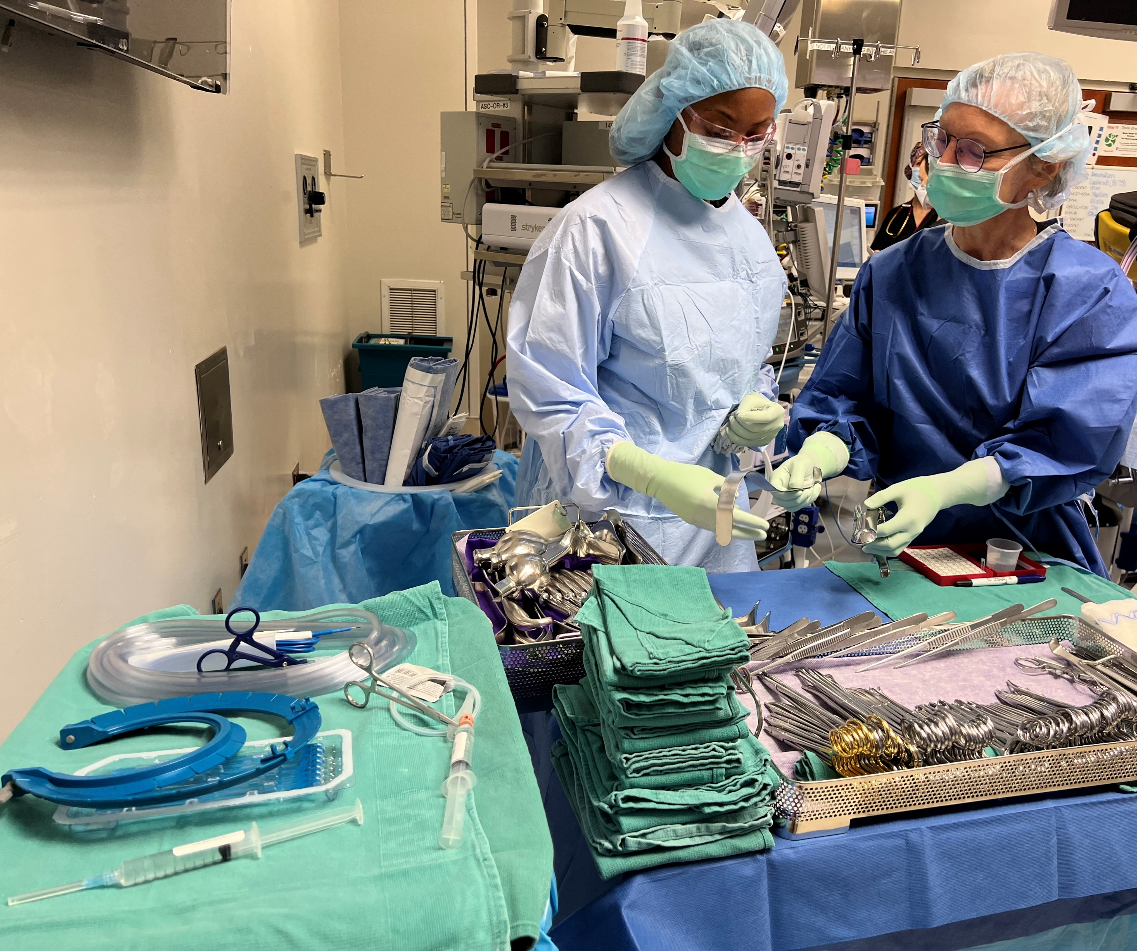
About gynaecology
As a researcher, surgeon, clinician and educator, Cindy highlights the different aspects to careers in this field: investigating issues and aiming to find clinical solutions, working directly with patients, and helping to train and support the next generation of gynaecologists.
“Robotic surgery allows for very complicated surgery to be done with more precision, flexibility and control than open surgery as it is performed through very small incisions.
“Additionally, technologic advances with medical devices allow surgically implanted devices to be placed with less anaesthesia and through smaller incisions. Finally, the accuracy of radiographic and other diagnostic technologies has improved so much that we are detecting earlier stages of medical conditions which allows for minimally invasive treatments to be performed.”
– Cindy
11 futurumcareers.com
Cindy in the operating room

Slide 12
Pathway from school to gynaecology
Study biology, chemistry, physics and mathematics. Working in OB/GYN also involves having strong interpersonal and communication skills, so taking language courses can be very useful too.
To work in gynaecology, you must complete a medical degree before undergoing specialised training in obstetrics and gynaecology. If you are attending university in the US, you will need to do a pre-med degree before you start studying medicine.
If you have the option to choose courses during your university degree, Cindy recommends deductive reasoning, psychology, communication, epidemiology, ethics, anatomy, biochemistry, pathophysiology, pharmacology, pathology and immunology. “In addition, math skills that will help would be algebra, geometry, statistics and probability,” she adds.
Cindy recommends Career Girls, which has a fantastic page on working in obstetrics and gynaecology, details of what an average day might involve, and interviews with various obstetrics and gynaecology role models.
12 futurumcareers.com

Slide 13
Explore careers in gynaecology
“Working in gynaecology is very rewarding, but it is a demanding career and, thus, you must be passionate about the field. Gynaecologists will see patients in the clinic and operate at the hospital, so every day will be different. Skills that would be useful are dexterity, patience, communication, problem solving, flexibility, resilience, organisational skills and physical stamina.”
– Cindy
If you are interested in working with women’s health issues but do not want to be a gynaecologist, then there are lots of other options too. Nurses, midwives, general practitioners and psychologists, as well as jobs within non-profit organisations and women’s centres, all play important roles in improving women’s health.
Indeed.com has some useful information on working in obstetrics and gynaecology, including which skills you need to develop to be successful in this career.
According to the US Bureau of Labour Statistics, the average annual salary for obstetricians and gynaecologists in the US is $277,000.
Cindy recommends watching this 15-minute video by Med School Insiders about what it is like to work in OB/GYN.
13 futurumcareers.com

Slide 14
Cindy’s career
“I was first inspired to pursue a career in gynaecology because I grew up sewing my own clothes with my mother and sister; I always enjoyed working with my hands. Sewing, in many respects, is like performing a surgery. You must understand the anatomy or material you are working with, know the techniques necessary to perform the task, and have the creativity and skill to finish the procedure/ product.
“In medical school, I was drawn to the specialty of surgery and wanted to improve women’s health conditions that require surgery. I did additional training to become a urogynaecologist, one who specifically performs reconstructive pelvic surgery involving the lower urinary tract organs and gynaecologic organs.
Cindy in the clinic
14 futurumcareers.com

Slide 15
“Three major experiences of my childhood led me to be a researcher, surgeon and educator. As expressed, my mother taught me to sew at a very young age – cutting out the patterns and sewing with my hands. My father taught me to be a good researcher as I would watch him read dental manuals and journals. Lastly, when I was a teenager, I learned how to become a dance instructor. Teaching others gave me much satisfaction, so I wanted a profession where I could also teach what I know.
“Balancing research, surgery and education during my work is not easy, and it can get very busy. There are times I need to prioritise tasks, so staying organised and preparing ahead of time to meet specific deadlines is very important. I am passionate about all three areas and strive to do my best in each of them.
“They all interconnect. When I am performing surgery, I have several trainees in the operating room and educate them on the surgical techniques and other clinical aspects. My research often involves clinical trials that involve the recruitment of patients, so I get them involved and educate my patients on the advances and improvements in patient care discovered through research.
15 futurumcareers.com

Slide 16
“I find it very gratifying to pass on knowledge, skills and wisdom to the next generation, and I enjoy helping my mentees achieve more than they could do alone. Mentees also challenge me, helping me stay abreast of newest developments!
The worst piece of advice I was ever given was that I was told there was no need for me to work hard when I first came on faculty, since I had a very successful and world-renowned surgeon as a husband. This did not fit my personality and so I disregarded it, worked hard, and became successful in my own right.
“I feel very grateful that over the past 24 years, my involvement in research, patient care and trainee education has enabled me to make contributions that have significantly impacted the quality of patient care. In 2017, I was awarded the Rodney Appell Continence Care Champion, one of the most prestigious recognitions in the field of continence care. In addition, in 2021, I received the Duke School of Medicine Career Mentoring Award in Clinical Research/Population Health which recognised excellence in research mentoring.”
16 futurumcareers.com

Slide 17
Cindy’s top tips
Be curious and open to the opportunities that are presented to you, no matter how small they may seem.
Follow the 4 Ps:
When given an opportunity, PERFORM. Do the best that you can.
Nothing that is worth something is easy, so be PATIENT and learn from any mistakes that you make.
PERSEVERENCE is very important to achieve your goals.
Lastly, follow your PASSION, even if someone says you should pursue something else.
Cindy and colleagues
17 futurumcareers.com

Slide 18
Talking points
What would you find rewarding about working with patients in a clinical environment?
Which health issues would you be interested in studying as a researcher?
How is robotic surgery helping gynaecologists with their work?
Cindy recommends many courses that could support a career in gynaecology. Which of these interests you the most, and why?
How successful are you at implementing the 4Ps that Cindy highlights? Which of these attributes do you need to develop further, and how could you do so?
18 futurumcareers.com
© Magic mine/Shutterstock.com

Slide 19
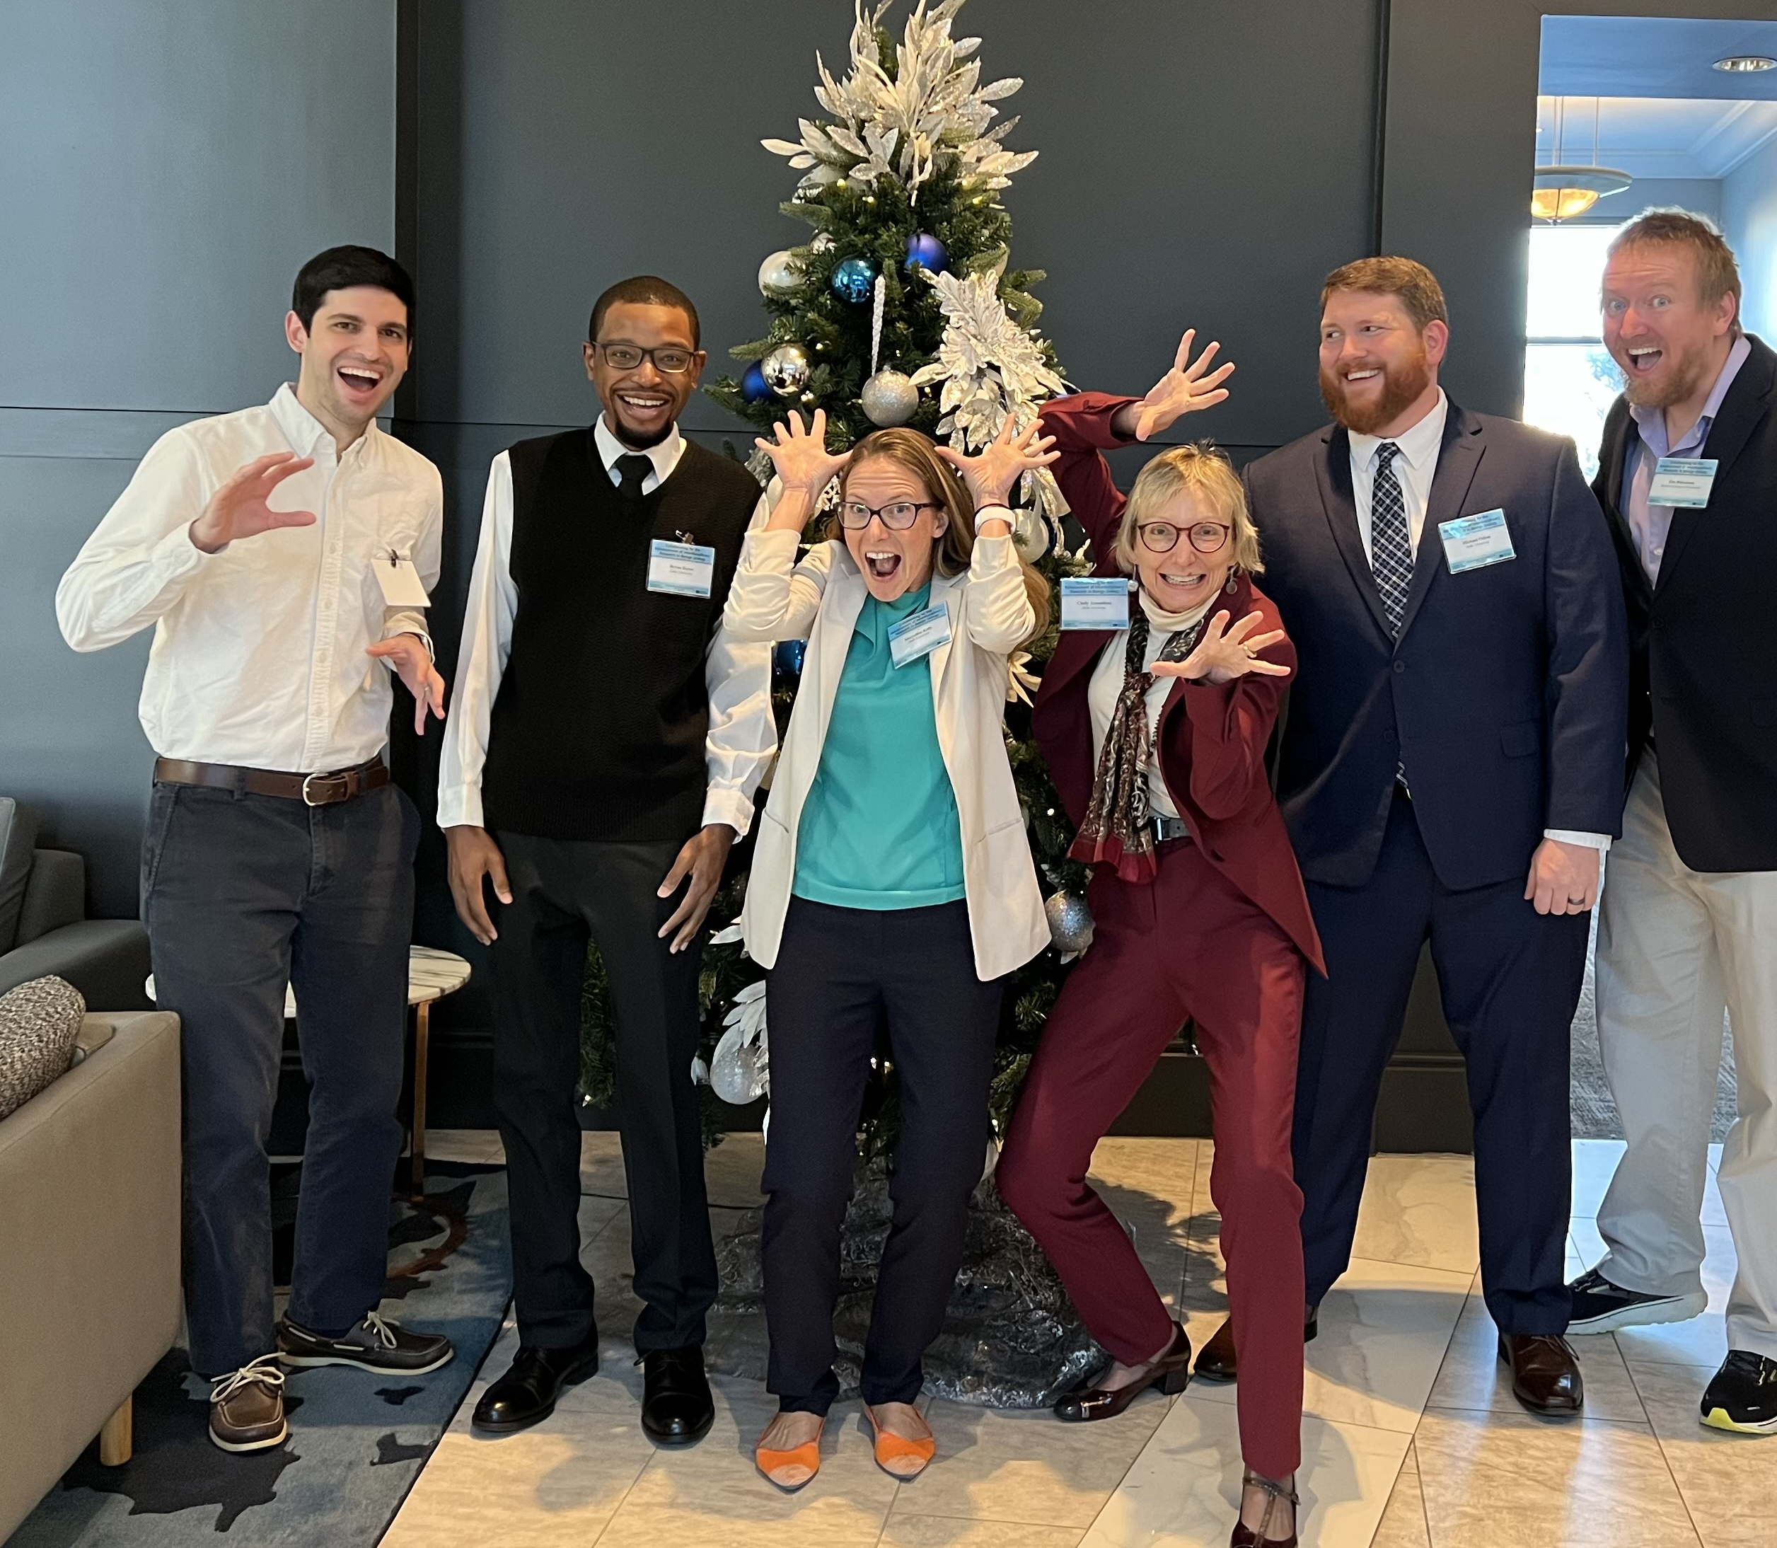
KURe – the K12 Urologic Research Career Development Program
As part of her commitment to education and mentoring other scientists, Cindy leads Duke University School of Medicine’s KURe Program * which supports researchers to build independent research careers. We meet three programme participants.
19 futurumcareers.com
Cindy and trainees

Slide 20
Meet Cassandra
Duke Division of Urogynecology, Assistant Professor of Obstetrics and Gynecology, Duke University School of Medicine
Fields of research: Obstetrics and Gynaecology, Urogynaecology
“The most impactful thing that has changed my career path has been mentor relationships. There are people who will tell you it can’t be done; find the people that believe in you and will help you navigate the unbeaten path. I am from a very small town in North Carolina and am the first in my family to go to college. A very special high school physics teacher believed in me and sponsored me for a full tuition scholarship to Duke and it changed my life.
Dr Cassandra Kisby, MD
20 futurumcareers.com

Slide 21
“I am a urogynaecologist; I treat women with bladder and pelvic issues. For my current research, I am using regenerative medicine technologies (such as stem cells) to help women who have pelvic floor disorders or were born with differences in bladder and gynaecologic anatomy.
“During fellowship in urogynaecology, I decided I had a special interest in urogenital congenital anomalies, meaning anatomic differences of the bladder and genitals in women. For example, some women can be born with a double uterus. Over the last two years, I’ve created a Congenital Anomaly Program, which has grown into a multi-disciplinary treatment programme. It was featured in the Duke OB/GYN magazine.
“My hope is to share my research and clinical skills with the next generation of clinician-scientists; the future is very bright.”
Cassandra in the operating room
21 futurumcareers.com

Slide 22
Cassandra’s top tips
1. Learn about the differences between
mentors, sponsors and career coaches. At each stage of your career, find a few with whom you can form formal relationships.
2. Sometimes the cost of education can be
a barrier. Seek out local and national scholarships to prevent debt from driving your career decisions.
3. Look into summer programmes at local
colleges and universities. These are a great way to network and get exposed to science and research.
Cassandra performing pelvic surgery
22 futurumcareers.com

Slide 23
Meet Eric
Department of Biomedical Engineering, Duke University
Field of research: Neuroscience
“The Duke KURe Program and Dr Amundsen helped kick start my translational research programme. Making my research objectives relevant to human conditions made me stand out compared to having only pre-clinical studies.
“My research is currently focused on developing a peripheral nerve stimulation device to manage LUTS and improve bladder emptying in underactive bladder (UAB). I hope to increase our understanding of the muscular and neural alterations in the lower urinary tract that may accompany UAB and provide a foundation for clinicians to develop innovative therapeutics to improve patient outcomes.
Dr Eric Gonzalez, PhD
23 futurumcareers.com

Slide 24
“We began a clinical pilot study, mentored by Dr Amundsen, to determine the influence of bladder and urethral electrical stimulation on bothersome symptoms and bladder function in adult women with UAB. This is the first step in developing alternative therapeutics.
“It is challenging navigating your career and differentiating your research enough to receive funding. It is rewarding working on solutions to problems that many older adults face.
“The KURe Program provided an opportunity to collaborate with clinicians and develop mentorship in clinical research. It also provided protected time to support collecting preliminary data for my next awarded grant.
“I am proud of being awarded an NIH Mentored Research Scientist Development Award to support four years of my research. For the future, I plan to continue pursuing a career in clinical research.”
Eric’s top tip
You can get your foot in the door by volunteering to help in a laboratory.
24 futurumcareers.com

Slide 25
Meet Byron
Department of Pathology, Duke University School of Medicine
Field of research: Pathology
“Currently, my research focuses on discovering better treatment options for patients that suffer from frequent urinary tract infections (UTIs) by using mice. I am specifically interested in treating pain and other symptoms that relate to the nervous system.
“My key successes include developing a mouse model of UTI induced pain and urinary frequency, which enabled me to discover what goes on in the bladder after a UTI. The next step is to use this mouse model to study anxiety and depression, since these are other symptoms experienced by patients.
Dr Byron Hayes, PhD
25 futurumcareers.com

Slide 26
“A lot of my time is spent designing experiments and going through trial-and-error as these are unanswered research questions. Fortunately, when discoveries are made, it gives you a strong sense of accomplishment, knowing that you have contributed to your field of research.
“I plan to start my own research lab in the future, studying interactions between the nervous system and bladder after infection. I will focus on the bladder and brain/ spinal cord, since the bladder is regulated by the brain.”
Byron’s top tip
Start working in a lab early. This is important so you can truly learn whether it’s the right path for you. If it is, you will be able to start getting the right guidance to make your path forward clearer.
The ‘Elevated Plus Maze’ is a common behaviour test used to check if rodents are showing signs of anxiety based on whether they avoid going onto the exposed arms of the maze. (© Byron Hayes)
26 futurumcareers.com

Slide 27
Talking points
Cassandra highlights the importance of mentors, sponsors and career coaches. What could each of these sets of people offer you? If you do not know, how could you find out?
Eric’s advice is to volunteer in a laboratory. Do you know any laboratories near you? If not, who could you talk to in order to help you find one?
Byron highlights the trial-and-error nature of being a researcher. How do you cope with failure or ‘error’? Why is it important to accept that science involves things going wrong?
Who do you consider a mentor in your own life? Is there a person or organisation you could approach about finding a mentor?
27 futurumcareers.com
© Magic mine/Shutterstock.com

Slide 28
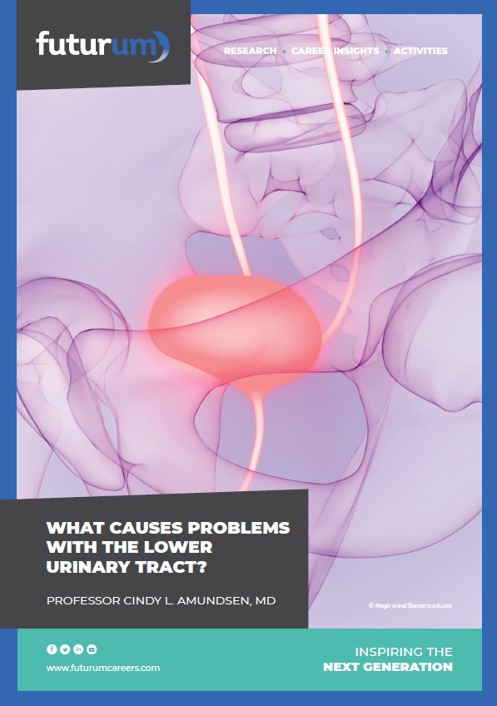
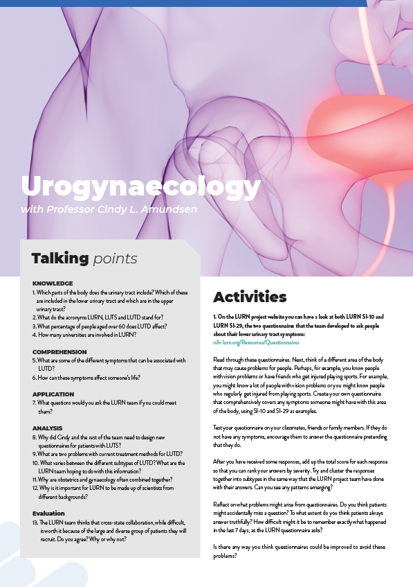
More resources
Download Cindy’s article
Download Cindy’s activity sheet
28 futurumcareers.com

Slide 29
Unless stated otherwise, all images © Cindy L. Amundsen @Duke Ob/Gyn Communications
29 futurumcareers.com

