Slide 1
PHYSICS & NANOSCIENCE with Yashaswi Nalawade

Slide 2
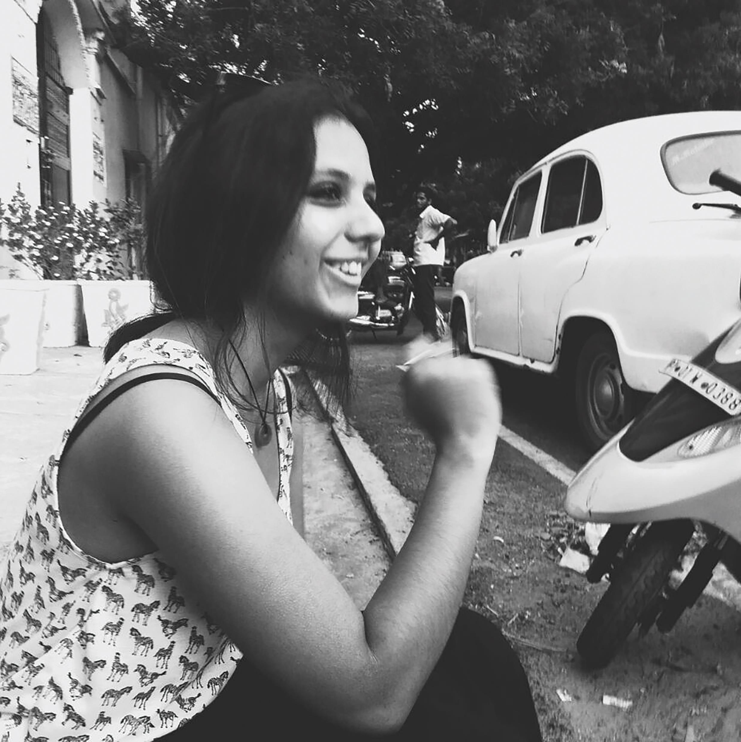
MEET YASHASWI
YASHASWI NALAWADE is currently working on her PhD in Professor Jonathan Coleman’s laboratory at Trinity College Dublin in Ireland.
Yashaswi is working on the synthesis of low-dimensional nanostructures, including graphene, dielectric inks and boron-nitride nanotubes. The findings will facilitate research incorporating nanotechnology in a wide range of fields and applications.
Let’s learn more about her research…

Slide 3
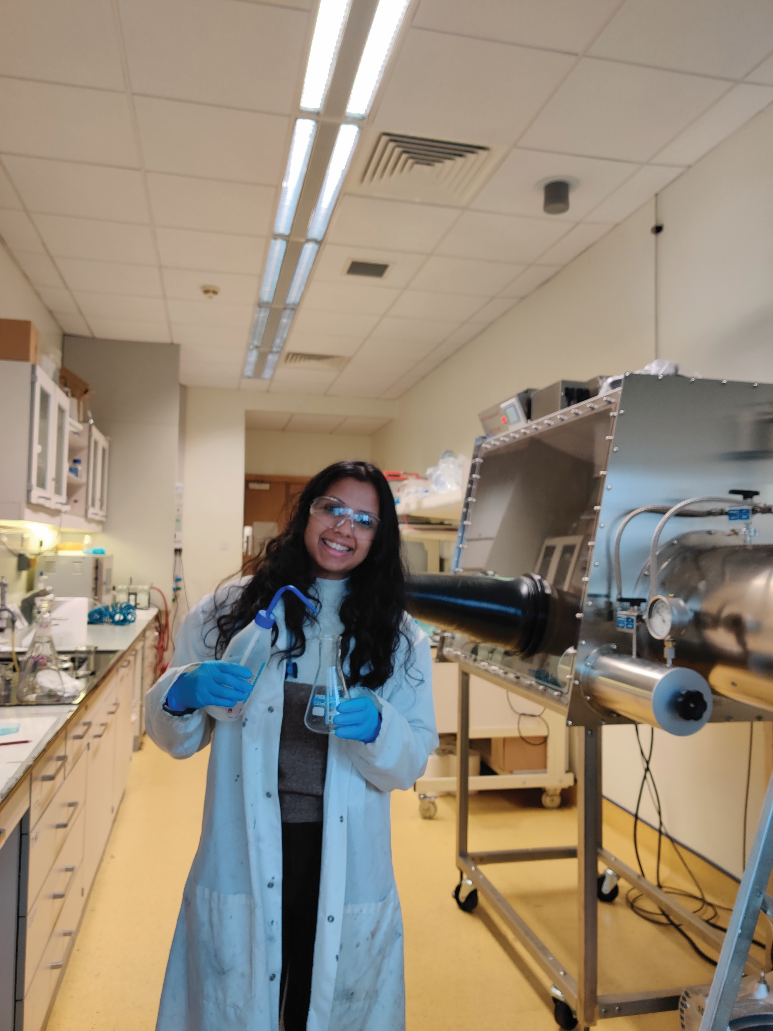
NANOTECHNOLOGY
A branch of science that is concerned with working at the nanoscale, that is, materials that are around 1 to 100 nanometres.
One nanometre is one billionth of a metre, which is unimaginably small – but these materials offer enormous potential for the development of a range of different technologies that could shape the world of the future.
For instance, electronics is increasingly reliant on nanomaterials and the rise of 2D and 3D printing has led to a need for researchers to invent and/or develop materials that are suitable to print electronics.
To print electronics, ink is needed – but not just any ink. These inks need to be conducting, semi-conducting or insulating (which is also known as dielectric).
Yashaswi preparing the nanomaterial ink in the wet chemistry lab in the CRANN centre, Trinity College Dublin.

Slide 4
YASHASWI’S RESEARCH
There has been a recent shift in nanoscience, from the production and characterisation of 2D nanomaterials from layered crystals to optimising and tailoring functional inks that are suitable for printing electronics.
The growth in printed transistors and supercapacitors needs to be supported by a parallel growth in printed dielectrics.
“My research involves synthesising and optimising insulating inks – i.e. going from a dielectric layered crystal to 2D nanosheets of insulating nature which can then be tailored into inks to be printed. The field of printed electronics, albeit very young, has shown promise in everyday applications to replace silicon-based devices. It allows for the development of wearable electronics, cheap, flexible and disposable devices which could have major societal impact and change our relationship with technology. It can also facilitate research that incorporates nanotechnology in sustainable energy and will help us make advancements in solar panels, wind turbines, etc.”
- Yashaswi

Slide 5
TALKING POINTS
What is nanotechnology?
How small is one nanometre?
What does dielectric mean?
What does Yashaswi’s work involve?
What are some of the applications of printed electronics?

Slide 6
SYNTHESISING NANOMATERIALS
Nanomaterials can be synthesised using household items, such as graphite from pencils and a kitchen blender! Developing these materials into complex designs and devices is where the challenge lies.
“We use a technique called Liquid Phase Exfoliation (LPE) to synthesise our 2D nanomaterial dispersions. Powder of the bulk crystal is mixed with a specific solvent and sonicated, i.e. subjected to ultrasound energy for several hours. The sonic energy creates bubbles or ‘cavitations’ within the liquid, which, on collapsing, release large amounts of shear energy that splits apart the layers in the crystal, thus producing 2D sheets in the liquid dispersion.” - Yashaswi
The nanosheets produced by this technique are a range of sizes and thicknesses. Liquid Cascade Centrifugation, which involves subjecting the dispersion to centrifugation so that the centrifugal force pulls the material out of the solution, is then used. The size of the nanosheet extracted is dependent on the speed at which the centrifuge is run at, so the higher the speed, the smaller the nanosheets.
Yashaswi performing I-V measurements on printed capacitors placed in a vacuum chamber.

Slide 7
THE TEAM WORKS WITH:
Graphene – produced from graphite and was the material that gained the field of 2D nanomaterials attention around the world. A well-known conductor of electricity, but graphene boasts even better properties, such as high electrical conductivity and high thermal conductivity. In addition, a sheet of graphene can be more than 50 times stronger than steel and as pliable as rubber!
Boron-nitride (BN) – has a structure that is almost the same as graphene but is also insulating.
Both graphene and BN are easily available, cheap, non-toxic and easy to handle, making them extremely suited to a range of applications.
TMDs (Transition Metal Dichalcogenides) – a group of semiconducting materials which can be exfoliated to make semiconducting nanosheets, which allow the fabrication of transistors and optoelectronic devices, etc.

Slide 8
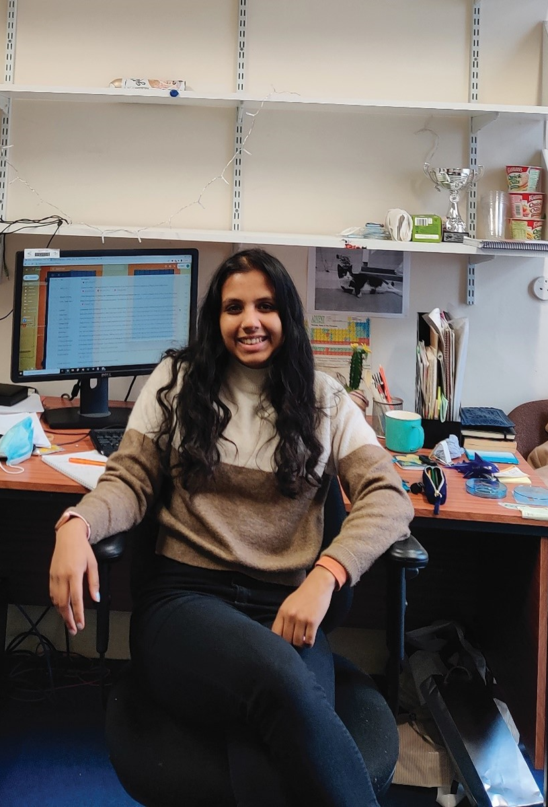
YASHASWI’S ROLE
Yashaswi investigates dielectric nanomaterials and the deposition of dielectric films suitable for printed electronics. This involves the synthesis of dielectric nanosheets in dispersion and tailoring them into an ink that is suitable for printing.
“Recently, I have contributed to this research by publishing a paper which details the liquid phase exfoliation of bismuth oxychloride (BiOCl) nanosheets, a high permittivity insulating material and further demonstrating BiOCl dielectric capacitors deposited using an aerosol-jet printer. A stacked heterostructure was printed with graphene electrodes sandwiching an insulating film of BiOCl. The working of the capacitor was studied to characterise the quality and properties of the dielectric films.”
- Yashaswi
Yashaswi at her office desk in Westland Row, Trinity College Dublin.

Slide 9
TALKING POINTS
How is sonic energy used in Yashaswi’s work?
In what way is centrifugal force important in her work?
In what way does boron-nitride (BN) differ to graphene?
What makes graphene and BN suitable for a range of applications?
How is Yashaswi contributing to the team’s research?

Slide 10
ABOUT PHYSICS & NANOSCIENCE
At the incredibly small scales of nanoscience, materials demonstrate properties that simply do not exist on larger scales, which is exciting for a range of different fields because what was once thought impossible to achieve is now possible.
Nanomaterials have a high surface area to volume ratio, which means they can function as extremely effective catalysts and speed up chemical reactions. The possibilities within the field were thought unrealistic just a few years ago, which should tell us that the possibilities for the future are probably beyond what most of us can imagine today.
“I was sure I wanted to pursue something in applied physics that involved doing experiments and working with my hands in a lab. With that in mind, nanoscience was the obvious choice. It is a fast-growing field of applied physics and has much scope in commercial applications.”
- Yashaswi
Yashaswi preparing the nanomaterial ink in the wet chemistry lab in the CRANN centre, Trinity College Dublin.

Slide 11
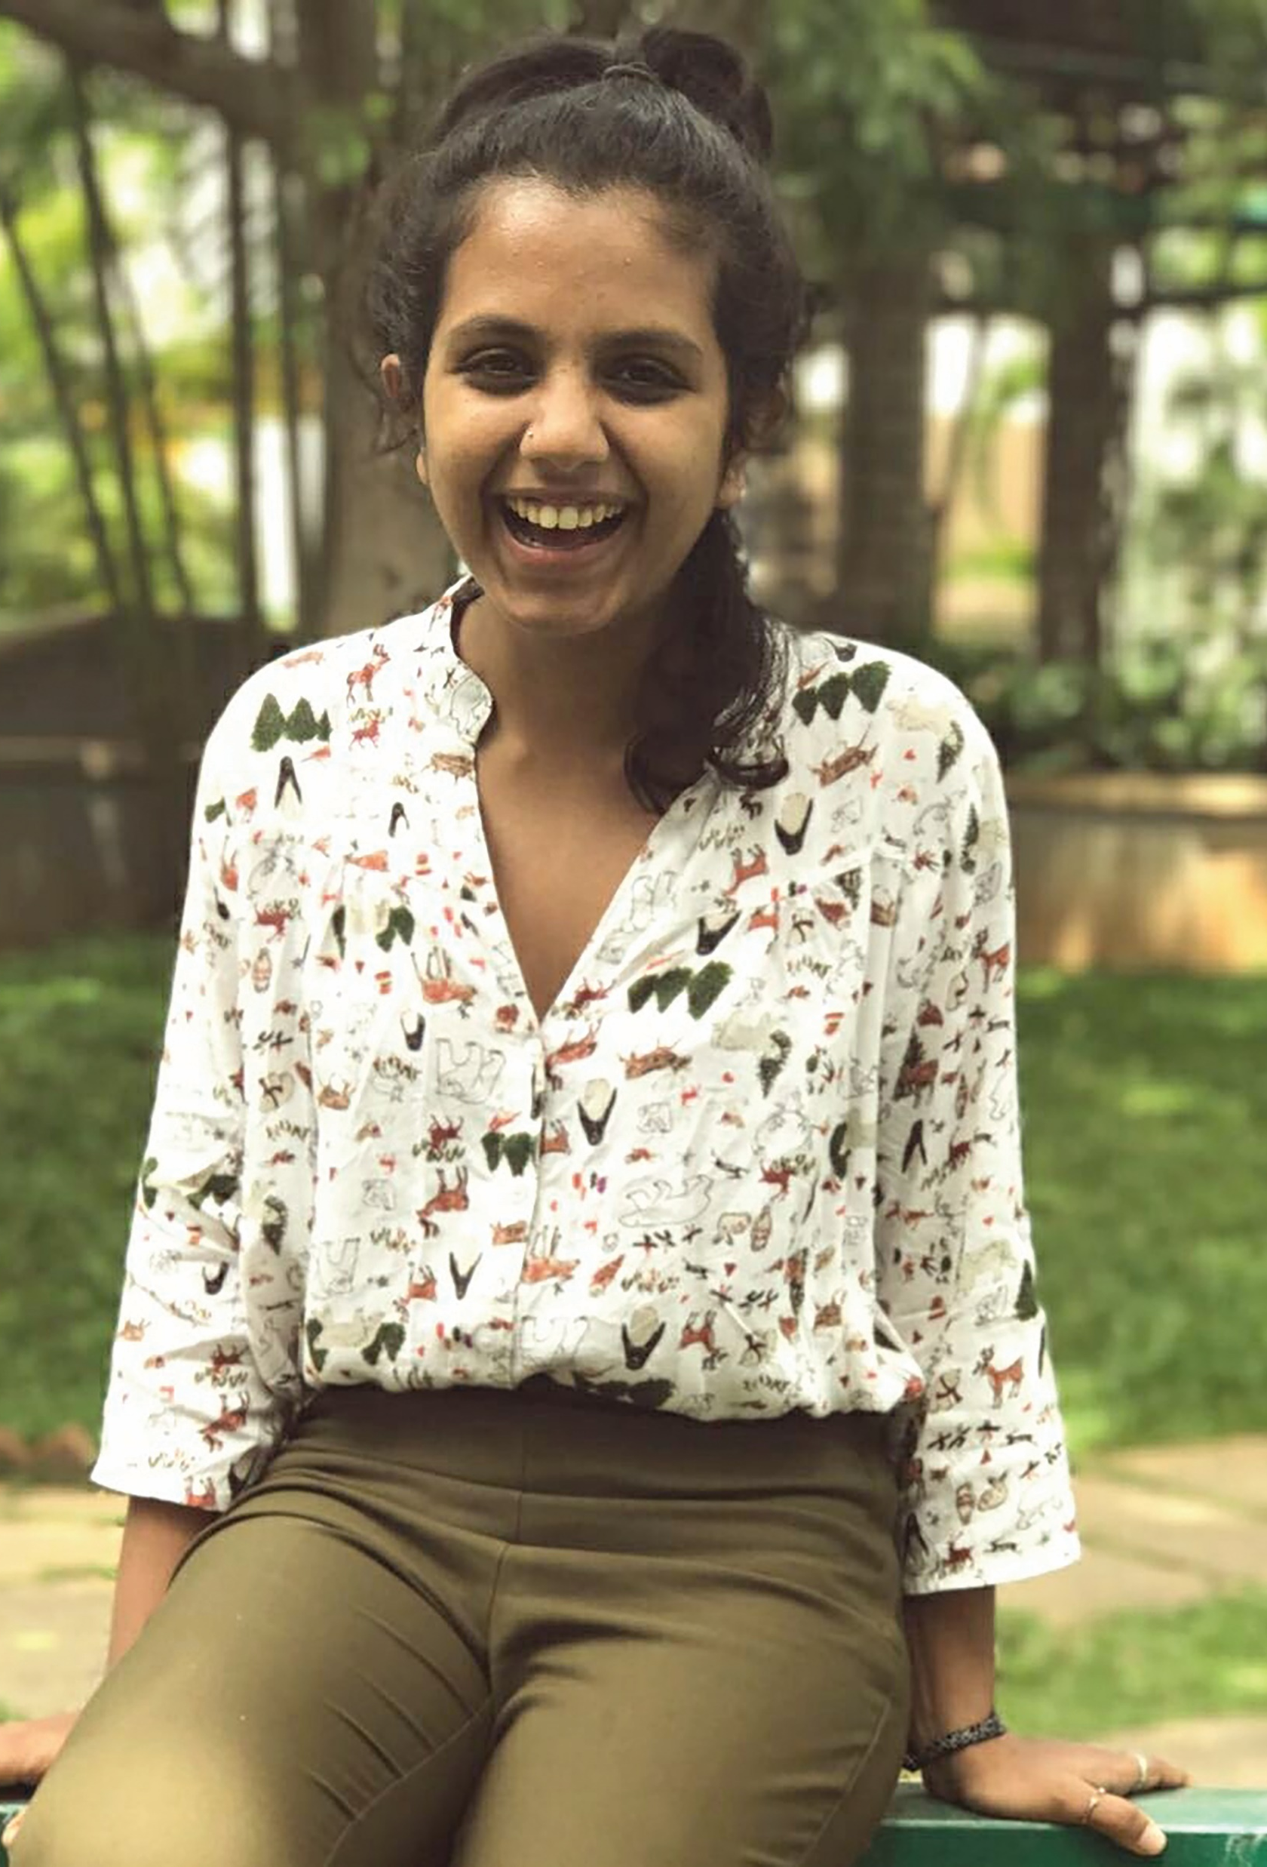
“People think that nanoscience is making tiny robots that would be inserted into our bodies and swim around and fix problems, but these are misleading notions. In reality, when we reduce the size of objects to nanoscale, they behave very differently to their ‘bulk’ version. For example, if we were to build a nanorobot to swim in your blood, it would experience a much higher viscous force from the medium – it would be like us trying to swim in oil. This would require the robot to have a motor to propel it forward. But of course, it is unrealistic to have a motor that powerful which is that small.”
- Yashaswi

Slide 12
EXPLORE A CAREER IN NANOSCIENCE
Nanowerk goes into some detail about what nanotechnology is and why it is important. The site also includes a wealth of information on different nanomaterials, resources and jobs within the field.
FutureLearn hosts introductory courses on how nanotechnologies are applied in various fields, such as healthcare. You can join many courses for free and it is conducted 100% online, so you can study from anywhere.
As a PhD student, you receive a stipend of around £16,000 to £18,000 a year, for a period of four years.
The salary for an experienced nanotechnologist varies, depending on the level of experience and the specific job title. According to National Careers, the upper pay scale around £40,000.

Slide 13
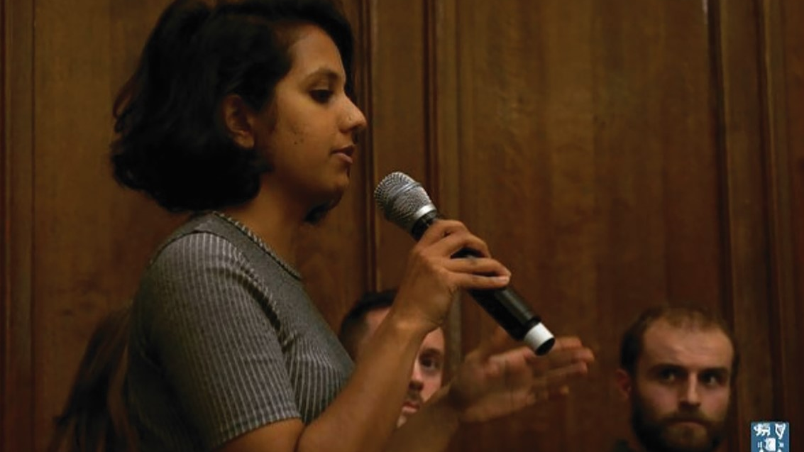
PATHWAY FROM SCHOOL TO NANOSCIENCE
Yashaswi says that students should certainly consider studying physics, chemistry and maths in school and beyond. If there are any statistics classes or modules offered you should think about taking them, as they will prove to be a big help for budding nanoscientists.
2 or 3 A levels, or equivalent, including maths and a science for a degree.
Relevant degree subjects include nanoscience, physics, chemistry, electronics engineering, materials science and computer science.
You will usually need a degree or a postgraduate Master’s qualification in nanotechnology, or a related course which includes nanotechnology.
Yashaswi giving a talk to the undergraduate class about options after a bachelor’s degree in science.

Slide 14
TALKING POINTS
It what way do you think materials change at the nano scale? Which properties change?
Why are nanomaterials so effective as catalysts?
According to Yashaswi, what misconceptions do people have about nanoscience?
What financial incentive is there to study a PhD?
Of the subjects related to nanoscience, which interests you the most and why?

Slide 15
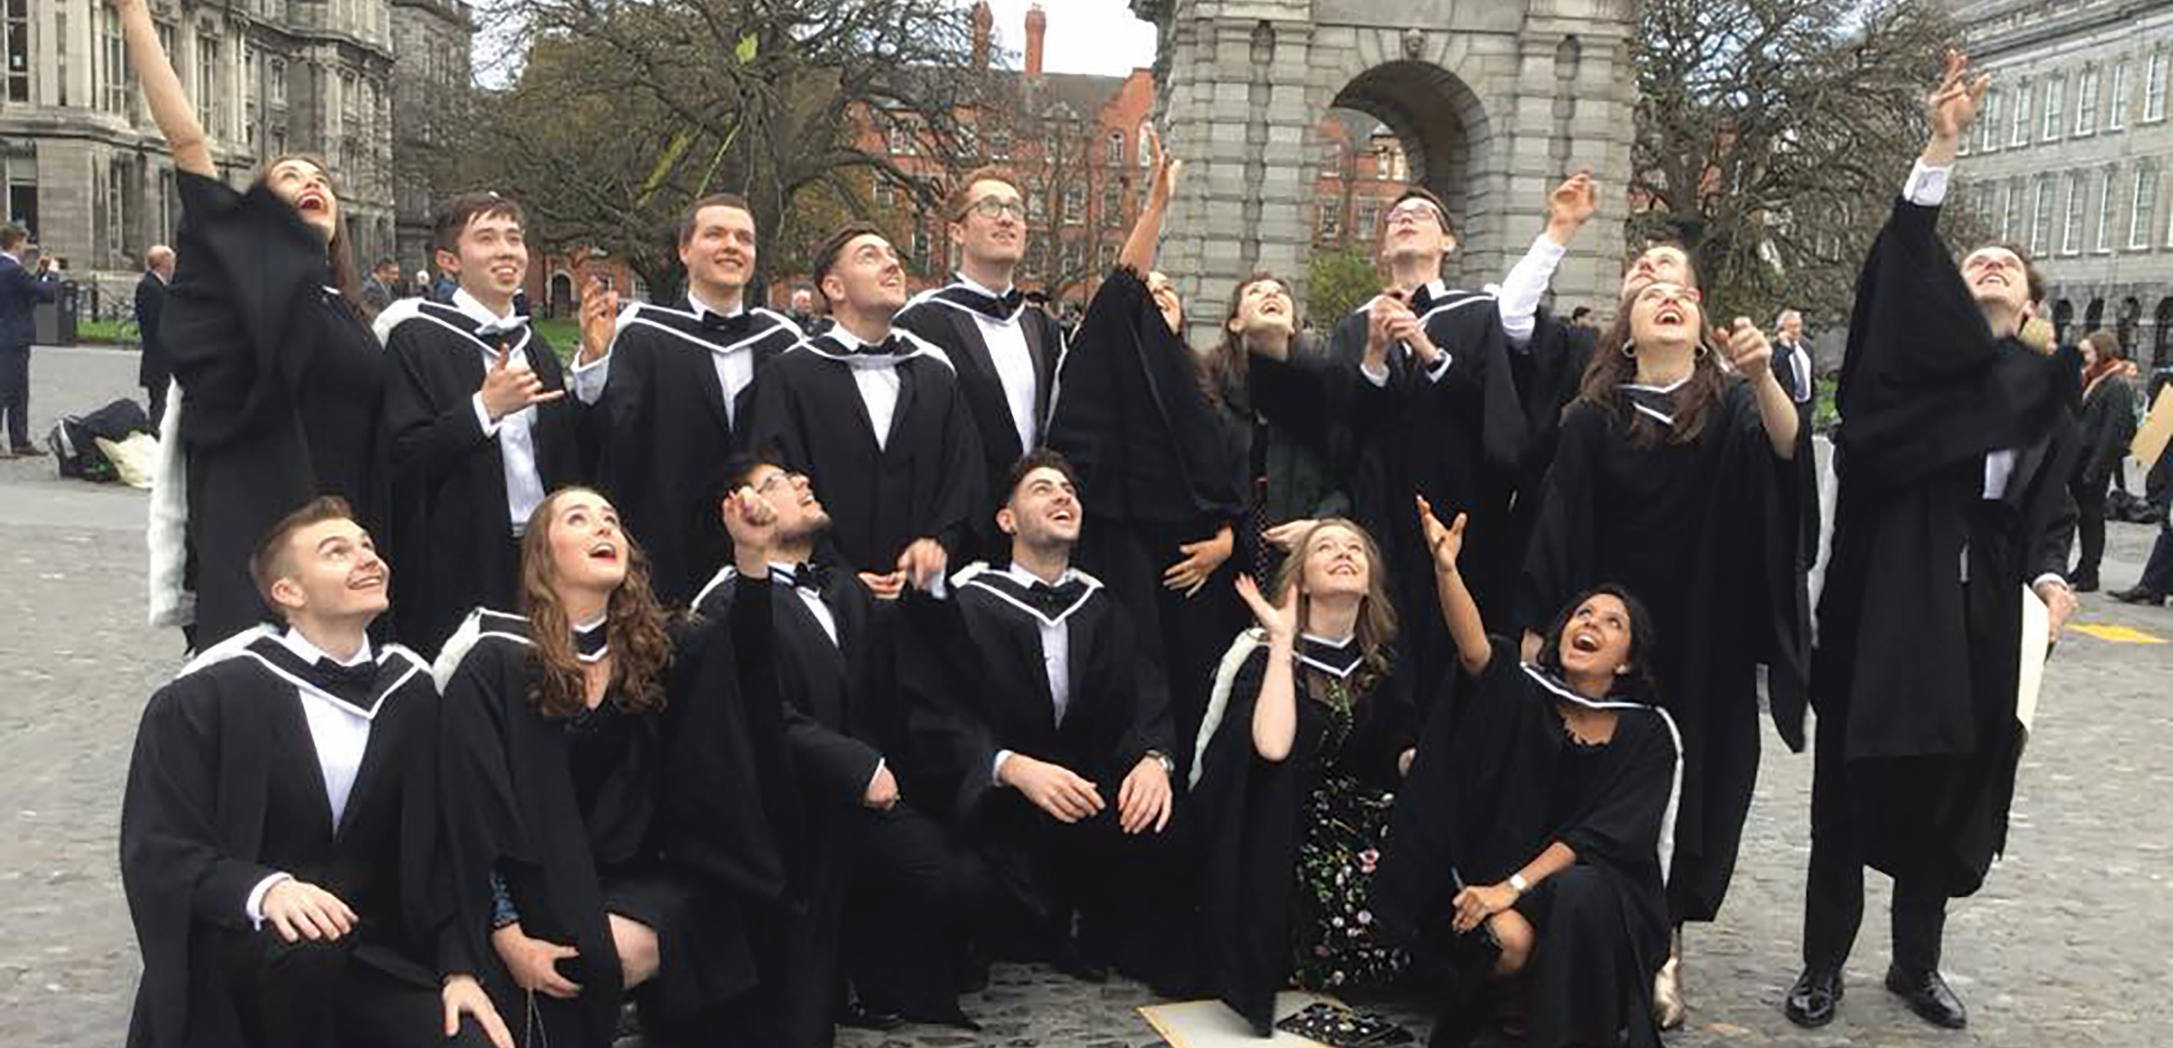
HOW DID YASHASWI BECOME A NANOSCIENTIST?
What were your interests when you were growing up?
“I was always only ever interested in science as a child. This was probably because I was constantly exposed to it as both my parents are from a science background too! I wouldn’t say I was a voracious reader or was watching loads of animal/nature shows, but there was always an underlying curious mind and any problem was approached scientifically.”
Who or what inspired you to become a scientist?
“I was introduced to a lot of big picture physics questions from a young age by my father – he would always tell me the problems scientists and mathematicians were working on. This instilled a curiosity in me to be involved in these topics myself.”
What attributes have made you successful as a scientist?
“I am naturally curious, always asking why and how until I am satisfied with the answer, always questioning why things are the way they are. Most importantly, I’m not afraid to say I don’t know or understand something. There’s no shame in that and, in fact, it helps you acquire more knowledge.”
Trinity College Dublin’s physics undergraduate class of 2017 after the graduation ceremony.

Slide 16
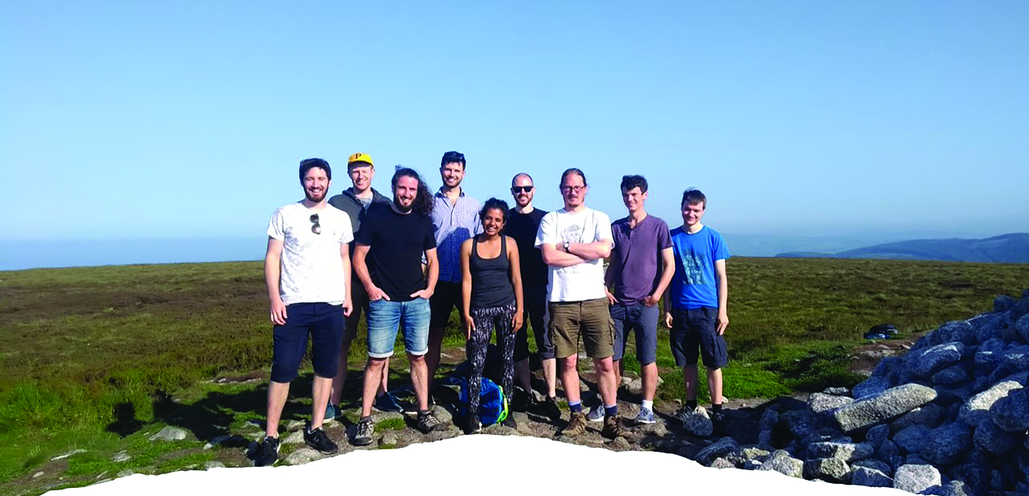
How do you overcome obstacles in your work?
“I actually work much better in a team than on my own – I am quite good at discussing a problem and troubleshooting with my group members. So, any time I encounter an obstacle, I find it helpful to discuss it with my colleagues or supervisor.”
What are your proudest career achievements, so far, and what are your ambitions for the future?
“I am generally proud I haven’t lost my interest and thirst for science – it’s definitely not easy to maintain. Getting my PhD position in a well-renowned research group was a big moment for me and a step in the right direction! Now that I am in my final year and have published a paper, I feel much more confident I’m doing what I love. As of now, I hope in the future I become involved in something that is meaningful, with a clear goal towards bettering our lives (for example, I would love to be involved in researching sustainable energy technology), without losing my love of science.”
The Jonathan Coleman Research Group on its annual hike to Fairy Castle.

Slide 17
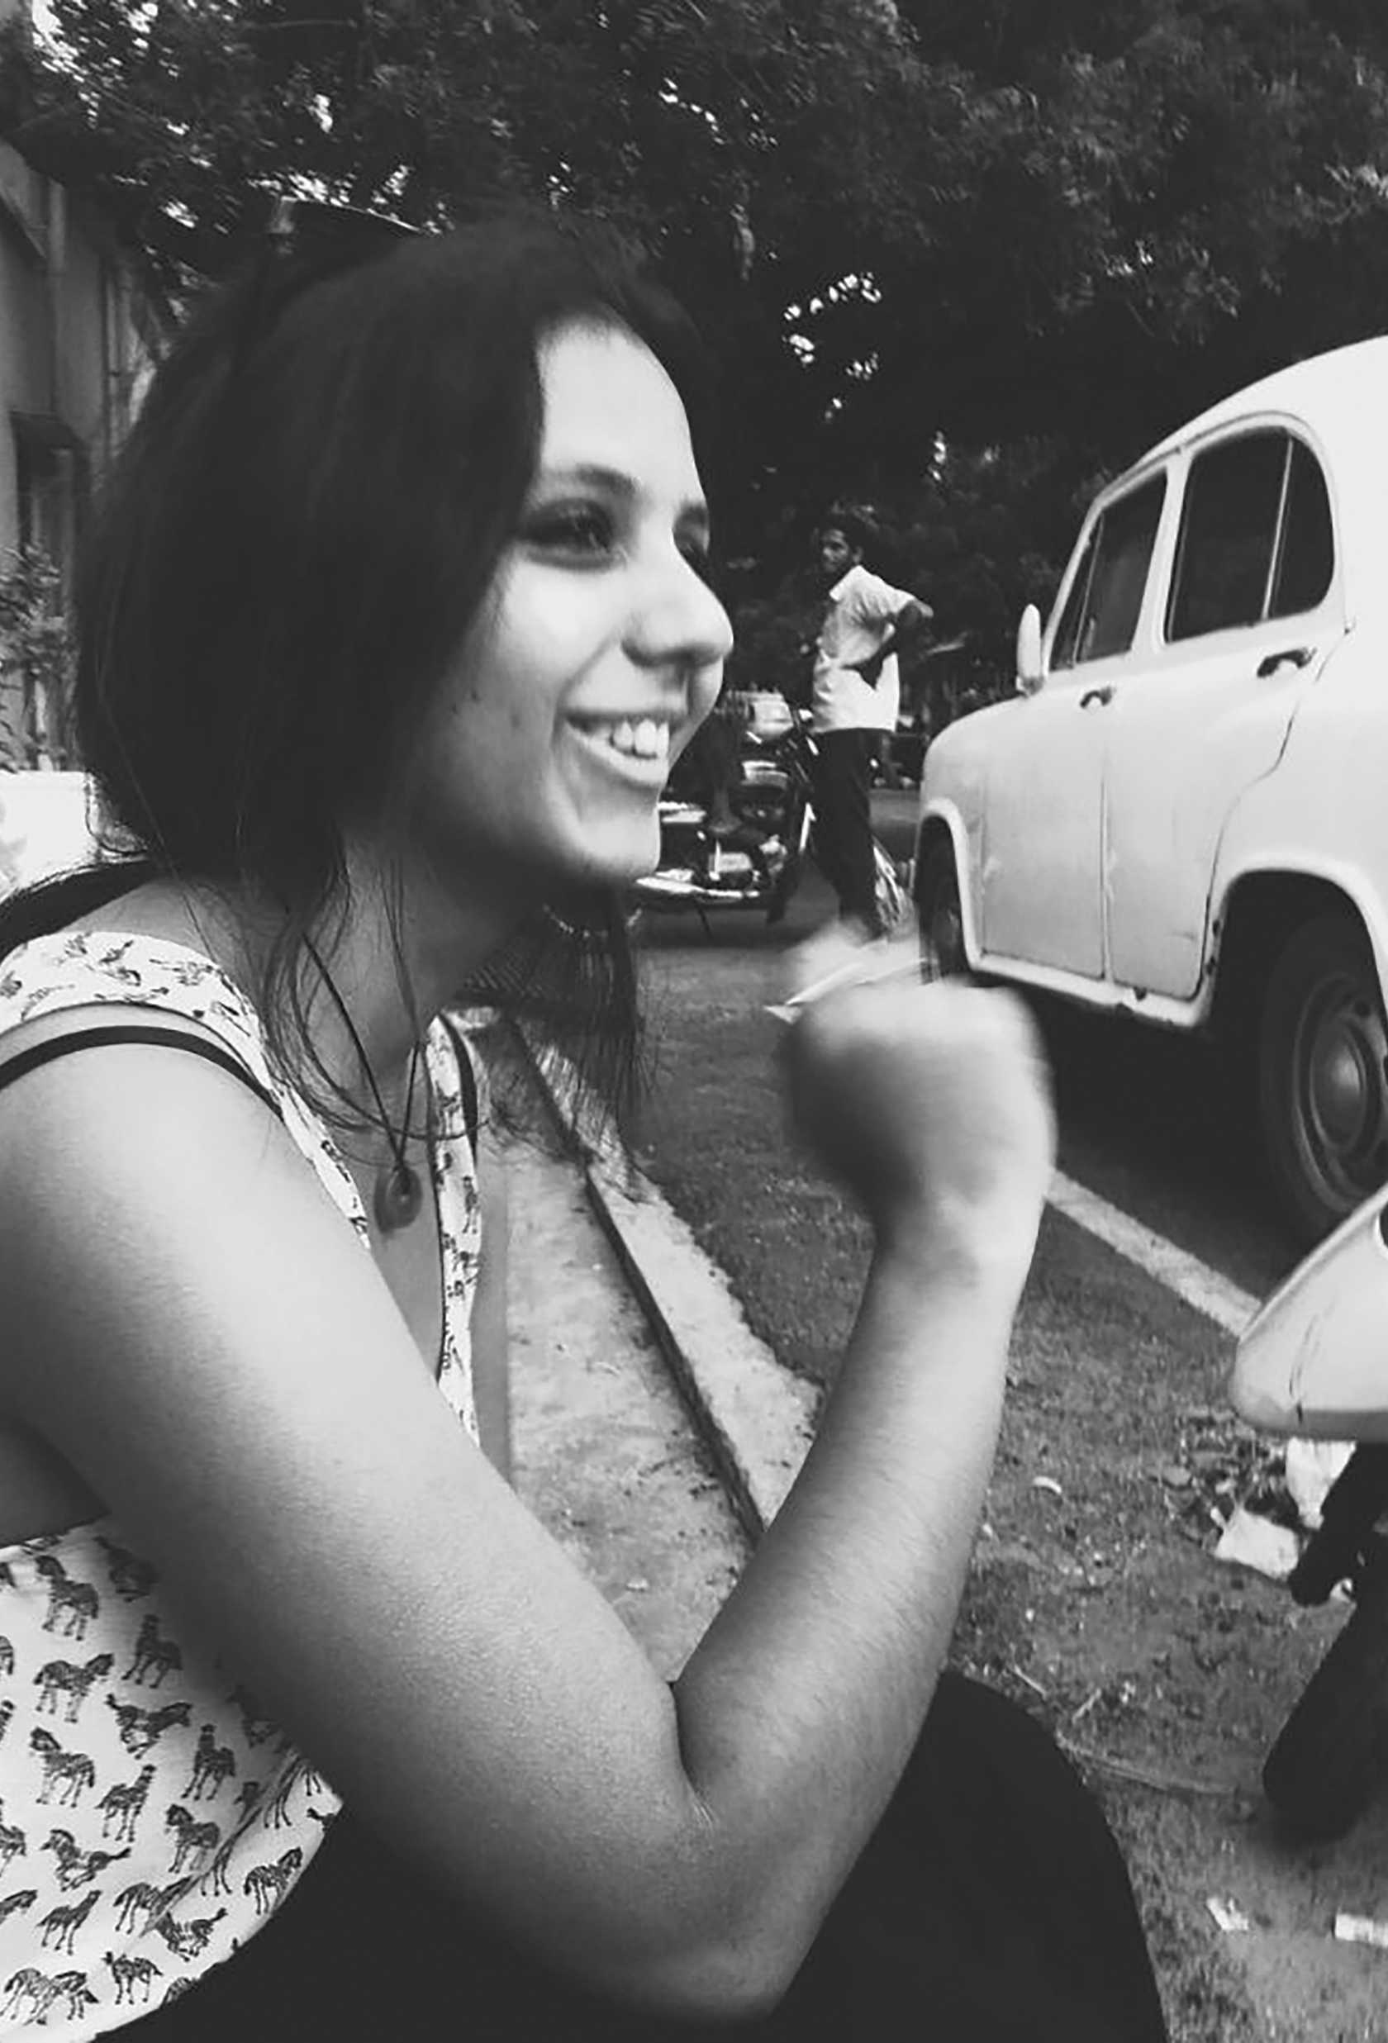
YASHASWI’S TOP TIPS
01 Keep at it! You do not have to be a genius to have a career in science – you just have to work hard and have a genuine interest in it. Never be afraid to say that you do not understand something, especially as most people around you have the same questions that you do. Ask for help as much as you can!
02 Avoid specialising in one niche topic, as a broad understanding will provide you with the skills, knowledge and experience you will need to focus on a more specific area in the future. Instead of direct entry courses, perhaps consider choosing general science courses for your first years in college.
03 Ask for internships and work experience in labs during college as much as you can. A lot of professors are looking for summer students and it is a great way to get a taste of research before making any big decisions.

Slide 18
TALKING POINTS
When was the last time your were curious about something and wanted to learn more?
How often do you ask questions? In what lessons could you be asking more?
Why is admitting you do not understand something a good thing?
How would you feel publishing your own PhD paper?
Which of Yashaswi’s top tips is most useful for you and why?

Slide 19
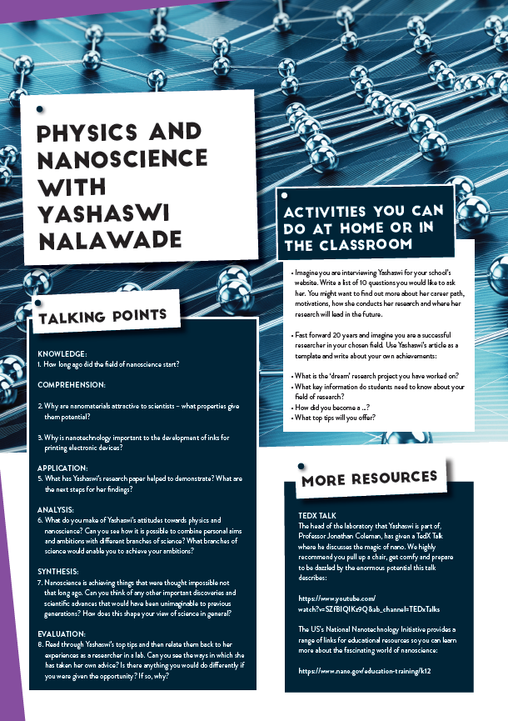
Dig deeper into Yashaswi’s research
Download her activity sheet

Slide 20
