Slide 1
INSPIRING THE
NEXT GENERATION
FUTURUM
PODCAST
Careers in aviation
Professor Anna Smallwood and Dr Thomas Budd
ftlyip
futurumcareers.com

Slide 2
Pre-listening | Break it down | Post-listening | Learn more
Meet Anna and Thomas
Pre-listening:
In this podcast, Professor Anna Smallwood and Dr Thomas Budd discuss the opportunities available in the exciting and constantly-evolving aviation industry.
What different roles are you aware of in the aviation industry?
What subjects do you think it would be useful to study if you want a career in aviation? Why?
Professor Anna Smallwood
Dr Thomas Budd
Centre for Air Transport Management,
Cranfield University, UK

Slide 3
Pre-listening | Break it down | Post-listening | Learn more
Break the podcast down:
Up to 04:30
What similarities and differences do you think exist between careers in the technical and management sides of the aviation industry?
How do you think the climate change is impacting air transport?
How do you think the aviation sector needs to adapt to a changing climate?
What do you think a ‘traditional’ air transport skillset involves?
What ‘non-traditional’ skills do you think are needed to help the sector adapt to climate change?

Slide 4
Pre-listening | Break it down | Post-listening | Learn more
04:30 – 06:30
What skills did Anna learn while studying English literature that help her in her career in air transport management?
What skills do you think she learnt while working as cabin crew?
In preparing her for her career, which experiences (studying at university or working as cabin crew) do you think were more valuable, and why?
In what ways do you think you would benefit from a university education?
In what ways do you think you would benefit from a ‘different type’ of education? What would you like this type of education to look like?

Slide 5
Pre-listening | Break it down | Post-listening | Learn more
06:30 – 08:30
Why do you think some roles in aviation are still dominated by men?
How do you think the aviation industry could increase diversity?
08:30 – end
What subject(s) do you most enjoy? How could you use knowledge from this subject in a career in aviation?
Why do you think ‘soft skills’ might be more important than technical skills in some aspects of careers in aviation? When do you think technical skills might be more important?
To what extent do you have strong transferrable skills, such as communication, teamwork and the ability to work to deadlines? How could you develop these?
How do you think artificial intelligence (AI) will influence aviation in the future?

Slide 6
Pre-listening | Break it down | Post-listening | Learn more
Post-listening:
Why is it vital that environmentally conscious people seek careers in the aviation industry?
“We need everybody’s skills, we need everybody’s input,” says Anna. What could you bring to the aviation industry?
What aspect of the aviation industry most interests you, and why?
What could you do to learn more about this aspect of aviation and how to pursue a career in it?
Which piece of advice from Anna and Thomas did you find most useful, and why?
What do you think air transport will look like in 50 years?
What further questions would you ask Anna and Thomas about aviation and/or their careers?*
*Submit questions to Anna and Thomas here

Slide 7
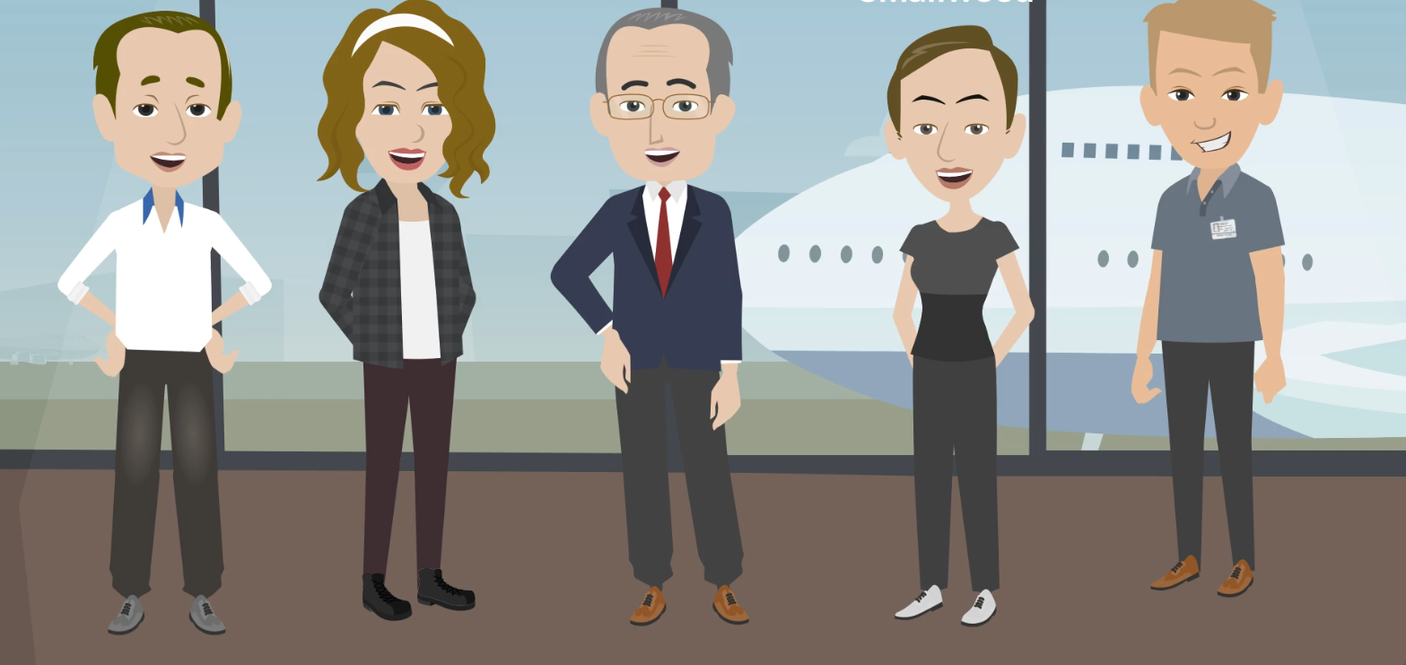
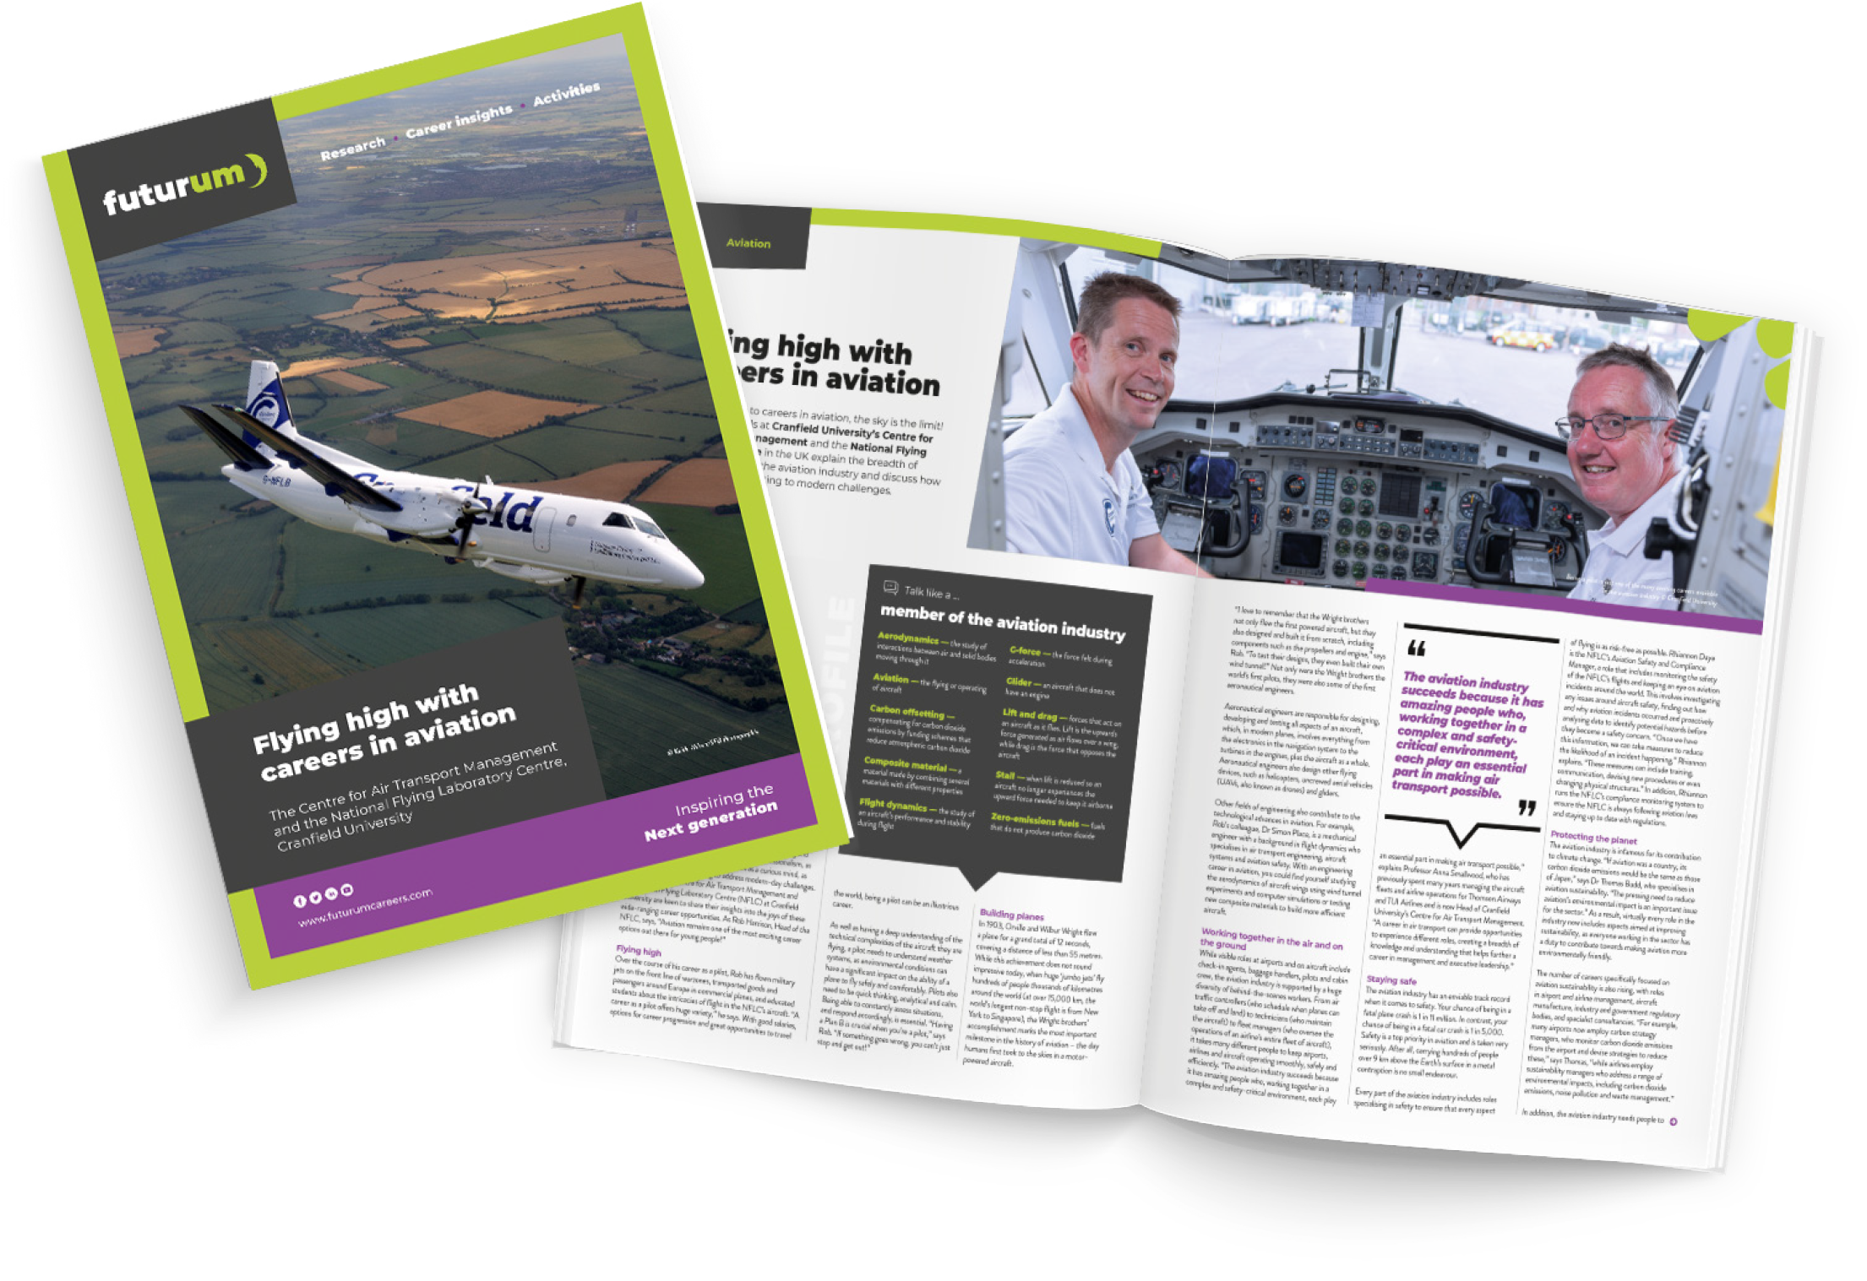
Pre-listening | Break it down | Post-listening | Learn more
Learn more about careers in aviation:
A
Read the article
A
Watch the animation
Download the PowerPoint
Download the activity sheet
A
A
ftlyip
futurumcareers.com

